Slide 1

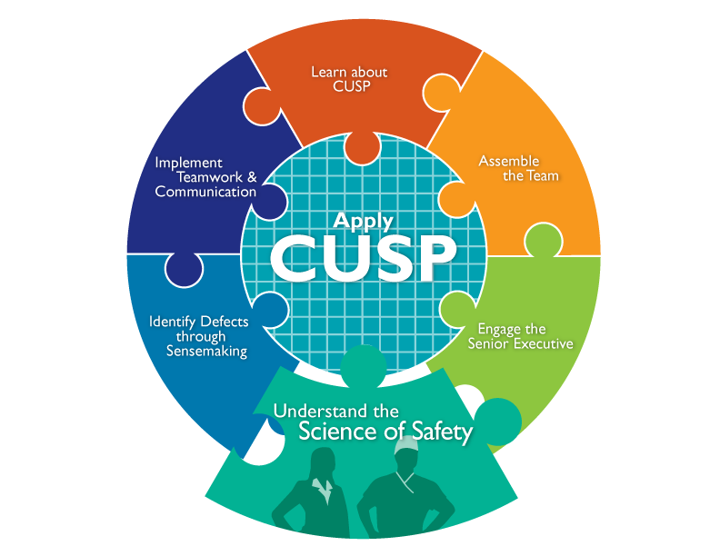

Slide 2
Learning Objectives
Indicate how teams make wise decisions when there is diverse and independent input
List the principles of safe design and identify how they apply to technical work and teamwork
Explain how system design affects system results
Describe the historical and contemporary context of the Science of Safety

Slide 3


Putting Safety in Context
Advances in medicine have led to positive outcomes:
  Most childhood cancers are curable
  AIDS is now a chronic disease
  Life expectancy has increased 10 years since the 1950s
However, sponges are still found inside patients’ bodies after operations.

Slide 4
Health Care Defects
In the U.S. health care system:
  7 percent of patients suffer a medication error²
  On average, every patient admitted to an intensive care unit suffers an adverse event^{3,4}
  44,000 to 99,000 people die in hospitals each year as the result of medical errors⁵
  Over half a million patients develop catheter-associated urinary tract infections resulting in 13,000 deaths a year⁶
  Nearly 100,000 patients die from health care-associated infections (HAIs) each year, and the cost of HAIs is $28 to $33 billion per year⁷
  Estimated 30,000 to 62,000 deaths from central line-associated blood stream infections per year⁸

Slide 5

How Can These Errors Happen?
People are fallible
Medicine is still treated as an art, not a science
Systems do not catch mistakes before they reach the patient

Slide 6

The Science of Safety
Every system is perfectly designed to achieve its end results
Safe design principles must be applied to technical work and teamwork
Teams make wise decisions when there is diverse and independent input

Slide 7
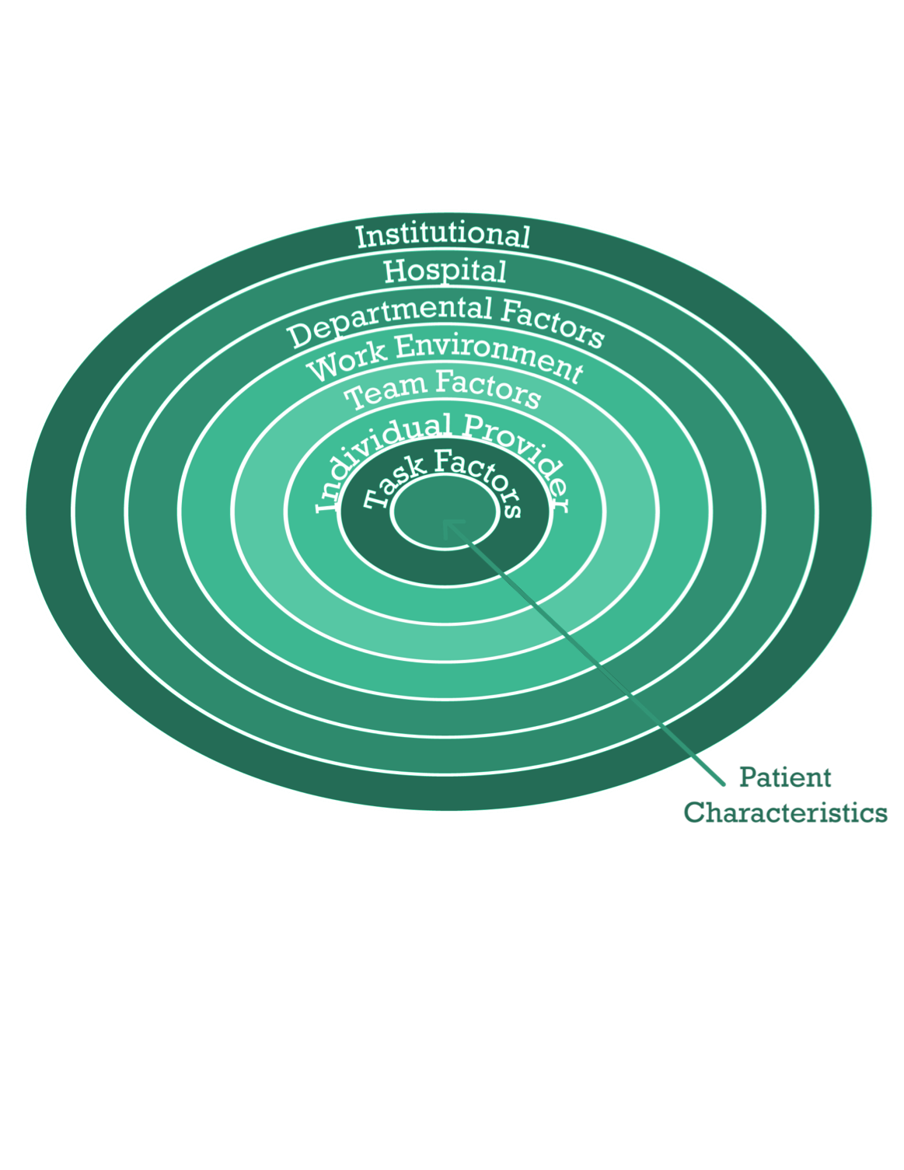
System-Level Factors Affect Safety⁹

Slide 8


Safety is a Property of the System

Slide 9
System-Level Factors Can Predict Performance
Examples of Impact of System-Level Factors
System Factor | Effect
Daily rounds with an intensivist | When ICUs are staffed with a multidisciplinary team, including daily rounds with an intensivist, mortality is reduced
Nurses responsible for more than two patients | When nurses are responsible for more than two patients, there is an increased risk of pulmonary complications in the ICU patient population
Point-of-care pharmacist or pharmacist who participates in rounds | A point-of-care pharmacist or one who participates in rounds reduces prescribing errors

Slide 10
Three Principles of Safe Design
Standardize
Create independent checks
Learn from defects

Slide 11

Standardize When You Can

Slide 12
Create Independent Checks

Slide 13
Learn From Defects

Slide 14

Exercise
Think about a recent safety issue in your unit and answer the four Learning from Defects questions:
What happened?
Why did it happen?
How will you reduce the risk of recurrence?
How will you know it worked?

Slide 15

Principles of Safe Design Apply to Technical Work and Teamwork

Slide 16

Technical Work and Teamwork

Slide 17
Exercise
How do you see technical and adaptive work fitting in your unit?

Slide 18

Teams Make Wise Decisions When
There is Diverse and Independent Input

Slide 19
How To Ensure Diverse and Independent Input
Appreciate the wisdom of crowds
  Emphasize that health care is a team effort
  Develop an environment where frontline providers can voice concerns, and are acknowledged when they express concerns
  Gather as many viewpoints as possible
Alternate between convergent and divergent thinking
    Divergent thinking occurs on rounds, during brainstorming sessions, and when trying to understand what might be occurring¹⁰
    Convergent thinking occurs while formulating a treatment plan or focusing on a specific task¹⁰

Slide 20
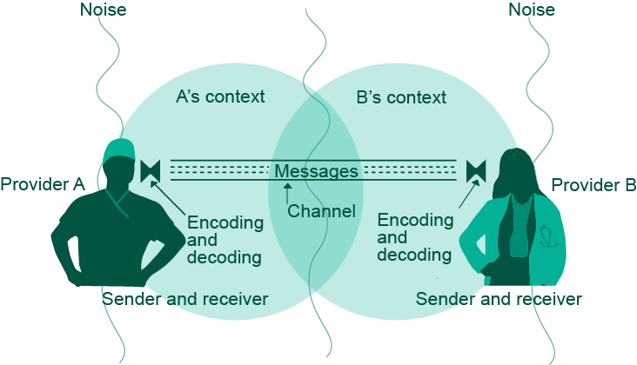
Basic Components and
Process of Communication¹¹

Slide 21

Diverse and Independent Input
HRET will insert chunked vignette still

Slide 22
Reduced CRBSI By Applying
Principles of Safe Design¹²
Time period | Median Catheter Related Blood Stream Infection (CRBSI) rate | Incidence rate ratio
Baseline | 2.7 | 1
Pre-intervention | 1.6 | 0.76
0-3 months | 0 | 0.62
4-6 months | 0 | 0.56
7-9 months | 0 | 0.47
10-12 months | 0 | 0.42
13-15 months | 0 | 0.37
16-18 months | 0 | 0.34

Slide 23

Understand the Science of Safety:
What the Team Must Do
Develop a plan so all staff on your unit view the Understand the Science of Safety video
Video screening should be mandatory for all unit staff
Create a list of who has watched the video
Describe the three principles of safe design:
  Standardize
  Create independent checks
  Learn from defects

Slide 24
Summary
Every system is designed to achieve its anticipated results
The principles of safe design are standardize when you can, create independent checks, and learn from defects
The principles of safe design apply to technical work and teamwork
Teams make wise decisions when there is diverse input

Slide 25

CUSP Tools
Daily Goals Checklist
Morning Briefing
Shadowing Another Professional Tool
Observing Patient Care Rounds
Team Check-Up Tool

Slide 26
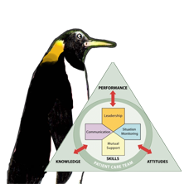
TeamSTEPPS Tools¹
  Brief
  Huddle
  Debrief
  SBAR
  Check Back
  Call Out
  Hand Off
  I PASS the BATON
  DESC Script
  *Please refer to the “Implement Teamwork and Communication” module for additional information*
As seen in TeamSTEPPS®

Slide 27
References
Agency for Healthcare Research and Quality, Department of Defense. TeamSTEPPS. Available at www.ahrq.gov/teamsteppstools/instructor/index.html
Bates DW, Cullen DJ, Laird N, et al. Incidence of adverse drug events and potential adverse drug events. JAMA. 1995;274(1):29–34.
Donchin Y, Gopher D, Olin M, et al. A look into the nature and causes of human errors in the intensive care unit. Crit Care Med. 1995;23:294–300.
Andrews LB, Stocking C, Krizek T, et al. An alternative strategy for studying adverse events in medical care. Lancet. 349:309–313,1997.

Slide 28
References
5. Kohn L, Corrigan J, Donaldson M. To err is human: building a safer health system. Washington, DC: National Academy Press; 1999.
6. Scott, RD. The Direct Medical Costs of Healthcare-Associated Infections in U.S. Hospitals and the Benefits of Prevention. March 2009. http://www.cdc.gov/ncidod/dhqp/pdf/Scott_CostPaper.pdf
7. Klevens M, Edwards J, Richards C, et al. Estimating Health Care-Associated Infections and Deaths in U.S. Hospitals, 2002. PHR. 2007;122:160–166.
8. Ending health care-associated infections, AHRQ, Rockville, MD; 2009. http://www.ahrq.gov/qual/haicusp.htm.
9. Vincent C, Taylor-Adams S, Stanhope N. Framework for analysing risk and safety in clinical medicine. BMJ. 1998;316:1154–57.

Slide 29
References
10. Heifetz R. Leadership without easy answers, president and fellows of Harvard College. Cambridge, MA: Harvard University Press;1994.
11. Dayton E, Henriksen K. Communication failure: basic components, contributing factors, and the call for structure. Jt Comm J Qual Patient Saf. 2007;33(1): 34–47.
12. Pronovost P, Needham D, Berenholtz S, et al. An intervention to decrease catheter-related bloodstream infections in the ICU. New Engl J Med. 2006;355(26):2725–32.

