Slide 1
Advanced Methods in Delivery System Research –
Planning, Executing, Analyzing, and
Reporting Research on
Delivery System Improvement
Webinar #2: Statistical Process Control
Presenter: Jill Marsteller, PhD, MPP
Discussant: Stephen Alder, PhD
Moderator: Cindy Brach, MPP
Sponsored by AHRQ’s Delivery System Initiative
in partnership with the AHRQ PCMH program
May 14, 2013

Slide 2


Speaker Introductions
Jill Marsteller, PhD, MPP is currently an Associate Professor of Health Policy and Management at the Johns Hopkins Bloomberg School of Public Health.
Dr. Marsteller’s presentation today will draw on her paper with Mimi Huizinga and Lisa Cooper on Statistical Process Control. This AHRQ PCMH Research Methods Brief is posted on the AHRQ PCMH website. Details will be provided at the end of this webinar.
Stephen C. Alder, PhD serves as chief of the Division of Public Health in the University of Utah Department of Family and Preventive Medicine. He is an associate professor of Family and Preventive Medicine.
Dr. Alder is currently working on an AHRQ-funded demonstration grant on “Primary Care Practice Redesign – Successful Strategies.” His presentation today is based on one part of the research conducted under that grant.

Slide 3
Statistical Process Control--
Possible Uses to Monitor and Evaluate Patient-Centered Medical Home Models
Jill A. Marsteller, PHD, MPP
Center for Health Services and Outcomes Research, Johns Hopkins Bloomberg School of Public Health
and Armstrong Institute for Patient Safety and Quality, Johns Hopkins Medicine
With Thanks to Mimi Huizinga, MD, Melissa Sherry, MPH and Lisa Cooper, MD

Slide 4
Statistical Process Control
Typically used for quality control
  Developed in 1920s at Bell Telephone Laboratories by Walter Shewart to aid in the production of telephone components that were of uniform quality
  Based on theory of variation
  Long history of use within manufacturing
  Gaining popularity in health care
    The Joint Commission uses SPC to analyze hospital performance
A key SPC tool is the control chart, which is the focus of
this presentation
  Combines time-series analysis with graphical representation
  of data

Slide 5
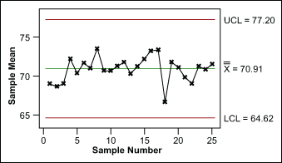
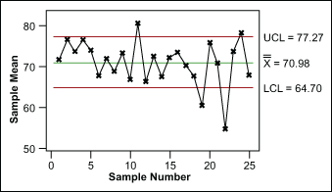
Control Charts Are a Primary
Tool of SPC
Common-Cause Variation
Allows determination of system’s “control”
  Wide fluctuations = out-of-control systems
  Out-of-control indicates opportunity to improve reliability
Distinguishes between common- and special-cause variation
  Common-cause variation = normal,
  random variation
  Special-cause variation
    Changes in the pattern of data that can
    be assigned to a specific cause
    Cause may or may not be beneficial, intentional
Special-Cause Variation

Slide 6
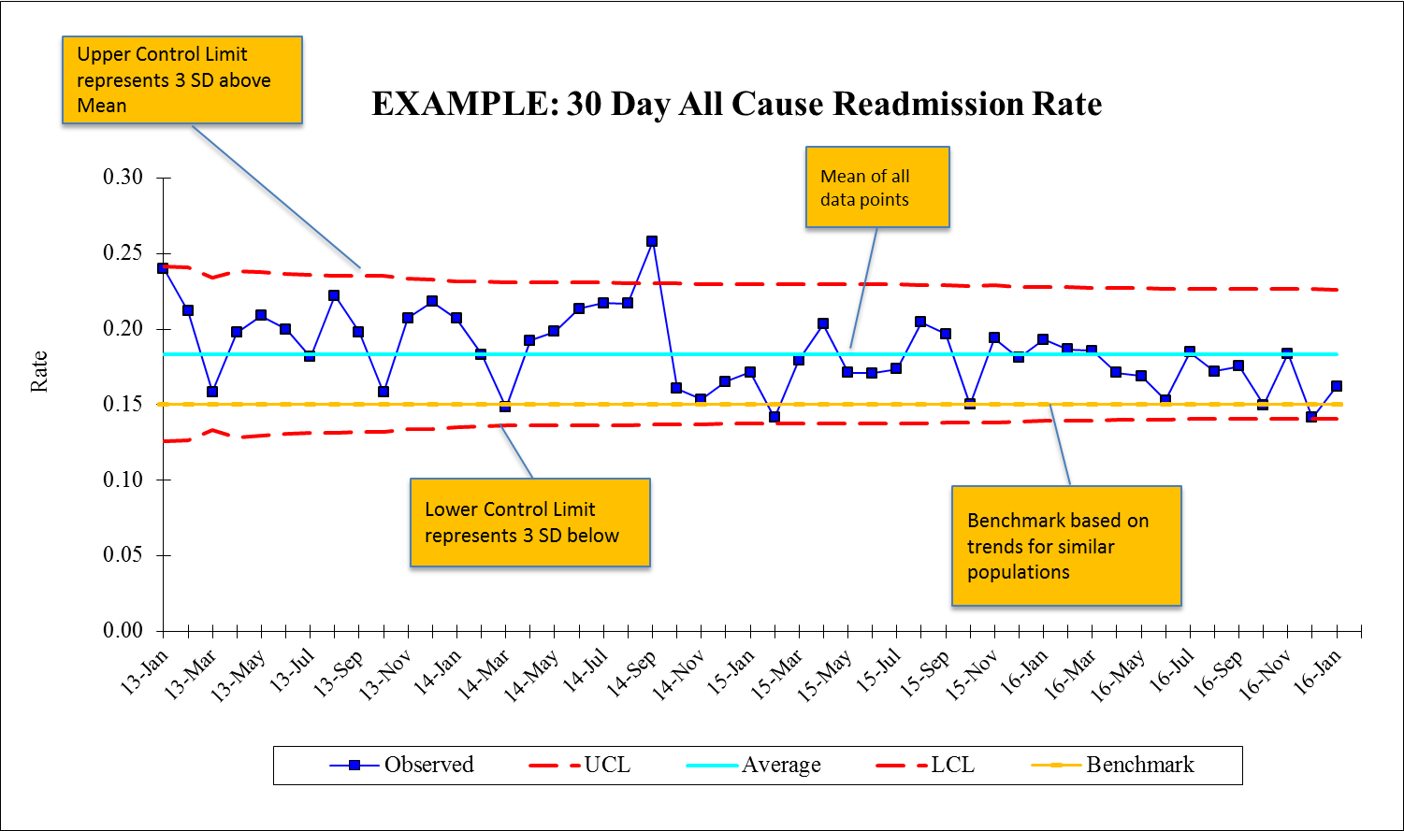
Features of an SPC Chart

Slide 7
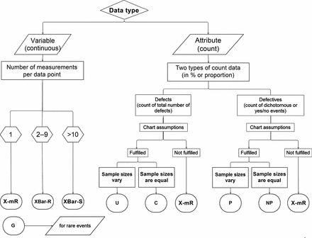
The Type of Control Chart Is Based on Your Data and Needs
Source: Radiographics. 2012 Nov-Dec;32(7):2113-26.

Slide 8
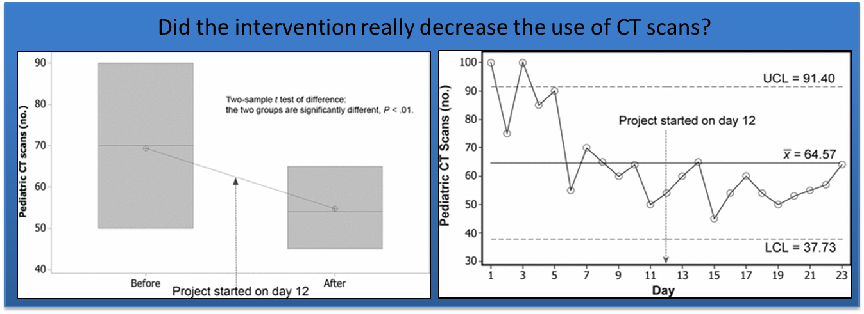
Why Should We Consider Using a Control Chart?
Differentiates true change from random noise
Emphasizes early detection of meaningful change
Visualization can engage additional stakeholders
Allows timing and degree of intervention impact to be detected
Images: Radiographics. 2012 Nov-Dec;32(7):2113-26.

Slide 9
Application to Health Care
Reducing variation in the delivery of health care is core tenet of highly reliable care
Most often used for Quality Improvement and practice management
Also useful as an easily interpretable approach for evaluating health care delivery system interventions
Statistical process control (SPC) is a branch of statistics that combines rigorous time-series analysis methods with graphical presentation of data, often yielding insights into the data more quickly and in a way more understandable to lay decision makers.
—JC Benneyan et al., Qual Saf Health Care 2003;12:458–464

Slide 10
Using a Control Chart to evaluate an Intervention
Establish common-cause variation in a stable period
  Observe process or outcome variables over time in the absence of an intervention
Monitor data for evidence of special-cause variation after intervention is introduced
  This indicates meaningful change
  Can be used to examine implementation or impact variables

Slide 11
Methodology: Key Steps
Identify process(es) or outcome(s) of interest
Identify measurable attributes
Select appropriate control chart given your variable of choice
Use SPC software to generate chart type and compute mean value over time period of interest
Characterize natural variation using upper and lower control limits (± 3 SDs around mean)
Track variable to observe patterns
Determine whether changes in variable over time meet criteria indicating special cause

Slide 12
Methodology: Special-Cause Variation Criteria*
One value outside control limits
2 of 3 consecutive values above or below mean and >2 SDs away from mean
≥ 8 values above or below mean, OR
≥ 6 values in a row steadily increasing or decreasing
Four out of five successive points more than 1SD from the mean on the same side of the center line
Obvious cyclical behavior
If these rules apply, the chance that changes seen are due to circumstances beyond regular variation is 99.7% (Benneyan et al. 2003)
                * There are several special-cause variation criteria sets.

Slide 13
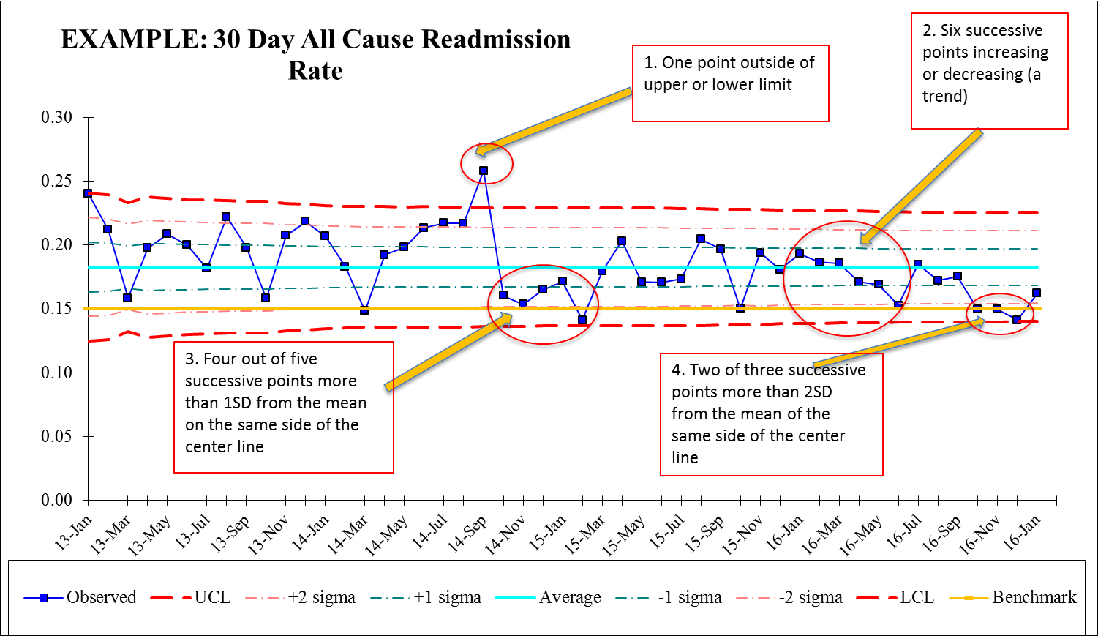
Identifying Significance in an SPC Chart: Examples

Slide 14
Uses of Control Charts
Monitor process measures
Identify early signs of correlation between processes
and outcomes
Identify differences across groups
Aid self-management interventions
  Monitor changes in individual patients (e.g., clinical outcomes, patient experience, financial measures)
Determine time from implementation to effect

Slide 15
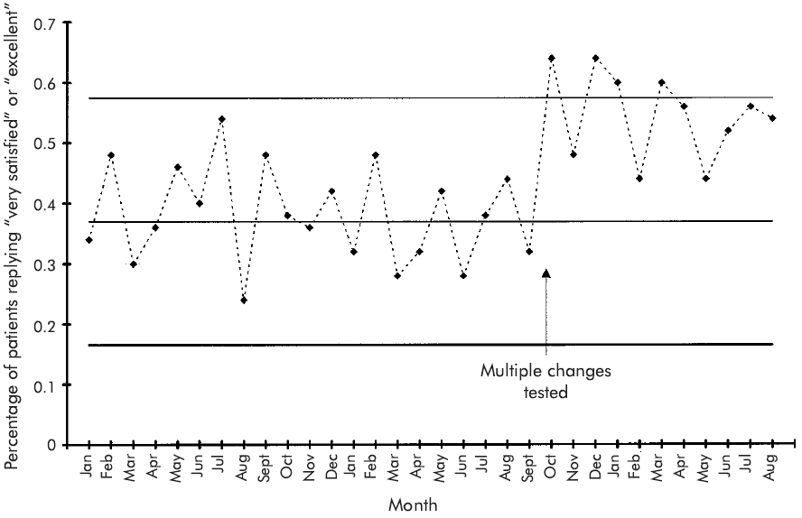
Example: Control chart of appointment access satisfaction

Slide 16
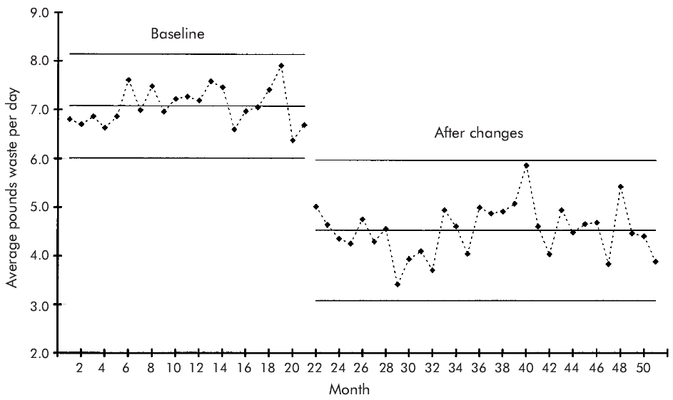
Example: Control chart of infectious waste

Slide 17
Limitations (1)
Requires frequent measurement
  Less data than traditional regression analysis (e.g., fewer sites or subjects), but control charts are only useful with data over many time periods
Involves some degree of autocorrelation
  Problem amplified with more frequent measurement
  (e.g., hourly vs. daily)
  Can reduce by using measurements 3 to 4 periods apart

Slide 18
Limitations (2)
Will not work in every situation
  For example, seasonal variability can impact control
  chart’s usability
  Must understand process and goals of improvement before using control charts
Requires expert consultation for initial use

Slide 19
THANKS!
Questions?

Slide 20

Statistical Process Control in Primary Care and Practice Redesign
AHRQ Delivery System Initiative & AHRQ Primary Care Initiative
Statistical Process Control
Advanced Methods Webinars
Stephen C. Alder, Ph.D.
Chief, Division of Public Health
Family and Preventive Medicine
May 14, 2013

Slide 21
Overview
Statistical Process Control in Primary Care
Disease surveillance and the 2002 SLC Olympics
Point-of-Care Testing as an Influenza Surveillance Tool
Use of SPC in Practice Redesign- Colon Cancer Screening Example

Slide 22


Slide 23
First Observations of Primary Care System Shifts
Joseph Lynn Lyon, MD, MPH – mid-1990s, observed that patient loads in urgent care clinics increased as the influenza epidemic emerged
Traditional influenza surveillance provided an epidemic post mortem rather than providing preventive benefit

Slide 24


Public Health Surveillance 2002 Olympics

Slide 25
Olympic Preparation Post 2001
September 11, 2001: Terrorist attacks on World Trade Center (NYC), Pentagon (Washington, DC) and Shanksville (Pennsylvania)
September 17 – November 20, 2001: Anthrax letters attack
Athletes begin arriving in Salt Lake City mid-January (as the annual influenza epidemic is emerging)

Slide 26
U. to monitor athletes for bioterror symptoms computers will look for any medical quirks
By Norma Wagner Deseret News staff writer
Friday, Jan. 11 2002
‘U. researchers since mid-October have been developing a surveillance system that analyzes data from electronic medical records to continuously monitor for abnormal patterns in patients' symptoms that could flag a bioterrorism attack’

Slide 27
Syndromic Surveillance:
Increased Gastro-intestinal Distress
Paper-Pencil surveillance shows significant increase in clinically identified GI distress
SPC-based surveillance using University of Utah Community Clinics EMR system allows near real-time capacity to both detect and investigate significant system shifts
Quickly identified GI involvement in culture/rapid test-confirmed influenza

Slide 28
Point-of-Care Testing as an Influenza Surveillance Tool: Methodology and Lessons Learned from Implementation
Lisa H. Gren, Christina A. Porucznik, Elizabeth A. Joy, Joseph L. Lyon, Catherine J. Staes, and Stephen C. Alder
Influenza Research and Treatment (2013), Article 242970

Slide 29
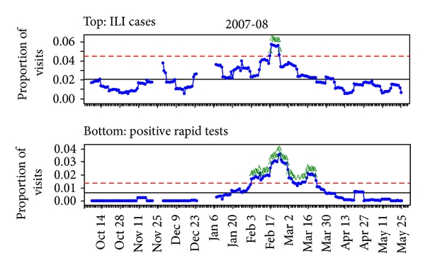

Slide 30
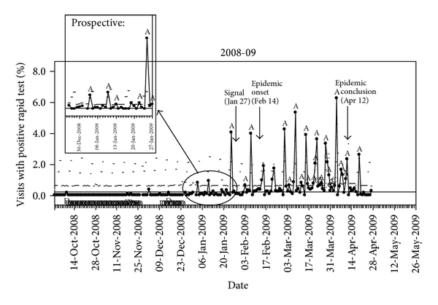

Slide 31
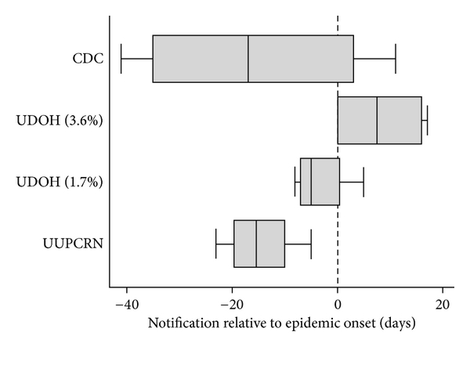
2004-2005 to 2007-2008 Influenza Seasons

Slide 32
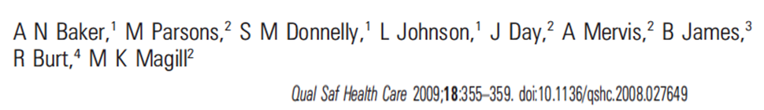
Improving colon cancer screening rates in primary care: a pilot study emphasizing the role of the medical assistant

Slide 33
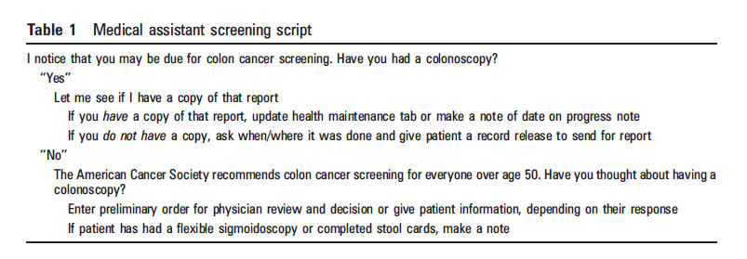

Slide 34
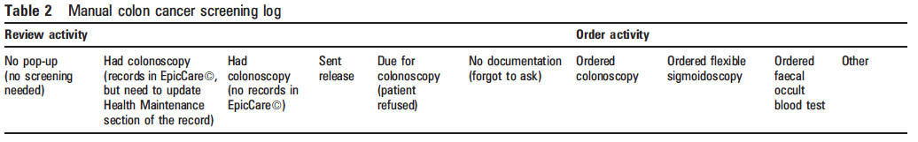

Slide 35
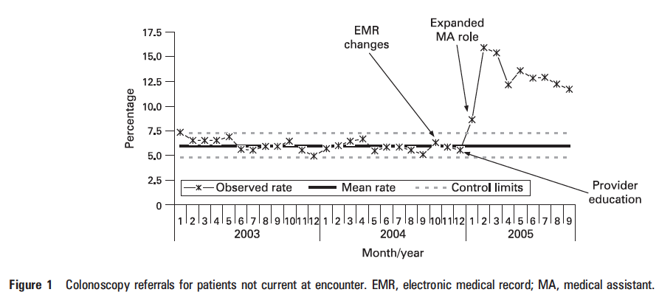

Slide 36
Conclusion
Electronic decision support tolls alone do not increase CRC screening referral rated. Facilitators, IT support staff and system changes were all necessary to effect change. The greatest barrier to CRC screening for providers seemed to be competing demands during a short patient visit. Adding redesigned clinical workflow, particularly an expanded role for the MA, appeared to increase referrals for CRC screening.

Slide 37
Statistical Process Control provides an important tool for monitoring variation in a system and identifying when transitions occur. Application of this approach can be at the patient, provider and population levels. Identifying transitions is a start – impact requires understanding the cause and adapting the system to reduce variation (improve the control) and improve performance.

Slide 38
Thank you for attending!
Webinar #3: Logic Models
Presenter: Dana Petersen, PhD
Discussant: Todd Gilmer, PhD
Moderator: Michael I. Harrison, PhD
Sponsored by AHRQ’s Delivery System Initiative in partnership with the AHRQ PCMH program
June 4, 2013 1 p.m.
Register for this and other events in our series on advanced methods in delivery system research here: http://bit.ly/EconometricaAHRQ

Slide 39
For more information about the AHRQ PCMH Research Methods briefs, please visit: http://www.pcmh.ahrq.gov/portal/server.pt/community/pcmh__home/1483/pcmh_evidence___evaluation_v2

