Slide 1
Advanced Methods in Delivery System Research –
Planning, Executing, Analyzing, and
Reporting Research on
Delivery System Improvement
Webinar #3: Logic Models
Presenter: Dana Petersen, PhD
Discussant: Todd Gilmer, PhD
Moderator: Michael I. Harrison, PhD
Sponsored by AHRQ’s Delivery System Initiative
in partnership with the AHRQ PCMH program
June 4, 2013

Slide 2


Speaker Introductions
Dana Petersen is a Health Researcher at Mathematica Policy Research. Dana is the lead author of the brief on Logic Models in AHRQ’s PCMH research methods series . Her presentation today is based on that methods brief.
Todd Gilmer, Ph.D., is a Professor of Health Economics and Chief of the Division of Health Policy in the Department of Family and Preventive Medicine at the University of California, San Diego. His presentation today draws on his AHRQ-funded research on Full Service Partnerships for housing and treating people who are homeless mentally ill.

Slide 3
The Logic Model: A Foundation to Implement, Study, and Refine Patient-Centered Medical Home (PCMH) Models
June 4, 2013
AHRQ Advanced Methods Webinar
Dana Petersen  Erin Fries Taylor  Deborah Peikes

Slide 4
Acknowledgements
David Meyers and Jan Genevro (AHRQ) for commissioning the methods brief from which this presentation is derived
Source – Petersen D, Taylor EF, Peikes D. Logic Models: The Foundation to Implement, Study, and Refine Patient-Centered Medical Home Models. Rockville, MD: Agency for Healthcare Research and Quality, February 2013. AHRQ Publication No. 13-0029-EF.
Available for download from pcmh.ahrq.gov

Slide 5
Outline of Presentation
Definition and Elements
Purposes and Users
How to Build a Logic Model
Applicability to PCMH (Medical Home) Models
Advantages and Limitations

Slide 6
Definition: What is a logic model?
A graphical depiction that shows:
  Necessary resources and inputs
  Intervention activities and processes
  Intermediate and ultimate outcomes of the intervention and the pathways through which it produces those outcomes
  Interrelationships among intervention components
  Contextual factors that may influence the intervention’s ability to produce results
Shows the links in the chain of reasoning about “what causes what”
Can vary in complexity and take many forms

Slide 7
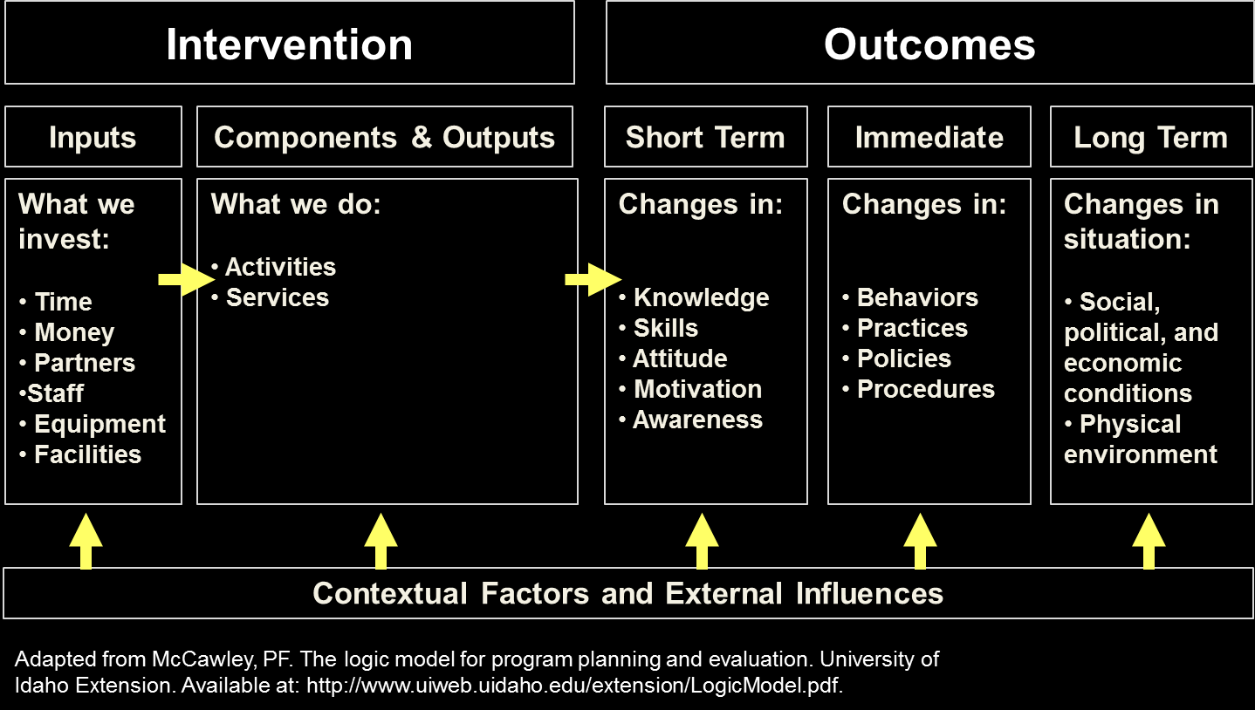
Elements of a Basic Logic Model

Slide 8
Purposes and users of logic models
Planners | Implementers | Evaluators
✓ | ✓ | ✓
✓ | ✓ | ✓
 | ✓ | ✓
 |  | ✓
 |  | ✓
Facilitate understanding of multi-faceted interventions
Clarify goals and conceptual gaps
Track progress and changing needs
Guide choice and timing of process and outcome measures
Provide a framework for interpreting results

Slide 9
Building a Logic Model
There is no single right way
  Depends on purpose and preference
Discuss these questions:
  What problem are you trying to solve?
  What outcomes would represent success?
  What intervention is required to achieve these outcomes?
  What inputs and resources are needed to deliver the intervention?
  What contextual factors are likely to affect the process?
Graphically illustrate answers and relationships

Slide 10
Applicability to medical home studies
Medical home models are multifaceted interventions
  Consist of multiple and interrelated components
  Affect change on multiple levels (patients, providers, practices, health systems)
  Include synergies and iterative feedback loops based on a continuous quality improvement framework
  Are tested in complex health systems contexts
Using logic models helps to overcome evaluation challenges raised by these complexities

Slide 11
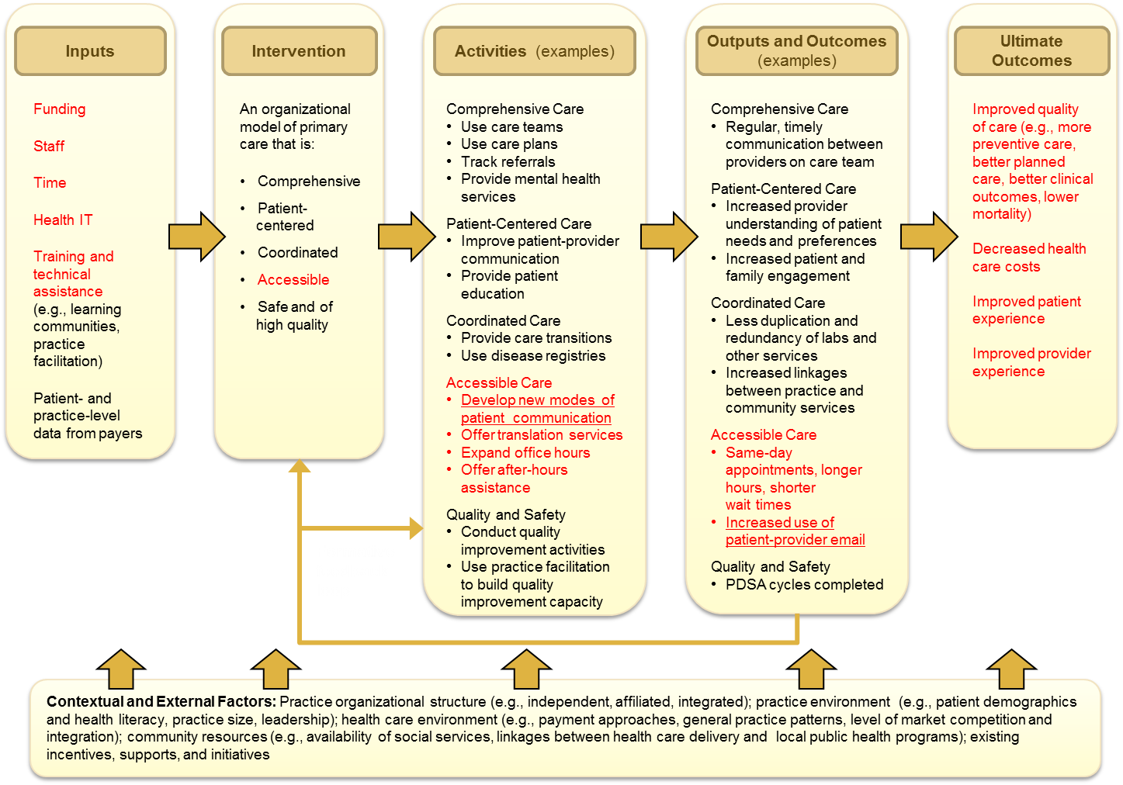
Example: Overarching Medical Home Logic Model

Slide 12
Example: Logic Model Related to Accessible Services
Inputs
Intervention
Activities
Outputs and Outcomes
Ultimate Outcomes
Funding
Staff
Time
Health IT
Training and technical assistance
Accessible
Care
New modes
of patient communication
Develop system for email communication between providers and patients
Outreach to patients about availability of email communication
Monitor and respond to email communications (by email, phone, or other means)
Outputs
Total number of emails received and sent
Distribution by provider and patient
Time spent by staff responding to emails
Degree of outreach to patients about email systems
Outcomes
Fewer in-person visits
More intensive in-person visits
Patients report better access
Fewer ER visits
Improved provider and patient satisfaction
Improved quality of care (e.g., more preventive care, better planned care)
Improved patient experience
Formative feedback
loop
Contextual and External Factors: Patient access to email and availability and ease of other forms of comunication (such as nurse advice line), patient familiarity with email, insurance coverage of email interactions, insurance co-pays

Slide 13
Advantages of Logic Models
Maintain a focus on intervention process and context
Balance brevity and complexity in data collection and analysis
Highlight systems change and interactions
Adapt to interventions of any scale

Slide 14
Limitations of Logic Models
Might oversimplify reality
Involve balancing depth and detail
Require mid-course review
Could inhibit creative thinking
Must be combined with other tools

Slide 15
More Information
The full brief contains a list of useful resources:
  General guides for developing logic models
  Examples of logic models for the medical home
The logic model brief and companion briefs in the series are available for download:
  http://pcmh.ahrq.gov/portal/server.pt/community/pcmh__home/1483/Optimal_Use_of_Logic_Models

Slide 16
Using Logic Models to Understand Variation in Implementation of Full Service Partnerships
June 4, 2013
AHRQ Advanced Methods Webinar
Todd Gilmer, PhD
Department of Family and Preventive Medicine
University of California, San Diego
AHRQ R01 HS01986-1

Slide 17
Overview
Background on the Mental Health Services Act and our study of Full Service Partnerships
Using a logic model to understand variation in implementation of FSPs
Using a logic model to explore how implementation factors related to fidelity relate to fidelity domains
Using a logic model to describe how one implementation factor is related to outcomes

Slide 18
Mental Health Services Act
In 2004, California voters approved proposition 63, which was signed into law as the MHSA
  Policy history included AB3777 (1988), AB34 (1999), and AB2034 (2000) which funded integrated models
1% tax on incomes > $ million to fund public mental health services in specific areas:
  Community Services and Supports
    Recovery oriented programs targeting the underserved: homeless, Latinos, Asians, older adults, transitional age youth
    28% of CSS funding to Full Service Partnerships
  Prevention and Early Intervention (e.g. stigma, suicide)
  Innovations (integrated mental and physical health)

Slide 19
Full Service Partnerships
FSPs provide supported housing and team based services with a focus on rehabilitation and recovery
FSPs are client centered and recovery oriented programs that do ‘whatever it takes’ to improve residential stability and mental health outcomes
FSPs were implemented with substantial stakeholder input, and were adapted to local environments, resulting in a wide diversity in approaches to both housing and services

Slide 20
Housing First
Developed in New York City by Pathways to Housing
Traditional housing model required treatment adherence and sobriety before placement
Housing first model emphasized immediate housing in scatter site apartments with tenancy rights
Adherence to the Housing First model can be measured using a fidelity scale
  Choice/affordability, scatter site housing, separation of housing and treatment, service philosophy, service array, team structure

Slide 21
Why use a Fidelity Scale to Study FSPs?
FSPs provide a natural experiment to study various approaches to housing and services
Housing First model provides a gold standard
Fidelity to Housing First provides a method of mapping FSP practices
Opportunity to identify both best practices among FSPs and the important elements of Housing First

Slide 23
Mixed Methods Study
Quantitative data
  Administrative data (N=8,553, 60% schizophrenia)
    Provides information on housing, service utilization and costs
    Difference-in-difference analysis
    Propensity score matched control group
  Fidelity to Housing First obtained through a survey of 94 FSP practices
    Survey based on the HF Fidelity Scale
    Respondents were FSP teams + clients
    Allows us to link practices to outcomes
Qualitative data
  Fidelity to Housing First obtained through 20 site visits
Notes:
Note: the Qualitative data will be discussed further by the next presenter.

Slide 24
FSP Survey Psychometrics Reveal a
Two Factor Model of Fidelity
Housing / service philosophy
  Housing process and structure
  Separation of housing and services
  Service philosophy
Service array / team structure
  Service array
  Team structure

Slide 25
Qualitative Analysis Reveal Implementation Factors
Individuals: Program director knowledge and beliefs about the intervention
Inner setting: Program culture, compatibility, communication, and readiness for implementation
Outer setting: Clients’ needs and resources (i.e. Target pop.), External policy and incentives

Slide 26
Implementation Domains
Fidelity Domains
Individuals
Housing / Service Philosophy
Inner Setting
Fidelity
Service Array Treatment
Outer Setting

Slide 27
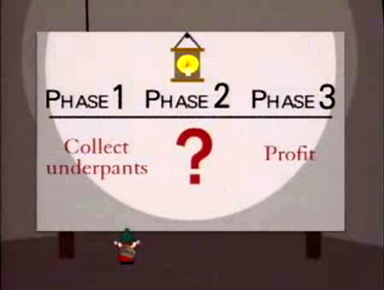
Gnomes Plan for Profit
South Park, S2, Ep17

Slide 28
Target Population
Indirect Effect
Direct Effect
Fidelity to HF
Client Outcomes
Total Effect

Slide 29
Changes in Days Homeless Over One Year by Quintiles of Fidelity, Adjusted and Unadjusted

Slide 30
Difference in Difference Estimates of Costs by Quintile of Propensity Score

Slide 31
Conclusions
Logic models are a useful tool in helping us to understand how variation in implementation is related to outcomes
Logic models can help identify gaps in our understanding mid-research
A logic model in this study helps to illustrates how program fidelity relates to the illness severity of the population enrolled, and how tat related to outcomes

Slide 32
Thank you for attending!
Webinar #4: Formative Evaluation
Presenter: Jeffrey Smith, PhD
Discussant: Cheryl McDonnell, PhD
Moderator: Michael I. Harrison, PhD
Sponsored by AHRQ’s Delivery System Initiative in partnership with the AHRQ PCMH program
July 15, 2013 1 p.m.
Register for this and other events in our series on advanced methods in delivery system research, here: http://bit.ly/EconometricaAHRQ

Slide 33
For more information about the AHRQ PCMH Research Methods briefs, please visit: http://www.pcmh.ahrq.gov/portal/server.pt/community/pcmh__home/1483/pcmh_evidence___evaluation_v2

