Slide 1
Advanced Methods Webinars:
Integrating Mixed Methods in Health Services and Delivery System Research
Presenters:
Benjamin Crabtree, PhD
Michael K. Magill, MD
Debra L. Scammon, PhD
Andrada Tomoaia-Cotisel, MHA, PhD(c)
Moderator: Michael I. Harrison, PhD
Sponsored by AHRQ’s Delivery System Initiative in partnership with the AHRQ PCMH program
December 3, 2013

Slide 2




Speaker Introductions
Ben Crabtree is a medical anthropologist. He is Professor and Director of Research at the Department of Family Medicine and Community Health, Rutgers-Robert Wood Johnson Medical School.
Michael Magill is Chairman of the University of Utah School of Medicine Department of Family and Preventive Medicine; Executive Medical Director, University of Utah Health Plans; and Director of Research, University of Utah Community Clinics/Community Physicians Group.
Debra Scammon is Emma Eccles Jones Professor of Marketing; Director, Masters of Healthcare Administration, David Eccles School of Business; and Adjunct Professor, Department of Family and Preventive Medicine, School of Medicine at the University of Utah.
Andrada Tomoaia-Cotisel is a Research Associate, Department of Family and Preventive Medicine, School of Medicine, University of Utah; and a Doctoral candidate, Department of Health Services Research and Policy, Faculty of Public Health Policy, London School of Hygiene and Tropical Medicine.

Slide 3
Integrating Mixed Methods in Health Services and Research
Benjamin F. Crabtree, PhD
(Rutgers Robert Wood Johnson Medical School)
William L. Miller, MD, MA
(Lehigh Valley Health Network)
Advanced Methods Webinar
December 3, 2013

Slide 4
Attributes of Mixed Methods Research
Rigorous collection and analysis of both qualitative and quantitative data
Qualitative and quantitative data are mixed (integrate or link) by combining them sequentially or by embedding
Can be incorporated in a single study or in multiple phases of a program of research
Designs are framed within a broader framework or theoretical lens
Data are combined or integrated into specific mixed methods research designs that direct the study
See: Creswell J, Plano-Clark V. Designing and Conducting Mixed Methods Research, 2nd Edition. Sage Pubs, 2011.

Slide 5
FYI: Qualitative Data Collection Include:
Interviews (e.g. key informant, depth, focus group)
Observations (e.g. unstructured, structured, participant)
Recordings (e.g. video and audio)
Existing documents (e.g. memos, reports, charts, etc.)

Slide 6

Lots of Mixed Methods Resources – Journal Articles
Curry, L. A., H. M. Krumholz, A. O’Cathain, V. L. Plano Clark, E. Cherlin, and E. H. Bradley. 2013. “Mixed Methods in Biomedical and Health Services Research.” Circulation 6 (1): 119–23.
Palinkas, L. A., S. M. Horwitz, P. Chamberlain, M. S. Hurlburt, and J. Landsverk. 2011. “Mixed-Methods Designs in Mental Health Services Research: A Review.” Psychiatric Services 62 (3): 255–63.
Zhang, W., and S. Watanabe-Galloway. 2013. “Using Mixed Methods Effectively in Prevention Science: Designs, Procedures, and Examples.” Prevention Science: The Official Journal of the Society for Prevention Research [Epub ahead of print].

Slide 7

Lots of Mixed Methods Resources - Books

Slide 8

Best Practices for Mixed Methods Research in the Health Sciences

Slide 9

A New Resource:

Slide 10
Health Services Research Theme Issue
Vol. 48, No. 6, Part II December 2013
Miller WL, Crabtree BF, Harrison MI, Fennell ML. Integrating Mixed Methods in Health Services and Delivery Systems Research (Editorial)
Fetters MD, Curry LA, Creswell JW. Achieving Integration in Mixed Methods Designs – Principles and Practices.
Bowers B, Cohen LW, Elliot AE, et al. Creating and Supporting a Mixed Methods Health Services Research Team.
Scammon DL, Tomoaia-Cotisel A, Day, RL, et al. Connecting the Dots and Merging Meaning: Using Mixed Methods to Study Primary Care Delivery Transformation.
Zickmund SL, Yang S. Mulvey EP, et al. Predicting Cancer Mortality: Developing a New Cancer Care Variable Using Mixed Methods and the Quasi-Statistical Approach.
Hamilton AB, Cohen AN, Glover DL, et al. Implementation of Evidence-Based Employment Services in Specialty Mental Health.
Gilmer TP, Katz ML, Stefancic A, Palinkas LA. Variation in the Implementation of California’s Full Service Partnerships for Persons with Serious Mental Illness.

Slide 11
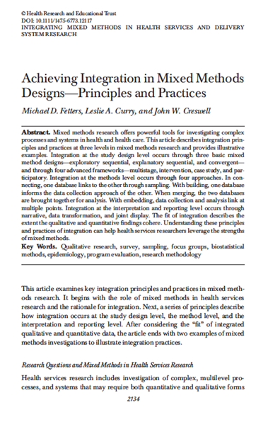
Three Basic Designs
Sequential Exploratory
Sequential Expanatory
Convergent
Notes:
Note that the Fetters, Curry and Creswell article provides a nice overview of mixed methods.

Slide 12
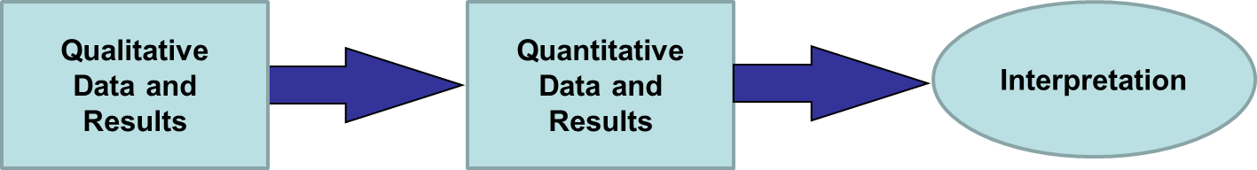
Sequential Exploratory Mixed Methods Design

Slide 13
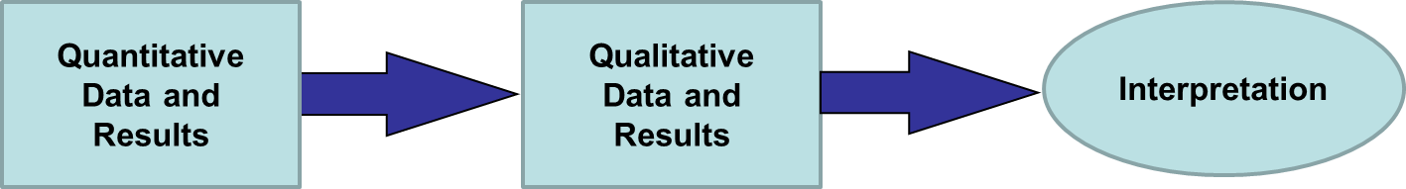
Sequential Explanatory Mixed Methods Design

Slide 14
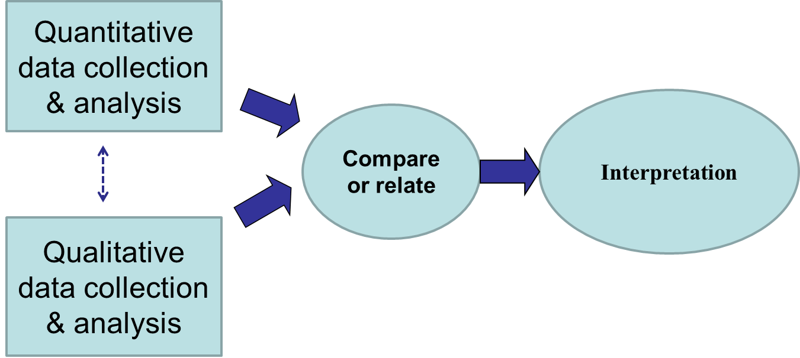
Convergent Mixed Methods Design

Slide 15

Four Advanced Frameworks
Multistage
Intervention
Case Study
Participatory
Methods Level Integration
Connecting
Building
Merging
Embedding
Interpretation & Reporting Level Integration
Narrative weaving
Data transformation
Joint display

Slide 16
HSR Theme Issue Includes Diverse Content!
Miller WL, Crabtree BF, Harrison MI, Fennell ML. Integrating Mixed Methods in Health Services and Delivery Systems Research (Editorial)
Fetters MD, Curry LA, Creswell JW. Achieving Integration in Mixed Methods Designs – Principles and Practices.
Bowers B, Cohen LW, Elliot AE, et al. Creating and Supporting a Mixed Methods Health Services Research Team.
Scammon DL, Tomoaia-Cotisel A, Day, RL, et al. Connecting the Dots and Merging Meaning: Using Mixed Methods to Study Primary Care Delivery Transformation.
Zickmund SL, Yang S. Mulvey EP, et al. Predicting Cancer Mortality: Developing a New Cancer Care Variable Using Mixed Methods and the Quasi-Statistical Approach.
Hamilton AB, Cohen AN, Glover DL, et al. Implementation of Evidence-Based Employment Services in Specialty Mental Health.
Gilmer TP, Katz ML, Stefancic A, Palinkas LA. Variation in the Implementation of California’s Full Service Partnerships for Persons with Serious Mental Illness.

Slide 17
Crabtree & Miller Lessons from 20 Years of Mixed Methods Research
Remember the research questions!
Mixed methods research is best done in collaborative teams
Collaborative teams take time and relationship building (see Bowers, et al. and Scammon, et al. in HSR Theme Issue)
Think of both individual projects, but also a program of research with multiple projects
Reporting stories to accompany numbers provides an effective means for engaging readers and policy makers
Too often, quantitative approaches are misapplied to phenomena requiring qualitative or mixed methods
Ensure the strengths and weaknesses of each selected method complement each other
Continually evaluate methodology throughout the study

Slide 18
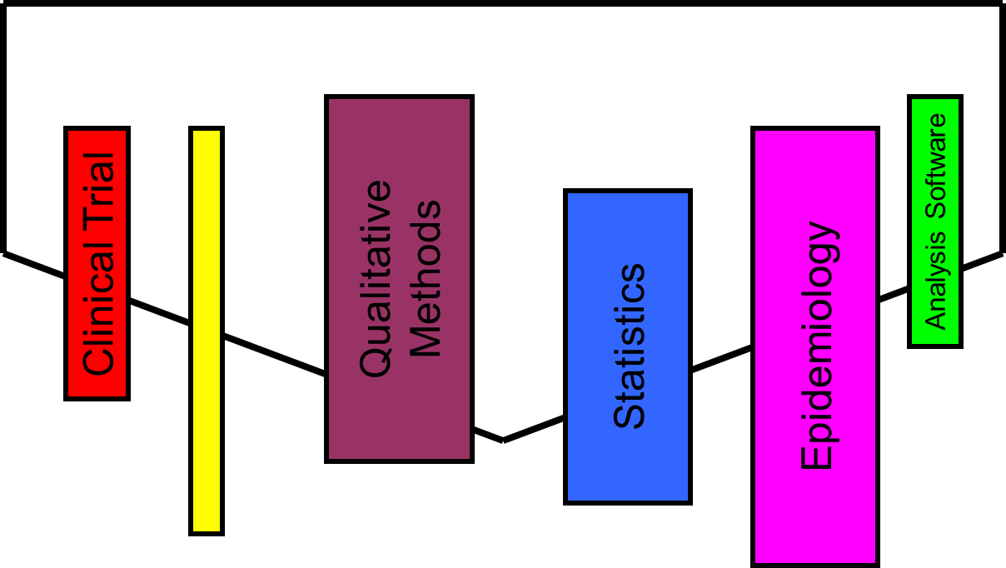
The “Mixed Methods Researcher” works best in TEAMS

Slide 19
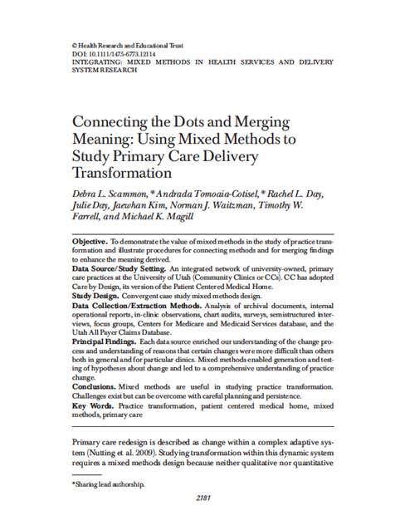
HSR Theme Issue Article by Scammon, et al. illustrates many of the core attributes of mixed methods designs.

Slide 20
Connecting the Dots and Merging Meaning: Using Mixed Methods to Study Primary Care Delivery Transformation
Advanced Methods Webinar
December 3, 2013
Debra L. Scammon, Ph.D.
Andrada Tomoaia-Cotisel, M.P.H., M.H.A., Ph.D. Candidate
Michael K. Magill, M.D.
Health Services Research
Vol. 48, No 6, Part II, December 2013

Slide 21
Acknowledgements
This project was supported by grants R18HS019136 and R18HS020106 from the Agency for Health Care Research and Quality (AHRQ).
The content of this presentation is solely the responsibility of the authors and does not necessarily represent the official views of the AHRQ.

Slide 22
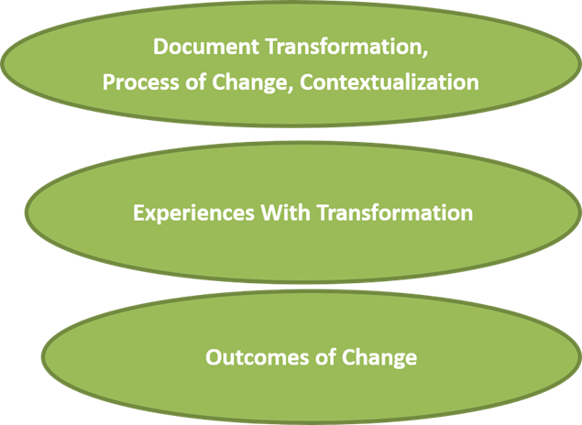
Retrospective Study of Primary Care Redesign
Study Aims:

Slide 23

Trans-disciplinary Team
Debra Scammon, Ph.D., Marketing and Consumer Behavior Researcher
Andrada Tomoaia-Cotisel, M.P.H., M.H.A., doctoral candidate in Public Health
Julie Day, M.D., Family Medicine Physician and Quality Medical Director, Community Clinics
Rachel Day, Research Associate and Technical Writer
Jaewhan Kim, Ph.D., Biostatician and Health Economist
Norman Waitzman, Ph.D., Health Economist
Timothy Farrell, M.D., Geriatrician and Family Medicine Physician
Michael Magill, M.D., Family Medicine Physician and Executive Medical Director University of Utah Health Plans (PI)

Slide 24
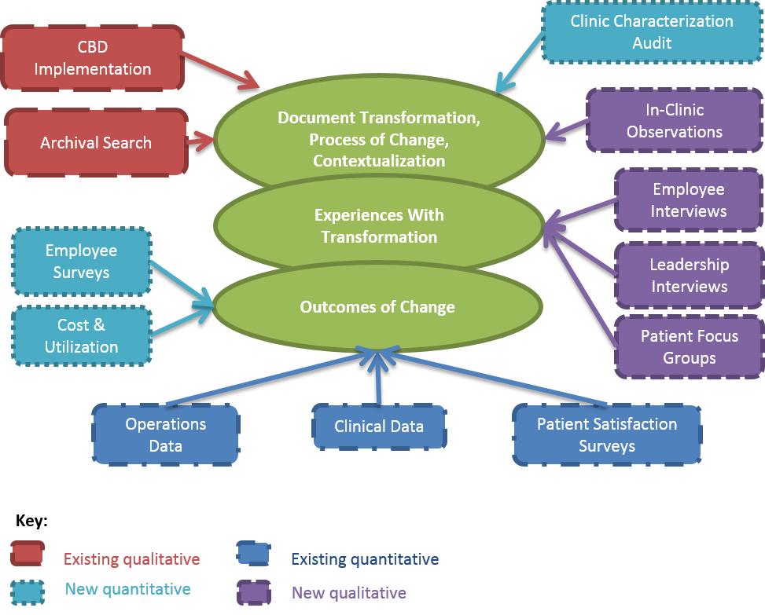
Overview of Study Aims and Mixed Methods

Slide 25
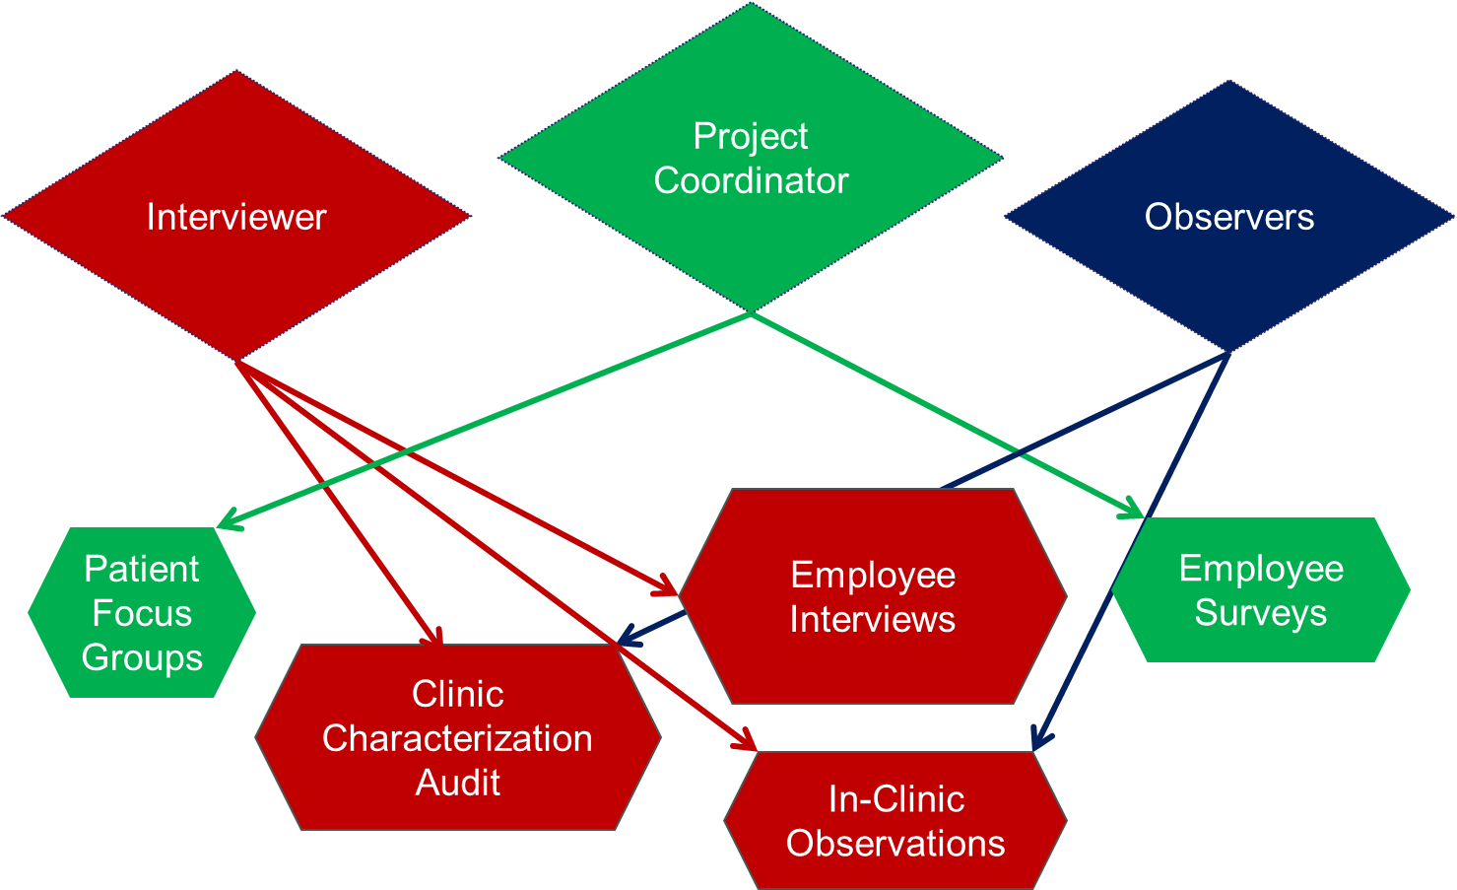
Connections Across Researchers and Methods

Slide 26
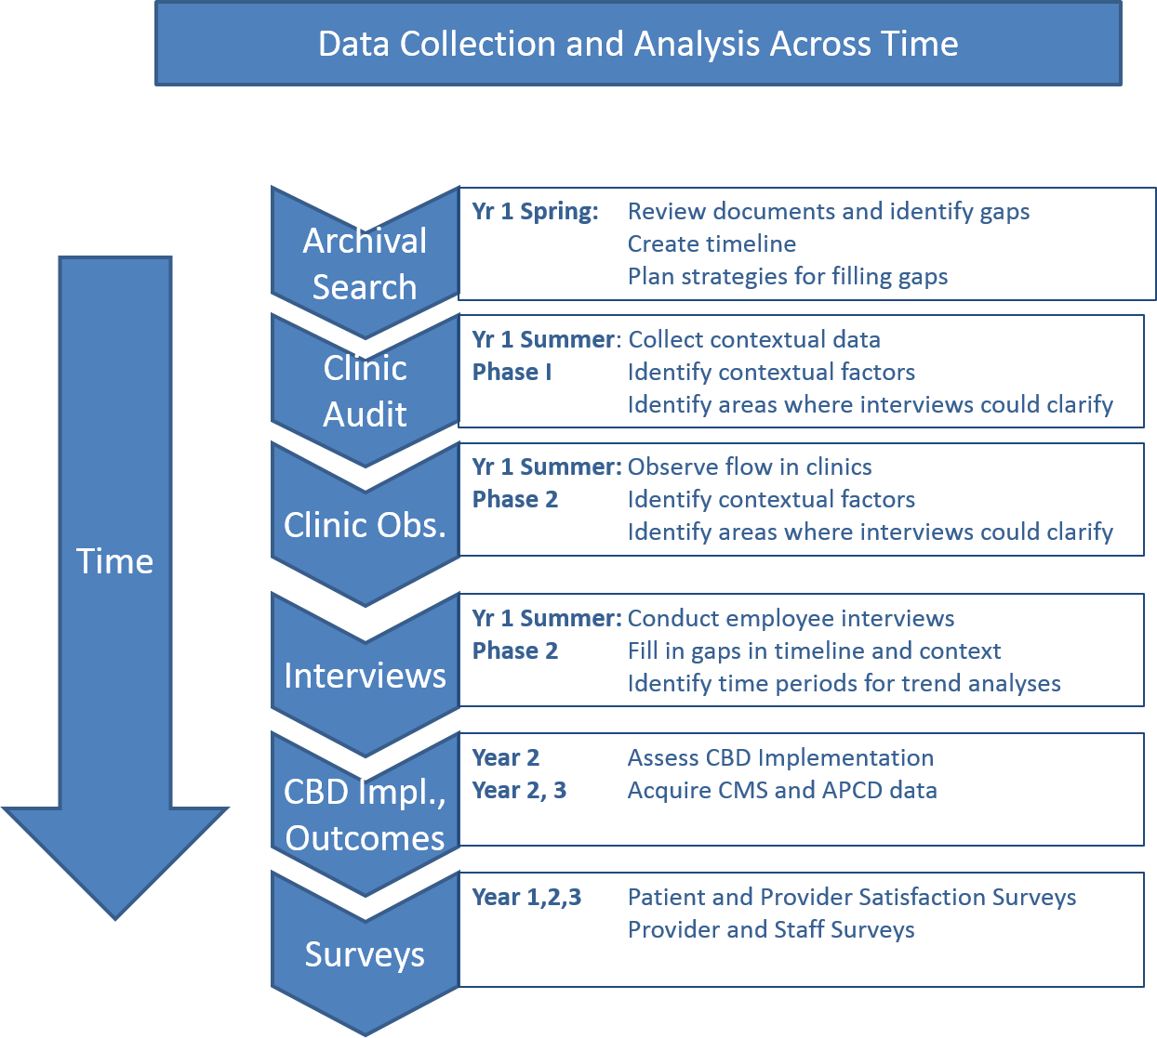
Data Collection and Analysis Across Time

Slide 27
Capitalize upon Existing Data
Operations data already collected by the organization we were studying
Infrastructure for collecting and reporting these data was already in place
  Consider nature of operations data
  Consider realities of extracting necessary data
Notes:
Examples
Operations data – CBD implementation assessment tool –
Infrastructure – Quality data reporting for CMS demonstration project implemented into Epic; reports generated quarterly
Nature of operations data –
measured elements evolved over time as strategy changed;
some measures were less than ideal – PCP not always identified in EMR
some assessments relied upon small sample – 5 visits/provider on one day in clinic
Data extraction – dependent on organization staff; only one person able to access data; must fit into organization work priorities ;
Staff didn’t prioritize research team needs

Slide 28
Plan New Data Collection Carefully
  Fit within workflow of the operational clinics
  Participants may need to adjust schedules
  Relevant to leadership and managers while meeting the needs of the research
  Be realistic about time required to obtain data
  Be flexible
  Report to management regarding implications of findings

Slide 29
Merging Data to Make Meaning
An example…

Slide 30
Does performance vary among teams?
CBD Implementation (Selected Measures from Planned Care) | Team 1 Led by Provider A | Team 5 Led by Provider B
Labs done prior to visit | 0% | 80%
AVS given to patient | 36% | 75%
Commitment to the Visions
“but I’m also one of the busiest providers … [so] it’s more a matter of you know, what works for me.” – Provider A (Team 1)
“… somebody comes in for bronchitis and… hasn’t had a mammogram; hasn’t had a colonoscopy; hasn’t had a flu shot… you have to slow down to provide all of those quality issues that you need...” – Provider B (Team 5)

Slide 31

Is implementation higher among those emphasizing quality over productivity?
Quality Scores (13 months average scores; % of eligible patients receiving recomm. screening) | Team 1 Led by Provider A | Team 5 Led by Provider B
Coronary artery disease | 77% | 91%
Diabetes | 65% | 78%
Heart Failure | 40% | 38%
Preventive Care | 49% | 80%
Total | 54% | 80%
Productivity (3 month average; relative value units) | Team 1 Led by Provider A | Team 5 Led by Provider B
Work RVUs (ratio) | 1.94 | 1
Appointment count (ratio) | 1.47 | 1

Slide 32
Does attempting to increase either (or both) put a burden on the care team?
Remember Team 5 had higher quality scores…
Employee Surveys (average for the team) | Team 1 Led by Provider A | Team 5 Led by Provider B
Teamness (higher = better) | 71 | 56
Professional Efficacy (higher = better) | 26 | 27
Exhaustion (lower = better) | 9 | 20
Cynicism (lower = better) | 11 | 15
Description of How the Team Functions
“… [we drop in] all the history from any labs done; any radiology done… we get those [specialty] results and we have them sitting on the desk in the room for the visit.” – MA (Team 5)
“with other doctors, yes. [On Team 1], no... we have so many regulars…” – Provider A (Team 1)

Slide 33
Insights from Mixed Methods on Practice Redesign
  Using mixed methods, we were able to:
  Document variation in implementation & outcomes
  Elucidate tension between productivity and quality
        Explore differences in the way providers approach redesign
  Explore differences in MAs’ ability to implement
  Elucidate resulting impact on team members

Slide 34

  Value of Mixed Methods Research
Each data source enriched our understanding of the change process
Mixed methods revealed a more complete understanding of the transformation process

Slide 35

Value of Mixed Methods Research
Facilitated more effective engagement between research team and CC leadership
Provided evidence base to support on-going practice redesign
Challenges exist but can be overcome with careful planning and persistence
Notes:
Mixed methods are useful in studying practice transformation
Examples of changes

Slide 36

Conclusions
Gained a more nuanced perspective on implementation
  appreciate multiple perspectives;
  revealed different aspects of change process and outcomes;
  extracted richer meaning than that available from any single source

Slide 37

Conclusions
Enhanced access to and interpretation of data
  inclusion of multi-disciplinary research team with members from inside and outside the organization

Slide 38

Conclusions
Facilitated exploration of interactions between components of a complex redesign effort
highlighted tensions
created through
interdependencies

Slide 39
Questions?

Slide 40
Thank you for attending!
Papers from the HSR special issue are available at:
http://onlinelibrary.wiley.com/journal/10.1111/(ISSN)1475-6773/earlyview
For more information about the AHRQ PCMH Research Methods briefs, please visit:
http://pcmh.ahrq.gov/page/evidence-and-evaluation
Other Webinars in the AHRQ Advanced Methods Series are available at:
http://www.ahrq.gov/professionals/systems/system/advanced-methods/index.html

