Slide 1

Assess and Adapt: Understanding the Science of Safety and Reliability
Lisa H. Lubomski, PhD
Assistant Professor, Johns Hopkins Medicine
Armstrong Institute for Patient Safety & Quality
Department of Anesthesiology & Critical Care Medicine

Slide 2
Learning Objectives
Define the need for creating reliability in health care
Describe “CUSP” as an intervention to improve reliability of health care delivery and outcomes
Discuss the why and how of CUSP Step One: Understanding the Science of Safety

Slide 3
How dangerous is health care?
Fewer than one death per 100,000 encounters
  Nuclear power
  European railroads
  Scheduled airlines
One death in less than 100,000 but more than 1,000 encounters
  Driving
  Chemical manufacturing
More than one death per 1,000 encounters
  Bungee jumping
  Mountain climbing
  Health care

Slide 4

Putting Safety in Context
Advances in medicine have led to positive outcomes:
  Most childhood cancers are curable
  AIDS is now a chronic disease
  Life expectancy has increased 10 years since the 1950s
However, sponges are still found inside patients’ bodies after operations.

Slide 5
Health Care Defects
In the U.S. health care system:
  7 percent of patients suffer a medication error²
  On average, every patient admitted to an intensive care unit suffers an adverse event^{3,4}
  44,000 to 99,000 people die in hospitals each year as the result of medical errors⁵
  Over half a million patients develop catheter-associated urinary tract infections resulting in 13,000 deaths a year⁶
  Nearly 100,000 patients die from health care-associated infections (HAIs) each year, and the cost of HAIs is $28 to $33 billion per year⁷
  Estimated 30,000 to 62,000 deaths from central line-associated blood stream infections per year⁸

Slide 6
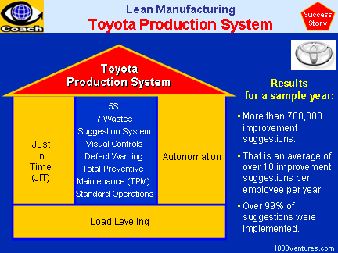
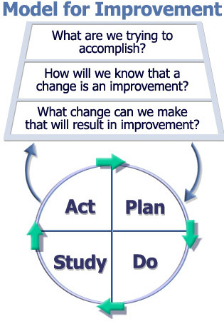

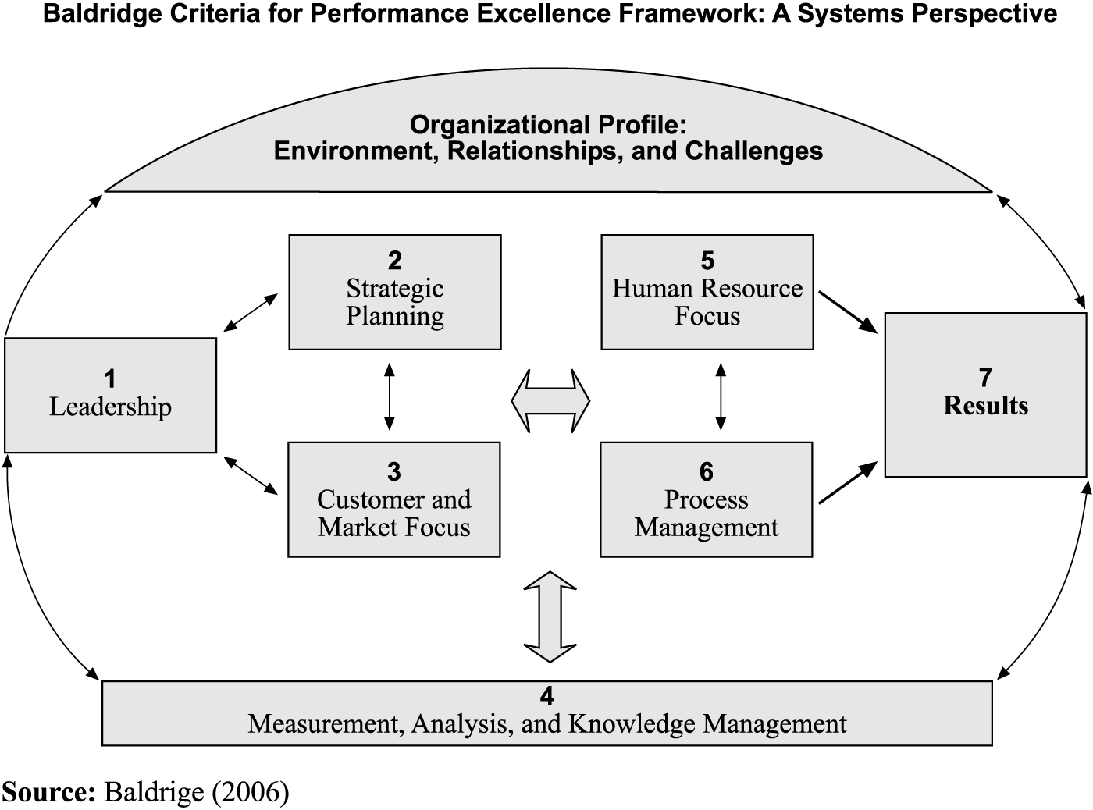
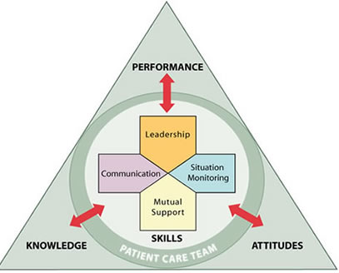
Challenging… So Many Solutions?
CUSP

Slide 7

The Need to Improve Safety Culture is Not Unique to Health Care

Slide 8
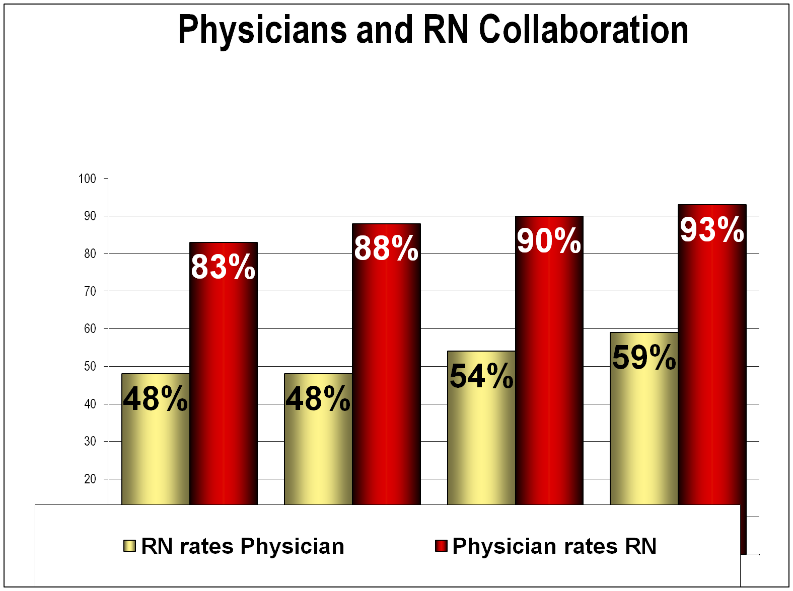
Physicians and RN Collaboration
% of respondents reporting above adequate teamwork
L&D RN/MD ICU RN/MD OR RN/Surg CRNA/Anesth

Slide 9
Goals of CAUTI Project
To reduce average CAUTI rates in participating unit by 25% through the following steps:
  To educate health care workers about the appropriate management of urinary catheters, including indications for the placement and continued use of urinary catheters
  To prevent the placement of unnecessary urinary catheters
  To promptly remove urinary catheters that are no longer needed

Slide 10
Model to Improve Care
Translating Evidence into Practice (TRiP)
Comprehensive Unit-based Safety Program (CUSP)
Summarize the evidence in a checklist
Identify local barriers to implementation
Measure performance
Ensure all patients get the evidence
  Engage
  Educate
  Execute
  Evaluate
Educate staff on science of safety
Identify defects
Assign executive to adopt unit
Learn from one defect per quarter
Implement teamwork tools

Slide 11
CUSP and CAUTI Interventions
CAUTI
Care and Removal Intervention
Placement Intervention
CUSP
Educate on the Science of Safety
Removal of unnecessary catheters
Proper care for appropriate catheters
Determination of appropriateness
Sterile placement of catheter
Identify defects
Assign executive to adopt unit
Learn from defects
Implement teamwork and communication tools
Notes:
This slides summarizes the interventions of this effort:
The 5 elements of the Comprehensive Unit-based Safety Program or CUSP
Care and Removal
Removal of unnecessary indwelling catheters based on HICPAC recommendations
Proper care for appropriate indwelling catheters
3) Placement Intervention
Determination of appropriateness of indwelling catheter based on HICPAC recommendations
Sterile placement of indwelling catheter

Slide 12
What is CUSP?
Comprehensive Unit-based Safety Program
An intervention to improve teamwork and safety culture and learn from mistakes
http://www.ahrq.gov/professionals/education/curriculum-tools/cusptoolkit/index.html

Slide 13
Use of CUSP Results In:
Improved engagement of staff and senior leadership
Improved communication among care team members
Shared mental models
Knowledge and awareness of potential hazards and barriers to safety
Collaborative focus on systems of care

Slide 14
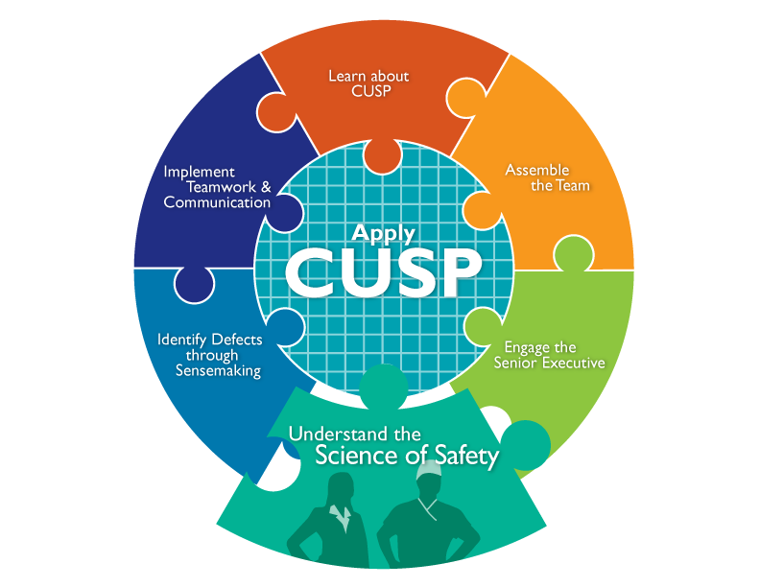
CUSP Toolkit

Slide 15
The Science of Safety
Every system is perfectly designed to achieve its end results
Safe design principles must be applied to technical work and teamwork
Teams make wise decisions when there is diverse and independent input

Slide 16
Understanding System Factors
Corporate
Regional
Clinic
Work Environment
Team Factors
Individual Provider
Task Factors
Patient Characteristics
Adapted from Vincent

Slide 17
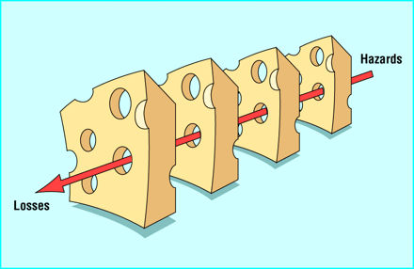
System Failures Leading to Error
(Reason, 1990)

Slide 18
Three Principles of Safe Design
Standardize
Create independent checks
Learn when things go
wrong

Slide 19
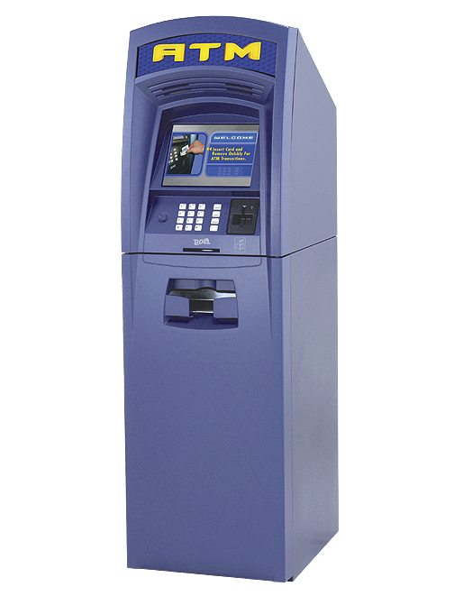
Eliminate Steps

Slide 20
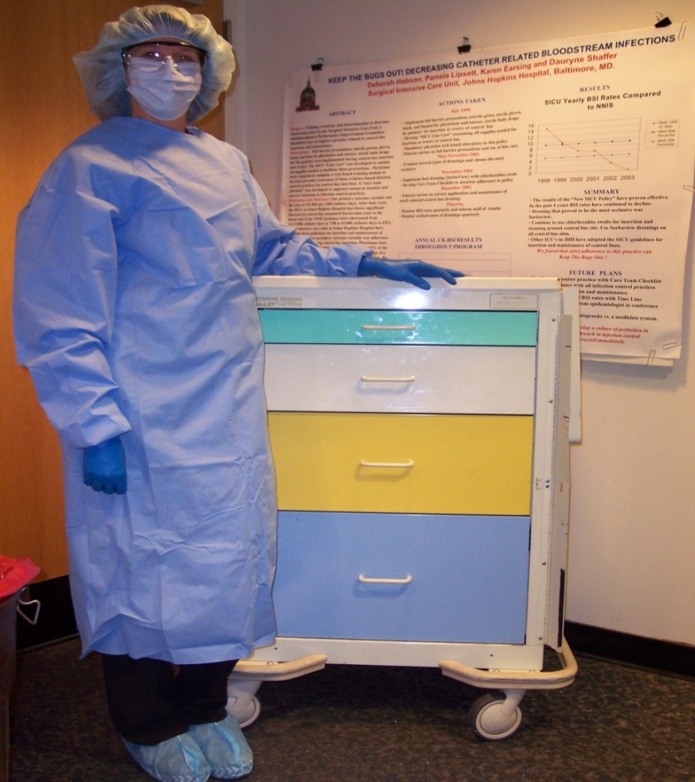
Standardize

Slide 21
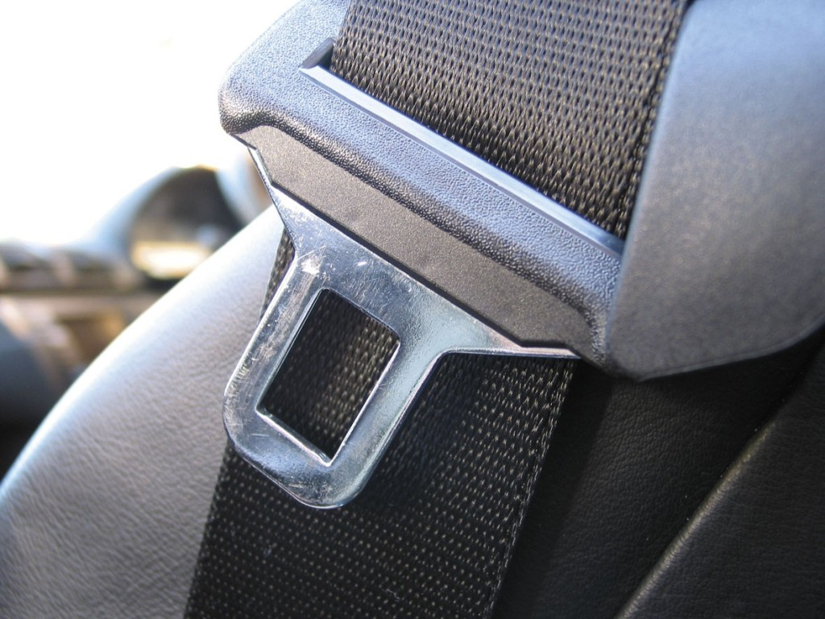
Create Independent Checks

Slide 22
Evidence-based Behaviors to Prevent CLABSI
(MMWR. 2002;51:RR-10)
Remove Unnecessary Lines
Wash Hands Prior to Procedure
Use Maximal Barrier Precautions
Clean Skin with Chlorhexidine
Avoid Femoral Lines

Slide 23
Independent Check: CLABSI Insertion Checklist
(Crit Care Med 2004;32(10):2014.)
Before the procedure, did clinician inserting line:
  Wash hands
  Sterilize procedure site
  Drape entire patient in a sterile fashion
During the procedure, did they:
  Use sterile gloves, mask and sterile gown
  Maintain a sterile field
Did all personnel assisting with procedure follow the above precautions?
Are staff empowered to stop the procedure if violation occurs?

Slide 24
Learn When Things Go Wrong
First vs. Second order problem solving
  Fixing the immediate problem
  Fixing the system factors that allowed the problem to occur

Slide 25
Principles of Safe Design Apply to Technical and Teamwork

Slide 26
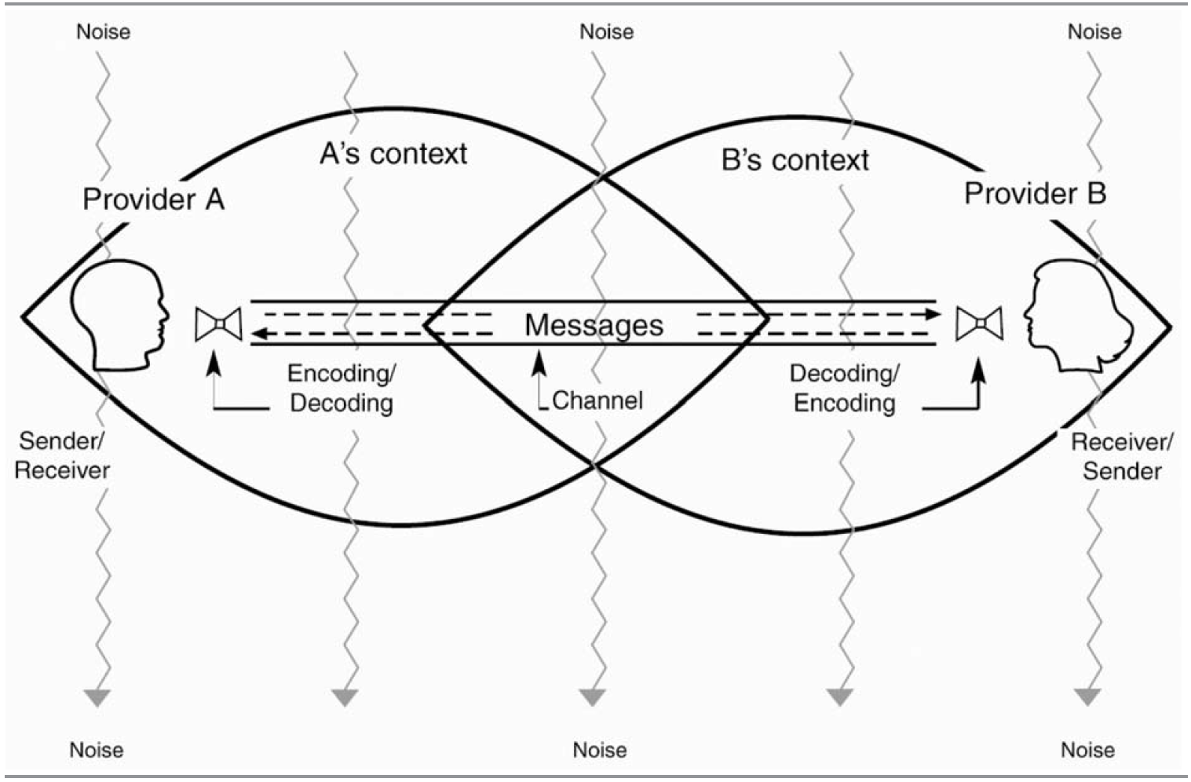
Safe Teamwork: the Challenge of Communicating (Dayton 2007)

Slide 27
Teams Make Wise Decisions When There is Diverse and Independent Input (Heifetz R, 1994)
Wisdom of Crowds *
  Seek involvement from clinicians at all levels of the organization
Alternate between convergent and divergent thinking
  What does everyone think?
  What will be “our” policy/procedure/practice?
Get from the dance floor to the balcony level
  Individual challenges
  System challenges

Slide 28
Science of Safety Education
Mandatory Science of Safety Training
Adaptive Activity/training done Prior to CAUTI technical work
Safety Survey to identify at-risk Departments
Unit Safety Teams
Unit Safety Action Plans
Senior Executive Partnerships

Slide 29
Learning from CUSP
Culture is local
  Implement in a few units, adapt and spread
  Include frontline staff on improvement team
Not linear process
  Iterative cycles
  Takes time to improve culture
Couple with clinical focus
  No success improving culture alone
  CUSP alone viewed as ‘soft’
  Vehicle for clinical change

Slide 30
Principles: Science of Safety
Accept that we will make mistakes
Focus on systems rather than blame
Speak up if you have concerns listen when others do
Create clear goals, ask questions early
Standardize, create independent checks, and learn from mistakes
Notes:
This slide summarises the main message so far: Changing situations is more effective than trying to change human nature.

Slide 31
Summary
Safety is a property of system
We need lenses to see the system
We need to provide a safe space to voice what we see
CUSP is a structured approach to learn from mistakes and improve safety culture
Educating on the Science of Safety is Step 1

Slide 32
Summary
Every system is designed to achieve its anticipated results
The principles of safe design are standardize when you can, create independent checks, and learn from defects
The principles of safe design apply to technical work and teamwork
Teams make wise decisions when there is diverse input

Slide 33
Action Items
Have all members of the CUSP CAUTI Team view the Science of Improving Patient Safety video
Put together a roster of who on your unit needs to view the Science of Safety video
Develop a plan to have all staff on your unit view the Science of Improving Patient Safety video
  Assess what technologies you have available for staff to view
  Identify times for viewing it (e.g., staff meetings, individual admin hours)

Slide 34
References
Agency for Healthcare Research and Quality, Department of Defense. TeamSTEPPS. Available at www.ahrq.gov/teamsteppstools/instructor/index.html
Bates DW, Cullen DJ, Laird N, et al. Incidence of adverse drug events and potential adverse drug events. JAMA. 1995;274(1):29–34.
Donchin Y, Gopher D, Olin M, et al. A look into the nature and causes of human errors in the intensive care unit. Crit Care Med. 1995;23:294–300.
Andrews LB, Stocking C, Krizek T, et al. An alternative strategy for studying adverse events in medical care. Lancet. 349:309–313,1997.

Slide 35
References
Kohn L, Corrigan J, Donaldson M. To err is human: building a safer health system. Washington, DC: National Academy Press; 1999.
Scott, RD. The Direct Medical Costs of Healthcare-Associated Infections in U.S. Hospitals and the Benefits of Prevention. March 2009. http://www.cdc.gov/ncidod/dhqp/pdf/Scott_CostPaper.pdf
Klevens M, Edwards J, Richards C, et al. Estimating Health Care-Associated Infections and Deaths in U.S. Hospitals, 2002. PHR. 2007;122:160–166.
Ending health care-associated infections, AHRQ, Rockville, MD; 2009. http://www.ahrq.gov/qual/haicusp.htm.
Vincent C, Taylor-Adams S, Stanhope N. Framework for analysing risk and safety in clinical medicine. BMJ. 1998;316:1154–57

Slide 36
References
Reason JT. Human Error. New York, NY: Cambridge University Press, 1990.
Heifetz R. Leadership without easy answers, president and fellows of Harvard College. Cambridge, MA: Harvard University Press;1994.
Dayton E, Henriksen K. Communication failure: basic components, contributing factors, and the call for structure. Jt Comm J Qual Patient Saf. 2007;33(1): 34–47.
Pronovost P, Needham D, Berenholtz S, et al. An intervention to decrease catheter-related bloodstream infections in the ICU. New Engl J Med. 2006;355(26):2725–32.

Slide 37
Thank you!
Questions?

Slide 38
Funding
Prepared by the Health Research & Educational Trust of the American Hospital Association with contract funding provided by the Agency for Healthcare Research and Quality through the contract, “National Implementation of Comprehensive Unit-based Safety Program (CUSP) to Reduce Catheter-Associated Urinary Tract Infection (CAUTI), project number HHSA290201000025I/HHSA29032001T, Task Order #1.”

