Slide 1
Breaking Down Barriers to Aseptic Catheter Insertion
Milisa Manojlovich, PhD, RN, CCRN
Associate Professor
University of Michigan School of Nursing
Stacy Martin, RN, BSN, CIC
Manager, Infection Prevention
Moffitt Cancer Center
Stephanie Carraway, MPH candidate
Infection Prevention Specialist
Moffitt Cancer Center

Slide 2
Learning Objectives
Discuss results of a study that identified common barriers to the use of aseptic insertion technique.
Describe the “Four E’s” and associated strategies to guide practice change.
Apply the concept of mindfulness to catheter insertion.
State how one hospital assessed catheter insertion practices and implemented strategies to correct improper techniques.
Notes:
Hospital staff provide ongoing support and expertise (r/t CAUTI prevention, catheter use and safety culture)

Slide 3
Polling Question
What is your role at the hospital?
Infection Preventionist
Physician
Nurse leader or nurse educator
Bedside nurse
Other…

Slide 4
Quality Improvement in the ED: A Focus on Urinary Catheter Insertion
Study purpose:
determine if changes (in the hospital and nationwide) have contributed to improved catheter insertion practices;
explore barriers and facilitators to adherence of urinary catheter insertion guidelines.
4

Slide 5
Methods
2 teams of nursing students
0630 – 2100, in 4 or 8 hour blocks of time
January 29 – June 30, 2014
Observation, checklists, field notes

Slide 6
Results
65 patients and 81 insertions were observed
In only 11% of cases was no one else present (buddy system in use)
Mean insertion time 6 minutes (range 2 – 22)
No hand hygiene prior to 74% of insertions
No hand hygiene in 91% post insertion
59% of insertion attempts were associated with a major break in sterile technique

Slide 7
Categories and Frequencies of Major Breaks in Sterility
Category | Frequency (%) | Examples
Contamination of sterile field | 22 (27%) | Nurse touched items on sterile field with bare non-sterile hands. Stethoscope/garment/torso touched sterile field.
Contamination of the catheter | 25 (31%) | Patient’s labia closed over the catheter during insertion and contaminated the catheter; nurse did not get a new one. Catheter tip touched genitalia before being introduced into urethra.
Breach of sterile barrier | 31 (38%) | Sterile gloved hand used to swab genitalia (without tongs); same hand used to insert catheter. Nurse inserting catheter ripped her sterile gloves, did not get new ones.
Notes:
*In many cases, there was more than one breach/case

Slide 8
Barriers to Aseptic Insertion Technique
Inconsistent or inconvenient locations for hand gel
Little room in cubicles to set up sterile field
Cotton wisps clung to tongs in kits
Common practice to don sterile gloves over clean gloves

Slide 9
Successful Strategies to Guide Practice Change: 4 E’s
Engagement
Education
Execution
Evaluation

Slide 10
Engagement
Activities strictly within the nursing domain may not perceived as being important or of much value, compared to activities that cross disciplinary boundaries.
Catheter insertion may be perceived as one of many “tasks” rather than as a component of evidence-based practice.

Slide 11
Strategies to Promote Engagement
Aseptic insertion of indwelling urinary catheters is a component of evidence-based practice, no matter what the discipline.
Develop a culture where evidence-based practice is recognized and rewarded.
Think in terms of nursing practice components rather than a set of tasks to be completed.

Slide 12
Education
There are few similarities between the controlled environment in which health care providers learn to insert catheters and the chaotic work environments in which they practice.
Health care providers may not have the skills to maintain aseptic technique given work environment constraints.
They may observe peers inserting catheters and notice that aseptic technique is not used.

Slide 13
Education Strategies
Develop competencies and consider annual competency testing for catheter insertion technique.
Require that there be oversight for catheter insertion by a licensed provider.
Use a buddy system at first when catheter insertion is necessary.
Develop a policy on catheter insertion techniques if none is in place.

Slide 14
Alternatives
Consider alternatives to indwelling urinary catheters first:
Bladder scanner to assess volume of urine in bladder
Straight catheter for one-time or intermittent needs
Condom catheter for men without urinary retention or obstruction

Slide 15
Appropriate Indications
Catheter is inserted for appropriate indication:
Acute urinary retention
Acute bladder outlet obstruction
Need for accurate output measurement
To assist in healing of open wounds in incontinent patients
To improve comfort at end-of-life, if needed
Strict prolonged immobilization (e.g., pelvic fracture)
Select peri-operative needs

Slide 16
Components of Aseptic Insertion
Set up a sterile field.
Perform hand hygiene immediately before and after insertion.
Use sterile gloves, drapes, sponges.
Use appropriate antiseptic or sterile solution for peri-urethral cleaning, and a single-use packet of lubricant jelly for catheter tip.
If catheter is accidentally contaminated, it is discarded, and a new sterile catheter is obtained.

Slide 17
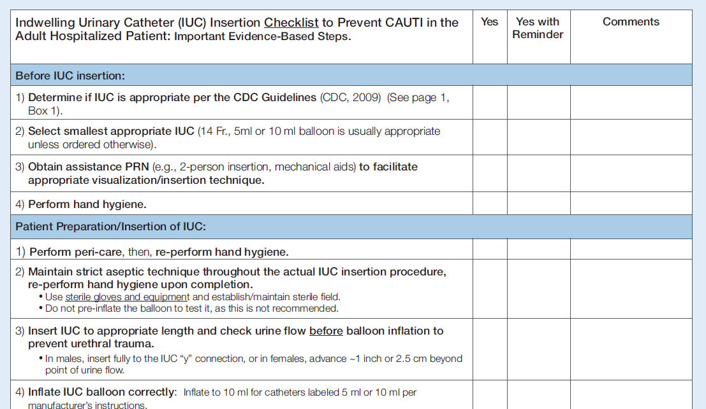
Sample Insertion Checklist – ANA Tool

Slide 18
Another Type of Checklist
Procedural Steps | Yes | No | NA
Place patient in supine position
Inspect the sterile catheterization kit and remove it from its outer packaging
Open the inner paper wrapping to form a sterile field
Form sterile field on bedside table or other flat surface but not patient bed
With washed hands carefully retrieve the absorbent pad from the top of the kit
Place absorbent pad beneath patient’s buttocks, with plastic side down
Don sterile gloves
Cover patient’s abdomen and superior pubic region with fenestrated drape
Organize contents of the tray on the sterile field
Pour antiseptic solution over the preparation swabs in the tray compartment
Squeeze some sterile catheter lubricant onto the tray to lubricate the catheter tip
Using gloved non-dominant hand, identify the urethra by spreading labia majora & minora
Use the thumb and index finger to spread the inner labia with gentle traction and pulling upward towards patient’s head
Non-dominant hand is not removed from this position
Use an expanding circular motion to clean the opening with remaining swabs
Lubricate distal end of the catheter with the sterile jelly
Holding the catheter in the dominant hand, gently introduce the catheter tip into meatus
Slowly advance catheter through the urethra into the bladder
If catheter is accidentally contaminated, it is discarded, and a new sterile catheter is obtained
* If catheter is accidentally inserted into the vagina, it is left in place until a new sterile catheter is obtained and inserted correctly
Once urine is observed in tubing, the catheter is advanced another 3 – 5 cm.
Balloon is inflated with entire contents of 10cc. syringe of sterile water only after urine is observed in tubing

Slide 19
Execution: Lack of Awareness
Those who insert catheters may not be aware of the consequences when aseptic insertion technique is violated.
Patients move from the ED to other units, and there is no systematic process to let ED staff know of patient outcomes.

Slide 20
Execution: Raising Awareness
Unit level strategies:
Report monthly CAUTI rates during staff meetings.
Post monthly CAUTI rates in a prominent location.
Organizational level strategies:
Post CAUTI rates for all units, so that comparisons can be seen.

Slide 21
Execution: Lack of Resources
Time, financial, space, equipment constraints can all contribute to situations where aseptic insertion techniques are not used.
Variation in human resources contributes to poor execution as well:
High turnover
Understaffing
Enough IPs to do the work

Slide 22
Execution Strategies that Focus on Improving or Reallocating Resources
Adequate supplies:
over-the-bed tables
hand sanitizers
sterile gloves
best type of kit to stock for your patient population
Would individual supplies be better than a kit?
Adequate facilities for hand hygiene
Location:
Where are kits located in relation to where the procedure is to take place?

Slide 23
Other Strategies to Improve Execution
A non-punitive culture
Visible and supportive leadership
Identify system-wide barriers to aseptic insertion:
Lack of adequate supplies
Lack of space for sterile field set-ups
Lack of manpower
Allocate resources to overcome as many barriers as possible

Slide 24
Evaluation
CAUTI rates, catheter days, costs of UTIs
Compliance with catheter insertion guidelines
Compliance with catheter maintenance and care
Hand hygiene rates

Slide 25
Other Resources
www.Catheterout.org
Strategies to Prevent CAUTI in Acute Care Hospitals, 2014 Update from SHEA:
http://www.jstor.org/stable/10.1086/675718

Slide 26
Mindful Practice
Catheter insertion is really a very complex task:
Multiple steps
Something can go wrong at any point
Does not evoke visceral response, yet harms are very real

Slide 27
Mindfulness
A mode of thinking based on sorting and prioritizing cognitive tasks
Used to achieve organizational goals
A flexible state of mind “engaged in the present with acute awareness of external events”

Slide 28
Becoming Mindful
Mindful practice is a cognitive process that tailors evidence-based practice recommendations to the individual patient by considering patient and contextual factors.
Maintain a big picture view.
Stay “in the moment.”
http://www.jstor.org/stable/10.1086/673147

Slide 29
Conclusion
Urinary catheters should only be inserted if there is an appropriate indication.
Aseptic insertion technique is strongly recommended, but multiple barriers can arise.
An approach that blends “The 4 E’s” with mindfulness may be successful at overcoming barriers.

Slide 30
Moffitt Cancer Center
Mission: Contribute to the prevention and cure of cancer

Slide 31
A Cancer Center’s Journey
Journey began 10/2011
Expanded surveillance house-wide
Established CAUTI Committee
Promote best practice re: Foley use & management
Reduce utilization by 20%
Reduce CAUTI rates by 10%

Slide 32
Identifying the Issue
Analysis of data showed high utilization
Little comparative data specific for Cancer Centers
ICU chosen as pilot unit
Trialed a daily needs assessment program
Not a success!
Partnered with industry to perform Foley Management Point Prevalence Study

Slide 33
What We Found
Results were surprising!
Foley management is an issue
Back to the basics
Engaged the unit managers
Education, education, education
Audit what you expect
Compliance increased

Slide 34
Keeping Our Eyes on the Goal
Journey continues: 05/2012
FHA HEN Project introduced
Moffitt joined & submitted house-wide data
Adopted On the CUSP: Stop CAUTI
CAUTI Rates added to Nursing Unit Dashboards
Case reviews of each CAUTI
Unit audits continued

Slide 35
The Data
Overall CAUTI Rates
Foley Utilization Rates

Slide 36
Refocusing Efforts
CAUTI rates plateaued
Foley manufacturer offered program to assess insertion technique
Back to the basic basics!
Results were surprising—again!
Correct insertion technique observed in only 1 out of 10
Assessed RN & Onc Tech
Experienced & novice

Slide 37
Polling Question
Does your institution allow Nurse Techs/Nurse Aides to insert Foley?
Yes
No

Slide 38
The 4 E’s in Action
Engagement
Presented the results to managers & staff
Education
Utilized “Train the Trainer” model
Execution
Combined new product rollout w/competency demonstration
Industry involved in re-design of tray = engineered compliance
Evaluation
Pending

Slide 39
Data Speaks

Slide 40
Learning & Sustaining
Lessons Learned
Basics do need to be assessed and addressed
Ongoing competency & audits necessary
Industry helpful in patient care improvement
Plans for Future & Sustainability
Perform follow-up evaluation
Implement Nurse Driven Removal Protocol

Slide 41
Thank you!
Questions?

Slide 42
Funding
Prepared by the Health Research & Educational Trust of the American Hospital Association with contract funding provided by the Agency for Healthcare Research and Quality through the contract, “National Implementation of Comprehensive Unit-based Safety Program (CUSP) to Reduce Catheter-Associated Urinary Tract Infection (CAUTI), project number HHSA290201000025I/HHSA29032001T, Task Order #1.”

