Slide 1
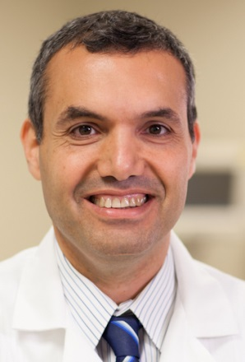
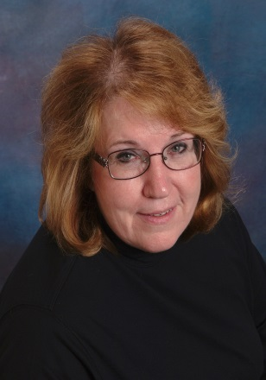
Building a Team and a Process to Reduce CAUTI Risk
Mohamad Fakih, MD, MPH
Professor of Medicine
Wayne State University School of Medicine
Medical Director, Infection Prevention and Control
St. John Hospital and Medical Center
Barbara Lucas, MD, MHSA
Project Consultant
Michigan Health & Hospital Association
Keystone Center for Patient Safety and Quality

Slide 2
Learning Objectives
Describe what is needed to build a team to reduce CAUTI risk
  Determine the essential members
  State what is expected from them
Explain the process to reduce CAUTI risk
  Know the approved indications for catheter use
  Understand how to implement and sustain a process to evaluate appropriate catheter use

Slide 3
Building a Successful Team:
Why are we doing this?
Two Goals for the CAUTI Collaborative:
Improve the culture of safety on your unit through the Comprehensive Unit-based Safety Program (CUSP)
Reduce your unit’s CAUTI rate by 25%
Both goals require strong commitment at the
organizational leadership and unit level!

Slide 4
Building a Successful Team:
Must be Multidisciplinary
Required:
  Team Leader
  Nurse Champion
  Physician Champion
  Executive Partner
  Front-line Nurses
  Infection Preventionist
Optional: case managers/discharge planners, etc.

Slide 5
Building a Successful Team:
The Team Leader
Ideal Characteristics:
  Opinion leader, with demonstrated commitment to patient safety
  Team player, respected by others, empowered by leadership
  Strong organizational, management, and communication skills
Role Expectations
  Recruit team members and define team roles
  Understand and clearly articulate project goals
  Delegate tasks and hold others accountable
  Lead team meetings and participate in collaborative activities to meet project requirements
  Track project progress

Slide 6
Building a Successful Team:
The Team Leader
Specific Tasks:
  Explain project to unit staff and management team
  CAUTI reduction:
    Ensure staff education about CAUTI and appropriate indications for catheter use
    Facilitate the development of a process to review the appropriateness of catheter use
  CUSP implementation:
    Ensure staff education about patient safety
    Use CUSP tools to improve teamwork/patient safety

Slide 7
Building a Successful Team:
The Team Leader
Specific Tasks, continued:
  Data:
    Be very familiar with the data collection schedule
    Ensure timely collection and submission for:
      Readiness Assessment and HSOPS
      Outcome and Process Data
      Team Checkup Tools
  Sustainability:
    Support the integration of CUSP/CAUTI into daily workflow and unit operations

Slide 8
Building a Successful Team:
The Nurse Champion
Expectations/Tasks:
  Responsible for facilitating the education of other nurses
  Develops and shares expertise in
    technical skills to reduce CAUTI
    adaptive work of the CUSP model to improve teamwork and patient safety on that unit
  Promotes the goals and interventions of the project both on the unit and within the larger organization
  Serves as a role model for nurse empowerment

Slide 9
Building a Successful Team:
The Nurse Champion
Ideal Characteristics:
  Strong organizational/management/and communication skills
  Know to have a strong commitment to patient safety
  Respected by peers; advocates on behalf of nurses
  Has good rapport with the medical staff
  Preferably from that unit: nurse manager, charge nurse, nurse educator, or frontline nurse
  Optional, but less desirable: nurse from organization at large:
    quality improvement professional
    infection prevention professional

Slide 10
Building a Successful Team:
The Physician Champion
Expectations/Tasks:
  Responsible for the education of medical staff about the appropriate indications for urinary catheter use
  Serves as the liaison to promote the goals and interventions of the project to unit medical staff and hospital medical staff
  Actively works with the team and other physicians to develop and implement strategies to remove identified physician barriers

Slide 11
Building a Successful Team:
The Physician Champion
Ideal Characteristics:
  Strong communication and quality improvement skills
  Empowered by leadership
  Respected by medical staff peers and nursing staff
  Demonstrates a spirit of collegiality to all team members
  Possible choices: Urologist, infectious disease specialist, hospitalist, quality/patient safety officer or any physician interested in improving safety and quality

Slide 12
Building a Successful Team:
The Executive Partner
Expectations/Tasks:
  Advocate for the project goals and the team with other senior leadership and the Board
  Meet regularly with the team to review data/progress
  Assist the team with prioritization of safety defects
  Facilitate removal of barriers
  Share the project’s progress with senior leadership and the Board

Slide 13
Building a Successful Team:
The Executive Partner
Ideal Characteristics:
  Strong communication skills
  Approachable and willing to commit time
  Strong commitment to patient safety/quality improvement
  Respected by peers and others with commitment to safety
  Potential candidates include: CMO, CNO, Chief Quality or Patient Safety Officer

Slide 14
Building a Successful Team:
Front-Line Nurses
Expectations/Tasks:
  Responsible for inspiring the commitment of other nurses on the unit to the project goals
  Help to educate peers formally and by example
  Help the team identify practical ways to:
    ensure proper catheter insertion and maintenance
    achieve daily assessment of catheter necessity
    improve teamwork with physicians and other staff
    make the unit safer for patients

Slide 15
Building a Successful Team:
Front-Line Nurses
Ideal Characteristics:
  Strong teamwork and communication skills
  Strong commitment to patient safety
  Sufficient experience/tenure on that unit
  Respected by peers on the unit
  Practical, flexible, willing to speak up
  Not intimidated by medical staff

Slide 16
Building a Successful Team:
Infection Preventionist
Expectations/Tasks:
  Meet regularly with the team to review data/progress
  Often may be the person responsible for data collection and/or data entry
  Serve as the “content expert” or infection prevention consultant to the team
  Help the team develop/implement/monitor appropriate infection prevention strategies
  Communicate the project goals and progress as appropriate in infection prevention meetings and other settings within the hospital

Slide 17
Building a Successful Team:
Infection Preventionist
Ideal Characteristics:
  Team player with good communication skills
  Knowledgeable about:
    CAUTI definitions
    HICPAC guidelines
    Evidence-based infection prevention practices regarding catheter use

Slide 18
Summary: Before Starting…
Do you have commitment from your leadership?
Have you shared the project goals within your unit and your organization?
Are you ready to:
  build a multidisciplinary team?
  communicate the technical work/changes needed to stakeholders (nurses and physicians)?
  build a rounding process to check for catheter appropriateness?
  commit to regular data submission and review ?

Slide 19
Summary: To be Successful…
To achieve BOTH project goals of improving your unit safety culture and reducing CAUTI’s you will need:
A multidisciplinary, unit level team
Strong backing from organizational leadership
A respected and effective team leader
A committed physician and nursing champion
Nursing AND physician ownership of the work to make care safer for patients

Slide 20
Indications for Catheter Use
Appropriate and inappropriate indications for urinary catheter use are based on the new CDC HICPAC guidelines 2009

Slide 21
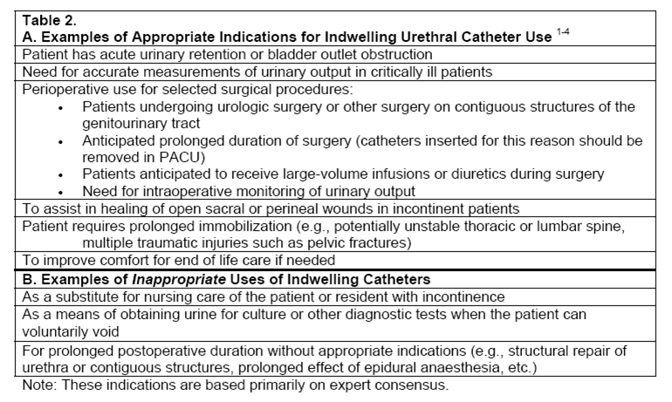
2009 Prevention of CAUTI HICPAC Guidelines
(Gould et al, Infect Control Hosp Epidemiol 2010; 31: 319-326)

Slide 22
Other Acceptable Indications?
May consider including certain institutionally - acceptable reasons for use
Caution: not to have acceptable indications to fit your current practice at the facility

Slide 23
Other Acceptable Indications?
A more helpful approach would be to have more clarity established at your institution on what each of the indications means

Slide 24
Accurate measurement of urinary output in the critically ill patients
We see this indication applicable to patients in the intensive care setting
Clearly define who is critically ill when you establish your acceptable indications

Slide 25
Acute Urinary Retention or Obstruction
Outflow Obstruction | Acute Urinary Retention
Prostatic hypertrophy with obstruction | Medication-induced
Urethral obstruction | Medical (neurogenic bladder)
Urinary blood clots with obstruction | Trauma to spinal cord

Slide 26
Perioperative Use in Selected Surgeries
Intraoperative | Anticipated prolonged duration of surgery, large volume infusions during surgery, or need for intraoperative urinary output monitoring
Surgical Site | Urologic surgery or other surgery on contiguous structures of the genitourinary tract

Slide 27
Perioperative Use in Selected Surgeries
NOTE: Spinal or epidural anesthesia may lead to urinary retention (prompt discontinuation of this type of anesthesia should prevent need for urinary catheter placement)
The goal is to remove the catheter shortly after the surgery is completed

Slide 28
Assist Healing of Perineal and Sacral Wounds in Incontinent Patients
This is an indication when there is concern that urinary incontinence is leading to worsening skin integrity in areas where there is skin breakdown.

Slide 29
Hospice/Comfort Care/Palliative Care
Patient comfort at end-of-life: depends on what the patient perceives as more comfortable

Slide 30
Required Immobilization for
Trauma or Surgery
Examples include:
  Unstable thoracic or lumbar spine
  Multiple traumatic injuries, such as pelvic fractures

Slide 31
Chronic indwelling urinary catheter
Defined as present for >30 days
It is not infrequent to see patients admitted from extended care facilities with a chronic urinary catheter without being able to find the reason for initial placement when assessed. We suggest that these patients represent a special category and may need a different assessment for the appropriateness of catheterization. We consider them to have an acceptable use till further evaluation is done.

Slide 32
Unacceptable Reasons for Placement
Urine output monitoring OUTSIDE the intensive care unit (e.g., congestive heart failure receiving diuretics )
Incontinence without sacral or perineal pressure sore
Prolonged postoperative use
Others (include those transferred from intensive care, morbid obesity, immobility, confusion or dementia, and patient request)
Clearly define all of the indications to avoid using the catheter inappropriately

Slide 33
Creating a Process to Evaluate Urinary Catheter Need
Educate nursing staff on appropriate urinary catheter utilization
This may include providing them with printed educational material, lectures, posters, pocket cards
The most important education occurs during rounds where the healthcare worker champion discusses the appropriate indications for urinary catheter use with the nurses

Slide 34
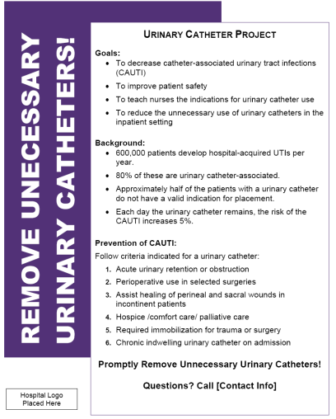
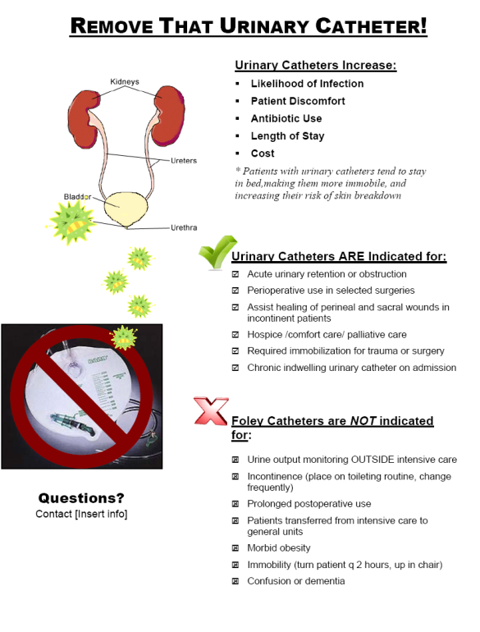
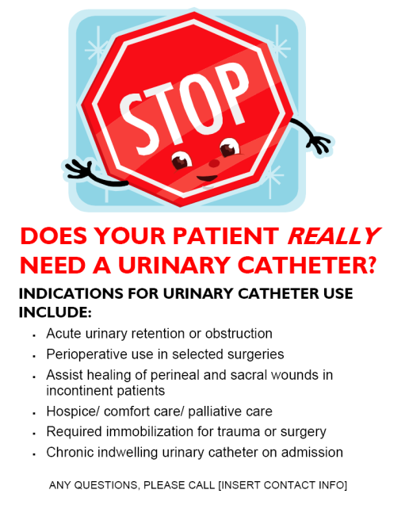
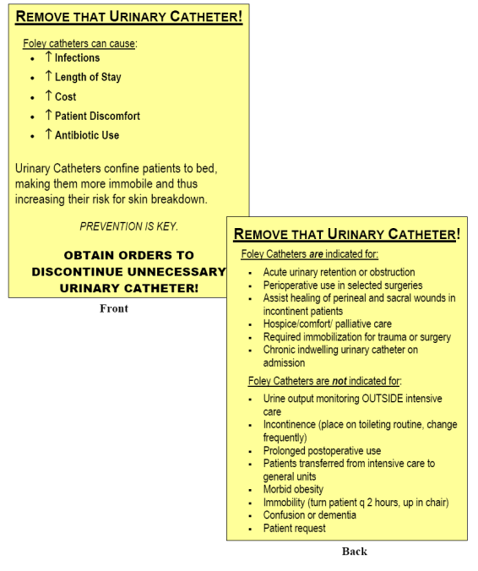
Tools Used with Intervention
Lecture for nurses
Pocket cards, posters

Slide 35
Creating a Process to Evaluate Urinary Catheter Need
A healthcare worker champion (usually a nurse, alternatively an infection preventionist, or quality improvement healthcare worker who is knowledgeable of indications for urinary catheter utilization) participates in daily nursing rounds
Members of nursing rounds may include:
    Nurse Manager (or charge nurse)
    Case Manager (or discharge planner)
    Social Worker
    Bedside nurses assigned to patients

Slide 36
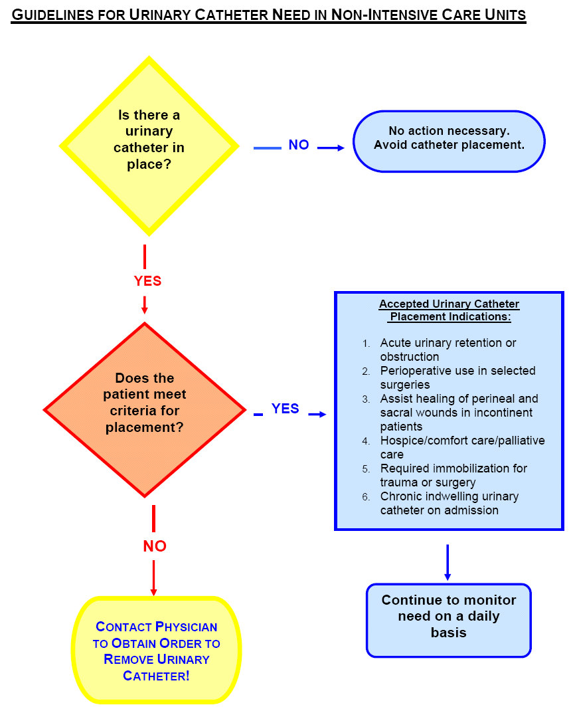
Main Education is Performed during Nursing Rounds
Does the patient have a urinary catheter
Reason for catheter use
If no appropriate indication, the patient nurse will contact the physician to discontinue the urinary catheter
This process will be continued after implementation with the patient’s nurse owning the process

Slide 37
Creating a Process to Evaluate Urinary Catheter Need
Key Factor for Success: a nurse manager who supports this initiative and holds the nursing staff accountable for removing non-indicated urinary catheter
Each unit needs to have a facilitator who will take the responsibility to reinforce the process after the initial intervention is completed to ensure sustainability
Potential facilitators include a unit nurse champion with interest in patient safety or the charge nurse

Slide 38
Creating a Process to Evaluate Urinary Catheter Need
The patient's bedside nurse will be coached to own the process of evaluating whether the patient has a urinary catheter placed, and to evaluate the need for the catheter
The bedside nurse should note the catheter's presence and evaluate the indication during the patient's daily nursing assessment. This will be continued after implementation
The process may be enforced by integrating it into the patient’s daily nursing assessment

Slide 39
Addressing Barriers to Implementation
Provide solutions to barriers
Encourage the use of facilitators to make the process easier
Examples:
Skin care in the incontinent
Using weight for patients that require close fluid monitoring

Slide 40
What if There Are No Nursing Rounds? Options?
The nurse champion discusses with each nurse on the unit the presence and need of the catheter
Alternatively, nurse champion and mid level provider may round on patients to evaluate presence, need, and discontinue catheter if no need

Slide 41
What if There Are No Nursing Rounds? Options?
Recognition of catheter presence, and evaluation of need as soon as the patient is admitted to the unit (whether from ED, OR, ICU, or different non-ICU)
Partnering with other stakeholders (case managers, physical therapists, wound care nurses, infection preventionists) to prioritize the importance of addressing the urinary catheter need

Slide 42
Important Issues
A continued reduction in urinary catheter utilization may be a marker of the program’s success
The risk of urinary tract infection increases the longer the urinary catheter is present. A single patient who has a urinary catheter placed without indication for a prolonged period of time may affect your effort significantly

Slide 43
Important Issues, continued
ICUs have a high prevalence of urinary catheter utilization. Utilization may be significantly reduced on the general medical-surgical units if patients transferred out of the ICUs are evaluated for catheter necessity
The emergency department and the operating room are areas where a large number of urinary catheters are placed. Addressing the appropriateness of placement of urinary catheters in the emergency department and promoting removal of the urinary catheters post-operatively in the recovery area may also help reduce unnecessary urinary catheter use

Slide 44
How to Get Successful Results
Both nurses and physicians should evaluate the indications for urinary catheter utilization
Physicians should promptly discontinue catheters when no longer needed
Nurses evaluating catheters and finding no indication should contact the physician to promptly discontinue the catheter
Partner with different disciplines (e.g., case management, nursing, infection prevention) to successfully achieve your goals

Slide 45
How to Sustain Your Success
Identify unit champions to promote the need to evaluate the appropriateness of urinary catheter use
Incorporate the following questions during nursing rounds:
  Does the patient have a urinary catheter?
  What is the reason for use?
Provide feedback on performance to nurse managers related to prevalence of utilization
If no improvement in utilization is seen, evaluate appropriateness of utilization (indications vs. non-indications)
The long term goal is for the patient care nurses to own the process of evaluation of urinary catheter need

Slide 46
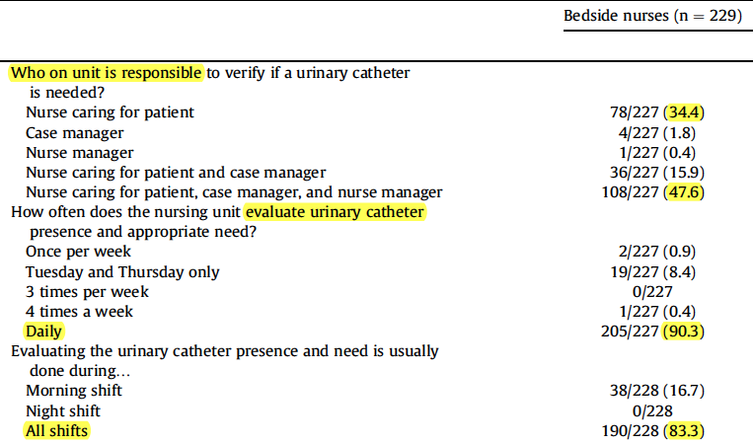
And the Nurses Own the Catheter…
Fakih, Am J Infect Control 2013; 41: 236-239

Slide 47
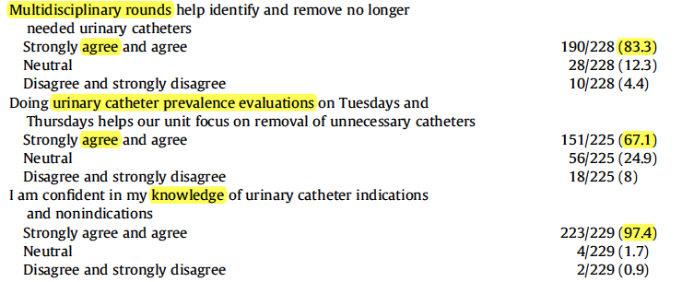
And the Nurses Own the Catheter…
Fakih, Am J Infect Control 2013; 41: 236-239

Slide 48
Additional Areas to Address
Leadership support is crucial
Define barriers to implementation
Obtain physician and nursing buy-in
Provide alternatives to the “Foley” catheter

Slide 49
Think about the whole picture: areas to address
Non-ICU
Evaluate need on admission
Evaluate for continued need
PACU/OR
ED
Evaluate for continued need
Discontinue no longer needed before transfer
ICU
Remove promptly after surgery before transfer out
Avoid initial placement
Reevaluate for continued need after patient stabilizes

Slide 50
Thank you!
Questions?

Slide 51
Funding
Prepared by the Health Research & Educational Trust of the American Hospital Association with contract funding provided by the Agency for Healthcare Research and Quality through the contract, “National Implementation of Comprehensive Unit-based Safety Program (CUSP) to Reduce Catheter-Associated Urinary Tract Infection (CAUTI), project number HHSA290201000025I/HHSA29032001T, Task Order #1.”

