Slide 1
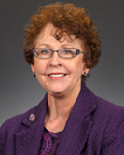

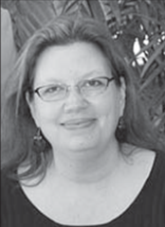

CAUTI Sustainability:
Embedding CAUTI Policies, Using Data to Monitor Progress and Hardwiring CUSP Principles
Diane Byrum, RN, MSN, CCRN, CCNS, FCCM
Manager, Quality Implementation Programs
Society of Critical Care Medicine
William S. Miles, MD, FACS, FCCM, FAPWCA
Director of Surgical Critical Care and the Medical
Director of the Surgical Trauma Intensive Care Unit
Carolinas Medical Center, Charlotte, NC
Ginger Dickens, MSN, RN, CNML, CCRN
Nurse Manager
Maury Regional Medical Center, Columbia, TN
Pat Posa RN, BSN, MSA, FAAN
System Performance Improvement Leader
Saint Joseph Mercy Hospital, Ann Arbor, MI

Slide 2
Learning Objectives
Describe how to use data to change culture and sustain goals.
Explain ways that CUSP concepts can be used and sustained.
Identify components for successful change.

Slide 3
Sustaining Gains: Embedding CAUTI Policies
Diane Byrum RN, MSN, CCRN, CCNS, FCCM
Manager, Quality Implementation Programs
Society of Critical Care Medicine

Slide 4
Project Impact
Society of Critical Care Medicine
Project Dispatch is focused on patient-centered outcomes research and aims to provide clinicians with information on how to adapt and adopt successful interventions in their own ICU.

Slide 5
Quality Health Care
Quality Health Care-
“the degree to which health services for individuals and populations increase the likelihood of desired health outcomes and are consistent with current professional knowledge” (p. 1161)
Lorh KN N Engl J Med. 1990;332:1161-71

Slide 6
Change Requires RESPECT
Speak respectfully of the past, realistically of the present and optimistically of the future….

Slide 7
Begin with the END in mind
Remember – Quality issues are often process related, not people related
Fix the process, fix the problem
- Standardize, simplify
- Decrease reliance on individual decision-making

Slide 8
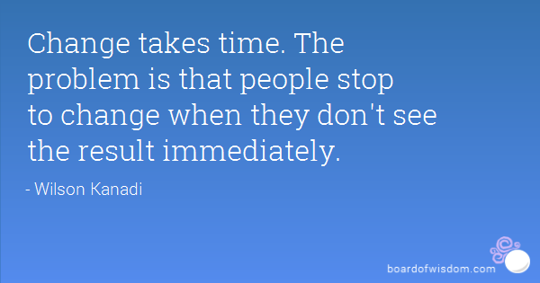
Lessons Learned = Sustaining the Gain
Recognize that change takes time

Slide 9
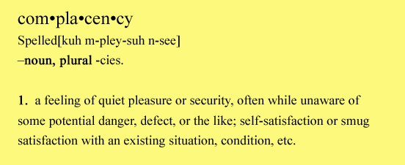
Lessons Learned = Sustaining the Gain
Ensure administration is aware of your efforts and results
Encourage and reward participation and problem identification
Avoid complacency with success

Slide 10
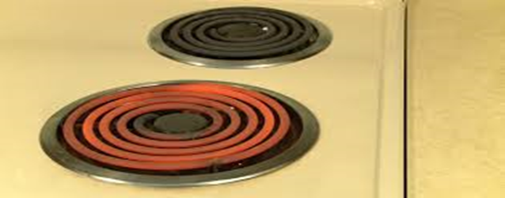
Lessons Learned = Sustaining the Gain
Keep CAUTI project on the “front burner”
Staff meetings, create healthy competition
Jerri’s Story: https://www.youtube.com/watch?v=wl_aZto-K8Q

Slide 11
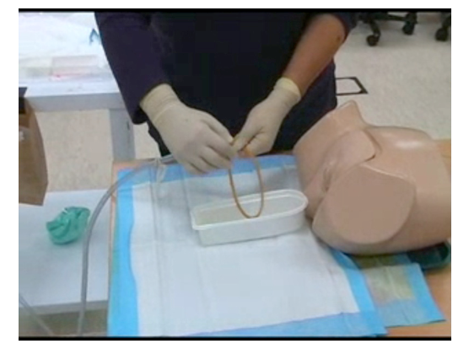
Lessons Learned = Sustaining the Gain
Continue to work on staff competency (insertion and foley care techniques)
Hard wire Foley education into all new employee education

Slide 12


Lessons Learned = Sustaining the Gain
Set short term attainable goals
Celebrate success – Create fun!!!
Continue to engage the nay-sayers

Slide 13

Lessons Learned = Sustaining the Gain
Treat a “CAUTI with respect – Learning from defects tool

Slide 14
Tier 1 Protocol: Use of Indwelling Urinary Catheter Kit
Assess and document competency of health care workers performing insertion
Measure monthly for 6 months; re-evaluate. If rate has dropped below indicated levels proceed back to Tier 1
Measure CAUTI rates monthly
Encourage use of alternatives to indwelling catheter
Tier 2 Protocol: Enhanced Practices – Evaluation of indication for use, maintenance, and removal technique
Follow maintenance and removal template for care and removal of the catheter
Assess daily the necessity of the indwelling catheter
Use standard indwelling urinary catheter kit with pre-sealed junction
Ensure proper aseptic insertion technique
Sources:
HICPAC CDC Guidelines on CAUTI Prevention
www.catheterout.org
Consider Root Cause Analysis or Focused Review of CAUTI or catheter use to identify improvement opportunities
Monitor CAUTI rates closely. Proceed to Tier 2 if either of the following conditions are met over a period of 6 months:
ICU ≥ 9 CAUTIs/10,000 patient days
2 CAUTIs/1,000 catheter days
Non-ICU, Acute Care ≥ 3 CAUTIs/10,000 pt days & 2 CAUTIs/1,000 catheter days

Slide 15
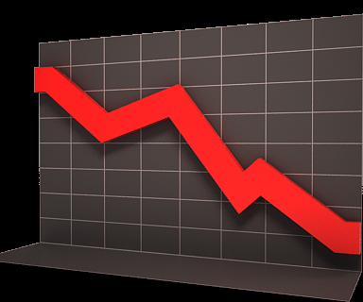




Lessons Learned = Sustaining the Gain
Data drives practice and improvement….

Slide 16
Using Data for Sustainability
CAUTI Collaborative
William S. Miles, MD, FACS, FCCM
Director of Surgical Critical Care and the Medical
Director of the Surgical Trauma Intensive Care Unit
CO-Lead COHORT 9

Slide 17
The Power of Measuring Results
If you do not measure results, you can not tell success from failure.
If you can not see success, you can not
reward it.
If you can not reward success, you are probably rewarding failure.
If you can not see success, you can not learn from it.
If you can not recognize failure, you can not correct it.
If you can demonstrate results, you can win
public support.
Adapted from Osborne & Gaebler, 1992

Slide 18
Learning from Data
We don’t all define a process in the same way.
We all assume steps without spelling them out.
We don’t all address a problem in the same way, and there are variations in our processes.
Without using data and validation, we will not get the same results.

Slide 19
Ten Steps to Designing, Building and Sustaining a Results-Based Monitoring and Evaluation System
Planning for Improvement — Selecting Results Targets
Selecting Key Indicators to Monitor Outcomes
Conducting a Readiness Assessment
The Role of Evaluations
Using Your Findings
1
2
3
4
5
6
7
8
9
10
Agreeing on Outcomes to Monitor and Evaluate
Baseline Data on Indicators—Where Are We Today?
Monitoring for Results
Reporting Your Findings
Sustaining the
M&E System Within Your Organization
The World Bank, 2004

Slide 20
Ways to Use Data

Slide 21
WHAT is the PDSA Cycle?
A process improvement approach to evaluate change.
This model allows for integration of new and existing systems.
This model promotes small scale rapid cycle change over short periods of time.

Slide 22
The PDSA Cycle for Learning and Improvement

Slide 23
Repeated Use of the Cycle
Changes That Result in Improvement
A
P
DATA
S
D
D
S
P
A
A
S
P
D
A
P
S
D
Hunches Theories Ideas
Notes:
31

Slide 24
Use the PDSA Cycle for:
Testing or adapting a change
Implementing an improvement
Spreading the improvements to the rest of your organization
Maintaining a process by reassessing and making it current

Slide 25
PDSA Cycles Must Be:
Active
  Quickly plan and make process changes
Iterative
  Cycle after cycle
Learning
  Take time to study effects of your actions

Slide 26
Root Cause Analysis
A way of looking at unexpected events, data results, and outcomes to determine all of the underlying causes of the event and recommend changes that are likely to improve them.
Data can be validated, vetted, and changes made to achieve outcomes

Slide 27
RCA Tools
The 5 Whys?
Appreciation
Drill Downs
Cause and Effect Diagrams (Fishbone Diagrams)

Slide 28
Success
“There are no secrets to success. It is the result of preparation, hard work, and learning from failure.”
General Colin L. Powell

Slide 29
Carrots and Sticks Methodology
Base these carrots and sticks on your local hospital culture
You know what drives your employees and staff
Carrots: CAUTIi-Carnival, CAUTI-Cash, Increased bonuses, etc
Sticks: Negative incentives, Peer Pressure, No bonus, etc.
CMS Value Based Purchasing

Slide 30
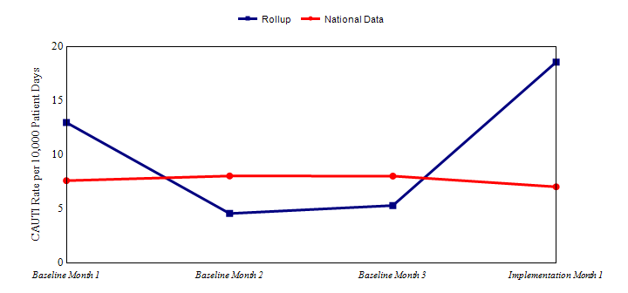
Use Engaging Improvement Methods
Use Data for feedback: rapid cycle
Use Data to generate awareness, not to inflame
Show Evidence-Based Guidelines, as needed
Christin Ko

Slide 31
Using Data for Sustainability
Consider Cultural Assessment
Present Data on CAUTI: Initially and Regularly
  Prevalence
  Morbidity
  Mortality
Present the Business Case for CAUTI Prevention:
  CAUTI Cost Calculator
  LOS Reduction
  CMS Non-reimbursement Policy for HAI
Christin Ko

Slide 32
Carrots and Sticks
Which one?
Not as simple as choosing one or other
Success depends on:
  Spin you put on incentives
  Having incentives real-time
  Continuing strategies your institution employs
  Carrots dressed as sticks may be most important
The Economist, “Designing Rewards: Carrots Dressed as Sticks,” print edition, January 16, 2010

Slide 33
The Economist, “Designing Rewards: Carrots Dressed as Sticks,” print edition, January 16, 2010
Incentive bonus = Good performance
Incentive bonus minus potential penalty = Better performance
CARROT DISGUISED
AS STICK
CARROT

Slide 34
The Economist, “Designing Rewards: Carrots Dressed as Sticks,” print edition, January 16, 2010
Clearly, both of these programs relied on carrots — but in one, the carrots were enticingly dangled to motivate positive efforts, while in the other, the carrots were “frozen,” and used to give employees the occasional whack when needed.
What the researchers discovered was that “fear of loss was a better motivator than the prospect of gain.”
Both approaches worked, but employees were more motivated to work harder to ensure that an award was not taken away.
“Carrots...may work better if they can somehow be made to look like sticks.”

Slide 35
The New England Journal of Medicine, “Redesigning Employee Health Incentives — Lessons from Behavioral Economics,” August 4, 2011.
In an article in The New England Journal of Medicine, the authors stated that the “effectiveness of incentive programs depends critically on how the incentives are timed, distributed and framed.”
Several factors might influence outcomes:
  The most common implementation mechanism is less effective dollar for dollar than other approaches.
  One of these key factors is that most individuals “...place more weight on the present than the future — they’re more attracted by immediate than delayed benefits and more deterred by immediate than delayed costs.”
Emily C. Haisley, Kevin G. Volpp, Thomas Pellathy, and George Loewenstein, “Promoting Completion of Health Risk Assessments with Lottery Incentives.” Am J Health Promot (in press).

Slide 36
BARRIERS
Using Data for Sustainability
Not using data effectively
  Meeting regularly/reviewing data
  Validating and Discuss with Outliers
Not having real-time data – stay current
Not using data as part of culture of safety
Not having explicit intent to continue a program and resources
  Don’t just give “lip-service”
  Prove it!
Changing the people involved in the success
  Moving them up the administrative ladder

Slide 37
Creating a Culture of Confidence
Confidence is at the very heart of effective performance.
Confidence comprises “positive expectations for favourable outcomes” (Professor Rosabeth Moss Kanter)
On the way up, success creates positive momentum. People who believe they are likely to win are also likely to put in the extra effort at difficult moment to ensure that victory.
On the way down, failure feeds on itself. Growth cycles produce optimism, decline produces pessimism.”
Moss Kanter, R (2004). Confidence: Leadership and the Psychology of Turnarounds. London: Random House.
Notes:
Professor Kanter is a professor of Harvard Business School.
As performance starts running on a positive or negative path, the momentum can be hard to stop!

Slide 38
Building a Culture of Confidence
How can we build and maintain a culture where success cycles are amplified and failure cycles are minimized?
  Build Awareness of Strengths
  Build Awareness of Strengths
  Cultivate a Positive, Appreciative Environment
  Ensure Leaders and Managers Model the Way
  Make Customer and Stakeholder Feedback Visible
    Transparency
  Build Strong Cohesive Teams and Social Networks
Moss Kanter, R (2004). Confidence: Leadership and the Psychology of Turnarounds. London: Random House.
Notes:
Build Awareness of Strengths Because people typically don’t get much feedback on their strengths during their life and career, they frequently don’t understand their strengths as well as their weaknesses. Many even experience anxiety, discomfort and embarrassment when talking about their strengths as they have learned to fear complacency, failure and being too different from the rest of the ‘pack’. There are many ways to build self-awareness about strengths, including reflecting more on one’s conscious experience, feedback from colleagues and other stakeholders and keeping a journal or diary of tasks that energise you. However, we have found that the best approach is to use an objective strengths profiling tool such as ©Strengthscope (www.strengthscope.com). The benefit of such a tool is that it provides a common language for people to start exploring their strengths and enables them to focus their energies on relevant opportunities to apply these more fully.
Develop Positive Action Routines
Self-awareness is crucial, but not sufficient. As part of ongoing performance dialogues, managers should work in partnership with employees to explore how their strengths can be made more productive, not only in the person’s current role, but in tasks and projects outside their role. Like professional athletes, employees need to build and practice positive routines or ways of doing their work which reflect who they really are and what comes most naturally to them. These action routines will result in successes which in turn will reinforce confidence.
Cultivate a Positive, Appreciative Environment When people feel they have been successful and their efforts and achievements are recognised, it generates positive emotions and good moods. This positive emotion becomes contagious and boosts energy, morale and discretionary effort, fuelling the success cycle. By helping executives and line managers understand the importance of sharing and celebrating successes and putting in place organisation-wide mechanisms and processes for facilitating such sharing, a more positive performance culture will prevail. It is important that this is done across organisational boundaries as even others’ successes can make us feel more energised and positive provided these are communicated and celebrated in an appropriate manner. Authentic and frequent recognition and praise for a job well done at local line manager level is also essential in creating a culture where effort and hard work will flourish.
Ensure Leaders and Managers Model the Way The “shadow of the leader” effect is strong at work in organisations. Leaders and managers should understand the impact that their values, attitudes and actions have on the workforce and should be invited to consider what type of “shadow” they cast now and how this can be strengthened in the future. In our experience, there are still too many leaders out there that cast a long and negative shadow, sapping energy and life from organisations. We would recommend educating and developing leaders and managers to understand and apply positive psychology and strengths-based concepts, principles and techniques in building a culture of success and confidence. This learning needs to be practical, relevant and ideally supported by on-the-job coaching in order to ensure maximum learning transfer. This type of investment has an added benefit, as managers and leaders are more likely to stay with the organisation if it invests in their development and advancement. Improved retention and stability of leadership will in turn give rise to increased investment of time and trust by leaders in ensuring the organisation is a success and so the success cycle is amplified further.
Make Customer and Stakeholder Feedback Visible
Success brings positive feedback and rewards from customers and other stakeholders on the outside. However, employees often only hear about this feedback when failures occur or performance falls below expectations (e.g., when customers complain or when shareholders are unhappy with company performance). It is important to ensure this feedback is balanced and employees also get positive feedback from shareholders, customers and other stakeholders. This will all contribute to a more appreciative atmosphere and build confidence. One way to do this is to invite teams to interview their own customers (internal or external) and stakeholders using an appreciative inquiry interview process. Once the data has been analysed, this can then be reported back at a team meeting with a view to exploring successes, strengths, weaker areas and opportunities for improvement and growth.
Build Strong Cohesive Teams and Social Networks Positive emotions produced through success strengthen relationships and give rise to a host of individual and team-based outcomes including improved collaboration, creative problem-solving and employee wellbeing. When people are in a positive frame of mind, they are more likely to be generous, supportive and tolerant of one another. This is turn reinforces teamwork and commitment. It also means people can more freely acknowledge their vulnerability (concerns, fears, etc.), admit their mistakes and learn from them.

Slide 39
Sustaining a Culture of Confidence
Building a culture of confidence is largely about amplifying successes and strengths to ensure the ‘voices’ of possibility, optimism and self-belief drown out the ‘voices’ of self-doubt, negativity and pessimism.
With the right mindset, approaches-using DATA and results real time, leaders can build accountability for the turnaround, focus on small ‘wins’ to start build confidence
Inspires people to optimize their strengths and take initiative, accountability—
  Sustain a Culture of Confidence.
Notes:
To turn around a failure cycle can be tough, particularly when successive failures have occurred, which have sapped the morale and energy from a team and/or organisation. However, like Moss Kanter, we contend that this is primarily a leadership challenge.

Slide 40
Successful Hospitals
Examples
Using validated resources
  AHA/IHI collaboratives
Adopting a culture of safety
  AHRQ Culture of Safety Survey
  Take results seriously
  Educate and re-educate new/established hires
Top Down/Down to Top Mentality
  CEO to Environmental services to patients and families

Slide 41
Successful Hospitals
Examples
Process to evaluate, validate, publish, celebrate data
  Know what works at your institution
  Make it a part of the culture/behavior
Transparency – patients and families are part of committee
Celebrate wins, publicly evaluate losses
  Make your data and processes transparent

Slide 42
QI Process
Quality Improvement
is a Process, not an Event
Anonymous

Slide 43
SUMMARY
Use process to collect, evaluate, adapt, and publicize data
Use real-time data/transparency
Utilize specific data mining tools that work
  Monitor and evaluate frequently
Process of “Carrots and Sticks”
Participate in AHA collaboratives and AHRQ resources to maximize effects
Use your data to be accountable, transparent, and sustain your Culture of Confidence

Slide 44
Hospital Unit Story:
Maury Regional Medical Center
Ginger Dickens, MSN, RN, CNML, CCRN
Nurse Manager
Maury Regional Medical Center Columbia, TN

Slide 45

Maury Regional Medical Center,
Columbia, TN
Largest hospital between Nashville, TN and Huntsville, AL
275 bed facility with a medical staff of more than 200 physicians and 2,000 employees
Serves a region of more than a quarter of a million people in southern middle Tennessee
Maury Regional
Health System
Columbia
  Maury Regional Medical Center
  Family Health Group (100 providers)
  EMS Services
Lewisburg
  Marshall Medical Center 25 Beds
Waynesboro
  Wayne Medical Center 80 Beds
  EMS Services
Hohenwald
  Lewis Health Center - Primary Care Clinic & Diagnostics open 14 hours per day
  EMS Services
Spring Hill
  Imaging, Surgery Center, Radiation Oncology, Multi-Specialty Physician Clinics
Pulaski
  Physical Medicine Services

Slide 46

Maury Regional Medical Center
Columbia, TN
MRMC is proud to have been recognized for its quality of care and operations
Services include:
Cancer Center
Emergency Services
Heart Center
Neonatal Intensive Care
Neurology and Neurosurgery
Orthopedic Services
Surgical Services
Women’s Center

Slide 47


Quality of Care
Recent recipient of the TNCPE 2014
Excellence Award
2015 – formally recognized as a “Planetree Designated®” Patient-Centered Hospital. It’s one of 28 hospitals in the U.S. and the first in Tennessee.

Slide 48

The Joint Commission
Disease-Specific Care for Inpatient Diabetes
Disease Specific Care for Joint Replacement - Hips
Disease Specific Care for Joint Replacement – Knees
Disease Specific Care for Sepsis
Disease Specific Congestive Heart Failure

Slide 49
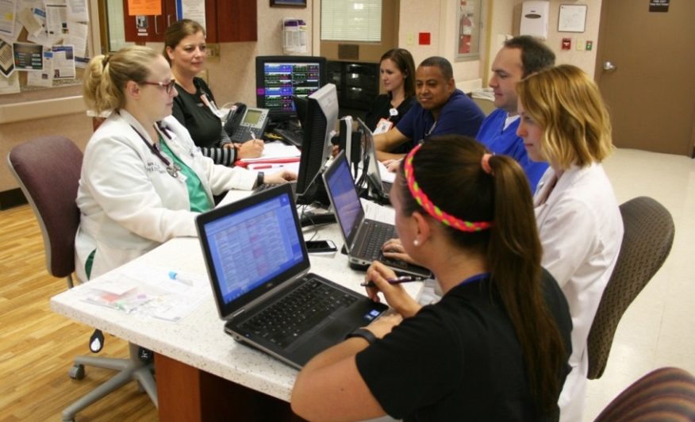
Critical Care at MRMC
24 beds of critical care on two floors
One team of staff servicing all areas
24/7 Intensivist coverage
NP 7 days per week
All admissions require Intensivist consult
60% BSN or higher (39 BSN and 4 MSN)
47% CCRN Certified Nurses (34)

Slide 50
Team Design
Physician Champion
Infection Prevention
Frontline staff/Champions
Clinical Educator
Wound Care
Supply Chain
Senior Leadership/Administration

Slide 51
Journey Timeline – 2012
Review of external catheter options
Physician order sets updated for POD #1
Foley removal stickers as reminders
Unit Based Quality Team
Standard securement device
Discovered Foley bags had two different types of closure devices
Covered the sample port of Foley
Nurse Driven Protocol

Slide 52
Journey – 2013
Documentation class for all licensed CC RNs
Removed curtains from patient rooms, replaced with mini blinds and window tint
Added sinks to hallways for increased access
Adopted Gel In/Wash Out practice
If Foley present on admission – consider removing/re-inserting if not contraindicated.

Slide 53
Journey – 2014
Universal decolonization/CHG baths initiated
Physician Education
Urine culture stewardship
Physician CPOE order sets updated, no automatic UA or C&S
Science of Safety video for all licensed staff
Back to Basics education on insertion technique and maintenance bundle
CAUTI Status Board
Pocket cards and Policies
Organizational, Departmental, and Personal Goal

Slide 54
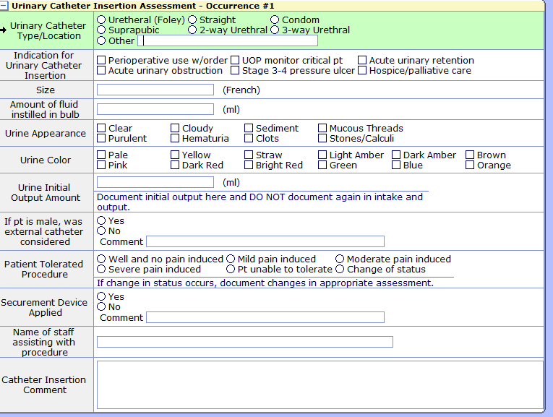
Urinary Catheter Insertion Assessment

Slide 55
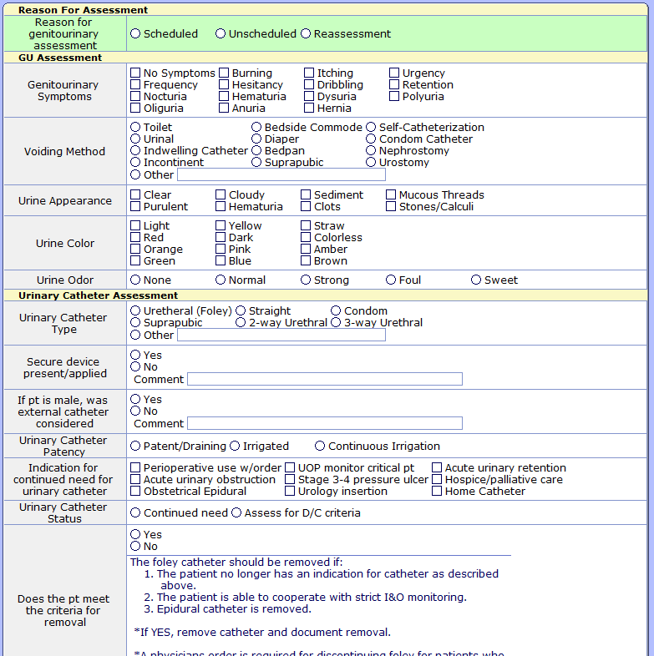
GU Shift Assessment

Slide 56
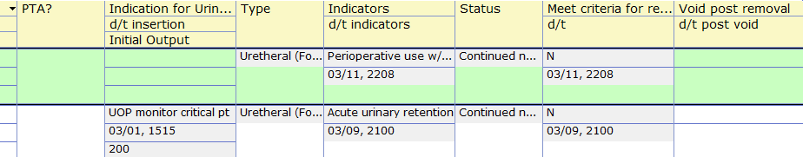
CAUTI Status Board
Notes:
Gives quick look as a group of pts
Also being piloted on one unit to see who needs foley DC’d each am

Slide 57
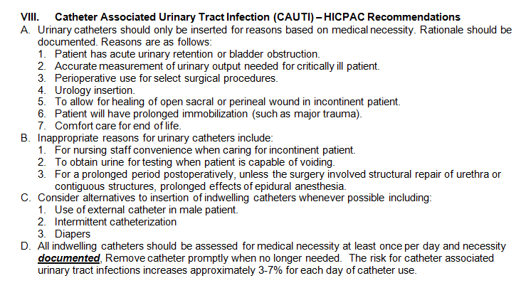
Physician Infection Prevention Education
Notes:
Physician IP Education – contains HICPAC indications
for UC placement

Slide 58
Measures Follow-up
Maintenance Bundle Audit Findings
  Monthly Point Prevalence Study with feedback
    Changed our ED stock to only urimeter kits so admissions to CC would already have urimeter in place
    Alternate bag hanger
      Patient beds do not have an appropriate hanger for catheter bag while in the low position
      CT tables needed place to hang catheter bag
    Catheter Care charting not being done in EMR
      Educated Nurse Techs and added to charting

Slide 59
Measures Follow-up
Lead Charge in CC – Audit Tool
Interdisciplinary Daily Rounds – Refocus on appropriate reason/order and getting catheters out
Patient Safety Committee Rounds
  Included how many patients have urinary catheters
  What is the plan for removal?
  Do you feel comfortable using the nurse driven protocol for removal?

Slide 60
Nurse Driven Removal Protocol
2014 – tightened the indications for insertion, maintenance, and removal to strictly mirror the 2009 HICPAC guidelines
With rounding learned some staff were not comfortable using protocol for removal without physician’s order
  Have to keep checking back with, educating staff
  Lead charge nurses conduct audit nightly
  Made the decision to replace any catheter that comes into critical care with seal broken

Slide 61
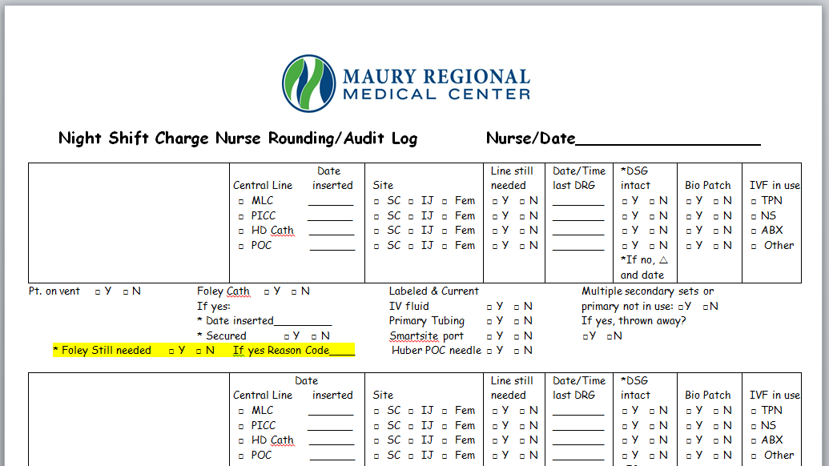
Lead Charge Audit Tool

Slide 62
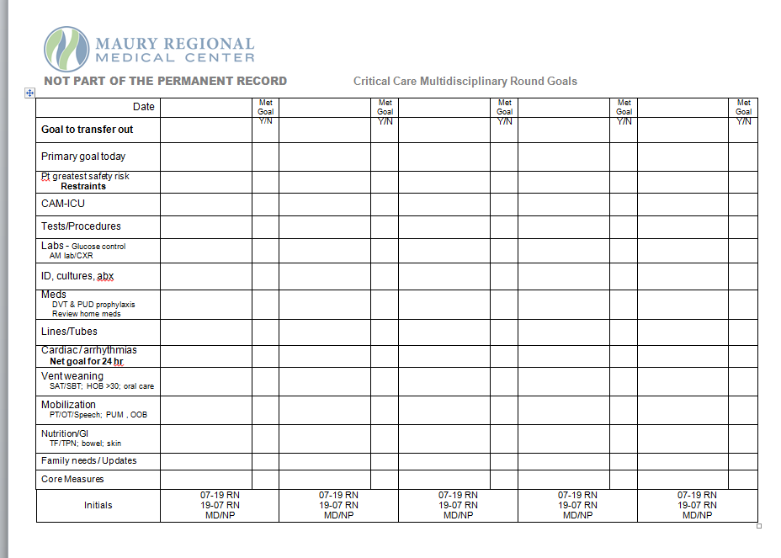
Critical Care Interdisciplinary Rounding Tool

Slide 63
Data Graph

Slide 64

Celebrate Success!
Mark the milestones
Newsletters
Unit Meetings
Management Team
Recognition

Slide 65
What happens when a CAUTI occurs?
Event Analysis
Team notification – Nurse Manager, Medical Director, and Frontline staff notification – email and huddle
Infection Prevention Council report out

Slide 66
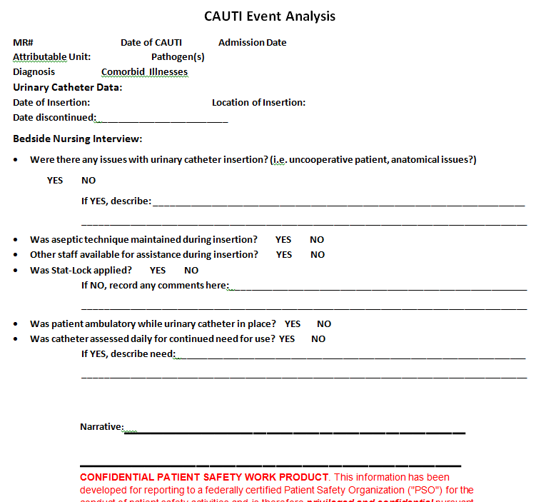
Event Analysis Tool
Notes:
Learn from Defects
Have own tool but process of what happened and focus on process not the person

Slide 67
Reporting
Scorecard – Zero CAUTI is goal
Critical Care Committee
Patient Safety Council
Quality Council
Senior Leader and Administrative Support
Notes:
Quality Council redesigned. Senior Leaders are core members and infection rates reviewed monthly

Slide 68
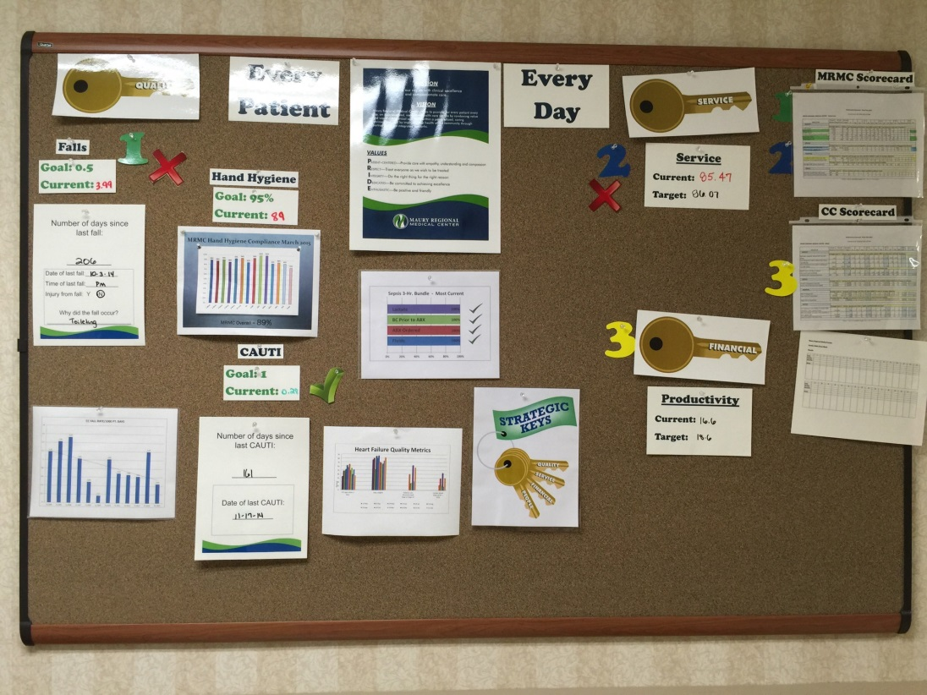
Visual Management Board
Notes:
Monthly scorecard to
individual units
Units have visual management
boards to communicate data

Slide 69
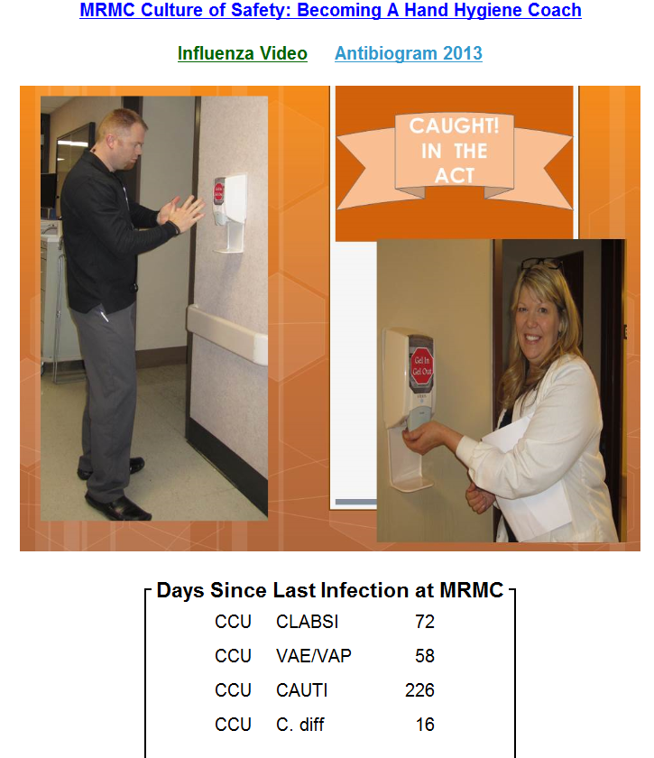
Real Time Reporting
Staff can access data
on intranet page

Slide 70
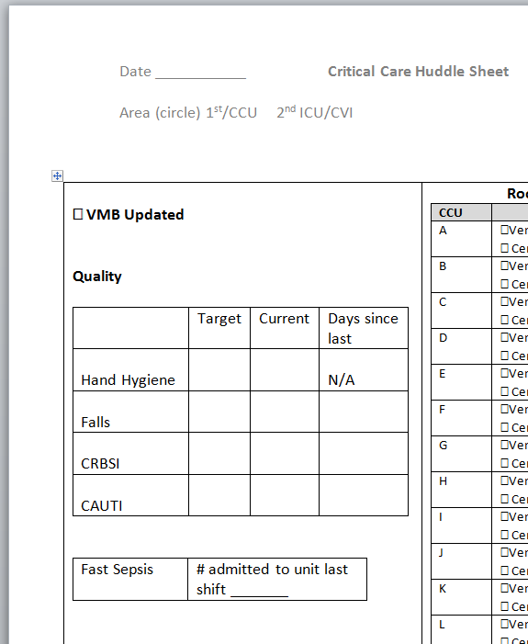
Shift Huddle

Slide 71
CUSP Initiative Takeaways
Team formation/engagement
Have senior leadership support
Understand safety as a system design
Process review – educate and execute
Learn from what goes well and what does not
Communicate

Slide 72
Succession Planning
This is not a project – it is who we are
Onboarding new staff
Common Goal nurtures/enhances MD and RN relationships
Senior Leader Quote – Wish we had done it sooner!
Notes:
Why Does it Matter So Much? Carrying it forward
Our patients are from the community we serve
It is our common goal as an organization and as a unit
It reflects on our personal and professional commitment to patient safety

Slide 73

Sustaining CUSP
Pat Posa RN, BSN, MSA, FAAN
System Performance Improvement Leader
Saint Joseph Mercy Hospital
Ann Arbor, Michigan
patposa@gmail.com

Slide 74
Sustaining CUSP
Sustaining CUSP takes work and your team should expect to face challenges. The struggles often come because the team has lost sight of the steps of CUSP.

Slide 75
The Comprehensive Unit-based Safety Program (CUSP)
Educate staff on the science of safety
Identify defects
Partner with the Senior Executive
Learn from defects
Improve teamwork and communication

Slide 76
How is CUSP different?
CUSP identifies problem areas –
  What staff think are impeding patient care vs. what managers/directors think are priority areas
CUSP improvement tools are designed for bedside caregivers – easy for busy staff to use
  Unit drives its own quality
Lean/Six Sigma/CQI – focus more on streamlining the process than identifying the problem areas
CUSP can complement other quality improvement methods – must use multiple tools!
Notes:
76

Slide 77

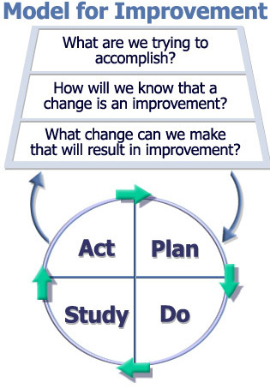
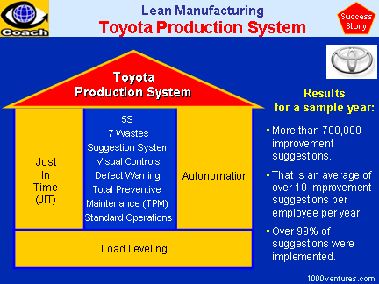
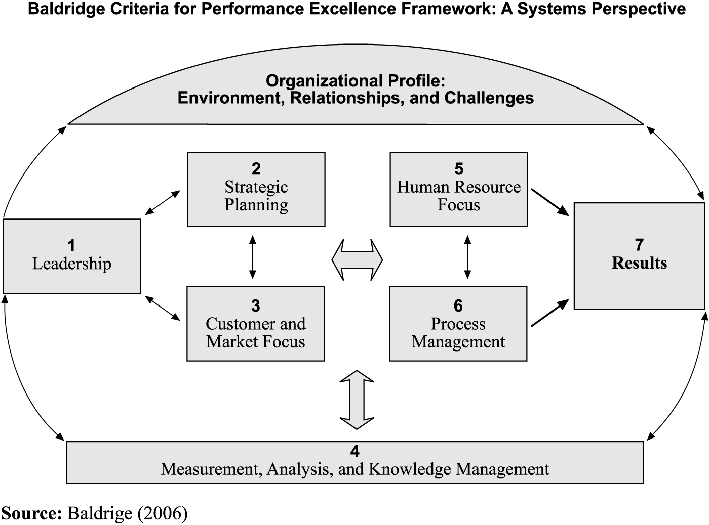

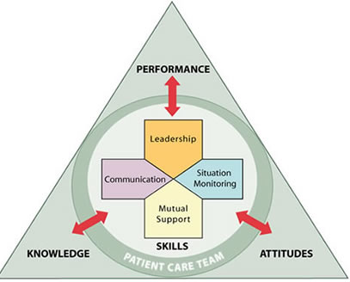

Integrate & Coordinate with Other Efforts

Slide 78
Basic Principles of Safe Design
  Standardize
  Create independent checks for key process
  Learn from mistakes

Slide 79
Basic Principles of Safe Design
Assess whether your unit continues to practice safe design principles
Have your CUSP team name the 3 principles of safe design and write down an example of how you or your team has applied each of these principles.

Slide 80
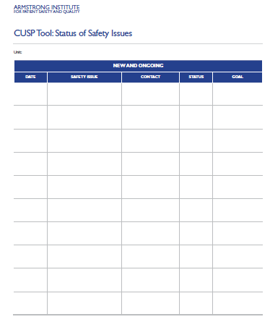
Identifying Defects:
Defects can come from many different sources
Staff feedback
Event reporting
Quality and safety measures
Gaps in application of the
evidence
Staff Safety Assessment survey
  How will the next patient be harmed?
  What steps can you do to prevent this harm?
    By either preventing the mistake, making the mistake visible or mitigating the harm
Talk about administering the SSA survey every 6 months to 1 year
  Great tool to help staff own patient safety
Keep track of the safety issues identified and status of resolution

Slide 81
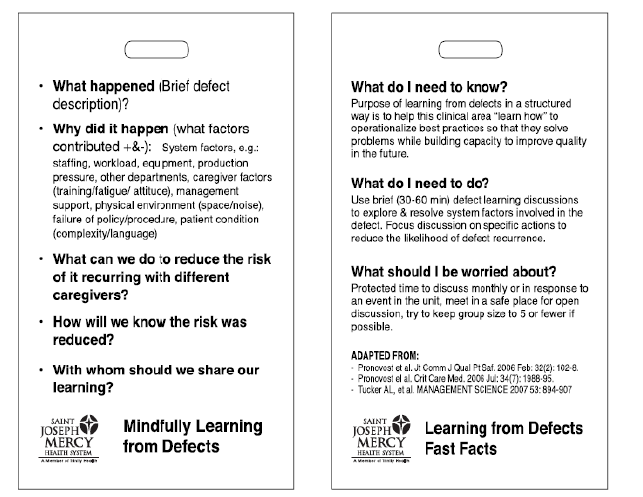
Learn from Defects
As one of the principles of safe design—we need to learn from our mistakes
Use the Learn from a Defect tool for any defect you identify
  Staff concern, incident report, gaps in application of the evidence
  We use it as the framework for post fall/skin huddles, morbidity and mortality conference, voice reports, reviewing unplanned transfers to a higher level of care , etc
  Make the tool easily accessible (e.g.: badge cards)

Slide 82
Measure how well you are sustaining your CUSP work
You want to evaluate if your team is achieving the CUSP mission
  Empowering the staff to own safety
  Developing strong partnerships with your senior executive
  Continuously learning from defects
  Working to strengthen teamwork and patient safety culture

Slide 83
Measure how well you are sustaining your CUSP work
CUSP score card (use this or develop your own)
Number of CUSP meetings canceled within last 6 months (Goal: 0)
Number of Senior Executive absences from a CUSP meeting within the past 6 months (Goal: 0)
Percentage of staff that have received science of safety training (Goal: >90% within past 2 years)
CUSP Champion, Provider Champion and Unit Manager have received training in CUSP and patient safety topics (Goal: all three receive training)
Number of defects learned from in past 6 months using the Learning from Defects tool (Goal: >2)
Number of patient safety improvement plans currently in effect (Goal: >2)
Average percent positive score for Safety Climate Domain from most recent safety survey (Goal: >80%)
Unit response rate for most recent safety survey (Goal: >80%)
Define your own CUSP team measures of success

Slide 84
Safety Culture
Continue to assess safety culture annually
Evaluate the action plan you developed after the last safety survey and see how far you’ve come
Celebrate successes and share with all frontline staff to let them know their voices have been heard
Consider the barriers you still face and what you will need to do to overcome them

Slide 85
Teamwork and Communication Tools
Select other tools (at least one every 6 months/one year) to implement
  Learn from a defect
  SBAR (Team STEPPS)
  Daily rounds/goals
  Pre-procedure briefing (Team STEPPS)
  Morning briefing (Team STEPPS)
  Huddles
  Shadowing
  Crucial Conversations
  Executive Safety Rounds/Partnership
  Handoff standardization (Team STEPPS)

Slide 86
Other Strategies to Sustain CUSP
Make science of safety training a part of orientation for all new staff regardless of role (Goal: 90% of all staff trained every two years)
Advertise CUSP meetings widely and open meetings to new team members
Encourage new staff to take an active role in CUSP
Hold periodic meetings for new staff to provide an overview of the CUSP approach and the important role of frontline staff
Regularly ask staff to identify defects (can use SSA, part of Executive safety rounds)
Make the CUSP initiative visible (e.g.: through bulletin boards, newsletters, review of results from LFD, etc.)
Expand the CUSP team/concepts to other units

Slide 87
Thank you!
Questions?

Slide 88
Funding
Prepared by the Health Research & Educational Trust of the American Hospital Association with contract funding provided by the Agency for Healthcare Research and Quality through the contract, “National Implementation of Comprehensive Unit-based Safety Program (CUSP) to Reduce Catheter-Associated Urinary Tract Infection (CAUTI), project number HHSA290201000025I/HHSA29032001T, Task Order #1.”

