Slide 1
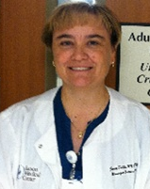

Engaging The Nurse, Physician, Patient/Family; CUSP – Learn from Defects
Jenny Tuttle, RN, MSNEd, CNRN
Clinical Nurse Leader
Neuro/Medical/Surgical ICU
Tucson Medical Center
Tucson, Arizona
Christin Ko, MD, MBA, SFHM, FACP
Assistant Professor
Feinberg School of Medicine
Northwestern University
Chicago, IL

Slide 2
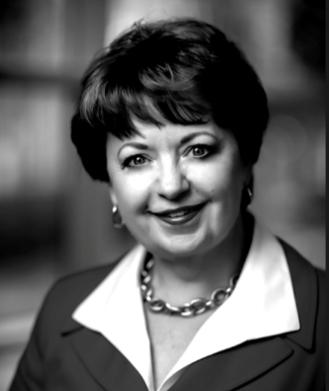
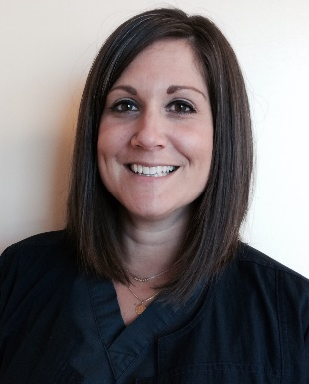
Additional Presenters
Sue Collier, MSN, RN, FABC
Clinical Content Development Lead
Health Research & Education Trust
American Hospital Association
Emily Pasola MSN, RN, CNL
Clinical Nurse Leader
Surgical Intensive Care Unit
Saint Joseph Mercy Hospital
Ann Arbor, Michigan

Slide 3
Learning Objectives
  Define nurse, physician, and patient and family engagement.
  Describe the benefits and examples of engaging key team members as partners in reducing CAUTI in the ICU
  Identify the key elements of the CUSP: Learning From Defects process and how it can be used to improve performance
  Identify the scope, and challenges and solutions around physician engagement

Slide 4
Case Study
08/02/12 – Ms. C is a 66 y.o. who is in the OR for an exploratory lap. An indwelling urinary catheter was inserted in OR. Ms. C was transferred to ICU post-op. Nurse OR gave report to Nurse ICU.
08/03/12 – Ms. C is stable. The indwelling urinary catheter is still in place. Ms. C’s son has been with her since surgery, but he has not been included in any rounds with the nurses or physicians, because they occur outside of visiting hours. Daily rounds and morning huddle did not include assessment of the indwelling catheter.

Slide 5
Case Study
08/04/12 – Ms. C is febrile (38.9°C) and complains of diffuse abdominal pain. WBC has increased to 19,000. She has cloudy, foul-smelling urine and urinalysis shows 2+ protein, + nitrite, 2+ leukocyte esterase, WBC – 15/mm3 of unspun urine and 3+ bacteria. Urine culture was 10,000 CFU/ml E. coli. The abdominal pain seems localized to the surgical area.
8/04/12 – Ms. C is diagnosed with a CAUTI by the attending physician. The physician ordered a course of antibiotics. During morning huddle the infection preventionist reviewed the prevalence of urinary catheter use. Several staff indicated that a higher prevalence of UTI in the ICU is not unusual. When Ms. C’s son was at the bedside during visiting hours, he stated he was angry and concerned that his mother has an infection.

Slide 6
How Might Nurse, Physician, and Patient/Family Engagement Impact This Scenario?
Consider these three elements as we discuss engagement of each role (nurse, physician, patient/family):
Concerns/fears: What might be some unique issues or concerns each role has relative to UC?
Skills/Knowledge (e.g. communication skills, information/education): What do they need to know to adopt new practices and to be confident it’s the right thing?
System support (policies, protocols, check lists, teamwork): What can the system do to promote evidence-based practice and a culture of safety?
Notes:
[NURSING ENGAGEMENT]
Key messages: Nurses can effectively impact patient outcomes by supporting the role evidence-based practices and engaging other team members to adopt these practices.
Questions: Is there a nurse-driven removal protocol in place? Did the nurses feel like they have the information they need on catheter indications and need? Can they call out any concerns or bring them up with the physician and/or peers? What concerns might the nurse have that could impact their decision making and care?
[PHYSICIAN ENGAGEMENT]
Key messages: Physicians can effectively impact patient outcomes by supporting evidence-based practices and engaging with other team members to adopt these practices.
Questions: Is there a physician champion on the CAUTI prevention team? Does the physician know the proper indwelling urinary catheter indications in the ICU? Does the medical staff have the data concerning prevalence of urinary catheter use in critical care units? Did daily assessments during rounds on the patient include an evaluation of the need for urinary catheters? What concerns might the physicians have that could impact their decision making and care?
[PATIENT/FAMILY ENGAGEMENT]
Key messages: Patients and their family members can effectively impact patient outcomes by understanding and supporting evidence-based practices and engaging with other team members to adopt these practices.
Questions: Do Ms. C and her son know the risks associated with an indwelling urinary catheter? How might they be involved in rounds with the medical team? How might family members be engaged in other care decisions? Can they call out any concerns or bring them up with the physician and nurses? What concerns might the patient or family have that could impact their decision making and care?
E.g. nurse driven protocols, huddles focused on safety issues, consistent use of checklists, teamwork practices (TeamSTEPPS), family presence policies

Slide 7

Reducing CAUTIs:
Nurse Engagement in the ICU
Jenny Tuttle, RN, MSNEd, CNRN
Clinical Nurse Leader
Neuro/Medical/Surgical ICU
Tucson Medical Center
Tucson, Arizona

Slide 8

Laying the Groundwork
Education to staff
  Who = Case Studies, Current unit data
  What = Making clear goals, protocols and expectations
  Where = Unit specific? Department?
  When = Rounding, every shift
  Why = Provide the stats, harm, cost

Slide 9
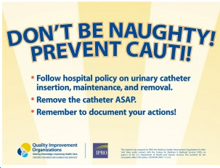
Providing the Tools to Succeed
Review of current supplies
Listen and identify opportunities to make
  workflow easier.
  - Extra techs?
Give staff an opportunity to be apart of the decision making.
It may cost more in supplies but every CAUTI avoided is worth it
Reminders – flyers, t-shirts, slogan,
computer based assessments
Notes:
Atlanta quality innovative network – NY – DC - NC

Slide 10
Making Staff Accountable
Are they following your hospital based guidelines?
  Auditing/survey – asking open questions
  Nursing based - Urinary insertion/removal protocol
Providing current data
  Bulletin board
  Unit newsletter

Slide 11

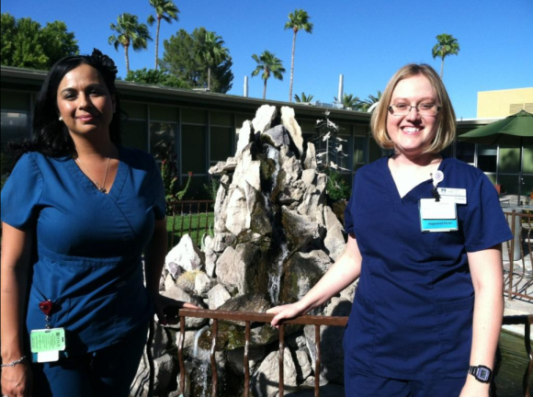
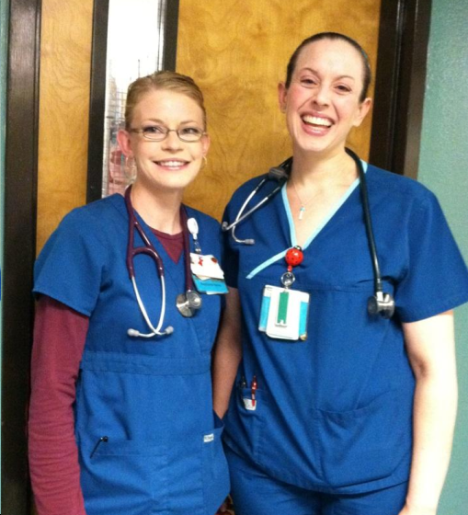
Acknowledge the Successes
Rewards
  Even small rewards stand out
  “high five”
  “Sunflower” (North Shore University Hospital, NY)
Notes:
Visual cues were introduced to promote the program. On "Foley Fridays," nurses wore T-shirts emblazoned with "Nurses Stopping CAUTI Usage (NSCU)." Soon, physicians and staff in other ICUs were wearing the T-shirts and answering questions from staff, patients, and families who saw them in the hallways. They also created a smiling sunflower at the nurses' station, to which a leaf was added for every CAUTI-free day. At the time of presentation, the sunflower was adorned with 236 leaves.
Early Catheter Removal, Education Cut CAUTIs in ICU
Marcia Frellick
May 28, 2015
North Shore University Hospital in Manhasset, New York.
Medscape

Slide 12

Attaining Physician Engagement :
From the Medical Executive to the Individual Physician
Christin H. Ko, MD, MBA

Slide 13
Agenda
Definition of Physician Engagement
Scope of Physician Engagement
Challenges around Physician Engagement
Solutions : General and Specific
Putting It All Together : Scenario-Solution Summary

Slide 14

Definition of Physician Engagement
An intentional and deliberate process
To bring physicians and other stakeholders together
To address problems and continuously improve care and the patient experience
From Ken Cohen

Slide 15
What it Looks and Feels Like
Invest their Time
Curious
Enthusiastic
Contribute
Influence Others
Adapted from J. Silversin

Slide 16
Why Does It Matter ?
Evidence Links Physician Engagement to :
    Better Outcomes
    Greater Impact on Quality and Safety
  Dickinson H et al : Engaging Doctors in Leadership : Review of the literature. University of Birmingham 2008
  Reinertsen et al :Engaging Physicians in a Shared Quality Agenda. IHI Innovation Series White Paper . Cambridge , MA IHI 2007
  Ham C et al :Engaging Doctors in Leadership : What Can We Learn from International Experience and Research Evidence? University of Birmingham 2008
Notes:
Citation

Slide 17
Scope of Physician Engagement

Slide 18
Scope of Physician Engagement
Medical Executive
CMO, CQO
Medical Executive Committee Members
Physician Champion
Hospitalist
Infectious Disease Specialist
Individual Physicians
Non-surgeons
Surgeons
Nephrologist
Geriatrician
Urologist
Hospital Epidemiologist
Physician
Stakeholders

Slide 19
Challenges Around Physician Engagement

Slide 20
Challenges Surrounding
Physician Engagement
Institutional Culture :
  Different Incentives and Goals from Physicians
  May See Physicians as Barriers
Physician Culture :
  Trained to be Autonomous and Independent
  Medico- legal Concerns
Physician Worklife :
  Limited Time
  Attend at Several Hospitals
  Not Hospital Employees
  Not Aware of Projects
  Lack of QI Skills

Slide 21
Solutions : General

Slide 22
Solutions : 3 General Approaches
CUSP Model : 4 E’s
IHI Approach : 6 Elements
6 Drivers

Slide 23
10 Hospitals Study: 6 Drivers
Realignment of Financial Incentives
Physician Compact
Strong Physician Engagement
Data and Enablers
Engaged Leadership
Appropriate Compensation
Academic Promotion
Taitz, JM et al BMJ Qual Saf 2012

Slide 24
IHI Approach : 6 Elements
Engaging Physicians in Quality and Safety
Discover a Common Purpose
Reframe Values and Beliefs
Segment the Engagement Plan
Use Engaging Improvement Methods
Show Courage
Adopt an Engaging Style

Slide 25


Discover a Common Purpose
Good Patient Outcomes
Improved Efficiency
Excellent Reputation
Greater Cause

Slide 26

Reframe Values and Beliefs
View Physicians as Partners

Slide 27
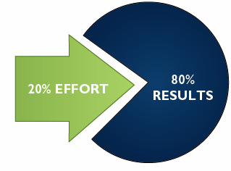
Segment the Engagement Plan
Early Adopters
Hospitalists
Infectious Disease
Nephrologist
Surgeons
Urologists
Pareto Principle

Slide 28
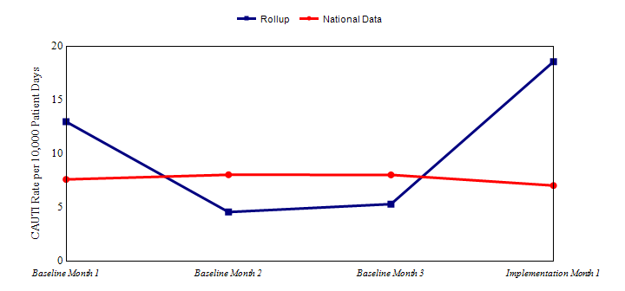
Use Engaging Improvement Methods
Use Data for feedback : rapid cycle
Use Data to generate awareness, not to inflame
Show Evidence-Based Guidelines as needed

Slide 29

Show Courage

Slide 30

Adopt an Engaging Style
Involve Physicians from the Beginning
Build Trust
Communicate Often
Value Their Time

Slide 31
CUSP MODEL :
Engage Physicians Using the 4 E’s
How does this make the world a better place?
Engage (adaptive)
Medical Executive
Educate
(technical)
What do we need to know?
Execute (adaptive)
What do we need to do? What can we do with our resources and culture?
Physician Champion
Evaluate (technical)
How do we know we improved safety?
Individual Physician
Adapted from : Pronovost PJ, Berenholtz SM, Goeschel CA, et al. Creating high reliability in health care organizations Health Serv Res 2006;41(4, pt 2):1599-1617.
Notes:
SAY:
The 4 E’s engagement model will assist in identifying and recruiting team members. Created by the Johns Hopkins University’s Quality and Safety Research Group, the 4 E’s help teams implement patient safety interventions by focusing change efforts around technical and adaptive work. The model features four elements for starting and sustaining initiatives: engage, educate, execute, and evaluate. These four elements depict the primary means for engaging unit team members to ensure patient safety initiatives are carried out in a way that encourages sustainability.
Engage
Engagement primarily embodies adaptive work, in which unit teams help staff understand the results of preventable harm caused by a clinical problem. This is done by sharing stories about patients affected by a problem and estimating the number of patients who are harmed. Emphasizing unit team members’ involvement in improving the unit lends not only to the success of the initiative but also to the sustainability of the effort.
Educate
Education uses predominantly technical work and requires unit teams to guarantee that staff and senior leaders understand what is necessary to prevent a given clinical problem.
Execute
Execution of a sustainable intervention requires adaptive work. Unit team members will apply a plan of action based on the unit’s resources and culture and analyze their roles within the plan.
Evaluate
Evaluation is technical work and requires that the unit team collect and submit data to analyze the success of an initiative. In addition to data submission, this work requires unit team members to ask themselves, “How do we know we improved safety?”
ASK:
Think of a time when you needed to share an idea with a colleague. Re-create the encounter but use the 4 E’s to convince him or her of the value of your idea and answer these questions:
How does this make the unit a better place?
What do we need to know?
What do we need to do?

Slide 32
Solutions : Specific

Slide 33
Physician Stakeholders
Medical Executive
CMO, CQO
Medical Executive Committee Members
Physician Champion
Hospitalist
Infectious Disease Specialist
Individual Physicians
Non-surgeons
Surgeons
Nephrologist
Geriatrician
Urologist
Hospital Epidemiologist
Physician
Stakeholders

Slide 34
Medical Executives &
Medical Executive Committee
Consider Cultural Assessment
Present Data on CAUTI : Initially and Regularly
  Prevalence
  Morbidity
  Mortality
Present the Business Case for CAUTI Prevention :
  CAUTI Cost Calculator
  LOS Reduction
  CMS Non-reimbursement Policy for HAI

Slide 35
Physician Champion :
Choosing One
Respected Clinician
Courageous and Sociable
Good Communication Skills
Motivated – Internal Engine
Consider Hospitalists, Infectious Disease, Urologist, Nephrologist, Geriatrician, Hospital Epidemiologist

Slide 36
Physician Champion :
Role and Responsibilities
Communicate to other physicians
Education of medical staff about the appropriate indications for urinary catheter use
Assist with development of processes
Assists with implementation of technical and adaptive components
Assist with physician barrier removal
Urologist, infectious disease specialist, hospitalist, quality/patient safety officer or any physician interested in improving safety and quality
Fakih, Mohamad. Building a Team and Process to Reduce CAUTI Risk. On the CUSP: Stop CAUTI Cohort 5 Onboarding Call #1; 2012. http://www.onthecuspstophai.org
Notes:
MD CHAMPION
urologist, infectious disease specialist, hospitalist, quality/patient safety officer or any physician interested in improving safety and quality
Responsibilities of this role include:
Explaining the project to medical staff who have patients on this unit
Assisting with education of medical staff about the appropriate indications for urinary catheter use
Participating in the CUSP activities of the project
Help to overcome any perceived physician barriers during implementation

Slide 37
Physician Champion :
Equipping and Supporting
Provide Materials and Resources
Provide Leadership Support
Connect with Early Adopters and Supporters
Have a Communication Plan
Consider Incentives/Recognition/Reward

Slide 38
Sample Script
“I understand you feel that way, Bob. The evidence isn’t perfect. But it never is, is it?
And the leading minds - the CDC, AHRQ and the IDSA - have all recommended we make this change.
I don’t think we’re going to reinvent science here at this hospital and I think we should adopt these changes.
Sure, there might be risk in making the change but we’ve seen the evidence of the harm that’s occurring with our current approach.
What is the risk to our patients of not making the changes ?”
Adapted from IHI

Slide 39
Individual Physicians : General Physicians and Specialists
Make it As Easy as Possible
Involve Early in Decisions : Design and Plans
Physician Champion Presentation at Staff Meetings
Provide Data and Feedback
Appeal to Professional Pride
Engage Medical Leadership support, eg Chief of Staff
Use Scripts to Engage
Frame it : “WIIFM”
One on One Education
Listen Carefully
Ask : “What will it take for you to Participate or Commit”
Rewards/Recognition

Slide 40
Individual Physicians : Surgeons
A Chief of Staff and a Surgeon: “ Surgeons are very tribal… so what you need to do if you have something you think is a best practice at your hospital… you need to get….either the Chair of Surgery or some reasonable surgeon…If you come in and you’re an internist… into a group of surgeons…the first thing we’re going to do is say ‘Look, you’re not one of us’…the way to get buy-in from surgeons is you got to have a surgeon on your team”
Saint et el Joint Comm Journal Qual Safety 2009

Slide 41
What NOT to do……
Use Inflammatory Language : Message Carefully
Adopt “One Size Fits All” Mentality
Use Only Educational Material/Meetings
Give Up

Slide 42
Putting It All Together :
Scenario – Solution Summary

Slide 43
Putting It All Together :
Scenario – Solution Summary table
Engagement Level | Problem Scenario | Solution
Medical Executive Committee | Leadership Does Not see CAUTI as a Priority. Part I | Consider Cultural Assessment
Medical Executive Committee | Leadership does not see CAUTI as a priority. Part II | Prepare and present a good business case Remind about the CMS nonpayment rule Give monthly CAUTI/catheter prevalence data Consider a Physician Compact /Written Engagement Plan
Physician Champion | Choosing a Physician Champion | Choose courageous and social communicators Consider Hospitalists, ID, urologist, nephrologist
Physician Champion | Equipping the Physician Champion | Support from Leadership Provide Evidence based Resources and Data/outcomes Connect with Early Adopters Craft a Communication plan
Physician Champion | Lack of Physician Champion | Identify strong nurse champions Leverage CDC CAUTI Expert videos Provide scripts as needed
Individual Physicians : Non-Surgeons | Lack of Buy- In to New Practice | Make it As Easy as Possible to do the right thing Involve Early in Decisions : Design and Plans Physician Champion Presentation at Staff Meetings Provide Data and Feedback Engage Medical Leadership support ,eg Chief of Staff Use Scripts to Engage Frame it : “WIIFM” One on One Education Listen Carefully Ask : “What will it take for you to Participate or Commit” Rewards/Recognition
Individual Physicians : Surgeons | Resistance to Early Indwelling Urinary Catheter Removal | All of the above plus: Engage medical leadership support ie Chief of Surgery Participate in SCIP initiative Engage a surgeon or urologist as a champion/team member Leverage organizational policies Consider Posting Data on Individual Physicians : only if culturally correct
Adapted from Catheterout.org

Slide 44
Patient and Family Engagement
Sue Collier, RN, MSN, FABC
Clinical Content Development Lead
Health Research & Education Trust
American Hospital Association

Slide 45
Patient and Family Engagement (PFE)
Consider these three elements as we discuss engagement of the patient and their family:
Concerns/fears: What are their unique concerns or issues?
Skills/Knowledge : What do they need to know to be part of the team?
System support: What can the system do to promote PFE?
Notes:
Concerns/fears: Risks of an infection, esp. as it relates to UC
Skills/Knowledge (e.g. communication skills, information/education): What do they need to know to be part of the team? How might they be involved in rounds with the medical team? How might family members be engaged in other care decisions? Can they call out any concerns or bring them up with the physician and nurses? What concerns might the patient or family have that could impact their decision making and care?
System support (policies, protocols, check lists, teamwork): What can the system do to promote PFE? E.g. huddles focused on safety issues, consistent use of checklists, teamwork practices (TeamSTEPPS), family presence policies
Key messages: Patients and their family members can effectively impact patient outcomes by understanding and supporting evidence-based practices and engaging with other team members to adopt these practices.

Slide 46
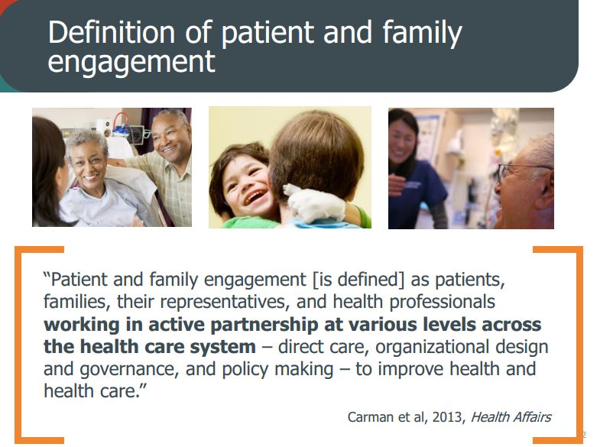
PFE Defined
Notes:
Much like MD engagement, it is intentional and deliberate
RN engagement: Opportunity to be part of the decision making process
Similar purpose

Slide 47

Evidence Boost: A review of research highlighting how patient engagement contributes to improved care

Slide 48
Creating the Environment for PFE
Mutual respect for skills and knowledge
Honest, clear, two-way communication
Understanding and empathy by being accessible and responsive
Mutually agreed upon goals through joint planning and evaluation
Shared planning and decision-making (doing things with patients-families, not for or to them)
Notes:
The first step to ensuring PFE in the ICU or any setting is to create an environment, culture that promotes and sustains PFE: This requires:
Mutual respect for skills and knowledge
Honest, clear, two-way communication
Understanding and empathy by being accessible and responsive
Mutually agreed upon goals through joint planning and evaluation
Shared planning and decision-making (doing things with patients-families, not for or to them)
The Cascade Effect of Shared Decision Making
Patient-centered care hinges on shared decisions
Shared decision processes support informed patients
Informed patients make better choices and communicate more effectively to providers
Open communication promotes efficiency, reduces waste, supports evidence-based care
Informed patients often prefer lower-cost and less intensive treatments
Build trust
Involve from the beginning
Set goals, expectations

Slide 49
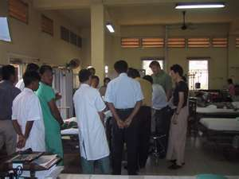
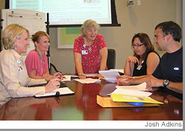

Examples of PFE Practices
Including patient/family in rounds
Supporting family presence
Including patient/family in CAUTI prevention education
Sharing patient stories in quality team meetings
Developing Patient-family advisor roles and councils
Encouraging Patient Advisors to serve on safety and quality performance improvement teams
Notes:
unique perspective of the patient & family

Slide 50
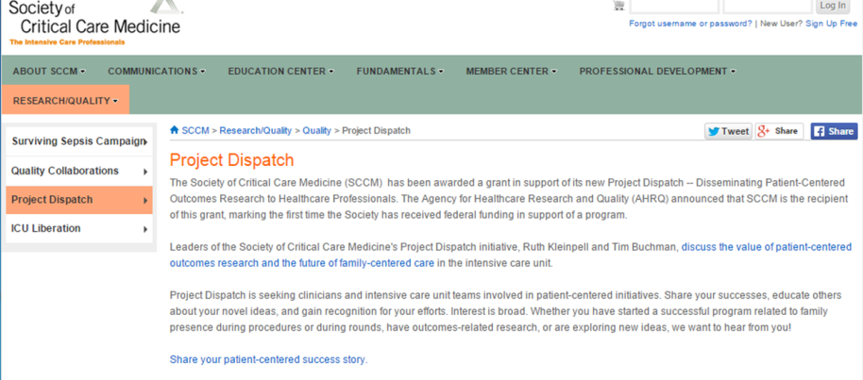
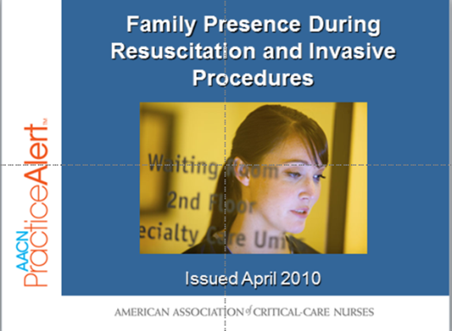
SSCM and AACN PFE Initiatives
SCCM
  Project Dispatch (Disseminating Patient-Centered Outcomes Research to Healthcare Professionals)
  THRIVE project (effects of ICU)
  ACCCM Statement on EOL Care in ICU
  Podcasts (Family Presence, Family-centered rounds, Integrating communication bundles)
  AACN
  Scope & Standards for Acute & Critical Care Nursing Practice
  Practice Alert: Family Presence During Resuscitation and Invasive Procedures
  Clinical Practice Guidelines for Support of the Family in ICU

Slide 51
Your Organization’s PFE Practices
How does your organization demonstrate the principles and practices of patient and family engagement in infection prevention, especially CAUTI prevention?
What is your organization’s long-term plan to advance patient- and family-centered care across all areas of patient safety, especially CAUTI prevention?
Who is guiding your unit’s or organization’s efforts in this area?

Slide 52
Selected Resources For
Engaging Patients and Families as Partners in Safety
AHRQ CUSP Toolkit, Patient Family Engagement. Retrieved from http://www.ahrq.gov/professionals/education/curriculum-tools/cusptoolkit/modules/patfamilyengagement/index.html.
Association for Professional in infection Control and Epidemiology. Patient safety resources for consumers. Retrieved from http://www.apic.org/For-Consumers/Patient-safety-resources.
Institute for Patient and Family Centered Care. Retrieved from http://www.ipfcc.org/advance/topics.html.
Centers for Disease Control and Prevention. FAQs about Catheter-Associated Urinary Tract Infection. Retrieved from http://www.cdc.gov/HAI/ca_uti/uti.html
Carman KL, Dardess P, Maurer ME, Workman T, Ganachari D, Pathak-Sen E. A Roadmap for Patient and Family Engagement in Healthcare Practice and Research. September 2014. www.patientfamilyengagement.org and http://patientfamilyengagement.org/#sthash.ACZ81zY8.dpuf
Reinertsen JL, Bisognano M, Pugh MD. Seven Leadership Leverage Points for Organization-Level Improvement in Health Care (Second Edition). Cambridge, Massachusetts: Institute for Healthcare Improvement; 2008. Available on www.ihi.org
Guide to Patient and Family Engagement in Hospital Quality and Safety, Rockville, MD; Agency for Healthcare Research and Quality; May 2013, AHRQ Publication No. 13-0033. http://www.ahrq.gov/professionals/systems/hospital/engagingfamilies/index.html

Slide 53
Learn From A Defect
Emily Pasola MSN, RN, CNL
Clinical Nurse Leader
Surgical Intensive Care Unit
Saint Joseph Mercy Hospital
Ann Arbor, Michigan

Slide 54
Finding the Defects
Staff feedback
  Shift huddles, staff meetings
Event reporting
  Root Cause Analysis, hospital reporting system
Quality and safety measures
  Monthly data reports
  Recurring gaps
Staff Safety Assessment survey
  Anything that you do not want to happen again….

Slide 55
Learn From a Defect
Supporting a culture of safety
Easy to use
  efficient
Continuity
Non-punitive
  “What” went wrong, not “Who” went wrong
Ownership
  Engages frontline staff
  collaborative, multidisciplinary
Communication
  Structured method
  Key words at Key times
Improve Quality

Slide 56
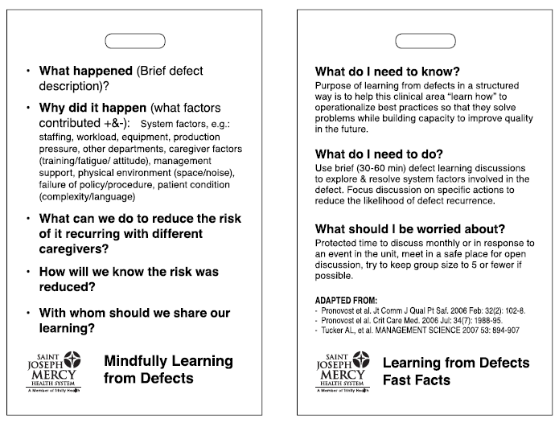
Learning from Defects Fast Facts

Slide 57
EXAMPLES

Slide 58
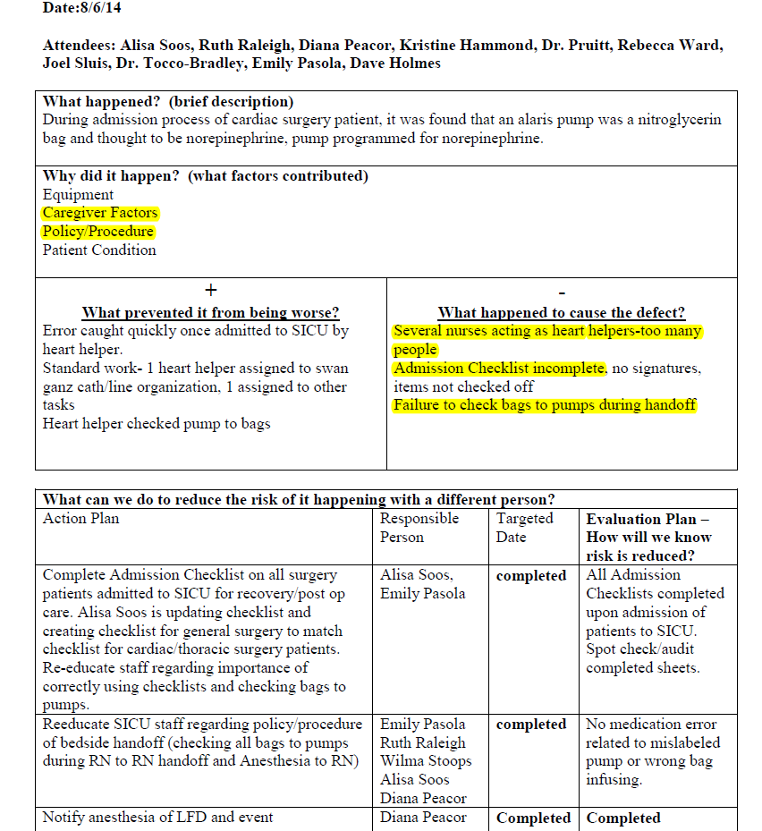
Example 1
Notes:
People and process factors

Slide 59
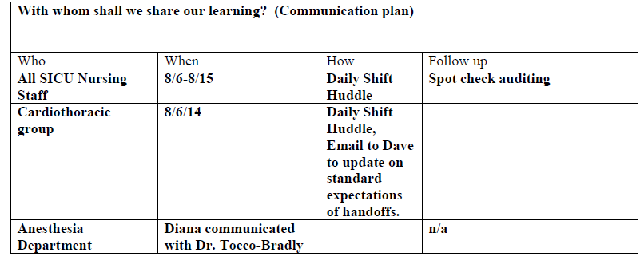
Example 2

Slide 60
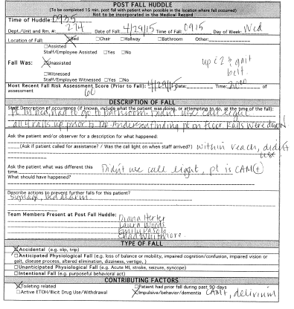

Slide 61
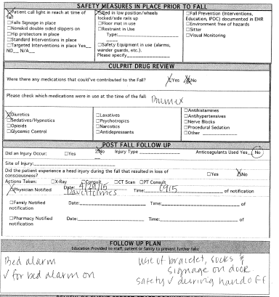
Example 4

Slide 62
Next Steps:
Assess your ICU’s level of engagement of nurses, physicians and patients/families
  Are there opportunities for improvement?
  What are the barriers you are facing with regards to engagement?
  Utilize the learning from defects tool
Review the concepts and tools referenced here today to help bolster your ICU’s level of physician/nurse/patient and family engagement

Slide 63
Thank you!
Questions?

Slide 64
Funding
Prepared by the Health Research & Educational Trust of the American Hospital Association with contract funding provided by the Agency for Healthcare Research and Quality through the contract, “National Implementation of Comprehensive Unit-based Safety Program (CUSP) to Reduce Catheter-Associated Urinary Tract Infection (CAUTI), project number HHSA290201000025I/HHSA29032001T, Task Order #1.”

