Slide 1
Infectious Complications Related to the Catheter Other than CAUTI
Mohamad Fakih, MD, MPH
Medical Director, Infection Prevention and Control
St. John Hospital and Medical Center
Professor of Medicine
Wayne State University School of Medicine
Detroit, MI
Nasia Safdar, MD, PhD Associate Professor, Infectious Disease Division
University of Wisconsin, Madison
Hospital Epidemiologist
University of Wisconsin Hospital and Clinics
Kathlyn Fletcher, MD, PhD
Associate Professor of Medicine
Medical College of Wisconsin and the Milwaukee VAMC
Associate Program Director, MCW Internal Medicine Residency

Slide 2
Learning Objectives
Describe patients with urinary catheters as potential reservoirs for transmission of multidrug resistant organisms
Discuss the impact of unnecessary antibiotic use in causing C. difficile infection
Summarize the role of unit culture on prevention of CAUTI

Slide 3
Polling Question 1: Which of the following is more likely in patients with urinary catheters? (choose one)
Patient developing symptomatic CAUTI
Patient being given inappropriate antibiotics for asymptomatic bacteriuria
Patient developing bacteremia from a urinary source

Slide 4
Patients with Urinary Catheters…
Catheter associated bacteriuria often misdiagnosed as CAUTI (Cope, Clin Infect Dis 2009; 48:1182–8; Al-Qas Hanna Am J Infect Control 2013; 41: 1173-7)
Clinicians administer antibiotics even to patients with history of Clostridium difficile infection (Shaughnessy, Infect Control Hosp Epidemiol 2013;34(2):109-116)
Bacteremia related to urinary tract: <4% of patients with bacteriuria

Slide 5
Infectious Complications + Catheter
Urinary catheter
CAUTI
Endocarditis, septic arthritis, osteomyelitis
Asymptomatic urinary colonization
Inappropriate antimicrobial use
Bacteremia form urinary source
MDRO colonization
Clostridium difficile Infection
Upper urinary tract involvement
MDRO transmission
MDRO related infection
MDRO: multidrug resistant organism

Slide 6
Risk
Patient with indwelling catheter and colonized urine
Healthcare worker exposes other patients
Organisms contaminate environment and may survive for months
Shared instruments (fomites) expose other patients
Unnecessary antibiotics and their side effects, risks for MDRO, and Clostridium difficile
Solution: minimize catheter exposure, avoid unnecessary cultures, and promote appropriate antimicrobial use
Increased Risk
Reduced Risk

Slide 7
Polling Question 2: Multidrug Resistant Organisms (choose one)
Antibiotic resistance is associated with $20 billion direct healthcare cost per year
Antibiotic resistance is associated with about $1 billion direct healthcare cost per year
Developing new antibiotics is more important than preventing infections and preventing the spread of resistance

Slide 8
4 Core Actions to Fight Deadly Infections (CDC; Antibiotic Resistance Threats, 2013)
Preventing infections and preventing the spread of resistance
Tracking resistant bacteria
Improving the use of today’s antibiotics
Promoting the development of new antibiotics and developing new diagnostic tests for resistant bacteria

Slide 9
Example: Carbapenem Resistant Enterobacteriaceae…
Very resistant organisms to many antibiotics
Klebsiella pneumoniae carbapenemase (KPC) and New Delhi metallo-beta-lactamase (NDM)
Responsible for outbreaks in hospitals
Mortality up to 50%, with limited antimicrobials available

Slide 10
CRE: What is New? (MMWR 2013; 62 (9):165-70)
Estimate of the proportion of CRE in US hospitals:
At least one CRE infection (1st 6 months 2012): 3.9% short acute care hospitals and 17.8% in long term acute care hospitals
In 2001: CRE was 1.2% of Enterobacteriaceae

Slide 11
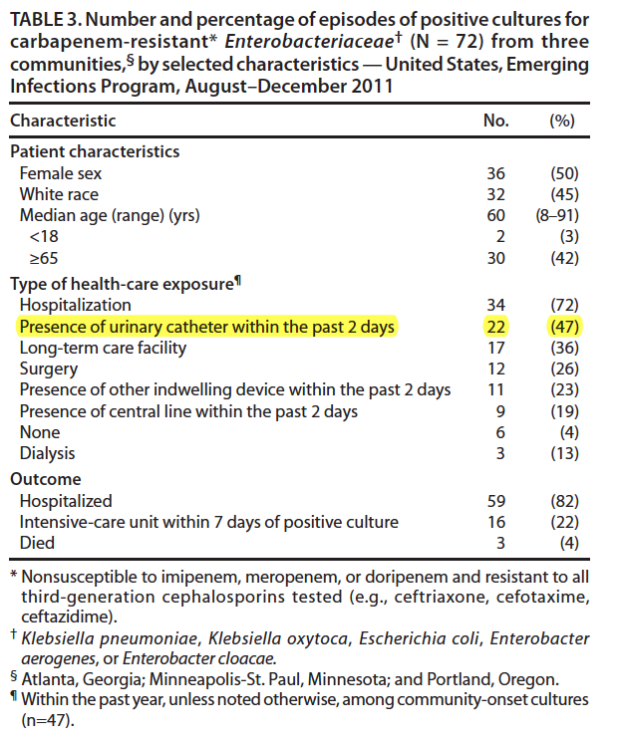
CRE and the Urinary Catheter (MMWR 2013; 62(9):165-70)
Emerging Infections Program (3 states)
72 CRE were identified
Most came from the Atlanta metropolitan area (n=59)
Most CRE were Klebsiella species (49) followed by Enterobacter species (14) and E. coli (9).
Urine: most common source (89%)
Blood: (10%)

Slide 12
CRE and the Urinary Catheter (MMWR 2013; 62(9):165-70)
Implications of the findings:
Higher mortality than other infections
Additional resistance to other antimicrobial classes and no available novel antimicrobials
Potential rapid spread in healthcare settings
CRE potential to spread in the community setting

Slide 13
LTACHs vs ICUs: Multidrug Resistance and CAUTI (Chitnis, Infect Control Hosp Epidemiol 2012; 33(10):993-1000)
National data on CAUTI in the ICUs vs. LTACHs
Microbiology evaluated included resistance
ICUs: most common 2 organisms E. coli and Candida sp; LTACHs: most common 2 organisms for CAUTI Klebsiella and Pseudomonas sp.
LTACHs: more MDROs associated CAUTIs

Slide 14
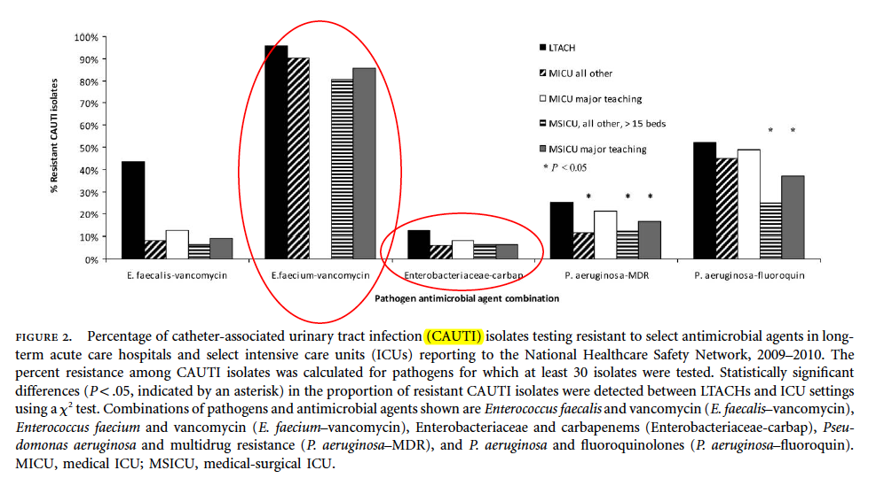
LTACHs vs ICUs: Multidrug Resistance and CAUTI (Chitnis, Infect Control Hosp Epidemiol 2012; 33(10):993-1000)

Slide 15
LTACHs vs ICUs: Multidrug Resistance and CAUTI (Chitnis, Infect Control Hosp Epidemiol 2012; 33(10):993-1000)
More VRE (faecalis) isolates were reported in LTACHs (44%) than in ICUs (7%–13%).
LTACHs: higher proportion of multidrug resistant P. aeruginosa CAUTI isolates (25%) compared to acute care MICUs (12-16%).
No significant difference in CRE CAUTI isolates between LTACHs and ICUs, but 42% of LTACHs reported a CRE CAUTI compared to ICUs (8%–21%).

Slide 16
MDROs and CAUTI: NHSN 2009-10 (Sievert, Infect Control Hosp Epidemiol 2013; 34: 1-14)
2,039 hospitals
CAUTI organisms: CRE klebsiella sp 12.5%, CRE E. coli 2.3%, VRE faecium 86%, fluoroquinolone resistant E. coli 67%
20% of facilities reported a CRE Klebsiella sp.

Slide 17
MDROs and CAUTI: NHSN 2009-10 (Sievert, Infect Control Hosp Epidemiol 2013; 34: 1-14)
Selected organisms reported comparing the ICU vs. non-ICUs: more resistance in ICUs.
More impetus for us to focus on urinary catheter use in ICUs?

Slide 18
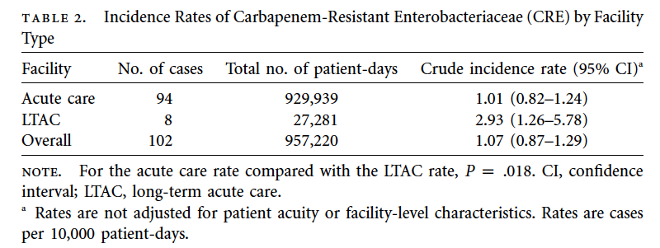
CRE in Michigan (Brennan, Infect Control Hosp Epidemiol 2014: 35(4):342-349)
17 acute care and 4 LTACs, 6 months data on CRE infection or colonization
102 cases: K. pneumoniae (87%), E. coli (13%)

Slide 19
CRE, Michigan, and Urinary Catheter (Brennan, Infect Control Hosp Epidemiol 2014: 35(4):342-349)
Cases evaluated: 61% from urine, 15% respiratory, 10% blood
49% of cases were on the general care wards (so, it is not only the ICUs!!!)
%

Slide 20
What about Nursing Homes? (Wang, Eur J Clin Microbiol Infect Dis (2012) 31:1797–1804)
Prospective evaluation of 15 nursing homes in Southeastern Michigan, compared patients with and without device (urinary catheter, feeding tube or both)
Compared 90 patients with device (60 had a urinary catheter) vs. 88 patients without
Device group had 48% higher infection rate, and 55% higher UTI rate
54% of device group were colonized with resistant organisms compared to 40% of patients without device (p<0.01)

Slide 21
What do we learn from the studies?
Urinary catheter use is associated with isolation of MDROs
This is seen at acute care hospital, LTACH, and nursing homes, in the ICU and non-ICU
Reducing unnecessary urinary catheter use may help reduce MDRO colonization and consequently spread in the healthcare setting.

Slide 22
If you give a patient a urinary catheter…..
Urinary Catheter
CAUTI
Asymptomatic bacteriuria
Antibiotic Treatment
Clostridium difficile infection

Slide 23
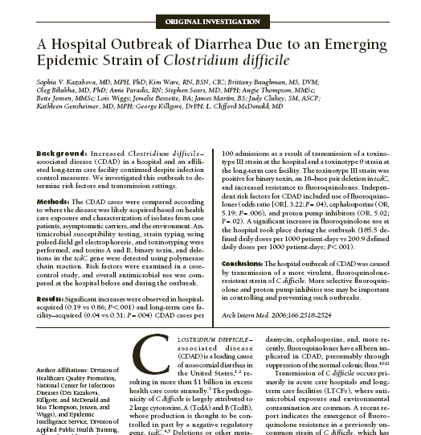
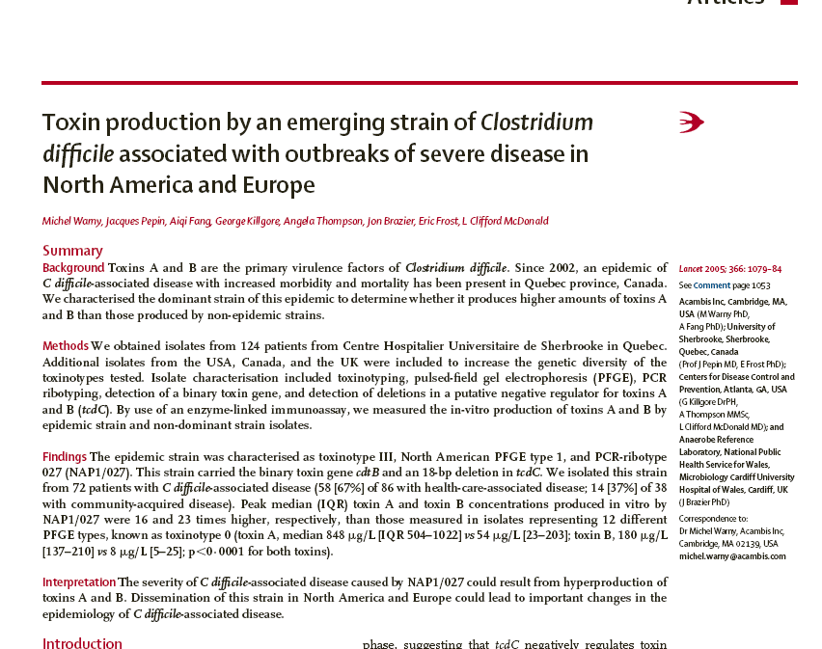
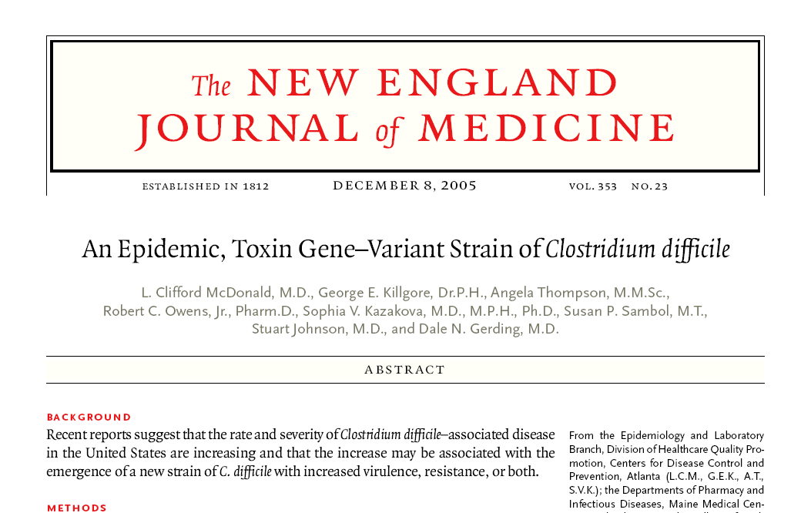
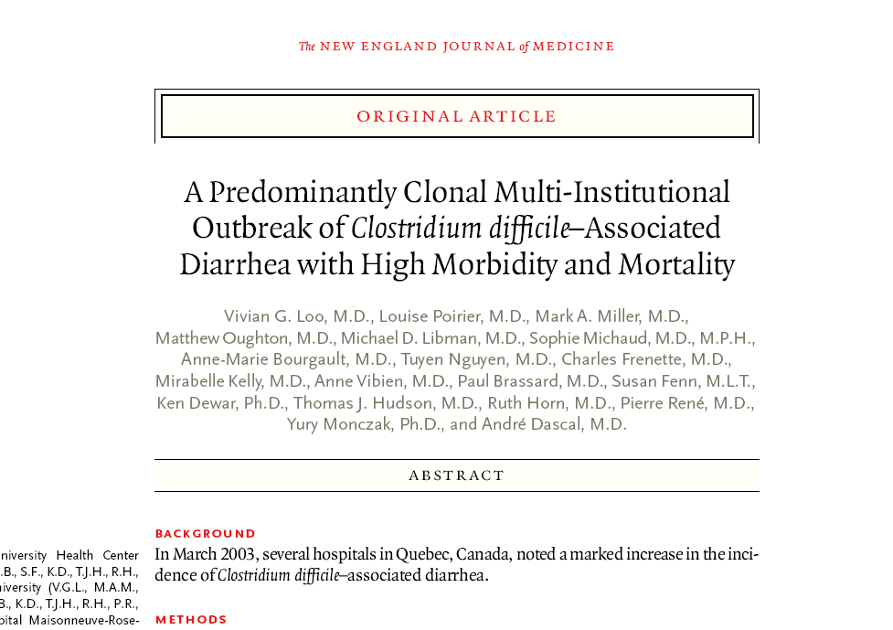
Journal Articles about C diff

Slide 24
Antimicrobial agents that induce C. difficile
Commonly used for treatment of uropathogens, including MDROs

Slide 25
Pathogenesis of Clostridium difficile
Antimicrobial exposure
C diff acquisition
C diff colitis
Asymptomatic
C diff colonization
Hospitalization

Slide 26
Outcomes of C. difficile Infection
The overall colectomy rate is 8.7 per 1000 CDI cases (Kasper et al Infect Control Hosp Epidemiol. 2012 May;33(5):470-6)
The estimated number of deaths attributed to CDI, based on multiple cause-of-death mortality data, increased from 3,000 deaths per year during 1999–2000 to 14,000 during 2006–2007. Over 90% of deaths occur in patients over the age of 65 years. (Hall et al Clin Infect Dis. 2012 Jul;55(2):216-23)

Slide 27
Outcomes of CDI
Using 2008 data, CDI may have resulted in $4.8 billion in excess costs in US acute-care facilities (Dubberke et al Clin Infect Dis. 2012 Aug;55 Suppl 2:S88-92)
Recurrence Rates range from 20-30% for first recurrence
Increased length of stay with CDI
Need for ICU care if severely ill
May need urinary catheter……

Slide 28
Antibiotic Stewardship
We have met the enemy and he is us
Walt Kelly
ANTIBIOTIC USE AND CLOSTRIDIUM DIFFICILE

Slide 29
Inappropriate antibiotic use and C. difficile infection
126 consecutive patients with CDI.
In 93 (73.8%) episodes, at least 1 preceding course of antibiotics was inappropriate. (Am J Infect Control. 2013 Nov;41(11):1116-8
Decreasing inappropriate use should lead to reductions in CDI.

Slide 30
Impact of antibiotic stewardship on CDI
Notes:
Hospital-acquired meticillin-resistant Staphylococcus aureus (MRSA), Clostridium difficile and extended-spectrum β-lactamase (ESBL)-producing coliform rates following a restrictive antibiotic policy in a district general hospital over 2 years. pt/occ.bds, patient-occupied bed-days; DDDs, defined daily doses.

Slide 31
How Culture Plays a Role in CAUTI Prevention
Kathlyn E. Fletcher, MD MA
Associate Professor of Internal Medicine
Medical College of Wisconsin
Milwaukee VAMC

Slide 32
What we know from previous work
Qualitative studies by Krein (2013) and Harrod (2013) provide a conceptual model to test

Slide 33
Barriers to appropriate use
Lack of MD and RN engagement
MD disinterest
RN not recognizing the potential severity (“loosely coupled errors?”)
Workload issues leading to work-arounds
Weighing risk of catheters v. other issues (i.e. falls)
Patient/family request
Especially incontinence
ED practice
Convenience in ED
Perception that floor nurses wanted them

Slide 34
Facilitators to appropriate use
MD and RN engagement
Nurse champions
Patient request
Education
ED practice
Engaging ED leadership
Education
Monitoring

Slide 35
Our qualitative study
Goal: To understand unit-level culture around CAUTI prevention
Interviews and observations at 4 institutions
2 units per site
Nurses, physicians, hospital leadership
Qualitative analysis of the transcripts
These are interim results

Slide 36
Physician barriers
Buy-in is sporadic
“Some people see it and some people don’t. The people who actually see it, you know, are more prone to doing the thing. The people who don't, you know, just think it is a burden.”
-Unit medical director

Slide 37
Physician barriers
Knowledge or problem and financial consequences
“I think certain ones feel it's very important and I think other ones will once they realize how it affects the general welfare of the patient plus reporting and plus not getting paid for infections anymore. So I think there's not enough knowledge base on their part of how this is going to affect the bottom line financially as well as, you know, the patient.”
-Infection control professional

Slide 38
Physician barriers
Time for checklists
Interest in checklists versus other things

Slide 39
Nurse barriers
Similar to MD barriers in terms of enthusiasm
“So there are mixed feelings. You know, the people who see the value in it actually are very very enthusiastic about it. The people who think it is burdensome because it's another thing for them to do are not really enthusiastic. There are mixed feelings about it actually.”
-Unit medical director

Slide 40
Nurse barriers
Workflow issues
Risk of Foley v. other risks
“I think they always agree with, you know, best practices. I just think sometimes workflow or, you know, if you have a patient who yes they can void but every time the patient uses the urinal they make a big mess, we're not worried about the patient's skin. That's another issue with incontinence in this environment, you know, the benefits versus the risks of placing the Foley catheter. Yeah, they probably want to go ahead and place that Foley catheter. Maybe we can try that condom catheter or something else first. I think those are, I guess I kind of mentioned that before, but I think those are the day-to-day clinical practice frustrations where it's sometimes hard to do the right thing.”
-RN

Slide 41
Nurse and physician barriers
Especially in the ICU, the belief in the need for close monitoring of I’s and O’s
“Most of our patients are critically ill so we do need the Foley so we can measure output, you know, have very accurate I & Os for patients. But we do try to remove them as quickly as possible.”
-Nurse educator
“Response to lessons learned: “I'd give more attention to the ICUs. I would say that again, well, we are very justified, you know, most of the time in having Foley catheters. We do truly need them. I think sometimes we give ourselves a free pass when maybe we didn't deserve it and, you know, maybe we should spend a little more time in that practice environment to see if we can decrease the number of actual Foleys that we have and still be able to achieve good, you know, accurate intake and output. It's challenging but, you know, there may be opportunities there.”
-RN

Slide 42
Patient and family barriers
Not a substantial contributor in our study

Slide 43
Administrative barriers
Measurement and reporting
In response to what lessons have you learned…
“Do you have all day? Just -- it's not as simple as it seems especially when you have a computerized record and you have so many different factors involved and so many different people involved in making decisions and what is important and not important and how to roll it out. And then also just the documentation of it. You know, you want it measured but they're not agreeing in how to document it or how to measure it.”
-Infection control professional

Slide 44
Administrative barriers
Dedicated, sustained attention to the issue
“So that's the other hardship. And having to dedicate people underneath to be able to follow through on it. It can't be just infection of the team doing it. It has to be on every floor. It has to be an active involvement. So you actually need champions on the unit level.”
-Infection control professional

Slide 45
Effective strategies
Feedback the data
Keep it simple (e.g. days since last CAUTI)
Keep it consistent
Reward good performance
Enthusiasm and support from the top down (hospital administration) and the bottom up (unit-level champions)
Sustained focus so it’s not lost amongst competing priorities

Slide 46
Summary
Thus far, our data supports the models proposed by Krein and Harrod
Physician barriers lessened, but still present
Nurse barriers are similar
Patient barriers are lessening
Identified new administrative barriers (reporting issues)
Sustained effort with simple message may be an important key

Slide 47
Thank you!
Questions?

Slide 48
Funding
Prepared by the Health Research & Educational Trust of the American Hospital Association with contract funding provided by the Agency for Healthcare Research and Quality through the contract, “National Implementation of Comprehensive Unit-based Safety Program (CUSP) to Reduce Catheter-Associated Urinary Tract Infection (CAUTI), project number HHSA290201000025I/HHSA29032001T, Task Order #1.”

