Slide 1
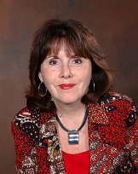
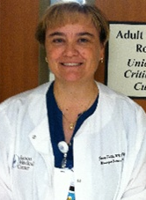
Leveraging Cultural Change to Reduce Urinary Catheter Use
Linda Greene, RN,MPS,CIC
Manager Infection Prevention
Highland Hospital
Jennifer Tuttle, RN, MSNEd
Adult Critical Care Unit
Tucson Medical Center

Slide 2
Learning Objectives
  Describe the way in which improvement in the clinical culture can facilitate efforts to reduce urinary catheter use
  Identify ways in which use of the HSOPS results and the team check-up tool can identify opportunities for improvement
  Utilize case studies to develop strategies to overcome barriers to decreasing urinary catheter device utilization

Slide 3
Polling Question #1
What is your background:
State Lead
CUSP Faculty
Fellow or Mentor for CAUTI project
Unit champion
Team member
Other

Slide 4
Polling Question #2
What is your greatest challenge with catheter removal ?
Physician Resistance
Nursing Resistance
Real or perceived need for accurate I and O
Unit culture which does not make catheter removal a priority

Slide 5
What is the Culture?
Culture is made up of the values, beliefs, underlying assumptions, attitudes and behaviors shared by a group of people
Culture is the behavior that results when a group arrives at a set of - generally unspoken and unwritten - rules for working together

Slide 6
Clinical Culture
The set of attitudes and behaviors in a clinical area or patient care unit
Strongly influenced by leadership, experience, history and tradition

Slide 7
The Culture of Safety and Assessment of Harm
Believe that failure to follow guidelines may cause harm
Built in alerts
Consequences for failure to implement

Slide 8
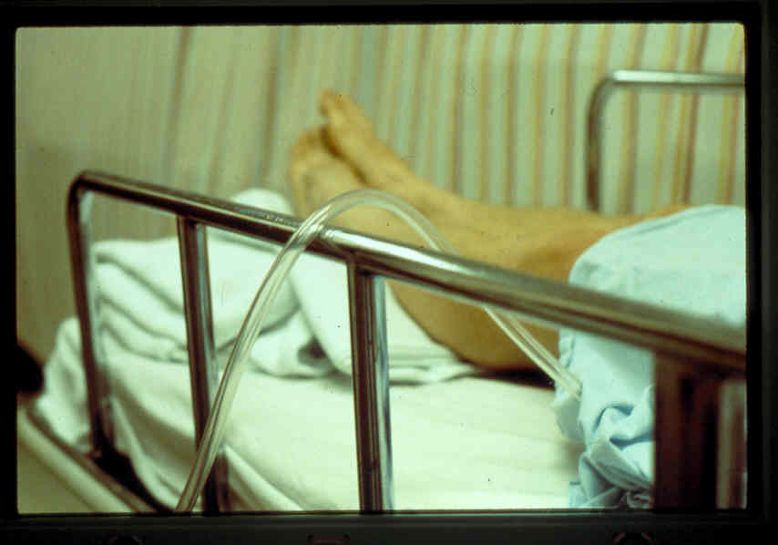
The Case of the Catheter

Slide 9
Safety and Urinary Catheters
Seat Belt | Yes | No
Believe in it | x
Built in safety alerts | x
Consequences | x
Urinary Catheter | Yes | No
Believe in it | ?
Built in safety alerts |  | x
Consequences | ?

Slide 10
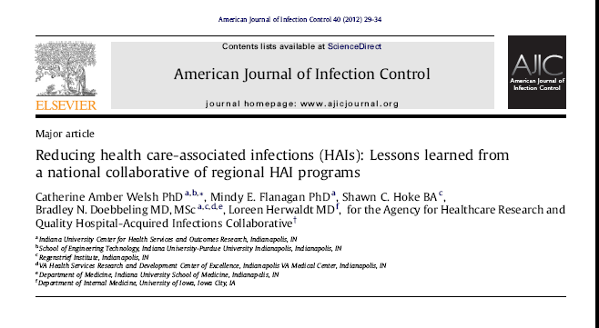
Clear Lessons and Culture

Slide 11
Findings
Fostering change – overcoming barrier
Communication- standardized processes and metrics
Local focused implementation – implementation at unit level
Frontline staff engagement
Organizational learning
Support, resources and accountability
Feedback and reinforcement

Slide 12
Stakeholder Assessment
Who are the Key Drivers?
Intensivists
Nurse Manager
MD Director
Nurses
ICU BUS

Slide 13
The ICU Culture
How important is reduction in urinary catheter use?
Medical Director
Nurse Manager
Nurses
Intensivists
Others
Notes:
In any clinical area you will find that individuals have power bases, positions and strength of position. This varies from unit to unit. Understanding what position may have the greatest influence may help

Slide 14
Three Levels of Organizational Culture
“…values reflect desired behavior but are not reflected in observed behavior.” (Schein, 2010, pp. 24, 27)
Behaviors
Beliefs & Values
Underlying Assumptions
Desired Behavior: Round to assess catheter appropriateness | Observed Behavior: Do not participate in rounds
Value: Teamwork | Value: Autonomy
Assumption: Safety is a system property | Assumption: Safety is a result of individual competency
Notes:
Once we recognize that culture varies by unit and by profession we can think about the assumptions and values that each of us have that give rise to our behaviors. For example… describe.
Basic underlying assumptions: Unconscious, taken for granted beliefs & values; Determine behavior, thought, feeling
Espoused beliefs and values
Observed behavior

Slide 15
Four Components of Safety Culture
Reporting Culture
Just Culture
Flexible (Teamwork) Culture
Learning Culture
  Effective reporting and just cultures create atmosphere of trust
  Sense-making of patient safety events and high reliability result from an explicit plan to engineer behaviors from each component of safety culture
HRO
LEARNING
FLEXIBLE
JUST
REPORTING
Notes:
Slide 11. Psychologist James Reason categorized safety culture into four components. These components represent four areas of beliefs and behaviors that interact to produce an organization that is informed about risks and hazards, takes action to become safe, provides feedback about the effect of those actions, and thus moves toward high reliability. HRO stands for a high reliability organization.
The foundation of every culture of safety is
Reporting -- the people in direct contact with risks and hazards freely report their errors and near-misses
Just -- James Reason introduced the concept of Just Culture, which he describes as…
an atmosphere of trust in which people are encouraged, even rewarded, for providing essential safety-related information—but in which they are also clear about where the line must be drawn between acceptable and unacceptable behavior.”
Flexible – A flexible culture is one that adopts team behaviors such as those taught in the TeamSTEPPS curriculum. These behaviors increase the likelihood that front line workers share information, manage changing work loads, and the organization as a whole adapts and learns from experience.
Learning – a learning culture correctly interprets information from its safety systems and has the will to implement change. In most important respects, an informed culture is a safety culture.”
Reporting
“Any safety information system depends crucially on the willing participation of the workforce, the people in direct contact with the hazards. To achieve this, it is necessary to engineer a reporting culture—an organization in which people are prepared to report their errors and near-misses.”
Just – James Reason introduced the concept of Just Culture, which he describes as…
“What is needed is a just culture, an atmosphere of trust in which people are encouraged, even rewarded, for providing essential safety-related information—but in which they are also clear about where the line must be drawn between acceptable and unacceptable behavior.”
Flexible – “A flexible culture takes a number of forms, but in many cases it involves shifting from the conventional hierarchical mode to a flatter professional structure, where control passes to task experts on the spot, and then reverts back to the traditional bureaucratic mode once the emergency has passed.” Teams are the fundamental units of learning in high reliability organizations
Learning
“An organization must possess a learning culture—the willingness and the competence to draw the right conclusions from its safety information system, and the will to implement major reforms when their need is indicated. . . In most important respects, an informed culture is a safety culture.”
A safe, informed culture should be a high reliability organization, an organization that is mindful because it :
Is preoccupied with failure
Is sensitive to how each team member affects a process
allows those who are most knowledgeable about a process to make decisions, and
resists the temptation to blame individuals for errors within complex processes

Slide 16
Goals of Culture Assessment
Identify areas of culture in need of improvement
  Identify impairments in organizational learning
Increase awareness of patient safety concepts
Evaluate effectiveness of patient safety interventions over time
Conduct internal and external benchmarking
Meet regulatory requirements
Identify gaps between beliefs and observed behaviors within subcultures and microcultures
Notes:
Slide 14. By conducting the HSOPS you can achieve 6 goals….

Slide 17
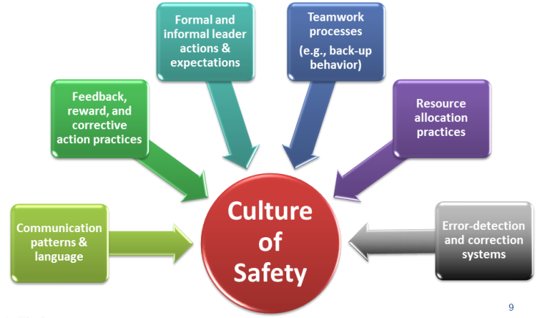
Core Aspects of Safety Culture

Slide 18
HSOPS Dimensions
Supervisor/manager expectations and actions promoting patient safety
Organizational learning-continuous improvement
Teamwork within unit
Communication openness
Feedback and communication about error
Nonpunitive response to error
Staffing
Hospital management support for patient safety
Teamwork across hospital units
Hospital handoffs and transitions

Slide 19
Using Results to Leverage Change
Example- Hospital x Greatest opportunities:
Feedback & Communication About Errors
Supervisor/Manager Expectations & Actions Promoting Safety
Hospital management support for patient safety
Teamwork across hospital units (i.e. ED)

Slide 20
Connect the Dots to the Urinary Catheter
Is management engaged?
Do we give routine feedback on appropriateness?
Are evidence based guidelines implemented, shared and incorporated into practice?
What strategies can we develop that can improve or enhance this?

Slide 21
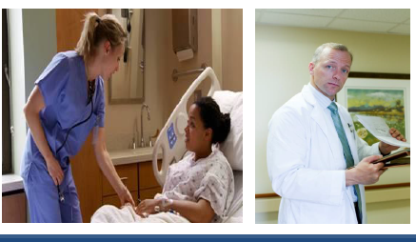
Leverage the Power and the Wisdom of the Front Line
What Can We Do?

Slide 22
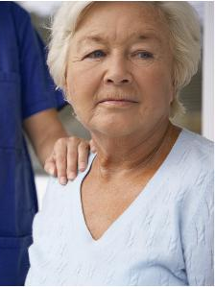
Case Scenario #1
Teamwork across Hospital Units
Nurse ED gives report to Nurse Med on the medical floor. “Patient A is an 87-year-old woman with cellulitis in her right lower extremity. She arrived from her long-term care facility with fever, inflammation, swelling of the leg. She is alert, but confused. We started a peripheral IV and antibiotics. She’s also complained of some nausea and vomited once. We gave her an antiemetic. You’re ready for her now? Wonderful. I’ll send her up with the transport tech.”
Nurse Med calls back to the ED 20 minutes later and asks for Nurse ED. “Patient A arrived with drenched linens after she urinated on herself. And then, she kept trying to get out of bed, telling us she had to go to the bathroom. Why didn’t you put a catheter in her? You told me she was confused. She’s going to fall trying to get up.”
Notes:
No shared mental model. Each person thinks they no best about the patient.

Slide 23
Scenario #2
Hospital management Support for Patient Safety
The surgical unit is not discontinuing urinary catheters despite the fact that a nurse driven removal protocol is in place. When discussing the issue with the front line staff, they report that the chief of surgery has created a road block despite the fact that the protocol was vetted with stakeholders and approved by the medical executive committee.
The Nurse manager does not “want to make waves” and has not made the nurses accountable for following the new protocol.
You approach the Chief of Surgery but he is non engaged and somewhat hostile. He tells you that in his department they do not practice “ Cookie Cutter” medicine.
Thoughts ?

Slide 24

Tools
Separate the People from the Problem
  Disentangle the relationship from the substance
Focus on Interests, not Positions
Work together to find creative and fair solutions

Slide 25
Back to the Surgeon
Why is the surgeon opposed to the new protocol?
Is there a rational reason?
How might we engage him?
What is the common interest here- patient safety?
What about the nurse manager?

Slide 26

A Sense of Urgency
“Plans and actions should always focus on others' hearts as much or more than their minds. Behaving with passion, conviction, optimism, urgency, and a steely determination will trump an analytically brilliant memo every time.”

Slide 27
A Different Direction
Contextual Journey
INSIDE OUT
  Observe then define
  Observation for understanding
Anthropology foundation
Solutions are uncovered, guided by insiders, those directly involved – creates ownership
Traditional Journey
OUTSIDE IN
  Define, then observe
  Observation for compliance
Manufacturing foundation
Solutions are pre-defined, guided by outsiders, those indirectly involved – buy-in
Our New Journey

Slide 28
Polling Question #3
What strategies for catheter removal have you implemented in your organization?
Nurse driven protocols
Automatic reminder or stop orders
Daily rounding
None of the above

Slide 29


CAUTI ICU Team:
A Success Story
Melanie Bunger RN - Nights Aunne Shepler RN - Nights
Julie Davis RN- Days Pat Smothers, PCT - Days
Stephanie Donovan RN, MSNEd Jenny Tuttle RN, MSNEd, Lead
Lisa Hymson, Infection Control Lisa Vasquez RN - Days
Nina Mazzola, Manager Infection Control

Slide 30


Hospital Information
611 bed – Major teaching hospital
Unit 450 – 16 bed ICU
  Neuro/Neurosurgical
  Medical
  Pulmonary
  Vascular surgery
  General surgery

Slide 31

Our Journey
Building a Team
Choosing strong peers to support goal
All shifts represented
Audit Process
Customizing tool to evaluate for deficits
Identifying barriers – Cracking the ICU mentality
Case Reviews - Team
Isolating root cause
Review processes/practices
Identifying vented patient populations – guideline
Collaboration with other Departments
Emergency Room
Operating Room
Transportation
Radiology
Providing the staff the tools/supplies
Assessing supplies currently available
Product trials

Slide 32
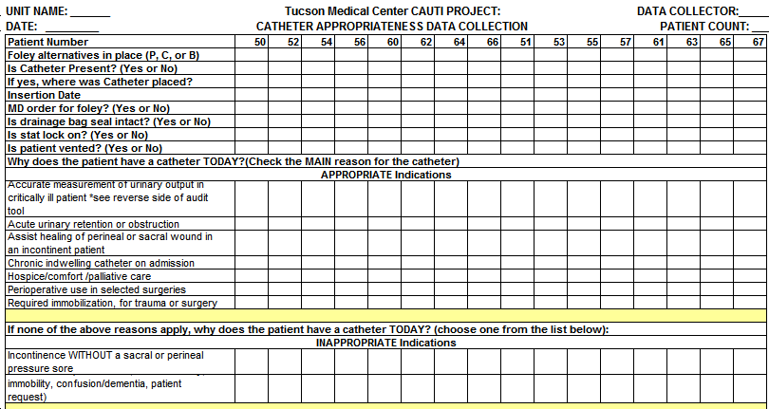
Audit Tool

Slide 33
Ventilator Guideline
Conditions that require a Foley:
  SEPSIS (24 HRS)
  CRRT
  ARF
  Pressors with titration
  Therapeutic Hypothermia
  IABP
  SAH with CSW/SIADH/DI
  SAH with triple H therapy
  Lasix- continual infusion
Conditions that do not require a Foley:
MIV
Tube feeding
Pressors with minimal titration
Chronic Lasix
Mildly sedated or drowsy Respiratory failure pts not chemically paralyzed and/or sedated
Case dependent situations
33

Slide 34

Providing the Tools to Succeed
Executive Support
Supplies
  Scales
  External devices
  Bladder scanner
  Premium pads
Daily Conversations
Engaging the staff
  Challenging the status quo
  Giving them an opportunity to give feedback

Slide 35
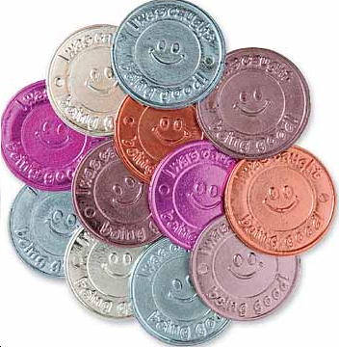
Rewarding the Behavior
Infection Control – Cake the first month
Culture “Change”
Updates

Slide 36
Utilization Rates

Slide 37

Lessons Learned
We all own this: Infection Control, Nursing, Physicians …..
Physician buy-in
Bringing all the stakeholders
Don’t give up – keep at it

Slide 38


Thank You !!!

Slide 39
Summary and Next Steps
What is your organizational culture?
How can you utilize the components of the culture of safety model to assess and improve your organizational culture?
How can you leverage HSOPS results for change?

Slide 40
Thank you!
Questions?

Slide 41
Funding
Prepared by the Health Research & Educational Trust of the American Hospital Association with contract funding provided by the Agency for Healthcare Research and Quality through the contract, “National Implementation of Comprehensive Unit-based Safety Program (CUSP) to Reduce Catheter-Associated Urinary Tract Infection (CAUTI), project number HHSA290201000025I/HHSA29032001T, Task Order #1.”

