Slide 1


Mindfulness: Engaging Frontline Providers in Antimicrobial Stewardship
CAPT Arjun Srinivasan, MD
Associate Director for Healthcare Associated Infection Prevention Programs
Division of Healthcare Quality Promotion
Scott Flanders, MD
Professor of Medicine
Director, Hospital Medicine Program
Director, Hospital Medicine Safety Consortium
University of Michigan

Slide 2
Learning Objectives
  Identify the barriers and facilitators to engaging frontline providers in antibiotic stewardship
  Describe how to integrate antimicrobial prescribing into unit culture
  Discuss the importance of improving antibiotic use at the national level

Slide 3

Antibiotic Stewardship
Why We Must
How We Can
CAPT Arjun Srinivasan, MD
Associate Director for Healthcare Associated Infection Prevention Programs
Division of Healthcare Quality Promotion

Slide 4
POLLING QUESTION
“Does your hospital currently have an antibiotic stewardship program?”
Yes
No

Slide 5
Why We Have to Improve Antibiotic Use
Antibiotics are unlike any other drug, in that the use of the agent in one patient can compromise its efficacy in another.
A lot of in-patient antibiotic prescriptions are unnecessary or sub-optimal.
We are running out of antibiotics.
We won’t get new ones soon.
Antibiotic overuse contributes to huge threats to the safety of our patients.

Slide 6
Antibiotic misuse adversely impacts patients - C. difficile
Antibiotic exposure is the single most important risk factor for the development of Clostridium difficile.
  Antibiotic exposure increases risk of CDAD by 7-10 fold for up to 30 days and 3 fold for the next 60 days. ¹
  Up to 85% of patients with CDAD have antibiotic exposure in the 28 days before infection²
1. Hensgens MPJ Antimicrob Chemother. 2011 Dec 6.
2. Chang HT et al. Infect Control Hosp Epidemiol 2007; 28:926–931.

Slide 7
Clostridium difficile Infections (CDIs) and Deaths Reach and Remain at Historic Highs
CDI hospitalizations
  Increased 3-fold 2000-2009
  250,000 per year
Deaths linked to CDI
  14,000 in 2007
$1 billion in medical costs
  CDIs in hospital patients only
Epidemic strain
  Causes more cases and severity
  Strong link to quinolone exposure
Lucado J, et al, Available at http://www.hcup-us.ahrq.gov/reports/statbriefs/sb124.pdf.; Hall AJ et al.. Presentation at the 49th Annual IDSA Meeting.; Dubberke ER et al. Clin Infect Dis 2008;46:497–504.; McDonald LC et al. N Engl J Med 2005;353:2433–41.

Slide 8
Antibiotic misuse adversely impacts patients - adverse events
In 2008, there were 142,000 visits to emergency departments for adverse events attributed to antibiotics.
1. Shehab N et al. Clinical Infectious Diseases 2008; 15:735-43

Slide 9
Antibiotic exposure increases the risks of resistance
Pathogen and Antibiotic Exposure | Increased Risk
Carbapenem Resistant Enterobactericeae and Carbapenems | 15 fold 1
ESBL producing organisms and Cephalosoprins | 6- 29 fold 3,4
Patel G et al. Infect Control Hosp Epidemiol 2008;29:1099-1106
Zaoutis TE et al. Pediatrics 2005;114:942-9
Talon D et al. Clin Microbiol Infect 2000;6:376-84

Slide 10
Susceptibility Profile of Typical CRE
Antimicrobial | Interpretation |  | Antimicrobial | Interpretation
Amikacin | I |  | Chloramphenicol | R
Amox/clav | R |  | Ciprofloxacin | R
Ampicillin | R |  | Ertapenem | R
Aztreonam | R |  | Gentamicin | R
Cefazolin | R |  | Imipenem | R
Cefpodoxime | R |  | Meropenem | R
Cefotaxime | R |  | Pipercillin/Tazo | R
Cetotetan | R |  | Tobramycin | R
Cefoxitin | R |  | Trimeth/Sulfa | R
Ceftazidime | R |  | Polymyxin B | MIC >4mg/ml
Ceftriaxone | R |  | Colistin | MIC >4mg/ml
Cefepime | R |  | Tigecycline | S

Slide 11
Most Common Reasons for
Unnecessary Days of Therapy
576 (30%) of 1941 days of antimicrobial therapy deemed unnecessary
Hecker MT et al. Arch Intern Med. 2003;163:972-978.
HAI Regional Training HAI Training Requirements is sponsored by SHEA and the CDC

Slide 12
Assessment of Treatment of UTI in 36 Hospitals
Treatment | No. | (%)
Patients treated for UTI present on admission, without indwelling catheter | 111 | —
Urine culture was not ordered, although standard practice before treatment | 18 | (16.2)
Urine culture was positive, but no documented symptoms were present | 23 | (20.7)
Urine culture was negative, and no documented symptoms were present | 3 | (2.7)
No. of patients with potential for improvement in prescribing | 44 | (39.6)
MMWR March 7, 2014 / 63(09);194-200

Slide 13
Stewardship To Reduce C. difficile Infection
Stewardship program formed at a community hospital to address high C. difficile rates.
Focused on post-prescription review of broad spectrum agents (but not quinolones)
25.4% decrease in targeted antibiotics
  216 DDD/1000 patient days to 161 .
More than three fold reduction in C. difficile infections (3.7% to 0.9%).
Am J Infect Control 2013;41:145

Slide 14
Antibiotic Stewardship to Combat C. difficile
2014 meta-analysis on the impact of stewardship on C. difficile included 16 studies.
Stewardship programs were significantly protective against C. difficile
  Pooled risk ratio 0.48; 95% CI: 0.38, 0.62
Restrictive interventions were most effective.
Protection especially strong in geriatric settings.
Feazel LM et al. J Antimicrob Chemother, March 2014

Slide 15
P. aeruginosa susceptibilities before and after implementation of antibiotic restrictions
(CID 1997;25:230)
P<0.01 for all increases

Slide 16
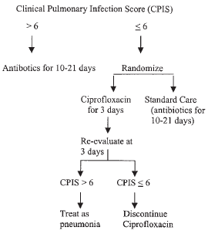
Stewardship optimizes patient safety: decreased patient-level resistance
 | Cipro | Standard
Antibiotic duration | 3 days | 10 days
LOS ICU | 9 days | 15 days
Antibiotic resistance/ superinfection | 14% | 38%
Study terminated early because attending physicians began to treat standard care group with 3 days of therapy
Singh N et al. Am J Respir Crit Care Med. 2000;162:505-11.

Slide 17
Clinical outcomes better with antimicrobial management program
Percent
RR 2.8 (2.1-3.8)
RR 1.7 (1.3-2.1)
RR 0.2 (0.1-0.4)
AMP = Antibiotic Management Program
UP = Usual Practice
Fishman N. Am J Med. 2006;119:S53.

Slide 18
What is “Antibiotic Stewardship”
Ensuring that every patient gets:
An antibiotic only when one is needed
The right agent
At the right dose
For the right duration

Slide 19
Goals of Antimicrobial Stewardship
Optimize Patient Safety
Decrease or Control Costs
Reduce Resistance

Slide 20
Goals of Stewardship
Reducing antibiotic use and saving money are NOT the primary goals of antibiotic stewardship.
They simply happen to be desirable side effects.

Slide 21
Changing the Way We Think About Antibiotic Stewardship
A lesson learned from experience with infection control.
Infection prevention works best when it’s viewed as everyone’s responsibility with healthcare epidemiology and infection control as a resource to help.
Stewardship should be the same- it’s not something someone does “to you” or “for you.”

Slide 22
Re-Thinking the Model
The goal of the stewardship program is not to dictate antibiotic choices.
It’s to ensure that there are systems and support to help every provider use antibiotics optimally.
For this to work, every provider has to play a role in stewardship.

Slide 23
Changing the Way We Think About Antibiotic Stewardship
We need other groups to assume leadership roles in stewardship:
  Hospitalists- pneumonia, urinary tract infections, skin and soft tissue infections
  Intensivists- antibiotic use in critical care
  Surgeons- surgical prophylaxis and surgical site infections
Stewardship efforts are most effective when they are a partnership between the stewardship team and clinicians.

Slide 24
Core Elements for Antibiotic Stewardship Programs
Leadership commitment from administration
Single leader responsible for outcomes
Single pharmacy leader
Antibiotic use tracking
Regular reporting on antibiotic use and resistance
Educating providers on use and resistance
Specific improvement interventions

Slide 25
Interventions to Improve Use
Ultimately, specific interventions to improve the use of antibiotics are where the rubber meets the road for stewardship programs.

Slide 26
Stewardship Opportunities in UTI
Study | Patient Population | Lack of Adherence to Guidelines
Dalen, 2005 | Ottawa Hospital 29 patients with catheter associated ASB | 52% prescribed antimicrobials inappropriately
Gandhi, 2009 | U Michigan 49 patients with UTI diagnosed | 32.6% did not meet criteria for UTI (most due to lack of symptoms)
Cope, 2009 | Houston VA 164 episodes of catheter associated ASB | 32% prescribed antimicrobials inappropriately
Dalen DM et al. Can J Infect Dis Med Microbiol. 2005;16:166.
Gandhi T et al. Infect Control Hosp Epidemiol. 2009;30:193.
Cope M et al. Clin Infect Dis. 2009;48:1182.

Slide 27
Improving UTI Treatment
Hospital conducted a simple educational campaign on when and when not to send urine cultures and when and when not to treat positive urine cultures.
Significant drop in number of patients who got inappropriate empiric therapy: 13% post intervention vs. 31% pre-intervention.

Slide 28
CAUTI and Antibiotic Stewardship-
A Perfect Combination
Efforts at CAUTI prevention often entail:
Improving urine culturing practices:
  Only send cultures when there is a real suspicion of a UTI.
  Send the cultures the right way
Eliminating treatment of asymptomatic bacteruria.
These are certainly goals shared by the stewardship team.

Slide 29

Engaging Frontline Providers in Antimicrobial Stewardship:
Barriers and Facilitators
Scott A. Flanders, M.D.
Professor of Medicine
Director, Hospital Medicine Program
Director, Hospital Medicine Safety Consortium
University of Michigan

Slide 30
Why frontline providers?
Stewardship team has limited reach
“Top-down” initiatives important, but only step 1
  Formulary restriction
  Data Monitoring
Many practices needing change are hard to spot from “behind the front”
  Treatment of asymptomatic bacteriuria!
  Prolonged treatment duration
Not everyone has a robust stewardship program

Slide 31
Who should we engage?
Groups where “culture” drives practice
  Intensive Care Units
  Urology
  Orthopedic surgery, etc.
Non-physician team members
  PAs, NPs, nursing, clerical assistants
Patients
  Infection prevention (hand hygiene, device use)
  Indication, duration
HOSPITALISTS

Slide 32
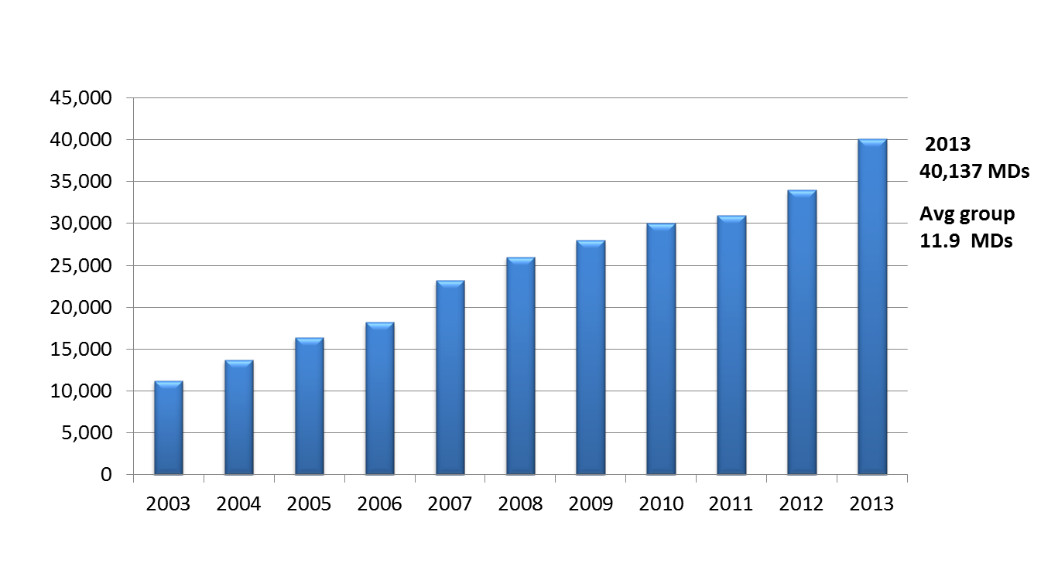
Growth of Hospital Medicine
AHA Survey: Hospitalists at 68% of hospitals; 93% of hospitals > 200 beds

Slide 33
The “Culture” of Antibiotic Overuse
Hospitalized patients are ill
  Early, appropriate antibiotics are life saving
“Chagrin” factor
  Avoid chagrin of not treating an infection
  Overuse viewed as better than underuse
Individual vs. Society
  Physicians prioritize individual patient needs
Good News!
  You can have your cake and eat it too!
  You can meet all the “needs” of physicians AND improve the way antibiotics are used

Slide 34
Three Effective Interventions
Documentation/visibility at the point of care
  Drug and indication
  Day of therapy and expected duration
Appropriate length of treatment
  UTI, pneumonia, skin and soft tissue infections
72 hour antibiotic time-out
  Right diagnosis
  Right drug
  Right dose and duration

Slide 35
Our Attempt to Improve
The Big 3 Infectious Diagnoses in U.S. Hospitals
Ranking at UMHS
Urinary Tract Infections #1
Pneumonia #2
Skin and Soft Tissue Infections #3
Gandhi T, et al. ICHE 2009

Slide 36
Testing and Treatment for UTI
60% of patients lack guideline indications for urine culture
Positive urine culture
  40% have UTIs by adjudicated review
  25% of UTIs had inappropriate treatment duration
  65% of asymptomatic bacteriuria was treated
  385 excess antibiotic days at UMHS alone
Hartley S, et al. ICHE, 2013

Slide 37
POLLING QUESTION
Does your hospital have guidelines that describe appropriate criteria for ordering urine cultures?
Yes
No

Slide 38
Improving Antibiotic Use
Engage hospitalists
Standardize recommendations for testing
Standardize treatment algorithms
Integrate algorithms into our “systems”
72 hour time-out to review urine cultures
Measure the impact
IHI Forum, 2013

Slide 39
SHOULD THIS PATIENT BE EVALUATED FOR A URINARY TRACT INFECTION*?
Does the patient have any of the following without alternate explanation?
Urgency, frequency, dysuria
Suprapubic pain/tenderness
Flank pain or tenderness
New onset delirium
Fever >100.4 F/Rigors
Acute hematuria
Increased spasticity or dysreflexia in a spinal cord injury patient
> 2 SIRS criteria (T > 38.5 C or < 35 C, HR > 90, RR >20 or PaCO2< 32 mmHg, WBC >12 K/mm³ or <4 K/mm³ or > 10% bands)
YES
NO
Send U/A & urine culture
Document indication for sending urine culture
Start empiric therapy
(see reverse side)
Do NOT send urine culture
*Symptom based screening is not reliable in the following cases: pregnancy, prior to urologic procedures, patients with complex urinary anatomy
(i.e., nephrostomy tubes, urinary tract stents, h/o urinary diversion surgery in the past, or renal transplant), patients admitted to the ICU, or
neutropenia. Use your clinical judgment for this population.

Slide 40
EMPIRIC THERAPY BASED ON CLASSIFICATION OF URINARY TRACT INFECTION
PATIENT CATEGORY | PREFERRED | 2ND LINE | DURATION
ASYMPTOMATIC BACTERIURIA Defined as having NONE of symptoms 1-8 on the reverse side | Do not treat except in pregnancy, prior to urologic procedures, or neutropenia Candiduria: Change catheter. Do not treat except prior to urologic procedures or in neutropenia
UNCOMPLICATED LOWER TRACT UTI | TMP/SMX or Nitrofurantoin | Ciprofloxacin or Cephalexin | TMP/SMX x 3 days Nitrofurantoin x 5 days (contraindicated if CrCl <60 mL/min) Ciprofloxacin x 3 days Cephalexin x 7 days
COMPLICATED LOWER TRACT UTI Male, urinary catheter present or removal within the last 48 hrs., GU instrumentation, anatomic abnormality or obstruction, significant co-morbidities | Ceftriaxone or TMP/SMX or Piperacillin-tazobactam (if risk for resistant gram negatives or enterococcus) | Ciprofloxacin | 7 days if prompt resolution 5 days if quinolone used 14 days if delayed response to therapy or bacteremia
SEPSIS WITH UTI, PYELONEPHRITIS, PERINEPHRIC ASCESS | Ceftriaxone or Piperacillin-tazobactam (if critically ill, septic or recently hospitalized or concern for enterococcus) | Severe PCN allergy Vancomycin PLUS Aztreonam | Sepsis with and without bacteremia: 10-14 days⁺ Uncomplicated pyelonephritis: Ciprofloxacin x 7 days TMP/SMX x 14 days Beta-lactams x 10-14 days Perinephric abscess: prolonged duration - consult ID and urology ⁺With bacteremia: step down to oral quinolone if susceptible
* Empiric choices should take into account recent previous cultures*
Follow culture results and de-escalate therapy based on final results and sensitivities.
FOR EACH ANTIBIOTIC: DOCUMENT INDICATION AND PLANNED DURATION FOR ALL PATIENTS

Slide 41
Treatment of Asymptomatic Bacteriuria
*
* p<0.05

Slide 42
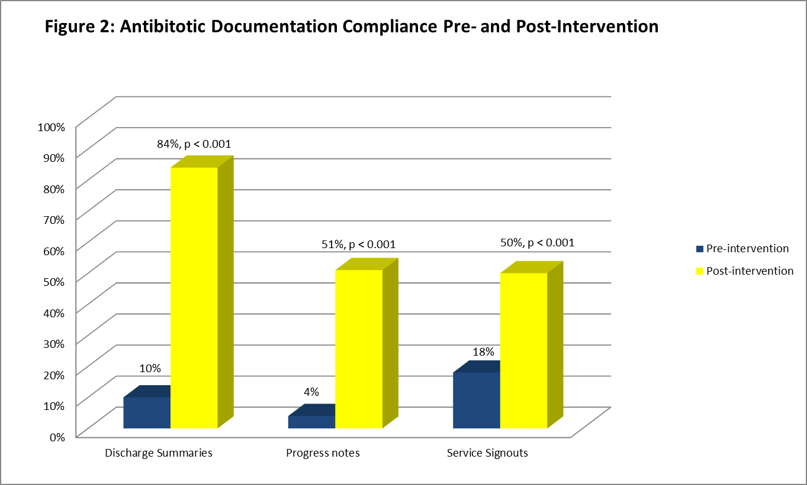
Incentivize Improved Documentation

Slide 43
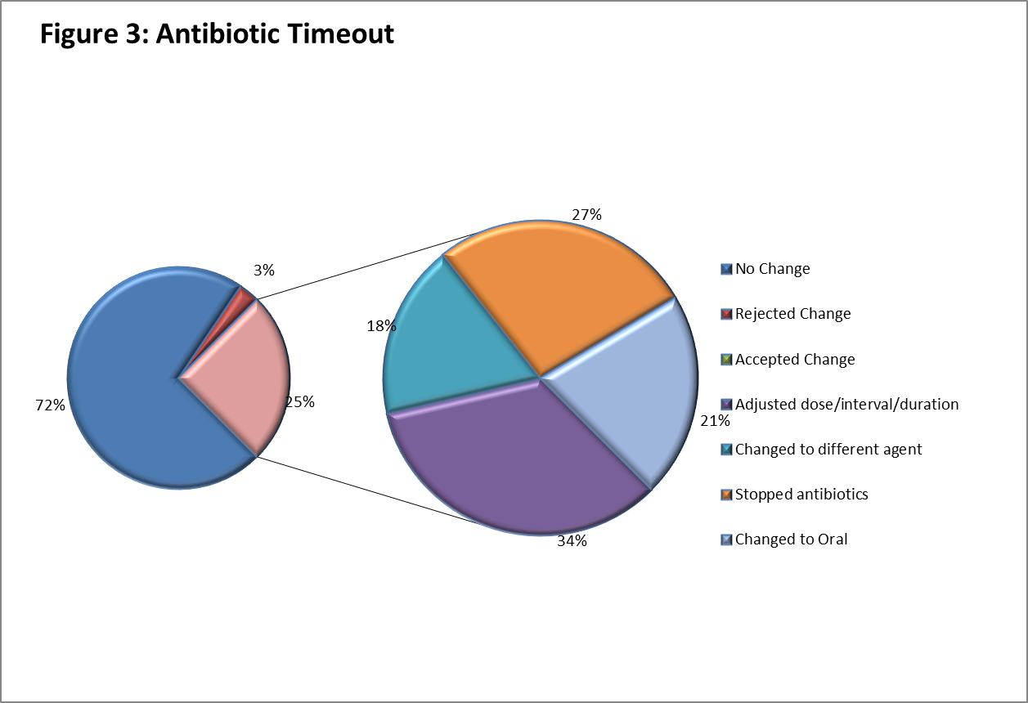
72 Hour Time-out with Pharmacists

Slide 44
Barriers and Facilitators
Barrier: real-world issues
  Large / multiple groups make communication difficult
  Poor continuity / hand-offs
  Nurses are overwhelmed
  High patient loads
  IT / CPOE
  Another !#$#% QI project?
Facilitator: Start small and build
  One doctor, one patient, one day
  Create a process that works
  Integrate it into existing systems

Slide 45
Barriers and Facilitators
Barrier: changing the culture
  “Our doctors don’t want to be told what to do”
Facilitator:
  Find a champion (ID / “Frontline” partner-Ideal)
  Find a “leader” to support the work
  Win your first battle
  Sell your successes
  Make the new process the “norm”
    Incentives / Awards
    Competitions

Slide 46
Thank you!
Questions?

Slide 47
Funding
Prepared by the Health Research & Educational Trust of the American Hospital Association with contract funding provided by the Agency for Healthcare Research and Quality through the contract, “National Implementation of Comprehensive Unit-based Safety Program (CUSP) to Reduce Catheter-Associated Urinary Tract Infection (CAUTI), project number HHSA290201000025I/HHSA29032001T, Task Order #1.”

