Slide 1
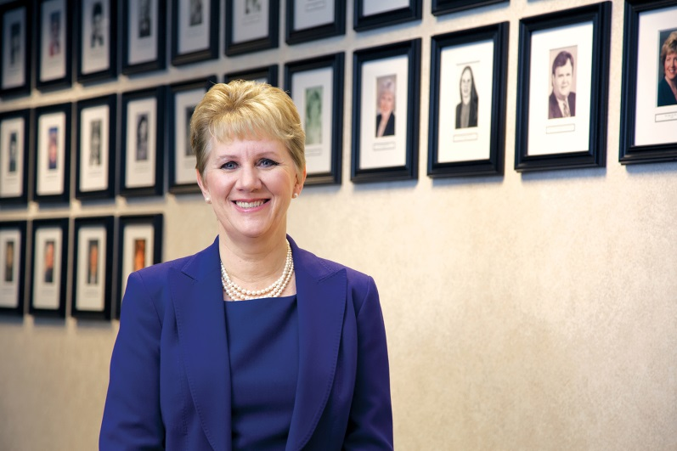
Navigating Hierarchy in the Clinical Setting: Working and Communicating with Others
Susan M. Hohenhaus, LPD, RN, CEN, FAEN
Executive Director
Emergency Nurses Association

Slide 2
Learning Objectives
Describe the relationship between hierarchy and patient safety
Explain communication strategies that empower team members to speak up and challenge when appropriate
Identify characteristics of high performing teams and barriers to their performance

Slide 3
Why No Title in the Title Slide?
Why are we talking about this at all?
  CAUTI calls and titles
What we model matters.

Slide 4
Hierarchy- What Does it Mean and Where Does it Come From
Then (1380 Oxford English Dictionary): ‘a system of orders of angels and heavenly beings‘
Now: a group of individuals ranked according to authority, capacity, or position

Slide 5
How did we get here-
Historically speaking?
“100 years ago, a series of studies about the education of health professionals, led by the 1910 Flexner report, sparked ground-breaking reforms. Through integration of modern science into the curricula at university-based schools, the reforms equipped health professionals with the knowledge that contributed to the doubling of life span during the 20th century.”
--FRENK, J., CHEN, L., BHUTTA, Z., COHEN, J., CRISP, N., EVANS, T., FINEBERG, H., GARCIA, P., KE, Y., KELLEY, P., KISTNASAMY, B., MELEIS, A., NAYLOR, D., PABLOS-MENDEZ, A., REDDY, S., SCRIMSHAW, S., SEPULVEDA, J., SERWADDA, D. & ZURAYK, H. 2010. Health professionals for a new century: transforming education to strengthen health systems in an interdependent world. The Lancet, 376, 1923-58.

Slide 6
“Here in the 21st Century, all is not well.”
“Glaring gaps and inequities in health persist both within and between countries, underscoring our collective failure to share the dramatic health advances equitably.”
Evolving health threats
  New infectious, environmental, and behavioural risks
  Rapid demographic and epidemiological transitions
  Health systems worldwide are struggling to keep up, as they become more complex and costly, placing additional demands on health workers.”
    -Frenk, J et al

Slide 7
Who is your Tribe?
“Professional education has not kept pace with these challenges, largely because of fragmented, outdated, and static curricula that produce ill-equipped graduates. The problems are systemic: mismatch of competencies to patient and population needs; poor teamwork; persistent gender stratification of professional status; narrow technical focus without broader contextual understanding; episodic encounters rather than continuous care; predominant hospital orientation at the expense of primary care; quantitative and qualitative imbalances in the professional labour market; and weak leadership to improve health-system performance. Laudable efforts to address these deficiencies have mostly floundered, partly because of the so-called tribalism of the professions—ie, the tendency of the various professions to act in isolation from or even in competition with each other.”
-Frenk, J et al
Notes:
Emphasis mine and Mark Bahnisch, Centre for Medical Education Research & Scholarship, School of Medicine, The University of Queensland; Fellow, Centre for Policy Development

Slide 8
Handwashing- does hierarchy get in the way?
“Not MY (YOUR) job!”
Pronovost’s ICU work and hierarchy worked eventually, but was not well accepted initially.
Notes:
During Patient Safety Awareness Week last week, the following interview from the New York Times caught my attention. In Doctor Leads Quest for Safer Ways to Care for Patients, Dr. Peter J. Pronovost, medical director of the Quality and Safety Research Group at Johns Hopkins Hospital in Baltimore, describes his quest for patient safety after the misdiagnosis of his father and the death of a child from a catheter-associated infection.
At one point in the interview, Dr. Pronovost talks about improving physician handwashing practices. Part of the solution was for the nursing staff to make sure the doctors wash their hands and if the doctors didn’t wash, the nurse could stop the procedure. The following excerpt from the interview demonstrates how both the nurses and doctors responded:
Q. HOW DID THAT FLY?
A. You would have thought I started World War III! The nurses said it wasn’t their job to monitor doctors; the doctors said no nurse was going to stop takeoff. I said: “Doctors, we know we’re not perfect, and we can forget important safety measures. And nurses, how could you permit a doctor to start if they haven’t washed their hands?” I told the nurses they could page me day or night, and I’d support them. Well, in four years’ time, we’ve gotten infection rates down to almost zero in the I.C.U.
Wonderful outcome, right? Yes, but the strategy was not well-accepted initially. Later in the interview, Dr. Pronovost discusses the benefits of empowering nurses and avoiding the hierarchical structure seen in so many settings. As nurses, we spend the most time with patients, we are aware of subtle changes in their condition, and we have a duty to speak up when patient safety is at risk. Along the same lines, we also have the right to be heard. In short, to have a successful team, mutual respect and effective communication are critical.
How comfortable are you with your team? What approach would you take in reminding a colleague (nurse, physician, or anyone else) to wash his or her hands?

Slide 9
Hierarchies: the Berlin Wall of
Patient Safety
“To maximize patient safety considerations the medical hierarchy needs to be balanced in favour of teaching and learning rather than the exercise of power.”
-Hierarchies: the Berlin Wall of Patient Safety
MM Walton Qual Saf Health Care. 2006 August; 15(4): 229–230

Slide 10
Toxic Hierarchy and Patient Safety:
A Few Case Examples
“Does Anyone Have Anything Else to Add?”
Bedside Calculations as “Shame and Blame”
“My name is Greg.”

Slide 11
Plasticity vs. Dominance
“Institutional and cultural resilience and embeddedness may not have been given adequate weight in shifting educational, organisational and policy agendas towards ‘interprofessional practice’.”
-Mark Bahnisch, Centre for Medical Education Research & Scholarship, School of Medicine, The University of Queensland; Fellow, Centre for Policy Development

Slide 12
STUMP the EXPERT
Is hierarchy always “BAD”?
“What can be done if “BAD” hierarchy is enforced by the C-Suite?”
What communication tools can be used to break down the “BAD” hierarchy and support the “GOOD”?

Slide 13
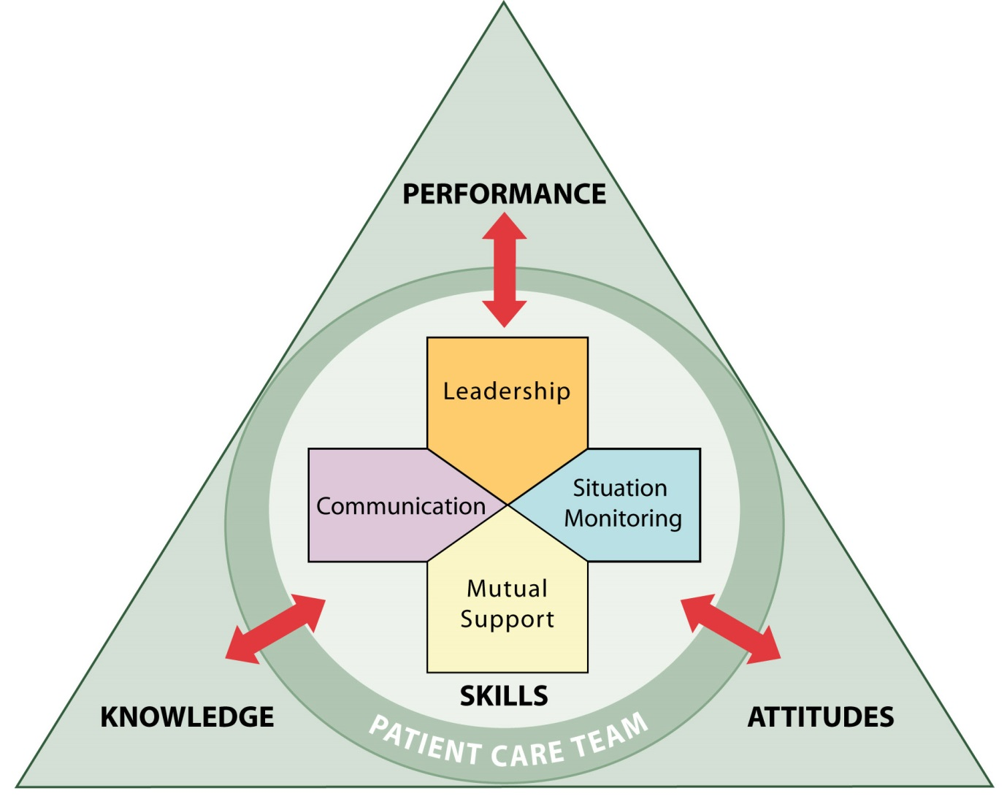
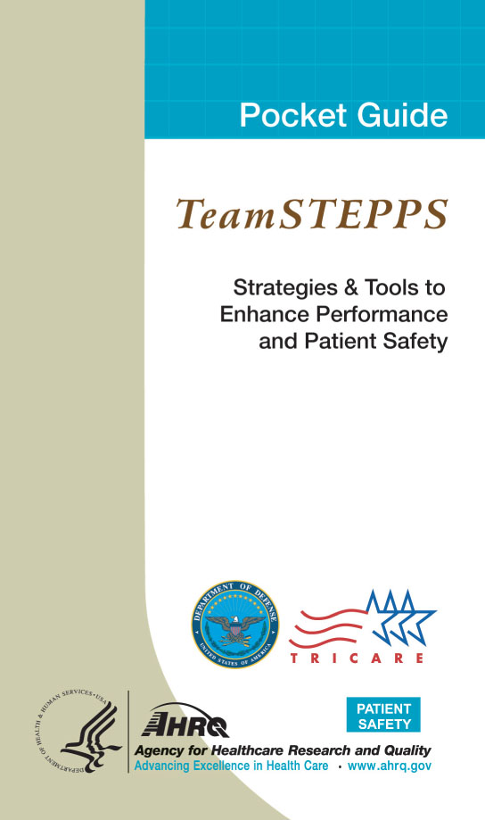
TeamSTEPPS
Why, I am so glad that you asked!

Slide 14
Communication and Hierarchy
Clearly assert concerns and suggestions
Use an assertive statement
  (nonthreatening and ensures that critical information is addressed)
    Make an opening
    State the concern
    State the problem
    Offer a solution
    Reach an agreement
    OR escalate

Slide 15
TeamSTEPPS reminds us…
Expert Team Leaders
  Organize the team
  Articulate clear goals
  Make decisions through collective input of members
  Empower members to speak up and challenge, when appropriate
  Actively promote and facilitate good teamwork
  Skillful at conflict resolution

Slide 16
Barriers to Team Performance
Inconsistency in team membership
Lack of time
Lack of information sharing
Hierarchy
Defensiveness
Conventional thinking
Varying communication styles
Conflict
Lack of coordination
and follow-up
Distractions
Fatigue
Workload
Misinterpretation of cues
Lack of role clarity

Slide 17
High performing teams…
  Hold shared mental models
  Have clear roles and responsibilities
  Have clear, valued, and shared vision
  Optimize resources
  Have strong team leadership
  Engage in a regular discipline of feedback
  Develop a strong sense of collective trust and confidence
  Create mechanisms to cooperate and coordinate
  Manage and optimize performance outcomes
  (Salas et al. 2004)

Slide 18
Check The Ego at the Door
“Status and ego should remain at the door of the meeting room and all safety team members should have equal authority to identify issues and challenge unsafe practices, regardless of title.”
-Hohenhaus, Frush 2005

Slide 19
Quote
The most important scientific revolutions all
include, as their only common feature, the
dethronement of human arrogance from one
pedestal after another of previous
convictions about our centrality in the
cosmos.
-Stephen Jay Gould (US author, naturalist, paleontologist, and popularizer of science) [1941-2002]

Slide 20
What we Model Matters
“If we could change ourselves, the tendencies in the world would also change. As a man changes his own nature, so does the attitude of the world change towards him. … We need not wait to see what others do”
          -Gandhi

Slide 21
Thank you!
Questions?

Slide 22
Funding
Prepared by the Health Research & Educational Trust of the American Hospital Association with contract funding provided by the Agency for Healthcare Research and Quality through the contract, “National Implementation of Comprehensive Unit-based Safety Program (CUSP) to Reduce Catheter-Associated Urinary Tract Infection (CAUTI), project number HHSA290201000025I/HHSA29032001T, Task Order #1.”

