Slide 1
No More CAUTI – preventing catheter associated urinary tract infections
Elizabeth Mizerek, MSN, RN, CEN, CPEN, FN-CSA
Assistant Professor of Nursing
Mercer County Community College

Slide 2
Learning Objectives
Define the impact of CAUTI
Describe decision making scenarios around catheter insertion indications
Explain policies, procedures and insertion competencies

Slide 3
Insertion indications

Slide 4
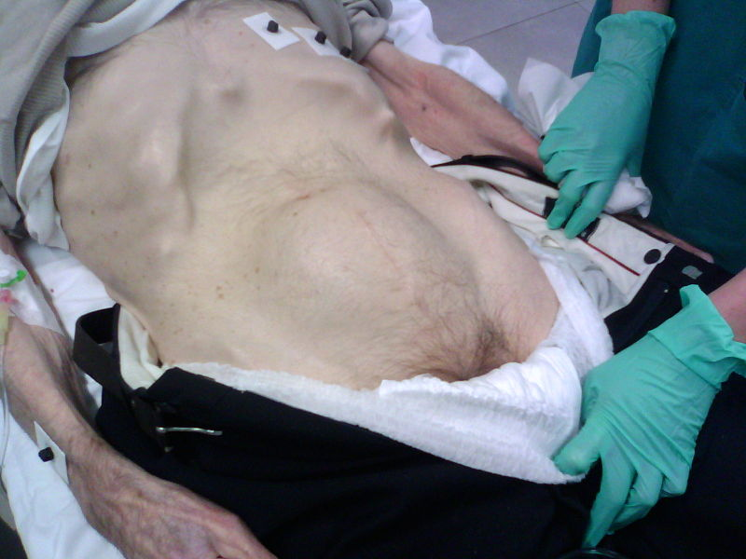
Appropriate catheter indications
Urinary retention or urinary flow obstructions

Slide 5
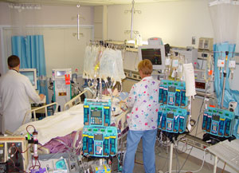
Appropriate Catheter indication
Monitoring fluids in critically ill patients

Slide 6
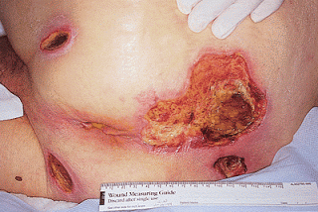
Appropriate catheter indications
Healing of significant sacral or perineal wounds

Slide 7

Appropriate catheter indications
Improving comfort at end of life

Slide 8
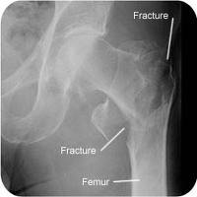
Appropriate catheter indications
Selected perioperative use

Slide 9
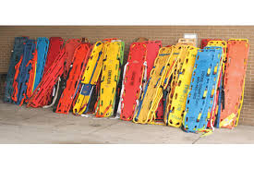
Appropriate catheter indication
Immobilization due to trauma

Slide 10
Alternative to indwelling catheter
Bladder scanner to assess volume of urine in bladder
Straight catheter
Condom catheter for men

Slide 11
Inappropriate catheter indications

Slide 12
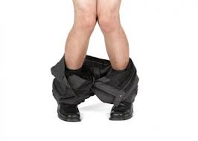
Inappropriate catheter indications
Incontinence
Catheters do not protect skin

Slide 13
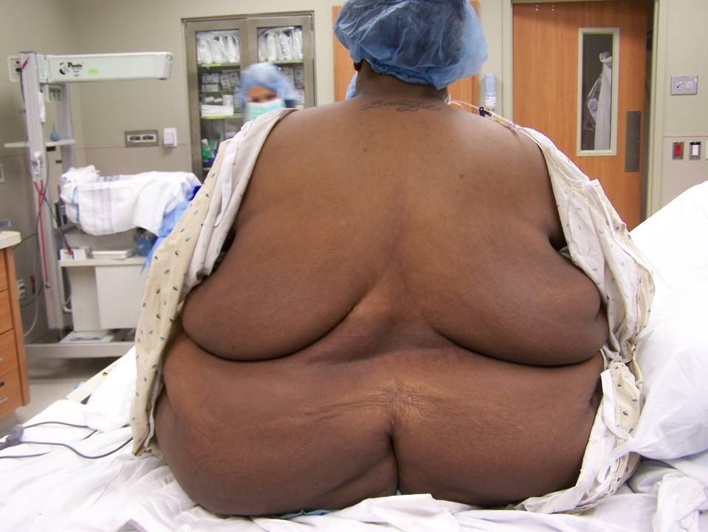
Inappropriate catheter indications
Morbid obesity

Slide 14
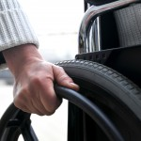
Inappropriate catheter indications
Limited mobility or debility
Catheters do not prevent falls

Slide 15

Inappropriate catheter indications
Dementia or confusion
Catheters do not prevent falls

Slide 16
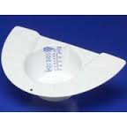
Inappropriate catheter indications
Monitoring of fluids in non-critically ill patients
You can monitor output many ways

Slide 17

Inappropriate catheter indications
Urine specimen collection
Straight cath!

Slide 18
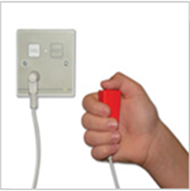
Inappropriate catheter indications
Patient or family request
Educate patient and family on catheter risks

Slide 19

Inappropriate catheter indications
Staff convenience
Catheters don’t save us time

Slide 20
Decision making scenarios

Slide 21
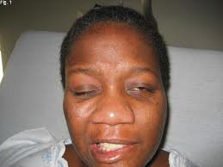
Catheter or no catheter?
Acute stroke patient with left sided weakness who is going to receive IV t-PA

Slide 22


Catheter or no catheter?
Family requests foley for patient….and provider orders it.

Slide 23
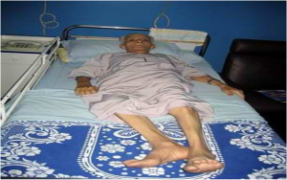
Catheter or no catheter?
Hip fracture going to OR…..eventually

Slide 24
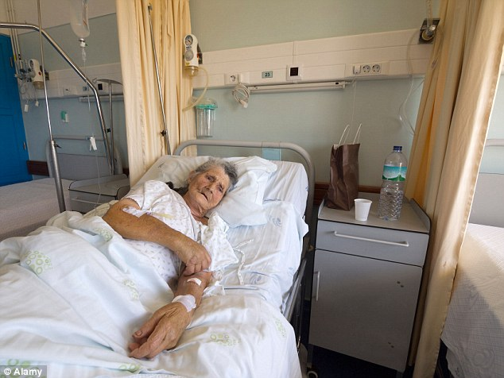
Catheter or no catheter?
Elderly, confused non-ambulatory patient

Slide 25
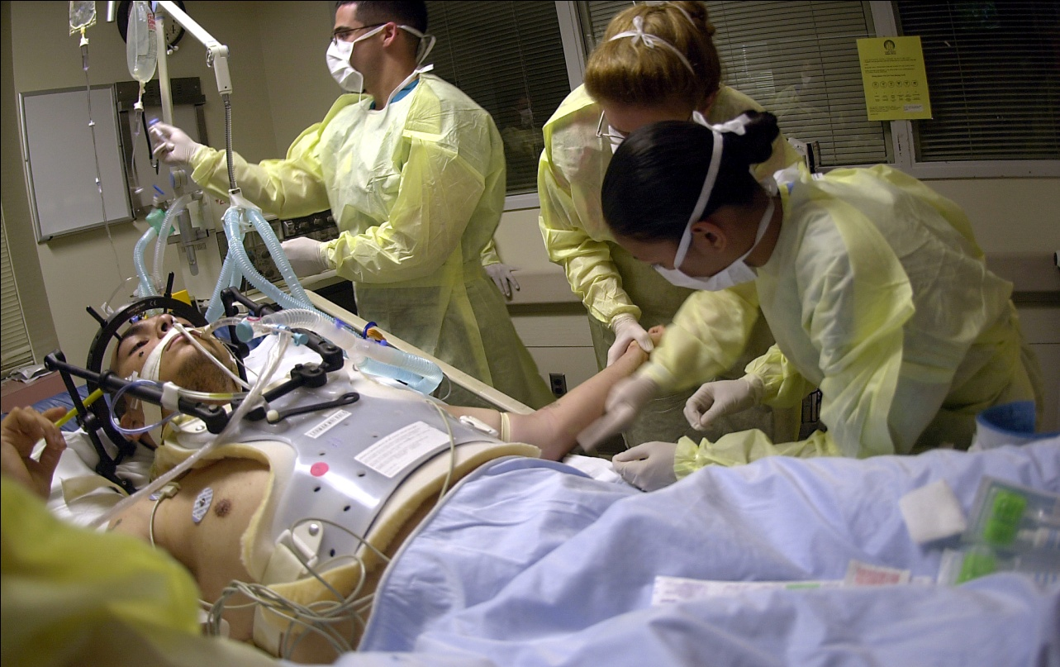
Catheter or no catheter?
Critically ill ICU patient

Slide 26
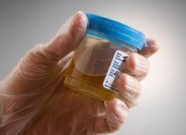
Catheter or no catheter?
Patient unable to provide clean catch urine

Slide 27
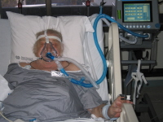
Catheter or no catheter?
Acute CHF receiving lasix on bi-pap

Slide 28
Demonstrated competency

Slide 29
Education
When, where and how to nurses learn to place indwelling urinary catheters?
Does the learning environment match the practice environment?

Slide 30
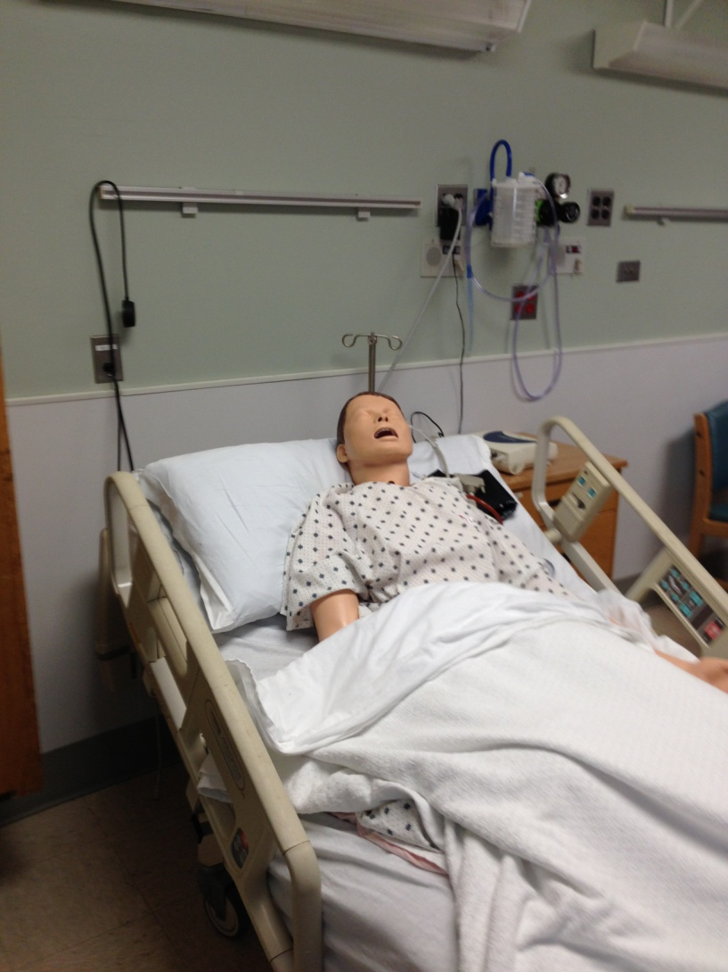

Slide 31
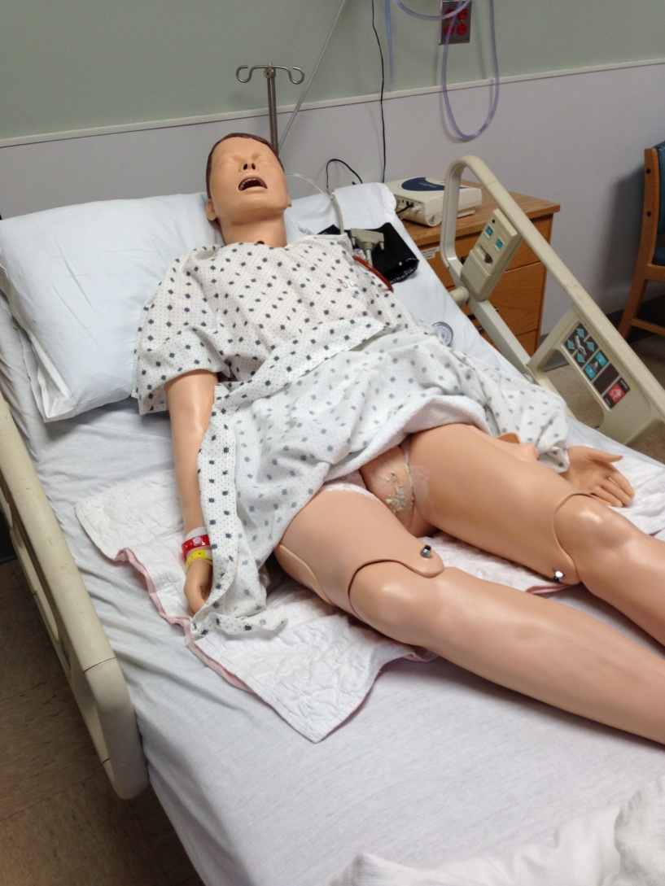

Slide 32
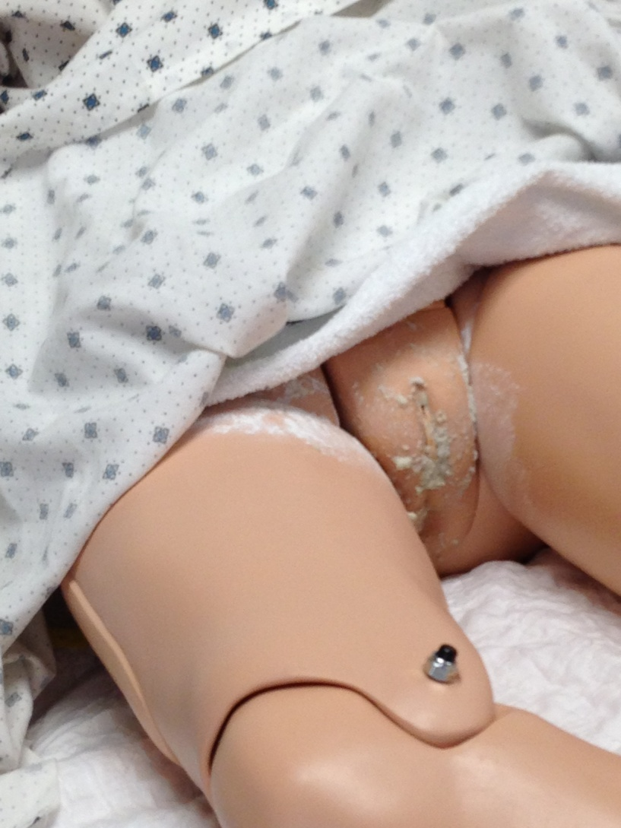

Slide 33
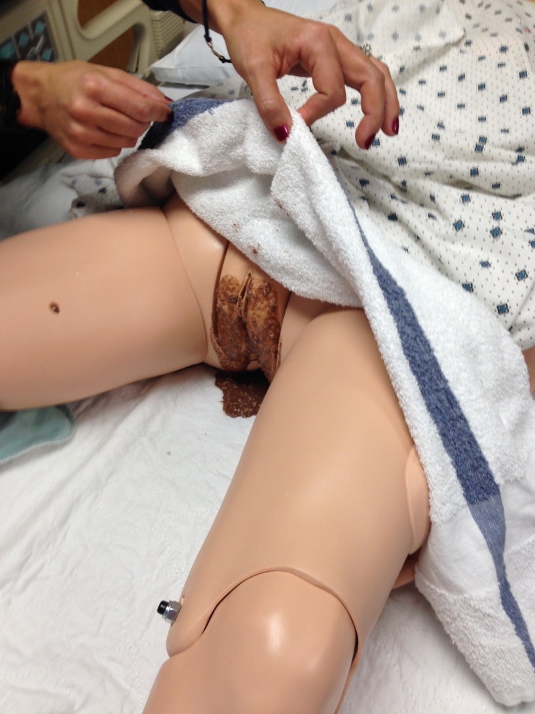

Slide 34
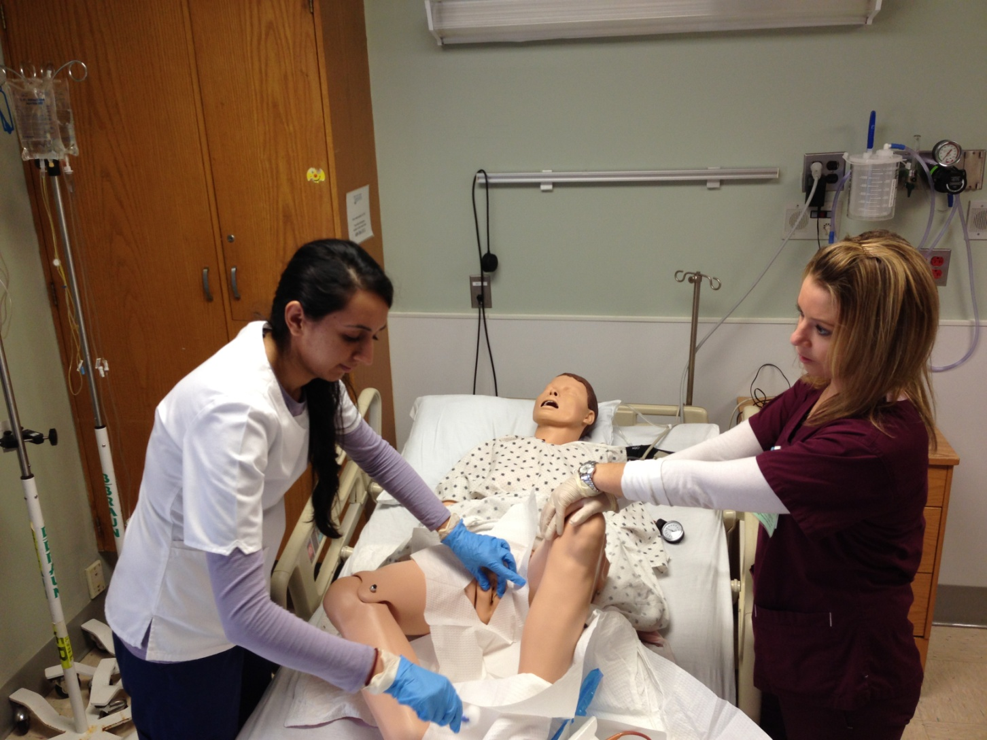

Slide 35
Some additional thoughts…

Slide 36
Teamwork
Shared mental model – trained nurses and techs together
Teamwork to facilitate placement
Empowered all staff to speak up when breach of sterile technique noted – patient safety!

Slide 37
Conclusion
A indwelling urinary catheter is not a life-saving procedure
Think, slow down, appropriate technique
Safe practice, safe care!

Slide 38
Thank you!
Questions?

Slide 39
Funding
Prepared by the Health Research & Educational Trust of the American Hospital Association with contract funding provided by the Agency for Healthcare Research and Quality through the contract, “National Implementation of Comprehensive Unit-based Safety Program (CUSP) to Reduce Catheter-Associated Urinary Tract Infection (CAUTI), project number HHSA290201000025I/HHSA29032001T, Task Order #1.”

