Slide 1


Preventing CAUTI in Special Populations:
Focus on Procedure-Related Catheter Use
David A. Pegues, MD
Professor of Medicine, Division of Infectious Diseases
Medical Director, Healthcare Epidemiology, Infection Prevention and Control
Hospital of the University of Pennsylvania
Gregory D. Kennedy, MD, PhD
Associate Professor
Vice Chairman of Quality
Associate Chief, Section of Colorectal Surgery
Division of General Surgery
University of Wisconsin School of Medicine

Slide 2
Learning Objectives
Describe the indications for urinary catheter use in surgical settings
Articulate the catheter management challenges in the surgical settings
Recognize the value in using incentives to change behavior regarding catheter use

Slide 3
Epidemiology
UTI:
  Common healthcare-associated infection¹
    12.9% of HAIs; estimated 93,300 cases per year in US in 2011
  ~70% attributable to an indwelling urethral catheter
~25% of hospital inpatients will have an indwelling urinary catheter during admission¹
  Most have urinary catheters 2-4 days
Daily risk of acquisition of bacteriuria:
  3% to 8% per day of urinary catheterization
  ~100% at 30 days
  Duration of catheterization = biggest risk factor
  ¹ Magill SS, et al. N Engl J Med 2014;370:1198-208

Slide 4
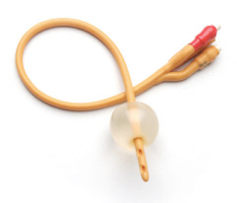
Polling Question 1
Does your facility currently perform surveillance for CAUTI on surgical units?
Yes
No
No but we’ll have to in January 2015
SUTI + IUC = CAUTI

Slide 5
2012 NHSN CAUTI Rates and Device Utilization Ratios, Selected Surgical Units
Dudeck MA, et al. Am J Infect Control 2013;41:1148-66.

Slide 6
IUC Use in Other Procedure Areas
Labor and Delivery (C-section)
Electrophysiology/Cath lab
Interventional Radiology (GU procedures)
Ambulatory Surgical Centers

Slide 7
“Lifecycle” of the Urinary Catheter:
Focus on Procedure-Related Catheter Use
1. Prevent Unnecessary and Improper Placement
2. Maintain Awareness and Proper Care of Catheters in Place
3. Prompt Catheter Removal
4. Prevent Catheter Replacement
Meddings J, Saint S. Clin Infect Dis 2011;52:1291-3.

Slide 8
Why use Urinary Catheters Perioperatively?
Monitoring urine output during and after major surgery
Guiding volume resuscitation
Preventing risk of post-operative urinary retention

Slide 9
HICPAC Appropriate Indications for Indwelling Urinary Catheter Use
Appropriate Indications
Patient has acute urinary retention or obstruction
Need for accurate measurements of urinary output in critically ill patients.
Perioperative use for selected procedures: urologic surgery or other surgery on contiguous structures of genitourinary tract, anticipated prolonged surgery duration (removed in post-anesthesia unit), anticipated to receive large-volume infusions or diuretics in surgery, operative patients with urinary incontinence, need to intraoperative monitoring of urinary output.
To assist in healing of open sacral or perineal wounds in incontinent patients.
Requires prolonged immobilization (e.g., potentially unstable thoracic or lumbar spine)
To improve comfort for end of life care if needed.
Gould C, et al. Infect Control Hosp Epidemiol 2010;31:319-26.

Slide 10
HICPAC Inappropriate Indications for Indwelling Urinary Catheter Use
Inappropriate Indications
As a substitute for nursing care of the patient or resident with incontinence
As a means of obtaining urine for culture or other diagnostic tests when the patient can voluntarily void
For prolonged postoperative duration without appropriate indications (e.g., structural repair of urethra or contiguous structures, prolonged effect of epidural anaesthesia, etc.)
Routinely for patients receiving epidural anesthesia/analgesia.
Gould C, et al. Infect Control Hosp Epidemiol 2010;31:319-26.

Slide 11
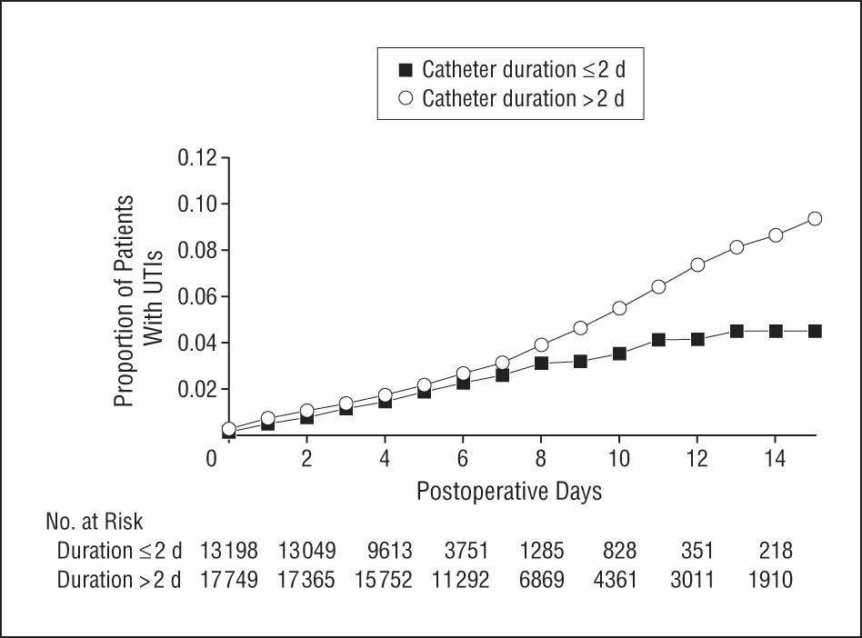
Urinary Catheter Use in Surgery
SIP data, Jan-Nov, 2001
N=35,904 patients undergoing major surgery
Catheter prevalence 86%
Catheter duration >2 d 50%
P=.004
Wald HL, et al. Arch Surg 2008;143:551-7.

Slide 12

Polling Question 2
What is your compliance with SCIP-Inf-9 process measure?
<80%
80-89%
90-95%
>95%
What is SCIP-Inf-9?

Slide 13
SCIP-Inf-9
SCIP-Inf-9:
  Surgery patients whose urinary catheters were removed on the first or second day after surgery
  One of 12 clinical process of care measures (domain weight 20%) in FY15 Hospital Value-Based Purchasing (VBP) Program
  Current compliance rat– 97%; nearly “topped out”
  Exemptions:
    Patients who had a urological, gynecological or perineal procedure performed
    Patients who had physician/APN/PA documentation of a reason for not removing the urinary catheter postoperatively
https://data.medicare.gov/Hospital-Compare/Hospital-Process-of-Care-Measures-National-Average/2jjc-dc2m Accessed 6/25/14

Slide 14
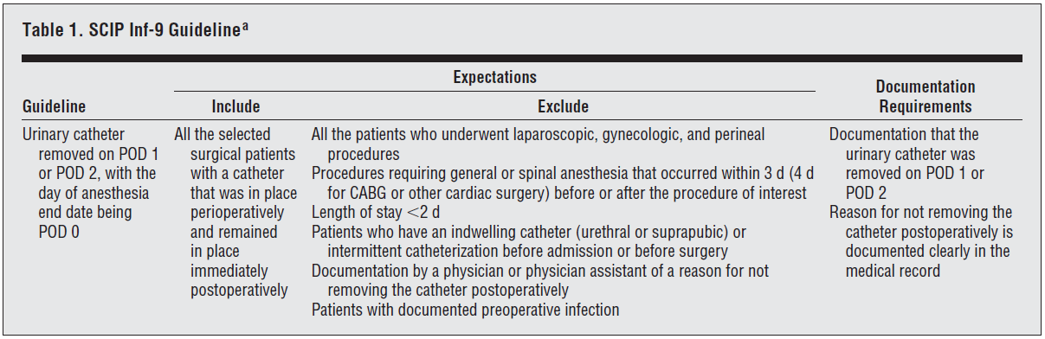
Impact of SCIP-Inf-9 on Postoperative UTIs
Aim: Correlate SCIP-Inf-9 compliance and exemption status with monthly rates of UTI among general and vascular surgery patients
Methods: Retrospective case-control study
Owen RM, et al. Arch Surg.2012;147:946-53.

Slide 15
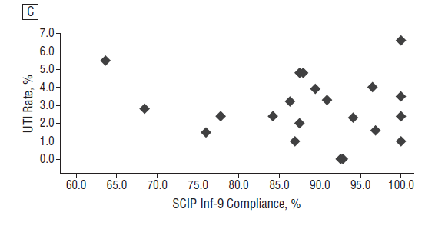
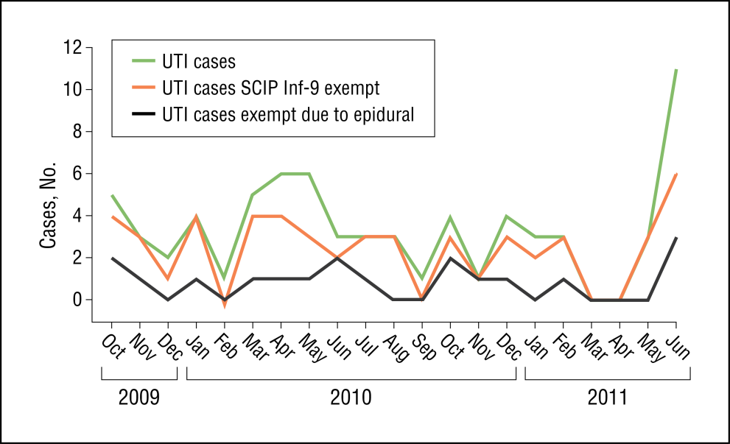
Impact of SCIP-Inf-9 on Postoperative UTIs
Correlation Between UTI rates and SCIP Inf-9 Compliance
Relationship Between UTI Cases and Exemption Status
R=-12.4 (P=0.59)
MV odds ratios for UTI: exempt (8.34), pancreatic surgery (4.12), female (3.00), 10-y age increment (1.28)
Conclusions: SCIP-9 should be modified with fewer exemptions
Owen RM, et al. Arch Surg 2012;147:946-53.

Slide 16
Postoperative Urinary Retention (POUR)
Incidence: varies widely
  General surgery ~3.8%
  Anorectal surgery 10.7-84%
  Hernia repair 1-52%
Risk Factors:
  Preoperative—age >50 yo, male, BPH, previous pelvic surgery, neurological disease, medications
  Intraoperative—procedure, anesthesia
  Postoperative—Bladder volume >270mL in PACU, sedatives, analgesia (CEI, PCEA)
BPH= benign prostatic hypertrophy; CEI=continuous epidural infusion; PCEA = patient-controlled epidural analgesia

Slide 17
Incidence of POUR and Management after Joint Arthroplasty
286 consecutive patients undergoing TKA or THA
  Complications, risk factors, and management of POUR
Risk of POUR: epidural > PCEA > CPNB
 | Non-POUR N=213) | POUR (N=73) | P value
UTI, No. (%) | 8 (3.8%) | 7 (9.6%) | 0.054
LOS, days (range) | 6 (5-8) | 7 (6-9) | 0.007
Management of POUR | No. (%) (N=73)
Straight cath x 1 | 18 (24.6%)
Straight cath x 2 | 6 (8.2%)
IUC x 48 hr | 49 (67.1%)
Balderi T, et al. Minerva Anestesiol 2011;77:1-8. TKR=total knee replacement; THA=total hip arthroplasty; CPNB=continuous peripheral nerve block

Slide 18
Predicting POUR
International Prostate Symptom Score (IPSS):
  Designed by American Urological Association¹
  Seven questions related to BPH:
    Incomplete emptying
    Frequency
    Intermittency
    Urgency
    Weak stream
    Straining
    Nocturia
Performance in predicting POUR following lower limb arthroplasty has been variable
- Scored 1-5
- For nocturia = average # of episodes of nocturia/night)
¹ Barry MJ, et al. J Urol 1992148:549-57.

Slide 19
Predicting POUR after Lower Limb Arthroplasty
100 consecutive male patients undergoing:
  TKR (n=55) or THA (n=45)
  8 patients excluded with pre-op IUC
  Mean age 68 years (range, 25-86 years)
  Spinal anesthesia (100%); peripheral nerve block (38%)
IPSS | No. of patients | POUR and catheterization
Mild (0-7) | 59 (61.4%) | 27.1%
Moderate (8-19) | 27 (29.3%) | 63.0%
Severe (20-35) | 6 (6.5%) | 83.3%
Kieffer WKM, Kane TPC. Ann R Coll Surg Engl 2011;94:356-8.

Slide 20
Tamsulosin to Prevent POUR
Design:
  P, R, DB, PC single center trial
  232 male patients undergoing elective GU surgery
    Varicocelectomy, inguinal herniorrhapy, scrotal surgery
Methods:
  Tamsulosin 0.4 mg (N=118) or placebo (N=114)
  2 hr pre- and 10 hr post-surgery
Results:
  Incidence of POUR—tamsulosin vs. placebo
    7/118 (5.9%) vs. 24 /114 (23.1%); P=0.001
Madani AH, et al. IBJU 2014;40:30-6.

Slide 21
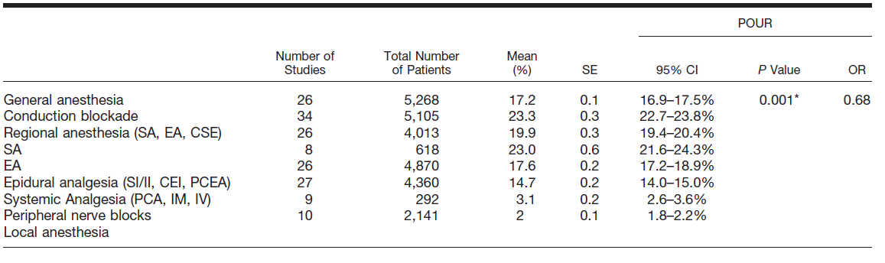
Incidence of POUR after Anesthesia and Analgesia: Systematic Review
* For comparison of general anesthesiology vs. conduction blockade
CSE combined spinal-epidural; CEI continuous epidural infusion; EA epidural anesthesia; IM intramuscular; IV intravenous; PCA patient-controlled anesthesia; PCEA patient-controlled epidural analgesia; SA spinal anesthesia; SI/II single injection/intermittent injection.
Bladini G, et al. Anesthesiology 2009;11:1139-57.

Slide 22
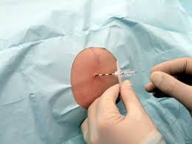
Polling Question 3
Do you know whether urinary catheters are routinely inserted in patients receiving epidural anesthesia at your facility?
Yes, in all patients
Yes, but only in selected patients
Never
Don’t know

Slide 23
Spinal and Epidural Anesthetic Risk Factors for POUR
Site of insertion lumbar > thoracic
Long-acting local anesthetics
Hydrophilic opioids (morphine)
Opioids with high-μ receptor selectivity (morphine, fentanyl)
Epinephrine
Higher-dose bupivicaine (>0.1%)
Bladini G, et al. Anesthesiology 2009;11:1139-57.

Slide 24
Duration of Postoperative Urinary Catheter Use
Question—Appropriate duration of IUC for patients with thoracic epidural catheters?
  RCT comparing risk of UTI among patients at low risk of POUR undergoing thoracic epidural analgesia
  Early removal (N=105) and standard care (N=110)
  Early removal of the IUC following epidural analgesia reduces the risk of UTI
Outcome | ER vs. SC | Risk Ratio (95% CI)
UTI rate | 1.9% vs. 13.6% | 0.14 (0.03-0.59)
In/out catheter | 7.6% vs. 1.8% | 4.1 (0.91-19.2)
In/out catheter + 24 h reinsertion | 2.8% vs. 0% | UD (p=0.23)
Zaouter C, et al. Reg Anesth Pain Med. 2009;34:542-8.

Slide 25
Duration of Postoperative Urinary Catheter Use
Question—Duration of IUC use for patients undergoing anorectal surgery?
  Mean 5 days (range, 3-10 days) ¹
  Incidence of POUR varies widely: 5%-58%
  CAUTI risk 40-60%
  No risk factors for POUR (dysuria, rectal CA w/ positive LNs)—1 day²
¹ Bladini G, et al. Anesthesiology 2009;11:1139-57.
² Benoist S, et al. Surgery 1999;125:135-41.

Slide 26
Urinary Catheterization for Urogenital Surgery
Q1—Using a urinary catheter vs. not using a urinary catheter
Q7—Comparison of short vs. long duration catheter use
Outcome | Number of Studies | Risk Ratio (95% CI)
Urinary retention | 1 | 0.12 (0.03-0.47)
UTI | 4 | 1.35 (0.75-2.45)
Recatheterization | 3 | 5.10 (0.25—103.59)
Outcome | Number of Studies | Risk Ratio (95% CI)
Urinary retention | 4 | 0.80-4.46 for studies
UTI, 1 vs. 3 days | 3 | 0.50 (0.29-0.87)
Recatheterization, 1 vs 3 days | 2 | 1.04 (0.36-3.01)
Phipps S, et al. Cochrane Reviews 2006 CD004374(updated 2009).

Slide 27
Duration of Postoperative Urinary Catheter Use
Q—Duration of post-op catheterization for patients undergoing bariatric surgery?
  Immobility ≠ Immobilization
  Goal <24 h

Slide 28
Perioperative IUC Management and POUR Risk
Lower Risk Higher Risk
  Outpatient
  Short duration
  IVF <750 mL
  Local anesthesia
Inpatient
Most major surgery
Prolonged duration
  IVF >750 mL
  Anorectal
  Lumbar epidural anesthesia/analgesia
<24 h
IUC
>24 h
IUC
Avoid IUC

Slide 29
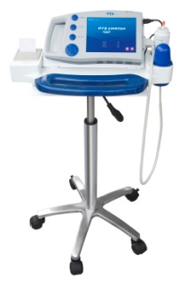
Polling Question 4
Do providers at your facility utilize a post-removal protocol to manage post-operative urinary retention among surgical patients?
Yes
No
No, but we are considering it
What is a post-removal protocol?

Slide 30
Recommended Intervention
Develop a protocol for management of postoperative urinary retention, including nurse-directed use of intermittent catheterization and use of bladder scanners
Lo E et al. Infect Control Hosp Epidemiol. 2014;35:464-79.

Slide 31
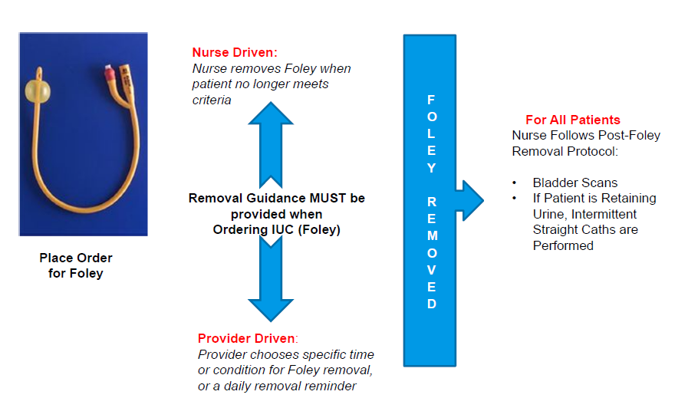
Nursing Algorithm for Managing Patients after Catheter Removal

Slide 32
Summary—1
Reduce procedure-related urinary catheter use by:
  Limiting indications to selected procedures and patients at increased risk of POUR
  Limiting duration—order sets and nurse-driven removal protocol
  Limiting reinsertion—post-removal protocol with bladder scanning

Slide 33
Implementing a Program:
Hurdles Cleared and Lessons Learned
Gregory D. Kennedy, MD, PhD
Associate Professor
Vice Chairman of Quality
Associate Chief, Section of Colorectal Surgery
Division of General Surgery
University of Wisconsin School of Medicine

Slide 34
UW CAUTI Team
Problems
  CAUTI rates high
  Device utilization high
  SCIP-Inf-9 compliance low (<80%)

Slide 35
Approach
Multidisciplinary team
  MD team leader
  RN team leader
  Executive team leader
  Unit RNS
  Clinical nurse specialist
  Infection control specialist

Slide 36
CAUTI Framework
Insertion
  Would require standard approach
  Use CLABSI work as blueprint
Maintenance
  Paucity of data on how to manage catheter once in place
Removal
  Low-lying fruit. Starting point!

Slide 37
Protocol
Protocolize catheter removal
  Empower the unit RNs to remove urinary catheters based on specific criteria.
  Initiate bladder management protocol
Early failure
  Lack of physician buy-in
  No consideration of valid concerns
    Postoperative urinary retention (POUR)
    Catheter removal in patients with epidural

Slide 38
Pre-Implementation Observation
Prospective data collection January 2012 on general surgery ward including patients undergoing elective operation that would require an admission to the hospital
96 patients included in the collection– 7 excluded as they did not have an operation
2/89 patients with CAUTI

Slide 39
Epidural and Catheter Removal
Epidural utilization– 32%
Implications of Epidural
 | Epidural
 | Yes | No | P-value
Retention | 48.4% | 18.5% | 0.002
UTI | 6.5% | 9.2% | 0.645
Reinsertion | 22.6% | 9.2% | 0.07

Slide 40
POUR and Reinsertion
Rate of Urinary Retention=28%
Implications of Urinary retention
 | Retention
 | Yes | No | P-Value
UTI | 11.1% | 7.2% | 0.68
Catheter replacement | 40.7% | 2.9% | <0.001
Reinsertion and UTI | 18.8% | 6.0% | <0.001

Slide 41
Outcomes of Collection
Fed data back to anesthesia on rates of retention with epidural.
Data back to faculty to relieve some concerns regarding POUR (overwhelming sense was that POUR was >75%).

Slide 42
Implemented Removal and Management Protocol
Indications for catheter clearly spelled out.
Presence of catheter part of IMOC rounds
Education of nurses to empower them to remove catheters-- mandatory training sessions of all nurses.
Protocol presented in all physician departments at various venues to garner support

Slide 43
Jan 2011:
Hospital-wide CAUTI surveillance
Jan 2012:
Annual SIC Education
May 2012:
  CAUTI on nursing scorecards
Jan 2013:
Annual SIC Education
May-June 2012:
  CAUTI Champion education
Oct 2013:
Trial monitoring foley maintenance
Mar 2012:
CAUTI Kudos!
Oct 2011:
  Nurse removal protocol
Bladder management protocol
  CAUTI toolbox
June 2012:
  Daily CNS rounding, all units
Nov 2013:
CHG bathing
Apr 2012:
EMR Icons for Active foley, Active bladder management
Jul 2012:
  Monthly unit-level Catheter days & CAUTI rates on ASE scorecard
  MD education
Nov 2011 – Jun 2012:
Pilot of daily CNS rounding
    Survey Update

Slide 44
CAUTIs in the ICU and Non-ICU

Slide 45
CAUTI on Surgery Ward Decreased

Slide 46
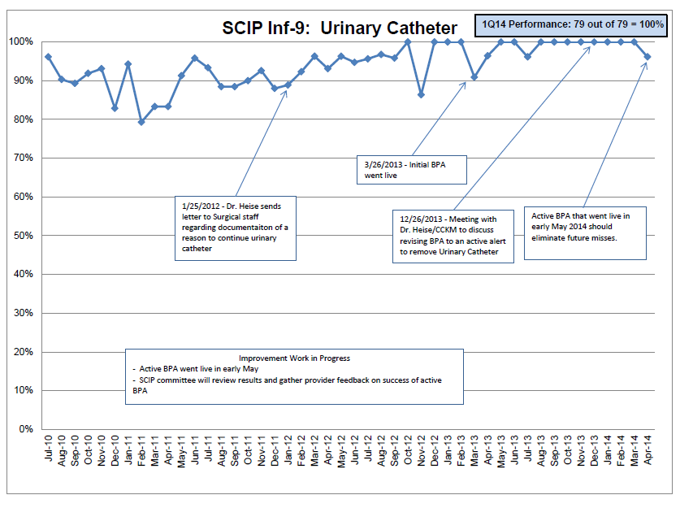
SCIP Inf-9 Compliance Improved

Slide 47
CAUTI Group Continues….
Streamline Inventory: standard catheter to be stocked on all units
  Silver coated catheter phased out, ~$50,000 annual cost reduction
  16-Fr will be standard on adult units.
  Urimeter will be standard on adult units to avoid need to break connection to add on should output monitoring be needed
  Other sizes/configurations available from CS for ordering as needed
New tray design to be reviewed:
  Betadine swabs instead of cotton balls/betadine solution.
  StatLock included.
  Single layer tray designed to aid in maintaining asepsis expected from vendor in coming months.
Trial of observers for insertions underway Med/Surg ICU, Neuro ICU, Ortho, General Surgery
Better patient level data to assess impact of location of insertion, catheters from OSHs, reinsertion frequency, etc.

Slide 48
Summary—2
Multidisciplinary team critical
  Size of the team cannot be too cumbersome
Include critical stakeholders– especially your most vocal naysayers (i.e., embrace your surgeons)
Show the data
Thick skin– change is hard and conflict is inevitable!

Slide 49
Thank you!
Questions?

Slide 50
Funding
Prepared by the Health Research & Educational Trust of the American Hospital Association with contract funding provided by the Agency for Healthcare Research and Quality through the contract, “National Implementation of Comprehensive Unit-based Safety Program (CUSP) to Reduce Catheter-Associated Urinary Tract Infection (CAUTI), project number HHSA290201000025I/HHSA29032001T, Task Order #1.”

