Slide 1
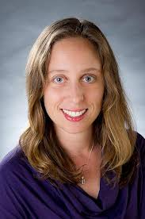

Preventing CAUTI in Specialized Patient Populations: The ICU
Hannah Wunsch, MD, MSc
Herbert Irving Assistant Professor of Anesthesiology and Epidemiology
Columbia University
Eugene Chu, MD, FHM
Director of Hospital Medicine
Boulder Community Hospital
Associate Clinical Professor of Medicine
University of Colorado School of Medicine

Slide 2
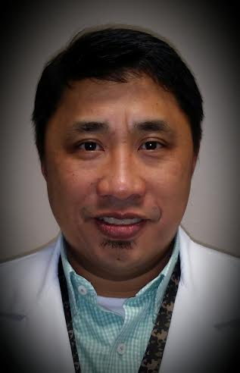
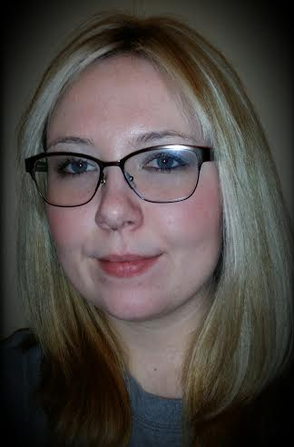
Additional Presenters
University Medical Center of Southern Nevada
Las Vegas, NV
Marlon Medina BSN, RN
Ashley E. Komacsar BSN, RN

Slide 3
Learning Objectives
Describe the relationship between culture change and CAUTI reduction
  Understand the CUSP framework for initiating culture change
  Apply culture change theory to urinary catheter culture
Articulate the barriers to CAUTI reduction in the ICU population
  Understand unique barriers in the ICU population
  Compare reduction of CAUTIs with other similar issues in the care of ICU populations
Recognize the value in using incentives to change behavior regarding catheter use in the ICU
  Using positive incentives to change behavior in regard to catheter use in the ICU
  Catheter alternatives, nurse education, and engaging leadership

Slide 4
On the CUSP: Stop CAUTI
Culture Change:
The 4 E’s and the Elephant

Slide 5
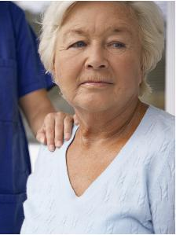
Case

Slide 6
What is the cause of Ms. B’s hypoxia?
Aspiration pneumonia
Acute coronary syndrome with CHF
Pneumothorax
Pulmonary embolism

Slide 7
What is the cause of Ms. B’s hypoxia?
Aspiration pneumonia
Acute coronary syndrome with CHF
Pneumothorax
Pulmonary embolism

Slide 8
Case
Urinary Catheter Harm
CAUTI
Increased Length of Stay
Patient dignity*
Trauma
Pressure ulcers
Immobility
Venous thrombo-embolism?
Falls?
*Saint S, Ann Intern Med 2002; 137: 125-7
Notes:
65 y/o female admitted with CHF. Poor mobility. Foley placed on rounds.
Diuresed, but developed CAUTI. d/c to SNF.
Readmitted with severe, refractory C. Diff. PO Vanc, IVIG, stool transplant.
Now immobile and developed pressure ulcers worsened by diarrhea.
HD#4: acute hypoxemia, clear cxr, hypotension. Submassive PE.
We want to stress that urinary catheters are not harmless devices. They may lead to urinary tract infections and cause mechanical trauma to the urethra and bladder. They also immobilize patients—increasing the likelihood of pressure ulcers, falls and prolonged inpatient stays. Dr. Saint has described this eloquently in 2002 as a “one point restraint” affecting patient rights, comfort, and dignity.
In a 2007 study, cases with CAUTI resulted in $1,300 to $1,600 in additional cost per patient.⁸

Slide 9
Aims
Understand the CUSP framework for initiating culture change
Apply culture change theory to urinary catheter culture
Notes:
Our goal is to assist healthcare facilities in preventing catheter-associated urinary tract infections (CAUTIs). We will describe urinary catheter use and the epidemiology of catheter-associated urinary tract infections. We will explain the steps that CMS (Center for Medicare and Medicaid Services) and HHS (Health and Human Services) have taken to reduce CAUTIs in the hospital setting.
We will also review how to reduce the risk of CAUTIs (for example, proper insertion techniques and appropriate use), discuss how to sustain your facility’s improvement (how to keep catheter utilization and CAUTI rates down), provide tools for avoiding unnecessary urinary catheter placement and metrics to calculate utilization rates.

Slide 10
Organizational Culture
…the shared set of social values and beliefs, both explicit and implicit, that guides actions and decisions within the organization

Slide 11
Where do we intervene?
Non-ICU
Evaluate need on admission
Evaluate for continued need
PACU/OR
ICU
ED
Avoid insertion unless required for surgery
Evaluate for continued need
Avoid initial placement
Reevaluate for continued need after patient stabilizes
Discontinue no longer needed before transfer out
Remove promptly after surgery before transfer out

Slide 12
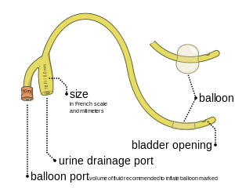
CAUTI ICU Culture
CAUTI
Indications
Orders
HICPAC
Insertion and Maintenance
Technique
Competency
Removal
Process
Structure

Slide 13

Leading Change
For anything to change,
someone has to start acting differently.
Notes:
Executives: change management
Individuals: self- help
Activists: change the world
Ted Talks: Derek Sivers: How to start a movement

Slide 14
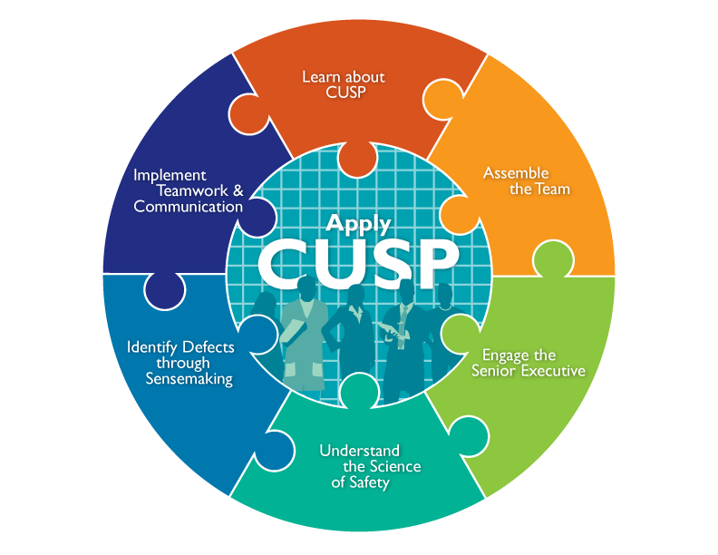

Culture Change Theory

Slide 15
Changing Patient Safety Culture
 | Senior | Team | Staff
 | leaders | leaders
Engage | How does this make the world a better place?
Educate | What do we need to do?
Execute | What keeps me from doing it?
 | How can we do it with my resources?
Evaluate | How do we know we improved safety?
Notes:
This slides summarizes the interventions of this effort:
The 5 elements of the Comprehensive Unit-based Safety Program or CUSP
Care and Removal
Removal of unnecessary indwelling catheters based on HICPAC recommendations
Proper care for appropriate indwelling catheters
3) Placement Intervention
Determination of appropriateness of indwelling catheter based on HICPAC recommendations
Sterile placement of indwelling catheter

Slide 16
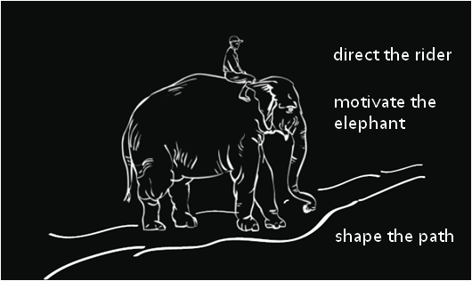

Can you get people to start behaving in a new way?
individual
Notes:
Rider = head, rational, cautious, analytical, conscious, long term, delayed gratification
Elephant – heart, emotional, spontaneous, instinctive, intuitive, subconscious, short term, instant gratification
Path – environment, context , framework, tools

Slide 17
Can you get people to start behaving in a new way?
organization
Notes:
Rider = head, rational, cautious, analytical, conscious, long term, delayed gratification
Elephant – heart, emotional, spontaneous, instinctive, intuitive, subconscious, short term, instant gratification
Path – environment, context , framework, tools

Slide 18
Can you get people to start behaving in a new way?
society
Notes:
Rider = head, rational, cautious, analytical, conscious, long term, delayed gratification
Elephant – heart, emotional, spontaneous, instinctive, intuitive, subconscious, short term, instant gratification
Path – environment, context , framework, tools

Slide 19
Can you get people to start behaving in a new way?
educate
engage
execute and evaluate

Slide 20

Can you get people to start behaving in a new way?
educate
engage
execute and evaluate

Slide 21
Can you get people to start behaving in a new way?
educate
engage
execute and evaluate

Slide 22
Can you get people to start behaving in a new way?
educate
engage
execute and evaluate

Slide 23

Population Health Improvement

Slide 24
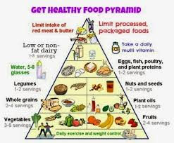
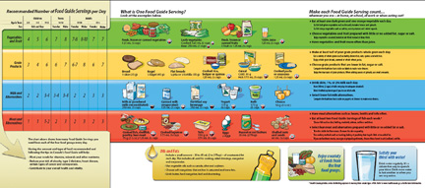
Eat Healthy!

Slide 25
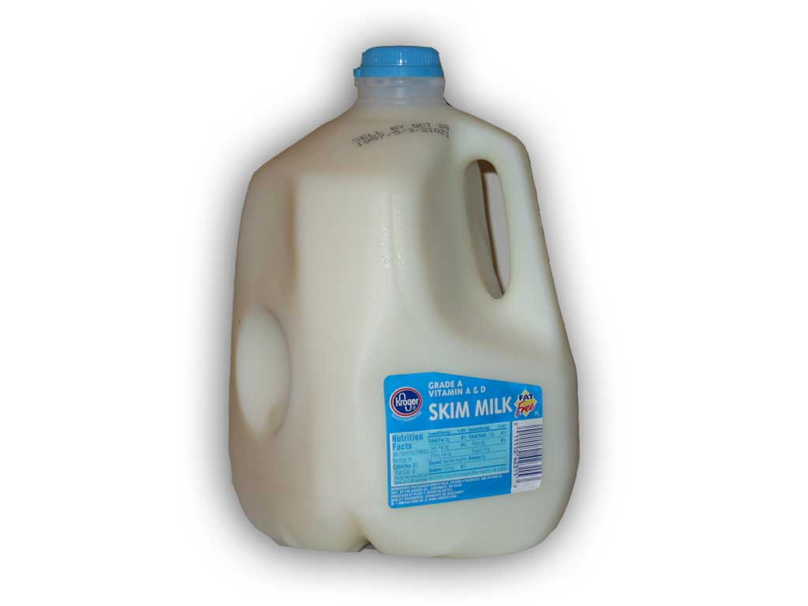
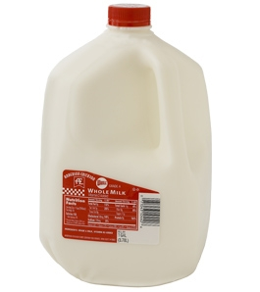
Use Skim Milk!

Slide 26
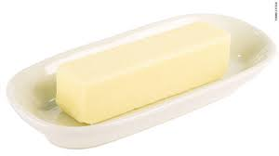
Use Skim Milk!

Slide 27
Can you get people to start behaving in a new way?
What looks like resistance is often a lack of clarity.
Educate | What do we need to do?
Notes:
What looks like resistance is often a lack of clarity.
“Eating a healthier diet.” West Virginia healthy eating campaign. Univ West Virginia professors
Where to start – paralysis of analysis.
By substituting 1% fat milk for whole milk alone -> reach USDA recommended levels of saturated fat.
One cup of whole milk – five pieces of bacon
One half gallon – tube full of fat
Pre campaign – skim milk 18% market share -> 35% post-campaign
Understanding without motivation (reach rider but not elephant)

Slide 28
Education – Direct the Rider
HICPAC guidelines
  Appropriate
  Inappropriate
Aseptic insertion technique
Maintenance technique
  Closed system
Skin care
Equipment usage
  Bladder scanner
  Condom cath
  Female urinals

Slide 29

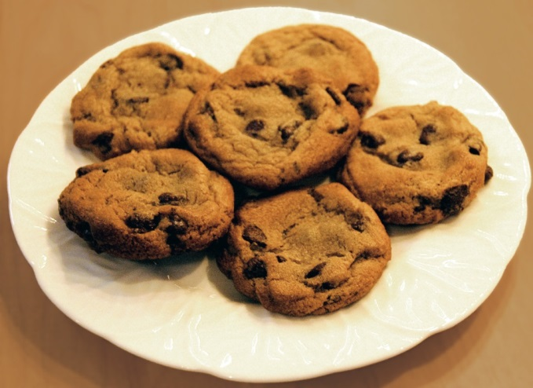
Taste Test

Slide 30


Which group attempted the puzzle for a longer time before giving up?
The group that could eat the cookies
The group that could only eat the radishes
No difference

Slide 31
Which group attempted the puzzle for a longer time before giving up?
The group that could eat the cookies
The group that could only eat the radishes
No difference

Slide 32

Can you get people to start behaving in a new way?
What looks like laziness is often exhaustion.
Engage | How does this make the world a better place?
Notes:
What looks like laziness is often exhaustion.
Radishes and cookies experiment.
“Taste perceptions” experiment on college students:
Reported to experiment hungry – no food for 3 hours.
One group told to eat only radishes. Other allowed to eat cookies.
Same students: told about problem solving experiment- college v high school students.
trace geometric shape without retracing any lines and without lifting pencil from paper – unsolvable.
Radish group gave up earlier (8 minutes v 19 minutes)
Self-control/willpower is exhaustible resource.
Boardroom conference table full of gloves – same gloves purchased at different prices for same company.
Passion without direction (reach elephant without rider)

Slide 33
Engage – Patients
Urinary Catheter Harm
CAUTI
Increased Length of Stay
Patient dignity*
Trauma
Pressure ulcers
Immobility
Venous thrombo-embolism?
Falls?
*Saint S, Ann Intern Med 2002; 137: 125-7
Notes:
65 y/o female admitted with CHF. Poor mobility. Foley placed on rounds.
Diuresed, but developed CAUTI. d/c to SNF.
Readmitted with severe, refractory C. Diff. PO Vanc, IVIG, stool transplant.
Now immobile and developed pressure ulcers worsened by diarrhea.
HD#4: acute hypoxemia, clear cxr, hypotension. Submassive PE.
We want to stress that urinary catheters are not harmless devices. They may lead to urinary tract infections and cause mechanical trauma to the urethra and bladder. They also immobilize patients—increasing the likelihood of pressure ulcers, falls and prolonged inpatient stays. Dr. Saint has described this eloquently in 2002 as a “one point restraint” affecting patient rights, comfort, and dignity.
In a 2007 study, cases with CAUTI resulted in $1,300 to $1,600 in additional cost per patient.⁸

Slide 34
Engage – Finances
Daily Census | ALOS | Yearly Admits | Foley Rate | Annual Savings
800 | 4 | 73,000 | 25% | $1.1M
400 | 4 | 36,500 | 25% | $552k
200 | 4 | 18,250 | 25% | $276k
www.catheterout.org

Slide 35
Engage – Vision
Imaginable
Feasible
Desirable
Focused
Flexible
Communicable
Notes:
Would you want a loved one to be a patient at your hospital? Your unit?
Would you want to be a patient in the unit where you work?
Can you say with 100 percent certainty that you believe that your hospital does everything it can to protect its patients?

Slide 36
Don’t Forget the Cookies

Slide 37

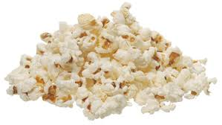
Free Popcorn

Slide 38
What characteristics were different between the groups?
Age
Gender
BMI
All of the above
None of the above

Slide 39
What characteristics were different between the groups?
Age
Gender
BMI
All of the above
None of the above

Slide 40
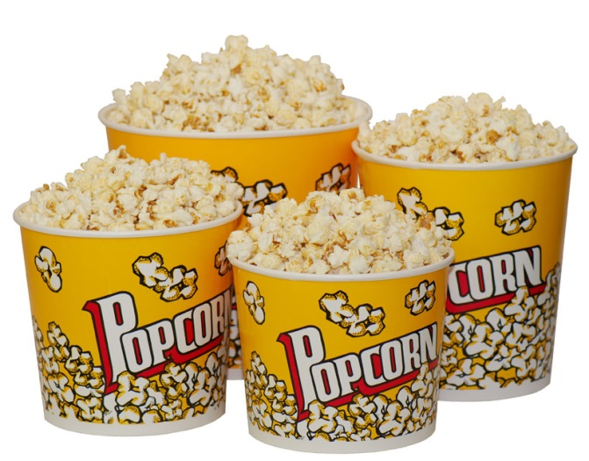
Can you get people to start behaving in a new way?
What looks like a people problem is often a situation problem.
Execute | What keeps me from doing it?
 | How can we do it with my resources?
Evaluate | How do we know we improved safety?
Notes:
What looks like a people problem is often a situation problem.
Shrinking movie popcorn buckets.
Chicago screening of Mel Gibson movie – Payback
Given free popcorn and drink and asked to come after movie to answer a few questions about the concession stand.
Stale popcorn in buckets too large to finish. (not eating for pleasure or for goal – unable to finish)
Bigger buckets = more eating (53% more eating – reproduced many times is various regions to various movies)
When people were told of the finding, they didn’t believe it – I know when I’m full. Things like that don’t trick me…
When other people looked at the data, they saw people problems (not understanding health consequences…)
Supersize me.

Slide 41
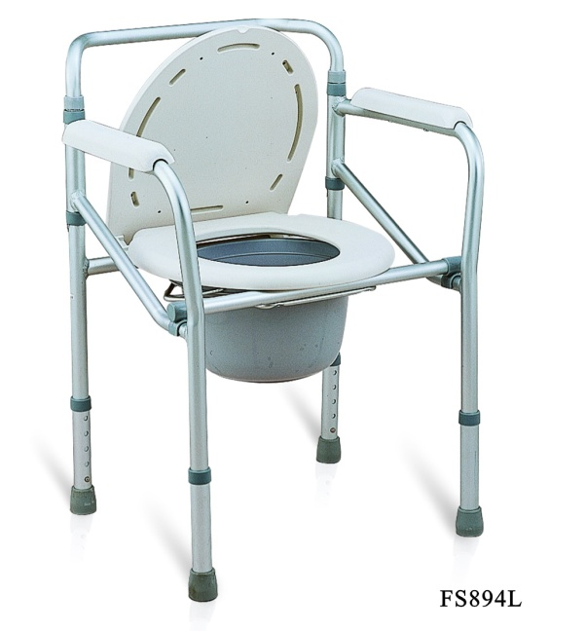
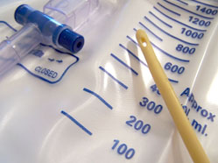
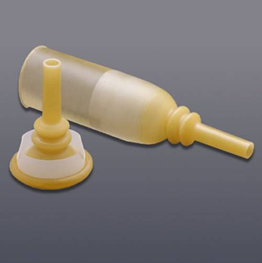
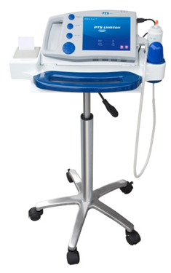
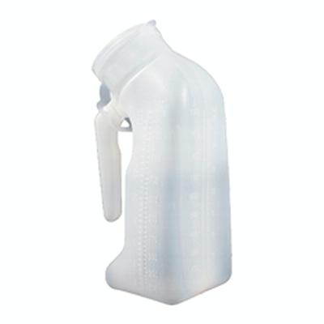
Execute – Structure

Slide 42
Execute – Processes
Orders with indications
Nurse driven removal protocol
Acute urinary retention protocol
Insertion and maintenance competency evaluations
ED and OR -> ICU processes
Monitoring and Feedback

Slide 43
Evaluation
Use data to assess progress:
  Hospital Survey on Patient Safety
  Infection rates
  Process measures
  Organizational and team culture

Slide 44
Can you get people to start behaving in a new way?
educate
engage
execute and evaluate

Slide 45
Organizational Culture
…the shared set of social values and beliefs, both explicit and implicit, that guides actions and decisions within the organization

Slide 46
CAUTI ICU Culture
CAUTI
Indications
Orders
HICPAC
Insertion and Maintenance
Technique
Competency
Removal
Process
Structure

Slide 47
Learning Objectives
Understand unique barriers in the ICU population
Compare reduction of CAUTIs with other similar issues in the care of ICU populations

Slide 48
Last patient of the morning (11:45 a.m.)
75 yo M
Hx of HTN, DM2
Admitted 24 hours earlier “for monitoring” after a pancreaticoduodenectomy (Whipple)
Doing well, good UOP, no vasopressors
Would you remove the urinary catheter as part of your plan for the day?

Slide 49
Why do ICU patients feel ‘special’?
“if you touch them they desaturate”
“they are on high doses of vasopressors and their kidney function is tenuous”
“they are at high risk for a sacral decub”
“they are at risk for abdominal compartment syndrome and I’m monitoring UOP”
They are “sick” and we need to know “ins and outs” every hour
The need for urinary catheters in the ICU will never go away

Slide 50
So why is it so hard to change things?
What is YOUR biggest barrier?
  The nurse/physicians in the unit want to take the Foley out, but the surgeon/oncologist also caring for the patient wants it in
  Everyone still wants ‘ins and outs’ every hour
  There are so many other things to discuss on rounds

Slide 51
So why is it so hard to change things?
What is your biggest barrier?
  The nurse/physicians in the unit want to take the Foley out, but the surgeon/oncologist also caring for the patient wants it in
  Everyone still wants ‘ins and outs’ every hour
  There are so many other things to discuss on rounds

Slide 52
ICU care is complex even in a ‘closed’ unit
ICU
  Intensivist
  Pharmacist
  Respiratory therapist
  Nurse
  Surgeon
  Infectious disease specialist
  (Resident)
Emergency medicine
  EM physician
  Nurse

Slide 53
Time frame
Time for care in the ED is short
Time for care in the ICU is long

Slide 54
So why is it so hard to change things?
What is your biggest barrier?
  The nurse/physicians in the unit want to take the Foley out, but the surgeon/oncologist also caring for the patient wants it in
  Everyone still wants ‘ins and outs’ every hour
  There are so many other things to discuss on rounds

Slide 55
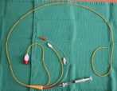
It used to be…
‘everyone still wants a wedge pressure on every sick patient’

Slide 56
Trend from 1993 to 2004
Soylemez Wiener & Welch JAMA 2007

Slide 57
Understanding Changes in Established Practice
Gershengorn & Wunsch CCM 2013

Slide 58
Understanding Changes in Established Practice
Gershengorn & Wunsch CCM 2013

Slide 59
Concentration of Catheters
Understanding Changes in Established Practice
Gershengorn & Wunsch CCM 2013

Slide 60
So why is it so hard to change things?
What is YOUR biggest barrier?
  The nurse/physicians in the unit want to take the Foley out, but the surgeon/oncologist also caring for the patient wants it in
  Everyone still wants ‘ins and outs’ every hour
  There are so many other things to discuss on rounds

Slide 61
Back to the 4Es (sort of)
-Engage
-Educate
****Empower *****
-Execute
****Celebrate*****
-(Evaluate)

Slide 62
A lot of people – and you only need one
Nurse
Pharmacist
Physical Therapist
Respiratory Therapist
PA
NP
Fellow
Resident
Medical Student

Slide 63
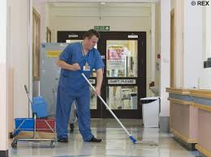
Example of empowerment…

Slide 64
ICU is a lot of ‘doing’
Place the Foley
Place the central line
Monitor Ins and Outs
Place the arterial line
Send off the ABG
Intubate
Change the ventilator settings
Order another test

Slide 65
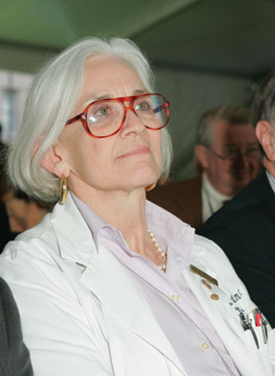
Human Nature
Linda Lewis
“Don’t just do something, stand there”

Slide 66

Celebrate the ‘removal’

Slide 67
On the CUSP: Stop CAUTI
A Journey to Prevent CAUTI & Improve Patient Safety in the ICU
University Medical Center of Southern Nevada
Las Vegas, NV
Marlon Medina BSN, RN
Ashley E. Komacsar BSN, RN

Slide 68
On the CUSP at UMC
Attended statewide implementation meeting
Form a dedicated CAUTI team
Participate in HSOPs survey
Review current catheter policy and order set
CAUTI rounds with executive champion
Team member participation in national and statewide coaching calls
Attend statewide Learning Session 2
Attend learning session 3/project wrap-up
Sustain the culture of change

Slide 69
Formation of CAUTI Team
Unit Manager
  For support, leadership, & time allocation
Unit Charge Nurses
  For support, consistency, resource, & data collection
Unit Team Leader
  Peer champion, coordinate project efforts, staff empowerment
Staff Nurses
  Heart of operation, implement CUSP at the bedside
Infection Control
  Data collection & submission, coordination of house-wide efforts
Physician Champion
  Support change at physician level, coordinate multidisciplinary care
Executive Champion
  Administrative support, allocation of resources

Slide 70
Review of Policy & Practice 2012
Physician Foley Daily Order Form
  Physician to order Foley with approved indication
  Physician to assess daily if catheter meets indication
Daily Bundle Checklist
  Daily tasks for best practice (i.e. Bag below bladder, use of securement device, seal not broken)
  Nurse to complete when care on sheet is completed

Slide 71
Executive Champion CAUTI Rounds
Our Chief Financial Officer & Executive Champion was invited to round on the unit
Explanation of CUSP given
A chance to interact with staff and voice safety concerns
Attended Bard catheter training class with CAUTI team members

Slide 72
Team Member Participation
National Content Calls
  Tuesdays once monthly
  Different and guest speakers present information on various areas within CUSP
State Coaching Calls
  Once monthly
  State data shared
  A chance for hospitals to network and exchange progress and offer assistance
CAUTI Team Unit Meetings
  Quarterly
  Perform analysis of CAUTI incidents
  Reflect on state and national content
  Brainstorm and implementation of projects within unit

Slide 73

Learning Session 2 & 3
April 16, 2013 in Reno, NV
Presentations from Nevada hospitals
  Saint Mary’s, Renown, Tahoe Pacific
Identifying Barriers
  Education, Increased Workload, Participation, Resources, Foley Alternatives
Learning from Defects
Prevention Strategies
Culture Change & Sustainment
Teamwork in Action
Team Sharing and Action Plan
Staff Safety Assessment Discussion
February 7, 2014 in Reno, NV
Project wrap-up and final data presentation
Sharing greatest successes & barriers
Culture Sustainment
Awards Presentation

Slide 74
On the CUSP in Action
Changes on NSCU
  CUSP Information boards assembled
  Foley Decision tree in every room
  Development of CAUTI Alert
  Increased staff vigilance and catheter removal
  Continued attendance of calls and regular meetings
House-Wide Changes
  Bard sponsored Foley Catheter Class & new departmental testing
  Providing and utilizing more Catheter Alternatives
  Change in stocking of urinary catheter trays
  Revision/Update of Foley policy
  Nurse-Driven Foley removal

Slide 75
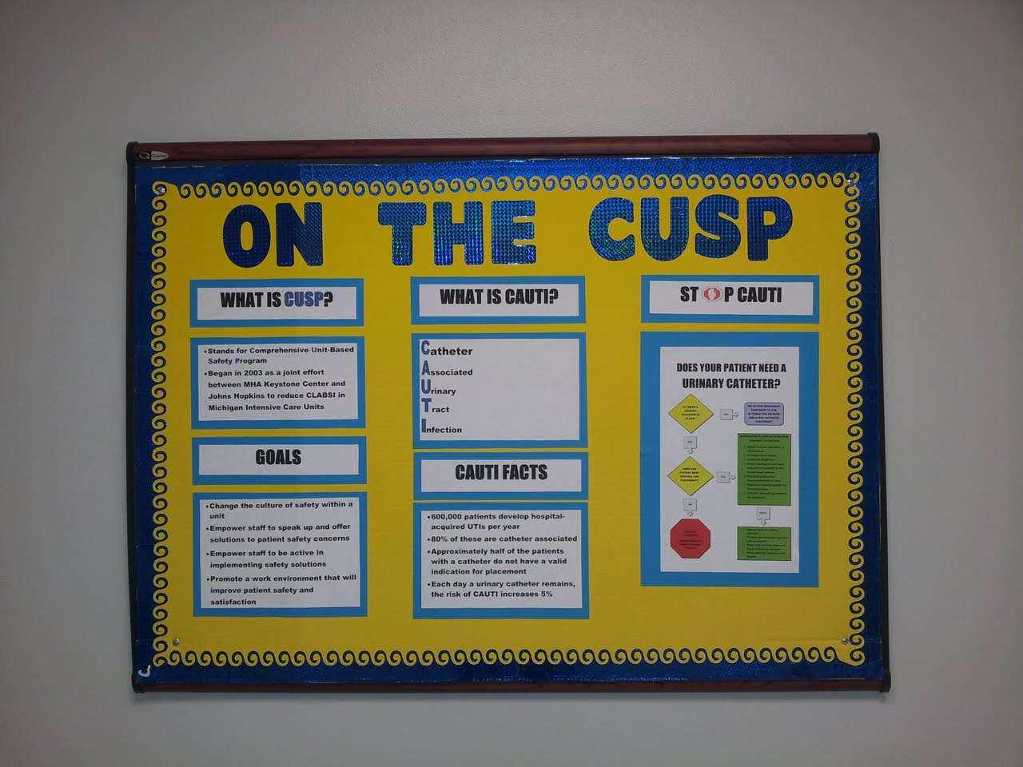
CUSP Information Boards
First CUSP project for NSCU
Created after CUSP implementation
Provides information on CUSP
Provides information on CAUTI
Used to engage staff, physicians, & family in unit project

Slide 76
Foley Decision Tree
Placed in every room
Insert date placed in top yellow diamond
Contain indications for catheter & maintenance
Makes indications visible to patient family and staff

Slide 77
CAUTI Alert
Tool to alert staff of a CAUTI
Lists date & time of event
Cites NHSN criteria for event labeled as a CAUTI
Raises awareness of incident for use for further prevention

Slide 78
Foley Catheter Training
Bard was invited to provide classes reviewing the product and current insertion and maintenance techniques
UMC department of Clinical Research & Education put together a departmental test placed on the UMC intranet for staff
Lab time also arranged for a “test out” on care and insertion
CAUTI Prevention incorporated into “Skills Fair” for floor specific competencies

Slide 79
Catheter Alternatives
Began to reinforce use of catheter alternatives such as the condom catheter
  Educate on proper application technique
  In-service on application of the Liberty condom Catheter
Pilot use of the female urinal
  Began a house-wide in-service on female urinal use after successful pilot on NSCU
  Well received by staff and patients
  Direct in-servicing provided to near 200 employees house-wide by NSCU’s CUSP team
Posters developed with tips for incontinence care and available continence devices

Slide 80
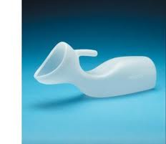
Tips for Female Urinal Use
Present the device to the patient; explain that it is a device to collect urine
Assist the patient in placing the urinal flat side down, handle up between the patient’s legs flush to the perineum
Adjust patient’s head to an upright position for comfort

Slide 81
Change in Stock of Catheter Trays
Prior to project, both trays with a conventional drainage bag and urimeter trays were stocked in the ED & OR
Often times, seal was being broken when pt received in ICU to place a temp sensing/urimeter drainage bag
Skin Council & Supply collaborated to place urinary catheter trays in ED & OR to allow for more appropriate product placement

Slide 82
Getting the students involved
Students are educated about On the CUSP: Stop CAUTI
Students created CAUTI prevention display as their unit project
Presented findings to staff and created care checklist for Foley care in patient rooms
Staff took great pride collaborating with students and sharing knowledge

Slide 83
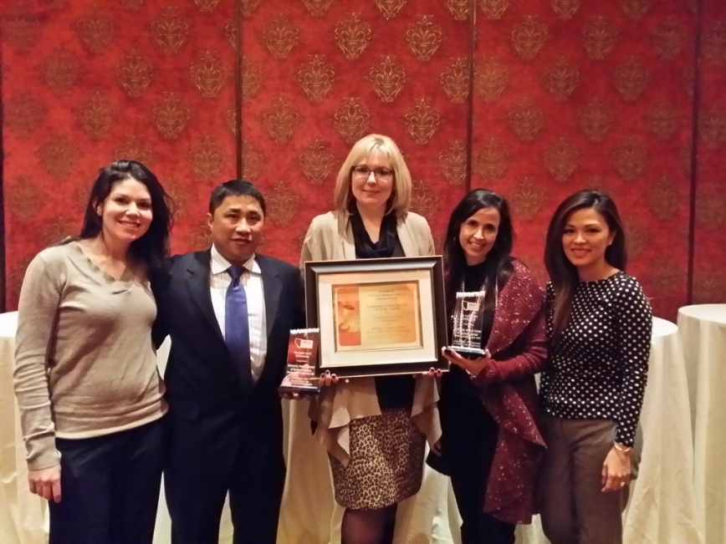
Brags
News of success house-wide
  Presented at IC meetings
Administrative support for continuing effort
  Support for Nurse-Driven Removal Protocol
Empowering staff to participate in activities beyond the bedside
Opportunities to share our story with hospitals in the community
  Keynote Presentation for Winter Plenary QIO Session
Awards presented for NSCU’s work at Learning Session 3
Article appearing in hospital newsletter The Pulse
Participation in CDC sponsored “Reverse the Trend” Webinar
Interview appearing in edition of APIC’s Prevention Strategist

Slide 84
Barriers
Physician Buy-in
Time & resources
  Securing more commodes, finding times to meet, funding
Staff schedule & availability
  Low census, floating
Competing Project Rollouts
  EMR implementation
  Competing Project Rollouts
Administrative Changes
Fear about life without a Foley, “New Trick Anxiety”

Slide 85
How are We Doing?
Staff is advocating for Foley removal when not indicated
Staff really taking ownership of CAUTI when occurring, reviewing what could be done
Physicians on ICU Team assess for indication during daily rounds
Catheter alternatives are used on a regular basis
Infection Control reports less investigation of CAUTI incidents
Foley Policy revised to reflect best practice including Nurse-driven Foley removal
Plaques and articles displayed in the units
Continuing to coordinate with Performance Improvement, Infection Control, Education, & other departments to reduce CAUTI
Continuing to develop program to continue moving towards ZERO CAUTI

Slide 86
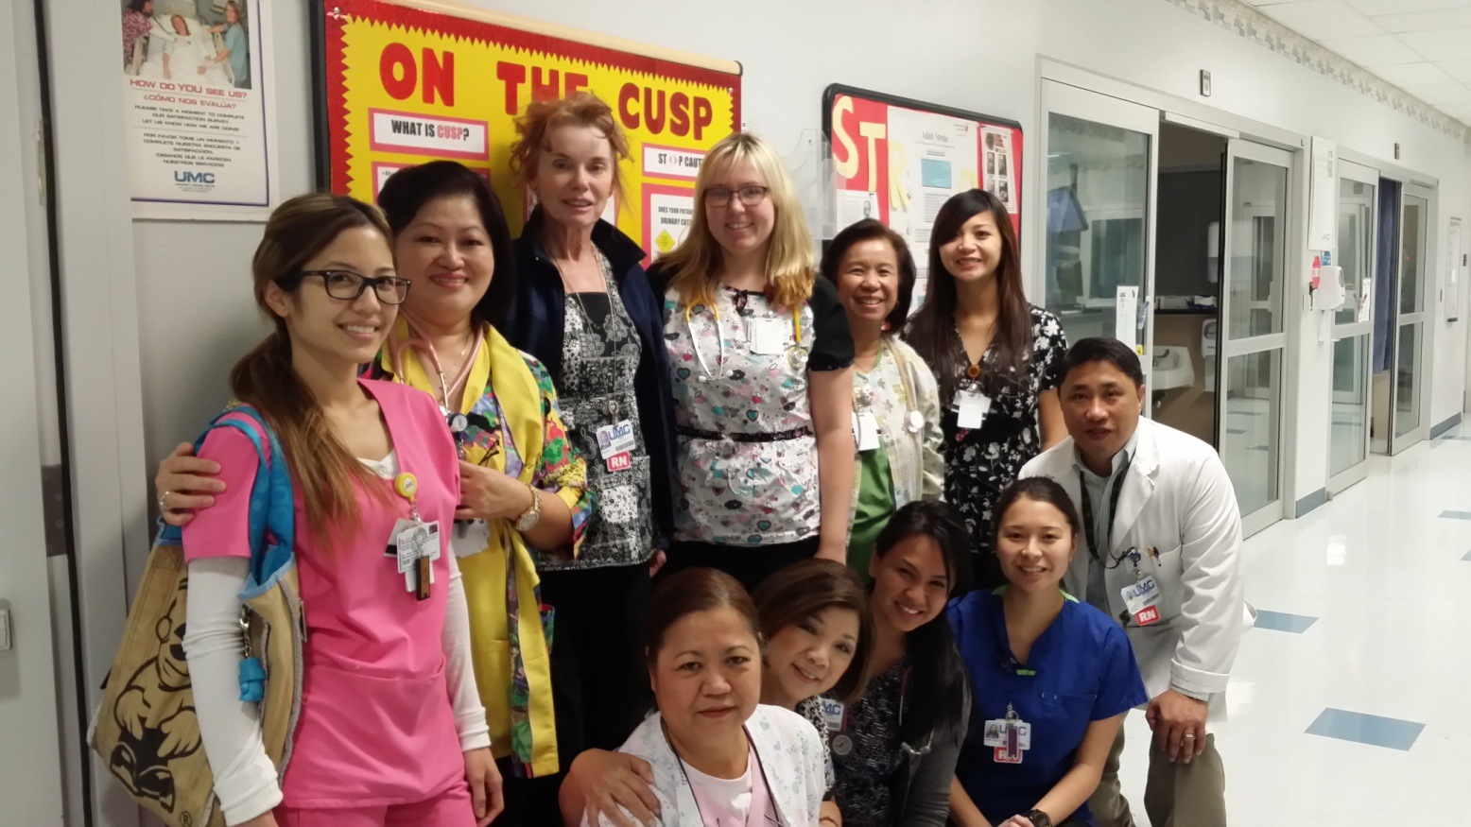
Thank You
Thank you

Slide 87
Thank you!
Questions?

Slide 88
Funding
Prepared by the Health Research & Educational Trust of the American Hospital Association with contract funding provided by the Agency for Healthcare Research and Quality through the contract, “National Implementation of Comprehensive Unit-based Safety Program (CUSP) to Reduce Catheter-Associated Urinary Tract Infection (CAUTI), project number HHSA290201000025I/HHSA29032001T, Task Order #1.”

