Slide 1
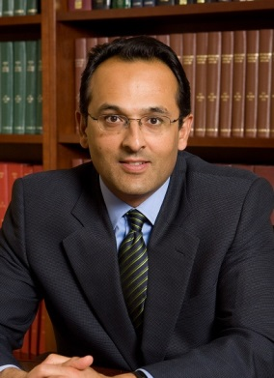
Preventing CAUTI: What to Do When it’s Time for Plan B
Sanjay Saint, MD, PhD
George Dock Collegiate Professor of Internal Medicine
Division of General Medicine
University of Michigan Health Systems
Associate Chief of Medicine, Ann Arbor VA Medical Center
Sarah Krein, PhD, RN
Research Associate Professor, Division of General Medicine
Department of Internal Medicine
University of Michigan, Ann Arbor
Kathlyn Fletcher, MD, PhD
Associate Professor of Medicine
Medical College of Wisconsin and the Milwaukee VAMC
Associate Program Director, MCW Internal Medicine Residency
Notes:
I would like to begin by acknowledging my collaborators.

Slide 2
Learning Objectives
Define basic principles of CAUTI prevention
Describe approaches to consider if CAUTI rates are not where you want them to be
State how the GPS can support units with ongoing CAUTI problems
Apply mindfulness to CAUTI prevention

Slide 3
Catheter-Associated Urinary Tract Infection (CAUTI)
UTI is a common cause of hospital-acquired infection
Most due to urinary catheters
Up to 20 percent of inpatients are catheterized
Leads to increased morbidity and health care costs www.catheterout.org

Slide 4
title
SEPTEMBER 17, 2013
“Many noninfectious catheter-associated complications are at least as common as clinically significant urinary tract infections.”

Slide 5
Addressing CAUTI Prevention within the Broader Patient Safety Context
Urinary Catheter Harm
CAUTI
Increased Length of Stay
Patient discomfort
Trauma
Pressure ulcers
Immobility
Partnership for Patients
Venous thrombo-embolism
Falls
(Slide courtesy of Mohamad Fakih)

Slide 6
How can we reduce catheter use and prevent CAUTI?

Slide 7
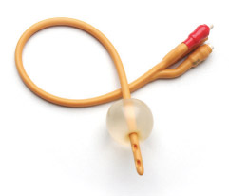
Disrupting the Lifecycle of the Urinary Catheter
1. Preventing Unnecessary and Improper Placement
1
4. Preventing Catheter Replacement
2. Maintaining Awareness & Proper Care of Catheters
4
2
3
3. Prompting Catheter Removal
(Meddings. Clin Infect Dis 2011)
Notes:
Much of the my discussion today will focus on ways to DISRUPT the lifecycle of the urinary catheter, so I have organized the discussion of interventions and challenges based upon 4 ways to address catheter use.
FIrst, to prevent unnecessary and improper placement.
Second, to maintain awareness and proper care of catheters already in place.
Third, to prompt catheter removal....by the use of catheter reminders and stop-orders,
and finally, to prevent catheter replacement. NEXT SLIDE

Slide 8
Disrupting the Lifecycle of the Urinary Catheter
1. Preventing Unnecessary and Improper Placement
1
4. Preventing Catheter Replacement
2. Maintaining Awareness & Proper Care of Catheters
4
2
3
3. Prompting Catheter Removal
(Meddings. Clin Infect Dis 2011)
Notes:
Much of the my discussion today will focus on ways to DISRUPT the lifecycle of the urinary catheter, so I have organized the discussion of interventions and challenges based upon 4 ways to address catheter use.
FIrst, to prevent unnecessary and improper placement.
Second, to maintain awareness and proper care of catheters already in place.
Third, to prompt catheter removal....by the use of catheter reminders and stop-orders,
and finally, to prevent catheter replacement. NEXT SLIDE

Slide 9
Disrupting the Lifecycle of the Urinary Catheter
1. Preventing Unnecessary and Improper Placement
1
4. Preventing Catheter Replacement
2. Maintaining Awareness & Proper Care of Catheters
4
2
3
3. Prompting Catheter Removal
(Meddings. Clin Infect Dis 2011)
Notes:
Much of the my discussion today will focus on ways to DISRUPT the lifecycle of the urinary catheter, so I have organized the discussion of interventions and challenges based upon 4 ways to address catheter use.
FIrst, to prevent unnecessary and improper placement.
Second, to maintain awareness and proper care of catheters already in place.
Third, to prompt catheter removal....by the use of catheter reminders and stop-orders,
and finally, to prevent catheter replacement. NEXT SLIDE

Slide 10
Disrupting the Lifecycle of the Urinary Catheter
1. Preventing Unnecessary and Improper Placement
1
4. Preventing Catheter Replacement
2. Maintaining Awareness & Proper Care of Catheters
4
2
3
3. Prompting Catheter Removal
(Meddings. Clin Infect Dis 2011)
Notes:
Much of the discussion today will focus on ways to DISRUPT the lifecycle of the urinary catheter, so I have organized the discussion of interventions and challenges based upon 4 ways to address catheter use.
First, to prevent unnecessary and improper placement.
Second, to maintain awareness and proper care of catheters already in place.
Third, to prompt catheter removal....by the use of catheter reminders and stop-orders,
and finally, to prevent catheter replacement. NEXT SLIDE

Slide 11
What about the ICU?

Slide 12
Just because a patient is in the ICU does NOT mean that the patient needs a Foley… The Key Question is this:
Are hourly assessments of urine output required?

Slide 13
What if you need further help in preventing CAUTI? Sarah Krein, PhD, RN

Slide 14
Polling Question What strategies have you used or considered using if your CAUTI rates are not as low as you might like?
Running up and down the hallway screaming
Conducting a focused review or “deeper dive” to identify improvement opportunities
Ensuring competency in insertion using aseptic technique
Assessing what indications are being used for catheter use
Talking with staff about possible barriers to prompt removal

Slide 15
Additional Approaches
Tier 1 & Tier 2
CAUTI GPS
Applying Mindfulness to CAUTI

Slide 16
Tier 1 Protocol: Use of Indwelling Urinary Catheter Kit
Assess and document competency of health care workers performing insertion
Measure monthly for 6 months; re-evaluate. If rate has dropped below indicated levels proceed back to Tier 1
Measure CAUTI rates monthly
Encourage use of alternatives to indwelling catheter
Tier 2 Protocol: Enhanced Practices – Evaluation of indication for use, maintenance, and removal technique
Follow maintenance and removal template for care and removal of the catheter
Assess daily the necessity of the indwelling catheter
Use standard indwelling urinary catheter kit with pre-sealed junction
Ensure proper aseptic insertion technique
Sources:
HICPAC CDC Guidelines on CAUTI Prevention
www.catheterout.org
Consider Root Cause Analysis or Focused Review of CAUTI or catheter use to identify improvement opportunities
Monitor CAUTI rates closely. Proceed to Tier 2 if either of the following conditions are met over a period of 6 months:
ICU ≥ 9 CAUTIs/10,000 patient days
2 CAUTIs/1,000 catheter days
Non-ICU, Acute Care ≥ 3 CAUTIs/10,000
pt days & 2 CAUTIs/1,000 catheter days

Slide 17
Additional Approaches
Tier 1 & Tier 2
CAUTI GPS
Applying Mindfulness to CAUTI

Slide 18
CAUTI Guide to Patient Safety (GPS) Purpose
Brief, trouble-shooting guide
Help identify the key reasons why hospitals may not be successful in preventing CAUTI
Once the barriers are identified, can then help identify possible solutions
Notes:
Sarah

Slide 19
CAUTI Guide to Patient Safety (GPS) Development
Understanding why some hospitals are better than others in preventing infection
Mixed-methods national studies focusing on three device-related infections: CAUTI, CLABSI and VAP
Funded by VA, NIH and AHRQ
Phone interviews and site visits to hospitals across the United States
Notes:
Sarah

Slide 20
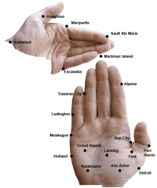
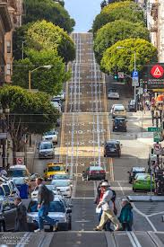
pictures

Slide 21
CAUTI Guide to Patient Safety (GPS) Development
Site visits require considerable time and resources
A tool that hospitals can self-administer to identify potential challenges and receive feedback including strategies for improvement
First step is the CAUTI GPS brief assessment
Notes:
Sarah

Slide 22
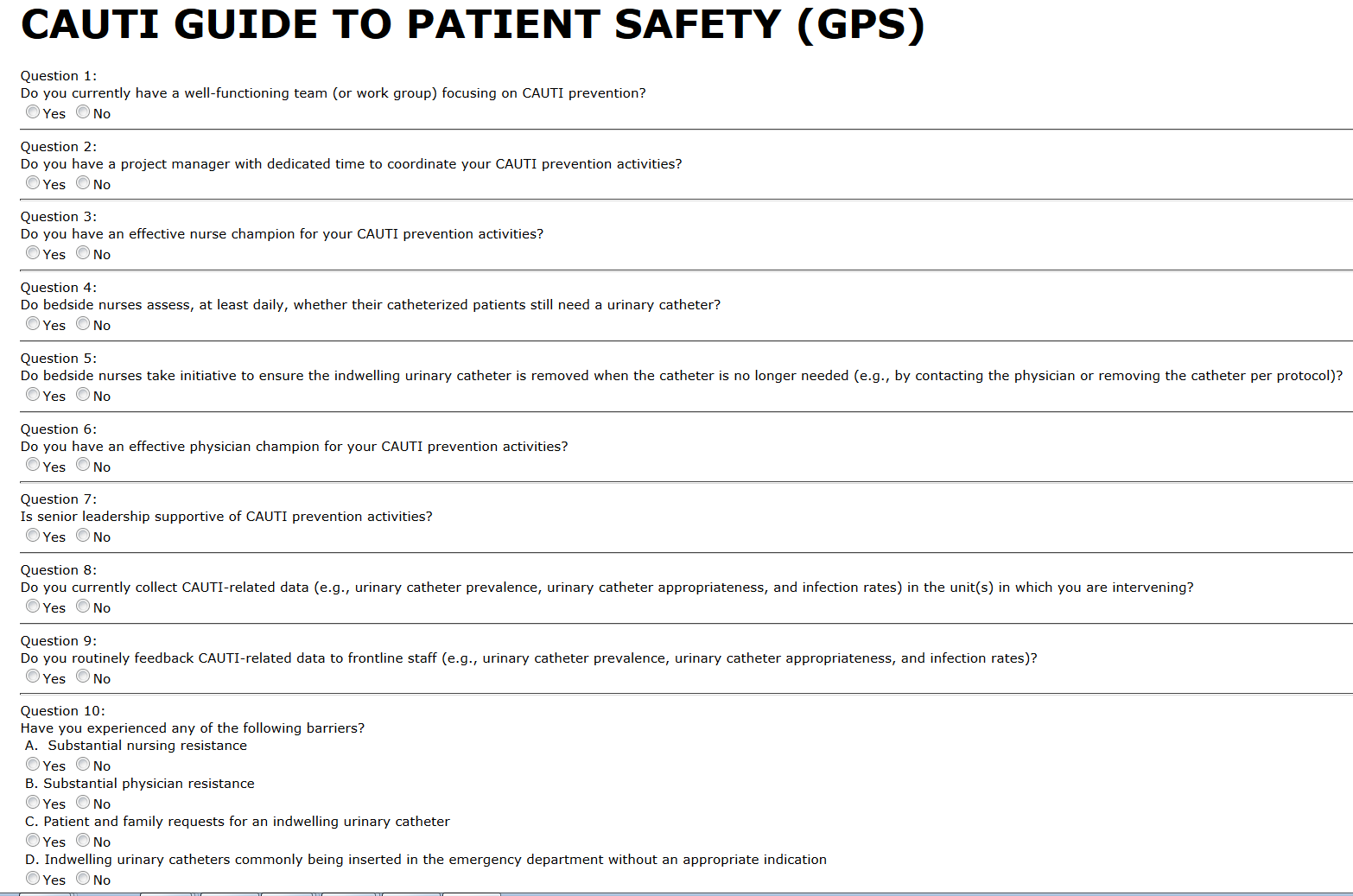
GPS

Slide 23
CAUTI Guide to Patient Safety (GPS) Development
Online tool
Each question linked to trouble-shooting tips
www.catheterout.org
Notes:
Sarah

Slide 24
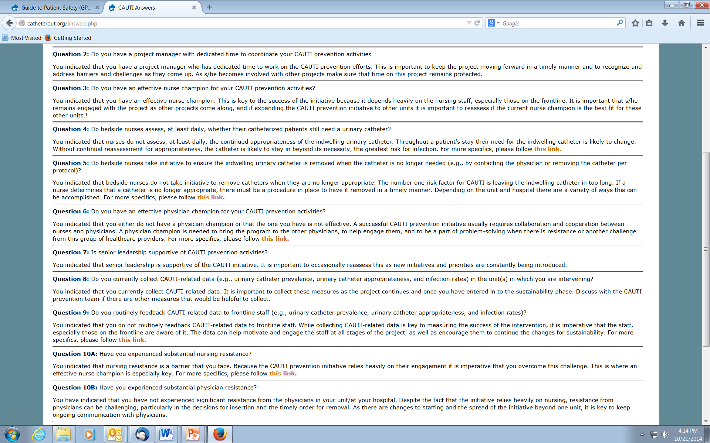
GPS questions

Slide 25
GPS questions 5

Slide 26
GPS Validation Study Kathlyn Fletcher, MD, PhD
Goals
To assess the unit-level culture surrounding the prevention of CAUTI and other hospital-acquired conditions
To compare the CAUTI GPS survey answers to qualitatively derived site assessments
Today’s focus

Slide 27
Methods: Overview
Setting: Four academic institutions
Two units per site (one MICU and one other unit)
Participants
Nurse manager, staff nurses, physicians, hospital leadership
Data collection
Nurse manager completed GPS and then was interviewed
Others were interviewed using more open-ended questions
Observations on the involved wards

Slide 28
Methods (cont’d)
Analysis
Inductive coding to define the culture
Deductive coding to identify elements/answers to the GPS
Comparison of nurse manager’s answers to others
Other comparisons for today…
Comparison of senior leadership to unit
Comparison of RNs to MDs

Slide 29
Get on the Same Page: Senior Leadership
Our observation
Infection control/quality officers are not always on the same page with nurse managers
Examples
Institutional versus unit-level champions
Actual preventive practices that are in place
How data is given to the front lines
Ideas
Ask the infection control professional or quality officer to take the GPS with your unit in mind

Slide 30
Get on the Same Page: Nurses and Doctors
Our observation
Doctors often have no idea about formal CAUTI prevention practices on their units
Examples
Doctors have no idea what the nurses do with respect to CAUTI prevention
MDs often aren’t aware of the existence of champions
Ideas
Have MDs take the GPS
Aggressively educate them based on gaps

Slide 31
Physician Involvement
Our observation
Often physicians are only passively involved in efforts
Examples
Most agree that physicians aren’t totally on board
Few think that they are an actual barrier
Ideas
There is room for more active partnering with MDs to move the dial toward “fully embrace”

Slide 32
Share the Outcomes Data
Our observation
Data is not consistently getting to the front-line MDs or RNs
Examples
Many know that data is collected
Few know how it is used or even see the results
Ideas
Use questions 8 and 9 with MDs and RNs
If this is true for your unit, reassess feedback mechanism

Slide 33
Other Resources…

Slide 34
Additional Approaches Sanjay Saint, MD, PhD
Tier 1 & Tier 2
CAUTI GPS
Applying Mindfulness to CAUTI

Slide 35
A Dilemma
Much of what we do in health care – especially in the hospital – is reflexive
If a patient is hypoxemic: we give oxygen
Low BP: IV fluids
Positive blood cultures: antibiotics
Frequency, urgency, and dysuria: dx UTI

Slide 36
A Dilemma
These rote responses are usually helpful
However, this reflex-like approach can lead to problems
Patient sick enough to be admitted from the ED: Foley catheter
Asymptomatic catheterized patient has a “dirty” urine: antibiotics

Slide 37
One Possible Solution: “Medical Mindfulness”

Slide 38
One Possible Solution: “Medical Mindfulness”
Being in the moment and considering decisions carefully before jumping to reflexive action
Daniel Kahneman:
Intuition (System 1): fast, automatic, effortless and difficult to alter
Reasoning (System 2): slower, effortful and flexible
In medicine, we are constantly toggling back-and-forth between the reflexive and the complex
How can we apply this to everyday practice?
Notes:
“Thinking, Fast and Slow”

Slide 39
Applying Mindfulness to Bedside Nursing: Catheter-Associated Urinary Tract Infection (Kiyoshi-Teo et al. Infect Cont Hosp Epid 2013)
Taking a 5-second “pause” before…
Inserting an indwelling catheter
Emptying the drainage bag or transporting the patient
Asking…
Is it absolutely necessary to use an indwelling catheter in this patient? Can I use an alternative?
Am I using proper technique? Do I need to ask for help? Can the catheter be removed today?

Slide 40
Conclusions
CAUTI and indwelling catheter use are important patient safety issues
Proven approaches to reduce catheter use: prevent CAUTI and other patient safety problems
Additional approaches if still unhappy with your CAUTI rates: Tiered approach, GPS, mindfulness
Thank you for your work on behalf of patients

Slide 41
Thank you! www.catheterout.org

Slide 42
Funding
Prepared by the Health Research & Educational Trust of the American Hospital Association with contract funding provided by the Agency for Healthcare Research and Quality through the contract, “National Implementation of Comprehensive Unit-based Safety Program (CUSP) to Reduce Catheter-Associated Urinary Tract Infection (CAUTI), project number HHSA290201000025I/HHSA29032001T, Task Order #1.”

