Slide 1

Reducing Unnecessary Urinary Catheter Use in the Emergency Department
Margarita E. Pena, MD, FACEP
Medical Director, Clinical Decision Unit
St. John Hospital and Medical Center
Detroit, MI

Slide 2
Learning Objectives
Explain how to establish guidelines for urinary catheter placement in the ED
Explain how to engage physicians with the guidelines
Describe the process for rechecking, revising and reviewing the guidelines

Slide 3
1. Establish Clear Guidelines
Identify ED physician champion
ID and ED physician champions collaborate to establish guidelines
They agree on a list of acceptable indications for UC use that are clearly identified
Reasons beyond CDC HICPAC appropriate indications for UC placement in the ED are added to the hospital-specific guidelines

Slide 4
2. Physician Engagement
The ED champion educates ED physician staff on the importance of appropriate ED UC use
Collaborative UC guidelines are presented and discussed
Final UC guidelines are placed on pocket cards and posters and discussed at department meetings and at (resident) lectures

Slide 5
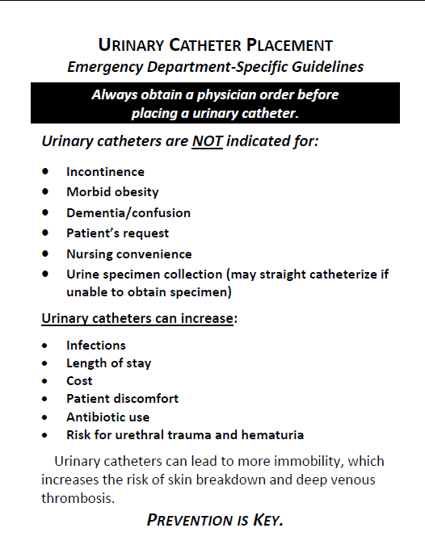
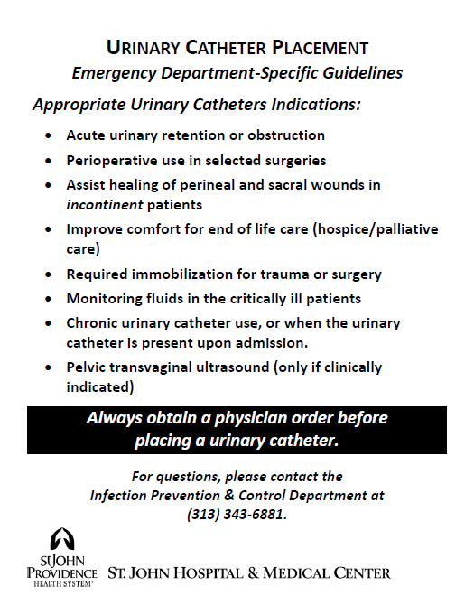
Spreading the Message

Slide 6
3. The 3 R’s: Recheck, Revise, Review
Recheck: reasons for guideline noncompliance; identify opportunities
- Ex. Resident champion identified for resident buy-in
Revise: alter guidelines PRN
- Ex. Indication for acute mental status changes with agitation removed
- Ex. UC requirement for emergent pelvic ultrasound removed after collaboration with Radiology
Review: guidelines periodically with all ED staff

Slide 7
YOU CAN DO IT!
Collaborative Guidelines
Physician Buy-In
The 3 R’s
Success!

Slide 8
Discussion Questions
Do you already have an ED attending physician champion?
What is the greatest barrier you anticipate in establishing this project?
What successful methods have you used in the past to ensure physician buy-in of clinical processes?

Slide 9
Thank you!
Questions?

Slide 10
Funding
Prepared by the Health Research & Educational Trust of the American Hospital Association with contract funding provided by the Agency for Healthcare Research and Quality through the contract, “National Implementation of Comprehensive Unit-based Safety Program (CUSP) to Reduce Catheter-Associated Urinary Tract Infection (CAUTI), project number HHSA290201000025I/HHSA29032001T, Task Order #1.”

