Slide 1

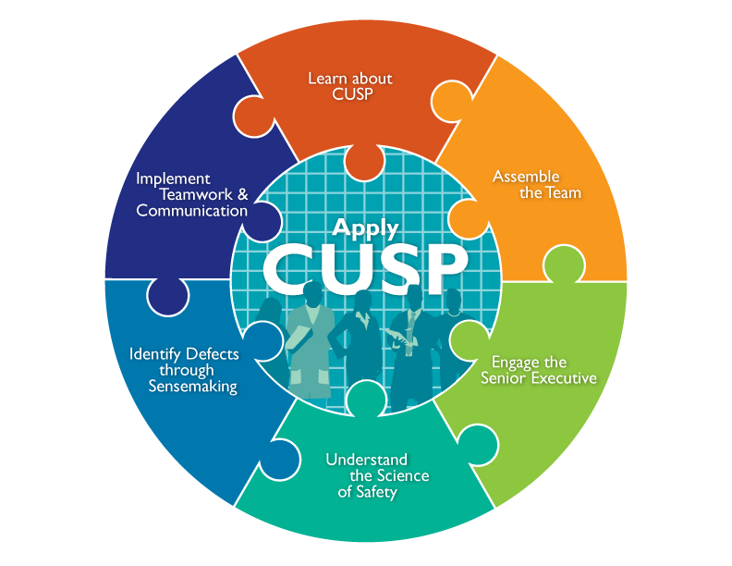
Sustaining Change
Eugene S. Chu, MD, FHM
Director of Hospital Medicine
Boulder Community Health
Associate Clinical Professor of Medicine
University of Colorado School of Medicine

Slide 2
Learning Objectives
Differentiate between implementation and sustainment.
Identify key elements in sustainment of process improvement initiatives.
Recognize the patient care unit’s readiness for sustainment.
Describe the steps to sustainment.

Slide 3
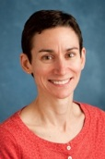
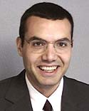
Acknowledgements…
Sarah Krein, PhD, RN
Research Associate Professor
Division of General Medicine
University of Michigan
Mohamad Fakih, MD, MPH
Medical Director
Infection Prevention and Control
St. John Hospital and Medical Center

Slide 4
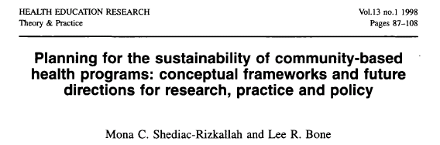
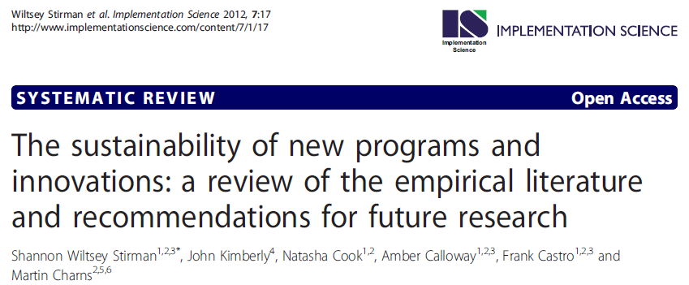
Journal Articles on Sustainment

Slide 5
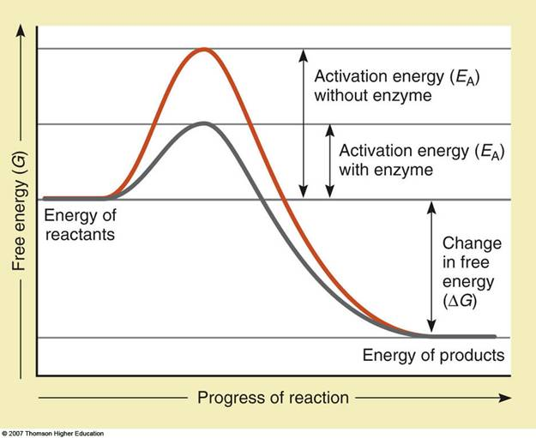
Implementation
CUSP
Engage and Educate
Notes:
Transitioning from implementation to sustainment.
Review how you affected change during implementation.
Discuss how you know it’s time to transition to sustainment.
Learn the similarities and differences between implementation and sustainment.

Slide 6
Implementation
CUSP
Execute and Evaluate
CUSP
Notes:
Transitioning from implementation to sustainment.
Review how you affected change during implementation.
Discuss how you know it’s time to transition to sustainment.
Learn the similarities and differences between implementation and sustainment.

Slide 7
Sustainment
Sustainment
CUSP
CUSP
Notes:
Transitioning from implementation to sustainment.
Review how you affected change during implementation.
Discuss how you know it’s time to transition to sustainment.
Learn the similarities and differences between implementation and sustainment.

Slide 8
Implementation
Technical
Socio-Adaptive

Slide 9
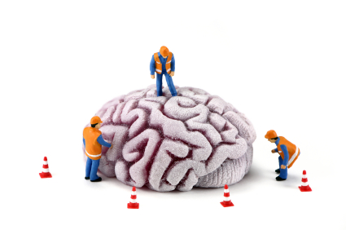
Implementation
Technical
Socio-Adaptive

Slide 10

Implementation
Technical
Socio-Adaptive

Slide 11

Implementation
Technical
Socio-Adaptive

Slide 12
Culture
…the shared set of social values and beliefs, both explicit and implicit, that guides actions and decisions within the organization

Slide 13
Culture
A coherent culture is one in which there is widespread agreement around core values and beliefs.
Notes:
The phrase "I know it when I see it" is a colloquial expression by which a speaker attempts to categorize an observable fact or event, although the category is subjective or lacks clearly defined parameters. The phrase was famously used in this sense by United States Supreme Court Justice Potter Stewart to describe his threshold test for obscenity in Jacobellis v. Ohio.[1] In explaining why the material at issue in the case was not obscene under the Roth test, and therefore was protected speech that could not be censored, Stewart wrote:
I shall not today attempt further to define the kinds of material I understand to be embraced within that shorthand description ["hard-core pornography"], and perhaps I could never succeed in intelligibly doing so. But I know it when I see it, and the motion picture involved in this case is not that.[2]
The expression became one of the most famous phrases in the entire history of the Supreme Court.[3]
Stewart's "I know it when I see it" standard was praised as "realistic and gallant"[4] and an example of candor.[5]
Jacobellis v. Ohio, 378 U.S. 184 (1964), was a United States Supreme Court decision handed down in 1964 involving whether the state of Ohio could, consistent with the First Amendment, ban the showing of a French film called The Lovers (Les Amants) which the state had deemed obscene.Nico Jacobellis, manager of the Heights Art Theatre in the Coventry Village neighborhood of Cleveland Heights, Ohio, was convicted and fined $2,500 by a judge of the Cuyahoga County Court of Common Pleas for exhibiting the film, and his conviction was upheld by the Supreme Court of Ohio.The U.S. Supreme Court reversed the conviction, ruling that the film was not obscene and hence constitutionally protected. However, the Court could not agree as to a rationale, yielding four different opinions from the majority, with none garnering the support of more than two justices, as well as two dissenting opinions. The judgment of the Court was announced by William J. Brennan, but his opinion was joined only by Justice Arthur Goldberg.Justice Hugo Black, joined by Justice William O. Douglas, reiterated his well-known view that the First Amendment does not permit censorship of any kind. Chief Justice Earl Warren, in dissent, decried the confused state of the Court's obscenity jurisprudence and argued that Ohio's action was consistent with the Court's decision in Roth v. United States and furthered important state interests. Justice John Marshall Harlan II also dissented, believing that states should have "wide, but not federally unrestricted" power to ban obscene films.The most famous opinion from Jacobellis, however, was Justice Potter Stewart's concurrence, holding that the Constitution protected all obscenity except "hard-core pornography." Stewart wrote, "I shall not today attempt further to define the kinds of material I understand to be embraced within that shorthand description; and perhaps I could never succeed in intelligibly doing so. But I know it when I see it, and the motion picture involved in this case is not that." (emphasis added)The Court's obscenity jurisprudence would remain fragmented until 1973's Miller v. California. Many legal observers feel that, after Miller, it remained confusing and vague. What is obscene in one place can well be completely legal in another.

Slide 14
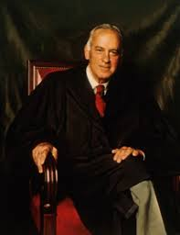
“I know it when I see it.”
Potter Stewart 1915-1985
Notes:
The phrase "I know it when I see it" is a colloquial expression by which a speaker attempts to categorize an observable fact or event, although the category is subjective or lacks clearly defined parameters. The phrase was famously used in this sense by United States Supreme Court Justice Potter Stewart to describe his threshold test for obscenity in Jacobellis v. Ohio.[1] In explaining why the material at issue in the case was not obscene under the Roth test, and therefore was protected speech that could not be censored, Stewart wrote:
I shall not today attempt further to define the kinds of material I understand to be embraced within that shorthand description ["hard-core pornography"], and perhaps I could never succeed in intelligibly doing so. But I know it when I see it, and the motion picture involved in this case is not that.[2]
The expression became one of the most famous phrases in the entire history of the Supreme Court.[3]
Stewart's "I know it when I see it" standard was praised as "realistic and gallant"[4] and an example of candor.[5]
Jacobellis v. Ohio, 378 U.S. 184 (1964), was a United States Supreme Court decision handed down in 1964 involving whether the state of Ohio could, consistent with the First Amendment, ban the showing of a French film called The Lovers (Les Amants) which the state had deemed obscene.Nico Jacobellis, manager of the Heights Art Theatre in the Coventry Village neighborhood of Cleveland Heights, Ohio, was convicted and fined $2,500 by a judge of the Cuyahoga County Court of Common Pleas for exhibiting the film, and his conviction was upheld by the Supreme Court of Ohio.The U.S. Supreme Court reversed the conviction, ruling that the film was not obscene and hence constitutionally protected. However, the Court could not agree as to a rationale, yielding four different opinions from the majority, with none garnering the support of more than two justices, as well as two dissenting opinions. The judgment of the Court was announced by William J. Brennan, but his opinion was joined only by Justice Arthur Goldberg.Justice Hugo Black, joined by Justice William O. Douglas, reiterated his well-known view that the First Amendment does not permit censorship of any kind. Chief Justice Earl Warren, in dissent, decried the confused state of the Court's obscenity jurisprudence and argued that Ohio's action was consistent with the Court's decision in Roth v. United States and furthered important state interests. Justice John Marshall Harlan II also dissented, believing that states should have "wide, but not federally unrestricted" power to ban obscene films.The most famous opinion from Jacobellis, however, was Justice Potter Stewart's concurrence, holding that the Constitution protected all obscenity except "hard-core pornography." Stewart wrote, "I shall not today attempt further to define the kinds of material I understand to be embraced within that shorthand description; and perhaps I could never succeed in intelligibly doing so. But I know it when I see it, and the motion picture involved in this case is not that." (emphasis added)The Court's obscenity jurisprudence would remain fragmented until 1973's Miller v. California. Many legal observers feel that, after Miller, it remained confusing and vague. What is obscene in one place can well be completely legal in another.

Slide 15
The 4 E’s of Change
Engage
Educate
Environment
Evaluate
Notes:
Engage: Passion, Vision, Finances
Educate: Facts and Flow
Environment: Structure – People and Things
Process – Protocols and Procedures
Evaluate: Forest and Trees

Slide 16
Sustainment
Effectiveness
Institutionalization
Capacity
Context

Slide 17
Sustaining Change
Engage
Educate
Environment
Evaluate
Effectiveness
Institutionalization
Capacity
Context

Slide 18
Sustaining Change
Engage
Educate
Environment
Evaluate
Effectiveness
Institutionalization
Capacity
Context

Slide 19
Engage
Vision
Passion
Finances

Slide 20
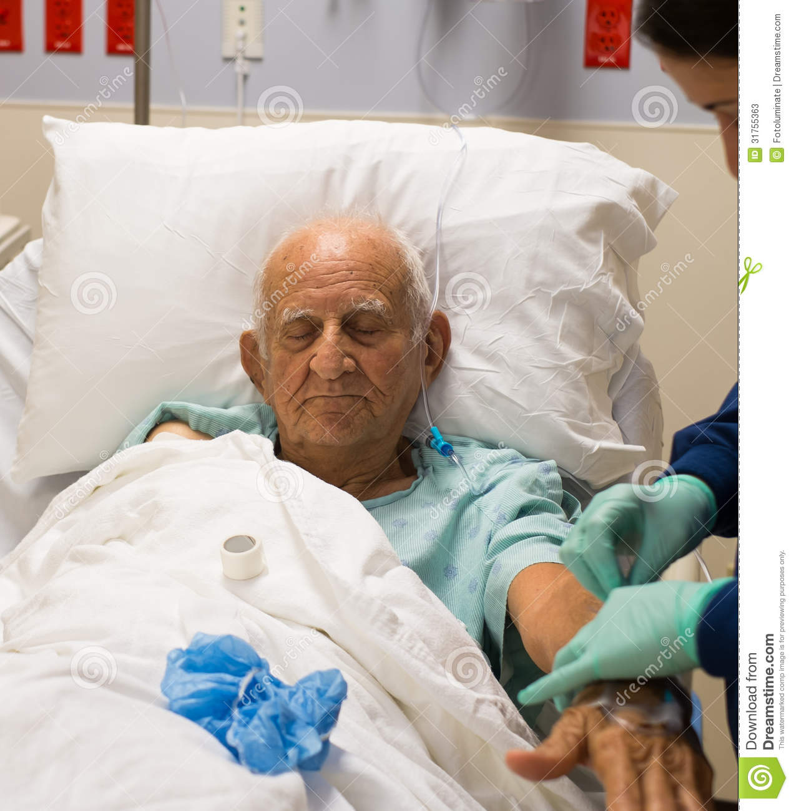
Passion
Notes:
88 y/o male with mild dementia, htn, chol, fell. to hospital for eval, Indiana. No fx. Not safe at home due to mobility. Functional incontinence. Foley placed -> SNF. Moved to CO to be with daughter. In assisted living. Didn’t know he was in CO. 4 days pta, asked – what’s “this” pointing to foley, doing in here. Left in place.
On DOA, did not show up for lunch, found obtunded in room. In ED, with fever, WBC 23, CXR -> ? Infiltrate (no cough) Satting well on RA. Urine looks cloudy. No n/v/d. No headache. Neck supple. UCx sent with >100k E.Coli

Slide 21

What is the diagnosis?
HCAP
Meningitis
C. diff
CAUTI
Notes:
88 y/o male with mild dementia, htn, chol, fell. to hospital for eval, Indiana. No fx. Not safe at home due to mobility. Functional incontinence. Foley placed -> SNF. Moved to CO to be with daughter. In assisted living. Didn’t know he was in CO. 4 days pta, asked – what’s “this” pointing to foley, doing in here. Left in place.
On DOA, did not show up for lunch, found obtunded in room. In ED, with fever, WBC 23, CXR -> ? Infiltrate (no cough) Satting well on RA. Urine looks cloudy. No n/v/d. No headache. Neck supple. UCx sent with >100k E.Coli

Slide 22
Indication for UC?
patient comfort
nurse convenience
incontinence
no indication
Notes:
88 y/o male with mild dementia, htn, chol, fell. to hospital for eval, Indiana. No fx. Not safe at home due to mobility. Functional incontinence. Foley placed -> SNF. Moved to CO to be with daughter. In assisted living. Didn’t know he was in CO. 4 days pta, asked – what’s “this” pointing to foley, doing in here. Left in place.
On DOA, did not show up for lunch, found obtunded in room. In ED, with fever, WBC 23, CXR -> ? Infiltrate (no cough) Satting well on RA. Urine looks cloudy. No n/v/d. No headache. Neck supple. UCx sent with >100k E.Coli

Slide 23

Passion
Success
Stories

Slide 24
What did the staff do with Mrs. B’s urinary catheter?
Change it to an antimicrobial coated catheter.
Leave it in, it’s more convenient for everyone.
Change it out every 3 weeks.
Wait until she fell asleep to take it out.

Slide 25
Finances
Daily Census | ALOS | Yearly Admits | Foley Rate | Annual Savings
800 | 4 | 73,000 | 25% | $1.1M
400 | 4 | 36,500 | 25% | $552k
200 | 4 | 18,250 | 25% | $276k
www.catheterout.org
Notes:
Hospital finances
Unit - budget
Individual – quality bonuses, advancement

Slide 26
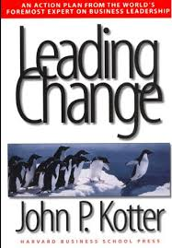

Vision
Imaginable
Feasible
Desirable
Focused
Flexible
Communicable
Accomplished

Slide 27
Sustaining Change
Engage
Educate
Environment
Evaluate
Effectiveness
Institutionalization
Capacity
Context

Slide 28
Education
FACTS
FLOW
Notes:
Hemodynamic stability
Q1H urine output

Slide 29
Facts
HICPAC guidelines
  Appropriate
  Inappropriate
CAUTI rates, definitions
UC utilization
Cost/CAUTI
Notes:
Hemodynamic stability
Q1H urine output

Slide 30
Flow
Skin care
Bladder scanner
Condom cath
Female urinals
Aseptic Insertion Technique
Maintenance Technique
Closed System
Notes:
Hemodynamic stability
Q1H urine output

Slide 31
CAUTI definition changes 2015?
Requirement for ≥ 100,000 CFU/ml organisms in urine culture
Exclusion of non-bacteria as sole pathogens
Use of same pathogen list for symptomatic UTI (SUTI) and asymptomatic bacteremic UTI (ABUTI)
All of the above

Slide 32
Sustaining Change
Engage
Educate
Environment
Evaluate
Effectiveness
Institutionalization
Capacity
Context

Slide 33
Environment
Structure
People
Things
Process
Procedures
Protocols

Slide 34


Structure: People
Notes:
Time as part of environment -> capacity

Slide 35
Structure: Leadership
Keep Effort Priority
Provide Expertise
Liaison with Peers

Slide 36
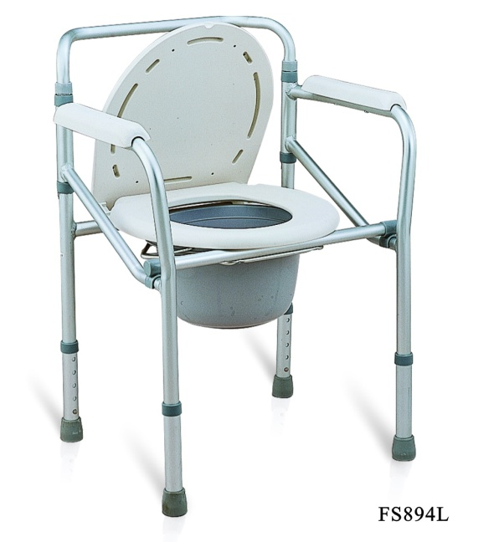
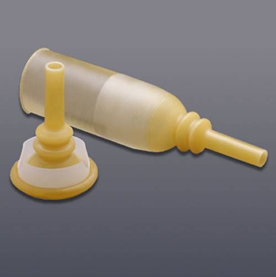
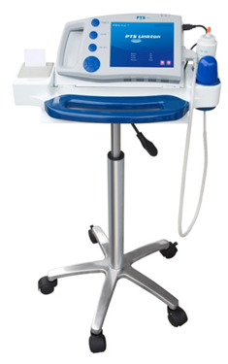
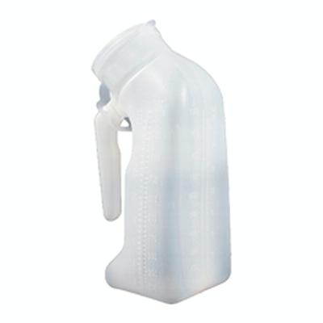
Structure: Things
Notes:
Urine meters

Slide 37
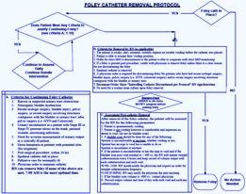
Process: Protocols
Notes:
Acute Urinary Retention Protocol, Urinary Cultures, Orders with Indications

Slide 38
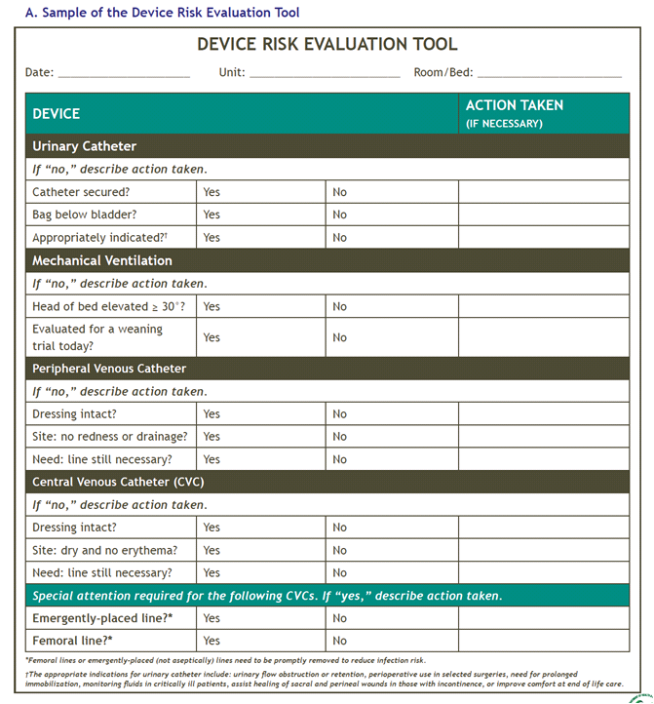
Process: Procedures
Notes:
ED and OR -> ICU processes, Insertion and Maintenance, Monitoring and Feedback

Slide 39
Sustaining Change
Engage
Educate
Environment
Evaluate
Effectiveness
Institutionalization
Capacity
Context

Slide 40
Context: Internal
Internal Environment
organization geared towards quality and safety
leaders adopting best practices
employee satisfaction and morale
(Krein et al, Soc Sci Med 2010; 71: 1692-1701)

Slide 41
Context: External
External Environment
public reporting
value based purchasing
hospital acquired condition penalties
(Krein et al, Soc Sci Med 2010; 71: 1692-1701)

Slide 42
Evaluation
Use data to assess progress:
Hospital Survey on Patient Safety
Infection rates
Process measures
Organizational and team culture

Slide 43
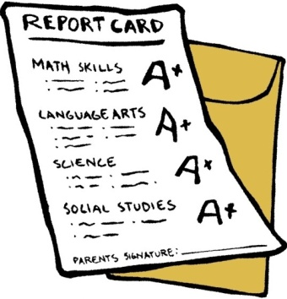
Evaluation: Metrics
Catheter Prevalence
CAUTI Rate
National State Hospital Unit Provider
Notes:
Hawthorne Effect

Slide 44
Our Metrics Are…
chart reviewed
automated
mixed
Notes:
88 y/o male with mild dementia, htn, chol, fell. to hospital for eval, Indiana. No fx. Not safe at home due to mobility. Functional incontinence. Foley placed -> SNF. Moved to CO to be with daughter. In assisted living. Didn’t know he was in CO. 4 days pta, asked – what’s “this” pointing to foley, doing in here. Left in place.
On DOA, did not show up for lunch, found obtunded in room. In ED, with fever, WBC 23, CXR -> ? Infiltrate (no cough) Satting well on RA. Urine looks cloudy. No n/v/d. No headache. Neck supple. UCx sent with >100k E.Coli

Slide 45
Evaluation: Metrics
Catheter Prevalence
CAUTI Rate
National State Hospital Unit Provider
Notes:
Hawthorne Effect

Slide 46
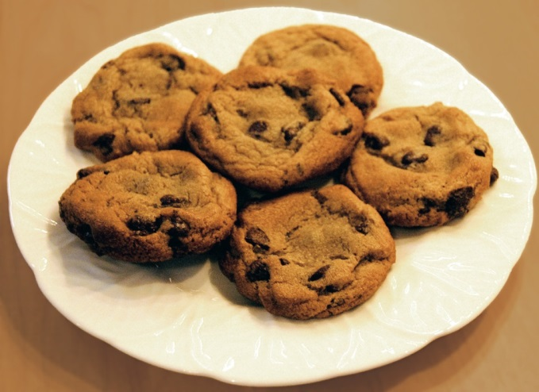
Don’t Forget the Cookies

Slide 47
Implementation Sustainment
Sustainment
CUSP
Execute and Evaluate
CUSP
Engage and Educate
Notes:
Transitioning from implementation to sustainment.
Review how you affected change during implementation.
Discuss how you know it’s time to transition to sustainment.
Learn the similarities and differences between implementation and sustainment.

Slide 48
Sustaining Change
Engage
Educate
Environment
Evaluate
Effectiveness
Institutionalization
Capacity
Context

Slide 49
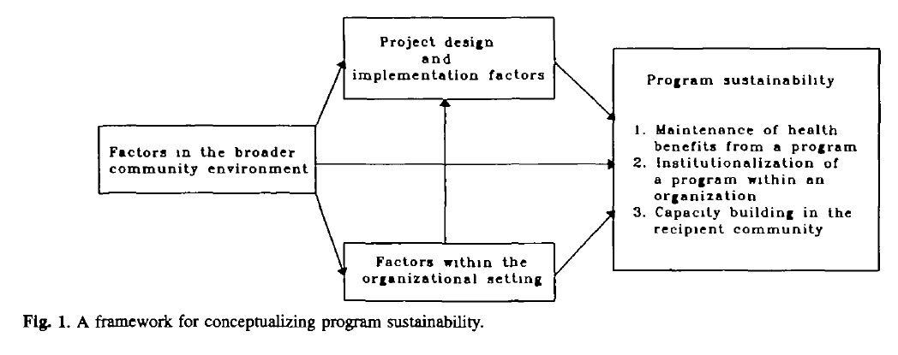
Program Sustainability Conceptual Model
(Shediac-Rizkallah, Health Educ Res 1998; 13: 87-108)
Model

Slide 50
Thank you!
Questions?

Slide 51
Funding
Prepared by the Health Research & Educational Trust of the American Hospital Association with contract funding provided by the Agency for Healthcare Research and Quality through the contract, “National Implementation of Comprehensive Unit-based Safety Program (CUSP) to Reduce Catheter-Associated Urinary Tract Infection (CAUTI), project number HHSA290201000025I/HHSA29032001T, Task Order #1.”

