Slide 1
AHRQ Safety Program for Ambulatory Surgery
Sustainability Module

Slide 2
Learning Objectives
Define sustainability
Create and implement a sustainability plan
Establish a sustainability measurement plan
Learn from examples of sustainability success
Understand the link between sustainability and spread

Slide 3
Overview
Defining sustainability and its importance in quality improvement
Linking sustainability and spread
Discussing barriers and solutions to sustainability
Developing and implementing a sustainability plan
Creating a sustainability measurement plan
Learning from examples of sustainabilty in different health care facilities

Slide 4
Definition of Sustainability
Ensuring gains are maintained beyond the life of the project¹, or the institutionalization or routinization of programs into ongoing organizational systems
¹Clinical Excellence Commission (CEC), Enhancing Project Spread and Sustainability – A Companion to the “Easy Guide to Clinical Practice Improvement.” Sydney, Australia: CEC. August 2008. http://www.cec.health.nsw.gov.au/__data/assets/pdf_file/0007/258343/spread-and-sustainability.pdf.

Slide 5
Importance of Sustainable Change in Continuous Improvement
Assist with variability in health care
Provide continuous high-quality care and reliable safe practices
Prevent project fatigue
Control processes
Monitor progress
Engage senior leaders
Establish improvement culture and engaged staff
Create cultural legacy

Slide 6
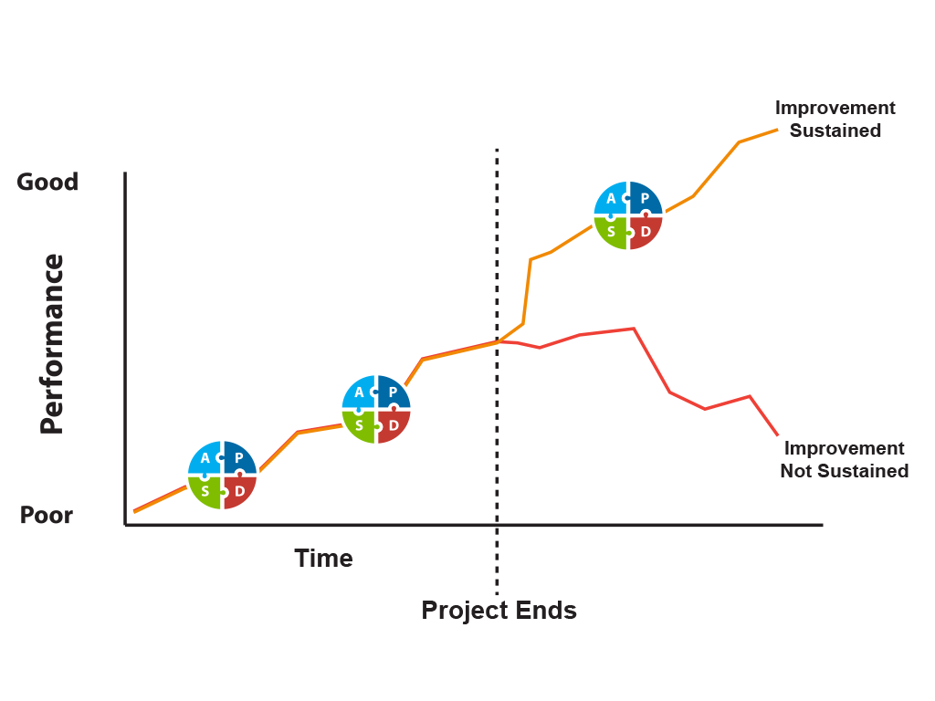
Sustainable Change After Project End?

Slide 7
What Does Sustainability Mean for Your Facility?
How do you see other projects sustained in your facility?
Are values, beliefs, and practices incorporated into the mission of your organization and/or are they incorporated into existing and routine care processes?
What steps are taken to create a new norm?

Slide 8
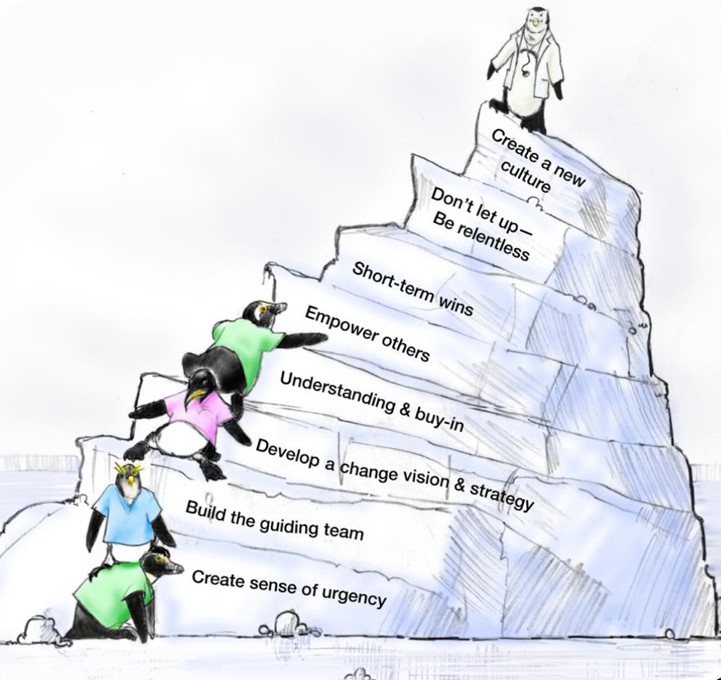
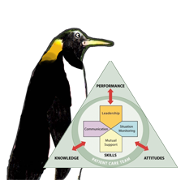
Facilitators of Sustainable Change²
As seen in TeamSTEPPS®
²Kotter J. Leading Change. Harvard Business School Press, Boston, MA, 1996, as cited in TeamSTEPPS Fundamentals Course: Module 8. Change Management: Instructor's Slides: TeamsTEPPS Fundamentals Course. November 2008. Agency for Healthcare Research and Quality, Rockville, MD. http://www.ahrq.gov/professionals/education/curriculum-tools/teamstepps/instructor/fundamentals/module8/igchangemgmt.html.

Slide 9
Sustainability and Spread
Spread is covered in detail in the Spread module of the AHRQ CUSP Toolkit
³Spread Module Toolkit for Comprehensive Unit-based Safety Program. Web-based Tool. Agency for Healthcare Research and Quality. http://www.ahrq.gov/professionals/education/curriculum-tools/cusptoolkit/modules/spread/index.html. Accessed July 2013.
Sustainability
Embedding a successful improvement into the culture and norms of a facility
Spread³
Implementing a successful improvement across multiple settings and/or facilities

Slide 10
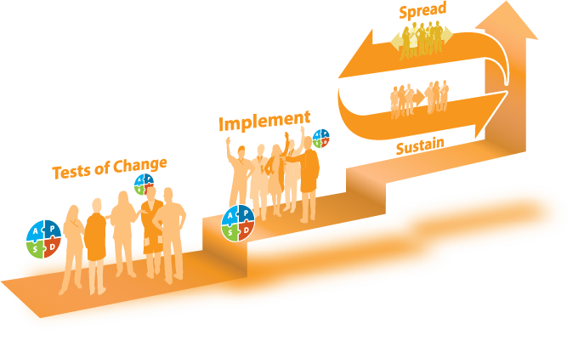
Linking Sustainability and Spread

Slide 11
Planning for Sustainability
Plan early
  Engage senior leaders and administration early
Identify barriers to sustainability
Discover potential solutions
Learn how to create a sustainability plan

Slide 12

Planning Early
Plan for resources
  Financial
  Staffing
Identify leaders and program champion(s)
Educate staff
Plan for modification of goal(s)
  Identify what continued success looks like

Slide 13
Potential Barriers to Sustainability
Lack of organizational infrastructure and resources
Staff turnover
Organizational skepticism
Individual resistance to change

Slide 14
Workable Solutions to Sustainability Barriers
Lack of organizational infrastructure and resources
  Develop strategies and flexibility to account for resource fluctuation
  Plan financial resources for maintaining improvements beyond the project end
Staff turnover
  Embed newly developed processes into new staff orientation and organizational policies
  Train staff continuously including train-the-trainer education
  Develop volunteer network to assist in case of staffing fluctuations and/or shortage (funding, staff turnover)

Slide 15
Workable Solutions to Sustainability Barriers
Managing skepticism¹
  Present ongoing evidence that the new process is a better one
  Show staff and stakeholders real data
  Reserve staff time away from normal duties to work on proposed improvements
  Encourage active senior leader engagement
    Consider measuring how frequently senior leaders and administrators review sustainability data/outcomes as indicators of engagement
¹Clinical Excellence Commission (CEC), Enhancing Project Spread and Sustainability – A Companion to the “Easy Guide to Clinical Practice Improvement.” Sydney, Australia: CEC. August 2008. http://www.cec.health.nsw.gov.au/__data/assets/pdf_file/0007/258343/spread-and-sustainability.pdf.

Slide 16
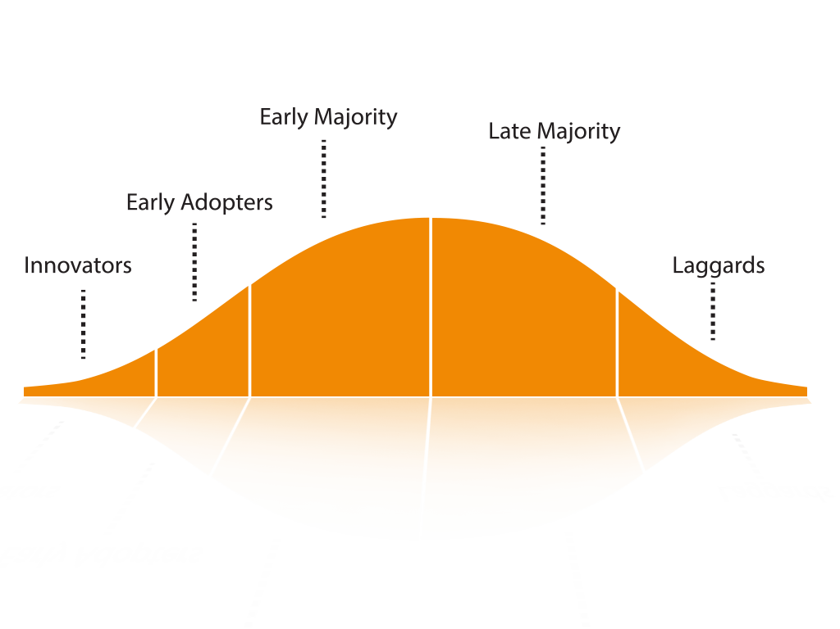
Barrier: Individual Resistance to Change
Rogers Diffusion of Innovations¹
¹Clinical Excellence Commission (CEC), Enhancing Project Spread and Sustainability – A Companion to the “Easy Guide to Clinical Practice Improvement.” Sydney, Australia: CEC. August 2008. http://www.cec.health.nsw.gov.au/__data/assets/pdf_file/0007/258343/spread-and-sustainability.pdf.

Slide 17
Factors That Influence Individual Resistance or Adoption
Perceived relative advantage¹
Fuzzy boundaries
Compatibility
Risk
Complexity
Task Issues
Trialability
Knowledge required to use it
Observability
Augmentation/support
Reinvention
¹Clinical Excellence Commission (CEC), Enhancing Project Spread and Sustainability – A Companion to the “Easy Guide to Clinical Practice Improvement.” Sydney, Australia: CEC. August 2008. http://www.cec.health.nsw.gov.au/__data/assets/pdf_file/0007/258343/spread-and-sustainability.pdf.

Slide 18
Steps to Creating and Implementing a Sustainability Plan
Identify and develop program champions
Build the implementation team
Empower frontline staff
Establish a sustainability measurement plan
Manage barriers to sustainability such as skepticism and resistance
Engage staff with stories
Recognize and celebrate success

Slide 19
1. Identify and Develop Program Champion(s)
Program champion(s) will—
  communicate and reinforce patient safety and program goals as a priority
  have physician, nursing, and administrative support
  be motivational and inspiring
  have influence
  be able to communicate the vision
  serve as a coach

Slide 20
2. Build the Implementation Team
This team will ideally include the following members:
  health administrator
  anesthesia professional
  circulating nurse
  data collector
  scrub technician
  surgeon
Identify a team leader to address team member concerns throughout the project
Include your program champion to persuade and motivate
Understand the program goals and components

Slide 21

3. Empower Frontline Staff
Frontline staff will—
Feel comfortable bringing up patient safety concerns to other team members or team leaders
Speak up when a potential break in patient safety protocol may occur or actually occurs
Be commended, and not punished, for speaking up about patient safety
As seen in TeamSTEPPS®

Slide 22
4. Establish a Sustainability Measurement Plan
Build systems for collecting process, outcome, and quality improvement activity data
Use data to continuously improve performance

Slide 23
5. Manage Skepticism and Resistance
Active involvement of the administrative and clinical champions including—
Motivation by the project leaders for team members to try the program interventions
Staff experiencing positive outcomes from new ways of doing things
Dedicated time and resources to carry out the interventions

Slide 24

6. Engaging Staff With Stories
Stories are a powerful way to engage staff in ways that numbers cannot
Encourage your team leaders to discuss actual patient stories to drive home important lessons
Select audio symbol to play audio, or access audio here:
https://www.ahrq.gov/professionals/quality-patient-safety/hais/tools/ambulatory-surgery/sections/sustainability/training-tools.html

Slide 25
7. Recognizing and Celebrating Success
Select audio symbol to play audio, or access audio here:
https://www.ahrq.gov/professionals/quality-patient-safety/hais/tools/ambulatory-surgery/sections/sustainability/training-tools.html

Slide 26
Establishing a Sustainability Measurement Plan
Assess readiness for sustainability
Build a measurement system
  Who, what, when, how to measure
Establish robust followup and transparent feedback system

Slide 27
Assess Readiness for Sustainability
Act on a sustainability plan only after gains have been achieved
Ask four key questions before carrying out the plan⁴:
  Is the intervention near the final stage of development? If there were room for further changes, would those alter the implementation?
  Has real, measurable improvement been demonstrated?
  Who cares about the improvement? Does the project represent the views of all involved?
  What policy or technological changes may make the project redundant? When might this happen?
⁴5 Million Lives Campaign. Getting Started Kit: Sustainability and Spread. Cambridge, MA: Institute for Healthcare Improvement; 2008. http://www.ihi.org/education/IHIOpenSchool/Courses/Documents/CourseraDocuments/13_SpreadSustainabilityHowToGuidev14[1].pdf. Accessed July 2013.

Slide 28

Tools for Assessing Readiness for Sustainability¹
Sustainability Scoring Tool (CCE: Australia Guide)
Change Achievement Success Indicator (CASI)
¹Clinical Excellence Commission (CEC), Enhancing Project Spread and Sustainability – A Companion to the “Easy Guide to Clinical Practice Improvement.” Sydney, Australia: CEC. August 2008. http://www.cec.health.nsw.gov.au/__data/assets/pdf_file/0007/258343/spread-and-sustainability.pdf.

Slide 29

Build a Measurement System
Choose who, what, when, and how to measure
  WHO will measure
    Example: Nurse/data coordinator tracks surgical site infection data monthly for reporting purposes
  WHAT to measure
    Set the goals
      Example: To sustain a low rate of surgical site infections within unit/facility
    Choose a Family of Measures framework
    Use process, outcome, and balancing measures

Slide 30
Family of Measures (FOM) Example⁵
Measure Type | Description | Surgical Safety Team FOM
Outcome | Patient or customer perspective: How is the system performing? What is the result? | Surgical site infection rate Percentage of staff with a safety culture assessment score > 4
Process | System processes: Are the parts or steps in the system performing as planned? | Percentage of on-time administration of prophylactic antibiotics Safe surgery checklist use/implementation
Balancing | Viewing the system from different directions or dimensions. What happened to the system as we improved the outcome and process measures? | Patient experience of care and/or satisfaction Staff satisfaction Cost per case
⁵Provost LP, Murray S. The Health Care Data Guide: Learning from Data for Improvement. Jossey-Bass, 2011.

Slide 31
When To Measure

Slide 32
How To Measure
Display data over time
  Tool: Run charts
Evaluate impact of changes on the system
  Tool: Small multiples of measures all presented on one page
Build followup evaluation into original implementation plan
Use both qualitative and quantitative data
Talk directly to team members to understand underlying barriers or facilitators to sustaining improvement

Slide 33
How To Measure: Run Charts⁵
Universal tool for improvement projects
Graphical display of data plotted in some type of order
Method for communicating and tracking variation and sustainability
Uses
  Displaying data to make process performance visible
  Determining whether a change resulted in improvement
Monitoring sustainability: Establish a threshold for alarm
  Example: An increase in surgical site infections to a rate of X% (too high) would alert staff that the process is outside of expected variation and action should be taken
⁵Provost LP, Murray S. The Health Care Data Guide: Learning from Data for Improvement. Jossey-Bass, 2011.

Slide 34
How To Measure: Run Chart Example

Slide 35
How To Measure: Small Multiples Example

Slide 36
Establish Followup and Feedback System
Assess progress of the sustainability process (intangible measurement of staff engagement and culture change, embedding into culture, etc.)
Monitor, review, adapt⁶
Communicate and engage
  Incorporate evaluation findings
  Initiate breakthrough conversations⁴
  Share proven safe practices and lessons learned
Review data regularly by senior leadership and all facility stakeholders
⁴5 Million Lives Campaign. Getting Started Kit: Sustainability and Spread. Cambridge, MA: Institute for Healthcare Improvement; 2008. http://www.ihi.org/education/IHIOpenSchool/Courses/Documents/CourseraDocuments/13_SpreadSustainabilityHowToGuidev14[1].pdf. Accessed July 2013.
⁶Swerissen H. Understanding the Sustainability of Health Programs and Organisational Change. A Paper for the Victorian Quality Council. June 2007. http://citeseerx.ist.psu.edu/viewdoc/download?doi=10.1.1.532.2737&rep=rep1&type=pdf.

Slide 37
Sustainability Examples: Organizational Structure
The Community Health Network in Indiana uses central line insertion kits that contain all the tools and checklists to comply with their improvement process’s central line bundle elements⁴
Many hospitals merge multiple workflows to streamline daily practice (i.e., medication reconciliation forms that double as admission order forms)
⁴5 Million Lives Campaign. Getting Started Kit: Sustainability and Spread. Cambridge, MA: Institute for Healthcare Improvement; 2008. Available at www.ihi.org. Accessed July 2013. http://www.ihi.org/education/IHIOpenSchool/Courses/Documents/CourseraDocuments/13_SpreadSustainabilityHowToGuidev14[1].pdf.

Slide 38
Sustainability Examples: Data
Baptist Memorial Health Care created a measurement system including⁴—
  An appointed facilitator
  A process for collecting, reporting, and inputting data into system database
  Generation of graphics to show performance trends
  Communication to senior leadership and medical staff
  Refining of the improvement plan based on data
Minnesota Children’s Hospitals and Clinics uses a screen saver slide show on all hospital computer terminals to display up-to-date intervention results
⁴5 Million Lives Campaign. Getting Started Kit: Sustainability and Spread. Cambridge, MA: Institute for Healthcare Improvement; 2008. Accessed July 2013. http://www.ihi.org/education/IHIOpenSchool/Courses/Documents/CourseraDocuments/13_SpreadSustainabilityHowToGuidev14[1].pdf.

Slide 39
Sustainability Examples: Capacity Building
The Advocate Health System in Chicago participates in capacity building by providing education around quality improvement, process improvement, and measurement techniques in regular staff seminars⁴
⁴5 Million Lives Campaign. Getting Started Kit: Sustainability and Spread. Cambridge, MA: Institute for Healthcare Improvement; 2008. Accessed July 2013. http://www.ihi.org/education/IHIOpenSchool/Courses/Documents/CourseraDocuments/13_SpreadSustainabilityHowToGuidev14[1].pdf.

Slide 40
Summary
Sustainability helps organizations embed processes into their organizational culture
Organizations need to be prepared to address barriers that can affect sustainability
An effective sustainability plan includes—
  Planning early in the improvement process
  Easy to reach goals
  Program champion
  Fit within organizational mission
  Ongoing evaluation and transparency of measures

Slide 41
Tools
Sustainability Scoring Tool¹
Change Achievement Success Indicator¹
AHRQ Sustainability Tool⁷
¹Clinical Excellence Commission (CEC), Enhancing Project Spread and Sustainability – A Companion to the “Easy Guide to Clinical Practice Improvement.” Sydney, Australia: CEC. August 2008. http://www.cec.health.nsw.gov.au/__data/assets/pdf_file/0007/258343/spread-and-sustainability.pdf.
⁷Tool 6A: Sustainability Tool. Preventing Falls in Hospitals. January 2013. Agency for Healthcare Research and Quality, Rockville, MD. http://www.ahrq.gov/professionals/systems/hospital/fallpxtoolkit/fallpxtk-tool6a.html.

Slide 42
References
Clinical Excellence Commission (CEC), Enhancing Project Spread and Sustainability – A Companion to the “Easy Guide to Clinical Practice Improvement.” Sydney, Australia: CEC. August 2008. http://www.cec.health.nsw.gov.au/__data/assets/pdf_file/0007/258343/spread-and-sustainability.pdf.
Kotter J. Leading Change. Harvard Business School Press, Boston, MA, 1996, as cited in TeamSTEPPS Fundamentals Course: Module 8. Change Management: Instructor's Slides: TeamsTEPPS Fundamentals Course. November 2008. Agency for Healthcare Research and Quality, Rockville, MD. http://www.ahrq.gov/professionals/education/curriculum-tools/teamstepps/instructor/fundamentals/module8/igchangemgmt.html.
Spread Module Toolkit for Comprehensive Unit-based Safety Program. Web-based Tool. Agency for Healthcare Research and Quality. http://www.ahrq.gov/professionals/education/curriculum-tools/cusptoolkit/modules/spread/index.html. Accessed July 2013.
5 Million Lives Campaign. Getting Started Kit: Sustainability and Spread. Cambridge, MA: Institute for Healthcare Improvement; 2008. http://www.ihi.org/education/IHIOpenSchool/Courses/Documents/CourseraDocuments/13_SpreadSustainabilityHowToGuidev14[1].pdf. Accessed July 2013.
Provost LP, Murray S. The Health Care Data Guide: Learning from Data for Improvement. Jossey-Bass, 2011.
Swerissen H. Understanding the Sustainability of Health Programs and Organisational Change. A Paper for the Victorian Quality Council. June 2007. http://citeseerx.ist.psu.edu/viewdoc/download?doi=10.1.1.532.2737&rep=rep1&type=pdf.
Tool 6A: Sustainability Tool. Preventing Falls in Hospitals. January 2013. Agency for Healthcare Research and Quality, Rockville, MD. http://www.ahrq.gov/professionals/systems/hospital/fallpxtoolkit/fallpxtk-tool6a.html.

