Slide 1
Daily Goals During Interdisciplinary Rounds
AHRQ Safety Program for Mechanically Ventilated Patients
AHRQ Pub. No. 16(17)-0018-35-EF
January 2017

Slide 2
Learning Objectives
After this session, you will be able to—
Identify the basics of communication
List benefits of Daily Goals
Describe ways to implement Daily Goals in your unit

Slide 3
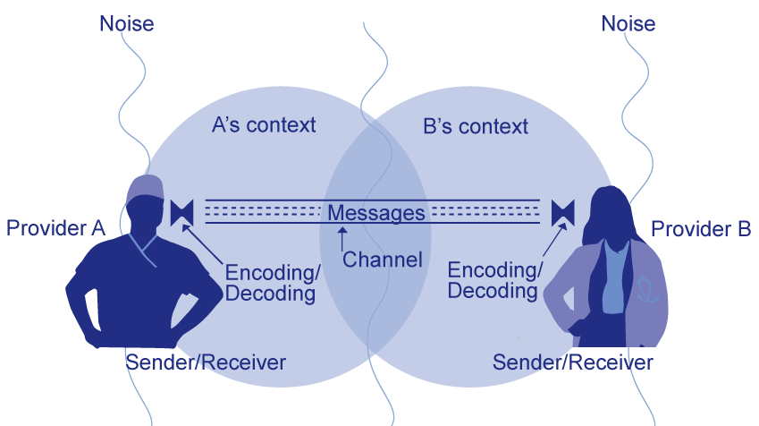
Basic Components and Process of Communication

Slide 4
Why Communication Matters¹
ICU rounds with multidisciplinary teams
decreases mortality
among
ICU patients
Kim MM, Barnato A, Angus D, et al. The effect of multidisciplinary care teams on intensive care unit mortality. Arch Intern Med. 2010 Feb 22;170(4):369-76. PMID: 20177041.

Slide 5
Why Communication Matters
Communication failure is—
The second most frequently identified root cause of ventilator-related sentinel events, year after year²
The leading contributing factor to medical errors, particularly in the intensive care unit (ICU) setting³
2. Sentinel Events Data – Root Causes by Event Type, 2004-2013. Joint Commission on Accreditation of Healthcare Organizations. http://www.jointcommission.org/assets/1/18/Root_Causes_Event_Type_2004-3Q_2015.pdf. Accessed April 15, 2015.
3. Lawton R, McEachan RR, Giles SJ, et al. Development of an evidence-based framework of factors contributing to patient safety incidents in hospital settings: a systematic review. BMJ Qual Saf. 2012 May;21(5):369-80. PMID: 22421911.

Slide 6
Why Communication Matters
Traits of high-performing ICUs with superior risk-adjusted survival
Have team-oriented culture
Share beliefs in providing excellent care
Communicate in an informal but direct way
Take a collaborative approach to problem solving

Slide 7

Barriers That Impact Communication
Interruptions
Verbal abuse
Fatigue
Workload
Change in team members
Ambiguous orders or directions

Slide 8
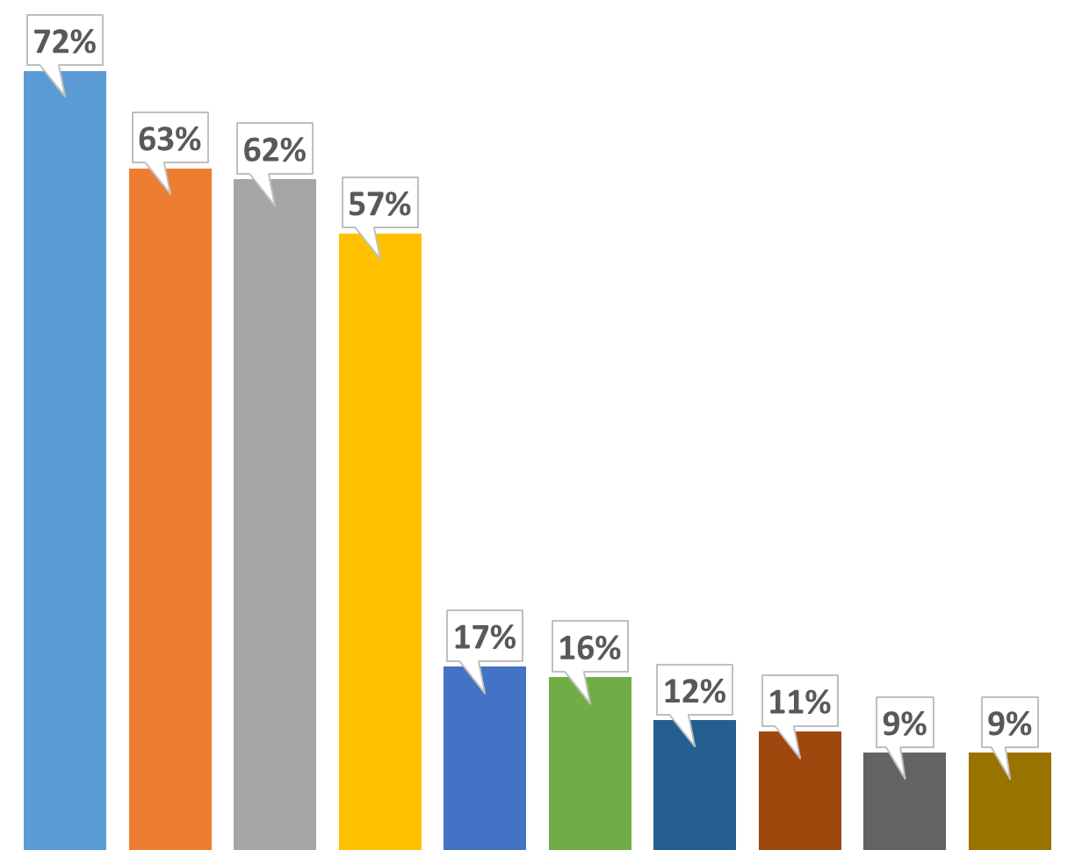
Communication Breakdowns Cause Sentinel Events
2013 Root Causes of Sentinel Events²
Human Factors 72%
Communication 63%
Leadership 62%
Assessment 57%
Information Management 17%
Physical Environment 16%
Care Planning 12%
Continuum of Care 11%
Medication Use 9%
Operative Care 9%
2. Sentinel Events Data – Root Causes by Event Type, 2004-2013. Joint Commission on Accreditation of Healthcare Organizations. http://www.jointcommission.org/Sentinel_Event_Statistics/. Accessed April 15, 2015.
A
B
C
D
E
F
G
H
I
J

Slide 9
Benefits of Daily Goals
Purpose: To improve communication among care team and family members regarding the patient’s plan of care.
Coordinate care plan for patients
Prompt caregivers to focus on what needs to be done
Allow providers to keep track of care plan established on rounds
Facilitate communication of care plan between daytime and nighttime staff

Slide 10
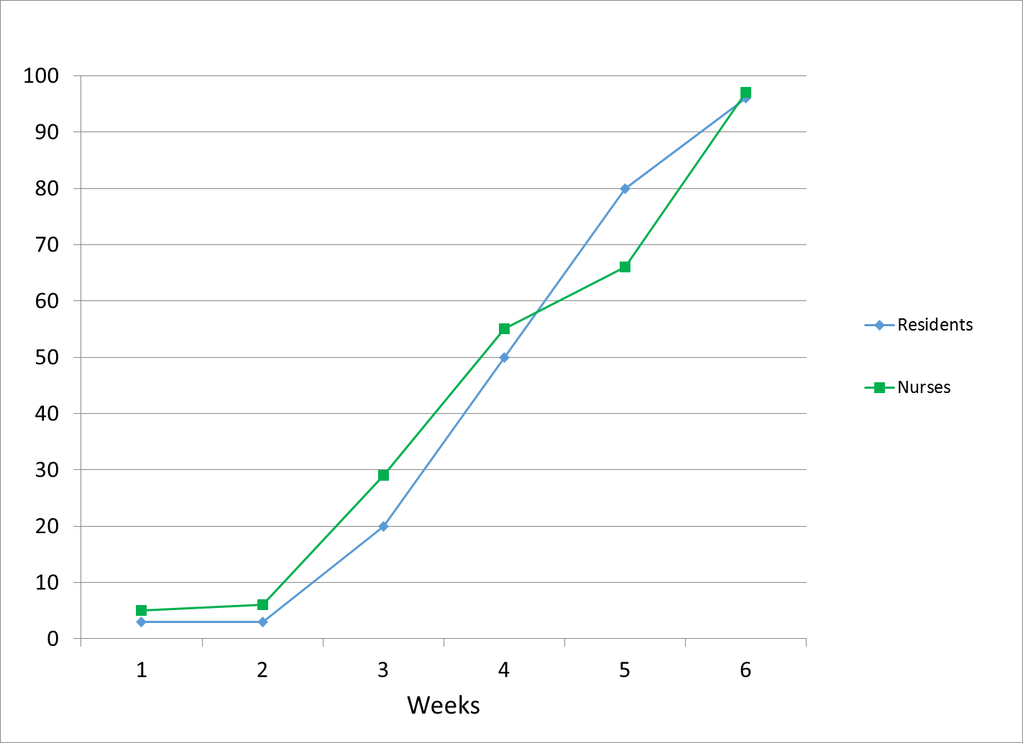
Daily Goals and Outcomes
Percentage of residents and nurses per week understanding daily goals⁴
4. Pronovost P, Berenholtz S, Dorman T, et al. Improving communication in the ICU using daily goals. J Crit Care. 2003 Jun;18(2):71-5. PMID: 12800116.

Slide 11
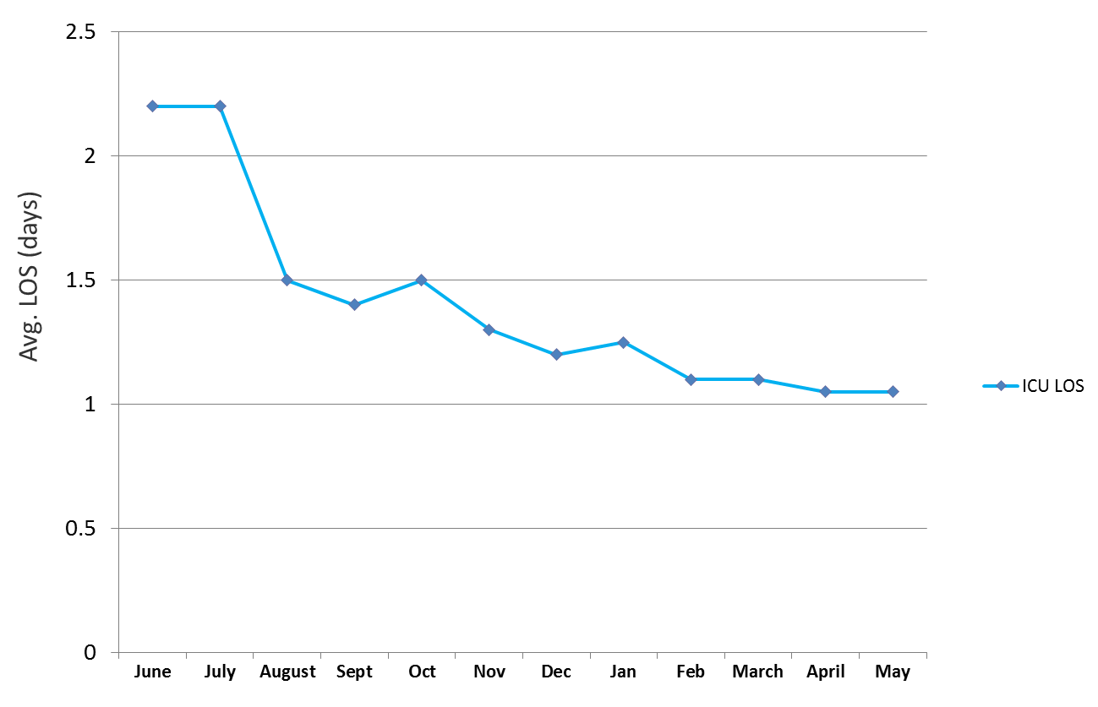
Daily Goals and Outcomes
Impact of daily care goal sheet on ICU length of stay (LOS)⁴
4. Pronovost P, Berenholtz S, Dorman T, et al. Improving communication in the ICU using daily goals. J Crit Care. 2003 Jun;18(2):71-5. PMID: 12800116.

Slide 12
Conventional Rounds
Encounter communication defects frequently
Are provider- rather than patient-centered
Use divergent discussion (brainstorming) rather than convergent discussion (explicit plan)
Prevent effective real-time or future feedback regarding plan of care

Slide 13
Rounds With Daily Goals
Create explicit goals and enable feedback toward goals to maximize patient achievement
Standardize communication to reduce encoding and decoding errors
Create independent checks
Add convergent thinking to often divergent rounds
Ensure diverse input when done well

Slide 14
Daily Goals Improve Communication and Care
Standardize communication to reduce encoding and decoding errors
Diminish perceptions of hierarchy
Foster diverse and independent input
Create redundancy to help ensure patients receive evidence-based therapies

Slide 15
Using Daily Goals
Do not use as “just” a checklist!
Use explicit language during discussions on Daily Goals
Address important questions
  What needs to be done to get the patient off the ventilator?
  What will we do today?
  What is the patient’s greatest safety risk?
Complete during rounds
  Nurse should read back to ensure agreement
Modify to fit your unit

Slide 16
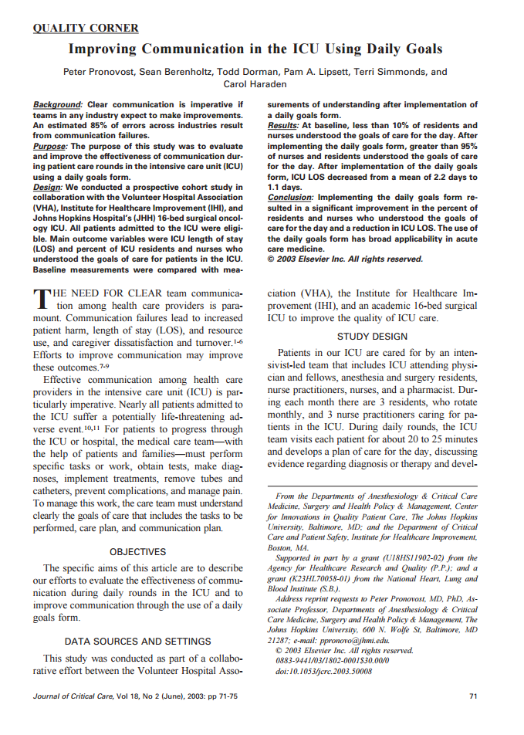
Evidence Favoring Daily Goals
Improving Communication in the ICU Using Daily Goals
Peter Pronovost, Sean Berenholtz, Todd Dorman, Pam A. Lipsett, Terri Simmonds, and Carol Haraden
Journal of Critical Care
Volume 18, Issue 2, June 2003, Pages 71-5

Slide 17
Evidence Favoring Daily Goals
Part of multifaceted interventions associated with significant and sustained reductions in hospital-acquired infections^{5,6,7}
Improved outcomes across diverse community and tertiary ICUs: medical, surgical, trauma, burn, and pediatrics
5. Pronovost P, Needham D, Berenholtz S, et al. An intervention to decrease catheter-related bloodstream infections in the ICU. N Engl J Med. 2006 Dec 28;355(26):2725-32. PMID: 17192537.
6. Berenholtz SM, Pham JC, Thompson DA, et al. Collaborative cohort study of an intervention to reduce ventilator-associated pneumonia in the intensive care unit. Infect Control Hosp Epidemiol. 2011 Apr;32(4):305-14. PMID: 21460481.
7. Berenholtz SM, Lubomski LH, Weeks K, et al. On the CUSP: Stop BSI program. Eliminating central line-associated bloodstream infections: a national patient safety imperative. Infect Control Hosp Epidemiol. 2014 Jan;35(1):56-62. PMID: 24334799.

Slide 18
Evidence Favoring Daily Goals
Observational studies demonstrate improved—
  ICU length of stay⁸
  Provider communication^{9,10}
    Identifying gaps in care
    Standardizing tasks
    Coordinating care for complex patients
  Understanding of patient care goals and plan¹¹
  Compliance with ventilator-associated pneumonia prevention interventions¹²
8. Narasimhan M, Eisen LA, Mahoney CD, et al. Improving nurse-physician communication and satisfaction in the intensive care unit with a daily goals worksheet. Am J Crit Care. 2006 Mar;15(2):217-22. PMID: 16501141.
9. Schwartz JM, Nelson KL, Saliski M, et al. The daily goals communication sheet: a simple and novel tool for improved communication and care. Jt Comm J Qual Patient Safety. 2008 Oct;34(10):608-13. PMID: 18947121
10, Siegele P. Enhancing outcomes in a surgical intensive care unit by implementing daily goals tools. Crit Care Nurse. 2009 Dec;29(6):58-69. PMID: 19952337.
11. Agarwal S, Frankel L, Tourner S, et al. Improving communication in a pediatric intensive care unit using daily patient goal sheets. J Crit Care. 2008 Jun;23(2):227-35. PMID: 18538216.
12. DuBose JJ, Inaba K, Shiflett A, et al. Measurable outcomes of quality improvement in the trauma intensive care unit: the impact of a daily quality rounding checklist. J Trauma. 2008 Jan;64(1):22-9. PMID: 18188094.

Slide 19
What Is Next? Preparing for Daily Goals
Assess the current state of rounds on your unit
Look at the samples of Daily Goals rounding tools
Educate providers using the Daily Goals fast facts
Present the idea to your ICU team
Obtain support from an ICU physician to champion the effort
Draft a Daily Goals tool suitable for your unit
Pilot the Daily Goals tool during rounds and solicit early feedback
Finalize Daily Goals rounding tool
Daily Goals samples and tools are located on the AHRQ Web site:
https://www.ahrq.gov/professionals/education/curriculum-tools/cusptoolkit/toolkit/dailygoals.html
https://www.ahrq.gov/professionals/education/curriculum-tools/cusptoolkit/videos/06c_daily_goals/index.html
https://innovations.ahrq.gov/qualitytools/intensive-care-unit-daily-goals-worksheet

Slide 20
What Is the State of Rounds on Your Unit?
Describe the structure of the participating unit(s)
  Type of unit (e.g., ICU, medical-surgical, ancillary)
  Open or closed
  Intensivists or hospitalists
  Number of beds
Are rounds currently held on the participating unit(s)?
How often are rounds held?
Who usually attends rounds?
What are the roles of each member?
Where do rounds usually take place?

Slide 21
What Is the State of Rounds on Your Unit?
Is there a defined structure/process for rounds?
  If so, what is it?
  Or does it depend on who is running them?
Are Daily Goals part of the rounding structure/process?
  If not, what are the barriers?
In the past year, has your current rounding process contributed to improved performance?
What is the major barrier for multidisciplinary rounds and Daily Goals implementation on your unit?

Slide 22
References
Kim MM, Barnato A, Angus D, et al. The effect of multidisciplinary care teams on intensive care unit mortality. Arch Intern Med. 2010 Feb 22;170(4):369-76. PMID: 20177041.
Sentinel Events Data – Root Causes by Event Type, 2004-2013. Joint Commission on Accreditation of Healthcare Organizations. http://www.jointcommission.org/assets/1/18/Root_Causes_Event_Type_2004-3Q_2015.pdf. Accessed April 15, 2015.
Lawton R, McEachan RR, Giles SJ, et al. Development of an evidence-based framework of factors contributing to patient safety incidents in hospital settings: a systematic review. BMJ Qual Saf. 2012 May;21(5):369-80. PMID: 22421911.
Pronovost P, Berenholtz S, Dorman T, et al. Improving communication in the ICU using daily goals. J Crit Care. 2003 Jun;18(2):71-5. PMID: 12800116.

Slide 23
References
Pronovost P, Needham D, Berenholtz S, et al. An intervention to decrease catheter-related bloodstream infections in the ICU. N Engl J Med. 2006 Dec 28;355(26):2725-32. PMID: 17192537.
Berenholtz SM, Pham JC, Thompson DA, et al. Collaborative cohort study of an intervention to reduce ventilator-associated pneumonia in the intensive care unit. Infect Control Hosp Epidemiol. 2011 Apr;32(4):305-14. PMID: 21460481.
Berenholtz SM, Lubomski LH, Weeks K, et al. On the CUSP: Stop BSI program. Eliminating central line-associated bloodstream infections: a national patient safety imperative. Infect Control Hosp Epidemiol. 2014 Jan;35(1):56-62. PMID: 24334799.
Narasimhan M, Eisen LA, Mahoney CD, et al. Improving nurse-physician communication and satisfaction in the intensive care unit with a daily goals worksheet. Am J Crit Care. 2006 Mar;15(2):217-22. PMID: 16501141.

Slide 24
References
Schwartz JM, Nelson KL, Saliski M, et al. The daily goals communication sheet: a simple and novel tool for improved communication and care. Jt Comm J Qual Patient Safety. 2008 Oct;34(10):608-13. PMID: 18947121.
Siegele P. Enhancing outcomes in a surgical intensive care unit by implementing daily goals tools. Crit Care Nurse. 2009 Dec;29(6):58-69. PMID: 19952337.
Agarwal S, Frankel L, Tourner S, et al. Improving communication in a pediatric intensive care unit using daily patient goal sheets. J Crit Care. 2008 Jun;23(2):227-35. PMID: 18538216.
DuBose JJ, Inaba K, Shiflett A, et al. Measurable outcomes of quality improvement in the trauma intensive care unit: the impact of a daily quality rounding checklist. J Trauma. 2008 Jan;64(1):22-9. PMID: 18188094.

