Slide 1
AHRQ Safety Program for Mechanically Ventilated Patients
Forming a Comprehensive Unit-based
Safety Program Team
AHRQ Pub. No 16(17)-0018-28-EF
January 2017

Slide 2
Learning Objectives
After this session, you will be able to—
Differentiate technical and adaptive work
Describe steps of a Comprehensive Unit-based Safety Program (CUSP)
Highlight the importance of forming a multidisciplinary team
List top strategies of successful CUSP teams

Slide 3
Key Concepts—Technical and Adaptive Work
TECHNICAL WORK | ADAPTIVE WORK
Procedural components of work, like elevating the head of bed | The “intangible” components of work, like ensuring an intensive care unit (ICU) team holds members accountable for procedures
Work that we know we “should” do, like using subglottic secretion drainage endotracheal tube for ventilation exceeding 72 hours | Work that shapes the attitudes, beliefs, and values of clinicians, so they consistently perform tasks the way they know they “should”

Slide 4
Steps of CUSP¹
COMPREHENSIVE UNIT-BASED SAFETY PROGRAM
Educate staff on Science of Safety Identify defects How will the next patient in your clinical area be harmed? What can be done to prevent or minimize this harm? How can we get the patient off the ventilator faster? Partner with a senior executive Learn from defects Improve teamwork and communication
ADAPTIVE COMPONENTS
1. Pronovost PJ, Berenholtz SM, Goeschel C, et al. Improving patient safety in intensive care units in Michigan. J Crit Care. 2008 Jun;23(2):207-21. PMID: 18538214.

Slide 5
Successful CUSP Teams
Are composed of engaged frontline clinicians who take ownership of patient safety
Include staff members who have different levels of experience and perspectives
Represent all stakeholders by bringing multiple disciplines together

Slide 6
Why Engage Across Disciplines
Successful efforts are—
Informed by science
Led by clinicians
Guided by measures
Informed by a systems view
Respect the wisdom of frontline staff!

Slide 7
Safety Program CUSP Team Members
Essential Team Members
Nurses
Physicians
Occupational therapists
Respiratory therapists
Physical therapists
Executive partner
Nurse leaders
Clinical technicians
Enhancing Team Members
Physician assistants
Nurse educators
Infection preventionists
Patient safety officers
Chief quality officers
Ancillary staff
Pharmacist
Social worker
Patient and family representatives

Slide 8
Core CUSP Team Roles
CUSP Facilitator
CUSP Champion
Unit Manager
Provider Champion
Nurse Champion
Senior Executive
CUSP Coordinator
Others
Tip: The CUSP Tool: CUSP Roles & Responsibilities provides a detailed list of expectations as well as reflection questions. Find this and other CUSP tools at http://www.ahrq.gov/professionals/education/curriculum-tools/cusptoolkit/index.html.

Slide 9
Team Roles—CUSP Facilitator
Supports the team to achieve exceptional performance
Serves as subject matter expert for CUSP
Provides safety culture survey support for teams
Gathers trending data for the unit
Shares lessons learned
Coordinates and leverages senior leadership, patient safety initiatives, and external resources

Slide 10
Team Roles—CUSP Champion
Works to ensure that the vision of CUSP is translated into action and that all staff members are engaged
Educates staff about CUSP; develops and implements a plan to educate staff on the Science of Safety
Sets agenda and invites team members to share relevant knowledge
Helps staff identify areas in need of improvement
Reviews project status, including resources needed and barriers encountered
Serves as the contact person for questions and gathers staff feedback

Slide 11
Team Roles—Unit Manager
Is often either a nurse manager or a unit manager
Plays an essential role supporting a unit’s CUSP work
Works with unit staff to implement new policies and procedures to achieve quality improvement goals and sustain patient safety efforts
Listens to concerns of staff in the clinical unit
Represents staff concerns in communications with hospital administration and senior management
Supports patient safety and quality improvement projects
Mentors the team to speak up and identify defects

Slide 12
Team Roles—Provider Champion
Is often a physician
Models leadership and active participation in safety work
Learns about CUSP and the Science of Safety, developing the lenses to lead change efforts
Galvanizes other providers to actively participate in safety initiatives
Respects contributions made by the frontline providers
Participates in defect investigation by articulating the provider processes involved and provides input regarding the patient-level factors

Slide 13
Who To Engage—Provider and Nurse Champions
Select champions who—
  Garner respect of other clinicians
  Model solid leadership skills and values of organization
  Are approachable
  Are inclusive of input from diverse and multidisciplinary team members
Create a compact or an agreement
  Identify clearly what is expected of champion
  Review performance regularly

Slide 14
Team Roles—Senior Executive
Is an active member of the CUSP team, partnering with team to develop problem-solving and leadership skills
Meets monthly with the CUSP team, engaging all frontline staff and partnering with the team to foster team autonomy
Helps prioritize safety initiatives, identify resources, and reduce barriers that might hinder CUSP work
Helps the team to understand the organization’s strategic goals and to align their efforts with those goals
Connects team to necessary stakeholders

Slide 15


Engage the Senior Executive
PLAY
Engage the Senior Executive video available at
http://www.ahrq.gov/professionals/education/curriculum-tools/cusptoolkit/videos/03a_engage_senior_exec/index.html.

Slide 16
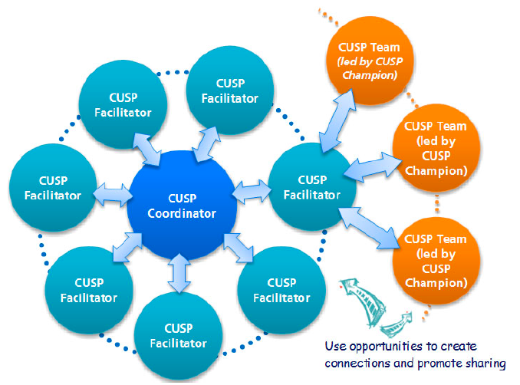
Team Roles—CUSP Coordinator
Helps spread and sustain the organization’s CUSP work by developing and supporting the growth and maintenance of strong CUSP teams.

Slide 17
Strategies for Success
AHRQ Safety Program for Mechanically Ventilated Patients

Slide 18
Mission Statement for CUSP Team
Could you share it with a team member in 30 seconds or less?
Can it be easily understood?
Does it reflect how you will measure success?
Does it align with your organization’s strategic safety and quality improvement goals?
Does it reflect patient- and family-centered care values?
Is it motivating?

Slide 19
Top 10 Strategies for Success
Get good engagement on patient safety culture surveys (i.e., ≥ 80% response rate)
Achieve a safety climate domain score of ≥ 80%
Staff owns safety—use unit-level data and staff inputs to drive improvement efforts
Use CUSP tools to learn from defects

Slide 20
Top 10 Strategies for Success
Protect that time!
CUSP champion seeks additional training on CUSP (with the unit manager and the provider champion)
Staff receives Science of Safety training

Slide 21
Top 10 Strategies for Success
Provider champion is engaged and regularly contributes to CUSP work
Senior executive is engaged and regularly contributes to CUSP work, including regular participation in walking rounds
CUSP meetings are held regularly and rarely canceled

Slide 22
Strong CUSP Teams…
Share a strong team orientation
Understand the advantage a team approach offers
Share a mental model of the team’s mission
Work together to achieve the mission
Build frameworks for team behaviors and norms

Slide 23
Assembling a CUSP Team
What’s our guiding framework?
Meeting logistics
Communication
Decisionmaking
Participation
Expectations
Tip: You can find more information and other CUSP tools at http://www.ahrq.gov/professionals/education/curriculum-tools/cusptoolkit/index.html.

Slide 24

Meeting Resistance?
Tune in to “What’s In It For Me?”
People resist loss, not change
Identify and mitigate real and perceived loss (e.g., time)
Perceived loss > real loss
Perceived loss is higher when communication is low

Slide 25

Communication Tips
Communicate prior to start of project
No surprises
Listen to and include those who resist
Create mechanisms to share results with clinicians
Value the dissenter

Slide 26

Don’t Ignore the Elephants in the Room
Not enough time
Not enough resources
Your champion can partner with your senior executive to help address barriers.
Use early successes to build support and momentum for the program.

Slide 27
Discussion
What strategies have you used that have led to an engaged team?
What other disciplines have you successfully engaged?
Did your approach vary by discipline? How?
Did you leave out someone you later regretted not having on the team?

Slide 28

Questions

Slide 29
References
Pronovost PJ, Berenholtz SM, Goeschel C, et al. Improving patient safety in intensive care units in Michigan. J Crit Care. 2008 Jun;23(2):207-21. PMID: 18538214.

