Slide 1
Learn From Defects in Care of Mechanically Ventilated Patients
AHRQ Safety Program for Mechanically Ventilated Patients
AHRQ Pub. No. 16(17)-0018-34-EF
January 2017

Slide 2
Learning Objectives
After this session, you will be able to—
Describe difference between first-order and second-order problem solving
List contributing factors that make defects in care more likely to occur
Use the Learning from Defects (LFD) tool to perform second-order problem solving
Evaluate the effectiveness of your intervention by measuring baseline and post-intervention performance
Present your findings to department leadership

Slide 3
What Is a Defect?
A defect is any clinical or operational event or situation that you would not want to happen again.
These could include incidents that you believe caused patient harm or put patients at risk for significant harm.¹
Pronovost PJ, Holzmueller CG, et al. A practical tool to learn from defects in patient care. Jt Comm J Qual Patient Saf. 2006 Feb;32(2):102-8. PMID: 16568924.

Slide 4
Comprehensive Unit-based Safety Program (CUSP)
CUSP STEPS
Educate staff on the science of safety
Identify defects
Partner with a senior executive
Learn from defects
Improve teamwork and communication
ADAPTIVE COMPONENTS OF CUSP

Slide 5
Principles of Safe Design
Standardize
Care
Create
Independent
Checks
Learn From Defects
Patient safety is a property of systems
Principles are applied to both technical tasks and adaptive teamwork
Teams make wise decisions when input is diverse, independent, and encouraged

Slide 6
Problem-Solving Hierarchy
First-Order
Problem Solving
Second-Order
Problem Solving
Recovers for one patient, but does not reduce risks for future patients
Example: You get the supply from another area or you manage without it
Reduces risks for future patients by improving work processes and increasing compliance
Example: You create a process to make sure line cart is stocked with necessary equipment

Slide 7
Problem-Solving Goal
First-order problem solving addresses immediate need, but does not improve patient safety culture
Second-order problem solving addresses future needs and improves overall patient safety culture

Slide 8
Where To Find Defects
Adverse event reporting systems
Sentinel events
Claims data
Infection rates
Complications
Staff Safety Assessments (SSA)
How will the next patient be harmed?
What can you do to prevent or minimize this harm?
Tip: The SSA, the LFD tool, and other CUSP tools can be found at http://www.ahrq.gov/professionals/education/curriculum-tools/cusptoolkit/index.html.

Slide 9
Learning From Defects
What happened?
From the view of the person involved
Why did it happen?
How will you reduce the risk of it happening again?
How will you know the risk was reduced?
1
2
3
4

Slide 10
Who Should Be Using the LFD Tool?
Core CUSP team guides the use of this tool
CUSP facilitator
CUSP champion
Unit manager
Provider champion
Senior executive
But everyone on the unit can and should participate in the process of learning from defects

Slide 11
Checking Your Assumptions
Bring a diverse group of team members together
Do not assume that everyone at the table is as familiar with the details of a defect as you are
Not familiar with the context of a defect being discussed? Do not hesitate to ask basic questions!
Well-versed? Take the time to describe a defect so everyone can help you see aspects of a defect you may not have appreciated before
Walk the process with the frontline staff

Slide 12
What Happened?
Select a defect to learn from
Put yourself in the place of those involved, in the middle of the event as it was unfolding
Take time to listen
Seek to understand rather than to judge
Ask clarifying questions and followup questions
Dig down to the reasoning and emotions behind actions and decisions

Slide 13
What Happened?
What Happened?
Who was involved?
What actions occurred?
What were care team members thinking and feeling?
What were patients thinking and feeling?
What was happening at the same time?
What happened that had a good outcome?
What tools or technologies were being used and how?

Slide 14
What Happened?
Reconstruct the timeline and explain what happened
Consider recreating to make defect real
Visualization tools
Process mapping
Diagrams or sketches
Role playing
Remember the “people side” of a defect—including the values, attitudes, and beliefs—in order to create a lasting change

Slide 15
Why Did It Happen?
Contributing factors from all levels of your health care system impact care delivery and, ultimately, patient outcomes
Develop a “system perspective” to see the hidden factors that led to the event
List all contributing factors and identify whether they harmed or protected the patient
Isolate how the providers were put into the position to make the mistake in the first place
Avoid assigning personal blame
This process is instrumental in building second-order problem solving skills necessary to learn from defects

Slide 16
System Factors Impact Safety²
Safety
Institutional
Hospital
Departmental Factors
Work Environment
Team Factors
Individual Provider
Task Factors
Patient Characteristics
Institutional
2. Vincent C, Taylor-Adams S, Stanhope N. Framework for analyzing risk and safety in clinical medicine. BMJ. 1998 Apr 11;316(7138):1154-7. PMID: 9552960.

Slide 17
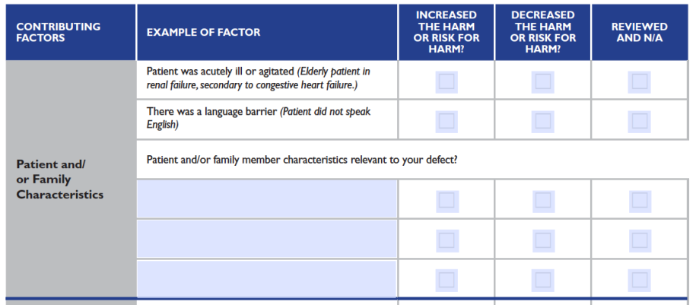
LFD Tool Contributing Factors

Slide 18
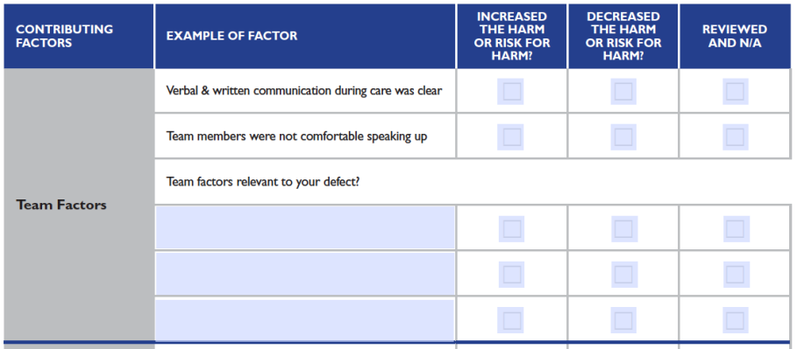
LFD Tool Contributing Factors

Slide 19
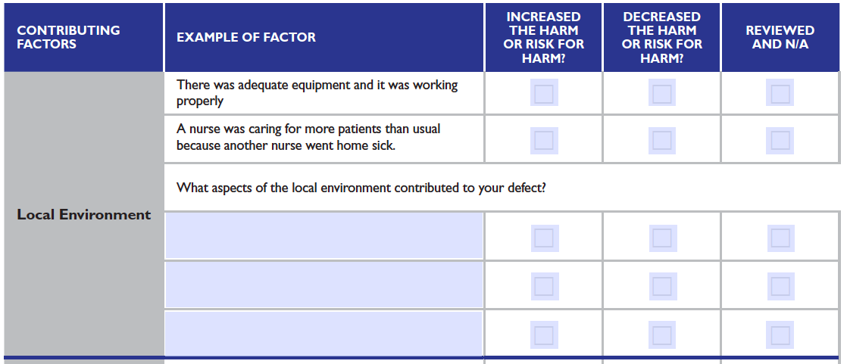
LFD Tool Contributing Factors

Slide 20
Why Did It Happen?
Try to go deeper as you identify contributing factors
Use the “5 Whys” technique
Why 1—Why did this contributing factor occur?
Why 2—Why did “Why 1” occur?
Why 3—Why did “Why 2” occur?
Why 4—Why did “Why 3” occur?
Why 5—Why did “Why 4” occur?
Consider having more than one meeting or additional fact-finding effort to find all contributing factors

Slide 21
Why Did It Happen?
Refer back to any drawings your team used to illustrate what happened
Look for weaknesses in the processes
Are there redundant steps?
Are there variables that make care inconsistent among providers?
Evaluate the way your workspaces are designed
Is the workflow reasonable?
Is the workflow efficient?

Slide 22
Why Did It Happen?
What about the people side of the defect?
Can you identify where the main points are?
Are there aspects of your patient safety culture that promote doing the wrong thing or engaging in a risky workaround?
What might your team do to build a stronger safety culture?

Slide 23
How Will You Reduce Risk Reoccurring?
What is its impact on causing the defect?
Does it occur rarely or have a high likelihood of reoccurring?

Slide 24
How Will You Reduce Risk Reoccurring?
Create choices by brainstorming possible interventions
Involve the entire team with flipcharts and Post-it notes
Prioritize most important contributing factors and most beneficial interventions
Take advantage of your diverse team!
Senior executive’s big-picture view of the organization and knowledge of resources
Team members’ connections throughout organization
Frontline staff with particular insight into the defect

Slide 25
How Will You Reduce Risk of Reoccurrence?
Weaker
Telling someone to “be more careful”
Intermediate
Eliminating or reducing distractions
Stronger
Making a process or device “mistake proof”
Make choices and select your intervention
Have your team vote on its favorite solutions
Consider rating solutions based on direct and feasible way to address the defect

Slide 26
How Will You Reduce Risk of Reoccurrence?
Remember the “people side” of the intervention
Consider who influences and impacts your intervention
Ask, “Are they likely to support or resist your intervention?”
Create an action plan like this hypothetical example to get them on board
Stakeholder | Action Plan To Engage | Lead Point on Action Plan | Followup Date for Lead To Report to Group
Respiratory therapist | Weekly meetings | Karen Smith | 5-8-2016
Nurse managers | Invite to rounds | Mark Johnson | 6-1-2016
Dr. Tom Richards | Review VAE rates | Dr. Chris Miller | 6-13-2016

Slide 27
How Will You Reduce Risk of Reoccurrence?
Remember that engagement is hard!
Use the wisdom of your diverse team to overcome barriers and solve problems
Make sure the intervention details are spelled out and understood by everyone
Ensure the intervention is carried out consistently

Slide 28
How Will You Know Risks Were Reduced?
Ask:
Do staff know about the interventions?
Are staff using the interventions as intended?
Do staff believe risks were reduced?
Make data-driven metrics the goal whenever possible
Incorporate subjective evaluations for valuable supplementary information

Slide 29
How Will You Know Risks Were Reduced?
Identify how you will measure success
Put an audit plan in place to track that measure
Include a way to feed data back to your group
Review your audits and adjust your intervention as needed
Revisit learning from defects process
Tip: Learning from defects is a continuous process as is the need to engage frontline staff.

Slide 30
How Will You Know Risks Were Reduced?
Evaluate the effectiveness of your intervention by measuring baseline and post-intervention performance
Present your findings to leadership and your frontline providers

Slide 31
Evaluating the Intervention
Not all interventions are created equal
Forcing Functions and Constraints
Automation and Computerization
Standardization and Protocols
Checklists and Independent Check Systems
Rules and Policies
Education and Information
Vague Warnings – “Be more careful!”
STRONGER

Slide 32
Not All Education Is Created Equal
Strive for concise, clear, and relevant messages
Avoid information overload in all manners of disseminating information
Share a concise message with a clear focus relevant to specific audience needs
Experiential learning with hands-on approach will be far more effective at motivating change than an automated email dense with data
Email Blast
Lecture
Hands-On Training
Team Meetings

Slide 33
Action Plan
Review the Learn From Defects tool with your team
Review a defect in your intensive care unit
Select one defect per month
Identify the top three contributing factors
Post stories of reduced risk—with data
Share with others

Slide 34
Questions?

Slide 35
References
Pronovost PJ, Holzmueller CG, et al. A practical tool to learn from defects in patient care. Jt Comm J Qual Patient Saf. 2006 Feb;32(2):102-8. PMID: 16568924.
Vincent C, Taylor-Adams S, Stanhope N. Framework for analyzing risk and safety in clinical medicine. BMJ. 1998 Apr 11;316(7138):1154-7. PMID: 9552960.

