Slide 1
Communication Strategies for Sustainability
AHRQ Safety Program for Mechanically Ventilated Patients
AHRQ Pub. No. 16(17)-0018-40-EF
January 2017

Slide 2
Learning Objectives
After reviewing this module, you will be able to—
Identify your target audience
Overcome the curse of knowledge
Articulate the goal of your message
Apply practical strategies to improve the effectiveness of team communications

Slide 3
AHRQ Safety Program
For Mechanically Ventilated Patients

Slide 4
Using Communication Strategies
Address barriers to sustainability
Competing priorities
Staff buy-in of initial intervention
Staff engagement
Consistency of implementation

Slide 5
Sustaining Your Efforts
CUSP fosters—
  Communication within multidisciplinary teams
  Frontline engagement
Communication is a two-way street
  Staff must have a voice
  Voice must be heard by organization
Use communication strategies to sustain your implementation efforts

Slide 6

Your Target Audience
New unit staff members
New team members
Existing staff, administrators, and/or providers

Slide 7
Your Target Audience
What does your audience—
What do you want to accomplish?
Want to know?
Need to know?
Need to do?
Change behavior
Garner buy-in
Provide status update
Ask for resources

Slide 8

What Does Your Audience Know?

Slide 9


Curse of Knowledge
Hard to imagine what it is like for someone not to know something that you know
Invokes emperor's new clothes syndrome

Slide 10





Curse of Knowledge
AMA…
Is that Against Medical Advice,
American Medical Association,
or Ask Me Anything?
For example–
“Peter says…”
“Obviously…”
AMA
If it is obvious, I better not ask.
Who’s Peter?

Slide 11
Overcoming the Curse of Knowledge
Find out what they know and what they need to know
Close the loop
  Get feedback from member of target audience
  Share draft
  Ask them!
Make it easy for your audience to understand your message

Slide 12
Overcoming the Curse of Knowledge
Use concrete language
Tell a story
Spell out logic
Explain acronyms and jargon
Supply any necessary details
Include background or context

Slide 13

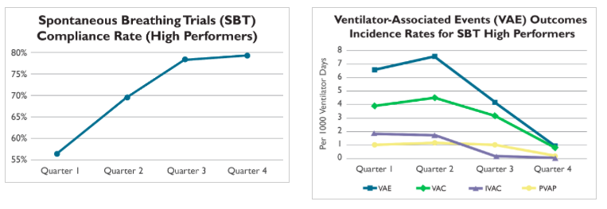
Communicating With Your Team
It’s not about what YOU know
Focus on what YOUR AUDIENCE needs to know

Slide 14
What Do You Want To Accomplish?
Change Behavior
Information can motivate change, but emotion helps propel it
Show, don’t tell
  Share stories or photos
  Direct attention to the destination
Cultivate a sense of identity around change
Encourage habits and make new behavior contagious
Share your data

Slide 15
What Do You Want To Accomplish?
Garner Buy-In
Prepare multipronged approach for approval
Target individual stakeholders
  Identify respected members of team
  Solicit feedback early
Address the wisdom of naysayers
  Find the kernel of truth in their doubts
  Take that truth seriously
Advocate for grassroots approach rather than lightning bolt approach
Share your data

Slide 16
What Do You Want To Accomplish?
Provide Status Update
Frame background information
Tailor update to audience
  Adapt for unit, interdepartmental, management, hospitalwide, or external audiences
  Be mindful of different goals and knowledge base
Identify key actions or upcoming decisions
Link to organizational goals
Share your data

Slide 17
What Do You Want To Accomplish?
Ask for Resources
Be specific and clear with your requests
Be prepared with evidence to support requests
Share your data
Anticipate obstacles and solutions
Provide alternatives, where possible
Offer a reasonable timeframe to address concerns
Find evidence to support interventions on the program Web site at http://www.ahrq.gov/HAImvp.

Slide 18
If I had more time,
I would have written a shorter letter.
And added my data.

Slide 19
Practical Tips
Identify your audience
  What do they want to know?
  What do they need to know?
  What do they need to do?
Determine what you want to accomplish
Overcome the curse of knowledge
Focus on the audience–it’s not about you
Be concise and be clear
Share your data

Slide 20
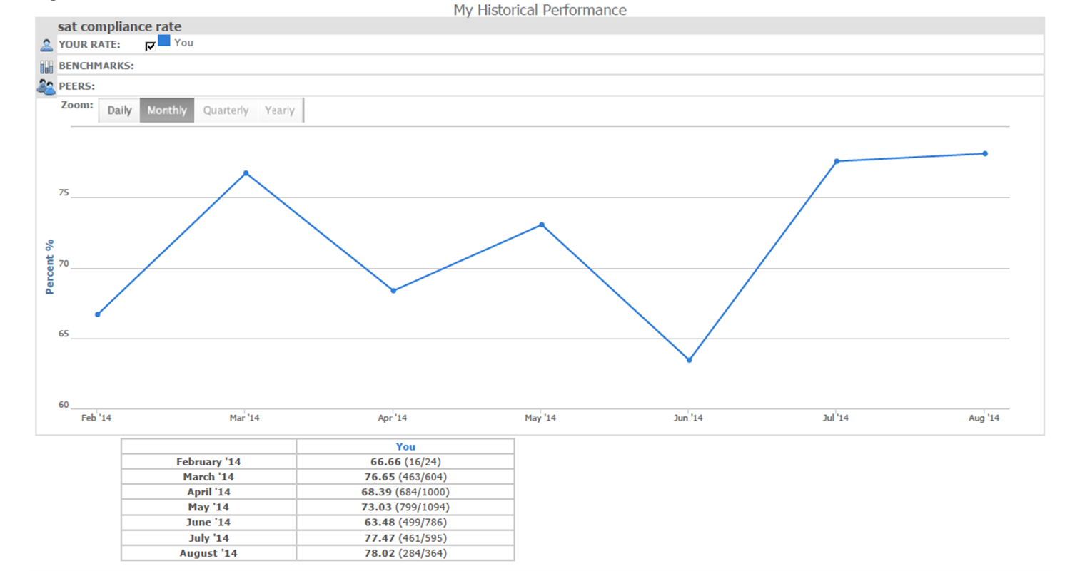
Sample Generated Report

Slide 21
Monthly SAT Compliance Rate
Spontaneous Awakening Trials
80%
75%
Percent %
70%
65%
60%
Feb 2014
March 2014
April 2014
May 2014
June 2014
July 2014
Aug 2014

Slide 22
Monthly SAT Compliance Rate
1
Spontaneous Awakening Trials
80%
75%
Percent %
70%
65%
60%
2
Feb 2014
March 2014
April 2014
May 2014
June 2014
July 2014
Aug 2014
3

Slide 23
As SBT Compliance Rises, VAE Rates Plummet

Slide 24
Questions?

