Slide 1
Overview: Getting Patients Off the Ventilator Faster
AHRQ Safety Program for Mechanically Ventilated Patients
AHRQ Pub. No. 16(17)-0018-25-EF
January 2017

Slide 2
Learning Objectives
After this session, you will be able to—
Describe the impact of mechanical ventilation
List the interventions used in the AHRQ Safety Program for Mechanically Ventilated Patients
List benefits of the recommended interventions

Slide 3
How do we get patients off the ventilator Faster?

Slide 4
Never doubt that a small group of thoughtful, committed citizens can change the world; indeed, it is the only thing that ever has.
– Margaret Mead
“
”

Slide 5
Impact of Mechanical Ventilation
Affects 800,000 hospitalized patients in the United States each year¹
Five to 10 percent of mechanically ventilated patients develop a ventilator-associated event (VAE)^{2,3}
1. Carson SS, Cox CE, Homes GM, et al. The changing epidemiology of mechanical ventilation: a population-based study. J Intensive Care Med. 2006;21(3):173-82. PMID: 16672639.
2. Klompas M, Khan Y, Kleinman K, et al. Multicenter evaluation of a novel surveillance paradigm for complications of mechanical ventilation. PLoS ONE. 2011 Mar 22;6(3):e18062. PMID: 21445364.
3. Klein Klouwenberg PM, van Mourik MS, Ong DS, et al. Electronic implementation of a novel surveillance paradigm for ventilator-associated events: feasibility and validation. Am J Respir Crit Care Med. 2014 Apr 15;189(8):947-55. PMID: 24498886.

Slide 6
Impact of Mechanical Ventilation
Historically, ventilator-associated pneumonia (VAP) was considered one of the most lethal healthcare-associated infections⁴
35% mortality rate for ventilated patients⁵
24% for patients 15–19 years
60% for patients 85 years and older
4. Safdar N, Dezfullian C, Collard HR, et al. Clinical and economic consequences of ventilator–associated pneumonia: a systematic review. Crit Care Med. 2005;33(10):2184-93. PMID: 16215368.
5. Wunsch H, Linde-Zwirble WT, Angus DC, et al. The epidemiology of mechanical ventilation use in the United States. Crit Care Med. 2010;38(10):1947-53. PMID: 20639743.

Slide 7
Impact on Mechanically Ventilated Patients
Posing a significant burden to patients and caregivers
Short-term
Increase in complications
VAP
Sepsis
Acute respiratory distress syndrome (ARDS)
Pulmonary embolism
Barotrauma
Pulmonary edema
Increase in health care costs
Increase in length of stay
Long-term
Slower overall recovery time
Debilitating physical disabilities
Lingering cognitive dysfunction
Psychiatric issues, including anxiety, depression, and post-traumatic stress disorder

Slide 8
Financial Impact of Mechanical Ventilation
Average acute care cost for ventilated patient = $2,300 per day⁶
After fourth day, cost rises to over $3,900 per day⁷
If ventilator days were reduced by just 20 percent, patient throughput would increase leading to—
Higher revenue
Ability to care for more patients
6. Berenholtz SM, Pham JC, Thompson DA, et al. Collaborative cohort study of an intervention to reduce ventilator associated pneumonia in the ICU. Infect Control Hosp Epidemiol. 2011;32(4):305-14. PMID: 21460481.
7. Lipitz-Snyderman A, Steinwachs D, Needham DM, et al. Impact of a statewide intensive care unit quality improvement initiative on hospital mortality and length of stay: retrospective comparative analysis. BMJ. 2011;342:d219. PMID: 21282262.

Slide 9
Defining Ventilator-Associated Events
Previous VAP surveillance definitions were subjective and nonreproducible
VAEs are now identified with a combination of objective criteria:
Deterioration in respiratory status after a period of stability or improvement on the ventilator
Evidence of infection or inflammation
Laboratory evidence of respiratory infection

Slide 10
VAE-Attributable Hospital Mortality⁸
 |  |  | DAYS TO EXTUBATION |  |  | DAYS TO HOSPITAL DISCHARGE |  |  |  | HOSPITAL MORTALITY
OUTCOME |  |  | OR (95% CI) | P |  | OR (95% CI) | P |  |  | OR (95% CI) | P
All VAE tiers versus no VAEs
 |  | VAC-plus | 3.12 (2.96–3.29) | <.0001 |  | 1.46 (1.37–1.55) | <.0001 |  | 1.98 (1.60–2.44) |  | <.0001
 |  | VAC-alone | 2.32 (2.19–2.45) | <.0001 |  | 1.29 (1.21–1.37) | <.0001 |  | 2.35 (1.91–2.90) |  | <.0001
 |  | IVAC-plus | 3.45 (3.23–3.68) | <.0001 |  | 1.52 (1.41–1.63) | <.0001 |  | 1.87 (1.44–2.42) |  | <.0001
 |  | IVAC-alone | 3.71 (3.35–4.10) | <.0001 |  | 1.69 (1.51–1.90) | <.0001 |  | 1.86 (1.27–2.73) |  | .002
 |  | Possible pneumonia | 3.16 (2.84–3.52) | <.0001 |  | 1.38 (1.22–1.56) | <.0001 |  | 2.15 (1.43–3.23) |  | .0002
 |  | Probable pneumonia | 3.50 (3.10–3.95) | <.0001 |  | 1.50 (1.31–1.70) | <.0001 |  | 1.63 (1.02–2.61) |  | .04
VAC = Ventilator-associated condition
IVAC = Infection-related ventilator-associated complication
8. Klompas M, Kleinman K, Murphy MV. Descriptive epidemiology and attributable morbidity of ventilator-associated events. Infect Control Hosp Epidemiol. 2014;35(5):502-10. PMID: 24709718.

Slide 11
What Do We Need To Do?
Improve patient and family experience
Reduce complications
Get patients off the ventilator
Get patients ready to leave the intensive care unit (ICU) faster
Improve efficiency while reducing costs

Slide 12
AHRQ Safety Program Goals
To reduce risk of patient harms associated with mechanical ventilation
Reduce ventilator-associated events, including VAP (Centers for Disease Control and Prevention [CDC] definition of VAEs)
Reduce the duration of mechanical ventilation, length of stay, and mortality
To achieve significant improvements in teamwork and safety culture in ICUs

Slide 13
How Will We Get There?
Key Concepts—Adaptive and Technical Work
TECHNICAL WORK | ADAPTIVE WORK
Procedural components of work, like elevating the head of bed and using subglottic secretion drainage endotracheal tubes | The “intangible” components of work, like ensuring acute-care team members hold each other accountable for quality care delivery
Work that lends itself to standardization (e.g., checklists and protocols) | Work that shapes the attitudes, beliefs, and values of clinicians, so they consistently perform tasks the way they know they “should”

Slide 14
Building on Previous State-Level Success…
Michigan Keystone ICU program
Reduced central line-associated blood stream infections (CLABSI)^{9,10}
Reduced VAP⁶
Reduced mortality rate⁷
Improved safety climate in ICUs¹¹
Reduced health care cost¹²
Improved patient outcomes
6. Berenholtz SM, Pham JC, Thompson DA, et al. Collaborative cohort study of an intervention to reduce ventilator associated pneumonia in the ICU. Infect Control Hosp Epidemiol. 2011;32(4):305-14. PMID: 21460481.
7. Lipitz-Snyderman A, Steinwachs D, Needham DM, et al. Impact of a statewide intensive care unit quality improvement initiative on hospital mortality and length of stay: retrospective comparative analysis. BMJ. 2011;342:d219. PMID: 21282262.
9. Pronovost P, Needham D, Berenholtz S, et al. An intervention to decrease catheter- related bloodstream infection in the ICU. N Engl J Med. 2006;355(26):2725-32. PMID: 17192537.
10. Pronovost PJ, Goeschel CA, Colantuoni E, et al. Sustaining reductions in catheter related bloodstream infections in Michigan ICUs: observational study. BMJ. 2010;340:c309. PMID: 20133365.
11. Sexton JB, Berenholtz SM, Goeschel CA, et al. Assessing and improving safety climate in a large cohort of intensive care units. Crit Care Medicine. 2011;39(5):934-9. PMID: 21297460.
12. Waters HR, Korn R Jr, Colantuoni E, et al. The business case for quality: economic analysis of the Michigan Keystone Patient Safety Program in ICUs. Am J Med Qual 2011;26(5):333–9. PMID: 21856956.

Slide 15
…and National-Level Highlights
National On the CUSP—Stop BSI program¹³
Initiative to implement Comprehensive Unit-based Safety Program (CUSP), a proven culture change model, along with bundled interventions to prevent CLABSI
A total of 1,071 intensive care units in 45 States
A 43 percent reduction in CLABSI rates
The number of intensive care units that achieved CLABSI rate of zero more than doubled
13. Eliminating CLABSI, A National Patient Safety Imperative: Final Report. Content last reviewed January 2013. Agency for Healthcare Research and Quality, Rockville, MD. http://www.ahrq.gov/professionals/quality-patient-safety/cusp/clabsi-final/index.html. Accessed September 21, 2016.

Slide 16
Ventilator-Associated Events Successes
Centers for Disease Control and Prevention Epicenters’
Wake Up and Breathe Collaborative¹⁴
What: Prospective quality improvement collaborative
Who: 12 ICUs affiliated with 7 hospitals
Why: Prevent VAEs through less sedation and earlier liberation from mechanical ventilation
How: Increase performance of paired daily spontaneous awakening trials (SATs) and spontaneous breathing trials (SBTs)
14. Klompas M, Anderson D, Trick W, et al. The Preventability of Ventilator-Associated Events: The CDC Prevention Epicenters' Wake Up and Breathe Collaborative. Am J Respir Crit Care Med. 2015 Feb 1;191(3):292-301. PMID: 25369558.

Slide 17
Ventilator-Associated Events Successes
CDC Epicenters’ Wake Up and Breathe Collaborative¹⁴
Ventilator Days and Length of Stay (LOS) Reductions
-2.4 vent days
-3.0 ICU days
-6.3 LOS days
VAE Reductions
-37% in VACs
-65% in IVACs
SATs and SBTs Increases
+63% in SATs
+16% in SBTs
+81% in SBTs done with sedatives off
14. Klompas M, Anderson D, Trick W, et al. The Preventability of Ventilator-Associated Events: The CDC Prevention Epicenters' Wake Up and Breathe Collaborative. Am J Respir Crit Care Med. 2015 Feb 1;191(3):292-301. PMID: 25369558.

Slide 18
Interventions

Slide 19
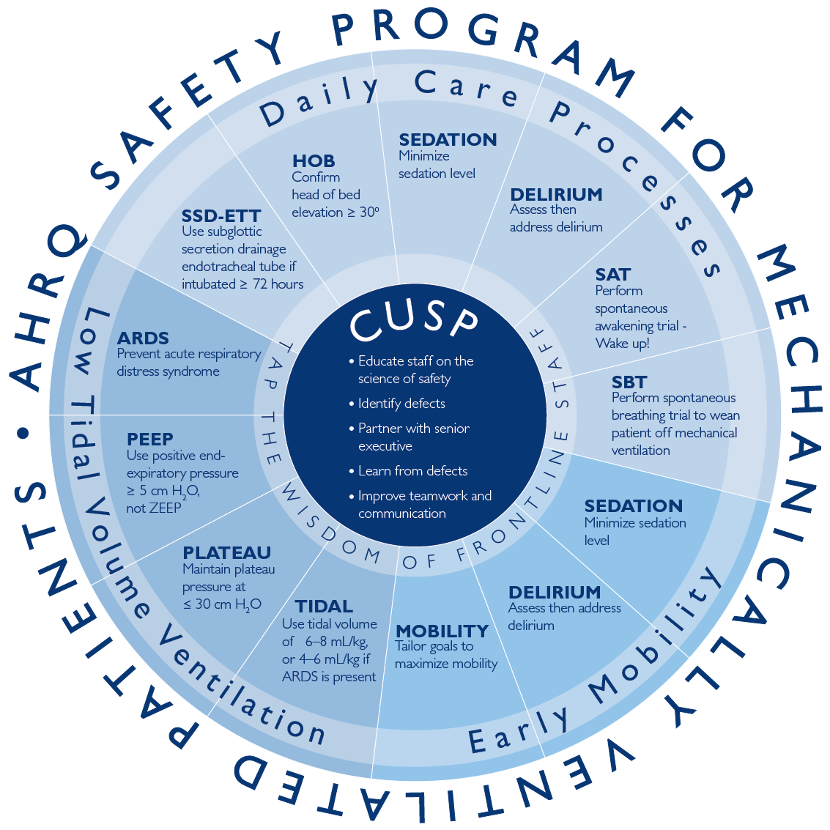
Interventions
CUSP
Daily Care Processes
Early Mobility
Low Tidal Volume Ventilation

Slide 20
Intervention 1—CUSP¹³
Comprehensive Unit-based Safety Program
Educate staff on the Science of Safety
Identify defects
How can we get patients off the ventilator faster?
Partner with a senior executive
Learn from defects
Improve teamwork and communication
13. Eliminating CLABSI, A National Patient Safety Imperative: Final Report. Content last reviewed January 2013. Agency for Healthcare Research and Quality, Rockville, MD. http://www.ahrq.gov/professionals/quality-patient-safety/cusp/clabsi-final/index.html. Accessed September 21, 2016.

Slide 21
Intervention 2—Daily Care Process Measures
Use subglottic secretion drainage endotracheal tubes in patients expected to be ventilated for >72 hours
Elevate head of bed to a semi-recumbent position (≥30°)
Minimize sedation level
Use SAT with validated sedation scale daily
Assess readiness to wean daily with SBT
Assess then address delirium

Slide 22
Intervention 3—Daily Early Mobility
Use multidisciplinary and coordinated approach
Employ a nurse-driven protocol
Minimize sedative use and interrupt sedation daily
Screen for eligibility for mobilization
Tailor goals to maximize mobility

Slide 23
Intervention 4—Low Tidal Volume Ventilation¹⁵
Prevent ARDS
Use positive end-expiratory pressure ≥5 cm H₂O, not zero end-expiratory pressure
Maintain plateau pressure at ≤30 cm H₂O
Use tidal volume of 6–8 cc/kg predicted body weight in patients who do not have ARDS, 4-6 cc/kg predicted body weight in patients who do have ARDS
15. Lellouche F, Lipes J. Prophylactic protective ventilation: lower tidal volumes for all critically ill patients? Intensive Care Med. 2013;39(1), 6-15. PMID: 23108608.

Slide 24
2014 SHEA Compendium Update¹⁶
Society for Healthcare Epidemiology of America
Elevate the head of the bed 30–45 degrees
Provide endotracheal tubes with subglottic secretion drainage ports for patients likely to require more than 48 or 72 hours of intubation
Manage ventilated patients without sedation whenever possible
16. Klompas M, Branson R, Eichenwald EC, et al. Strategies to prevent ventilator-associated pneumonia in acute care hospitals: 2014 update. Infect Control Hosp Epidemiol 2014;35(8):915-936. PMID: 25026607.

Slide 25
2014 SHEA Compendium Update¹⁶
Interrupt sedation once a day (SAT)
Assess readiness to extubate once a day (SBT)
Pair SATs with SBTs
Employ early exercise and mobilization
Use noninvasive positive pressure ventilation whenever feasible
16. Klompas M, Branson R, Eichenwald EC, et al. Strategies to prevent ventilator-associated pneumonia in acute care hospitals: 2014 update. Infect Control Hosp Epidemiol 2014;35(8):915-36. PMID: 25026607.

Slide 26
2013 Society of Critical Care Medicine PAD Guidelines¹⁷
Establish an overarching protocoled approach to daily ICU patient management using 2013 Pain, Agitation, and Delirium (PAD) Guidelines
Assess and treat pain first (may be sufficient)
If patient remains agitated after adequately treating pain
Start with bolus sedation as needed
Use continuous sedation if boluses exceed 3 per hour
Avoid continuous benzodiazepines in most patients
17. Barr J, Fraser GL, Puntillo K, et al.; American College of Critical Care Medicine. Clinical practice guidelines for the management of pain, agitation, and delirium in adult patients in the intensive care unit. Crit Care Med. 2013 Jan;41(1):263-306. PMID: 23269131.

Slide 27
2013 Society of Critical Care Medicine PAD Guidelines¹⁷
Interrupt sedation daily
If necessary to restart, use lowest dose possible to maintain target level of consciousness
Avoid deep sedation; instead, target awake or alert
Screen for delirium with validated tool
If delirious, first seek reversible causes and attempt nonpharmacological management
Use ABCDE bundle to improve outcomes for your patients
17. Barr J, Fraser GL, Puntillo K, et al.; American College of Critical Care Medicine. Clinical practice guidelines for the management of pain, agitation, and delirium in adult patients in the intensive care unit. Crit Care Med. 2013 Jan;41(1):263-306. PMID: 23269131.

Slide 28
ABCDEF Bundle¹⁸
Intervention
Awakening and
Breathing coordination
Choose light sedation
Delirium monitoring/management and
Early exercise/mobility bundle
Family and patient involvement (new)
18. Balas MC, Burke WJ, Gannon D, et al. Implementing the awakening and breathing coordination, delirium monitoring/management, and early exercise/mobility bundle into everyday care: opportunities, challenges, and lessons learned for implementing the ICU Pain, Agitation, and Delirium Guidelines. Crit Care Med. 2013;41(9):S116-27. PMID: 23989089.

Slide 29
Questions?

Slide 30
References
Carson SS, Cox CE, Homes GM, et al. The changing epidemiology of mechanical ventilation: a population-based study. J Intensive Care Med. 2006;21(3):173-82. PMID: 16672639.
Klompas M, Khan Y, Kleinman K, et al. Multicenter evaluation of a novel surveillance paradigm for complications of mechanical ventilation. PLoS ONE. 2011 Mar 22;6(3):e18062. PMID: 21445364.
Klein Klouwenberg PM, van Mourik MS, Ong DS, et al. Electronic implementation of a novel surveillance paradigm for ventilator-associated events: feasibility and validation. Am J Respir Crit Care Med. 2014 Apr 15;189(8):947-55. PMID: 24498886.
Safdar N, Dezfullian C, Collard HR, et al. Clinical and economic consequences of ventilator–associated pneumonia: a systematic review. Crit Care Med. 2005; 33(10):2184-93. PMID: 16215368.

Slide 31
References
Wunsch H, Linde-Zwirble WT, Angus DC, et al. The epidemiology of mechanical ventilation use in the United States. Crit Care Med. 2010; 38(10):1947-53. PMID: 20639743.
Berenholtz SM, Pham JC, Thompson DA, et al. Collaborative cohort study of an intervention to reduce ventilator associated pneumonia in the ICU. Infect Control Hosp Epidemiol. 2011;32(4):305-14. PMID: 21460481.
Lipitz-Snyderman A, Steinwachs D, Needham DM, et al. Impact of a statewide intensive care unit quality improvement initiative on hospital mortality and length of stay: retrospective comparative analysis. BMJ. 2011;342:d219. PMID: 21282262.
Klompas M, Kleinman K, Murphy MV. Descriptive epidemiology and attributable morbidity of ventilator-associated events. Infect Control Hosp Epidemiol. 2014;35(5):502-10. PMID: 24709718.

Slide 32
References
Pronovost P, Needham D, Berenholtz S, et al. An intervention to decrease catheter- related bloodstream infection in the ICU. N Engl J Med. 2006;355(26):2725-32. PMID: 17192537.
Pronovost PJ, Goeschel CA, Colantuoni E, et al. Sustaining reductions in catheter related bloodstream infections in Michigan ICUs: observational study. BMJ. 2010;340:c309. PMID: 20133365.
Sexton JB, Berenholtz SM, Goeschel CA, et al. Assessing and improving safety climate in a large cohort of intensive care units. Crit Care Medicine. 2011;39(5):934-9. PMID: 21297460.
Waters HR, Korn R Jr, Colantuoni E, et al. The business case for quality: economic analysis of the Michigan Keystone Patient Safety Program in ICUs. Am J Med Qual 2011;26(5):333–9. PMID: 21856956.

Slide 33
References
Eliminating CLABSI, A National Patient Safety Imperative: Final Report. Content last reviewed January 2013. Agency for Healthcare Research and Quality, Rockville, MD. http://www.ahrq.gov/professionals/quality-patient-safety/cusp/clabsi-final/index.html. Accessed September 21, 2016.
Klompas M, Anderson D, Trick W, et al. The Preventability of Ventilator-Associated Events: The CDC Prevention Epicenters' Wake Up and Breathe Collaborative. Am J Respir Crit Care Med. 2015 Feb 1;191(3):292-301. PMID: 25369558.
Lellouche F, Lipes J. Prophylactic protective ventilation: lower tidal volumes for all critically ill patients? Intensive Care Med. 2013;39(1), 6-15. PMID: 23108608.
Klompas M, Branson R, Eichenwald EC, et al. Strategies to prevent ventilator-associated pneumonia in acute care hospitals: 2014 update. Infect Control Hosp Epidemiol 2014;35(8):915-36. PMID: 25026607.

Slide 34
References
Barr J, Fraser GL, Puntillo K, et al.; American College of Critical Care Medicine. Clinical practice guidelines for the management of pain, agitation, and delirium in adult patients in the intensive care unit. Crit Care Med. 2013 Jan;41(1):263-306. PMID: 23269131.
Balas MC, Burke WJ, Gannon D, et al. Implementing the awakening and breathing coordination, delirium monitoring/management, and early exercise/mobility bundle into everyday care: opportunities, challenges, and lessons learned for implementing the ICU Pain, Agitation, and Delirium Guidelines. Crit Care Med. 2013;41(9):S116-27. PMID: 23989089.

