Slide 1
Optimize
Briefings and Debriefings
AHRQ Safety Program for Surgery
Implementation
AHRQ Pub. No. 16(18)-0004-15-EF
December 2017
Notes:
SAY:
This module is the first of two parts discussing briefings and debriefings. Teamwork and culture improvement are a big part of this project. Evidence supports that addressing cultural issues in conjunction with the technical work improves infection rates. Both safety culture and technical interventions must be managed to sustain progress.
Briefings and debriefings provide strong tools for managing some of that change. Even interventions with an abundance of evidence can prove difficult to implement. This work is not an easy checklist. Here we will address the many aspects of briefings and debriefings: the fundamentals, the lessons learned by many organizations and from the literature, what works and successful implementation strategies. The goal is not to add yet another required piece of paper, but to develop a meaningful process that benefits the entire care team and our patients.
This module will review the evidence and lessons learned, and will provide tips for maximizing the briefing and debriefing process. Also, a hospital team will share its story about implementing and then optimizing briefings and debriefings, as well as share its successes.

Slide 2
Learning Objectives
Describe characteristics of effective briefings and debriefings
Present the evidence base for briefings and debriefings to your surgeons and surgical staff during a staff meeting
Prioritize and investigate defects identified by the team during operating room debriefings
Notes:
SAY:
First, let’s describe the characteristics of effective briefings and debriefings, along with what matters about these processes. Implementing the briefing and debriefing process will require evidence to garner surgeon and other stakeholder buy-in. We will present the evidence base for briefings and debriefings for you to share with the surgical staff.
Each hospital is likely in different stages of briefings. Some may have implemented briefings; some have not.
ASK:
Have you implemented a briefing process that did not go so well?
SAY:
Others are in more mature stages and can offer strong lessons in how to achieve success with briefings and debriefings.
The critical component of earning stakeholder buy-in and turning debriefings into a meaningful process comes after the debriefing meeting has ended. Teams must prioritize and investigate defects identified during operating room debriefings. Debriefings are an opportunity to uncover both latent and actual errors to reduce risk over time, make your work more efficient, and improve patient safety. They are an opportunity to LISTEN to the wisdom of your frontline providers as defects occur.

Slide 3
Safety Program for Surgery Approach
LOCAL PROBLEMS
COMMON PROBLEMS
Comprehensive Unit-based Safety Program (CUSP)
Reducing Surgical Site Infections
Translating Evidence Into Practice
Prework: Measure frontline perceptions of safety culture with HSOPS survey
Emerging evidence
  Skin preparation
  Normothermia
  Glucose control
  Antibiotic redosing
Local opportunities to improve
Collaborative learning
Summarize the evidence in a checklist
Identify local barriers to implementation
Measure performance
Ensure all patients get the evidence
  Engage
  Educate
  Execute
  Evaluate
Educate staff on science of safety
Identify defects
Partner with senior executive
Learn from defects
Improve teamwork and communication tools
ADAPTIVE WORK
TECHNICAL WORK
Notes:
SAY:
This safety program has a strong technical component. We summarize the evidence around what therapies work and what therapies have efficacy for our patients, and then we must respond with locally useful guidance.
ASK:
How do we take the evidence and turn it into something that care providers can use?
How do we augment our work processes to include the emerging evidence?
SAY:
In addition, the adaptive work is addressed with the Comprehensive Unit-based Safety Program (CUSP) involving the management of culture. Similar to the systematic management of technical work, CUSP provides tools for managing the safety culture in our environment, including the science of safety, a process for identifying and learning from defects, and the relationship with your senior executive. It also includes improving teamwork and communication.

Slide 4
Comprehensive Unit-based Safety Program¹
CUSP SAFETY PROGRAM FOR SURGERY
Educate staff on the science of safety
Identify defects
Partner with a senior executive
Learn from defects
Improve teamwork and communication
ADAPTIVE COMPONENTS
Notes:
SAY:
The best places in a surgical setting to improve that teamwork and communication are in the briefing and debriefing phases of a surgical case. We will share a few tools to support briefing and debriefing. Many tools are available. The key is to develop a tool that works for your surgical arena and fits your work process.

Slide 5
Basics of Briefing and debriefing
AHRQ Safety Program for Surgery
Implementation
Notes:
SAY:
Let’s take a few moments to discuss the basics of briefing and debriefing.

Slide 6
Overview of Critical Team Interactions
  (regularly scheduled)
  Planning and preparation
Briefings
  Learning and improvement
Debriefings
Handoffs
Huddles
  Ensuring continuity of care
  Replanning
  (emergent, as needed)
Notes:
SAY:
First, we will clarify some language. Even with a goal of clear communication, we often use the same terms for different things, or different terms for the same things. So for the sake of our discussion, this is how we will refer to critical team interactions.
The four primary types of critical team interactions in surgery are briefings, debriefings, huddles, and handoffs. Briefings are regularly scheduled meetings designed to plan and prepare for the procedure. By default, they occur at the beginning of a case to ensure every member of the care team is on the same page.
ASK:
Does everyone understand and agree on the plan and the equipment required?
Is the team anticipating potential complications and preparing contingency plans?
SAY:
This powerful process improves both the recognition of issues and response time.
Debriefings are often brief meetings immediately following a case, either regularly occurring or under specific or novel circumstances. They provide an opportunity for the team to learn and for the system of care to improve over time. Debriefings also allow teams to identify issues that need to be addressed for future cases, like equipment issues or a breakdown in communication. By reflecting on how well teams work together, the team can then articulate successes and failures. Group discussion makes the successful interactions more likely to continue and allows less successful behaviors the chance for elimination.
Huddles occur on an emergent or as-needed basis. If something unexpected happens during a case, the plan may no longer suit the circumstances. The huddle pulls together the care team for replanning purposes.
Handoffs ensure continuity of care when the patient transfers to different clinical areas or to different providers.

Slide 7

What Is a Briefing?
A briefing is a discussion between two or more people, often a team, using succinct information pertinent to an event.
Notes:
SAY:
As discussed, a briefing is a discussion between two or more people, often the surgical team, using succinct information pertinent to a case.

Slide 8
Purpose of a Briefing
Maps out the plan of care
Identifies roles and responsibilities for each team member
Heightens awareness of the situation
Allows the team to plan for the unexpected
Anticipates team members’ needs and expectations
Notes:
SAY:
The purpose is to map out a plan of care. Another goal is to identify roles and clarify responsibilities for each team member. Briefings heighten awareness of the situation and allow the surgical team to plan for the unexpected. It allows a forum that anticipates team members’ needs and expectations for the case.
ASK:
So what are the specifics of this patient?
Where could things go wrong with this procedure and specifically with this case?
If something goes wrong, what should we look for and what are we going to do if that happens?

Slide 9
Effective Briefings
Set the tone for the day
  Chaotic and harried
  OR
  Organized and efficient
Encourage participation and ownership by all team members
  Organize based on procedure
  Establish competencies
Anticipate events and plan for the unexpected
  Equipment, medications, consultations
  Intensive care unit bed
Notes:
SAY:
Effective briefings set the tone for the day.
ASK:
Will the case be chaotic and harried or will it be organized and efficient?
SAY:
Take a few minutes, or even a brief 30 seconds, to go through the plan. Clarify roles and responsibilities. The briefing process organizes the case and makes both the care and the day more efficient. Evidence supports the upfront investment of time, which pays dividends in efficiency of turnover time and case time. The case goes more smoothly and the team can better react to obstacles.
Encourage participation and ownership by every team member. In health care and other industries, people struggle with speaking up when they have a concern or are uncomfortable with the plan. We’d like to think it is not a problem, but frequently staff members are not encouraged to contribute. By setting the standard of expecting 100 percent participation, your surgical team gains a powerful tool.
Often surgical teams work with different or even unfamiliar providers for each case. Take the opportunity to introduce each team member, explain skill competencies, and assign tasks. Understand who is on the team, what their background is, what their expertise level is, where they might need assistance, and where they will contribute. This essential communication does not take much time and drastically improves communication.
When a team anticipates events and plans for the unexpected, they are better equipped to meet both the team’s and the patient’s needs.
ASK:
Do we have the equipment and medication on hand if a complication arises?
Is an intensive care bed available?

Slide 10
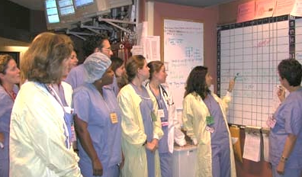
Briefing Checklist
TOPIC
Who is on core team?
All members understand and agree upon goals?
Roles and responsibilities understood?
Plan of care?
Staff availability?
Workload?
Available resources?
Notes:
SAY:
You will find typical things on a briefing checklist, and many examples are available. You may need to customize a checklist to fit the needs of your surgical area. Who is on the team? Do we have those roles? Do you understand your assigned role? Do we have a plan of care? In the event of a long case, what staff availability issues, breaks, or turnover issues are present? Any potential workload or resource issues, like equipment and supplies, or anything that could impact the case, should be discussed in the briefing.

Slide 11
Team Debrief
What can we do better next time?
Brief, informal information exchange and feedback sessions
Occur after an event or shift
Stress learning and improvement
Designed to improve teamwork skills
Designed to improve outcomes
  Accurate reconstruction of key events
  Analysis of why the event occurred
  Focus on what should be done differently next time
Notes:
SAY:
To recap, a debriefing provides an opportunity to reflect, learn, and drive continuous improvement. It can cover communication and interactions immediately after the case.
ASK:
How well did we interact together?
Did you not have the information you needed?
Were you working under a plan that was not consistent with what I thought the plan was?
SAY:
Debriefing can and should also cover topics that need more attention to address. We will share examples of equipment issues and malfunctions, or other defects that require a system correction. Take the opportunity to log any findings, discuss the problems, and direct the issue to where it can be resolved.
A strong feedback loop is absolutely critical for debriefing to achieve results. Debriefing alone can be an immensely powerful tool to raise awareness of provider concerns and engage providers in safety improvement work. Rather than expecting staff to complete yet another task with the information falling into a black hole, followup on issues identified from debriefing. As defects are addressed, share this feedback with all providers.

Slide 12
Root Causes of Sentinel Events in 2013²
63%
12%
11%
Reviewed by The Joint Commission in 2013
Notes:
SAY:
Communication failures across the health care system contribute to more than 60 percent of sentinel events. The Joint Commission defines a sentinel event as an unexpected occurrence involving death or serious physical or psychological injury, or the risk thereof. Serious injury specifically includes loss of limb or function.
ASK:
What can we do to improve communication among our surgical teams?

Slide 13
Evidence Supports Briefings
Reduce communication breakdowns and operating room delays³
Reduce procedure and miscommunication-related disruptions and nursing time spent in core⁴
Improve communication and teamwork, as feasible given current workload⁵
Reduce rate of complications, surgical site infections, and mortality⁶
Notes:
SAY:
Many studies link briefings and debriefings in the surgical services to key outcomes. There are no large, multiple site randomized controlled trials that have examined preoperative briefings or postoperative debriefings to date. However, there have been several multisite studies that found preoperative briefings to be effective when done as intended, rather than perfunctory ticking off the boxes.
You can reduce the number of communication breakdowns. You can reduce operating room delays. Reduce procedure and miscommunication-related disruptions. Reduce traffic in the operating theater. Briefings and debriefings can improve communication and teamwork; reduce complications like surgical site infections (SSI), and reduce mortality rates.

Slide 14
Evidence Supports Briefings
Discussions across disciplines make briefings and debriefings effective⁷
Checklists where providers “tick the box” are not effective^{6,7}
Complete briefing defined as a preoperative meeting where all team members are present and contribute^{8–10}
  Conducted in only 62% of over 6,700 cases at 5 hospitals¹⁰
  Could have prevented 14% of complications other than death¹⁰
Notes:
NOTE:
See Russ et al., 2013 for a review of existing literature. See Haynes et al, 2011 and Mayer et al., the 2015 study of the WHO surgery checklist in 8 hospitals in 8 different countries and followup rebuttal to arguments highlighting mixed results found in other smaller studies.
SAY:
Existing evidence demonstrates that it is the discussion, particularly across disciplines that make briefings and debriefings effective. Just the act of ticking off the box on a briefing checklist is not effective.
A complete briefing is defined as a preoperative meeting where all team members are present and contribute to the discussion. A study of 6,714 surgical admissions across 5 academic and community hospitals suggested that complete briefings were conducted in only 62 percent of surgical cases. Results suggested that 14 percent of complications other than death could have been prevented with complete briefings.

Slide 15
Evidence Supports Briefings
Create shared mental model among team members¹¹
Reduce task-related conflict in multi-disciplinary teams¹²
Clarify roles and responsibilities^{8,9,12}
Anticipate changes and plan for emergent patient needs¹¹
Notes:
ASK:
Why are briefings effective?
SAY:
Briefings provide a critical mechanism for creating a shared mental model among team members. This is particularly critical for reducing task-related conflict in multidisciplinary teams. The surgical setting involves functionally diverse teams, where people do different tasks based on specialized knowledge and must work together to coordinate their efforts. These differences increase the probability that team members may see or perceive the teams needs, goals, or priorities differently, leading to conflict or unclear expectations. Briefings can help clarify roles and responsibilities, as well as how they might change or be adapted in an emergency.

Slide 16
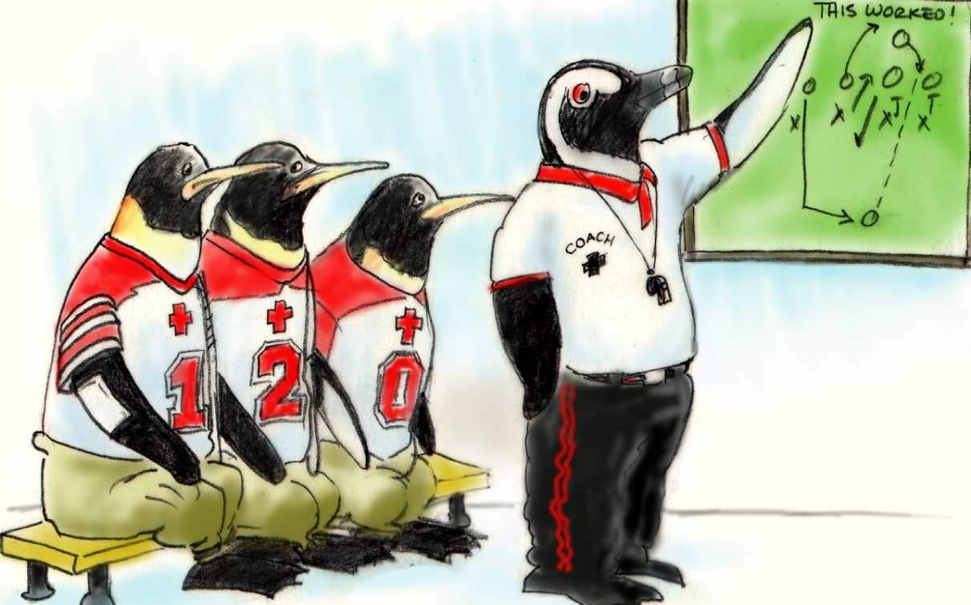
Briefing and Debriefing Checklist
TOPIC
Communication clear?
Roles and responsibilities understood?
Situation awareness maintained?
Workload distribution?
Did we ask for or offer assistance?
Were errors made or avoided?
What went well, what should change, what can improve?
Notes:
SAY:
A debriefing checklist addresses how the team works together.
ASK:
Was our communication clear?
Were our roles and responsibilities clear?
Were we able to maintain a common situation awareness of what was happening?
Did we do a good job of managing the workload and switching people in and out for long cases?
What went well, what should we change, and what can we improve next time?

Slide 17
Why Briefings and Debriefings?
Teams perform better when they–
  Have a high-quality plan
  Share that plan
  Learn and improve over time
Briefings and debriefings can help, but they do not guarantee good planning.
Checking the box Mindful engagement
≠
Notes:
SAY:
Fundamentally, these goals are quite basic. We know teams perform better when they have a plan, when that plan is shared and coordinated, when all involved understand the approach, and last, when they are overcoming obstacles that obstruct that plan.
Despite these simple concepts, it remains tricky to get them to work.
ASK:
Is this because many briefings and debriefings have devolved into mere checklists?
SAY:
Checklists can be great tools and consistent reminders of how to walk through a process. But checking the boxes does not equate to mindful engagement, as the evidence clearly demonstrates.

Slide 18
Why Briefings and Debriefings?
Surgical safety checklists associated with significant reductions in mortality⁶
Later, 50% of reductions associated with preexisting safety culture rather than checklist alone¹³
  Surgical units with strong safety culture yielded significant benefit with briefing checklist
  Units with weaker safety culture saw minimal improvement
Staff that value teammates and tools are mindful of process and achieve results
Notes:
SAY:
When the World Health Organization published its surgical safety checklist a number of years ago, the use of briefing and debriefing checklists was associated with large reductions in mortality. That checklist is included on Slide 29. Later studies failed to see that effect, including a followup on that initial WHO study. The evidence showed that 50 percent of the decrease in mortality was associated with the facility’s preexisting safety culture, rather than the checklist. So, if an organization enjoyed a good safety culture, implementing these tools yielded significant benefit. But an organization with a relatively poor safety culture saw minimal improvement from the checklist tools.
And that is because of mindfulness. When people value these tools and their teammates, they pay attention to them as they use new tools, with significant results. If staff members do not feel valued and simply check off a box, it becomes an administrative task without strong benefits. Building mindfulness and improving the overall safety culture is the tough but necessary part of any intervention.

Slide 19
How Do You Create a Mindful Process?
Coaching, role modeling, and feedback
  Show that the organization values this process
  Build effective communication behaviors
Briefing and debriefing process closes the loop with outcomes
  Identifies defects and encourages correction
  Validates the process
Notes:
SAY:
Two ways to build a mindful process include coaching and briefing. Coaching involves role modeling and feedback. It’s having leaders who recognize the value of effective communication and model that behavior for peers. These leaders and champions are respected in the organization and show by example that the organization values this behavior. As discussed earlier, evidence shows that active executive partnerships sustain improvement efforts.
Second, the briefing and debriefing process closes the loop with outcomes. Nothing is more demotivating to frontline staff than repeatedly dealing with the same issues.
ASK:
Can you imagine the frustration of debriefing after each case and it sounds like a broken record? The same issues resurface in case after case, but nothing changes.
Will they continue to debrief on those issues?
Why would anyone waste time?
SAY:
That debriefing process is going to fade over time if nothing changes. Debriefing identifies system defects in a way that allows and encourages correction. It validates the process and encourages a consistent delivery of care.
ASK:
How are you going to leverage debriefing and achieve meaningful results?
How are you going to track those defects, follow up, and advise staff on the resolution?
SAY:
It is an investment, but it is critical to value frontline staff, resolve barriers to system issues, and ultimately improve patient care.

Slide 20
Operating room briefings and debriefings
AHRQ Safety Program for Surgery
Implementation

Slide 21
Timeout: The Universal Protocol
Right patient
Right procedure
Right site
Notes:
SAY:
Timeout is one form of a briefing that challenges teams. Often, the timeout has become an administrative function. We know this because wrong-sided surgeries would never happen if timeouts were more effective. But that’s not the case. But timeouts provide a hard stop at a critical time to confirm the care team on the right page with this patient.

Slide 22
Briefings: Expanding the Timeout
Introduce all team members by first and last names
Write names and roles on white board
Facilitate timeouts
Share goal of the operation (surgeon)
Identify all issues or concerns (entire team)
Notes:
SAY:
Briefings are an expansion of the timeout with more flexibility. Different sections can occur at different times. In fact, that flexibility is paramount to success—making sure the briefing protocols fit the workflow of your cases, your day, and how your team works together.
In many briefing and debriefing processes, one particular flaw has been noted repeatedly–timing. If a protocol requests information at the wrong point in time, it interrupts the case rather than supporting team communication and execution of tasks. It is not helpful to question patient positioning at the point of incision. A briefing protocol must reflect the process your frontline providers have established for each surgical area.
Successful briefings allow all team members to introduce themselves, particularly in clinical settings that frequently include new faces on the surgical team. Write down the assigned roles on a white board and give team members an opportunity to share relevant skills. Encourage full participation and questions, including how to facilitate a timeout.
The surgeon should share the goal of the operation. Each care team member should have the opportunity to identify issues or ask questions.

Slide 23
What Is Most Likely To Go Wrong?
Safety concerns
Identify critical steps of the procedure?
Is required equipment available?
Is someone trained on the equipment available?
Is instrumentation available?
Need implants?
Has attending physician reviewed latest test results from lab and radiology?
Notes:
ASK:
What is most likely to go wrong?
Where are the critical steps of this procedure?
What equipment do we need to have available?
Do we have the right expertise available to use that equipment, any instrumentation, implants, et cetera?
Has the attending physician reviewed the latest x-ray and lab results?
SAY:
Discuss these safety concerns. These are types of questions frontline providers need to know before every case. .

Slide 24
What Is Most Likely To Go Wrong?
Operating room best practices
Antibiotic type, dosage, and redosing
Beta blockers
Glucose control
Positioning
Blood loss and blood availability
Deep vein thrombosis prophylaxis
Normothermia warmers usage and availability
Notes:
SAY:
Include your surgical site infection intervention bundle on your briefing checklist. This provides an opportunity for the surgical team to process each item before the case starts.
ASK:
Do we have enough of the right type of antibiotics on hand?
SAY:
Cover beta blockers, glucose control, positioning (at the right point in time), blood loss and blood availability, deep vein thrombosis prophylaxis, patient warming, et cetera. It does not take much time for the surgical team to run through relevant items.

Slide 25
What Is Most Likely To Go Wrong?
Other concerns
Special precautions
Bed availability
Intensive care bed requirement
Staffing and shift changes
Time allotted for procedure
Notes:
SAY:
Include other concerns that may complicate the case, such as special precautions, bed availability, any special requirements for the patient setting after the surgery, staffing, et cetera.

Slide 26
Briefings: Best Practices
All team members should be present and participating, including the surgical attending
May include the patient in the discussion
Assign a point person to own the process
  Initiate the tool or checklist
Write names of providers on white board
Modify checklist to local context
Notes:
SAY:
It may seem oversimplified, but it is absolutely fundamental to have every member of the surgical team present and participating in the briefing process. In observations of hundreds of briefings, there was variability in who was actually present. In addition, we have also found significant variability in who engaged actively in the discussion.
Often the circulating nurse leads the protocol, while the rest of the team either listens passively or is distracted with other tasks. While many hospitals may label that exchange a briefing, it does not improve team communication, efficiency, or likely even patient care.
ASK:
How do you get everyone attending and participating in the briefing?
SAY:
Assign a point person to own the process and initiate the tool or checklist. Develop a structure that allows everyone to share information. Whiteboards make a visual and visible statement in the clinical environment, one that has been well received in several hospitals. Write the names of providers on the white board; this will reinforce team members’ ability to recall names, assess skill level, recognize roles and acknowledge assigned tasks.
Start with either your existing protocol or one from another organization, but tools must be tailored to fit your clinical area and work processes. Engage frontline providers through your CUSP team to design the checklist and process that mirrors your local context­­. They should pilot and revise any tool based on feedback from the frontline staff using the tool.

Slide 27
Timeout: Prior to Incision
Confirm patient identity, site, and procedure
Review perfusion plan, including–
  Cannulation
  Perfusion pressure goals
  Temperature
  Transfusion target
Confirm sterile environment
Confirm prophylactic antibiotic and beta blocker administration
Discuss glycemic control goals
Confirm blood availability
Notes:
SAY:
A timeout can occur just before incision to verify the patient identity, surgical site, and procedure. Review the perfusion plan, including cannulation, perfusion pressure goals, temperature, and transfusion target. Ensure the operating room is sterile and that prophylactic antibiotics and beta blocker plans are communicated and can be administered. Discuss the glycemic control goals and confirm the blood availability. Again, you will need to adjust the content for your timeouts to include all relevant information for your surgical setting.

Slide 28
Timeout: Best Practices
All team members present
Use a checklist to serve as reminder
Encourage 100% participation
Notes:
SAY:
Successful briefings and timeouts require the presence and attention of all team members. Briefings and timeouts should follow a checklist valued by the frontline providers using it. This improves the flow of information and the expectation of team members, and allows any uncertainties to be addressed proactively.

Slide 29
Debriefings in the Operating Room
Before surgeon leaves the operating room–
How could the case have been safer or more efficient?
Were any issues encountered including good catches?
What went wrong?
Were patient identification, history number, specimen name, and laterality correctly listed on paperwork via independent verification?
Is plan for postoperative transition of care communicated?
Notes:
SAY:
Structure debriefings so that they happen before the surgical attending leaves the operating room. As much of the team as possible should be present. That can prove a logistical challenge as staff may leave at different times. Finding the appropriate time to perform a short debriefing can be a challenge, but can be achieved.
ASK:
What could have made the case safer?
Were there any issues encountered?
Any good catches?
What went wrong, if anything?
Were patient identification and specimen name verified?
Is the plan for postoperative transition of care communicated?

Slide 30
Debriefings: Best Practices
Develop a system to review identified issues
Review issues with surgical site infection improvement team
Use the Learning From Defects tool
  Identify all contributing factors
  Develop plan to prevent defects from happening again
Notes:
SAY:
Debriefing comments present tremendous opportunities for patient safety improvement. Develop a system to review the issues or defects identified during the debriefing process. System defects cannot likely be corrected at the end of each case, but those comments are the challenges your frontline staff face on a regular basis. Review those defects with your CUSP team or a surgical site infection quality improvement team. The team can prioritize the issues and start addressing them. Some of them will be very easy fixes; some will not.
Use the Learning From Defects tool. It provides a strong structure to work through the problem and identify all contributing factors. With input from all stakeholders, you can develop a sustainable solution that meets the needs of the frontline staff and the patients.

Slide 31
Real-Time Identification of Defects
Customize form based on needs in your surgical unit
Initiate candid discussions with surgeons about effective strategies for briefing and debriefing
Provide protected time for nurse to address defects and communicate solutions
Maintain logbook of defects
Notes:
SAY:
To reiterate, customize every communication tool based on the needs in your surgical unit. Surgeons often lead the surgical care team and the formal conversations about each case. Initiate candid discussions with surgeons about effective strategies for briefing and debriefing. Share your expectations for the briefing and debriefing process in terms the surgeon can relate to. For instance, tell the surgeon how you will support their needs by addressing issues that plague their cases. Then show them.
The power of debriefings grows after the debrief ends. You will find a real-time identification of defects and real-time system of learning. Allocate protected time for a nurse to address the defects. Even a small amount of time, as little as 4 hours a month, can make a difference visible to the surgical staff. Keep a record of defects with a tracking mechanism of progress or actions taken. Share the log and progress at staff meetings. This feedback will show your staff that your organization value staff input and is willing to invest resources to alleviate staff concerns.

Slide 32
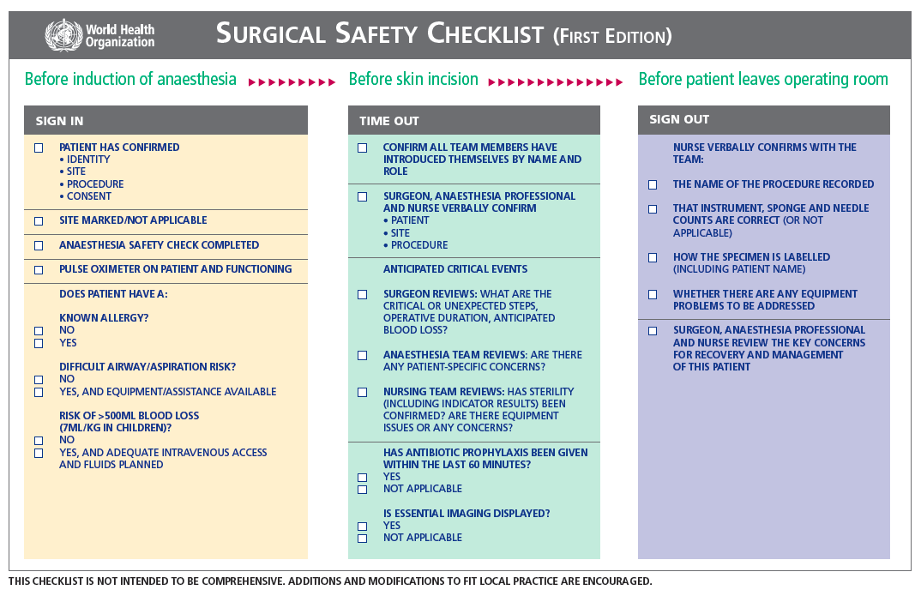
World Health Organization Checklist¹⁴
Notes:
SAY:
You may be familiar with the surgical safety checklist developed by the World Health Organization. If you do not already have a briefing checklist, it may provide a starting point for developing one that fits your surgical area.

Slide 33
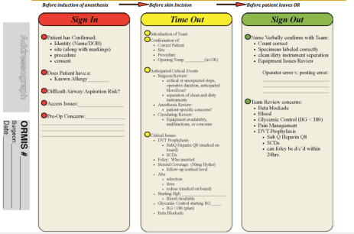
Colorectal Surgical Safety Checklist
COLORECTAL SURGICAL SAFETY CHECKLIST
Sample checklist created for colorectal surgical unit
Model for Briefing and Debriefing tool
Notes:
SAY:
Here is a briefing tool developed by the colorectal CUSP team for Johns Hopkins Hospital. It is more streamlined, designed specifically for its patient and case needs.
The debriefing tool is very simple, featuring a few lines to record anything that needs to be addressed for future cases. The perioperative or circulating nurse often completes this form, but your team can decide on the appropriate role on your unit.

Slide 34
Debriefing Defect Logbook
Sample debriefing log of defects
NURSE | ANESTHES-IOLOGIST | EQUIPMENT | COMMENT | ACTION PLAN
Smith | Jones | Instruments | Wrong tray; got a medium, but needed major 1 & 2 | Check type of case; possible preference card update
Hanks | Wilson | Equipment | Ultrasound was needed in another room, repeated calls during critical part of case. Frustrated M.D. stopped the procedure for the other OR and waited 15 minutes for the equipment to be returned | Contacted ultrasound manager Bob about getting another device. New clinical building impact; plan to teach sonographers how to use an alternate device in some cases to alleviate burden in short-term; long-term fix under review
Notes:
SAY:
This logbook example was first shared in the Implementing Your SSI Bundle module. It includes the type of issue, the stakeholders, details about the defect, and the action plan. Very simple in nature, it provides a mechanism to log defects and track progress. Share with your staff the issues identified last month or last quarter, the issues resolved, and any issues in progress and the status.

Slide 35
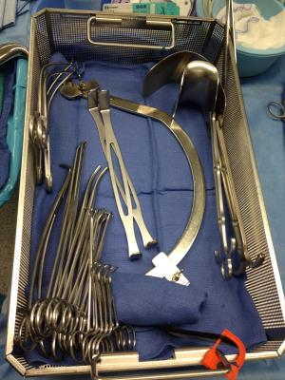
Example of Defects Addressed: Instruments
Problem
Conflict with colorectal surgical instrument set
Solution
Increased fleet from two to four
Reorganized set contents so it is only pulled for cases when needed
Impact
Instruments available when needed
Notes:
SAY:
You may recall this example from the Implement Your SSI Bundle module. The colorectal team identified a shortage of instrument sets numerous times through the debriefing process. Based on the recorded evidence, the team was able to advocate for expanding the fleet. Without the documented track record of multiple cases impacted by missing equipment, the hospital had not prioritized the request for additional resources.

Slide 36
Case Study: Laparoscopic Surgery Trays
Problem
Laparoscopic gastrointestinal tray had 137 instruments including many unnecessary implements
Hospital unionized employees processed open instruments, while contractors processed laparoscopic instruments
Reduced laparoscopic tray instruments by 60% to 54 key instruments
Fewer instruments to count and turn over saved money and time
Barriers
Intervention
Impact
Notes:
SAY:
Debriefing also uncovered an inefficiency related to instrument sets. The original laparoscopic gastrointestinal sets had almost twice as many instruments, requiring long counts of many instruments routinely not used on cases.

Slide 37
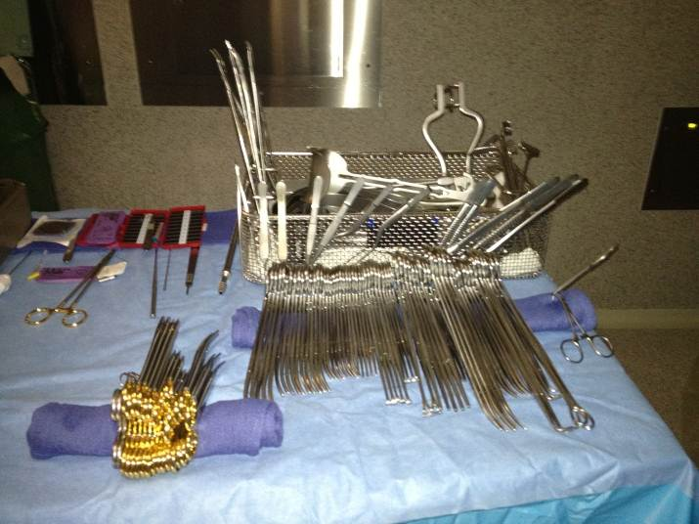
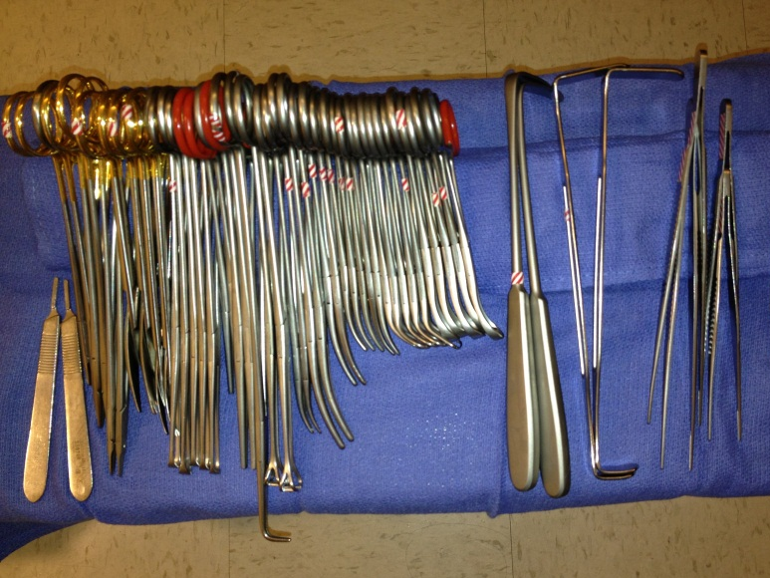
Case Study: Laparoscopic Surgery Trays
BEFORE
AFTER
137
instruments
54
instruments
Notes:
SAY:
Debriefing at the end of a case, the staff questioned why the sets included so many instruments that were not used. That comment was addressed through the CUSP team, and the trays were updated to reflect current needs.

Slide 38
Examples of Defects Addressed
Postings
Problem
Circulating nurse and scrub technician could not tell from posting if an abdominal and perineal setup was needed
Solution
Worked with posting office
Add “second setup needed” to posting sheet
Add surgeon notes section in perioperative management system
Impact
Set up before discussing case with surgeon
Incur fewer delays
Notes:
SAY:
This example stems from confusion around how cases were posted. Nursing staff had difficulty recognizing when different sets were needed for abdominal versus perineal cases. The equipment issues and subsequent delays were captured and recorded in the debriefing process. The CUSP team worked to change how the cases were posted. The new posting language, shown here, provides much clearer instructions about the equipment required for the upcoming case. Preparation for the case could begin before briefing with the surgeon with fewer errors and delays.

Slide 39
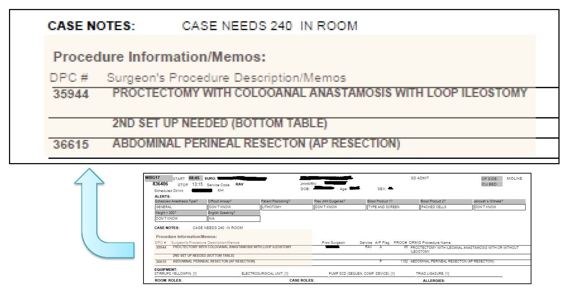
Examples of Defects Addressed
Postings
Sample posting from Johns Hopkins Hospital
Notes:
SAY:
The new posting language, shown here, provides much clearer instructions regarding the equipment required for the upcoming case.

Slide 40
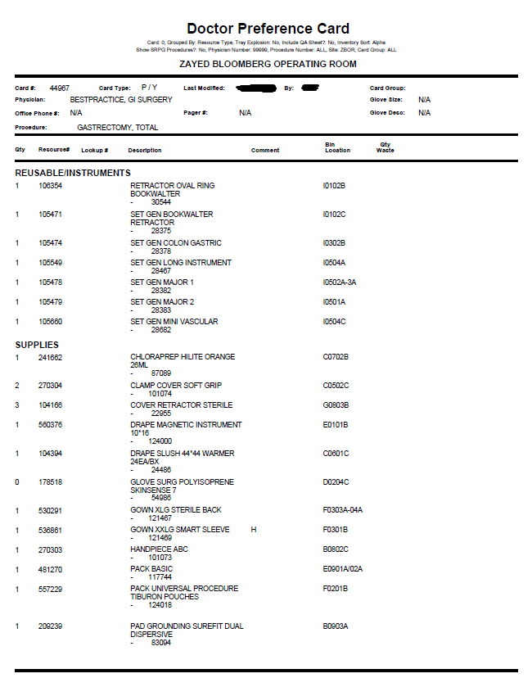
Examples of Defects Addressed
Update doctor preference cards (DPCs)
Problem
Equipment and/or instruments not available for cases
Solution
Decreased number of DPCs
Impact
Decreased surgeon to surgeon variability
Increased accuracy and efficiency
Sample DPC from Johns Hopkins Hospital
Notes:
SAY:
This is a strong example because preference cards cause headaches in hospitals all over the country. Preference cards specify surgeons’ preferred instruments for each procedure, but are often out of date or incomplete. In addition, the cards increase the inconsistencies between individual surgeons. By tackling the preference cards, the safety program team decreased the overall number of preference cards, removed inaccuracies, reduced waste, and drastically reduced variability among surgeons. Because the team included a respected surgeon champion, the team was able to respect the individual provider needs while also improving consistency. These changes resulted in quantifiable improvements in number of errors, inefficiencies, and counting time. Recall from the science of safety the first step—standardize care. The surgeons appreciated having the correct equipment available on time and the surgical team was better prepared for their cases.

Slide 41
What Can We Catch?
Wrong consents
Wrong patients
Incorrect equipment, implants, or instruments
Comorbidities that have a surgical impact
Incorrect specimen labels
Documentation issues
Unclear perioperative care instructions
Notes:
ASK:
What harm can you avoid?
What can we catch with briefings and debriefings?
Do we have the right consent?
Do we have the right patient?
Are we prepared with the right equipment, implants, instruments, and those types of things?
Have any specimens been labeled correctly?
SAY:
Raise the care team awareness of each patient’s needs, such as comorbidities, specimens, and documentation. Ultimately, patient care can be improved through effective briefings and debriefings.

Slide 42
What Can We Accomplish?
Create a shared mental model
Reduce missing equipment
Minimize team disruptions and reduce distractions
  Contribute to more than 70% of sentinel events^{5,6}
  Reduce hazards
Notes:
SAY:
The goal is to build a shared mental model among your team—the same idea about who is on the team, what the plan is, how to work together, what the patient needs.
Teams can reduce missing equipment and reduce hazards.
ASK:
Did you know that more than 70 percent of sentinel events involve human factors, such as team disruptions and unnecessary distractions?

Slide 43
Adapting to Local Context
Make interventions relevant and meaningful to staff
  Ineffective and inefficient to use the same checklist for all procedure types
  Adapt tools to needs of your clinical area
Allow frontline staff to drive improvement efforts
  Perioperative Staff Safety Assessment (2 questions)
  Surgical audits tools
Fixing local defects is a powerful (and visible) strategy to gain staff buy in and encourage participation
Notes:
SAY:
Over time, effective briefings also improve safety culture. They intersect the technical work of preventing SSIs with the adaptive work of teamwork and communication.
The interventions must be relevant and meaningful to your frontline providers. Avoid an irrelevant checklist that looks more like an outdated administrative task. Engage the people who will use the tool to customize it for their clinical area. Use the two-question survey, the Perioperative Staff Safety Assessment, for staff input. The surgical audit tools will also identify system flaws.
Fixing local defects is a powerful and visible strategy to gain staff buy-in and encourage participation.

Slide 44
Lessons Learned
Briefings and debriefings–
Reshape safety culture with time and commitment
Foster safety culture growth
Practice and expect open communication
Flatten the hierarchy
Focus on the patient
Adapt to local context so are meaningful to staff
Identify defects proactively as they occur
Notes:
SAY:
Reshaping safety culture takes time, commitment, energy, and focus. Briefing and debriefing provide powerful tools for real improvement in communication and teamwork.
It flattens the organizational hierarchy and places the focus firmly on the patient. It shares the wisdom of every role. By adapting to the local context, the process becomes meaningful to your frontline providers. Identify and address defects proactively to improve work processes and improve patient care.

Slide 45
Next Steps
Evaluate how tools fit into your local context
Get input from all stakeholders
Modify the tool to fit your needs
  Tailor to specific surgical procedure areas
  Create followup mechanism to address defects identified during briefings
Identify a surgeon champion who will implement briefings and debriefings for surgical cases
Pilot, revise, and implement briefings
Notes:
SAY:
Evaluate how these tools fit your local context. Recognize that every hospital team is likely in different stages with briefings and debriefings.
ASK:
Are there opportunities to revamp your process?
SAY:
Start by getting input from stakeholders. Ask what works and what does not work or what is missing. Tailor the tools to fit your intervention bundle and surgical area. Develop a process to follow up on the comments, or defects, uncovered during the debriefing process.
Identify a surgeon champion to pilot the new and improved briefing process. Observe the process and solicit feedback. It may take a few iterations to develop a process that works well. Be prepared to test, revise, and continually improve.

Slide 46
References
Pronovost PJ, Cardo DM, Goeschel CA, et al. A research framework for reducing patient harm. Oxford Journals. 2011;52(4):507-13. PMID: 21258104.
Sentinel Event Data: Root Causes by Event Type, 2004-2013. The Joint Commission. Office of Quality Monitoring. Apr 15, 2014. http://www.jointcommission.org/se_data_event_type_by_year_/. Accessed on Jan 9, 2015.
  Nundy S, Mukherjee A, Sexton JB, et al. Impact of pre-operative briefings on operating room delays: A preliminary report. Arch Surg. 2008; 143(11): 1068-72. PMID: 19015465.
  Henrickson SE, Wadhera RK, Elbardissi AW, et al. Development and pilot evaluation of a preoperative briefing protocol for cardiovascular surgery. J Am Coll Surg. 2009; 208:1115-23. PMID: 19476900.
  Berenholtz SM, Schumacher K, Hayanga AJ, et al. Implementing standardized operating room briefings and debriefings at a large regional medical center. Jt Comm J Qual Saf. 2009; 35(8):391-7. PMID: 19719074.

Slide 47
References
  Haynes AB, Weiser TG, Berry WR, et al.; Safe Surgery Saves Lives Study Group. A surgical safety checklist to reduce morbidity and mortality in a global population. N Engl J Med. 2009; 360:491-9. PMID: 19144931.
  Russ S, Rout S, Sevdalis N, et al. Do safety checklists improve teamwork and communication in the operating room? Asystematic review. Ann Surg. 2013 Dec;258(6):856-71. PMID: 24169160.
  Treadwell JR, Lucas S. Preoperative checklists and anesthesia checklists (ch. 13). Making health care safer II: An updated critical analysis of the evidence for patient safety practices. Evidence Reports/Technology Assessments, No. 211. Rockville (MD): Agency for Healthcare Research and Quality (US); 2013 Mar. Report No.: 13-E001-EF.
  Treadwell JR, Lucas S, Tsou AY. Surgical checklists: a systematic review of impacts and implementation. BMJ Qual Saf. 2014 Apr;23(4):299-318. PMID: 23922403.

Slide 48
References
  Mayer EK, Sevdalis N, Rout S, et al. Surgical checklist implementation project: the impact of variable WHO checklist compliance on risk-adjusted clinical outcomes after national implementation: a longitudinal study. Ann Surg. 2015 Mar 13. PMID: 25775063.
  Marks MA, Zaccaro SJ, Mathieu JE. Performance implications of leader briefings and team-interaction training for team adaptation to novel environments. J Appl Psychol. 2000 Dec;85(6):971-86. PMID: 11125660.
  Cronin MA, Weingart LR. Representational gaps, information processing, and conflict in functionally diverse teams. Acad Manage Rev. 2007 Jul;32(3):761-73.
  Haynes AB, Weiser TG, Berry WR, et al.; Safe Surgery Saves Lives Study Group. Changes in safety attitude and relationship to decreased postoperative morbidity and mortality following implementation of a checklist-based surgical safety intervention. BMJ Qual Saf. 2011 Jan;20(1):102-7. PMID: 21228082.
  Health Organization. Surgical Safety Checklist. http://www.who.int/patientsafety/safesurgery/tools_resources/SSSL_Checklist_finalJun08.pdf. Accessed on Aug 17, 2015.

Slide 49
Hospital team EXPERIENCE
AHRQ Safety Program for Surgery
Implementation
Briefings and Debriefings
Notes:
SAY:
Here is a brief overview of one surgical team’s experience implementing the briefing and debriefing process.
I will share some background information on this hospital for your reference. It has 10 operating rooms and averages about 800 cases a month. It covers all procedures except for transplants.
Three hospitals in the network have adopted this safety program process as well.

Slide 50
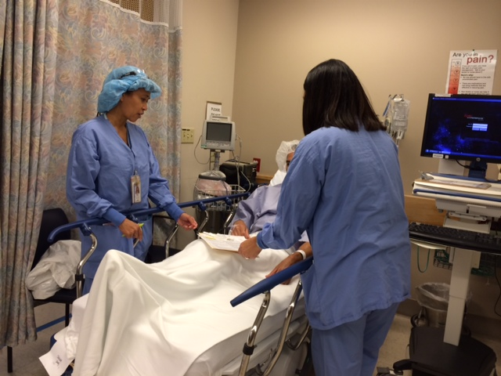
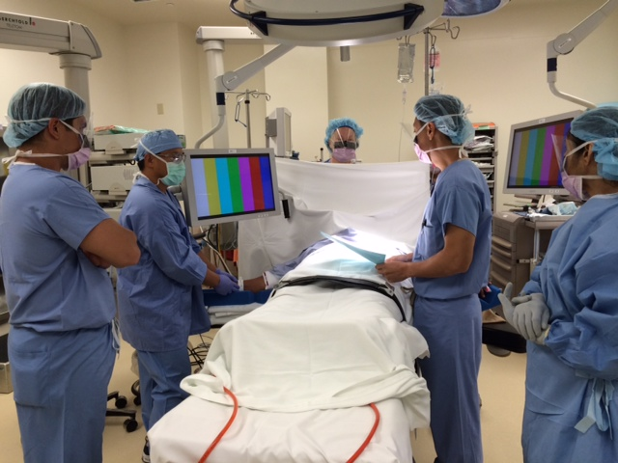
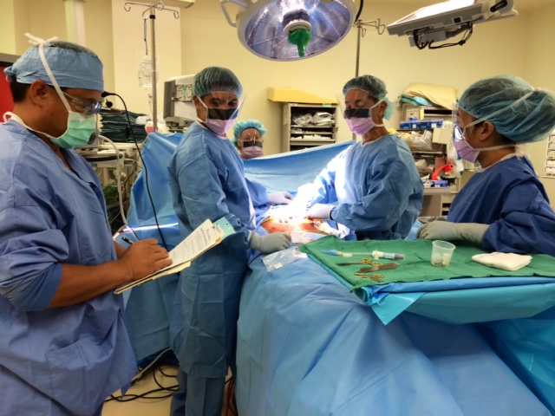
Briefings and Debriefings
Preoperative Verification
Briefing or Timeout
Debriefing
Notes:
SAY:
The surgical teams employ preoperative procedure verification, briefing, and timeout with a whiteboard before the start of each case.

Slide 51
Barriers to Debriefing
Team needed approval from the administration
Staff hesitant to incorporate another form
Team questioned if staff would comply with new form and process
Notes:
SAY:
This process started 3 years ago. At the hospital, it was handed down from the administration and was not initially well received. I am sure you can relate to yet another paper form. Hospital staff questioned whether it was going to work; what did they want staff to do? It’s been a journey. After the initial hesitation, the team was surprised with the success. That is one of the reasons the team wanted to share it.

Slide 52
Success With Debriefing
Championed by the surgical quality improvement team
Provides process to document concerns and issues
Reviews and shares followup opportunities
Improves morale as staff and surgeons see issues addressed
Reduces number of less-urgent issues escalated to management
Notes:
SAY:
It took having physician champions and surgeons onboard that made the implementation happen. As mentioned earlier, the system in place to document these issues is the first part. You definitely have to share it and follow up on the issues.
It was not easy, but the staff saw the team following up on issues. Morale went up, and it even helped with management. Before this process, staff were constantly interrupted with nonurgent issues. Now, providers document on the debriefing form and are confident that it will be followed up. So I’ll share with you how that followup is done.

Slide 53
Tips for Successful Debriefing
Make process easy for staff to use
  Place form in chart for every case
Provide a system to review issues
  Review with operating room management, staff, and surgeons
  Assign followup actions
Be transparent
  Keep a log of all defects
  Prioritize which (and when) defects will be addressed
  List steps taken to address defects
  Share the resolution of defects
Notes:
SAY:
Three things made the new process successful and continue to drive progress.
First, it needs to be a system that is easy to use. Previously, each operating room had a glitch book. It proved a difficult system: the book had to be located to record an issue; then it had to be collected, reviewed, and returned. The system wasn’t used much.
Instead, the checklist is placed in each chart for every case, so it is consistently available when it is needed. It is turned in at the end of the case. The checklist does not remain with the chart, but stays in the department.
Second, develop a system to review issues. Nothing will kill a new process faster then never reading what the frontline providers took the time to record. Review the comments with operating room management, frontline staff, and surgeons. After issues are identified, assign followup actions to correct system flaws.
Third, be transparent. Keep a log of all defects and prioritize which defects will be addressed and when. Record the steps taken to address defects and share the resolution of defects. Provide updates on progress on more difficult issues that require more time to correct.

Slide 54
Intraoperative Debriefing
Perform at case completion, usually after the first count and before surgeon leaves the operating room
Cover what went well, good catches, and room for improvement
Ask if instrument, sponge, and needle counts are correct
Record name of procedure and wound classification
If applicable, specify how specimen labeled or provide special instructions
Address equipment issues
Plan postoperative beta blockers, if applicable
Communicate key concerns for recovery and management of the patient
Notes:
SAY:
The team goes through the debriefing process near the end of the case. At first, the surgeons challenged the new process. They were concerned that they were expected to stop during the case and handle paperwork. We assured them that the surgery would continue, but the nurse would debrief to confirm the procedure, how to label the specimen, what went well, and any need for improvement.
The team also covers equipment issues and communicates postoperative plans. The debriefing form gets turned in for every case, whether or not there was something to write. Also, staff confirm that each checklist is returned.
The operating room nurses appreciated the debriefing. At the end of the case, the nurse performs the handoff in recovery. Verifying the procedure name and specimen labeling became routine for the cases, so the handoffs went smoother and all doubt was alleviated. Specimens could be handled and labeled properly while the patient and the surgical team were still in the room. Previously, mistakes might be uncovered after the case’s conclusion when the team had dispersed.

Slide 55
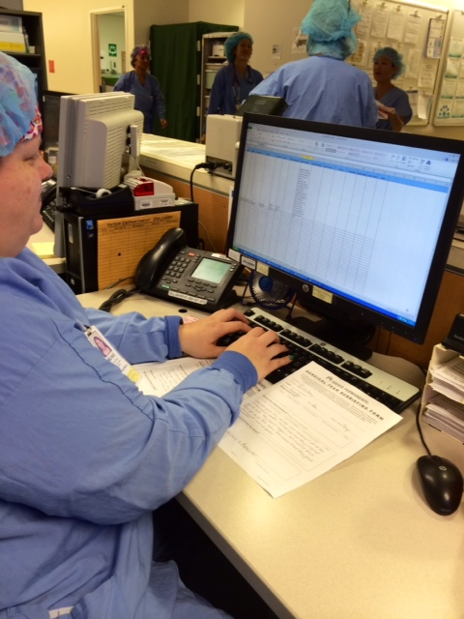
Logging Debriefing Comments
Record comments in a spreadsheet file
Use column headings applicable to local needs
Filter comments by subject, specialty, or procedure
Standing agenda item in the vascular team meeting reviews all vascular debriefing comments
Equipment issues reviewed in appropriate areas as well
Notes:
SAY:
A clerical staff member is assigned to input each debriefing comments on a daily basis. Our log is a spreadsheet that breaks the comments into categories. Then the appropriate comments are reviewed in the staff meeting for that group. For instance, any comments collected regarding the vascular surgical team are filtered and shared with that team.
The surgeons actually like the process. They can process the comments for the entire surgical area with all team members present. They are not involved in a case or with a patient. They became very invested in reviewing the comments and making improvements. Addressing those debriefing comments made their job easier.

Slide 56
Monthly Debriefing Report
Incorrect preference card
Inferior disposable light handles
Incorrect case scheduling
Not familiar with new equipment
Supply not available in computer to charge
Case not picked correctly
Carts and operating rooms not well stocked
Housekeeping not available to turn over room
Number of comments
Notes:
SAY:
A breakdown of the debriefing comments is posted each month. One issue pertained to disposable light handles. When the new equipment was piloted, it was OK. But once they were in the packs, the quality was poor. Multiple complaints about the light handles raised the priority, and the product was changed.
If staff mentioned they were not familiar with new equipment, a quick in-service training was scheduled. It was a concise way to share with the entire team the types of issues that were trending in their operating rooms.

