Slide 1
Building Your SSI Prevention Bundle
AHRQ Safety Program for Surgery
Onboarding
AHRQ Pub No. 16(18)-0004-15-EF
December 2017
Notes:
SAY:
In this module, you’ll learn about using building a local bundle to reduce surgical site infections.

Slide 2
Learning Objectives
After this session, you will be able to—
Develop and implement a surgical site infection (SSI) reduction goal and prevention bundle that addresses up to three surgical care processes
Build a bundle based on the results of your staff safety assessment
Review how to initiate audits of your processes
Create a team performance goal (improvement in outcome)
Proceed with improvements without strong evidence base
Locate AHRQ Safety Program for Surgery resources on the project Web site
Notes:
SAY:
After reviewing this module, you will be able to—
Develop and implement a surgical site infection or SSI reduction goal and prevention bundle that addresses up to three surgical care processes your team has identified for improvement
Understand how to use the results of your staff safety assessment to build a bundle
Review how to initiate audits of your processes
Create a performance goal (improvement in outcome) for your team
Learn how to proceed with improvements that do not have a strong evidence base
Locate safety program for surgery resources on the project Web site
Share what you have learned with your teams.

Slide 3
Background¹
Surgical site infections—
Are the most common nosocomial infections in the surgical patient
Are the most common colorectal abdominal surgery complications (3–30%)
Are associated with increased length of stay, readmission, and mortality
Cost, depending on infection location, $6,200–$15,000 per patient (superficial vs. organ space)
Notes:
SAY:
Colon surgery has some of the highest wound infection rates of any procedure. In the literature, the rates range from about 10 to 30 percent. Especially in colon surgery cases, patient with infections stay in the hospital longer, are more likely to be readmitted, have a greater need for reoperation, and have a higher mortality.
There are also less tangible or less direct consequences—such as lost work and the impact on family and friends who need to help care for patients with wound infections.
There’s also the cost consideration. Estimates are that wound infections cost the health system anywhere from about $6,200 to $15,000 per patient. The cost depends on the type of wound infection, whether it’s a superficial infection—which costs about $3,000 extra—or an infection in the abdominal cavity, which costs upwards of $15,000.

Slide 4
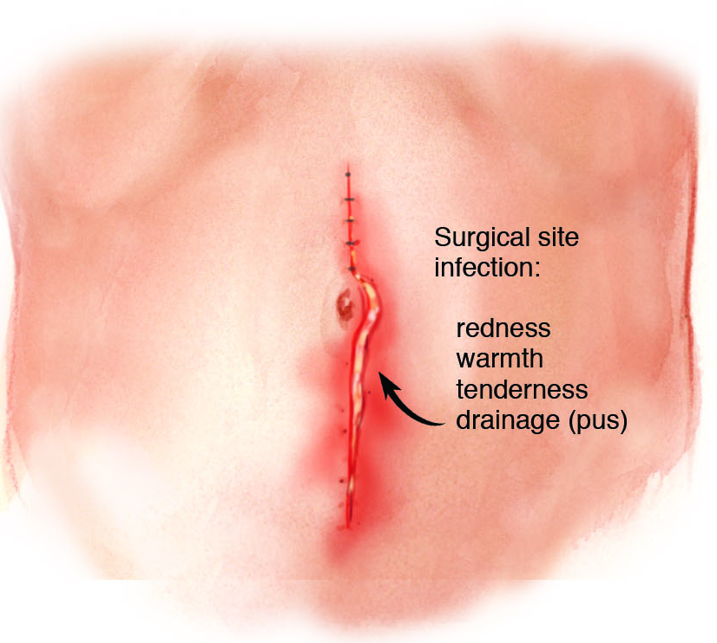
SSI Definitions²
Superficial
Purulent drainage from wound
Positive wound culture
Pain, redness, swelling
Diagnosis by surgeon
Deep
Purulent drainage from deep aspect of the wound
Dehiscence
Abscess on exam or CT scan
Organ Space
Infection in the surgical cavity (abdomen)
Notes:
SAY:
Let’s review definitions of wound infections. Standard definitions are on the Web site of the Centers for Disease Control and Prevention and on the Johns Hopkins Medicine Web site. Superficial wound infections are infections of the skin, seen with the naked eye and diagnosed when assessing a patient during a physical exam. For example, there’s purulent drainage from the wound, redness, and swelling, and wound cultures are positive for bacteria.
Deeper space infections are less common and trickier to diagnose. They’re on the deep aspect of the wound, at the level of the fascia, and are diagnosed with a computed tomography or CT scan.
And finally, organ-space infections are located in the surgical cavity. These can be abscesses that we drain in the surgical cavity with interventional radiology, surgery, or anastomotic leaks. Organ-space infections are the most complicated to treat, the most morbid, and the most expensive.

Slide 5
JHH Colorectal Surgery Readmissions
Readmission Rate: 17.6% (2009–12)
CHARACTERISTICS | READMITTED PATIENTS n=129, NO. (%) | NON-READMITTED PATIENTS n=606, NO. (%) | P | ODDS RATIO
INTRAOPERATIVE
Ostomy present | 74 (57) | 220 (36) | <0.001 | 2.59
Ostomy not present | 55 (43) | 386 (64)
Length of operation, mean hours (range) | 4.9 (1.5-12.2) | 4.2 (1.0-14.0)
POSTOPERATIVE
Surgical site infection (SSI) | 58 (45) | 108 (18) | <0.001 | 3.39
Superficial incisional SSI | 27 (21) | 89 (14.7) | 0.043 | 1.74
Deep incisional SSI | 4 (3.1) | 2 (0.3) | 0.004 | 14.78
Organ space SSI | 27 (21) | 17 (2.8) | <0.001 | 11.54
Length of stay, median days (range) | 9 (3-65) | 7 (1-153)
30-day mortality | 1 (0.8) | 19 (3.1)
Notes:
SAY:
In colorectal surgery patients, we have a readmission problem. The readmission rate at Johns Hopkins Hospital is about 18 percent. The factor driving readmissions is complications, and specifically infections, so care of coordination or handoff from post-discharge to home aren’t going to help these problems. SSI prevention is going to help keep these patients from being readmitted.

Slide 6
Pathogenesis of SSI
Host
Bacteria
Procedure
Notes:
SAY:
The pathogenesis of SSI is complicated. It reflects the interplay between the bacteria, the host, and the type of surgical procedure. For example, the colon is home to 100 trillion bacteria, especially gram-negative bacteria and anaerobes. This makes colon surgery much riskier for wound infections and other procedures.
Host risk factors include malnutrition, chemotherapy treatment, immunosuppressant medications, or steroids—all of which might weaken a patient’s immune system and make the patient more vulnerable to infection.
The type of procedure also influences a patient’s risk for wound infection. For example, infection risk differs whether a patient undergoes a rectal procedure or a colon procedure and whether an ostomy or stoma is involved.
Not surprisingly, there’s no one solution to preventing wound infection.

Slide 7
No Single SSI Prevention Bundle
Deeper dive into SCIP measures to identify local defects
Emerging evidence
  Antibiotics redosing and weight-based dosing
  Maintenance of normoglycemia
  Mechanical bowel preparation with oral antibiotics
  Standardization of skin preparation
Capitalize on frontline wisdom
  Comprehensive Unit-based Safety Program (CUSP)
  Staff Safety Assessment (SSA)
Notes:
SAY:
Based on this complexity, there is likely no one checklist or bundle for SSI reduction. Also, many hospitals have spent enormous amounts of energy and resources toward improving performance on the Joint Commission’s Surgical Care Improvement Project, or SCIP, measures, and it doesn’t make sense to ask hospitals to re-examine areas they already do well.
So in this program, we’re asking teams to identify local opportunities to improve in one of three ways:
In addition to SCIP measures, identify local defects that might contribute to SSI infection rates
Focus on some emerging evidence related to SSI reduction, including antibiotic redosing and weight-based dosing, maintenance of normoglycemia, the use of selected mechanical bowel prep with oral antibiotics, and standardization of the skin preparation
Mine the wisdom of frontline caregivers using the second step of the Comprehensive Unit-based Safety Program or CUSP—to identify defects, for example, by using the Staff Safety Assessment, in which we ask staff, how do you think the next patient will be harmed, how will the patient develop a surgical-site infection, and what we can do to try to prevent that harm?

Slide 8
Deeper dive into scip measures to identify local defects
Notes:
SAY:
In this section, we will take a deeper dive into SCIP measures to identify local defects.

Slide 9
Does SCIP Provide Enough Information?³
 | JOHNS HOPKINS | COMPARISON HOSPITALS
Surgery patients who were given an antibiotic at the right time (within 1 hour before surgery) to help prevent infection | 98% | 97%
Surgery patients who were given the right kind of antibiotic to help prevent infection | 98% | 98%
Surgery patients whose preventive antibiotics were stopped at the right time (within 24 hours after surgery) | 100% | 96%
Surgery patients who had hair removed from the surgical area before surgery using a safer method (electric clippers or hair removal cream instead of a razor) | 100% | 100%
Surgery patients who were actively warmed in the operating room or whose body temperature was near normal by the end of surgery | 98% | 99%
Notes:
SAY:
Remember that for most hospitals, SCIP represents a random sample of patients undergoing colon surgery. For example, SCIP data usually represent only about six patients a month even though you may do about 30 to 40 colorectal operations a month.
Looking at Johns Hopkins as an example, you can see that based on Hospital Compare data, Johns Hopkins Hospital does quite well at giving the right antibiotic to the patient at the right time. Johns Hopkins also does quite well at discontinuing antibiotics. However, other domains relating to antibiotic use can be improved.

Slide 10
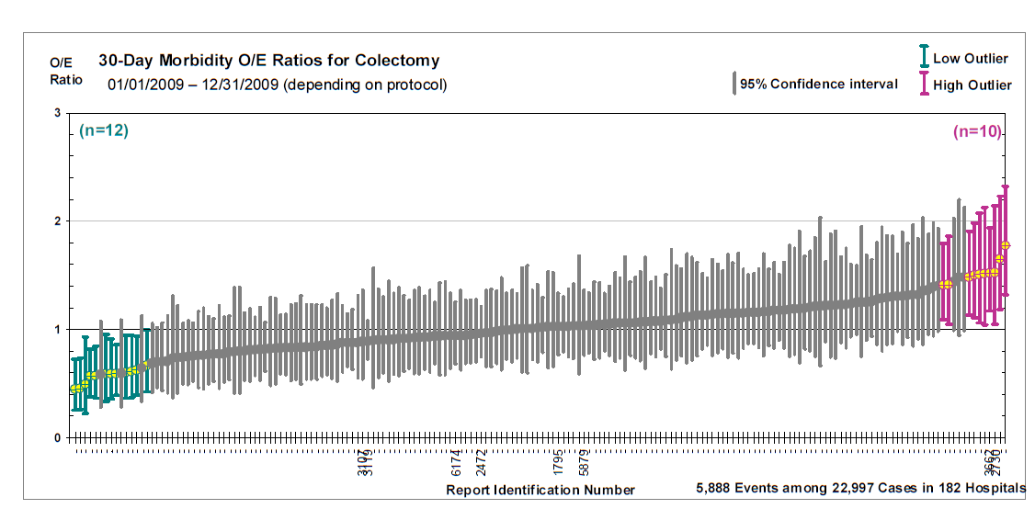
Observed to Expected Outcome Ratio
O/E means observed to expected; Report generated from NSQIP database in 2009
Notes:
SAY:
This chart shows the 30-day morbidity observed versus expected ratios for colectomy procedures from NSQIP in 2009.

Slide 11
Safety Issues & Improvement Opportunities⁴
CUSP STEP 2: SAFETY ISSUE IDENTIFIED | CUSP STEPS 4 & 5: OPPORTUNITIES TO IMPROVE
Infection Control | Skin preparation Hypothermia Contamination of wound with bowel contents | Antibiotic timing Selection and redosing Length of case
Coordination of Care | Increase utilization of preoperative evaluation center Improve surgical posting accuracy (case name and duration) Use computer assistance for antibiotic selection and redosing
Communication and Teamwork | Improve communication throughout perioperative period Empower team members to speak up Improve compliance with briefings/debriefings Implement teamwork tools
Equipment/Supplies | Accurate temperature probes Point of care glucose monitoring Under-body warmers Sanitizing wipes near anesthesia machine
Policies/Protocols | Standardize care/protocols/policies Monitor sterile technique policies
Education/Training | Ongoing education (with supportive data) Development of a SSI prevention checklist
Notes:
SAY:
These are the results of the Staff Safety Assessment conducted when Hopkins first started this work. And you can see, we identified defects with SCIP measures that the quality control department hadn’t noted.
The front line said, we’re not always giving the antibiotics at the right time. Sometimes they’re getting administered very quickly or maybe right at the incision. The right antibiotic use is inconsistent, and we’re definitely not redosing them. They even questioned whether our temperature data were accurate. They frontline suspected our temperature probes didn't work properly, and that some kind of under-body warmer would be more appropriate. So, those are things we thought we’d been working on as part of the SCIP measures, but the frontline indicated were not in place.

Slide 12
Perioperative Antibiotic Compliance
Michigan Surgical Quality Collaborative⁵
ANTIBIOTICS PRACTICES | ALL CASES n=3,002 NUMBER (%) | NONEMERGENCY n=2,743 NUMBER (%) | EMERGENCY CASES n=248 NUMBER (%)
Was SCIP-compliant antibiotic chosen? | 2,431 (81.4%) | 2,293 (83.6%) | 130 (52.4%)
Was antibiotic given within 1 hour before incision? | 2,712 (90.8%) | 2,544 (92.7%) | 159 (64.1%)
Was antibiotic weight adjusted? (n=972) | 552 (56.8%)
Was antibiotic redosed? (n=398) | 24 (6.0%)
Total surgical site infections | 269 (9.0%) | 245 (8.9%) | 24 (9.7%)
Reprinted with permission.
Notes:
SAY:
This slide shows data from the Michigan Surgical Quality Collaborative, which noticed only 80 percent of patients were receiving proper types of antibiotics. In emergency cases—where patients tend to be a high risk for complications like wound infections— only 50 percent of patients were getting the proper antibiotic.
You can see that weight-based dosing of cephalosporins and redosing were done even more rarely. We are going to talk about these later as “emerging evidence” to prevent SSIs.
So, even though there’s excellent level-one evidence to support the role of antibiotics in preventing wound infections, we have a long way to go, despite having worked on SCIP for so long.

Slide 13
Auditing Your Practice
Evaluate a sample of patients undergoing your targeted procedure for compliance with processes your team identified as potential areas to improve
  For example, the next 10–20 patients
Adapt tool from AHRQ Web site or develop new tool
Develop practical and feasible strategy to evaluate performance and identify defects
Empower frontline staff
Notes:
SAY:
It can also help to start with small tests of change, for example evaluating 10–20 patients.

Slide 14
How Do We Conduct Audits?
Retrospective chart review
Concurrent review
  Place audit tool on chart
  Complete over continuum of care
Audit of 5–10 patients is recommended
  Larger samples yield better estimates of performance
Data collection for internal purposes only
Notes:
SAY:
Conducting audits involves several steps.
The first is to conduct a retrospective chart review on 5–10 patients. You will also want to conduct a concurrent review on an additional 5–10 patients. To conduct a concurrent review, place an audit tool in the chart and follow the audit over the continuum of care for each patient.
Auditing more than 5–10 patients will yield better estimates of performance.
These data do not need to be submitted. They are simply a benchmark for your team to use as you evaluate current progress.

Slide 15
Intervention: Gentamicin Antibiotic Dosing
Interventions
Increased amount of gentamicin available in room
Added dose calculator in anesthesia record
Educated surgery, anesthesia, and nursing staff
Intervention
Despite 95% compliance on SCIP!
Notes:
SAY:
When the colorectal surgery CUSP team began to audit its practices, it found that our patients weren’t always getting the right antibiotic, particularly if they were penicillin allergic. Partnering with a senior executive, the team implemented a variety of interventions once it understood what the barriers were. And as a result, now more than 90 percent of the time patients can count on getting the appropriate dose of gentamicin.

Slide 16
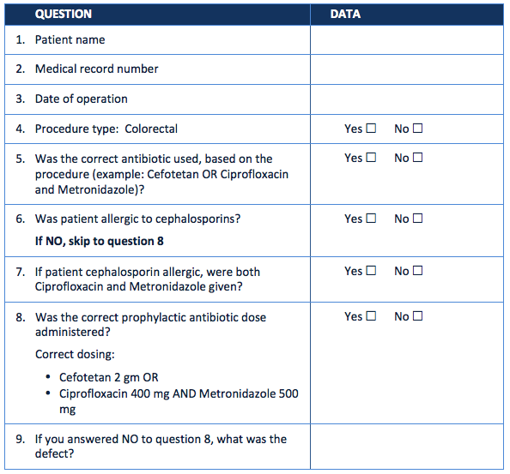
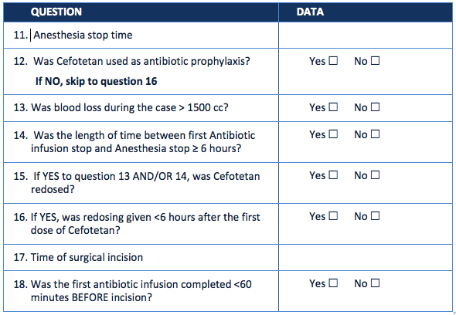
Antibiotic Audit Tool
Notes:
SAY:
This is the antibiotic audit tool. It has detailed questions related to best practices for antibiotic use. Using this tool will help identify defects that need to be addressed.

Slide 17
Intervention: Normothermia
Interventions
Confirmed that temperature probes were accurate first
  Needed surgeons to accept temperature data
  Compared indwelling urinary catheter and esophageal sensors in local trial
Initiated forced air warming intervention in the preoperative area after temperature accuracy established
Intervention
Notes:
SAY:
Again, the team used an audit tool to better understand its performance. The team found that patients coming out of the operating room were at a temperature greater than 36 degrees Celsius only 80 percent of the time. The audit process provided an opportunity for the team to obtain a better understanding of performance barriers, tapping into the wisdom of frontline providers. Working with the team’s senior executive partner, the team was able to achieve desired temperatures in greater than 90 percent of patients.

Slide 18
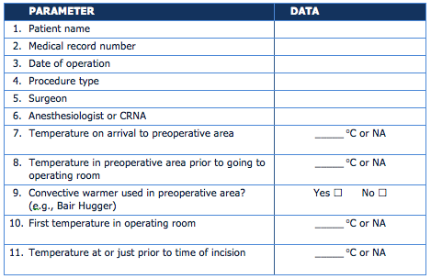
Normothermia Audit Tool (1 of 2)
Notes:
SAY:
This is the temperature audit tool. It has detailed questions related to best practices for maintaining normothermia. Using this tool will help identify defects that need to be addressed.

Slide 19
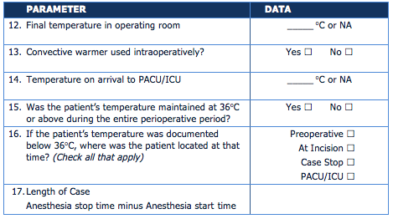
Normothermia Audit Tool (2 of 2)
Notes:
SAY:
These are additional questions on the temperature audit tool.

Slide 20
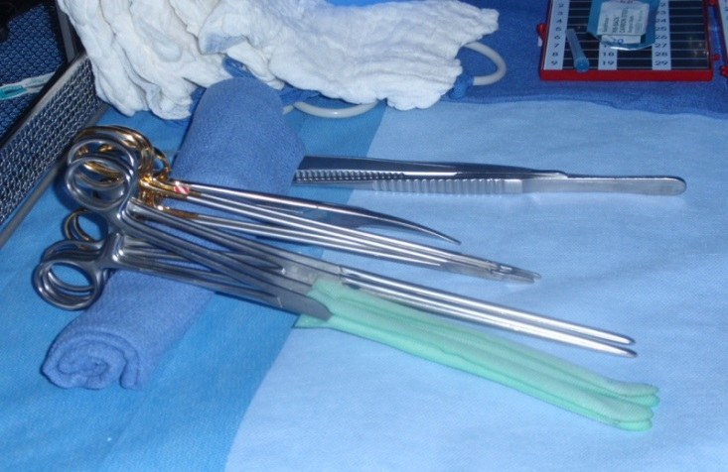
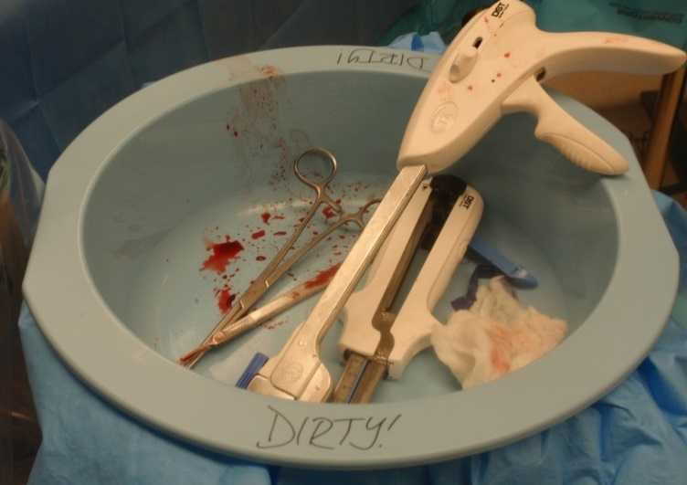
Separation of Clean and Dirty Instruments
Interventions
Separate tray of instruments used for bowel anastomosis
Extra suction along with both bovie tip and gloves opened and changed after anastomosis
Educational sessions with scrub techs and nurses about instrument separation
Real-time audits
Notes:
SAY:
In some colon infection meetings, staff members talk about implementing a closing set, or a separate instrument tray used when closing the fascia and the skin. But our frontline staff didn’t agree. They wanted to build a separate set for anastomoses. Then during bowel operations, they would have a separate set of instruments to use and then dispose of. It was easier for staff to identify the exact point of the anastomosis than when the closing procedures began.
We also include extra suctioning and change our gloves. These practices were self-audited and spread from general surgery to gynecological and pancreas surgeons, because they all operate on the bowel. And now it’s standard practice in the operating room, despite no evidence to support it. Based on input from all operating room providers, we felt it was the best practice.

Slide 21
BRINGING EMERGING EVIDENCE FOR SSI PREVENTION TO YOUR PATIENTS
Notes:
SAY:
In this section we will review emerging evidence for SSI prevention. This evidence is not a SCIP requirement, but has reasonable evidence to support adding it to your SSI bundles.

Slide 22
Emerging Evidence for SSI Prevention
Antibiotic usage
  Redosing
  Weight-based dosing of cephalosporins
Utilization of mechanical bowel preparation with oral antibiotics
Normoglycemia/prevention of hyperglycemia
Standardization of skin preparation
Notes:
SAY:
First, related to antibiotic usage in these new guidelines, the evidence suggests redosing antibiotics for cases that are longer than 4 hours, depending on your timeline. Also, regarding weight-based dosing for cephalosporins, the guidelines focus on weight-based dosing for cefazolin. Some hospitals have extended that to include weight-based dosing for cefotetan, with larger patients receiving 3 milligrams/kg of cefotetan. Also, the guidelines advocate the use of mechanical bowel preparation with oral antibiotics for colon surgery. Again, a group of national societies have endorsed this practice, so it helps to achieve staff buy-in and consider these interventions.
There also is emerging evidence for maintenance of normoglycemia or prevention of hyperglycemia in the perioperative period. And finally, evidence is emerging to support standardization of skin preparation with a dual-agent preparation solution that includes alcohol.

Slide 23
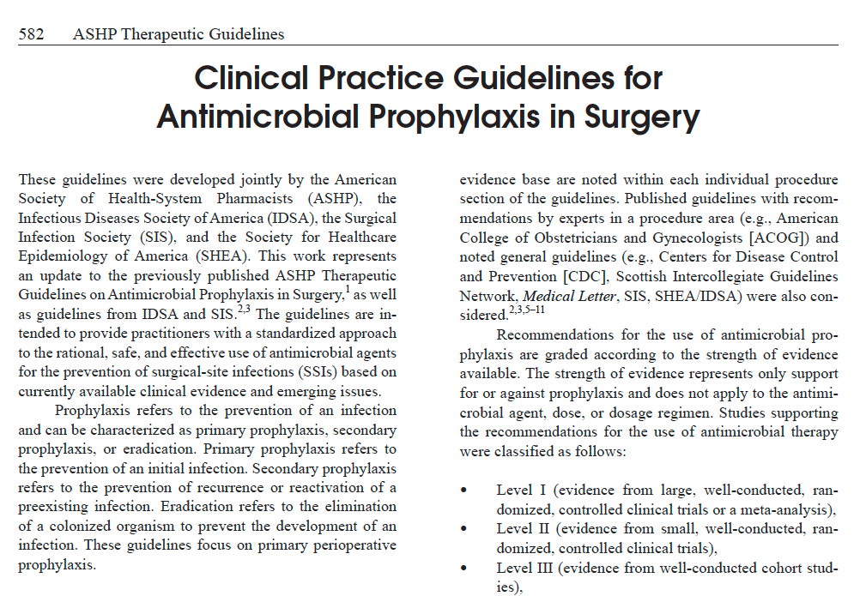
Source: ASHP⁶
Notes:
SAY:
These are the new antimicrobial guidelines from ASHP. They cover all types of surgeries, so there are recommendations for every type of surgery, but they do have a little table in there which tells you about different procedures, including colon surgery. And this is the table, and it tells you, for example, it tells you that if weight-based dosing is recommended or not, and at the bottom here they talk about the bowel prep and what to recommend for the bowel prep.

Slide 24
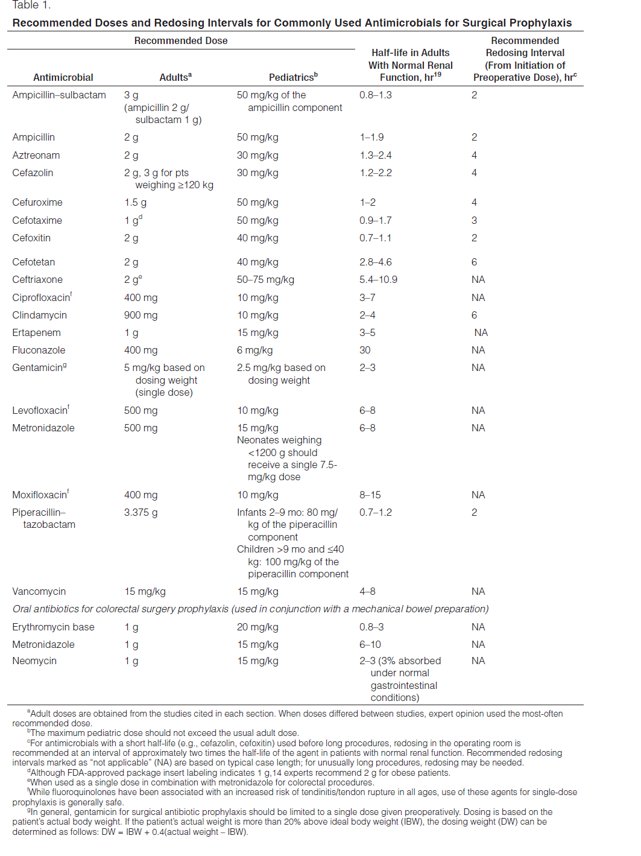
Antimicrobial Prophylaxis in Surgery
Redosing and weight-based dosing
Bowel preparation
Notes:
SAY:
This is the table, and it indicates whether weight-based dosing is recommended, and at the bottom of the page, bowel preparation recommendations are shown.

Slide 25
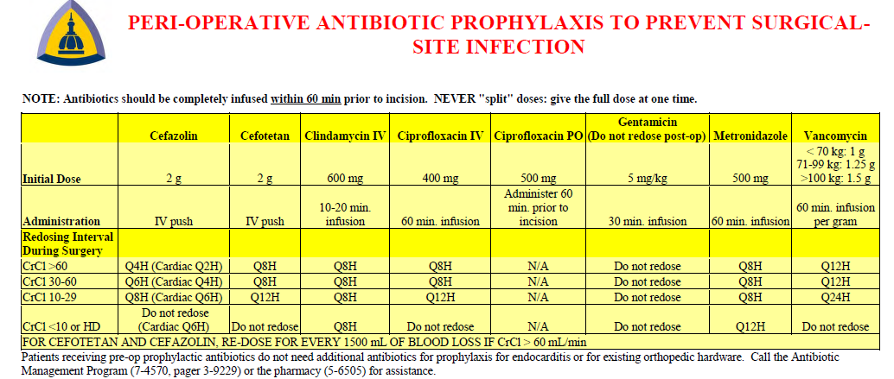
Johns Hopkins Hospital Antibiotic Poster
Perioperative Antibiotic Prophylaxis To
Prevent Surgical Site Infection
Notes:
SAY:
This is an example of a way to make a standard antibiotics protocol for your hospital. The infection control department at Johns Hopkins has taken these recommendations and selected standard antibiotics for different procedures. The selections were based on the culture evaluations and sensitivity of different bacteria from wound infections. So, for example, for colon surgery, cefotetan is used.
But this is the first step to developing a standard algorithm of what antibiotic to use for each procedure to eliminate some variability. With a standard procedure, you’re less likely to under dose or use an inappropriate antibiotic.
Redosing is also something to consider if you’re not already doing it. The goal is to maintain therapeutic levels throughout the entire case. However, the new guidelines recommend redosing cefoxitin every 2 hours, so it might be unreasonable. If you use cefoxitin, consider changing to another antibiotic.
Hospitals frequently implement policies and mandates, but we don’t always recognize our actual practice. Audit 15–20 patients to determine if your longer-case patients were redosed, whether weight-based dosing was done, and where there was room for improvement. Share the audit reports with the front line–that’s how you engage people. By sharing the data trends and defects, you allow frontline providers to own the results. That is how you change the culture and get the buy-in required for system success.

Slide 26
Interventions To Improve Antibiotic Efficacy
Standardize weight-based dosing of cephalosporins
Standardize antibiotics redosing
  Maintain therapeutic antibiotic serum levels throughout procedure
  Reconsider the use of cefoxitin due to its short redosing interval
Audit your practice!
Standardize selections based on your hospital procedures
Engage surgery, nursing, and anesthesia areas to implement a standard protocol
Consider integrating into electronic medical record, if available
Audit your results and share success
Notes:
SAY:
We know it’s important to maintain antibiotic serum levels during the entire procedure. What we’re learning is that antibiotic serum levels do not last as long as we thought they did. New guidelines from the Infectious Diseases Society of America, or IDSA, recommend redosing at shorter intervals. For example, previous guidelines recommended redosing cefotetan as routine prophylaxis for colon surgery at 8-hour intervals. The new guides recommend every 6 hours.
Similarly, IDSA recommends redosing cefazolin every 3 hours and cefoxitin every 2 hours.
Cefoxitin is a SCIP-approved antibiotic for colon prophylaxis. But the new guidelines indicate this might not be the best choice. Most colon operations are more than 2 hours, so if you use cefoxitin you would need to redose in almost every case. Your hospital may consider selecting an antibiotic that’s longer acting.
Also included in these guidelines are weight-based dosing of cephalosporin. Especially if you use cefazolin and Flagyl, you should consider increasing the dose of cefazolin to 3 mg for larger patients. Your safety program team can focus on this issue as it requires system changes and education for multiple disciplines.

Slide 27
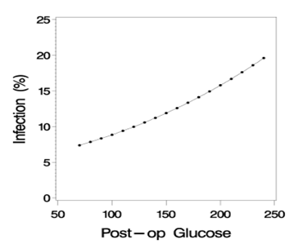
Hyperglycemia and Infection
Background
Hyperglycemia is common in hospitalized patients
38% of medical and surgical patients had hyperglycemia
  26% diabetic
  12% nondiabetic
In cardiac surgery, degree of postoperative hyperglycemia correlates with SSI, adopted as SCIP measures
Goal
Glucose <180mg/dl in all hospitalized patients
Infection (%)
Postoperative Glucose Levels
Postoperative hyperglycemia is associated with an
increased risk of SSI in general surgery patients.
Notes:
SAY:
Maintaining normoglycemia can reduce risk for wound infection. Hyperglycemia is common in hospitalized patients, even patients who are not diabetic.
In cardiac surgery patients, it’s documented that hyperglycemia correlates with the rate of wound infection, and this is a SCIP measure in this patient population. Smaller studies of general surgery patients also support a correlation between postoperative glucose levels and infection.
The Association of Endocrinologists recommends that all hospitalized patients maintain a glucose level less than 180 mg/dL. We believe that achieving this goal will also help to reduce SSIs. Maintaining normoglycemia is complex, requires coordination between multiple disciplines, and spans the continuum of care from the preoperative clinic to the OR to the ward. It requires proactive interventions because frequently in patients with diabetes, the first glucose on the day of surgery is 160, and then next time it is checked in the OR it is 220. We need to have a plan. Talk to your endocrinologists to see if you have an insulin drip protocol or other tools that might be helpful to implement this best practice.

Slide 28
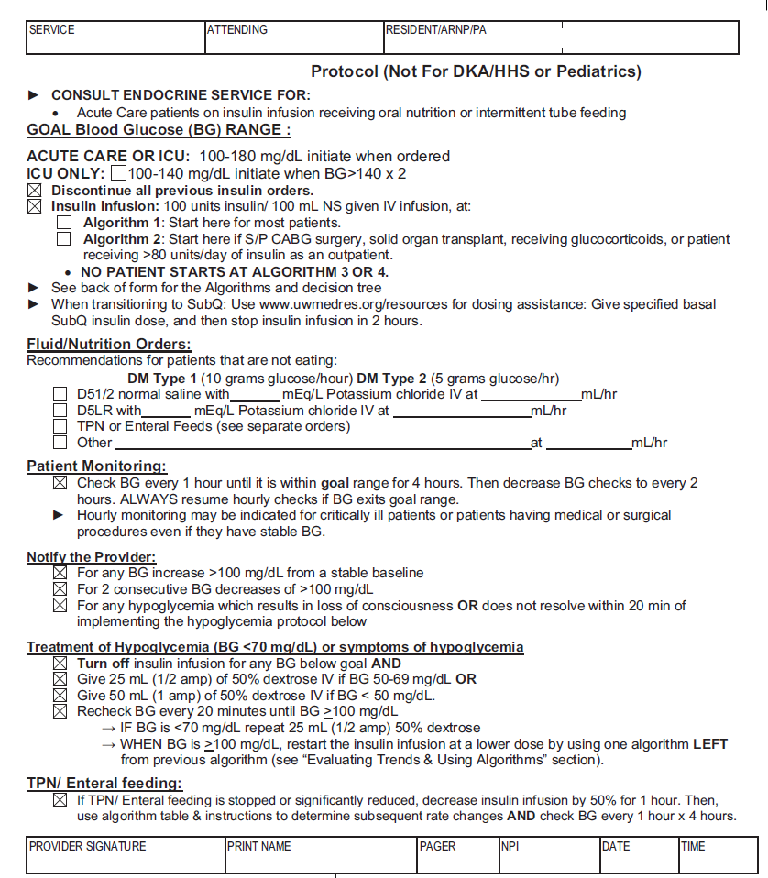
University of Washington/Glucose Control
Notes:
SAY:
This is one example from the University of Washington of a glucose-control pathway or algorithm for the operating room.

Slide 29
Could You Improve Glycemic Management?
Audit your current practice
Do you have a policy?
Consider gathering a multidisciplinary team to develop a protocol for your hospital
  Endocrinology
  Surgery
  Anesthesiology
  Nursing, ward and preoperative
Notes:
SAY:
Are you doing as well as you can on glycemic management? Your SUSP team can audit your current practice. You can pick just that post-op day one glucose and just check all those post-op day one glucoses on 20 patients. You can look at patients with diabetes — does your hospital have a policy? Do you check glucose levels of patients with diabetes in the prep area? Do patients get checked beforehand when they go to a pre-anesthesia clinic? What are the policies, and what do you do to address defects?
This needs to be a multidisciplinary approach. Incorporate the endocrinology department, as well as surgical and nursing providers. Developing a protocol extends to all points of patient care: from the preoperative areas, through the operating rooms, and to the floor rooms.

Slide 30
Preparation of the Surgical Site
Background
More than a thousand bacteria types reside on the skin
Staphylococcus and streptococcus species, among many others
Goal of Skin Preparation
Reduce bacterial burden on skin prior to incision
Best Practice Skin Preparation
Dual agent skin preparation
    Chlorhexidine + alcohol OR
    Povidone + iodine + alcohol
Include alcohol to increase durability of sterilization
Apply to specification, both in duration and amount
Must be dry before incision
Notes:
SAY:
The next area of emerging evidence relates to preparation of the surgical site. We know the skin can harbor thousands of types of bacteria, mostly staph and strep species. The colon harbors over 100 trillion bacteria with more anaerobes and gram-negative bacteria. A good skin preparation is the best way to address the former.
Based on the evidence, current best practice is to use dual-agent prep, a preparation that includes chlorhexidine and alcohol (ChloraPrep) or povidone-iodine and alcohol (DuraPrep). Both preparations have specific instructions for proper use. Even if your hospital is using one of these, the technique for application may not be correct. Considering auditing your practice and identifying areas for improvement. Remember to allow solutions with alcohol time to dry.
You can monitor progress in skin prep by reviewing the cultures from your wound infections with your infection control practitioner. You can see if you have a lot of colon superficial infections with staph and strep. If you improve your skin prep, it is likely that this will not happen.

Slide 31
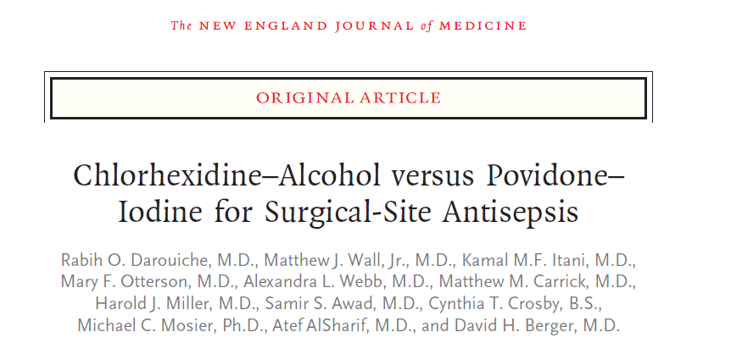
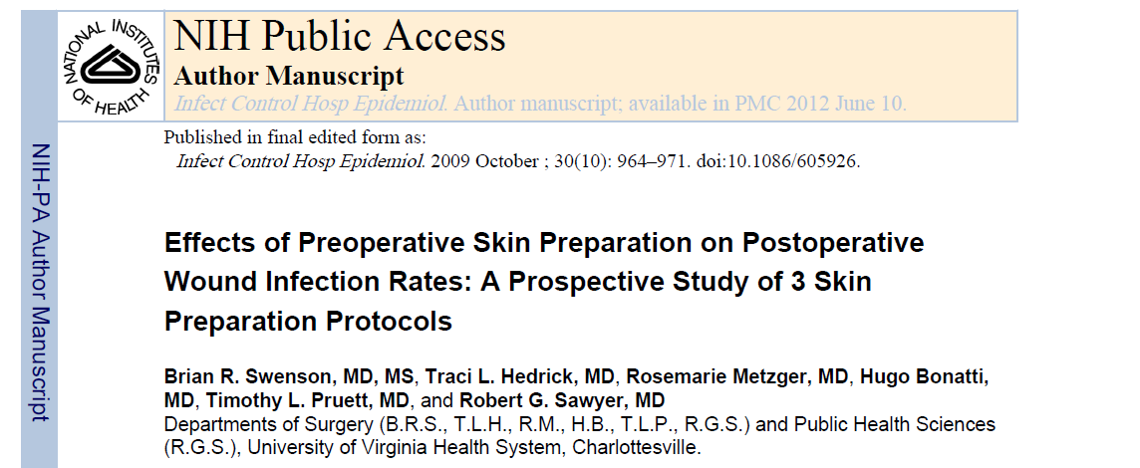
ChloraPrep better than Betadine
ChloraPrep and DuraPrep better than Betadine
Notes:
SAY:
The best practice uses dual-agent skin preparation, chlorhexidine plus alcohol or povidone-iodine plus alcohol, so either ChloraPrep or DuraPrep. The goal of the skin preparation is to increase the durability of the sterilization. For the sterilization to last, you need to administer these products as directed, including the appropriate area of skin to cover. In addition, any alcohol-based solution must be dry before the incision.
Standardize this process throughout the operating room. For example, when we transitioned to ChloraPrep, the ChloraPrep representative trained all surgical staff. We then required individual confirmation of the training before they started the new preparation product. Two papers support the dual-agent preparations. One is the 2009 ChloraPrep paper from the New England Journal of Medicine, which showed that ChloraPrep yielded better results than Betadine. The other paper from the University of Virginia showed that ChloraPrep and DuraPrep also exceeded Betadine results.

Slide 32
Is Skin Preparation an Area You Could Improve?
Audit Your Practices
What is being used for what cases?
Who is doing the prep?
How long are they taking for the prep?
Develop Standardized Educational Plan To Engage Frontline Providers
In-service training sessions
Video education
Change doctor preference cards
Audit again after implementing your interventions.
How well did you do? Share the results!
Notes:
SAY:
You need to audit your practices. A quality outcomes representative, an administrative representative, or a frontline staff member in your hospital can audit your practices. Look at the beginning of the case, see who’s doing the skin preparation,
ASK:
Did the ChloraPrep skin preparation take the full 3 minutes?
Was the application area allowed to dry?
SAY:
You can develop an audit tool to keep track of that and then share the data and devise an educational plan for standardizing who will be held accountable for it through, for example, in in-service training and video education.
And then keep auditing and see if you’ve demonstrated improvement or changes in practice.

Slide 33
Key Takeaways
No single SSI prevention bundle exists
  You need to identify the LOCAL defects
Auditing is a practical and feasible strategy to evaluate performance and surface defects
Tools provide a guideline and are adaptable to your local environment
CUSP methodology empowers frontline staff
Notes:
SAY:
In summary, there is not a single SSI prevention bundle that will work for every surgical line at every hospital. Each clinical area will have problems with different things at different times. Emphasize local defects with the Staff Safety Assessment, because asking the frontline staff is key.
Audits will also help identify defects and gaps between protocols and reality in care delivery. Auditing is an iterative process—once you create your bundle, it may not be consistent for every patient until you work through the system, audit your practice, continue educating, and actually hardwire those processes into your system.
Any tools should be adapted to your local environment. They provide starting points. The CUSP method is going to empower the front line to be part of this. Frontline staff will share with you why your bundle isn’t working, for instance, why a patient didn’t receive an element of your bundle, or what still needs improvement. With the feedback of your frontline staff you will start to see great improvement.

Slide 34
Action Items
Review staff safety assessment results
Pick 2–3 audit tools based on frontline feedback, SCIP measures, and emerging evidence
Audit 5–10 patients with each tool
Create a performance goal for each intervention
Develop your bundle
Implement interventions for system changes
Share your tools, ideas for new tools, and results
Notes:
SAY:
Some recommended action items include:
Review your staff safety assessment results with your frontline staff
Pick two or three audit tools and use them to audit 5 to 10 patients
Create a performance goal for each intervention
Develop your SSI bundle
Develop system changes to implement interventions
Share your experiences with your peers both within your health care organization

Slide 35
References
Wick EC, Hobson DB, Bennett JL, et al. Implementation of a surgical comprehensive unit-based safety program to reduce surgical site infections. JACS. 2012; 215(2):193-200. PMID: 22632912.
National Healthcare Safety Network. CDC/NHSN Surveillance Definitions for Specific Types of Infections. In: NHSN Patient Safety Component Manual. Atlanta: Centers for Disease Control and Prevention; January 2014:chapter 17. www.cdc.gov/nhsn/PDFs/pscManual/17pscNosInfDef_current.pdf. Accessed June 11, 2014.
Centers for Medicare & Medicaid Services. Hospital Compare. www.medicare.gov/hospitalcompare/profile.html#profTab=2&ID=210009&loc=21287&lat=39.2962372&lng=-76.5928888&name=johns%20hopkins%20hospital. Accessed May 30, 2010.

Slide 36
References
Johns Hopkins Medicine, Health Library. Surgical Site Infections. www.hopkinsmedicine.org/healthlibrary/conditions/surgical_care/surgical_site_infections_134,144/. Accessed June 19, 2015.
Hendren S, Englesbe MJ, Brooks L, et al. Prophylactic antibiotic practices for colectomy in Michigan. Am J Surg. 2011;201(3):290-293. PMID: 21367365.
American Society of Health-System Pharmacists. Clinical Practice Guidelines for Antimicrobial Prophylaxis in Surgery. http://www.ashp.org/surgical-guidelines. doi:10.2146/ajhp120568. Also note: Bratzler DW, Dellinger EP, Olsen KM, et al. Clinical practice guidelines for antimicrobial prophylaxis in surgery. American Journal of Health-System Pharmacy. 2013 Feb 1;70(3):195-283. PMID: 23327981. http://www.ashp.org/surgical-guidelines.

