Slide 1

Be Prepared To
Be Engaged
AHRQ
Guide to Improving Patient Safety in Primary Care Settings by Engaging Patients and Families
Notes:
The Agency for Healthcare Research and Quality, or AHRQ, funded the development of a Guide to Improving Patient Safety in Primary Care Settings by Engaging Patients and Families. AHRQ is a federal agency whose mission is to produce evidence to make health care safer, higher quality, and more accessible, equitable, and affordable.
The Guide includes four strategies, and the purpose of the strategies is to create opportunities for meaningful engagement between primary care practices and their patients and families to improve patient safety.
Our practice has chosen to adopt Be Prepared To Be Engaged and [list other strategies]. Today we’re going to talk about Be Prepared To Be Engaged.

Slide 2
What is it?
Be ready
Ask questions
Speak up
What they want to talk about
Their questions
Their health goals
Notes:
The Be Prepared To Be Engaged strategy helps patients and their families prepare for and become more fully engaged in their medical appointments. The goal is to help patients and families to be ready for the appointment, to ask questions, and to speak up. With the Be Prepared strategy, you provide patients with a Be Prepared Note Sheet and encourage them to write down what they want to talk about, their questions, and their health goals. This helps set the visit agenda and ensure that patients’ questions are answered.

Slide 3
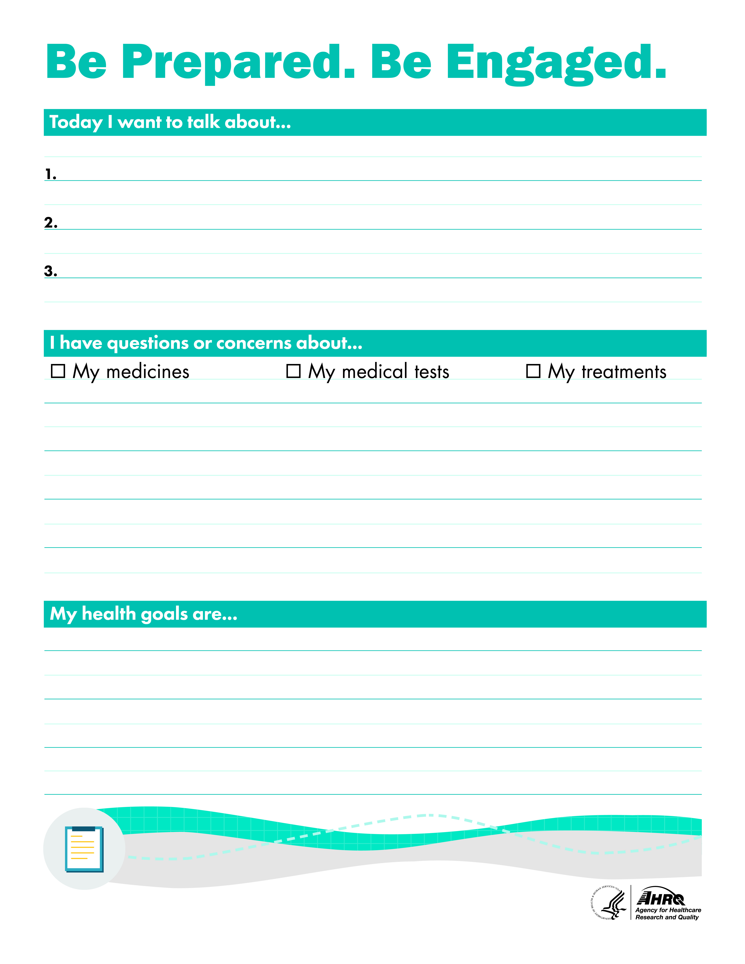
Be Prepared Note Sheet
Notes:
The Be Prepared Note Sheet contains three sections.
In the first section, patients can write what they want to make sure they talk about with their health care team. These are their top priorities. Knowing what these issues are should help the clinician set the visit agenda, and it should help patients make sure they remember the things they most want to talk about.
In the second section, patients can write down the questions they want to ask. Again, this will help the clinician manage time in the visit, knowing the issues that the patient wants to understand. And again, it will help ensure the patients remember their questions.
In the last section, patients can write their health goals. This should encourage communication between the clinician and patient and help the clinician understand what is important to the patient.
One patient reported, “Before your appointment, you think about what you want to ask your doctor. But then you get there and you forget about what you really want to ask. And then you go home and remember, but your appointment is over!”
The plan is to give patients the Be Prepared Note Sheet and a pen after they check in for their visit and encourage them to write down what they want to talk about, any questions they have, and what their health goals are. Patients can use their wait time to fill out the note sheet. When the clinician comes into the exam room, he or she will ask to review the note sheet, plan the visit, and discuss the issues and questions with patients.

Slide 4

Why is it important?
There are significant time pressures in primary care and patients often arrive unprepared.
The strategy helps patients come better prepared so time is used more effectively.
Notes:
There are significant time pressures within the primary care visit. When primary care practices are asked about the biggest threats to patient safety in primary care, they frequently answer “not enough time.”
Adding to the time pressures, patients often arrive at a primary care visit unprepared to discuss their concerns and questions. They often forget the questions they intended to ask or topics they hoped to discuss.
The Be Prepared To Be Engaged strategy aims to help patients and families come to the appointment better prepared. When patients and their families are well prepared for primary care visits, the visit time is used more effectively and the information exchanged is improved. Patients are more likely to leave the visit understanding their diagnosis and care plan, which should lead to improved patient followup and adherence to the care plan.

Slide 5
How can it help me?
When patients wrote down an agenda before their primary care visit, 74% of clinicians and 79% of patients agreed that communication during the visit improved.
Over 80% of the clinicians in the study wanted patients to continue to write down an agenda.
Notes:
Many clinicians initially react to the Be Prepared strategy skeptically, feeling they don’t have time for it. However, once you begin to use the note sheet and engage the patient, it should make more efficient use of your time.
The note sheet can help you set the visit agenda. You will know up front what your patients want to discuss, what questions they have, and what their health goals are. And you can plan the visits accordingly, even if that means asking patients to schedule an additional appointment because there won’t be time to discuss both their current complaint and all their nonurgent concerns, questions, and goals.
In a recent study, when patients wrote down an agenda before their primary care visit, 74% of clinicians and 79% of patients agreed that communication during the visit improved. Over 80% of the clinicians in the study wanted patients to continue to write down an agenda, as it gave them an efficient way to prioritize patients’ concerns.
Making sure all patients’ questions are answered during the visit can help reduce followup phone calls and emails. It can also help you identify problems that might prevent treatment adherence. Patients are more likely to adhere when they understand their instructions and their diagnosis.
The Be Prepared strategy can also help prevent “door knob questions.” A door knob question is a question from the patient as the clinician is leaving the room, when the clinician already has his or her hand on the door knob, and the patient says, “Oh, one more thing…”

Slide 6
How do I use it?
Identifying patients
Handing out
Asking about
Offering to help fill out
Reviewing and discussing
Customize this slide to match your practice's implementation strategy.
Notes:
[Note: This slide should be customized by the practice to communicate practice-specific decisions. Some examples are provided here.]
Our practice has decided to use the Be Prepared strategy with all our patients. OR Our practice has decided to use the Be Prepared strategy with our patients with [insert chronic diseases].
The [front desk] will give the note sheet to the patients [after they have signed in and finished their previsit paperwork]. We have a script to help you with what to say to patients about the note sheet. We want to give this to patients after they have finished their previsit paperwork because we don’t want this to become just another form to fill out.
When the [patient care technician rooms patients], he or she will ask patients if they have filled out their note sheet. We have a script to help you guide the patient if the patient doesn’t know what to write.
For patients who haven’t filled out the note sheet, the [PCT] will offer to help [after he or she has taken the patients’ vitals and documented the vitals and chief complaint]. We have a script for how to help the patient fill out the note sheet.
The [clinician] will review the note sheet and discuss it with the patient.
The Be Prepared strategy can be introduced and reinforced by every member of the team, from the front desk to the clinician.

Slide 7
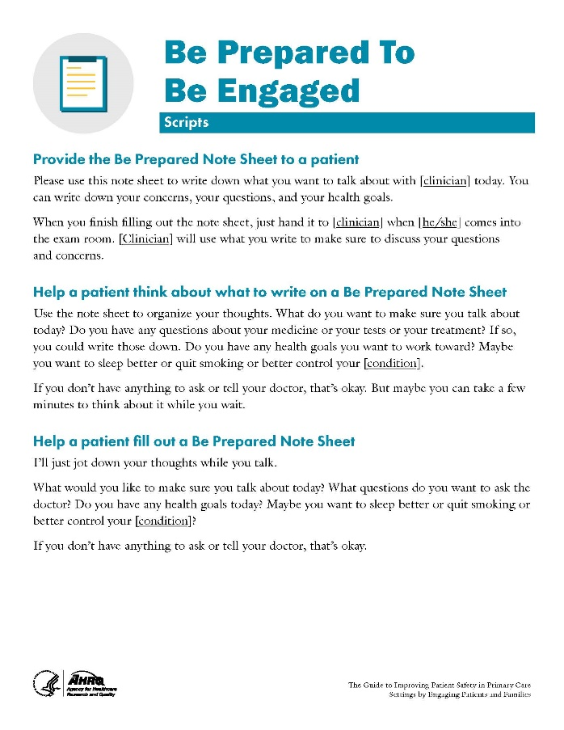
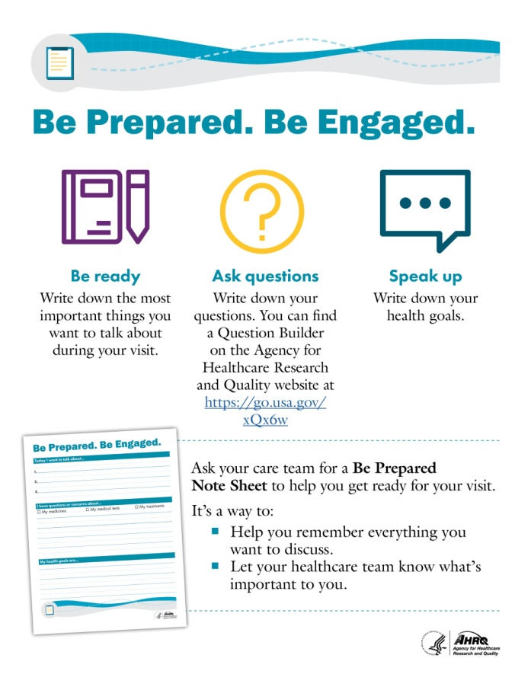
What tools are available?
Notes:
The tools that are available with the Be Prepared strategy are:
The Be Prepared Note Sheet, which I presented earlier.
Patient posters, which we will display in the waiting room to make patients aware of the note sheet and how to use it.
Sample scripts for:
Providing the note sheet to the patient.
Helping the patient think about what to write on the note sheet.
Helping the patient fill out the note sheet.

Slide 8
How will we evaluate it?
Number of followup questions
Visit length
Satisfaction
Reported use:
  Receive note sheet.
  Fill out note sheet.
Customize this slide to match your practice's implementation strategy.
Notes:
[Note: This slide should be customized by the practice to communicate practice-specific decisions. Some examples are provided here.]
We will use several measures to evaluate effectiveness.
How many followup questions (calls and emails) do we get pre- and post-implementation?
What is the average visit length with and without the note sheet?
What is patient satisfaction with Be Prepared?
What is clinician satisfaction with Be Prepared?
We will also evaluate our implementation success.
What percentage of patients receive the note sheet?
What percentage of patients fill out the note sheet?

