Slide 1
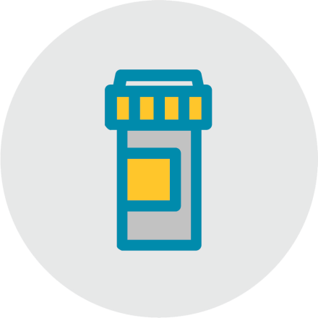
Create a Safe Medicine List Together
AHRQ
Guide to Improving Patient Safety in Primary Care Settings by Engaging Patients and Families
Notes:
The Agency for Healthcare Research and Quality, or AHRQ, funded the development of a Guide to Improving Patient Safety in Primary Care Settings by Engaging Patients and Families. AHRQ is a Federal agency whose mission is to produce evidence to make health care safer, higher quality, and more accessible, equitable, and affordable.
The Guide includes four strategies, and the purpose of the strategies is to create opportunities for meaningful engagement between primary care practices and their patients and families to improve patient safety.
Our practice has chosen to adopt Create a Safe Medicine List Together and [list other strategies]. Today we’re going to talk about Create a Safe Medicine List Together.

Slide 2
What is it?
Notes:
The Create a Safe Medicine List Together strategy is an effort to engage patients and families to actively participate in developing a complete and accurate medicine list. Patients are asked to bring in all the medicines they take, both prescribed and over the counter, including non-oral medications such as injections, inhalers, ointments, and drops, as well as medicines they only take occasionally.
Staff within your practice will work with the patients and their families to develop a complete and accurate medicine list, and clinicians will conduct medication reconciliation based on the complete and accurate list.

Slide 3
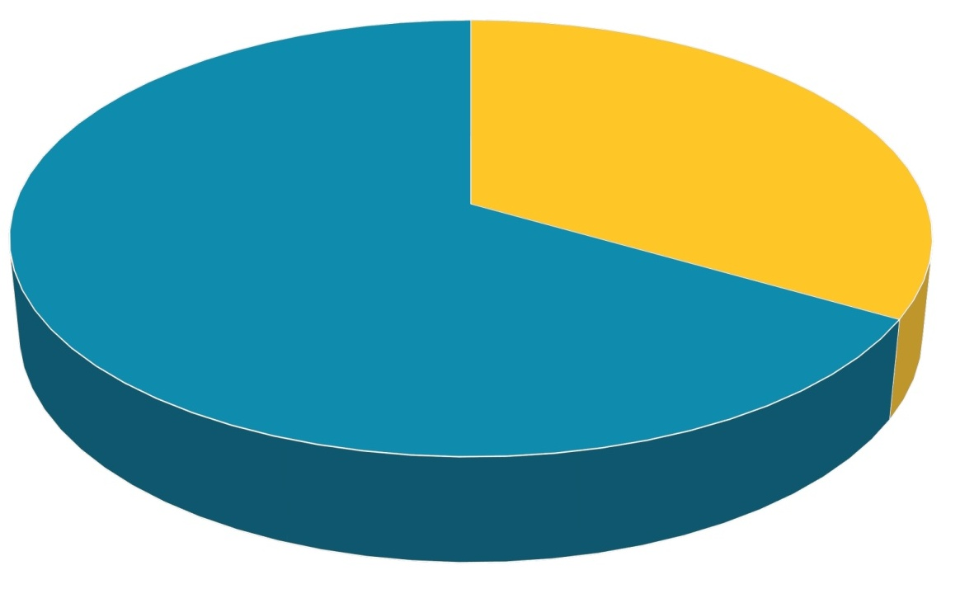
Why is it important?
3.2 billion ordered or prescribed
160 million of those result in error
2/3 of primary care visits involve medicines
For patients on 5+ medicines,
57% are not needed, are contraindicated, or are not taken as prescribed
Notes:
According to the Centers for Disease Control and Prevention, more than two-thirds of primary care office visits involve drug therapy, with 3.2 billion medicines ordered or provided each year. Studies show that 5 to 7 percent of those prescriptions result in error. That’s at least 160 million errors.
Almost half the people in the United States have used at least one prescription in the last 30 days, while one in five has used at least three. More than half of the medicines prescribed to patients on 5 or more medicines are not needed, are contraindicated, or are not taken as prescribed.
In the primary care setting, medication safety issues include prescribing errors, contraindications, overprescribing, underprescribing, and patient adherence. Creating a medicine list together can help uncover patients who are unintentionally overdosing by taking both the generic and name brand medicines, are taking outdated prescriptions, or are taking supplements that negatively interact with their prescription medicines.
One clinician summed it up like this, “I think this increases patient safety. The more accurate the list, the better it is for us to be able to manage the patient’s health and medication. If we know exactly what they are taking and how they are taking it, then we can implement further strategies such as how they should be taking their medication, when they should be taking it, or what to avoid, like foods, activities, or over the counter.”
Patients are especially vulnerable at the interfaces of care—between primary care and specialist or between primary care and acute care. Another clinician pointed out, “When patients are asked whether they’re taking any other medications, they may say no. But when they bring in their medications, you find all of these medications from specialists that significantly impact their care.”
And patients appreciate the value. One patient stated, “I brought all my medications to him, and I brought in every one of them. And I’m sure glad I did, because he helped me get all of my medicines straightened out. So I can take them when I can get the best benefit out of my medications. I was taking some in the middle of the day that should not be taken in the middle of the day to do the best that they can.”

Slide 4
How can it help me?
Results in a complete and accurate medicine list
Reduces medicine errors
Offers the opportunity to reduce the number of prescribed medicines
Improves the clinician and patient relationship
Notes:
The foundational step in any effort to review and manage medicines is ensuring that you have a complete and accurate medicine list for the patient. Patients may not know or remember the names or dosage for all their medicines, and the medicine list in the EHR may not be complete or up to date.
Asking patients to bring in all their medicines, including over-the-counter medicines, vitamins, and supplements, and then engaging them in creating a medicine list gives you the best chance to create a medicine list that is complete and accurate.
One clinician observed, “It closes the gaps, reduces medication errors, offers the opportunity to reduce the number of prescribed medicines, and improves the clinician and patient relationship.”
Here are some examples:
“I had a patient that ran out of his blood pressure medications, so he started taking somebody’s medicine that was in the home. It wasn’t the same medication or a similar dose. I only learned about it because he brought in the medication.”
“One of my chronically ill patients came in and I thought, ‘Why is this patient not on atorvastatin?’ I was checking my records and I didn’t see it. The patient wasn’t sure. Then she finally brought in her medications and I saw she was taking it and I was so glad. She was running out of it, and I caught that, so that was really good.”
“I had a patient come in with two bottles of the same medicine, which happens quite often. They go in to get their refills, but they hadn’t quite finished their other bottle. He was taking double the dose of the same medication.”

Slide 5
When should I use it?
List the target patient populations here.
Customize this slide to match your practice's implementation strategy.
Notes:
[Note: This slide should be customized by the practice to communicate practice-specific decisions. Some examples are provided here.]
Our practice has decided to use the Create a Safe Medicine List Together strategy with our patients who:
Have recently been in the hospital or emergency room AND/OR
Take 5 or more medicines AND/OR
Have a chronic condition.

Slide 6
How do I use it?
Requesting patients bring in medicines
Reminding patients to bring in medicines
Creating a safe medicine list together
Documenting the list in the EHR
Reviewing and reconciling the list
Updating the EHR
Customize this slide to match your practice's implementation strategy.
Notes:
[Note: This slide should be customized by the practice to communicate practice-specific decisions. Some examples are provided here.]
Because a thorough medicine review may be time consuming, this strategy uses both staff and clinicians to save clinician time.
The [patient care technician] will request that patients bring in their medicines to their next visit. We have a script to help you with how to make the request and what you can say to patients who are reluctant to bring in their medicines. For example, you might offer to patients that they can bring in photos of the medicine labels if they don’t want to bring in the actual medicines.
The [front desk] will give a reminder card to patients for their next visit [as they leave their current visit], [as well as a bag branded with our practice name to put the medicines in].
The automatic appointment reminder calls will now include a reminder for patients to bring in their medicines.
[As part of rooming the patient], [the PCT] will engage with the patient to compare the medicines the patient has brought in with the list in the EHR. [The PCT] will also ask the patient how he or she takes the medicine. [The PCT] will not form any judgments about what is being taken or how it is being taken. Nor will he or she provide the patient with any advice or education. Rather, [the PCT] will only try to develop a list in the EHR that reflects what the patient has brought in and what the patient says. We have two checklists available for this task – one to use if the patient has brought in medicines and one to use if the patient has not.
If there are any medicines that the patient says he or she is taking not as directed or as listed in the EHR, [the PCT] will document this in the EHR.
[As part of the office visit], [the clinician] will review the list and conduct medication reconciliation, considering:
Challenges in how the patient is taking the medicine.
Possible interactions with other medicines or over-the-counter medicines.
Overdoses.
Appropriateness as a treatment.
Avoidable regimen complexity.
Avoidable side effects.
[The clinician] will also discuss with the patient any medicine that [the PCT] has documented as being taken not as directed or as listed in the EHR. [The clinician] will update the EHR with any changes.
If a patient DOES bring in medicines, it is very important that we review the medicines with the patient. It is frustrating for a patient to go to the effort of bringing in medicines and find that we don’t use them.

Slide 7
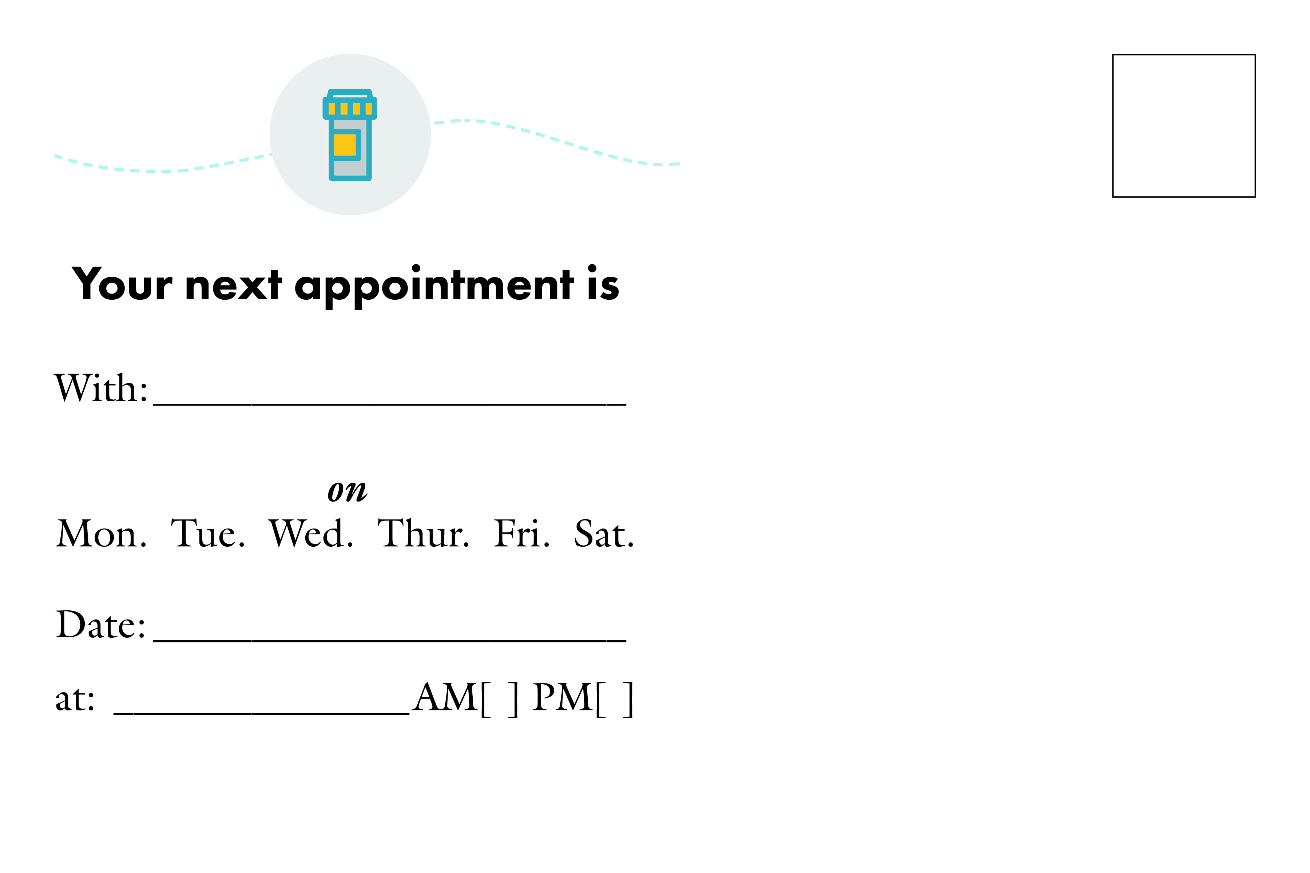
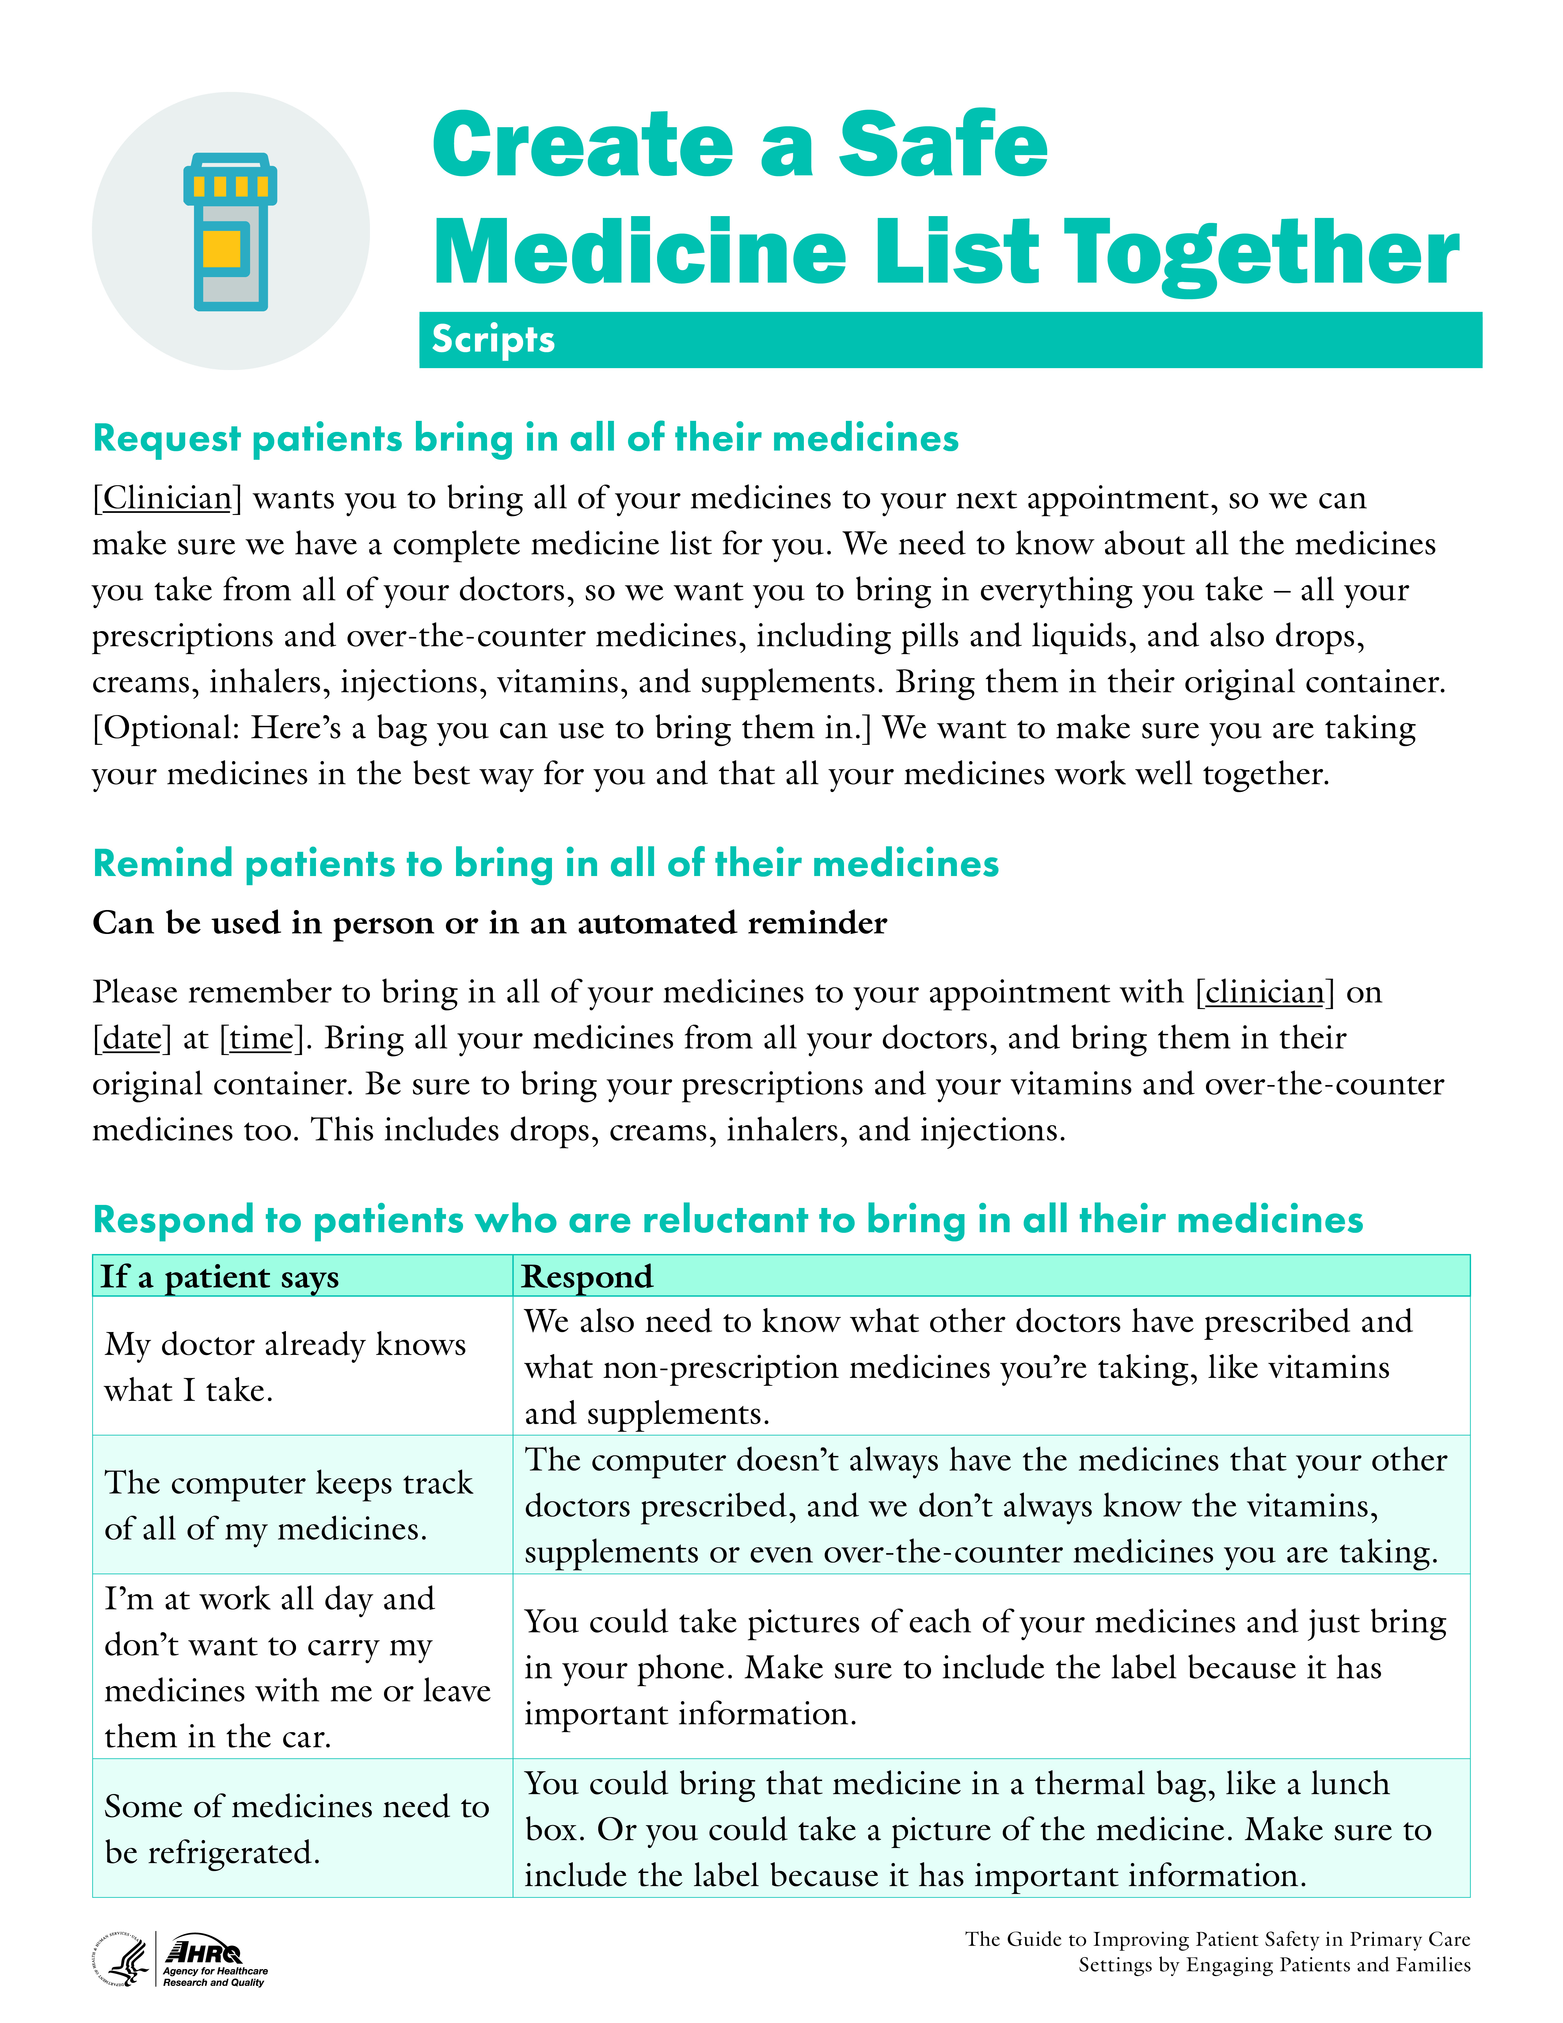
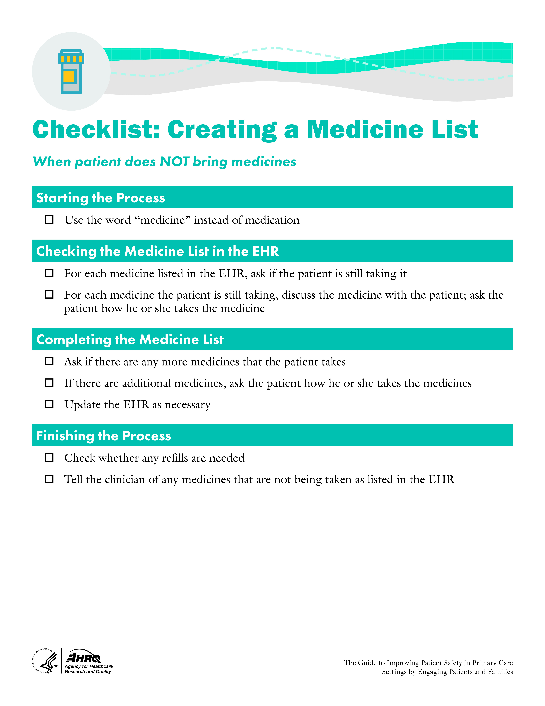
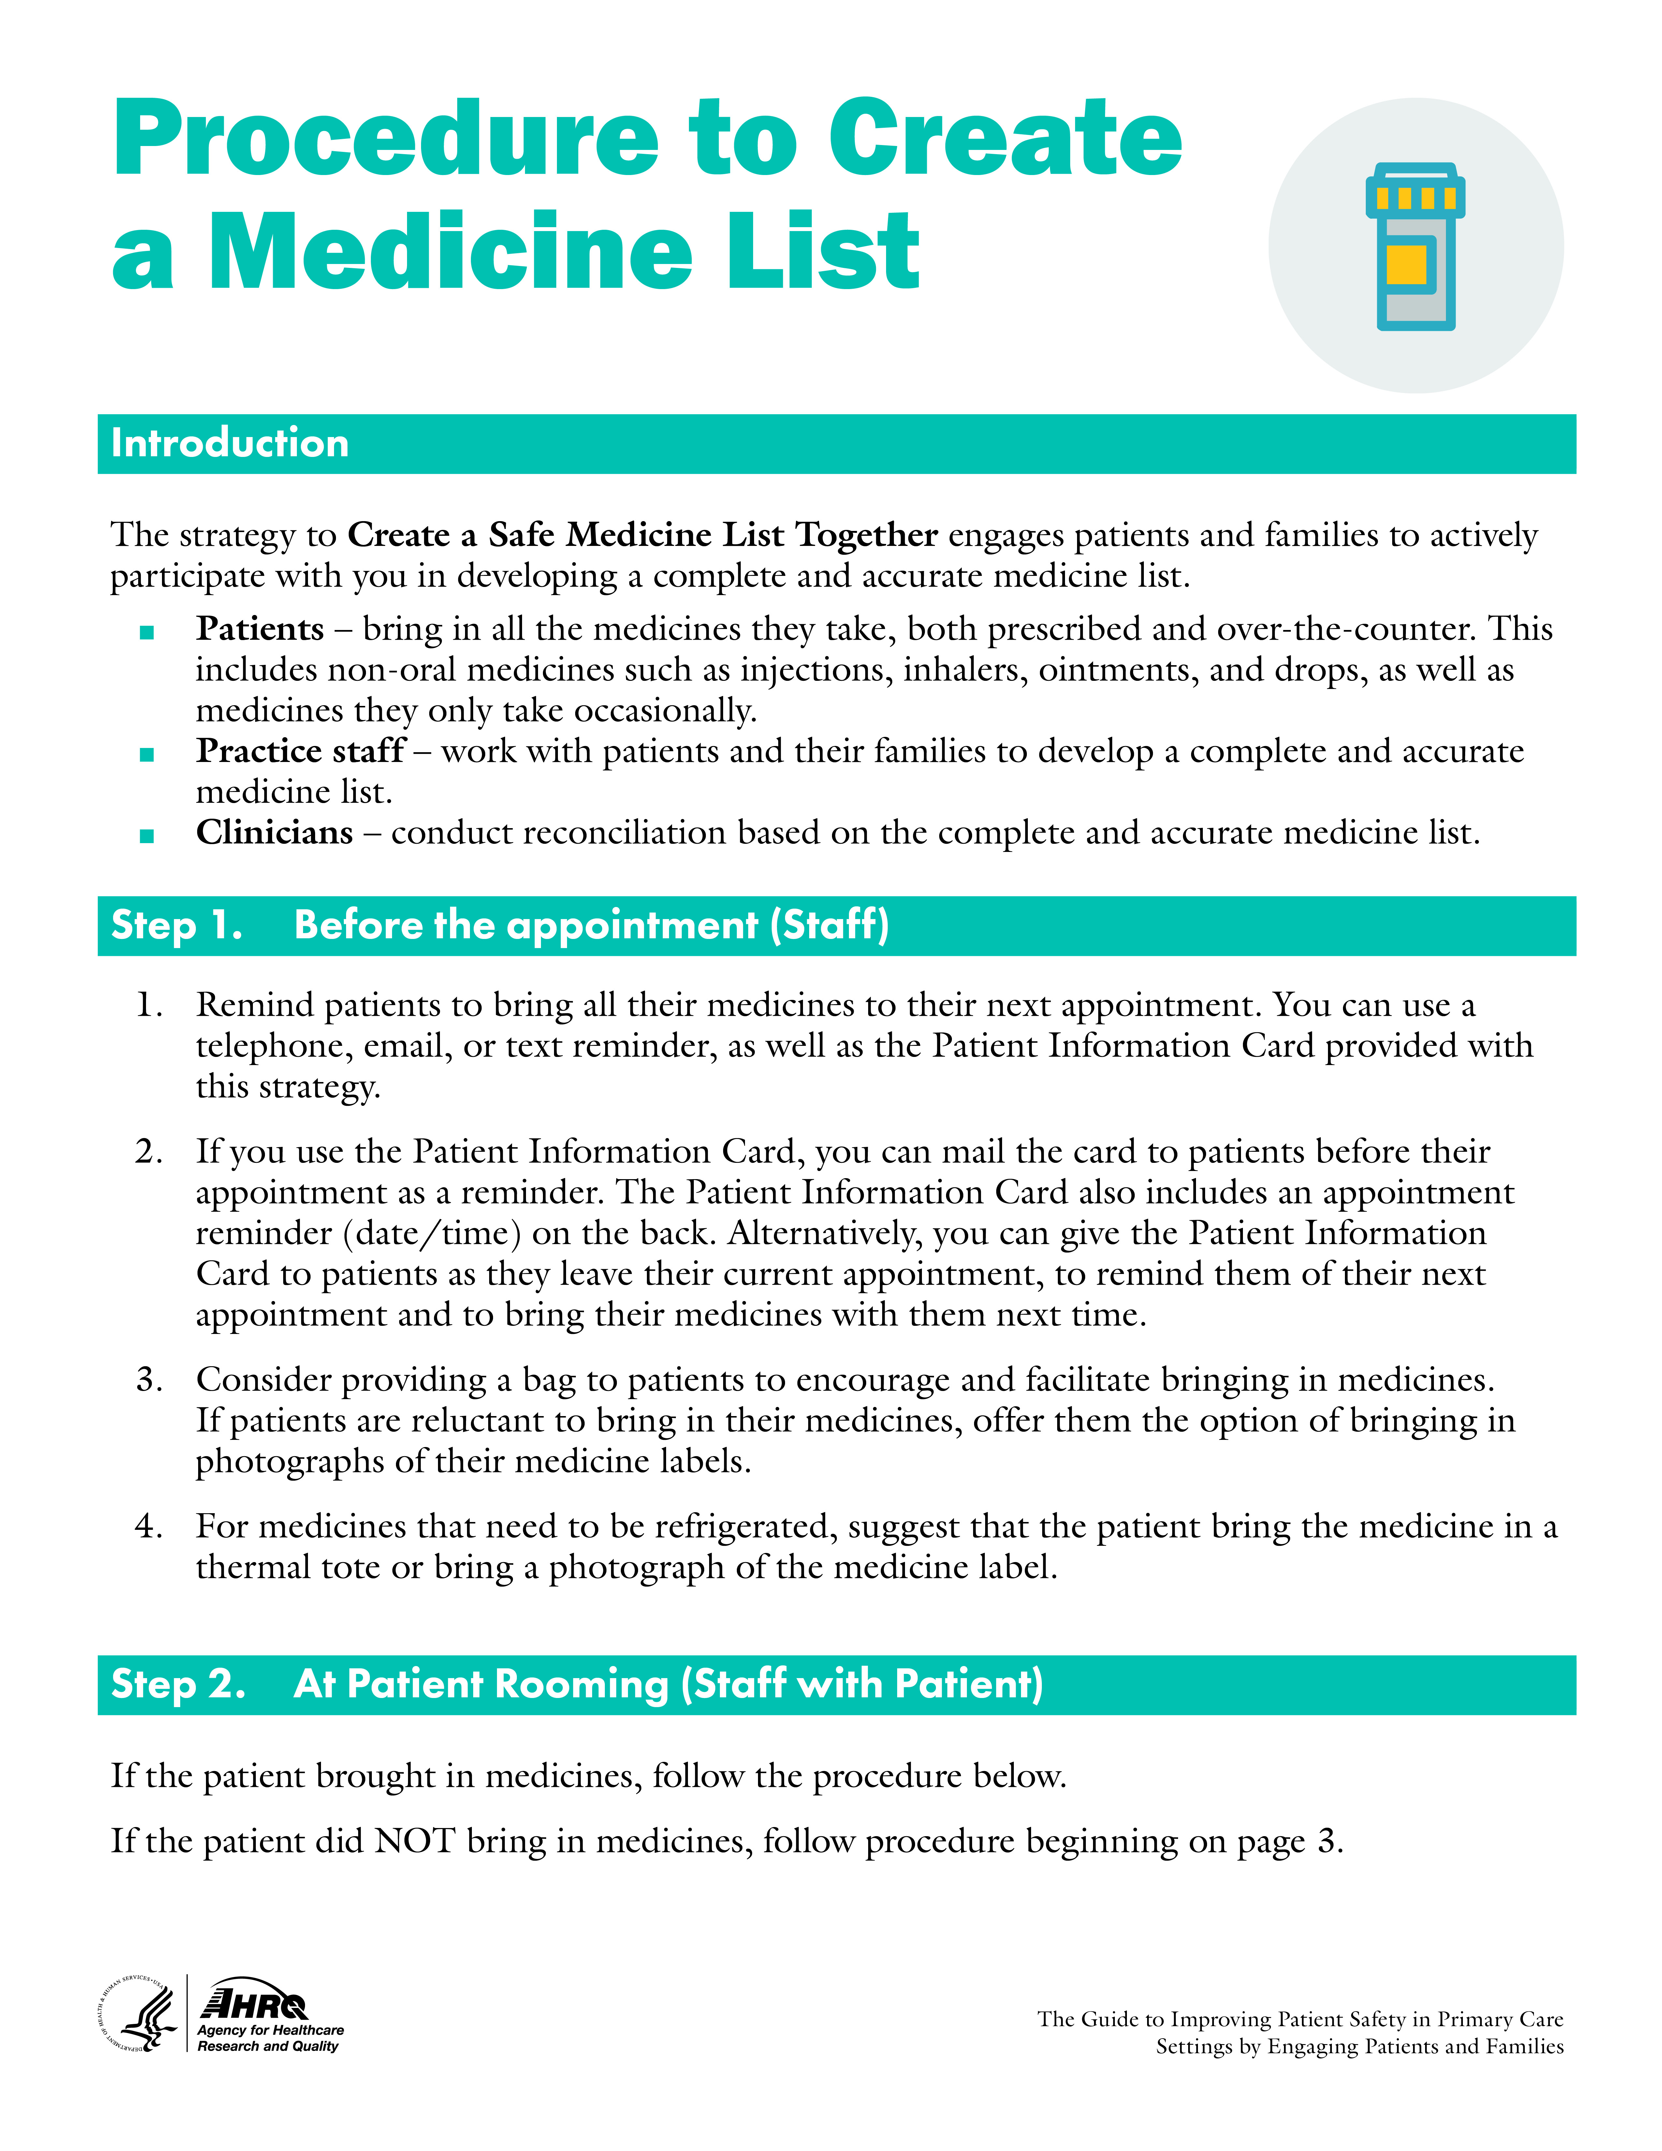
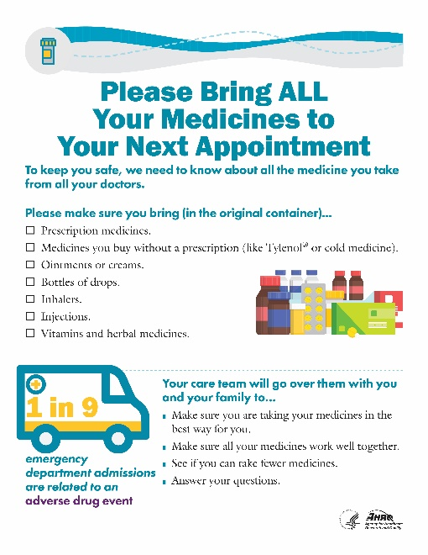
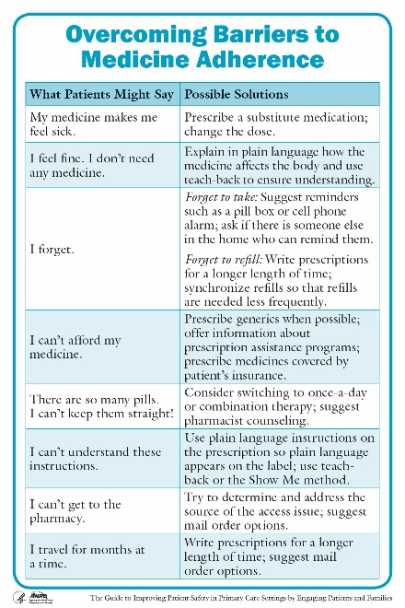
What tools are available?
Notes:
Several tools are available with the Medicine List strategy:
A patient reminder card we will give to patients to request that they bring in their medicines; and patient posters, which we will display in the waiting room to make patients aware of our request and why we are asking.
A clinician job aid that lists common barriers to medication adherence and potential solutions to overcome the barriers. Clinicians can use this aid when reviewing the medicine list with patients.
Several role play scenarios that we will use to practice and sample scripts that you can use to request patients bring in all of their medicines, remind patients to bring in all of their medicines, and respond to patients who are reluctant to bring in their medicines.

Slide 8
Scenario 1
Mr. Thomas – 78-year-old male with uncontrolled hypertension and knee pain
Lifts weights, walks often, rides stationary bike
Visiting for knee pain that is keeping him from exercising
EHR lists:
Hydrochlorothiazide 50 mg – 1 tablet PO QD.
Atorvastatin 20 mg – 1 tablet PO QD.
Low-dose adult aspirin 81 mg – 1 tablet PO QD.
Notes:
[Note: This slide is optional, to be used for role play.]
A 78-year-old male patient with uncontrolled hypertension, Mr. Thomas, has come in for a scheduled visit with his primary care clinician for knee pain. Mr. Thomas used to be a very active man and rode his bike everyday until about 2 months ago. He did have a few falls from his bike and has started using a stationary bike instead. He lifts weights and walks often. Having knee pain when riding or walking is a big concern.
The EHR lists the following medicines for Mr. Thomas:
Hydrochlorothiazide 50 mg – 1 tablet PO QD
Atorvastatin 20 mg – 1 tablet PO QD
Low-dose adult aspirin 81 mg – 1 tablet PO QD

Slide 9
Scenario 2
Mrs. Martin – 63-year-old female following up after reconstructive surgery for fractured skull from a fall
Struggling with depression after loss of father and sister
EHR lists:
Citalopram 20 mg PO QD.
Vitamin D 1,000 mg PO QD.
Notes:
[Note: This slide is optional, to be used for role play.]
A 63-year-old female patient, Mrs. Martin, is here to see her primary care clinician for a followup visit. Mrs. Martin has been struggling with depression after the loss of her father and then the unexpected loss of her sister. To make matters worse, Mrs. Martin is recovering from reconstructive surgery after fracturing her skull when she fell at work this past year.
The EHR lists the following medicines for Mrs. Martin:
Citalopram 20 mg PO QD
Vitamin D 1,000 mg PO QD

Slide 10
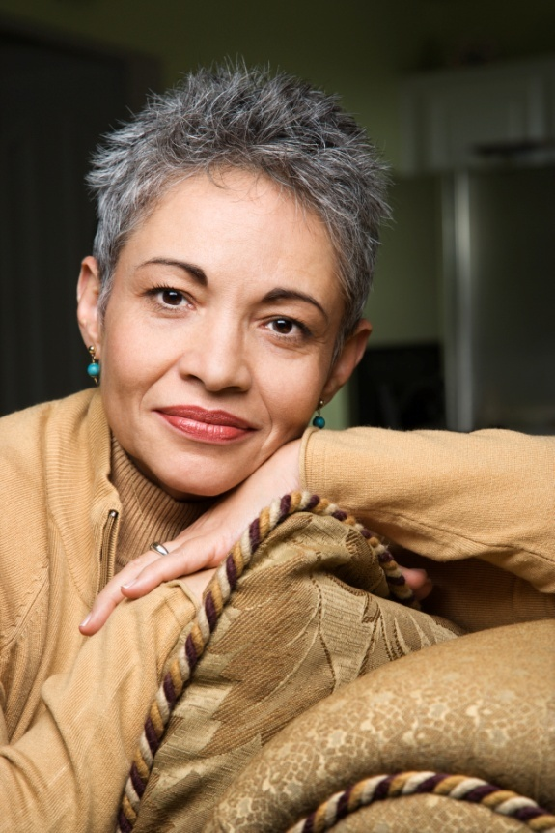
Scenario 3
Ms. Santiago – 46-year-old female following up after MI and placement of drug-eluting stent in RCA through angioplasty
Discharged from hospital 4 days ago
Unremarkable medical history prior to MI
EHR lists:
Vitamin D 1,000 mg – 1 tablet PO QD.
Notes:
[Note: This slide is optional, to be used for role play.]
A 46-year-old female patient, Ms. Santiago, is here for a scheduled followup visit. Ms. Santiago was discharged from the hospital 4 days ago after a myocardial infarction and the placement of a drug-eluting stent in the right coronary artery through angioplasty. Before the MI, Ms. Santiago had an unremarkable medical history and was taking Vitamin D 1,000 mg QD. She is married with three children ages 9, 12, and 15, and works full time as an elementary school teacher.
The EHR lists the following medicines for Ms. Santiago:
Vitamin D 1,000 mg – 1 tablet PO QD

Slide 11
How will we evaluate it?
Adverse drug events
Unsafe medicine issues
Medicine adherence
Satisfaction
Reported use
Bring in medicines.
Create safe medicine list together.
Customize this slide to match your practice’s implementation strategy.
Notes:
[Note: This slide should be customized by the practice to communicate practice-specific decisions. Some examples are provided here.]
We will use several measures to evaluate effectiveness:
How many adverse drug events occur pre- and post-implementation?
How many unsafe medicine issues are identified?
Does medicine adherence improve?
What is patient satisfaction with the strategy?
What is clinician satisfaction with the strategy?
We will also evaluate our implementation success:
What percentage of our target patient population brings in their medicines?
With what percentage of our target patient population do we work to create a complete and accurate medicine list using the strategy?

