Slide 1

Teach-Back
AHRQ
Guide to Improving Patient Safety in Primary Care Settings by Engaging Patients and Families
Notes:
The Agency for Healthcare Research and Quality, or AHRQ, funded the development of a Guide to Improving Patient Safety in Primary Care Settings by Engaging Patients and Families. AHRQ is a Federal agency whose mission is to produce evidence to make health care safer, higher quality, and more accessible, equitable, and affordable.
The Guide includes four strategies, and the purpose of the strategies is to create opportunities for meaningful engagement between primary care practices and their patients and families to improve patient safety.
Our practice has chosen to adopt Teach-Back and [list other strategies]. Today we’re going to talk about Teach-Back.

Slide 2
What is Teach-Back?
“Can you show me how you would use your inhaler at home?”
“I want to make sure we are on the same page. Can you tell me…”
“I want to make sure I explained things clearly. Can you explain to me…”
Notes:
Teach-back is an evidence-based health literacy intervention that promotes patient engagement, patient safety, adherence, and quality. With teach-back, you ask patients or family members to explain in their own words what they need to know or do. You ask them to teach it back to you.
Teach-back is a way to confirm that you have explained information clearly and that patients or family members have a clear understanding of what you have told them.
When you ask patients, “Do you understand?” they generally nod their heads, whether or not they understand. Sometimes they think they've understood, and sometimes they're embarrassed to admit they're confused. The only way to know for sure that they've understood is to hear them teach the information back to you in their own words.

Slide 3
Why is it important?
80%
of information shared in a primary care visit is immediately forgotten by patients
50/50
chance
that what is remembered is correct
Notes:
Research indicates that clinicians underestimate their patients’ needs for information and overestimate their ability to communicate effectively with patients.
In one study, up to 80% of the medical information patients were told during office visits was forgotten immediately; in another study, nearly half of the information retained was incorrect.
Patient misunderstandings and poor recall contribute to poor patient outcomes.
Teach-back is a proven strategy to ensure patients and their families have a clear understanding of information you communicate to them. Finding ways to improve communication between you and your patients and their families can directly address patient safety problems.

Slide 4
How can it help me?
Confirm that your patients have a clear understanding of what you have told them.
Prevent misunderstandings that would affect treatment adherence.
Minimize postvisit clarifying phone calls and emails.
Notes:
If patients have a clear understanding of what you have told them – their medications, their diagnosis, what they need to do when they go home, how they need to do it, the followup they need – they are more likely to adhere to it. Making sure patients have a clear understanding during the visit can also help reduce followup phone calls and emails.
One clinician who started using teach-back stated, “This was an education for me. I've been a physician for a long time, and I didn't realize a lot of things are not heard. Teach-back is a wonderful idea; we think we're getting our message across and obviously we are not.”
Another clinician reported, “It has been beneficial and efficient to use the last couple of minutes of the visit to perform teach-back to identify questions and concerns and address them immediately rather than having to reply to follow-up telephone calls.”
And patients appreciate it too. One patient, who works in a healthcare setting, was surprised to learn through teach-back that she had been taking her allergy medicines incorrectly for a year.
In another case, a patient was to take half a pill per day. She understood that to mean 1 to 2 per day, so she was overdosing herself. This confusion was uncovered using teach-back.
Other patients stated that it made them feel that the clinician cared enough about them to make sure they understood.

Slide 5

When should I use it?
  A new diagnosis
  Medication need and proper use
  Home care instructions
  Recommended behavior changes
  Treatment options
  Treatment plan
  Use of a new device
  Next steps
Notes:
Teach-back can be used when you explain:
A new diagnosis.
Medication need and proper use.
Home care instructions.
Recommended behavior changes.
Treatment options.
Treatment plan.
Use of a new device.
Next steps.
Teach-back is not necessarily appropriate for all patient visits. It may be awkward to use it with simple instructions or simple issues that do not require next steps.
However, remember that all patients can benefit from teach-back. Every patient, even those who are well spoken or well educated, may have trouble understanding, particularly if they are ill, tired, or frightened, such as when they are facing a new diagnosis.
Teach-back may take longer initially as you learn to adopt it into your standard workflow. Until it begins to come easy to you, you may want to focus on a specific population. For example:
Patients with a specific chronic condition, such as asthma or diabetes
First and last patient of the day
Patients with a new medication
Situations with a lot of people in the room to clarify concepts in a potentially chaotic environment and to involve family members

Slide 6
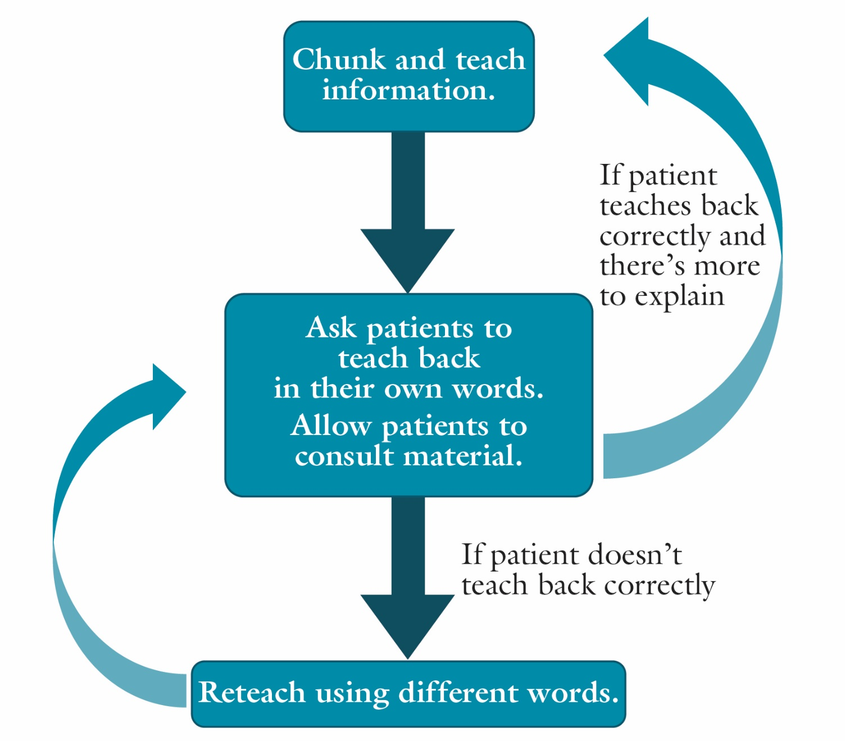
How do I use it?
Notes:
To use teach-back, start with the most important message, and don’t try to provide too much information at once. Use plain language and avoid medical jargon.
Ask the patient to teach information back to you in his or her own words. You might say, for example:
I want to make sure I explained everything clearly to you. Can you tell me what the plan is?
We made a lot of changes to your medicines today. Can you tell me how you are going to take them?
We talked about a lot of information. Can you tell me what to look out for the next few days?
One clinician described her experience with teach-back, “I remember my first reaction to teach-back was that it was odd, asking them what you just told them. But now I find it crucial. I don’t feel comfortable with someone leaving without any increase in understanding of what we discussed. I don’t feel effective if the patient can’t communicate that to me.”
It’s okay if they need to read written instructions or look at any material you’ve given them.
If the patient doesn’t teach back correctly, reteach it using different words. Don’t simply repeat what you’ve already said.
If the patient does teach back correctly, and there’s more to explain, repeat the process.
Document your use of teach-back by [insert procedure for documenting teach-back].

Slide 7
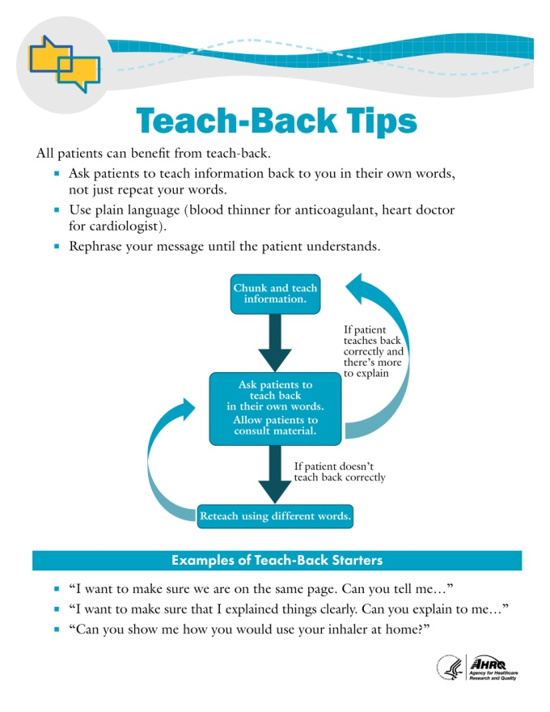
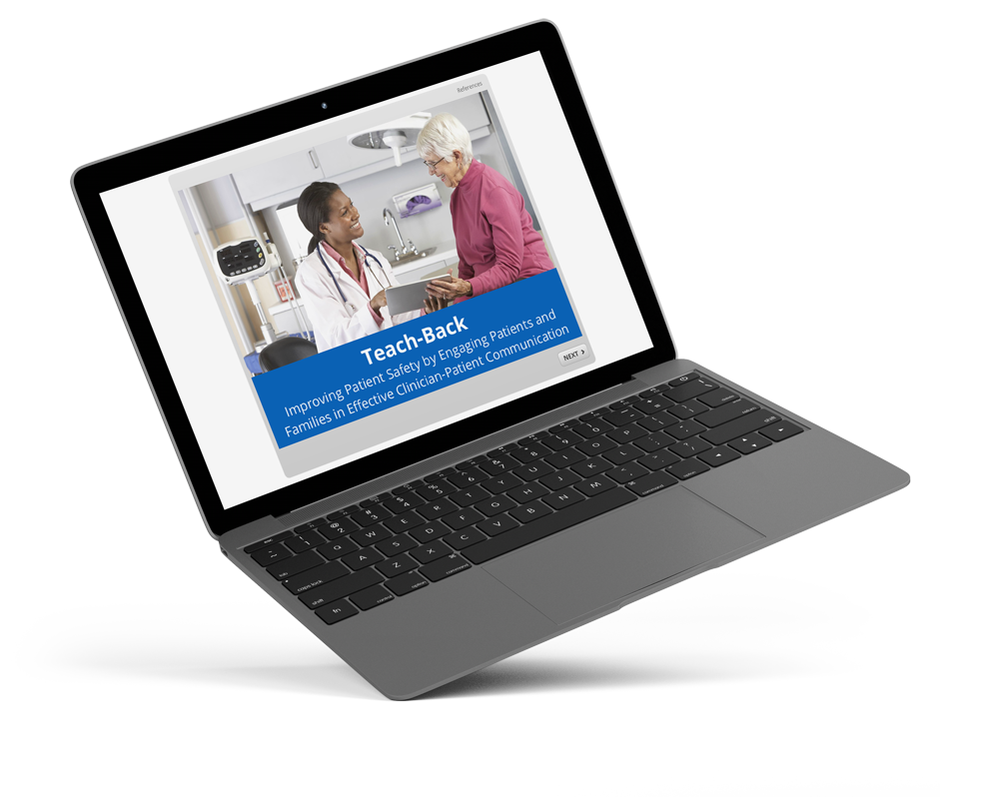
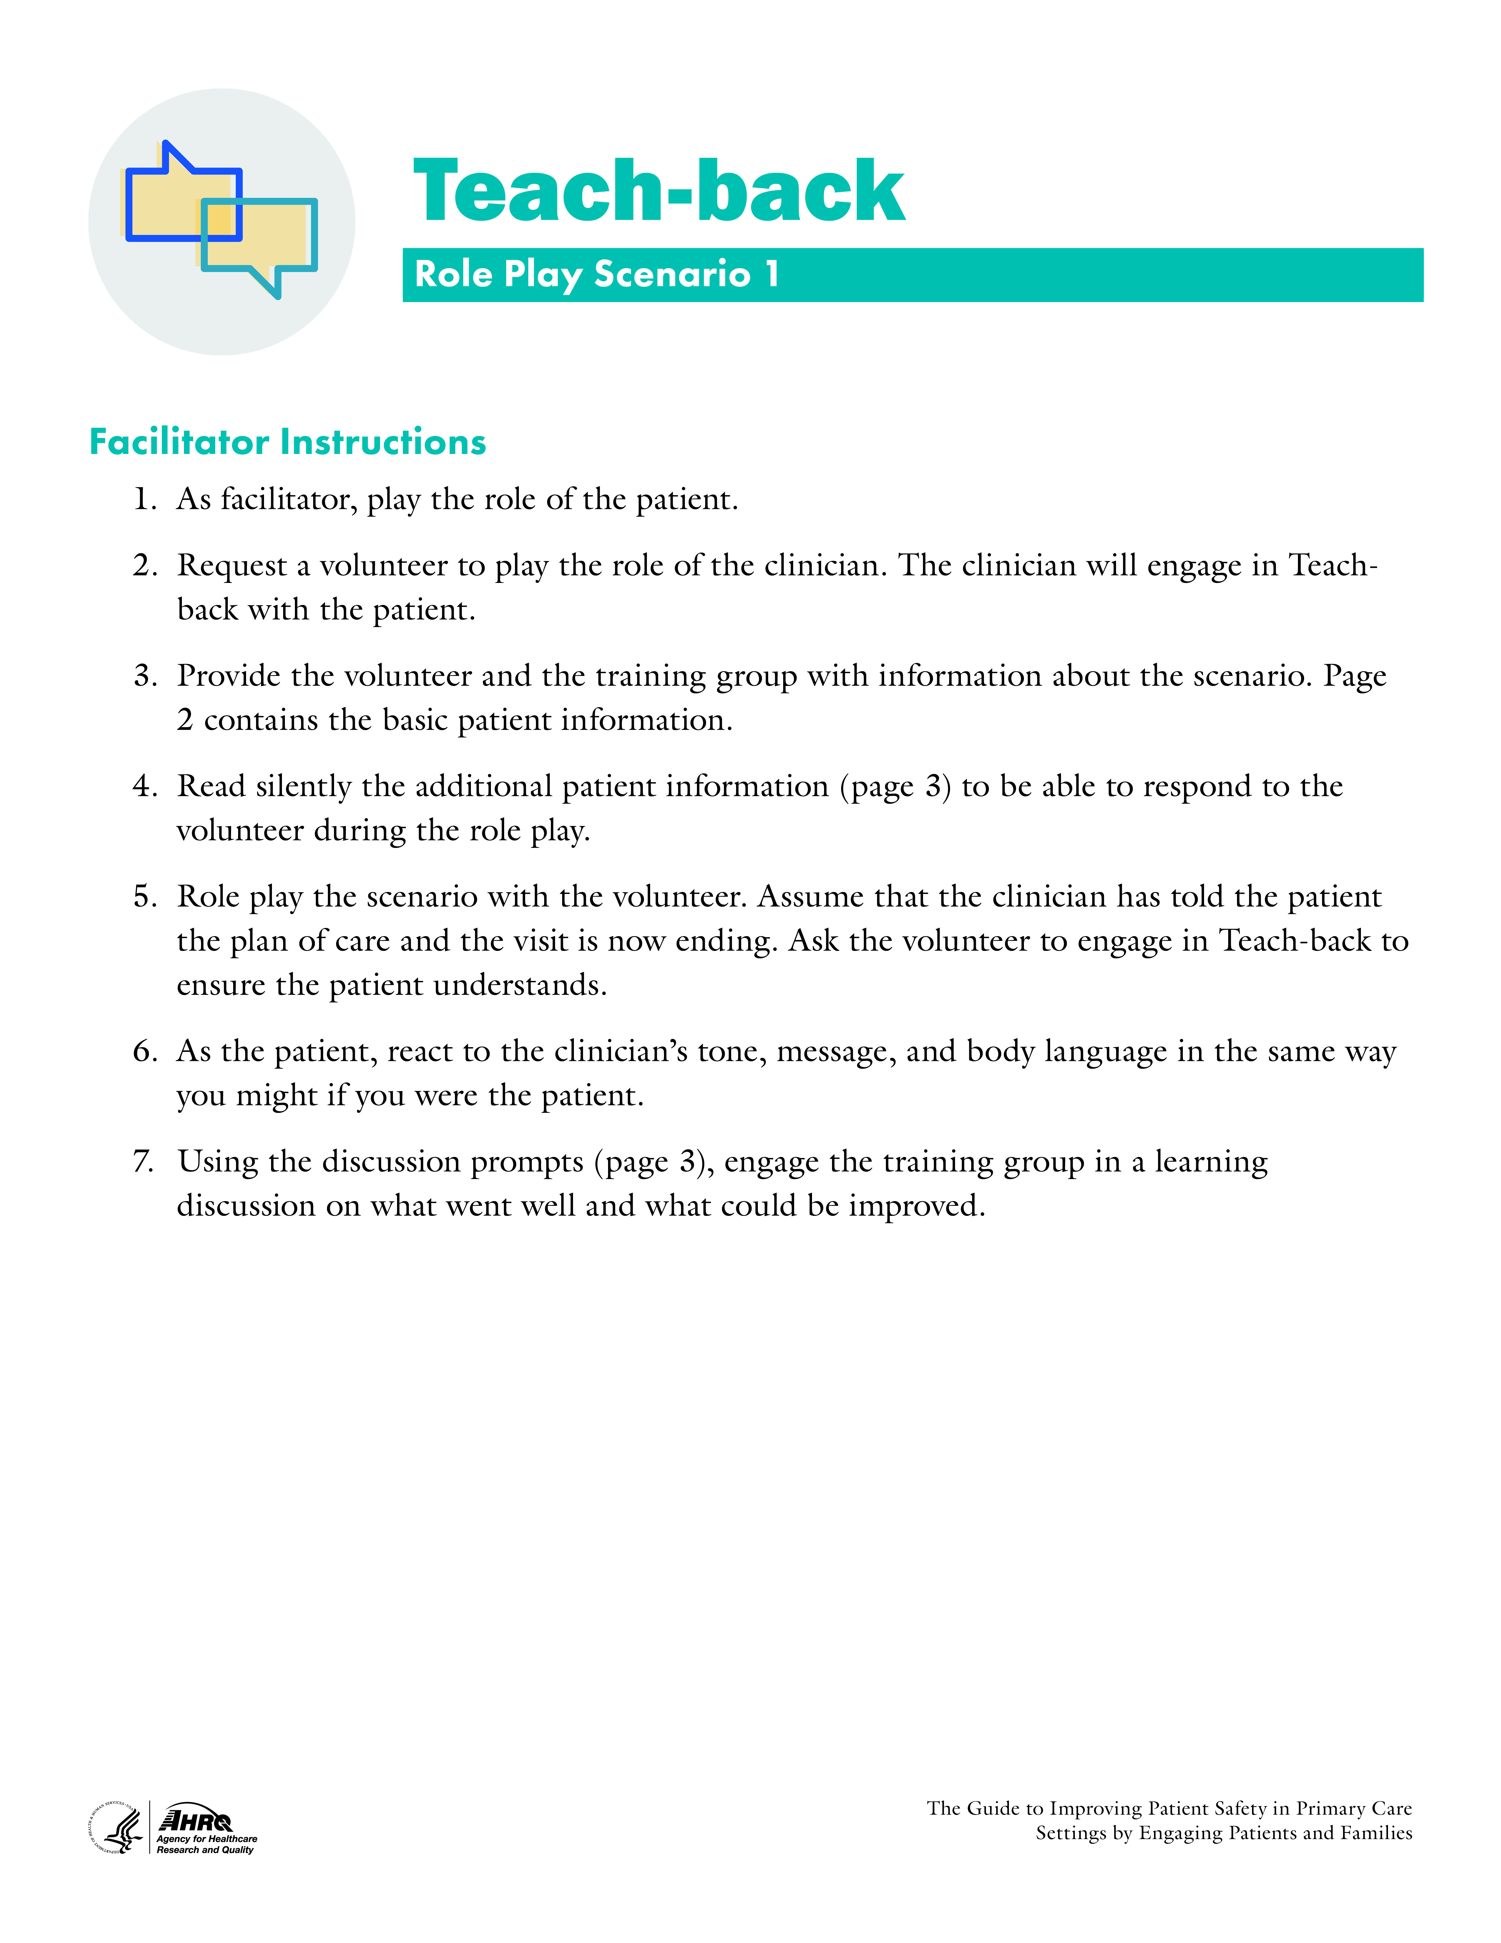
What tools are available?
Notes:
Several tools are available with the teach-back strategy.
We have an interactive learning module that I encourage you all to work through. I will send you the link to it. It is self-paced and takes about 10 minutes to complete. It contains guidance and tips for using teach-back, some of which I’ve covered here, but in more detail.
We also have a handout that you can use as a reminder as you start using teach-back.
And we have several role play scenarios that we will use to practice.

Slide 8

Scenario 1
Mr. Thomas – 78-year-old male with uncontrolled hypertension and knee pain
Visiting for knee pain, which is keeping him from exercising
Takes hydrochlorothiazide, atorvastatin, and low-dose adult aspirin
Not taking hydrochlorothiazide as prescribed because it makes him pee a lot
Positive PHQ 9 depression screening
Plan of care for Mr. Thomas:
  Stop the hydrochlorothiazide and start metoprolol (50 mg PO QD).
  Start fluoxetine (20 mg PO QD).
  Follow up with an orthopedist for a possible knee replacement.
  Continue atorvastatin (20 mg PO QD).
  Continue low-dose adult aspirin (81 mg PO QD).
Notes:
[Note: This slide is optional, to be used for role play.]
A 78-year-old male patient with uncontrolled hypertension, Mr. Thomas, has come in for a scheduled visit with his primary care clinician for knee pain. Mr. Thomas is a fit and active man who is frustrated that his knee pain is preventing him from exercising.
Mr. Thomas takes hydrochlorothiazide 50 mg – 1 tablet PO QD, atorvastatin 20 mg – 1 tablet PO QD, and low-dose adult aspirin 81 mg -- 1 tablet PO QD. Mr. Thomas reports he’s taking his hydrochlorothiazide about 3 to 4 times a week because the full dose causes him to pee a lot and disrupts his normal activities and sleep. The clinician has decided to change his blood pressure medicine to metoprolol.
Mr. Thomas’s PHQ 9 depression screening was positive, and after talking with him, the clinician has decided to prescribe an antidepressant.
The plan of care for Mr. Thomas includes the following:
Stop the hydrochlorothiazide and start metoprolol (50 mg PO QD).
Start fluoxetine (20 mg PO QD).
Follow up with an orthopedist for a possible knee replacement.
Continue atorvastatin (20 mg PO QD).
Continue low-dose adult aspirin (81 mg PO QD).

Slide 9

Scenario 2
Mr. Penny – 32-year-old male with
persistent cough, low-grade fever
for 3 days
Temp 38.1 C, BP 128/82,
weight 179 lbs
Tired, SOB on stairs, pain in chest
with deep breath
Decreased breath sounds lower
right, audible rales
Plan of care for Mr. Penny:
  Chest x ray
  Azithromycin 500 mg PO today, 250 mg PO next 4 days
  Followup from clinician with test results
  Fluids
  OTC acetaminophen or ibuprofen as needed
  Return in one week. Call sooner if no improvement.
Notes:
[Note: This slide is optional, to be used for role play.]
A 32-year-old male patient, Mr. Penny, has come in for a persistent cough and low-grade fever for the last 3 days. Mr. Penny’s temperature is 38.1 degrees Celsius, his BP is 128/82, and his weight is 179, down from 186 a year ago. Mr. Penny states he’s been more tired than usual, gets short of breath walking up stairs, and his chest hurts sometimes when he breathes deeply. Given the current information and decreased breath sounds on the right lower lobe and audible rales, his clinician suspects bacterial pneumonia.
Mr. Penny had blood collected in the office and is being sent to radiology for a chest x ray. Mr. Penny has been prescribed azithromycin, 500 mg PO today and 250 mg PO the next 4 days and advised to drink lots of fluids and to take acetaminophen or ibuprofen as needed for discomfort.
The clinician will follow up with Mr. Penny by telephone after diagnostic test results are available. Mr. Penny is requested to return to the practice in one week and to call the office if fevers continue or his condition does not improve.

Slide 10
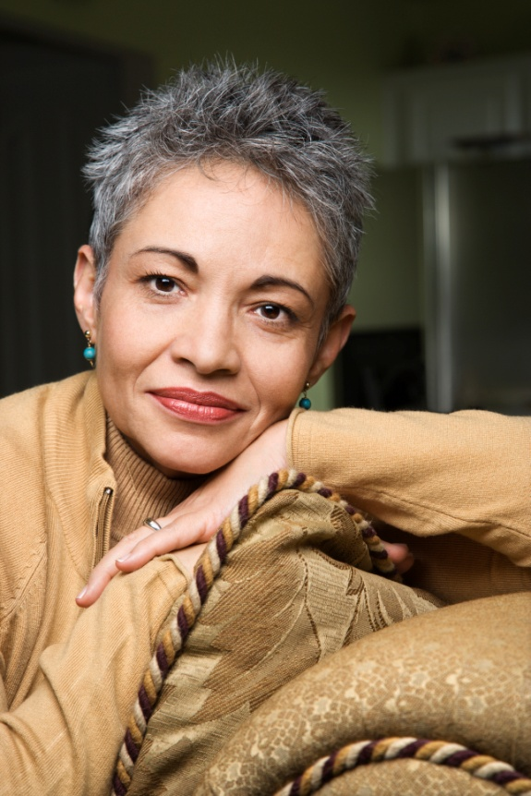
Scenario 3
Ms. Santiago – 46-year-old female following up after MI and placement of drug-eluting stent in RCA through angioplasty
Discharged from hospital 4 days ago
Overwhelmed by new health status and medicines
Plan of care for Ms. Santiago:
  Follow up with cardiologist as planned.
  Return to primary care practice in 2 months for Prevnar 13® vaccine.
  Continue taking prescribed medicines:
    Ticagrelor 90 mg – 1 tablet PO BID (morning and evening)
    Metoprolol 75 mg (25mg/tablet) – 3 tablets PO QD (morning)
    Lisinopril 10 mg – 1 tablet PO QD (morning)
    Low-dose adult aspirin (81mg/ tablet)—1 tablet PO QD (morning)
    Atorvostatin 80 mg – 1 tablet PO QD (evening)
    Vitamin D 1,000 mg – 1 tablet PO QD
Notes:
[Note: This slide is optional, to be used for role play.]
A 46-year-old female patient, Ms. Santiago, is here for a scheduled followup visit. Ms. Santiago was discharged from the hospital 4 days ago after a myocardial infarction and the placement of a drug-eluting stent in the RCA through angioplasty. Before the MI, Ms. Santiago had an unremarkable medical history and was taking Vitamin D 1,000 mg PO QD. She is married with three children ages 9, 12, and 15, and works full time as an elementary school teacher.
Today Ms. Santiago is feeling overwhelmed by her current health status and her new medicines. She can’t pronounce any of the medicines and doesn’t know what they do. She can’t keep anything straight and has already missed a few doses. She is sure that she has taken some of them twice because she forgot she had taken them already.
Ms. Santiago is scheduled to see her cardiologist in 10 days. The plan of care today for Ms. Santiago includes:
Follow up with her cardiologist as planned.
Return to the primary care practice in 2 months for Prevnar 13 vaccine.
Continue taking her prescribed medications:
Ticagrelor 90 mg – 1 tablet PO BID (morning and evening)
Metoprolol 75 mg (25mg/tablet) – 3 tablets PO QD (morning)
Lisinopril 10 mg – 1 tablet PO QD (morning)
Low-dose adult aspirin (81mg/ tablet)—1 tablet PO QD (morning)
Atorvostatin 80 mg – 1 tablet PO QD (evening)
Vitamin D 1,000 mg – 1 tablet PO QD

Slide 11
How will we evaluate it?
Number of followup questions
Quality outcome measure
Satisfaction
Reported use
  By clinicians
  From patients
Customize this slide to match your practice's implementation strategy.
Notes:
[Note: This slide should be customized by the practice to communicate practice-specific decisions. Some examples are provided here.]
We will use several measures to evaluate effectiveness:
How many followup questions (calls and emails) do we get pre- and post-implementation?
For our patients with diabetes, what is their HbA1C pre- and post-implementation?
What is patient satisfaction with teach-back?
What is clinician satisfaction with teach-back?
We will also evaluate our implementation success:
Do our clinicians report using teach-back?
Do our patients report that teach-back was used with them?

