Slide 1
Warm Handoff Plus
AHRQ
Guide to Improving Patient Safety in Primary Care Settings by Engaging Patients and Families
Notes:
The Agency for Healthcare Research and Quality, or AHRQ, funded the development of a Guide to Improving Patient Safety in Primary Care Settings by Engaging Patients and Families. AHRQ is a Federal agency whose mission is to produce evidence to make health care safer, higher quality, and more accessible, equitable, and affordable.
The Guide includes four strategies, and the purpose of the strategies is to create opportunities for meaningful engagement between primary care practices and their patients and families to improve patient safety.
Our practice has chosen to adopt Warm Handoff Plus and [list other strategies]. Today we’re going to talk about Warm Handoff Plus.

Slide 2
What is a Warm Handoff Plus?
Notes:
A Warm Handoff Plus is a handoff that is conducted in person, between two members of the health care team, in front of the patient (and family if present). It includes the patient as a team member so that he or she can hear what is being discussed about the clinical problem, current status, and plan of care.
The term “warm handoff” originated in customer service where it is used to describe referrals that ensure that the customer is connected to someone who can provide what he or she needs. In healthcare, this typically means that one member of the healthcare team introduces another team member to the patient, explaining why the other team member can better address a specific issue with the patient and emphasizing the other team member’s competence. Often it is used to describe the handoff between a medical provider and a behavioral health specialist.
The emphasis of the Warm Handoff Plus is specifically on engaging the patient and family in the handoff within the primary care practice. A warm handoff can occur between any two members of the healthcare team, including clinicians, medical assistants, front and back office staff, and members of the extended care team, such as the pharmacist, diabetes nurse educator, and social worker.

Slide 3
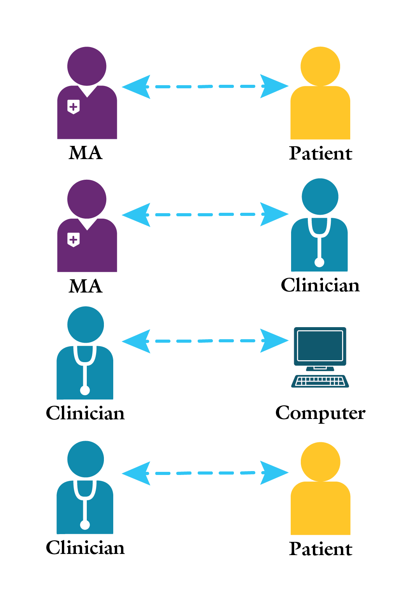
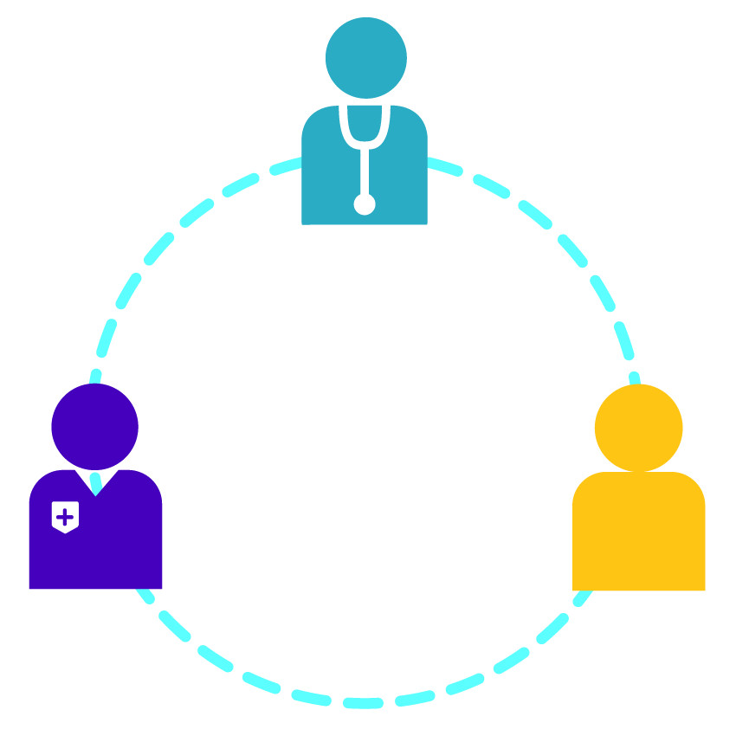
Why is it important?
Transactional Communications
Collaborative Communications
Notes:
A Warm Handoff Plus engages the patient and is a safety check. Communication breakdowns within the healthcare team or between the team and the patient or family can result in medical errors. Collaborative communication, promoted by the Warm Handoff Plus, helps to build trust and strengthen relationships, resulting in improved communication, patient outcomes, and patient and clinician satisfaction.
A Warm Handoff Plus is similar in concept to bedside rounding on inpatient units. It moves conversations between members of the healthcare team from outside the exam room into the exam room to engage the patient. The Warm Handoff Plus allows the patient (and family member) to verify the information being communicated between the healthcare team and to offer additional context as needed.
Here’s an example of a Warm Handoff Plus in action:
At a primary care practice that uses the Warm Handoff Plus, a medical assistant brought the patient to the exam room and started taking the chief complaint and vitals. As she went through his medicines one by one, asking him how he was taking each, the patient acknowledged that he was only taking one of them “about half the time.” When she finished with the rooming process, she went to get the doctor and they came back into the room together for the Warm Handoff Plus. She briefed the doctor in the room with the patient on all the information she had gathered. When she got to the medicine that the patient was only taking sometimes, the patient interrupted. “I take it every morning. I just forget to take it most nights, so I end up taking it about half the time.” The doctor immediately responded, “Then take both pills in the morning.” The Warm Handoff Plus provided an opportunity for communication that might otherwise have been missed and had a positive impact on patient safety and outcomes.

Slide 4
How can it help me?
Improves communication both with the patient and among the healthcare team
Makes communication more efficient
Prevents errors
Improves the clinician and patient relationship
Notes:
Communication breakdowns are a key threat to patient safety. Miscommunication and omissions can lead to medical errors and adverse events. A Warm Handoff Plus can help close the communication gaps and prevent errors.
Practices that have adopted the Warm Handoff Plus attest to its benefits. One clinician said, “It makes it a lot easier in that you don’t have to rehash and ask all the same questions. You can ask more specific questions.”
A nursing supervisor stated, “It is such a good idea, especially trying to get the patients and the doctors to be on one page.”
And a staff member reported, “There have been instances where the patient is being warm handed off to me, and the provider says something and then the patient says ‘No, that’s not the case.’”

Slide 5
When should I use it?
Transitions for Warm Handoff Plus
Customize this slide to match your practice’s implementation strategy.
Notes:
[Note: This slide should be customized by the practice to communicate practice-specific decisions on which transitions will now be handled with Warm Handoff Plus. An example is provided here.]
Initially, we will be using the Warm Handoff Plus with two types of transitions of care. First, the PCT-to-clinician transition of care will be a Warm Handoff Plus. The PCT will room the patient as is our current practice. When the clinician is ready to see the patient, the PCT will join the clinician in the exam room with the patient and conduct a Warm Handoff Plus. A checklist is available to help with the information that the PCT should convey in the handoff.
Our second type of transition will be a handoff to the lab. Whenever a patient needs labwork, the PCT will accompany the patient to the lab and explain to the lab tech in front of the patient what the patient needs.

Slide 6
How do I use it?
Notes:
For the transitions that we are targeting, to use a Warm Handoff Plus, conduct the handoff in person, in front of the patient. Currently, you might exchange information in the hallway or at a workstation. Or you might exchange information using the electronic health record. The PCT enters vitals and notes into the EHR, and the clinician retrieves that information from the EHR. Instead, with a Warm Handoff Plus, you will exchange the information in person, in front of the patient.
[Note: This would be a good place to show the Warm Handoff Plus video or refer to it.]
Here is a short – less than 5 minutes – video that shows a Warm Handoff Plus and explains the benefits.
OR
There is a short – less than 5 minutes – video that shows a Warm Handoff Plus and explains the benefits. I will send you the link to the video, and I encourage you to watch it.

Slide 7
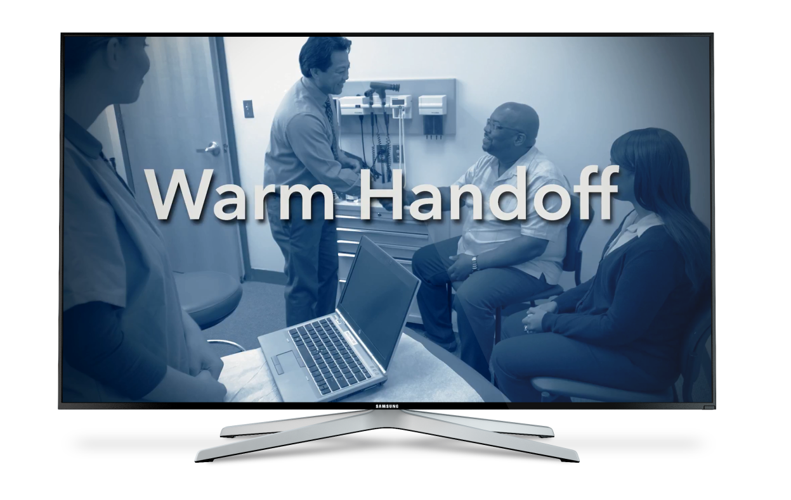
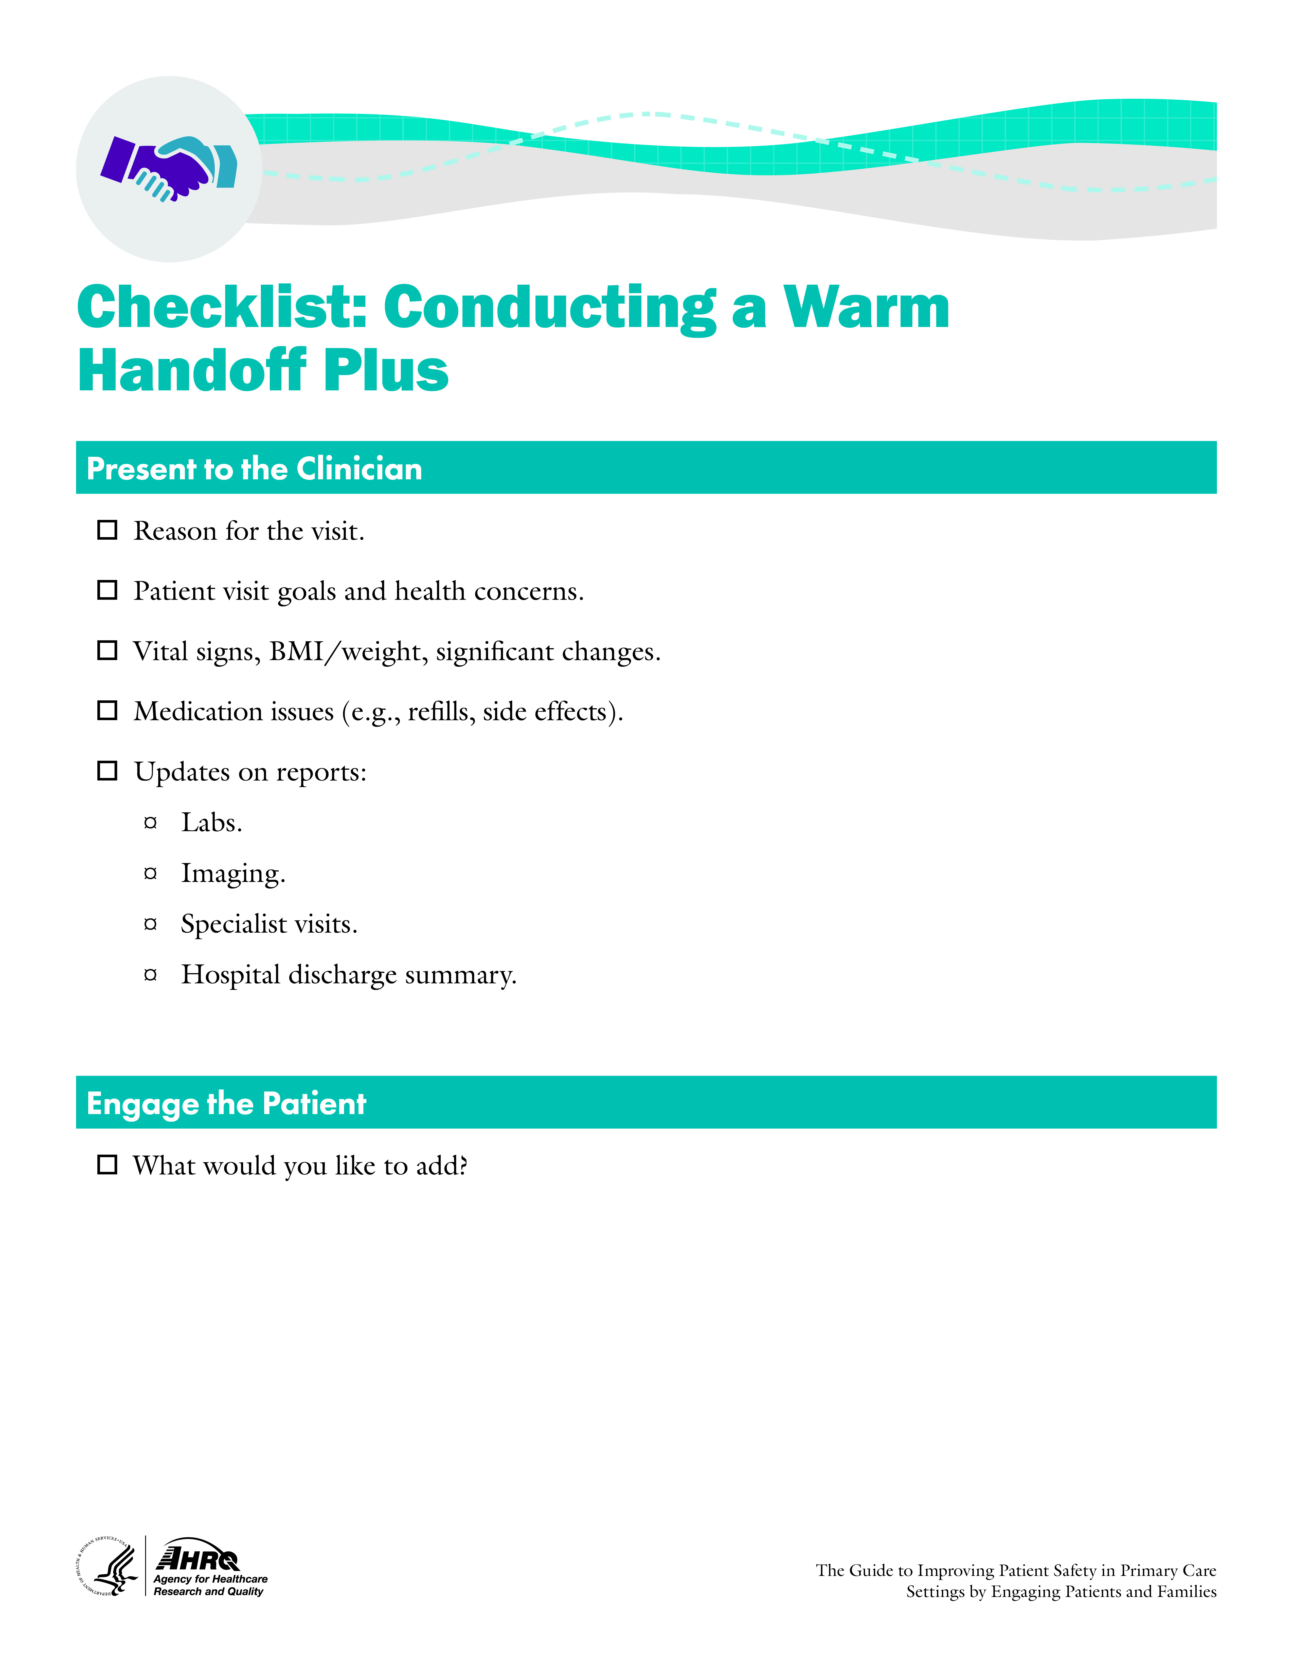
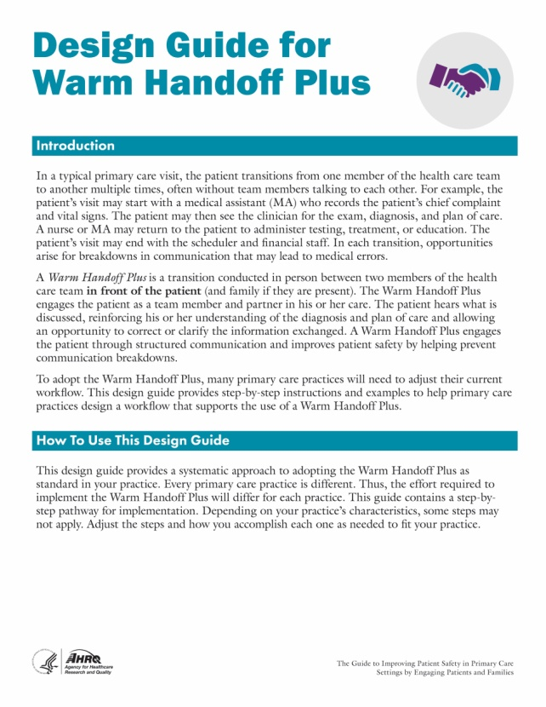
What tools are available?
Notes:
Several tools are available with the Warm Handoff Plus strategy.
In addition to the video, there are several role play scenarios that we will use to practice.
There is also a checklist that a [PCT] can use to conduct a Warm Handoff Plus with a clinician and a design guide that we used to design our implementation.

Slide 8
Scenario 1
Handoff from MA to clinician
Mr. Thomas – 78 year-old-male with uncontrolled hypertension and knee pain
Visiting for knee pain, which is keeping him from exercising
Temp 98.7 F, BP 152/91, weight 173 lb, up 2 lb
PHQ 9 depression screening score of 8
Medications:
Hydrochlorothiazide (Admits to not
taking as prescribed because it makes
him pee a lot)
Atorvastatin
Low-dose adult aspirin
Notes:
[Note: This slide is optional, to be used for role play.]
Mr. Thomas is a 78-year-old male patient with uncontrolled hypertension who has come in for a scheduled visit for knee pain. Mr. Thomas is a fit and active man who is frustrated that his knee pain is preventing him from exercising.
His current blood pressure is 152/91, temperature is 98.7 F., and weight is 173 lb, up 2 lb from his last visit.
Mr. Thomas takes hydrochlorothiazide 50 mg – 1 tablet PO QD, atorvastatin 20 mg – 1 tablet PO QD, and low-dose adult aspirin 81 mg – 1 tablet PO QD. Mr. Thomas admits he’s taking his hydrochlorothiazide about 3 to 4 times a week because the full dose causes him to pee a lot and disrupts his normal activities and sleep.
A PQH 9 was administered, and Mr. Thomas’s score was 8.

Slide 9
Scenario 2
Handoff from MA to clinician
Mrs. Sanchez – 63-year-old female with type II diabetes
Here for annual physical
Temp 98.6 F, BP 137/81, weight 146 lb, down 10 lb, BMI of 25
Weight loss attributed to daily walking, more vegetables, fewer sweets
HbA1C of 6.5
Taking metformin 1,000 mg QD after dinner as prescribed, no other meds
Notes:
[Note: This slide is optional, to be used for role play.]
Mrs. Sanchez has come into the office for her annual physical. Mrs. Sanchez is 63 years old with type II diabetes. Her vital signs are stable – BP 137/81, temperature 98.6 F.
Mrs. Sanchez is pleased with her 10 lb weight loss over the last year. Her current weight is 146 lb with a BMI of 25. She attributes her weight loss to walking daily and eating more vegetables and fewer sweets.
Previsit labs were drawn last week, and her current HbA1C is 6.5.
Ms. Sanchez is taking her metformin 1,000 mg QD after dinner as prescribed and is not taking any additional medicines.

Slide 10
Scenario 3
Handoff from MA to lab technician
Mr. Bauman– 61-year- old male with history of hypertension
Here for annual physical
Orders
Flu vaccine
CBC
Lipid panel
UA
Notes:
[Note: This slide is optional, to be used for role play.]
Mr. Bauman, a 61-year-old male with a history of hypertension, is here for his annual physical. The clinician has ordered a CBC, lipid panel, and UA. She has also ordered a flu vaccine.

Slide 11
How will we evaluate it?
Corrected miscommunications
Satisfaction
Reported use:
Warm handoff
With patient
Customize this slide to match your practice’s implementation strategy.
Notes:
[Note: This slide should be customized by the practice to communicate practice-specific decisions. Some examples are provided here.]
We will use several measures to evaluate effectiveness:
How many miscommunications are corrected during a Warm Handoff Plus?
What is patient satisfaction with Warm Handoff Plus?
What is clinician satisfaction with Warm Handoff Plus?
We will also evaluate our implementation success:
How often does the intended Warm Handoff Plus occur?
In what percentage of Warm Handoff Pluses is the patient included?

