Slide 1
Communication and Optimal Resolution (CANDOR): Grand Rounds Presentation
Presenter: Timothy B. McDonald, MD, JD
Notes:
This presentation will introduce you to Communication and Optimal Resolution, or the CANDOR process. Some organizations struggle to improve the way they and their care teams respond to medical harm. The CANDOR process aims to change that.

Slide 2
Do Less Harm Video
Notes:
To get started, let’s watch this video.
Video: Do Less Harm

Slide 3
Presentation Goals
Highlight the gap between optimal response to medical injury and current practices, and identify the reasons for this gap.
Describe the CANDOR (Communication and Optimal Resolution) process and how this toolkit will help organizations improve their response to medical injury.
Discuss next steps in the CANDOR implementation process.
Notes:
Today’s presentation goals are to:
Highlight the gap between optimal response to medical injury and current practices, and identify the reasons for this gap.
Describe the CANDOR process and how this toolkit will help organizations improve their response to medical injury.
Discuss next steps in the CANDOR implementation process.

Slide 4
The Problem
Despite major initiatives, patient harm from medical care occurs too often.
Limited progress in improving quality and patient safety is due to our inability to learn from care breakdowns.
Our response to injured patients rarely addresses their needs.
Notes:
All of us in health care want to provide excellent, high-quality medical care, but despite all of our patient safety work, patient harm is too common.
Organizations have quality and safety programs, but many struggle to ensure that solutions to errors are really addressing the cause of the error and not just checking the box on their process when they do their analysis of the error.
Patients want a health care organization, physician and/or care provider to be fully transparent when an error occurs, but often this doesn’t happen.

Slide 5
Patient Safety Background
2010 data from Medicare:
13.5% of hospitalized beneficiaries experienced an adverse event.
1.5% experienced harm that contributed to death.
44% of adverse events were preventable.
Levinson D, et al. OIG Report, Nov 2010
Notes:
From the book “To Err is Human,” as reported from the 2010 Medicare data:
13.5% of hospitalized beneficiaries experienced an adverse event.
1.5% experienced harm that contributed to their death.
44% of adverse events were preventable.

Slide 6
Following Harm: Not Always Transparent, Not Always Learning
Health Affairs (2012)
“Survey Shows That At Least Some Physicians Are Not Always Open or Honest With Patients”
Lisa I. Iezzoni, Sowmya R. Rao, Catherine M. DesRoches, Christine Vogeli, and Eric G. Campbell
Notes:
We haven’t made headway on safety, in part because we’ve struggled with transparency. In this Health Affairs article, doctors report they don’t always disclose medical errors.
In Rosemary Gibson’s book:
Responding to medical error is a part of health care where we should be most patient centered (true stress test), but where we are perhaps the least.

Slide 7
Consequences of Failed Response to Medical Injury
Compounds suffering of patients and family
Heightens distress of clinicians
Increases likelihood of litigation
Is a lost opportunity for improving quality
Degrades institutional culture/climate
Reduces public trust in health care
Notes:
Consequences are high when organizations and health care providers don’t respond to medical injury.
As we saw in the “Do No Harm” Video, families reported how the silence they experienced after the adverse event actually compounded the injury from the event itself.
When an organization or a care provider doesn’t communicate, or the communication doesn’t meet the patients’ or families’ expectations, it may lead to litigation as patients and families see this as their only way of getting answers to their questions.

Slide 8
What Do Patients Want?
The truth
What is it?
The facts
What are they?
Emotional first aid
Empathy and compassion
Recognition and validation of emotions
Nonabandonment
Accountability, including apology
Future prevention
Notes:
Open and honest communication after an adverse event is not easy and does require training and support.
It starts with answering the question: “What do we know?”
This is not always easy, as we may not have all the answers.
It is important to understand that communication doesn’t happen just once and then you are done; rather it is a process. During the first communication with patients and families, we need to set the stage for this as well, by telling them the facts that we know at the time and promising them more information later.
It is also important to recognize not only patients’ and families’ emotions at the time, but also the caregivers’ emotions, and to provide emotional support.
It is important to remember what patients want in our communication with them:
An explicit statement that an error occurred.
What happened and the implications it has on their health.
Why it happened:
This might be hard to answer at the time; but again, this is to stress that as the investigation occurs, we will meet with patients and families and update them on everything the organization and care team discovers during the investigation.
How recurrences will be prevented:
This will be part of the investigation and conversations with patients and families later.
Most importantly, the patient and family want to hear the organization and the caregivers apologize with sincerity.

Slide 9
Why It is Not Happening: Barriers Perceived and Real
Barriers
Fears
Litigation
Data Bank
Shame, blame
Reputation
Lack of skills
Lack of process
Benefits
Learning
Improving
Less litigation
Lower costs
Integrity
Morale
Healing
Notes:
It is important to recognize why organizations and care providers are resistant to this type of open and transparent communication.
Fear of:
Loss of reputation and trust.
Being sued.
Reporting issues, for example, State reporting requirements and the physician data bank.
Being shamed or blamed for the error.
Revealing poor skills/abilities.
Lacking an organizational process related to open and transparent communication that is fair and just.
Benefits from an open and transparent culture include:
Organizational learning that leads to improvements.
Potential decrease in adverse events being litigated, which can lead potentially led to lower malpractice expenses and claims.
Improved morale and trust amongst the organization and care providers as they see that this entire process is core to everyone’s mission which is to improve quality and safety.

Slide 10
Michelle Malizzo-Ballog
Notes:
Example case.
[If you like, you can also insert a picture of a case at your own organization.]
Michelle Malizzo-Ballog, pictured here with her mother and father.

Slide 11
Story of Michelle Malizzo-Ballog
39-year-old presents for endoscopic GI procedure under heavy-moderate sedation.
Had failed stent placement 2weeks prior due to discomfort, despite large amounts of narcotics
Repeat scheduled for 1 p.m. with anesthesia present
GI physician delayed. Arrives at 4 p.m., at which point anesthesia not available for elective case
Twice the dose of fentanyl, midazolam used
Standard monitors for HR, BP, O2 Sat used.
Dark room, patient on side, unable to auscultate.
Physician asks monitoring nurse to get different stent. Nurse leaves the room.
Notes:
Michelle was to have an endoscopic gastrointenstinal procedure under heavy-moderate sedation, due to a failed procedure two weeks prior. Anesthesia was scheduled to be present for this procedure, but due to other emergencies and the GI physician being late for this scheduled procedure, anesthesia was no longer available when the physician arrived. The physician decided to proceed and perform the procedure, anyway. The nursing staff in the room had Michelle connected to a monitor and monitored her heart rate, blood pressure, and oxygen saturation, but due to the patient’s position for the procedure and the equipment, they had a hard time actually seeing the monitoring equipment.
The physician doing the procedure asked the nurse responsible for monitoring Michelle’s vitals to get him a different piece of equipment that was not in the room during the procedure.

Slide 12
…Case Continued
Upon return, patient found to be in respiratory distress.
Code called.
No response to reversal agents.
Team assumes allergic reaction to medication as etiology of arrest.
Michelle resuscitated but brain dead.
Notes:
The nurse did as requested; when she returned, the nurse realized the patient was shaking. Her initial thoughts were that Michelle was having a seizure resulting in respiratory distress. Upon turning on the lights and doing an assessment, the team realized the patient was in cardiopulmonary arrest.
The code ensued, and eventually the care team was able to restore Michelle’s heart rate and intubate her, but she showed signs of brain death. The care team at this time had no idea why Michele suffered cardiopulumonary arrest, but during the code, Michelle had no response to reversal agents used for the sedation. The team assumed at this time Michelle had an allergic reaction to the medication.
The team immediately placed a call to the risk management department, and they responded immediately to the GI lab. This immediate response ensured that the critical data regarding the room, environment, and supplies were preserved and documented to help with the analysis of the event.

Slide 13
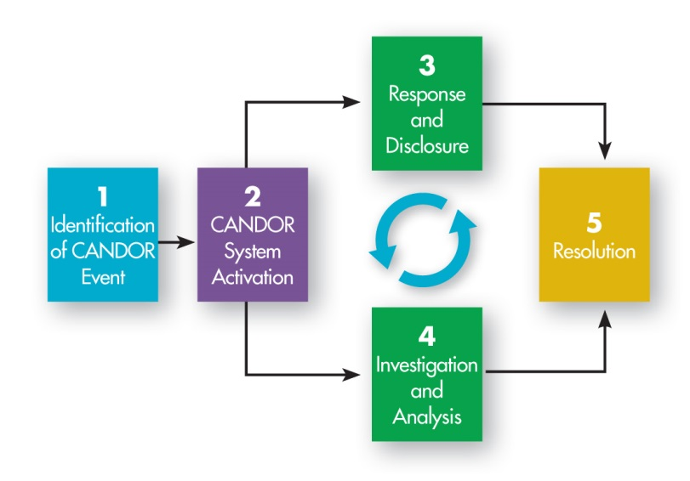
A Culture of CANDOR: Communication and Optimal Resolution
Notes:
The response to medical injury involves more than just what to do and what we say to the patient. The CANDOR process is an integrated approach involves different pieces; but for the process to work well, it centers on communication.

Slide 14
What Is the CANDOR Process?
An approach health care institutions and practitioners can use to respond in a timely, thorough, and just way to unexpected patient harm events.
Notes:
The CANDOR process is an approach that health care institutions and practitioners can use to respond in a timely, thorough, and just way to unexpected patient harm events.

Slide 15
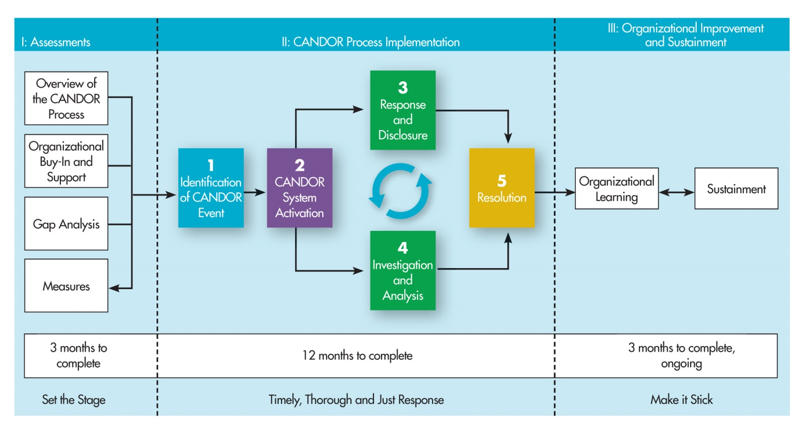
Assessment
Notes:
The first step in implementing the CANDOR process is for the organization to assess organizational readiness for change.

Slide 16
Current State Analysis
CANDOR represents major culture change for almost all organizations. “We already do this” is often said but rarely accurate.
Gap Analysis: Key informant interviews with various leaders, frontline staff
Notes:
To assess readiness for change, the organization should conduct a Gap Analysis. The Gap Analysis is a review of the organization to determine what processes, policies, and systems are currently in place and what will need to be changed or created to implement the CANDOR process.

Slide 17
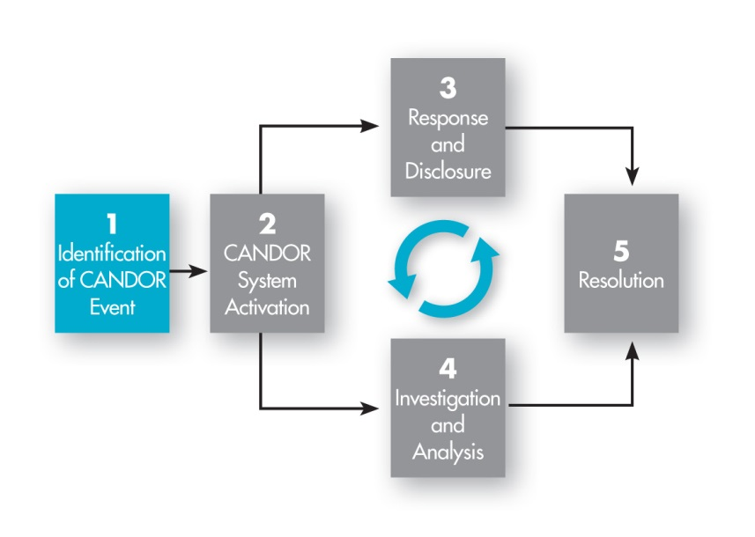
Identification of A CANDOR Event
Notes:
A good response to adverse events really hinges on knowing about them immediately. Our typical human reflex is not only to not necessarily be open with patients but also not to be honest with the organization when an adverse event occurs.
The statement “We can’t fix what we don’t know about” is never more true than when implementing the CANDOR process. The process starts with identifying and reporting the event.

Slide 18
CANDOR System Activation
Immediate reporting of near misses, good catches, unsafe conditions, and harm events to the organization is a critical first step in the CANDOR process:
Activates communication consultation and coaching
Starts event analysis and planning to prevent recurrences
Holds bills
In Malizzo case, critical to understanding system failures that led to her death
Important measure of culture
Engagement of learners
Barriers?
Notes:
Organizations that are implementing the CANDOR process need to emphasize the importance of reporting and remove the stigma attached to reporting. Once the report is received, the organization that has implemented the CANDOR process will activate the internal processes to ensure that:
Designated staff respond to the scene and provide an initial disclosure to the patient and family.
It involves the activation of the Care for Caregiver program for the organization.
An event report is completed, which will trigger analysis of the event. This will include holding all facility and professional fees related to the patient’s care until the analysis of the event is completed.
Readiness requires both the capability to make changes and the motivation to change. Items for discussion:
How can you link event reporting to your culture?
How can you engage learners (i.e., residents) to become champions of this process?
What other barriers must your organization overcome?

Slide 19
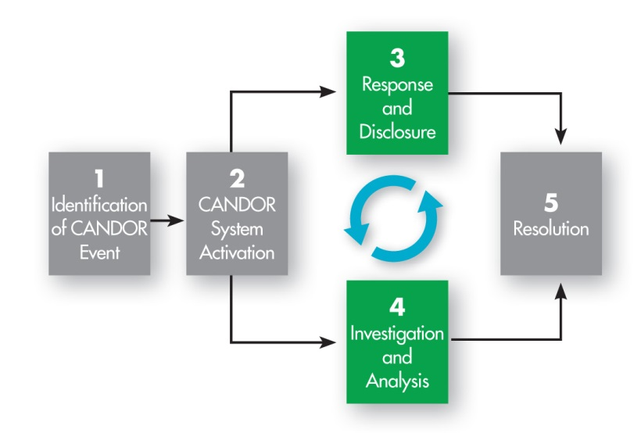
After Event Reporting: Harm Response, Mitigation, Prevention
Notes:
Once the CANDOR system is activated, two processes are occurring at the same time:
The Response to the adverse event: stabilization of the patient, care for the caregivers, and initial communication with the patient/family.
The Investigation: to determine how the event occurred, and how to mitigate that event or even prevent it from occurring again.

Slide 20
Investigation: Best Practices
Protected
Interdisciplinary, human factors expertise
Timely
Just
Comprehensive
Leads to broad performance, process improvements
Involves rapid feedback and dissemination
Notes:
The CANDOR process involves a thorough investigation of the adverse event; but in the old paradigm, the goal of investigation was “who/what can we blame for this error?” In this new paradigm, the focus of the event investigation is process improvement and conducting the investigation with a human factors approach.
Best practices related to event investigations are:
Results are protected.
The team is interdisciplinary and has human factors expertise.
Process is conducted timely, fairly, and comprehensively.
The goal of these investigations is:
Develop broad process improvements.
Provide all those involved, as well as the organization as a whole, with feedback on the investigation and its plans to prevent the adverse harm from occurring again.

Slide 21
Who Is to Blame in Malizzo Case?
Traditional approach
Nurse who left patient unmonitored
Physician who ordered too much fentanyl, midazolam
GI attending who decided to proceed with case despite lack of anesthesia coverage
Others?
Notes:
Example case.
[You can also insert information from a case at your own organization.]
In the old paradigm, it is about finding a person or persons to blame. In this case, the organization could blame:
Nurse
Physician
Others?

Slide 22
Just Culture
Seeks middle ground between historical “shame/blame-bad apple” approach and “blame-free” model after medical injury.
Distinguishes between human error (console), at-risk behavior (coach), reckless behavior (punish).
Why do we still focus on blame?
Notes:
For an organization to be successful in getting event reports, the organization must have a Just Culture.
Just Culture principles are a crucial accompaniment to the CANDOR process framework and will spark the shared accountability that is necessary for the CANDOR process implementation to be successful.
If a Just Culture is so important to an organization’s culture, why do we still focus on blame?
In a Just Culture, not only is shared responsibility the norm, but a commitment to eliminating the possibility of error is widespread within the culture. This is a cornerstone of the CANDOR process of investigating the root cause of how an error occurred, including the human factors. The entire organization must support this culture change.

Slide 23
Safety Attitudes
“The single greatest impediment to error prevention in the medical industry is that we punish people for making mistakes.”
-- Lucian Leape, MD, Professor, Harvard School of Public Health
Testimony to Congress
“Fallibility is part of the human condition. We cannot change the human condition. But we can change the conditions under which people work.”
--James Reason, PhD, Professor, The University of Manchester
Notes:
Safety Attitudes:
Dr. Lucian Leape stated, “The single greatest impediment to error prevention in the medical industry is that we punish people for making mistakes.”
James Reason stated, “Fallibility is part of the human condition. We cannot change the human condition. But we can change the conditions under which people work.”

Slide 24
What Is a Systems Approach?
Human error cannot be eliminated.
Futile goal.
Misdirects resources/focus.
Causes culture of blame and secrecy.
“Name, blame, shame, and train” mentality.
Promotes secrecy, collusion, repression.
It is about reducing HARM.
Ask what is responsible…not who is responsible.
Then, focus on solutions.
Notes:
Eliminating human error is a futile goal, as it is not a realistic approach.
The CANDOR process recommends that organizations take a systems approach with human factors integrated into the event analysis of an adverse event. In this approach, the goal is to:
Ask what is responsible, not who is responsible, and focus on system solutions.

Slide 25
Human Factors Engineering
“We don’t redesign humans; we redesign the system within which humans work.”
Notes:
Human factors engineering is about redesigning the system within which humans work, as we don’t redesign humans. This approach is used in the aviation industry, and it is part of the safety culture in health care organizations. Another example of redesigning systems within which humans work is the field of ergonomics; as we work more at desks and computers, these areas are redesigned to help prevent injuries from working in this environment. This approach should be part of the safety culture in health care organizations.

Slide 26
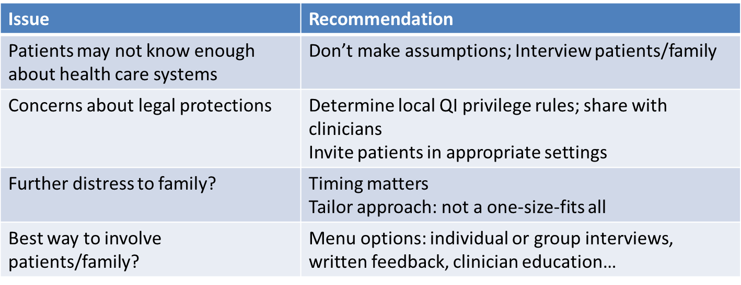
Involving Patients in Post-Event Learning
“[Patients] know our systems probably better than we know our systems because they have been through them so much.”
“…The whole investigation process is incomplete when you don’t involve [patients].”
“Patients and families could offer a unique perspective on norms and quality of care that would otherwise be lost.”
Etchegaray et al Health Aff 2014
Notes:
The CANDOR process promotes the involvement of patients and families throughout the process. This concept can be very concerning for organizations, but the CANDOR process will help to address these issues.
Issues/Concerns:
Patients may not know enough about health care systems—The CANDOR process encourages you not to make assumptions, and to interview patients and families to get their perspective on the event.
Concerns about legal protections—Invite patients in appropriate settings (i.e., patient-safety committees), determine local QI privileges, and share this information with caregivers.
Further distress to the family—Timing matters; but if you are open and continuously communicating with the patient and family, the organization will know the right time to approach them.
Best way to involve patients and family—Provide various options, because not every patient/family will want the same thing. Having options allows them to select what works best.

Slide 27
The Culture of CANDOR
Notes:
The culture of the CANDOR process provides the opportunity for continuous learning after the resolution of a CANDOR event. The information feeds into the organization’s metrics, allowing for clarification and improvement of the CANDOR processes and preventing similar harm events from occurring in the future.

Slide 28
Post-Event Reporting: Communication
Patient
Family
Caregivers
Notes:
Communication is at the heart of the CANDOR process. But the communication needs to be tailored for the audience and engaged in by individuals who understand the art of communication and have received communication training. Communication with the patient and family needs to be honest, open, and truthful and contain the facts of what is known at that moment. But it has to convey empathy and sincerity. Communication with the caregivers involved in the event needs to be supportive and ongoing.

Slide 29
Communication After a Harm Event
Not everyone is a good communicator.
Identify good communicators.
Understand conversations can be emotionally difficult.
Have backup resources.
Use just-in-time training and “coaching.”
Notes:
In the CANDOR process, there is training for CANDOR Communication Leads, as not everyone is a good communicator. We all can identify who is a good communicator and who we would want to give us difficult or bad news. These disclosure conversations can be emotionally difficult, not only for the patient and family, but also for clinician communicating with the patient/family. Not all clinicians should be conducting this initial communication with patients/families. It is important that, as part of the CANDOR process, clinicians reach out to the CANDOR Communication Leads to enlist help these conversations.

Slide 30
Inappropriate Disclosure to A Patient
Notes:
Let’s watch this video, as it demonstrates what happens when our communication is not handled well.

Slide 31
Strategies for Disclosure: Guidelines and Framework
Step 1: Get help
Remember disclosure is a process not an event.
Explain what happened (facts as known).
Describe implications for patient, treatment plan.
Offer genuine expression of regret/apology.
Plan for investigation/analysis.
Discuss how recurrences will be prevented.
Establish contact, supports, followup.
Organizational leadership is key.
Notes:
What we have learned from patients and families after a serious harm event is that every hour that goes by without effective communication results in additional harm to the patient/family. It is important that communication with the patient and family is planned and structured to meet the goals of the patient and family.
Keys to remember about the disclosure:
Disclosure is a process, not a single event.
Explain what happened, and reveal the facts known at the time.
Explain to the patient and family how the event could affect their treatment plan.
Offer a genuine expression of regret/apology for the event.
Explain how the event will undergo an investigation, and as more information is discovered, information will be shared with the patient and family.
Establish a hospital contact person for the patient and family to contact with questions/concerns.
Organizational leadership and support for the CANDOR process are key to ensure that it occurs.

Slide 32
Additional Tips
Be yourself—authenticity matters.
Anticipate potential reactions and questions.
Avoid blame.
“The lab always does this.”
“If only radiology had called me…”
Blaming other providers, “system.”
Weigh pros and cons of who goes in the room.
Take advantage of coaching and consultation.
Involve trainees, team members when appropriate.
Follow organizational processes.
Notes:
Additional tips to help the disclosure conversation:
Be yourself—Let them see your emotions/empathy.
Prepare for the conversation, and consider their potential reactions or questions.
Avoid blaming other people, departments, or systems, especially when the facts aren’t there to support this.
As a team, discuss who should be in the room when having conversations with the patient and family.
Use your resources, and get help in preparing for these conversations—your organization may develop a process related to disclosure, and it is important to follow that process.

Slide 33
How Are We Doing?
One-third to two-thirds of errors are not disclosed.
Blendon et al., NEJM 2002; Gallagher, JAMA 2009
Even when disclosure happens, it often does not meet patient expectations.
Gallagher et al., JAMA 2003; Kaldijian et al., JGIM 2007; Gallagher, JAMA 2009
Clinicians often lack adequate disclosure training.
Wu et al., JAMA 1991; White et al., Acad Med 2008; Bell et al., Acad Med 2010; Liao et al., Acad Med 2014
Notes:
As we can see from the data, there is still work to be done in open and transparent communication. The CANDOR process can help clinicians and organizations feel more comfortable with the act of disclosure, and patients and families will have communication that meets their expectations.

Slide 34
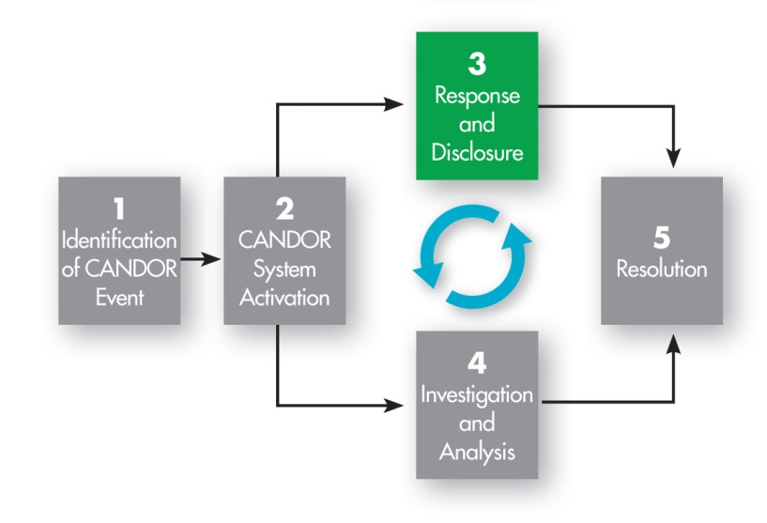
What about Caregivers?
Notes:
When the organization responds to the event, part of the CANDOR process Response is the activation of the organization’s Care for the Caregiver program.

Slide 35
Care for the Caregiver
Involvement in a medical error increases:
Burnout.
Likelihood of involvement in future errors.
Risk of depression.
Risk of suicide.
Leaving the practice of medicine.
Notes:
Involvement in a medical error can increase a clinician’s:
Chance for burnout.
Likelihood of involvement in future errors.
Risk of depression.
Risk of suicide.
Leaving the practice of medicine, nursing, or other practice area.

Slide 36
National Quality Forum Safe Practice #8
Care for the Caregiver:
Available to all employees involved.
Timely and systematic.
Just treatment.
Respectful.
Compassionate.
Supportive medical care.
Participation in event investigation, risk identification, and mitigation activities to prevent future events.
Supporting providers helps them care for their patients.
Notes:
In addition to the organization Medically Induced Trauma Support Services (or “MITSS”), the National Quality Forum has published guidance in a “safe practice” on caring for caregivers after an adverse event.
It explains that after an adverse event, regardless of whether it is due to human or system error, all employees involved (including administrators, clinical providers, and other staff), should receive care. It should be timely, systematic, just, respectful, and compassionate. If needed, supportive medical care should be offered, and the involved employees should be offered to meaningfully participate in the event investigation, in hopes that they contribute to efforts designed to prevent future events.
An organization that implements the CANDOR process must support not only the patients/families affected by an adverse event, but also the providers who care for the patients/families.

Slide 37
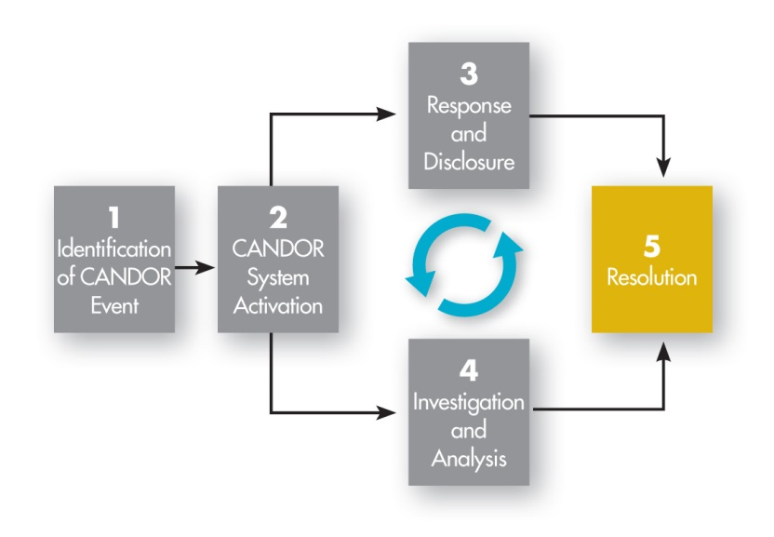
Resolution
Notes:
Resolution can be defined as the act of solving a problem, dispute, or contentious matter. In the CANDOR process, this definition applies as well, but resolution does not equate to a financial settlement. Rather, resolution is a process that addresses patients’ expectations. Resolution should lead to a settlement of issues related to the adverse event, but doesn’t always lead to a financial settlement.

Slide 38
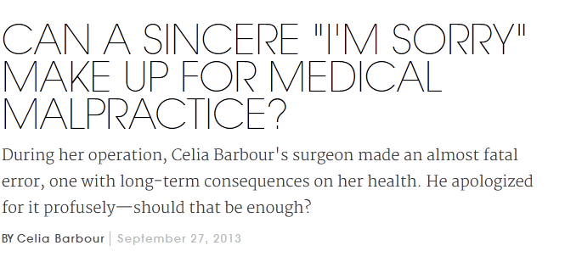
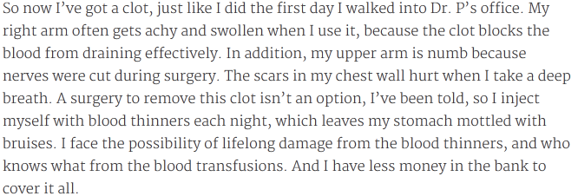
Accountability and Resolution
Notes:
In a September 27, 2013, column in Elle, journalist Celia Barbour chronicled her experience having a vein nicked during arm surgery, an injury that nearly killed her (http://www.elle.com/beauty/health-fitness/medical-malpractice-personal-essay). The surgeon gave her an immediate and sensitive apology for the error, accepting full responsibility. But no one offered her compensation, beyond the surgeon waiving his portion of the bill. She hasn’t sued—yet—but months later, she still struggles with whether the apology was enough.
This story illustrates the progress we’ve made toward accountability for error in medical care…and also what we haven’t yet been able to do for injured patients, which is to proactively offer just compensation.

Slide 39
Accountability: More Than Words
Interview study with cancer patients who thought something serious and harmful went wrong in their care.
Patients seek action following the disclosure that are congruent with the words.
“If you’re just going to apologize and you’re not going to fix anything, that’s insulting to my intelligence.”
“There’s got to be accountability. I don’t want to hear ‘I’m sorry.’ ‘I’m sorry’ is nothing. I want to hear what steps have been taken to correct the problem.”
“Don’t tell me you were sorry that the problem occurred. That just puts a band aid on something….I want to see results.”
Notes:
The concept of accountability relates to what patients want, following an adverse event, from their care providers and from the organization. Patients want:
An explanation.
An apology.
An understanding of the changes that have been made to prevent harm to another patient.
Patients are looking for the actions the organization is doing to prevent and learn from the adverse event.

Slide 40
What Are Resolution Conversations?
Discussions with patients/family after the initial communications about the adverse event
Often take place after event analysis is completed.
Many different forms, by different people, occur over time:
Explanation of event’s cause and prevention.
Responsibility/blame.
Nonfinancial, financial resolution.
Other followup.
Emotional tone differs from initial disclosure.
CANDOR will train risk managers, organization leaders in approaching these difficult discussions.
Notes:
Resolution can truly occur only after the organization has completed its investigation and analysis of the event. Remember that disclosure is a process, and the first step is to:
Let the patient and family know an adverse event occurred and then:
After the organization investigates the event, present the results to the patient/family, along with information as to what action the organization is taking to prevent a similar event from occurring again.
After the family receives this information, the organization convenes another meeting with the patient and family to discuss:
Whether the care provided met the standard of care or not.
Whether the organization has determined, based on the analysis of the event and other factors, that the event warrants compensation for the patient/family.
Understand that this part of the CANDOR process can also be very emotionally charged, but for different reasons. The organization needs to select individuals for these conversations who can effectively communicate with patients and families. As part of the CANDOR implementation process, these skills will be discussed, and tools will be presented to help the organization implement a the resolution component of the CANDOR process at their organization.

Slide 41
Putting It All Together
Notes:
The implementation of the CANDOR process can be broken down into three major buckets:
Assessments—We set the stage for this organizational change.
The CANDOR process—Once implemented, the organization responds to an event in a timely and thorough way.
Organizational learning and sustainment—The organization takes what they have learned from the event to improve and sustain the CANDOR process culture change and to help prevent a similar event from recurring in the future.

Slide 42
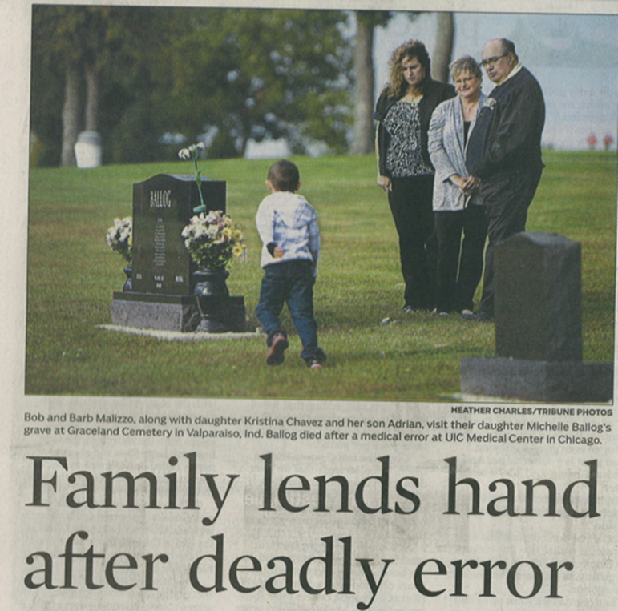
Example Case
Notes:
It is important to keep patients and families who were involved in a medical error at your organization involved in the process of improving patient safety at the organization.

Slide 43
Michelle Malizzo ’s Case: System Solutions
Routine use of capnography in heavy sedation cases
Adopted as ASA standard.
Better policies around anesthesia coverage.
Environmental strategies for patient monitoring
Equipment placement
Lighting
Alarms
Notes:
Example case.
[You can also insert information from a case at your own organization.]
As a result of the investigation and analysis of Michelle’s case, the following patient safety changes occurred:
The American Society of Anesthesiology adopted the standard that capnography be used in heavy sedation cases. (Capnography is the measurement and graphic display of carbon dioxide levels in the airways.)
The University of Illinois at Chicago adopted improved policies regarding anesthesia coverage for cases involving heavy sedation.
University of Illinois at Chicago also developed environmental strategies for patient monitoring that took into account:
Where equipment is placed to ensure providers are able to see patient monitoring screens.
Lighting in procedure rooms.
Alarm settings.

Slide 44
Next Steps
Organizational assessment
Communication training
Event analysis tools and training
Data capture, analysis, feedback
Ongoing support
Notes:
Next steps for your organization:
Conduct a Gap Analysis review.
Conduct communication training for your selected CANDOR Communication Leads.
Host event analysis training using tools from CANDOR.
Monitor progress by capturing data and providing feedback to the organization on this information.
Encourage and support the CANDOR process throughout the organization.

Slide 45
Questions?

