Slide 1
Communication and Optimal Resolution
(CANDOR)
Toolkit
Module 4: Event Reporting,
Event Investigation and Analysis
Notes:
Module 4 of the CANDOR Toolkit covers the Event Reporting, Event Investigation, and Analysis component of the CANDOR process.

Slide 2

Objectives
Define the key elements of a timely and comprehensive event reporting system.
Define the process of a timely and efficient event investigation.
Identify the key components of an effective event analysis.
Notes:
Objectives: At the end of this module, the learner will be able to:
Define the key elements of a timely and comprehensive event reporting system.
Define the process of a timely and efficient event investigation.
Identify the key components of an effective event analysis.

Slide 3
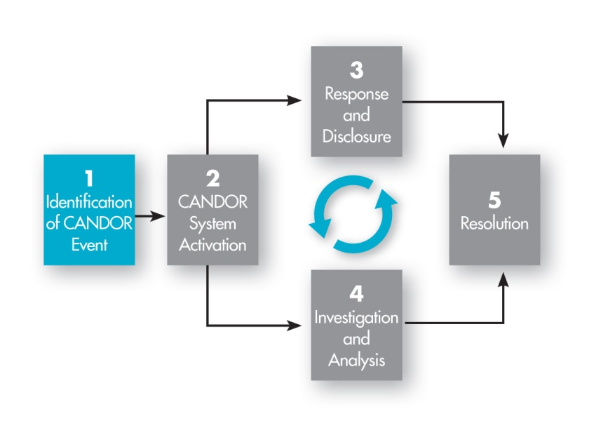
CANDOR Event Reporting,
Investigation, and Analysis
Notes:
The identification and reporting of a CANDOR event initiates the CANDOR process and is a key foundational element of the CANDOR process. The goal for an organization implementing the CANDOR process is to increase the reporting of patient harm events. When a patient harm event occurs, rapid and timely reporting and comprehensive documentation of the details of the event are imperative.
Ask the group to think about the organization’s current event reporting process. Do they believe the organization is aware of all the patient harm events? Have they heard of events that should have been reported but were not reported?
Event reporting is the trigger for other CANDOR processes and is critical to establishing the CANDOR process within an organization. How an organization receives, manages, and encourages reporting is fundamental to the CANDOR process. This module includes information on the development of a reporting culture and the role of frontline staff and the organization in reporting CANDOR events, as well as information on Event Investigation and Analysis.

Slide 4
Event Reporting Culture
¹
“The single greatest impediment to
error prevention in the medical industry is
that we punish people for
making mistakes.”
Dr. Lucian Leape
Professor, Harvard School of Public Health
Testimony before Congress on
Health Care Quality Improvement
Notes:
An organization’s event reporting culture significantly impact this step in the CANDOR process. Dr. Lucian Leape stated during testimony before Congress on health care quality improvement that “The single greatest impediment to error prevention in the medical industry is ‘that we punish people for making mistakes’.”
ASK:
How would you describe the organization’s culture relative to blame or responsibility for errors? How does the culture support or inhibit disclosing information to staff, patients, and families when a patient harm event occurs?
No one wants to hurt patients. Many health care systems reinforce a focus on individual behaviors designed to prevent mistakes and fail to recognize the impact of faulty systems, processes, and conditions that lead people to make mistakes. Approaches that focus on punishing individuals instead of changing systems provide strong incentives for people to report only those errors they cannot hide.
A culture of blame does not encourage event reporting and can inhibit individual and system-wide performance improvement in patient safety. A Just Culture supports disclosure and learning from errors and encourages viewing every event as an opportunity to learn how to improve system performance relative to patient safety. The CANDOR Event Reporting process is supported by a culture of safety.

Slide 5
Key Elements of an Event Reporting System
Supports a rapid response to harm events.
Obtain staff and providers’ feedback post-event.
Obtain patient and family feedback post-event.
Allows for immediate, anonymous, and/or confidential reporting and input from frontline staff and providers.
Provides potential protection of event analysis from discovery.
Provides immediate and ongoing feedback to reporters.
Protects patients from future harm events.
Notes:
A timely, comprehensive, and supportive event reporting system can positively impact an organization’s culture of safety. Key elements of an effective event reporting system include the following:
Supporting a rapid response to harm events, including the rapid response of the CANDOR Response Team to the location of the event.
Engaging all staff and providers as soon as possible following the event to secure their unique and valuable information on the event.
Engaging patients and family members as soon as possible following the event to secure their unique and valuable information on the event.
Allowing immediate, anonymous, and confidential reporting and input from frontline staff and providers. This element supports the creation of just culture.
Protecting the organization to ensure the event analysis is not discoverable during a potential lawsuit. This protection should be included in the organization’s policy on Event Investigation and Analysis to meet protections as allowed by State and Federal statutes.
Providing immediate and ongoing feedback to those who reported the event to help staff feel part of the process and the solutions.
Protecting patients from future harm, since the organization has a process to ensure continuous learning to prevent future harm events.
All of these elements support the foundation for a resilient reporting system.
ASK:
Which of these elements are part of your current event reporting system?

Slide 6
Sources for CANDOR Event Reports
Patients
Complaints
Providers
Event Reporting System
External Environment
FDA Device/Drug Reports
Internal Environment
Electronic Health Record
HCAHPS
Letters
Claims
Consumer Reporting
Morbidity and Mortality Forums
HSOPS
Peer Review
Event Reviews
Regulatory Bodies
Patient Safety Organizations
Notes:
Event reporting should be a component of a larger patient safety system. This diagram demonstrates the various sources of information, other than event reports, that might provide information indicating that a CANDOR event has occurred, including:
Patients: Complaints, HCAHPS scores, letters, claims, consumer reports
Providers: Event reporting system, morbidity and mortality forums, HSOPS surveys
Internal environment: Electronic health record surveillance, peer reviews, event reviews, employee surveys
External environment: FDA device/drug reports, regulatory bodies
All of these sources help create a cohesive environment for informing the organization as to whether a CANDOR event may have occurred.

Slide 7
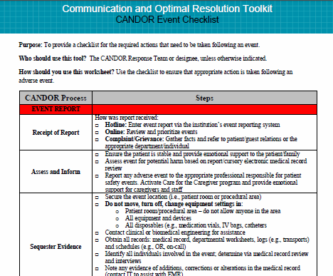
CANDOR Event Checklist
Notes:
The CANDOR Event Review Checklist helps organizations understand and document all the steps involved in event reporting, including;
How the event was reported.
Initial assessment of the patient.
Notification of the event to the appropriate professional responsible for patient safety events.
Activation of the Care for the Caregiver program.
Collection of evidence at the event location.
This checklist also includes information on event investigation and analysis, which will be covered in more detail in the rest of this module.
Many organizations implement the best practice of creating a hotline for staff to call when they feel a CANDOR event has occurred or is occurring. This hotline should be available 24 hours a day, 7 days a week, and staffed by the CANDOR Response Team member who understands the organization’s CANDOR process and how to activate the CANDOR system within 30 minutes of receiving the event notification. Other methods of reporting CANDOR events may include in-person reporting.
After initial reporting of the event, the CANDOR Response Team responds to the location of the event and uses the Event Review Checklist to begin the process. Within 60 minutes after a CANDOR event has been identified, an initial disclosure conversation should take place between a designated communicator and the patient and/or family. See Module 5 to learn more about the Response and Disclosure component of the CANDOR process.

Slide 8
Preparing Staff for a CANDOR Event Reporting System
Ensure staff understands how to prepare, and has the ability to submit, an event report.
Provide guidance on how to report an event.
Conduct training for all staff.
Provide a mechanism for followup and feedback on the event.
Support managers.
Seek feedback to identify ways to make the process “user friendly.”
Notes:
Every organization should prepare all staff to successfully comply with a CANDOR Event Reporting System. Strategies to prepare staff include:
Ensuring that every member of the organization understands how to prepare, and has the ability to submit, a report within the system.
Providing guidance on how to report an event, including requested patient information, where the event took place, a brief event description to prompt Risk Management staff to determine whether it is a CANDOR event, and contact information for followup. The organization should have a mechanism in place to address anonymous reports of harm events.
Conducting training of all frontline staff on event reporting. This training should include general rules of reporting, such as reporting only a factual account of the event, absence of blame or finger pointing, not placing original medical record information in the event reporting system, and keeping reports simple and brief.
A resilient, sustainable reporting system provides training to all new hires and periodic updates to existing staff. The system should also include a process for followup and feedback to staff who report events to help staff feel connected not only to the problem, but also the solutions. Risk Management personnel should ensure all parts of the organization are using the event reporting system and reach out to areas that might need additional training and support. Risk Management can also provide ongoing support to managers on the unit(s) where the event occurred. A key component of a successful reporting system includes a mechanism for user feedback that continuously informs leaders of opportunities for improvement in the reporting process.

Slide 9
Event Reporting Outcomes
Caregiver support
Patient and family engagement and support
Continuous organizational learning
Innovative solutions
Improved culture of safety
Notes:
The desired outcomes of the CANDOR Event Reporting process include:
Caregiver support, which promotes frontline safety champions during the initial disclosure process and following implementation of the program.
Full and transparent disclosure to the patient and/or family. This is not only the right thing to do, but also improves trust early in the process and has the potential of reducing long-term liability costs.
Continuous organizational learning as a result of identification of contributing factors that might help prevent similar events from happening in the future.
Identification of innovative solutions to prevent similar harm events and related hazardous behaviors or system processes.
Improved culture of safety as a result of open, fair, and just management of individual and system issues.
In the remainder of this module, we will discuss Event Investigation and Analysis activities. The way in which Event Investigation and Analysis is managed by teams can significantly impact frontline staff’s perception about the safety culture of the organization.

Slide 10
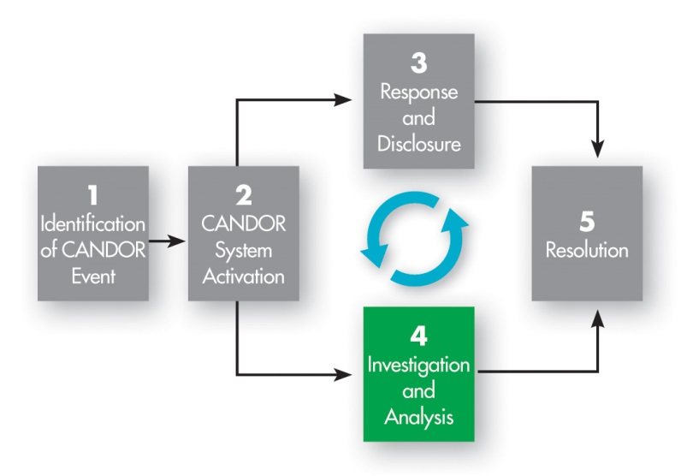
Event Investigation and Analysis
Notes:
The fourth component of the CANDOR process is Event Investigation and Analysis. Event investigation and analysis needs to be timely, efficient, and comprehensive and should include a systems review analysis.
Within the first 72 hours of a CANDOR event, the following actions should occur:
Schedule and complete interviews with involved staff.
Review all records.
Notify liability insurance carrier(s), if any.
Within 30-45 business days after the event, the investigation should allow for the determination of causal factors and appropriateness of standard of care. The sole objective of the Event Investigation and Analysis of an adverse event or near miss is to prevent future adverse events. This activity should not be used to apportion blame or liability.

Slide 11
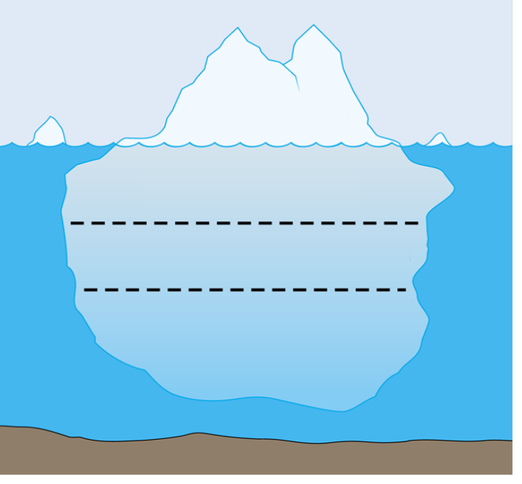
Setting the Stage for Event Investigation
Actual Harm to Patient
CANDOR Event
No Harm Event
Near Miss
Unsafe Conditions
Potential Harm to Patient
Notes:
One of the hallmarks of the CANDOR process is the focus on a systems approach to Event Investigation and Analysis. The rationale for a systems approach to Event Investigation and Analysis is that managing individual performance alone does not ensure that a harm event won’t happen again.
Human errors are abundant and inevitably repeated when system processes are not corrected or adjusted to prevent similar harm events from happening in the future. By focusing on system processes and factors that facilitated the event, adjustments can be made to minimize human error, resulting in fewer opportunities to produce a similar harm event again. A systems approach includes, as part of the event investigation, an analysis of how the system failed rather than focusing on individual blame.

Slide 12
System And Individual Accountability²
Why did the event happen? How prevalent are the behaviors associated with the event?
System accountability
  Processes, policies
  Prevention mechanisms
Individual accountability
  At-risk behaviors
  Performance factors
Additional Resource: AHRQ CUSP Toolkit - Apply CUSP
Notes:
Promoting a culture that is fair and just is a key goal of the CANDOR process. David Marx’s Just Culture model refers to a system of “shared accountability” in which health care institutions are accountable for the practices they have designed and for sustaining the safe choices they have made regarding patients, visitors, and staff. Staff, in turn, are accountable for the quality of the choices they make to ensure patients receive high-quality, safe care. The CANDOR process recognizes the need to balance system and individual accountability to create an environment that is non-punitive and non-threatening and promotes open reporting of harm events.
To strengthen system accountability, we want to learn what happened, why it happened, what normally happens, and what applicable procedure(s) are required. Only then can we learn why errors were truly made, and how we can implement policy, process, and improvement mechanisms to prevent the same errors from happening again.
As discussed in Module 2 of the CANDOR Toolkit, individual staff must also hold themselves accountable by recognizing when they are engaging in at-risk behavior and how their behavior might cause unjustifiable harm to patients. More importantly, staff must hold themselves and others accountable for making appropriate behavioral choices. Managing behavioral choices should be a responsibility of the individual and the organization.
More information on Just Culture can be found in the Apply CUSP module of the AHRQ CUSP Toolkit.

Slide 13
Traditional Event Investigation and
Analysis Process
Event
2-4 weeks later
Root Cause Analysis Team meets
1. Send report to leadership and board.
2. Follow up 6 weeks later to ensure compliance.
3. Close case, satisfied.
Determine “root causes.”
Assign a solution to each “cause.”
Assign person responsible.
Notes:
This diagram depicts the traditional Event Investigation and Analysis process in many organizations today. Generally speaking, about 2-4 weeks after an event occurs, a Root Cause Analysis team meets to determine the “root causes” for the event and assign a solution to each cause and a person responsible for implementing solutions to the root causes. Eventually, the team sends a report to leadership and the board, conducts followup 6 weeks later to ensure compliance with the solutions, and closes the investigation. Potential gaps in this process include:
The length of time for this process to take place.
The process does not support immediate actions.
Due to the length of time to respond, facts and details about the event are lost as individual memories fade. Also, the location where the event occurred is generally no longer intact, so information that could be gained from the location is lost.
As time passes, patients and families start to develop distrust of the organization and might believe the organization is hiding the truth about the event.
There is limited or no involvement of the caregivers in the investigation and analysis of the event.
The current process provides little guidance on how to support the patient, family, or caregivers involved in the event.
The next slide demonstrates how this process can be improved with the implementation of the CANDOR Event Investigation and Analysis elements.

Slide 14
CANDOR Process for
Event Investigation and Analysis
Event Occurs
Perform a preliminary review.
Activate CANDOR Response Team.
In-depth Review
Identify Core-review Team members.
Develop timeline.
Interviews, chart reviews, site visit.
Confirmation and Consensus Meeting
Share pertinent findings.
Followup
Obtain confirmation and consensus on contributing factors.
Evaluate and measure solutions.
Finalize event review documents.
Solutions Meeting
Develop targeted solutions.
Inspect scene.
Occurs within 72 hours after the event
Occurs at:
30 days
60 days
90 days
Occurs within 30-45 business days after the event
Notes:
The CANDOR Process for Event Investigation and Analysis helps organizations to implement a process that will allow for an immediate response to the event by establishing a CANDOR Response Team with a primary reviewer and establishes an Event Review Core Team for the investigation. The Event Review Core team includes the primary reviewer, an executive leader, and administrative support. The CANDOR Response Team is responsible for conducting interviews of those individuals involved in the event, and supporting the patient, family, and caregivers at the time of the event. As the Event Investigation and Analysis continues, the Event Review Core Team institutes a process for a consensus and confirmation meeting and establishes a solutions meeting focused on systems-based solutions.

Slide 15
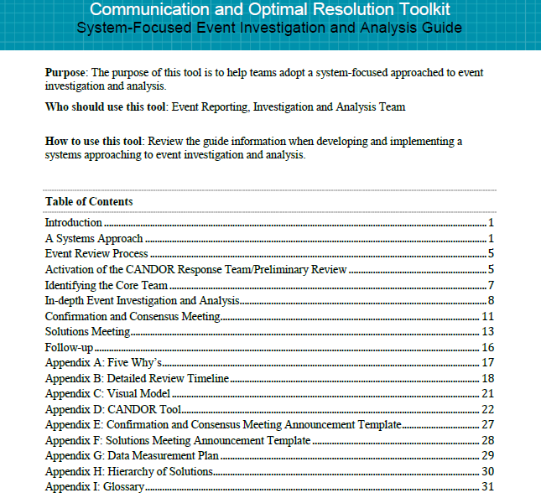
System-Focused
Event Investigation and Analysis Guide³
Notes:
The System-Focused Event Investigation and Analysis Guide is part of this module and provides detailed resources and information to help an organization understand the specific steps to implementing a systems-based approach to Event Investigation and Analysis. This guide can be used to conduct an in-depth review of an event, manage a confirmation and consensus meeting, and conduct a solutions meeting.

Slide 16
Followup
Patient and family^{4,5}
Caregivers
Patient and family advisory councils
Medical liability carriers
  Mello et al: Communication-and-resolution programs: the challenges and lessons learned from six early adopters⁶
  Boothman and Hoyler: The University of Michigan's early disclosure and offer program⁷
Notes:
To complete the Event Investigation and Analysis component of the CANDOR process, it is important to inform the patient, family, and the involved caregivers of the investigation and analysis results.
Resources available to help your organization engage patients and families include:
AHRQ’s Guide to Patient and Family Engagement in Hospital Quality and Safety, which focuses on four primary strategies for promoting patient/family engagement in hospital safety and quality of care.
A Roadmap for Patient and Family Engagement in Healthcare Practice and Research
Once the Event Investigation and Analysis is complete, it is important to provide these results to the liability carriers as well. Part of the CANDOR process implementation involves establishing open lines of communication with the organization’s and the physician’s liability carriers to ensure that all parties are aware of the results and how to move effectively to the Resolution component of the CANDOR process.
Resources to help your organization engage medical liability carriers include:
Communication-and-resolution programs: the challenges and lessons learned from six early adopters. Mello MM, Boothman RC, McDonald T, Driver J, Lembitz A, Bouwmeester D, Dunlap B, Gallagher T. Health Aff (Millwood). 2014 Jan;33(1):20-9. doi: 10.1377/hlthaff.2013.0828.
The University of Michigan's early disclosure and offer program. Boothman R1, Hoyler MM. Bull Am Coll Surg. 2013 Mar;98(3):21-5.

Slide 17

Event Investigation and Analysis
Outcomes
Caregiver support
Patient and family engagement and support
Continuous organizational learning
Innovative creation of solutions
Impact on the safety culture
Notes:
The desired outcomes of the CANDOR Event Investigation and Analysis process include:
Caregiver support through a systems approach to Event Investigation and Analysis—when event investigation and analysis is conducted from a systems approach, with a focus on identifying the system factors that contributed to the event, a fair and accountable culture can be established. Caregivers are supported through the event, rather than being punished.
Support of the patient and family—providing patients and families with honest and transparent information about the event and analysis builds trust in the organization and in the care being provided. This transparency also has the potential of reducing long-term liability costs.
Continuous organizational learning—this allows for identification of contributing factors that led to errors, which can help the organization improve and prevent similar events in the future.
Create solutions—once contributing factors and unrelated hazards are identified, sustainable and effective solutions can be identified and implemented.
Ultimately the new process can have a positive effect on the organization’s safety culture, as shifting to a systems approach to Event Investigation and Analysis supports a Just Culture.
In the next module, we will discuss the Response and Disclosure component of the CANDOR Process.

Slide 18
References
Leape LL. Testimony, United States Congress, House Committee on Veterans’ Affairs, October 12, 1997.
Apply CUSP module, CUSP Toolkit. Rockville, MD: Agency for Healthcare Research and Quality. http://www.ahrq.gov/professionals/education/curriculum-tools/cusptoolkit/modules/apply/index.html. Accessed August 8, 2015.
Guide to Patient and Family Engagement in Hospital Quality and Safety. Rockville, MD. Agency for Healthcare Research and Quality. http://www.ahrq.gov/professionals/systems/hospital/engagingfamilies. Accessed July 21, 2015.
Carman KL ,et al. A Roadmap for Patient and Family Engagement in Healthcare Practice and Research. Gordon and Betty Moore Foundation. Palo Alto, CA; September 2014. http://patientfamilyengagement.org/#sthash.HZNslZP1.WpGsc2si.dpuf. Accessed July 21, 2015.
Parker SH, Krevat SA, Morales CL, Fairbanks RJ. System-Focused Event Investigation and Analysis Guide. Columbia, MD: MedStar Health. Washington DC: Georgetown University.
Mello MM, et al. Communication-and-resolution programs: the challenges and lessons learned from six early adopters. Health Affairs. 33.1 (2014): 20-29. http://content.healthaffairs.org/content/33/1/20.full.pdf+html. Accessed September 10, 2015
Boothman, R and Hoyler MM. The University of Michigan's early disclosure and offer program. Bulletin of the American College of Surgeons. 98.3 (2013): 21-25. http://bulletin.facs.org/2013/03/michigans-early-disclosure/. Accessed August 21, 2015.

