Slide 1
Communication and Optimal Resolution
(CANDOR)
Toolkit
Module 6: Care for the Caregiver
Notes:
Module 6 includes information on the Care for the Caregiver component of the CANDOR process, which focuses on providing emotional support to caregivers following a CANDOR event. This module includes steps for establishing a Care for the Caregiver program at your organization.

Slide 2

Objectives
Describe how caring for the caregiver is a key component of the CANDOR process.
Identify the steps for developing a Care for the Caregiver team and program.
Define the second-victim phenomenon and the stages of healing and recovery for second-victims.
Describe the peer support challenges, strategies and interventions.
Notes:
Despite their effort to provide the best care possible to patients, health care providers are sometimes faced with the aftermath of adverse patient harm events. Caregiver grief following a CANDOR event can be devastating, especially as the initial response to a CANDOR event focuses on the needs of the patient and/or family. Organizations can demonstrate support for the caregivers by developing and implementing a Care for the Caregiver program—sometimes referred to as a program that addresses the needs of the “second-victim.”
At the end of this module, the participant will be able to:
Describe how caring for the caregiver is a key component of the CANDOR process.
Identify the steps for developing a Care for the Caregiver team and program.
Define the second-victim phenomenon and the stages of healing and recovery for second-victims.
Describe the peer support challenges, strategies and interventions.

Slide 3
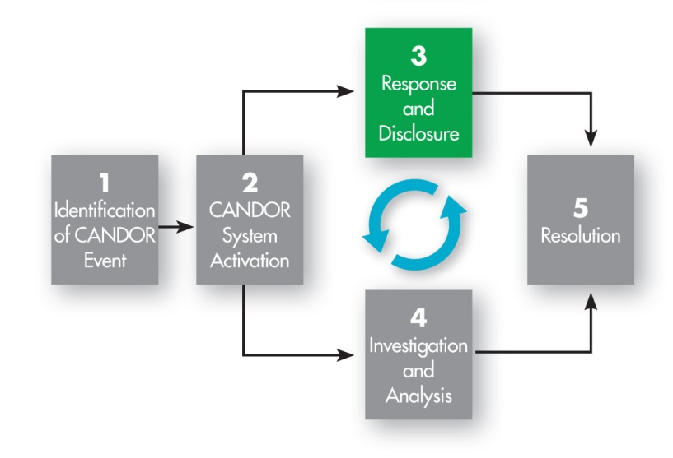
Care for the Caregiver*
*The Care for the Caregiver program is part of the Response and Disclosure component of the CANDOR process.
Notes:
The Care for the Caregiver program should be initiated as part of the Response and Disclosure component of the CANDOR process. Module 5 provides detailed information concerning the elements of disclosure to patients and families following a patient harm event. It is also important to provide care and support to the caregivers following a CANDOR event.

Slide 4

Establishing a Care for the Caregiver Team
Team Lead(s)
Team Members
  Include “natural” supporters: EAP, Pastoral Care.
  Engage other supporters: CMO, Clinical Specialists/Educators, Performance Improvement Specialists.
Notes:
The organization should first establish a team or task force that will be responsible for developing, implementing, and maintaining the Care for the Caregiver program for the organization. This team will also help identify and develop supporters, including peer supporters, who will provide the caregiver services. The following are suggestions for the Care for the Caregiver team composition, as well as peer supporters, who will assure this component of the CANDOR process is fully developed.
Team Lead(s): Representative(s) from Patient Safety and/or Risk Management, who are also connected to the CANDOR implementation process to ensure continuity.
Team Members: A diverse group of people that engage supporters. The supporters can be “natural” supporters that typically serve as formal or informal staff supporters, confidantes, or individuals whom caregivers seek out for advice and/or emotional support, such as chaplains, employee assistance program personnel (EAP), house manager/supervisor, nursing department managers, and physicians/residents. Other supporters could include: case manager(s), chief medical officer, clinical educator, quality improvement specialist, and clinical care managers.
The Care for the Caregiver program should include a “fast track” process that allows the caregiver to quickly access support and guidance following a patient harm event.

Slide 5
Establish Care for the Caregiver
Team Infrastructure
Create a business case and budget for the team.
Define how services will be activated and delivered.
  Care for the Caregiver Program Implementation Guide
Create a deployment timeline.
Recruit team members.
Market the program.
Notes:
Once the team leaders and members are identified, the team will need to define the Care for the Caregiver team infrastructure for their organization, which includes the process of how support will be provided to caregivers. The team should seek administrative support prior to developing the program to confirm that the team will initially activate the Care for Caregiver program only following a CANDOR event. As the program becomes more established and clinicians feel comfortable with the new process, the team may expand the scope of services and activate the program for other patient events or errors. The key steps for developing the Care for the Caregiver team infrastructure include:
Create a business case and budget for the team (see also Module 2 for additional information on building the business case for the CANDOR process).
Define how Care for Caregiver services will be activated and delivered, and establish the associated policies and procedures. The services should be confidential, available 24/7, and provide voluntary caregiver participation so that individuals have the right to accept or decline the caregiver services. The CANDOR Toolkit includes a Care for the Caregiver Program Implementation Guide, which contains detailed steps on how to implement a Care for the Caregiver program.
Create a deployment timeline. Pilot organizations generally spent 12-18 months deploying a Care for the Caregiver program.
Recruit peer supporters.
Market the program, and communicate when the services will be available to staff. Marketing should continue during and after deployment to help staff become aware of, and comfortable with, the Care for the Caregiver services.

Slide 6
Second-Victim Phenomena^{1,2}
Second-victim defined:
  “Health care team members who are involved in an unanticipated patient event, which might involve harm, become victimized in the sense that they are traumatized by the event.” ¹
Scenarios for second-victims:
  Patient or family “connects” with staff member
  Pediatric cases
  Medical errors
  Failure-to-rescue cases
  First death experiences
  Unexpected patient demise
Notes:
Multiple studies have shown that involvement in medical errors and adverse events can take a significant toll on clinicians. It is estimated that one in seven patients is affected by adverse events, and that as many as half of all clinicians will be involved in a serious adverse event at least once during their career.
The patient and the family are the first victim(s) after an event, but the second-victim is the caregiver(s) involved in the event. Frequently, these individuals may feel personally responsible for the patient outcome and that they have failed the patient, second-guessing their clinical skills and knowledge base. Dr. Wu discusses this concept in his article “Medical Error: The Second-Victim” and the associated “expectation of perfection”. The CANDOR process embraces Just Culture principles, which recognize that “active” errors represent predictable interactions between human operators and the systems in which they work.
A number of scenarios that are prone to the development of second-victims include, but are not limited to:
When a patient or family “connects” or bonds with a staff member
Pediatric cases
Medical errors
Failure-to-rescue cases
First death experiences
Unexpected patient demise
When a caregiver becomes a second-victim, the provision of support should extend beyond the individual caregiver and embrace the entire care team involved in the unanticipated patient harm event.

Slide 7
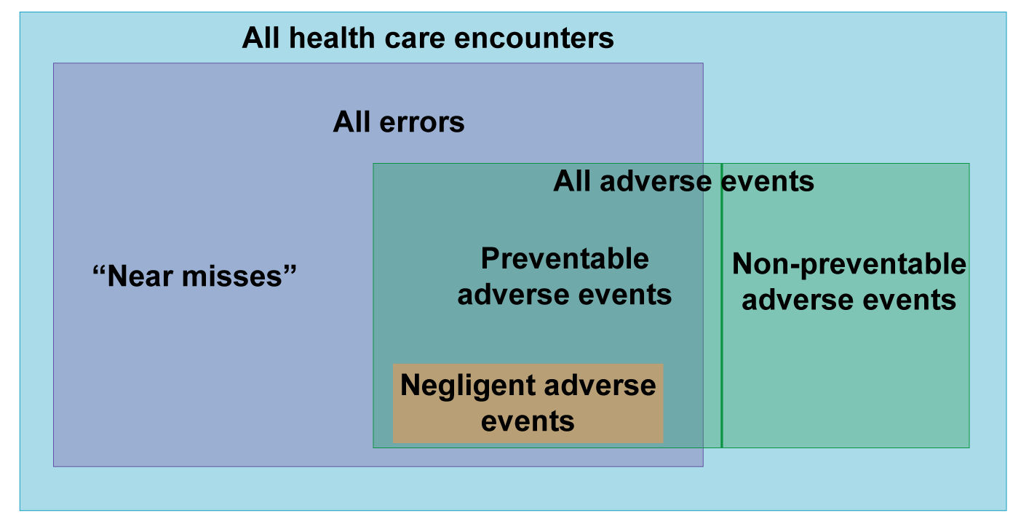
Understanding the Encounter^{3,4}
Adapted from Wachter RM. Understanding patient safety. McGraw Hill Medical, 2012.
Notes:
As referenced in Module 3, this diagram shows the distinction between adverse events and errors, and recognizes that not all adverse events are medical errors, and not all medical errors are adverse events. This distinction is important, even though some degree of emotional distress is likely when a clinician is involved in any error or adverse event, regardless of severity.
Providers can experience the negative effects of the second-victim phenomenon even in cases where no adverse event occurred, but they feared that an error may have occurred. Providers can also experience profound problems after adverse events that were not associated with medical error, such as an unexpected death after elective surgery in a healthy patient where nothing is found to have been done wrong even after careful review. Therefore, it is important to recognize the distinction between medical errors and adverse events, as providers can become second-victims with either. For the remainder of the module, we will use the term “event” when discussing activation of the Care for the Caregiver program in response to a CANDOR event.

Slide 8
Second-Victim Concerns and Symptoms
CONCERNS | SYMPTOMS
About the patient Is the patient/family okay? About me Will I be fired? Will I be sued? Will I lose my license? About peers What will my colleagues think? Will I ever be trusted again? About the next steps What happens next? | Extreme fatigue Sleep disturbances Rapid heart rate Increased blood pressure Muscle tension Rapid breathing Frustration Decreased job satisfaction Difficulty concentrating Flashbacks Loss of confidence Grief/remorse
Notes:
Second-victims can have specific concerns and symptoms following a CANDOR event. For example, second-victims might worry about the patient, themselves, their peers, and the future. The second-victim is often concerned about whether or not the patient and family are okay after the event and about how the event might impact their career or job. Many second-victims worry about how their peers will view them after the event, whether or not their colleagues will trust them to deliver safe care to patients, and if the organization is going to react negatively to the event.
A Care for the Caregiver program can be structured to help the second-victim through a peer support process designed to address any concerns or worries experienced by the second-victim. Additionally, the program can help caregivers deal with any physical or emotional symptoms experienced following the CANDOR event. These symptoms can include the ones listed on this slide.
The CANDOR process acknowledges and promotes the need for a caregiver program to support all team members following an unexpected patient harm event.

Slide 9
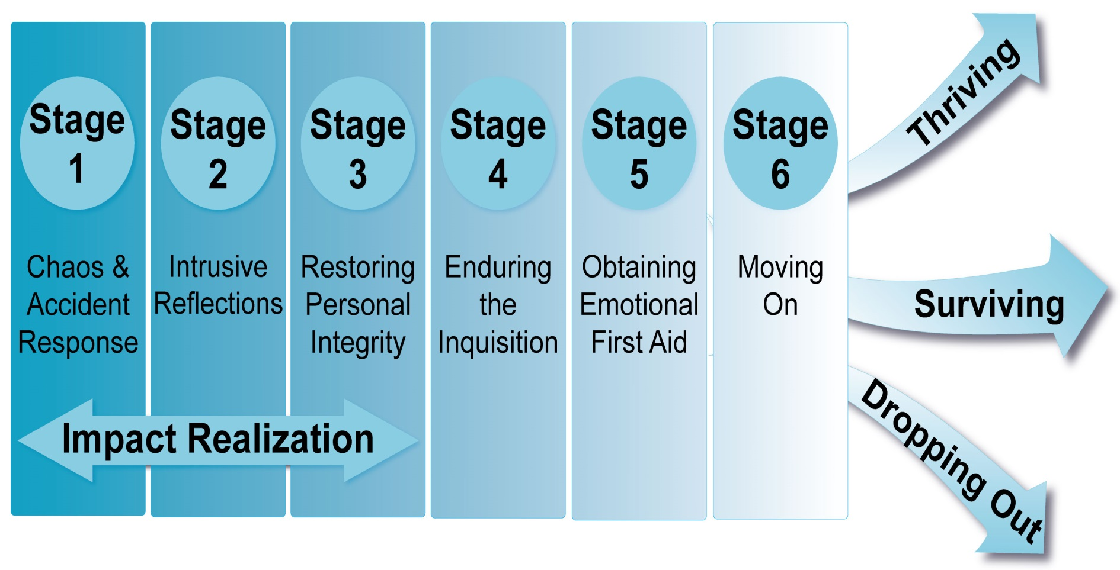
Second-Victim: Stages of Healing -
The Recovery Trajectory⁵
Notes:
The stages of healing after an unanticipated patient harm event are much like the stages of grief and have been described in the literature as the Recovery Trajectory.
The Recovery Trajectory has six stages. Stages 1 through 3 may occur individually or simultaneously. Throughout all stages, individuals may experience physical and/or psychosocial symptoms. A second-victim may relive the “initial” event when a similar clinical situation is presented. The reliving of the event is also known as a “tripping” or “triggering” event and can occur when the second-victim is going through stages 2-6.
On the next few slides, we will explore each stage and how a Care for the Caregiver program can support the second-victim at each stage.

Slide 10
Stage 1: Chaos and Accident Response
Stage characterized by the second-victim:
Care for Caregiver Program Response:
Realizing error occurred/organization recognizing event occurred.
Telling someone about event.
Requesting a different assignment.
Being distracted.
Identify second-victims.
Assess ability of staff member(s) to continue to work.
Notes:
The first stage of the Recovery Trajectory is the chaos and accident response. This stage is characterized by either the second-victim realizing that an event has occurred, or the organization recognizing that an event has occurred. During this stage, the second-victim might tell someone about the error/event as their way of asking for help. The second-victim might not be able to continue to care for the patient involved and might request reassignment. The second-victim might not be able provide care in the room where the event occurred and might appear distracted and/or experience a wave of emotions.
An example of the emotions, feelings, and reactions a second-victim might experience are described in the following quote from an anonymous second-victim: “Right after the…code, I was having trouble concentrating. It was nice to have people take over… that I trusted. I was in so much shock, I don’t think I was useful.”
The Care for the Caregiver program can assist the caregiver in this stage by identifying and contacting the second-victims after the event, and assessing the ability of staff member(s) to continue to work after the event.

Slide 11
Stage 2: Intrusive Reflections
Stage characterized by the second-victim:
Care for Caregiver Program Response:
Re-evaluating the scenario and dwelling on their involvement.
Self-isolating.
Experiencing feelings of internal inadequacy.
Ensure Care for Caregiver program activated.
Observe for presence of lingering physical and/or psychosocial symptoms.
Notes:
The next stage is intrusive reflections. This stage is characterized by the second-victim re-evaluating and dwelling on their involvement in the event, and potentially isolating themselves from co-workers, family, and support systems. The event might produce feelings of internal inadequacy, either because the event occurred or because of the emotions the second victim is experiencing.
An example of the emotions and thoughts that can occur at this stage from a second-victim are in the following quote from an anonymous second-victim: “I started to doubt myself… I thought maybe if I’d have done something another way, it wouldn’t have happened… but everything was more clear, looking at things in retrospect. I lost my confidence for some time.”
The organization can assist the caregiver experiencing stage 2 by ensuring that the Care for the Caregiver program has been activated and caregiver team members are aware of those who need support. During this phase, it is important that organizational resources observe the second victim(s) for the presence of lingering physical and/or psychosocial symptoms.

Slide 12
Stage 3: Restoring Personal Integrity
Stage characterized by the second-victim:
Care for Caregiver Program Response:
Gaining acceptance from those in work or social structure.
Managing gossip.
Being fearful of what is next.
Provide management oversight of the event.
Ensure adverse event report completed.
Manage unit/team’s overall response.
Evaluate if event debrief is indicated.
Notes:
Stage 3 focuses on restoring personal integrity. This stage is characterized by the second-victim gaining acceptance from coworkers by feelings that the gossip regarding the event has been managed or minimized. The second-victim is often fearful at this point about what is going to happen next and whether or not they will be able to regain the trust of their colleagues.
An example of the thoughts and emotions during this stage from a second-victim are contained in the following quote from an anonymous second-victim: “Every single day for months, I’d walk in and think, ‘Everyone knows what happened.’ I thought, ‘These people are never going to trust me again.’”
The Care for the Caregiver program can assist the caregiver in this stage by assuring that management oversight of the event continues, completing the event report, supporting leadership as they manage the unit/team’s overall response or “rumor control,” and evaluating whether an event debrief is indicated for the entire team.

Slide 13
Stage 4: Enduring the Inquisition
Stage characterized by the second-victim:
Care for Caregiver Program Response:
Recognizing the level of seriousness of the event.
Responding to multiple “whys” about the event.
Interacting with many different event responders.
Understanding event disclosure will occur.
Concerns about litigation.
Identify key individuals involved in event.
Develop understanding of what happened.
Support individual(s) involved in event.
Notes:
The next stage is called “Enduring the Inquisition.” During this stage, the second-victim often realizes the seriousness of the event and has, or is in the process of, responding to many CANDOR Response Team members concerning the “whys” about the event. The second-victim understands that disclosure of the event will occur with the patient and/or family and might be concerned about whether the patient and/or family will choose to sue the organization.
The thoughts and feelings a second-victim might experience during this stage are described in the following quote: “I didn’t know what to do or who to talk to professionally or legally. Clearly, I know we needed to keep that quiet—it might have been helpful to be able to talk to someone else, but I couldn’t do that.”
The Care for the Caregiver program can assist the caregiver enduring the inquisition by identifying key individuals involved in the event, developing an understanding of what happened, and supporting the individual(s) involved in event.

Slide 14
Stage 5: Obtaining Emotional Support
Stage characterized by the second-victim:
Care for Caregiver Program Response:
Seeking personal/professional support.
Being open to getting/receiving help and support.
Ensure emotional response plan is in progress.
Ensure patient safety/risk management representatives are known to staff and available.
Notes:
Stage 5 is characterized by the second-victim seeking personal or professional support from the organization or indicating an interest in getting help or support from outside of the organization. This stage can be seen in the following quote from one anonymous second-victim: “There was nobody I could tell, not even my husband. All I could say was, ‘I’ve had a really horrible day.’”
The Care for the Caregiver program can assist the caregiver experiencing stage 5 by ensuring the organization’s emotional response plan is in progress and that, if needed, the patient safety/risk management representatives are available to support the caregiver(s).

Slide 15
Stage 6: Moving On
Stage characterized by the second-victim:
Care for Caregiver Program Response:
Surviving
  Coping with the situation.
Thriving
  Ability to maintain work/life balance.
  Gains insight/perspective on the event.
  Advocate for patient safety initiatives.
Dropping out
  Transferring to a different unit.
  Quits.
Provide ongoing support
  Provide ongoing support.
  Encourage participation in case reviews involving the event.
  Support second-victim in “making a difference.”
  Provide ongoing support.
  Support second-victim in search for alternative employment.
Notes:
The final stage of the recovery trajectory is Stage 6 “Moving On.” Three possible results can come out of this stage of the trajectory:
Survives: Second-victim copes with the situation, may still have intrusive thoughts and/or persistent sadness, and continues to learn from the event. Statements include: “I figured out how to cope and how to say, ‘Yes, I made a mistake, and that mistake caused a bad patient outcome; but I haven’t figured out how to forgive myself for that or forget it. It’s impossible to let go.’” The caregiver program can support the surviving caregiver by providing ongoing support and maintaining open dialogue.
Thrives: Able to maintain a work/life balance, gain insight/perspective on the event, advocate for patient safety initiatives, and not base practice/work on the event. Statements include: “I was questioning myself over and over again… but then I thought… I’ve just had this experience in my life where I had to encounter this tragedy, but it made me a better person. It really did, and it gave me insight.” The caregiver program can support the thriving caregiver by providing ongoing support for the second-victim, encouraging participation in case reviews involving the event and supporting the second-victim in “making a difference” in the future.
Drops outs: The second-victim transfers to a different unit or facility, considers quitting the profession, and/or continues to have feelings of inadequacy. A second-victim who is dropping out might say, “A fresh start was good for me.” The Care for the Caregiver program can assist the caregiver experiencing the dropping out trajectory by providing ongoing support for the second-victim, which may include helping them search for alternative employment within or outside the organization.

Slide 16
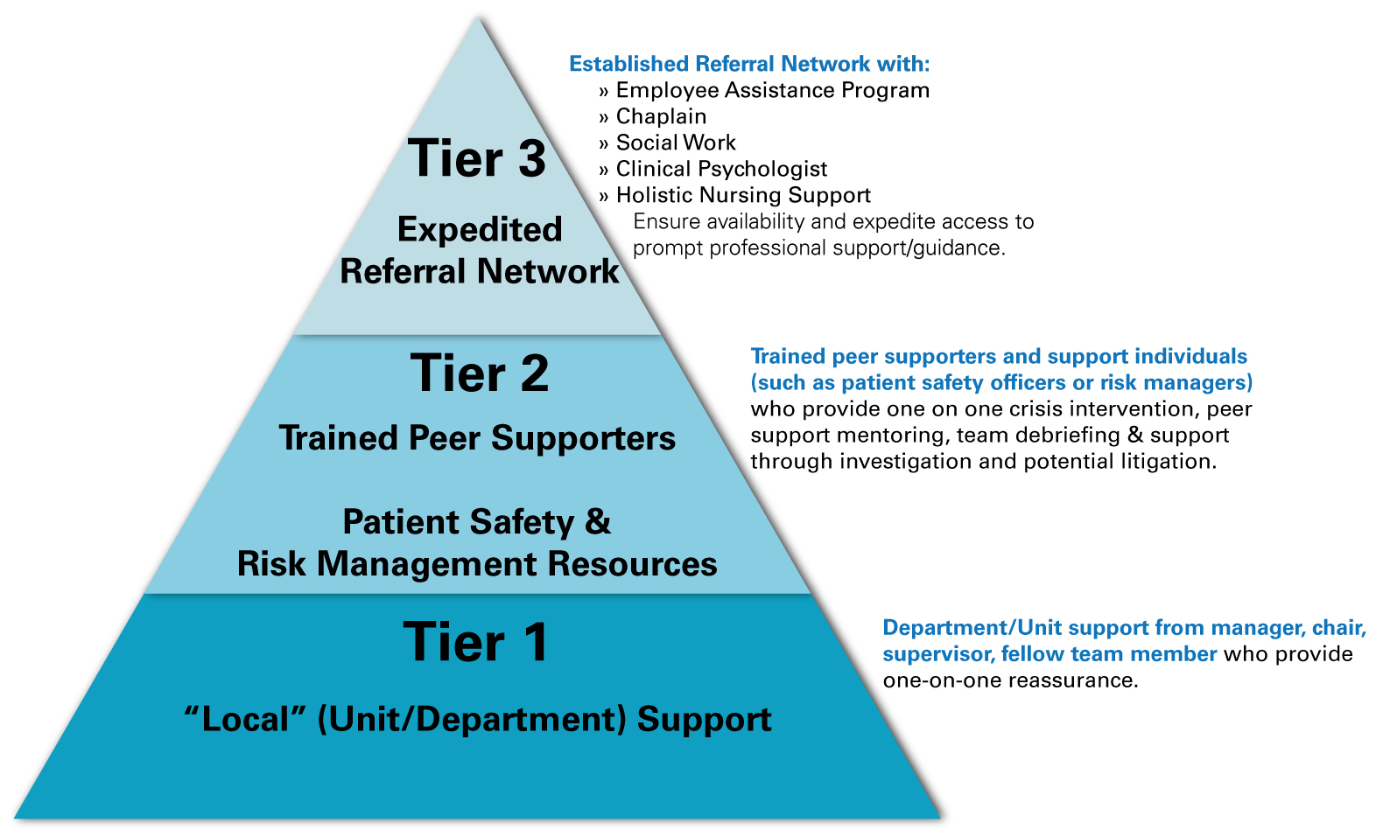
Providing Peer Support:
Strategies & Interventions
Notes:
An important component of the Care for the Caregiver program includes identifying peer supporters. Peer supporters need to understand the different levels or tiers of support that can be offered to second victims.
Tier 1 or Local Support: Involves support from the department leaders and colleagues/peers. This group can provide one-on-one reassurance to the second-victim.
Tier 2 or Trained Peer Supporters: Individuals who provide one-on-one crisis intervention and peer support mentoring to the second-victim through the investigation and analysis phase, and potentially through litigation.
Tier 3 or Expedited Referral Network: Additional referral resources to help support the second victim throughout the recovery trajectory.
Additional details on each of these tiers are available in the Care for the Caregiver support program tools.

Slide 17
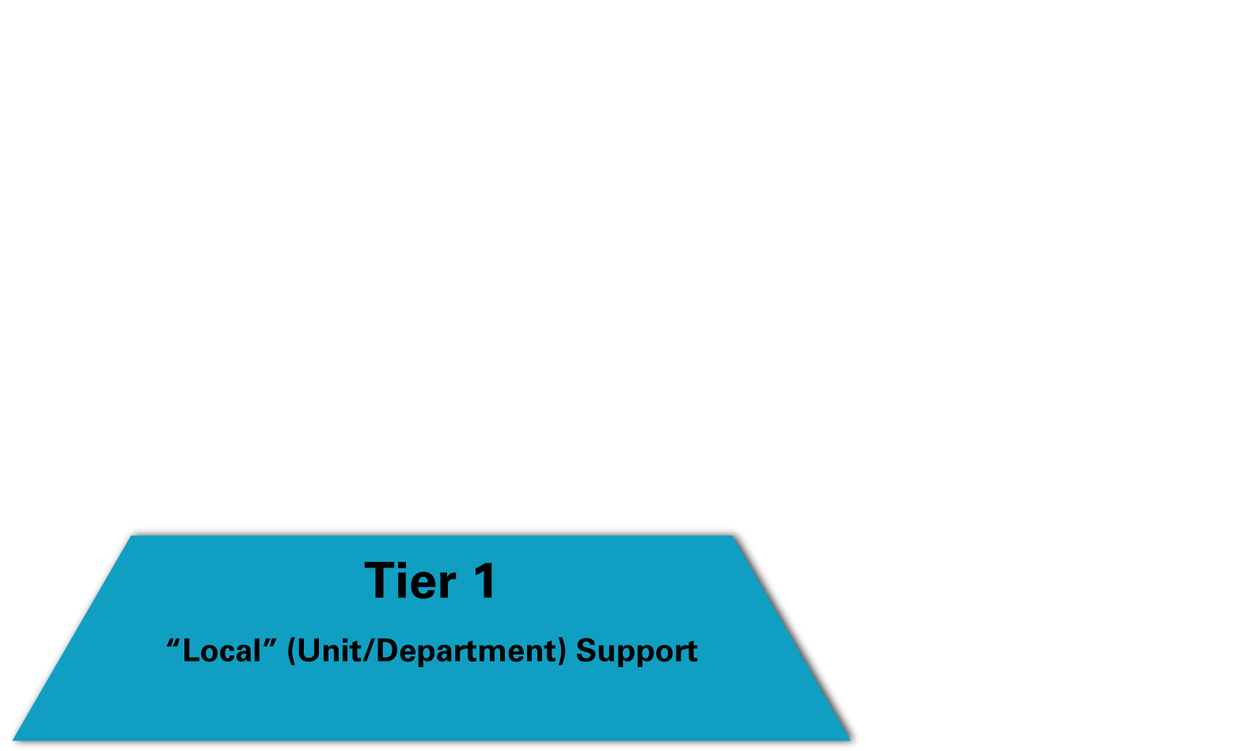
First Tier – “Local” Support
Department Leaders
Colleagues/Peers
Connect with clinical staff involved.
Reaffirm confidence in staff.
Consider calling in flex staff.
Notify staff of next steps.
Check on involved staff regularly.
Be “there” for your co-worker.
Practice active listening skills.
Offer support.
Don’t ask specific details.
Focus on colleague’s feelings.
Notes:
Tier 1 involves support from the department leaders and the second-victim’s colleagues/peers. In this tier, department leaders should connect with the clinical staff involved in the event and reaffirm their confidence in the clinical staff involved in the event. The department or CANDOR Response Team should consider calling in flex staff to relieve the clinical staff involved in the event, notify clinical staff involved in the event what is going to happen next, and keep them informed throughout the post-event period. The most important aspect of this level of support is checking on the involved staff regularly.
While the support of the department leader is important to the second-victim, so is the support from their colleagues/peers. The colleagues/peers of the second-victim can provide support by being “there” for the victim by practicing active listening skills when talking with the co-worker, and offering appropriate support without asking about specific details of the event. The focus during this tier is the feelings of the coworker and their emotional support.

Slide 18
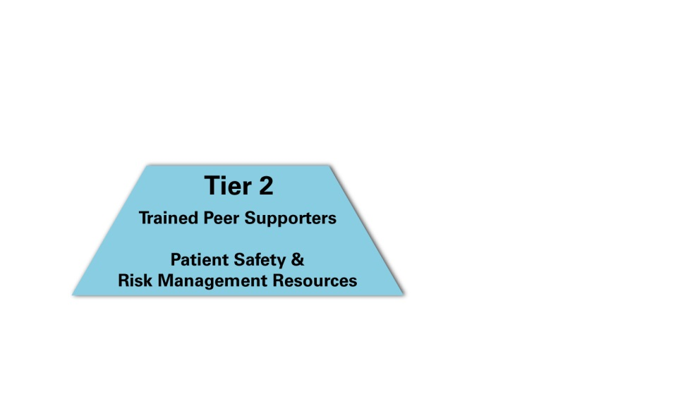
Second Tier – Trained Peer Supporters
Provide one-on-one support.
Hold team debriefings.
Notes:
Tier 2 support typically is provided by members of the Care for Caregiver program or initially by the CANDOR Response Team. All of these individuals should be trained to provide one-on-one support for the second-victim and to determine if the clinical team needs to conduct a team debriefing. If the team needs to debrief, the trained peer supporters can help facilitate the debrief. These individuals are also responsible for determining if it is safe for the caregiver involved in the event to continue with their duties, or if relief personnel need to be brought in to ensure patient care remains safe.
This level of support is given not only at the time of the event, but also as needed by the second-victim during the recovery trajectory.

Slide 19
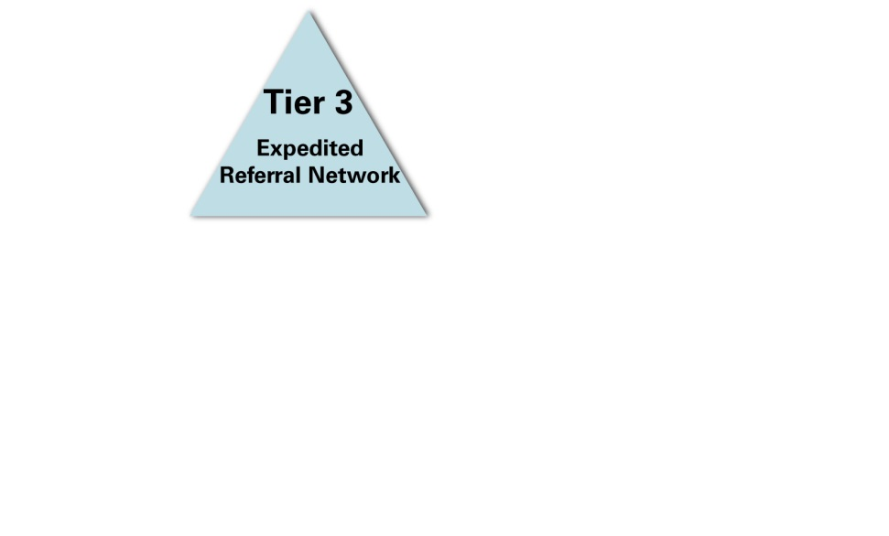
Third-Tier – Expedited Referral Network
Chaplains
Employee assistance program
Social services
Personal counselor
Notes:
Tier 3 support recognizes the needs of the second-victims and the trained peer supporter(s). If the trained peer supporter determines the needs of the second-victim are beyond the level of support they can provide, then the trained peer supporters should pursue additional resources to help the second-victim.
The organization should develop relationships with additional resources such as chaplains, employee assistance program contacts, social services, and personal counselor(s) during the development of the Care for the Caregiver program. These resources can offer unique and valuable additional support during this tier. Tier 3 support acknowledges the limitations of an organization’s trained peer supporters and reinforces the importance of pursuing additional help to meet the commitment to the caregivers and the organization’s vision for a CANDOR process.

Slide 20
Challenges to Providing Peer Support
Stigma to reaching out for help.
High-acuity areas have little time to integrate what has happened.
Intense fear of the unknown.
Fear of compromising collegial relationships because of the event.
Fear of future legal issues.
Notes:
An organization may experience a number of challenges when providing peer support as part of the Care for the Caregiver program. Some of these challenges include:
Dealing with the stigma of asking for help, which may be perceived as a sign of weakness.
Having time to integrate what has happened, especially in high-acuity areas such as emergency departments, intensive care units, and surgical/procedural areas.
Addressing an intense fear of the unknown following a patient harm event.
Recognizing the fears associated with a compromise in collegial relationships or a potential legal or licensure issue.
An effective peer support system can help address all these challenges.

Slide 21

How to Provide Peer Support
Talk through the experience.
  Depends on speaking and listening
Walk through the peer support interaction.
  Introduction
  Exploration
  Information
  Followup
Notes:
The two primary activities involved in peer support are talking through the experience and walking through the peer support interaction:
Talking through the experience with the second-victim allows the second-victim a chance to discuss their experiences surrounding the patient harm event. The peer supporter should practice active listening and remember that this step is not counseling, solving another’s problems, telling another person what to do, interrogating or questioning another person, judging another person, imposing one’s own beliefs on another person, or providing inaccurate information to the second-victim. Instead, this step involves listening to the second-victim’s story, helping the second-victim put the incident in perspective, and focusing on the second-victim’s feelings and reactions to the event, not just the details of the event.
Let’s review a sequence of activities that demonstrate a peer support interaction:
Introduction: The peer supporter initiates the conversation, introduces him- or herself as a peer supporter, and explains the goal of the peer support team.
Exploration: The peer supporter helps the second-victim express their emotions using questions to find out: What are their thoughts? What are their reactions? What are their symptoms?
Information: After the second-victim has expressed his/her emotions about the event, the peer supporter provides information. This is known as the “normalizing” part of the interaction. The peer supporter might want to discuss destructive behaviors, or normal reactions to unusual situations.
Followup: The peer supporter determines if an additional visit or resources are needed and schedules followup and additional resources, such as support from patient safety, risk management, and/or department leaders.
On the next few slides are videos that demonstrate how to conduct a peer support interaction.

Slide 22
Peer Support Demonstration
Physician
Demonstration
Nurse
Demonstration
Notes:
The following videos will help you understand how a peer support interaction can occur with a physician and a nurse.

Slide 23

Emotional Group Debriefing
Peer support for a team.
Led by trained facilitators.
Involve additional peer supporters, known as “lifeguards.”
  Provide support during debrief.
  Facilitate followup.
Notes:
While the Care for the Caregiver program typically focuses on providing assistance to an individual following a patient harm event, the organization may also need to prepare to provide peer support for a team. An emotional group debriefing may be a beneficial peer support service if an entire team was impacted by a patient harm event. It is important that this type of session be led by a trained peer supporter. Additional peer supporters known as “lifeguards” should be present to observe during the debrief, to support those having difficulty during the group debriefing, or to ensure there are additional people available to conduct followup with individuals after the debrief.

Slide 24
References
Scott SD, Hirschinger LE, Cox KR, McCoig M, Brandt J, and Hall LW. The natural history of recovery for the health care provider “second victim” after adverse patient events. Quality and Safety in Health Care. 2009: 18;325-330.
Wu AW. Medical error: the second victim. The doctor who makes the mistake needs help too. BMJ 2000;320:726–7.
AHRQ Primer: Support for Clinicians Involved in Errors and Adverse Events (Second Victims)
Wachter RM. Understanding patient safety. McGraw Hill Medical, 2012.
The Second Victim Phenomenon: A Harsh Reality of Health Care Professions, Perspective, May 2011, http://webmm.ahrq.gov/perspective.aspx?perspectiveID=102

