Slide 1
Communication and Optimal Resolution (CANDOR) Toolkit
Module 7: Resolution
Notes:
Module 7 of the CANDOR Toolkit describes the resolution phase of the CANDOR process.

Slide 2
Objectives
Define the CANDOR Resolution component and its importance in the CANDOR process.
List the steps of the resolution process and the roles of the resolution team and other stakeholders.
Identify the differences in the resolution process before and after CANDOR implementation.
Notes:
When adverse patient events occur, the patient and their family are looking for answers to the basic who, what, where, when, and ultimately, why questions. A well developed resolution process, as defined in the CANDOR process, can help provide answers to the patient and family, as well as staff. This module will help an organization understand key resolution concepts and their relationship to adverse events.
The objectives of this module are to:
Define the CANDOR Resolution component and its importance in the CANDOR process.
List the steps of the resolution process and the roles of the resolution team and other stakeholders.
Identify the differences in the resolution process before and after CANDOR implementation.

Slide 3
Definition of CANDOR Resolution¹
Resolution: the action of solving a problem, dispute, or contentious matter.
CANDOR Resolution: The actions associated with addressing the needs or issues of patients, families, and staff following a CANDOR event.
Notes:
Resolution is defined as the action of solving a problem, dispute, or contentious matter. Resolution in the CANDOR process involves actions associated with addressing the patient, family, and staff expectations. The main objective of resolution in the CANDOR process is to meet the needs and expectations of the patient. Not doing this can lead to a loss of trust from the patient.
This component of the overall process can lead to a financial settlement, but might not always lead to resolution of all issues related to the adverse event. Following patient harm events, the patient and/or family might sue the caregiver and/or organization, especially if a “deny and defend” approach is taken. However, litigation is not always a patient’s or family’s first instinct after an adverse event, so it is important to recognize the importance of disclosure and resolution in addressing unresolved needs or issues to prevent litigation and identify opportunities for improvement.

Slide 4
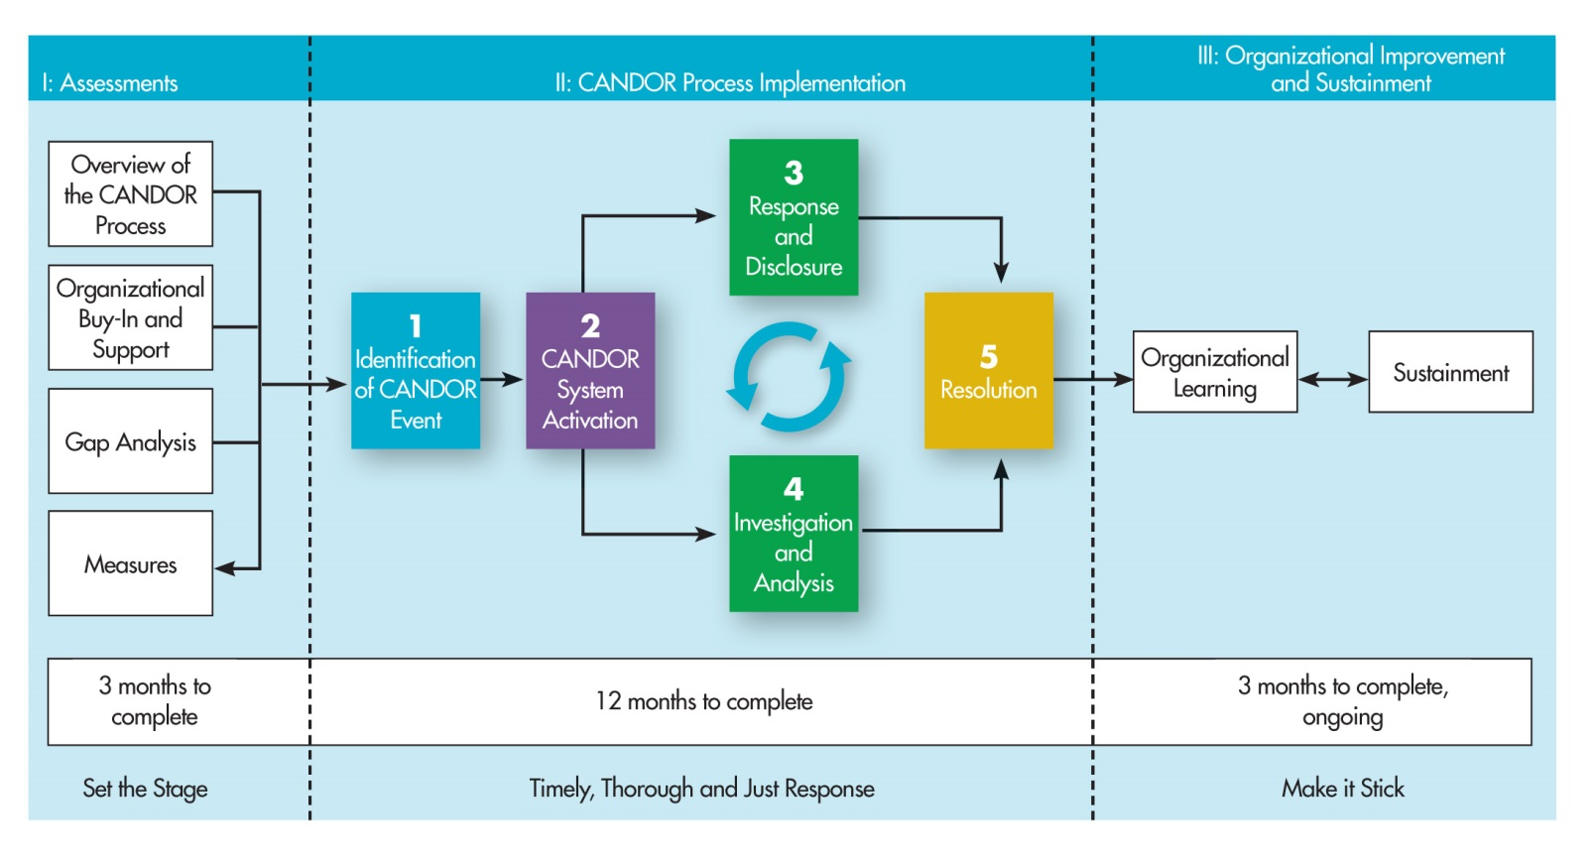
Resolution and the CANDOR Process
Notes:
Resolution is a key component of the CANDOR process. It is not a one-time occurrence and can be revisited throughout the CANDOR process. Resolution addresses the needs and concerns of patients after an adverse event. Patients want to hear from their care providers and/or the organization an explanation of what happened and a heartfelt and sincere apology for the adverse event. Patients want to know what will be done to prevent the event from happening again. The patient and/or family might also want to participate in this process so other patients won’t be harmed.
The key activities of the Resolution team include:
Compensating quickly and fairly when inappropriate medical care causes harm. The speed with which resolution occurs is important to the success of the effort. A team of representatives from finance, risk management, clinical staff, administration, and others should decide on appropriate compensation as soon as possible.
Providing staff and caregiver support as quickly and fairly as possible. The Care for the Caregiver program should be in place to support effective resolution.
Creating a learning organization in which patient harm is reduced through ongoing learning from patient experiences. Creating a learning organization is one of the most important outcomes in the CANDOR process. When harm occurs, patients often express the desire to protect others from future events. Becoming a learning organization supports the goal of preventing similar harm to patients in the future.
More information on supporting staff and creating a learning organization will be presented in the remaining modules.

Slide 5
CANDOR Resolution Team Skills
Members of the CANDOR Resolution Team should demonstrate:
Commitment to the CANDOR vision and processes.
Active listening skills.
Empathy.
Ability to clearly communicate, mediate and negotiate.
Legal knowledge of compensation calculations (by appropriate personnel).
Notes:
It is important that clinical practitioners, risk management/claims, and financial and legal personnel have the same understanding and approach to the resolution of an adverse event. The organization should establish a CANDOR resolution team that supports this collaboration to work together to re-establish trust with the patient. The resolution team should have a commitment to the CANDOR process and vision, and have knowledge and experience in the following:
Active listening skills—listener tells the speaker what they hear to assure and confirm understanding.
Empathy—the ability to understand another person’s condition from their perspective.
Ability to clearly communicate, mediate, and negotiate. These skills include nonverbal communication, attentive listening, managing stress in the moment, and the ability to recognize and understand one’s own emotions and those of the person you are communicating with. Mediating, or the ability to facilitate agreement or compromise between people, is key to an effective resolution process.
Ability to distinguish and separate process components: explanation, apology, prevention, and resolution process.
Legal knowledge of compensation calculations to help in developing a financial resolution, as appropriate.

Slide 6
CANDOR Resolution Team Resources
Internal (hospital or system level)
Clinical
Claims/finance
Legal (internal or outside counsel)
External (ad hoc)
Life expectancy/quality of life
Life care planners
Actuaries
Economists
Financial planners
Notes:
A resolution team in a CANDOR process environment needs access to a variety of both internal and external resources.
For the internal organizational resources, clinical, claims/finance, and legal personnel must be coordinated and integrated. This coordination ensures that all are working with the same goal and approach in resolving the CANDOR event.
The external resources are typically external consultants who serve as ad hoc members of the core team, who can help assess some of the intangibles. Typically, this ad hoc group consists of experts in:
Life expectancy/quality of life
Life care planners
Actuaries
Economists
Financial planners

Slide 7
Steps in CANDOR Resolution²
Overall Aim: Re-establish Patient Trust
Apology
Compensation
Commitment to improvement
Notes:
The steps in the Resolution component are focused on re-establishing trust with the patient and/or family. The steps to reestablish trust with the patient and/or family include an apology, compensation, and a show of organizational commitment to improvement.
In the CANDOR process, open and transparent communication with patients and families supports the patient’s and/or family’s need for an explanation of the patient harm event.
Some organizations choose to involve patients/families in some manner in the event analysis process. By doing so, the organization can demonstrate its commitment to making sure steps are taken to prevent a similar event from occurring in the future. Patients and family members, just like clinicians and other staff, have a desire to ensure that other patients and families do not experience similar harm events.
Not every adverse event deserves compensation, and not every patient or family wants financial compensation. However, patients and/or families frequently want to feel they are part of the improvement process. Assuming this role can help them regain trust in their care providers and the organization.

Slide 8
Essential Components of a CANDOR Apology³
Taking responsibility
Showing remorse
Making restitution
Notes:
The first step of the Resolution component is to apologize for the adverse event. This apology is a regretful acknowledgement of the event by the care provider and/or the organization. The purpose for this apology is to begin to re-establish trust with the patient and the patient’s family. A CANDOR event apology should consist of the following components:
Taking responsibility—This is not admitting guilt, but rather admitting that an adverse event occurred while the patient was under your care or in your organization.
Showing remorse—When speaking with the patient and/or family, it is important to show your honest emotions and feelings, and allow them to see how this event has affected you. There is also a difference in just saying the words “I’m sorry” and really saying the words with empathy.
Making restitution—In the initial disclosure of the adverse event, caregivers need to be careful not to promise things to patients and families. When the conversation turns to resolution after the event analysis has been completed, the organization should know whether the standard of care has been met or not, and whether it plans to financially compensate the patient/family or make other offers to help the patient/family feel whole again.

Slide 9
CANDOR Resolution: Compensation
Develop a compensation plan.
Determine fair and reasonable compensation for the patient/family after an adverse event.
Notes:
Although compensation is not appropriate in every resolution of an adverse event, organizations should develop a compensation plan as part of the CANDOR process. Determining whether or not a patient/family will be compensated after an adverse event is the individual organization’s decision. A multidisciplinary team should convene to make decisions about compensation and often includes representatives from finance, clinical, quality/patient safety/risk, and administration.
The CANDOR process supports a culture of safety, where the resolution process attempts to control the conversation by creating and managing expectations with internal and external groups. This is accomplished by the resolution team.

Slide 10
Creating a Compensation Plan
Consider whether there are recognizable damages.
Determine the cost of defending this claim compared to a well-thought-out compensation plan.
Identify trends occurring in your legal community regarding medical litigation.
Notes:
When implementing the CANDOR process, the organization should consider the following factors when developing the compensation plan:
Are there recognizable damages—that is, if the case went to court, would the law require compensation for those damages?
What would the cost of defending this claim be versus a well-thought-out compensation plan? What are the costs of past cases? Analyze past data to determine the monetary value of resolution.
What is occurring in your legal community regarding medical litigation? What are trends related to decisions and settlement amounts?
These factors should be considered when analyzing the strengths and weaknesses of a case should it ultimately proceed to litigation. The malpractice climate is different in each State, so organizations should be knowledgeable of the issues within their communities.

Slide 11
Determining Compensation
Valuation considerations:
Determine “specials” or out-of-pocket expenses.
Assess intangibles (such as pain and suffering).
Assess possible future injuries.
Assess lost income potential, loss of quality of life.
Apply liability defense costs.
Use existing organizational expertise to determine compensation.
Notes:
When determining compensation for an adverse event, many aspects of compensation should be considered, including those that are not necessarily obvious. Valuation is a methodical approach that considers many of those aspects:
“Specials” are nonmedical expenses, such as a mortgage payment, children's tuition, or other expenses that would pose a hardship for the patient or family due to the adverse event.
Out-of-pocket expenses include any co-payments or additional expenses that the patient/family has to pay related to the adverse event.
Intangibles, including pain and suffering and embarrassment.
Potential future injuries that may result from the adverse event.
Lost income potential and loss of quality of life. This is often age-related and estimated to be greater in younger individuals.
Liability defense costs—be mindful of litigation value, especially for punitive damage States.
Where appropriate, experts in life expectancy, a life care planner, economist, actuaries, and financial planners can help the organization understand other potential factors that should be considered when developing the compensation package after an adverse event.

Slide 12
Measuring Resolution Improvement
Organizational performance, relative to adverse events
Length of time to report the adverse event.
The severity level of adverse events reported.
Length of time it takes to disclose the event.
Financial impact
Dollars involved in settlement and actual suits.
Median and average payment to claimants.
Comparison of actual results to settlement.
Indirect Impact
Patient experience (use measures such as HCAHPS scores).
Staff and physician experience (utilize existing satisfaction measures, HSOPS scores, and other human resource metrics, such as reduced staff turnover or improved retention.
Notes:
A number of metrics can compare organizational performance both before and after the CANDOR process has been implemented to demonstrate improvement. These metrics include organizational performance relative to adverse events, financial impact, as well as other indirect impact measures, which could include other areas for improvement in patient safety and quality. Use the Building the Business Case for CANDOR worksheet for more information on performance metrics.

Slide 13
New Resolution Paradigm
Internal: differing roles and functions needed to participate, coordinate, and align.
External: important to communicate the vision and include key stakeholders in the process.
Notes:
A culture of safety requires open and ongoing communication with both internal and external groups to demonstrate the organization’s vision and interest in collaborating with key stakeholders to sustain the resolution process.
Staff who need to participate, coordinate, and align among internal groups include:
Insurance/Claims
Finance
Legal (internal and outside trial counsel)
Clinical (medical/nursing and other caregiver staff)
The external groups with which the organization should continue to engage in the process include:
Other health systems and insurance carriers
Plaintiff’s bar
Courts
The Resolution component of the CANDOR process will take time. Resolution of an event presents an opportunity for organizational learning and sustainment of change, which will be discussed in Module 8 of the CANDOR Toolkit.

Slide 14
References
(n.d.). Retrieved August 24, 2015, from http://www.merriam-webster.com/dictionary/resolution
Marcus, LJ, Dorn BC, McNulty EJ. Renegotiating health care: Resolving conflict to build collaboration. 2011; John Wiley & Sons.
Leape LL. Apology for errors: whose responsibility? 2012. Frontiers of health services management. 28.3:3.

