Slide 1
Clinical Care of the Hemodialysis Patient

Slide 2
Objectives
Summarize key reasons clinical care is important in vascular access infection (VAI) prevention
Identify five occasions in which hand hygiene is critical
Explain practices that all staff members can follow during site access in order to reduce VAI risk
Identify key points to share with staff on proper techniques and protocols
List three ways to reduce or end the use of catheters in your facility
Name four components of a great connection and disconnection
Explain ways to evaluate infection control practices in your facility
Notes:
SAY:
After viewing this module, you will be able to:
summarize key reasons clinical care is important in vascular access infection prevention;
identify five occasions in which hand hygiene is critical;
explain practices that all staff members can follow during site access in order to reduce VAI risk;
identify key points to share with staff on proper techniques and protocols;
list three ways to reduce the extent and duration of central venous catheter use in your facility;
name four components of a great connection and disconnection; and
explain ways to evaluate infection control practices in your facility.

Slide 3
Overview
Background
Why does it matter?
Taking CHARGE!
Next steps
Notes:
SAY:
This module, Clinical Care of the Hemodialysis Patient, is meant to give you a comprehensive overview and background on hemodialysis patient safety risks and proper clinical care for infection prevention. The module begins with a background on hemodialysis risks and the importance of proper clinical care. You will also learn common reasons for lapses in behavior in infection control during hemodialysis patient care. Next, the module will introduce the CHARGE! process for preventing infections. Finally, the module will discuss next steps you can take in your facility to implement and improve your clinical care.

Slide 4
Background Review
Infection
Sepsis
Death
Infection in hemodialysis patients
  Leading cause of morbidity
  Second leading cause of death
  Responsible for as many as 20 percent of all hospital admissions in hemodialysis patients¹
The incidence of sepsis in hemodialysis patients can be up to 100 times as high as it is compared with the general population²
In hemodialysis patients, the total death rate due to infection is roughly 75 per 1,000 patient years; sepsis is responsible for 75 percent of these infection-related deaths³
Notes:
SAY:
To understand why proper clinical care of the hemodialysis patient is so important, let’s review some facts about the infection rates in hemodialysis patients.
Infections are the leading cause of morbidity, they are second leading cause of death in hemodialysis patients, and they are responsible for as many as 20 percent of all hospital admissions in hemodialysis patients.¹ The incidence of sepsis in hemodialysis patients can be up to 100 times as high as it is in the general population.² In hemodialysis patients the total death rate due to infection is 76 per 1,000 patient years; sepsis is responsible for 75 percent of these infection-related deaths.³

Slide 5
High-Risk Patients
Hemodialysis patients—
Require long-term vascular access; some require ongoing central venous catheter (CVC) use
Are often immunocompromised
Are at higher risk for potential infection through exposure—
  Through patient-to-patient contact
  Through contact with contaminated sources, such as environmental surfaces, equipment, or supplies
  From health care providers⁴
Notes:
SAY:
Hemodialysis patients are at a higher risk for developing infection and complications because of their condition. Due to the need for long-term vascular access for hemodialysis patients, some require ongoing central venous catheter (CVC) use. Many patients are immunocompromised as well, making them further susceptible to illness and infection.
Hemodialysis patients are at a higher risk for potential infection through exposure from patient-to-patient contact, contact with contaminated sources, such as environmental surfaces, equipment, or supplies, and from health care providers.⁴

Slide 6
Results From NOTICE Infection Care Evaluators
Some practices were associated with better infection outcomes
  Good hand hygiene predicts avoidance of infection
  Appropriate cleaning of the injection port
  Proper needle insertion
  Proper assembly of supplies
  Applying a sterile dressing to the CVC exit site
Notes:
SAY:
In a previous phase of the NOTICE project, NOTICE infection care evaluators found some practices were associated with better infection outcomes. Good hand hygiene predicts avoidance of infection. Other practices positively associated with better infection outcomes include appropriate cleaning of the injection port, proper needle insertion, proper assembly of supplies, and application of a sterile dressing to the CVC exit site.

Slide 7
Why Do Lapses in Behavior Occur?
Do these factors play a role in lapses in dialysis facilities?
  Insufficient guidance, training, or reinforcement of proper procedures, protocols, and techniques
  Unclear or contradictory policies, protocols, or standards
  Insufficient or improper supplies and equipment
  Challenges in obtaining or accessing supplies and equipment
  Work environment distractions
  Insufficient or overworked staff
  New or inexperienced staff or high staff turnover
Notes:
SAY:
As mentioned in the Culture of Safety module, lapses in behavior occur for several reasons, including the fact that individuals are fallible. The following factors may also lead to potential patient harm in dialysis facilities:
1. Insufficient guidance, training, or reinforcement of proper procedures, protocols, and techniques,
2. Unclear or contradictory policies, protocols, and standards,
3. Insufficient or improper supplies and equipment,
4. Challenges in obtaining or accessing supplies and equipment,
5. Work environment distractions,
6. Insufficient or overworked staff, and
7. New or inexperienced staff or high staff turnover.
ASK:
Do any of these factors exist in your dialysis center?
How may these factors lead to lapses in behavior of individuals involved in the clinical care of a hemodialysis patient? What kinds of patient harm may occur because of these factors?

Slide 8
Lapses Put Patients at Risk for VAIs
Contamination of work environment, clean workspace, or supplies
Inadequate or no hand hygiene performed
Improper preparation of area prior to connection and after disconnection
Contamination of needles, other sterile supplies, or equipment
Lack of infection symptoms recognition
Notes:
SAY:
Lapses in behavior put patients at risk for VAIs. Anytime there is a contamination of a work environment, clean workspace, or supplies, the patient has a higher risk of an infection. Lapses in the practice of proper clinical processes can result in inadequate or no hand hygiene. They can also lead to improper preparation before connection and disconnection of needles, other sterile supplies, or equipment and their potential contamination with pathogenic organisms . The failure of staff to recognize clinical signs of infection also places a patient at higher risk.

Slide 9
VAI Quality Assessment and
Performance Improvement
Facility structures and processes affect care outcomes
When the actual outcomes don't measure up to the preferred outcomes, it is the facility’s duty to assess why and make necessary improvements
NOTICE findings suggest that six main interventions reduce VAI rates
Remember these interventions—CHARGE!
Notes:
SAY:
As the data suggest, hemodialysis is associated with a high risk of morbidity and mortality, often caused by infections. Quality assessments and performance improvement initiatives are encouraged in dialysis facilities to focus on the prevention of VAIs.
Performance improvement around VAIs can target many risk factors within a facility, including facility structures and processes that can affect care outcomes. When the preferred outcomes don’t match with the actual outcomes, it is the facility’s duty to assess why and make necessary improvements. Findings from the NOTICE project suggest that six main interventions reduce VAI rates and they can be remembered using the CHARGE acronym. The CHARGE! Model was created to help staff of dialysis facilities easily remember these six interventions.

Slide 10
The CHARGE! model’s six interventions
CHARGE!
Culture of Safety
Hand Hygiene
Access Site (Preparation/Cleansing)
Reduce and Remove Catheters
Great Connection/Disconnection Technique
Evaluation of Team Infection Control Practices
Notes:
SAY:
The CHARGE! Model consists of the six interventions shown in studies to drastically reduce and prevent VAIs. This module will go on to describe each intervention in more detail. The CHARGE! Model stands for:
Culture of Safety
Hand Hygiene
Access Site (Preparation/Cleaning)
Reduce and Remove Catheters
Great Connection/Disconnection Technique
Evaluation of Team Infection Control Practices
ASK:
Which of these areas have you focused on in your facility?

Slide 11
CHARGE! — Culture of Safety
A culture of safety is effective in reducing adverse events
Organizations with a strong culture of safety—
  Implement safe practices
  Foster a blame-free environment—errors can be discussed without fear of punitive retaliation
  Encourage teamwork and open communication regardless of roles
  Provide resources and tools to improve safety
Creating a safety culture is covered in other modules.
Notes:
SAY:
The first intervention in CHARGE is C, which stands for culture of safety.
Defects, or errors in systems, lead to unwanted outcomes such as harms (harming a patient) or adverse events (anything unwanted, even if no harm is caused). Maintaining a culture of safety in your dialysis facility is effective in reducing adverse events. Organizations with a strong culture of safety do the following:
Implement safe practices
Foster a blame-free environment, meaning that errors can be discussed without fear of punitive retaliation
Encourage teamwork and open communication regardless of roles
Provide resources and tools to improve safety
To learn more, creating a safety culture is covered in other modules, including the Culture of Safety module. The Comprehensive Unit-based Safety Program (CUSP) Toolkit and Team Strategies and Tools to Enhance Performance and Patient Safety (TeamSTEPPs) materials on AHRQ’s website are also good tools for implementing a culture of safety.

Slide 12
CHARGE! — Hand Hygiene
Hand hygiene is one of the most effective methods of infection prevention
Frequent and consistent hand hygiene before, during, and after dialysis treatment significantly minimizes infection risk to the patient
Hand hygiene is the responsibility of the care provider, the facility, and the patient and family
Notes:
SAY:
The second intervention in CHARGE is H, which stands for hand hygiene.
Hand hygiene is one of the most effective methods of infection prevention. Frequent and consistent hand hygiene before, during, and after dialysis treatment significantly minimizes infection risk to the patient. Hand hygiene is everyone’s responsibility, including not only the care provider and facility, but also the patient and family.

Slide 13
POLL: Why Isn’t Hand Hygiene
Regularly Performed in Your Facility?
Lack of education about proper hand-washing techniques
Inadequate access to proper germ-eliminating soaps or water
Inconvenient placement of hand-washing stations
Forgetfulness or lack of time management
Other reasons
Notes:
SAY:
Health care workers fail to wash their hands for a number of reasons. One reason is inadequate education, which includes a lack of education about proper hand-washing techniques and a lack of understanding of the importance of hand hygiene. Another reason is inadequate access, including inadequate access to proper germ-eliminating soaps or water and the lack or inconvenient placement of hand-washing stations. Other factors include individual staff issues, including forgetfulness or poor time management, as well as allergies to or intolerance of hand hygiene solutions.
DO:
Read the poll to yourself or to your team. Which factors, if any, play a role in why hand hygiene isn’t regularly performed in your facility?
Discuss polling results with participants.

Slide 14
Methods of Hand Hygiene
Alcohol-based hand rubs (ABHR)
  ABHR is the preferred means for routine hand hygiene in clinical situations in hemodialysis facilities
Soap and water
  Use when—
    hands are visibly soiled, or
    patient has known infection with Clostridium difficile or other spore-forming pathogens⁵
Notes:
SAY:
Several methods exist for hand hygiene. Some are more effective than others. According to World Health Organization guidelines on hand hygiene for health care workers, at present, alcohol-based hand rubs, or ABHR, are the only known means for rapidly and effectively inactivating a wide array of potentially harmful microorganisms on hands. ABHR is the preferred means for routine hand hygiene in clinical situations in hemodialysis facilities.
The hand hygiene method of using soap and water can be used when hands are visibly soiled, or if the patient has a known infection with Clostridium difficile or other spore-forming pathogens.⁵

Slide 15
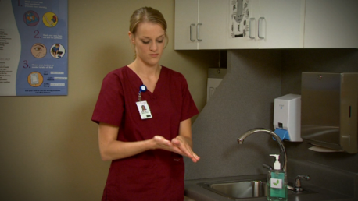
Hand Hygiene Review
Washing with ABHR
  Apply recommended amount of product to palm of one hand and rub hands together, covering all surfaces of hands and fingers, until hands are dry
Washing with soap and water
  Wet hands with water, apply recommended amount of product, cover all surfaces of the hands and fingers, and rub hands together vigorously for 15 seconds
  Rinse hands and dry thoroughly with a disposable towel
  Use towel to turn off the faucet
  Avoid using hot water to reduce risk of dermatitis
Notes:
SAY:
Let’s review the different methods of washing with ABHR and washing with soap and water.
For washing with ABHR, apply the recommended amount of product to the palm of one hand and rub hands together, covering all surfaces of hands and fingers, until hands are dry.
For washing with soap and water, wet hands with water, apply recommended amount of product, cover all surfaces of the hands and fingers, and rub hands together vigorously for 15 seconds. Next, rinse hands and dry thoroughly with a disposable towel, and use the towel to turn off the faucet. To reduce risk of dermatitis, avoid using hot water.

Slide 16
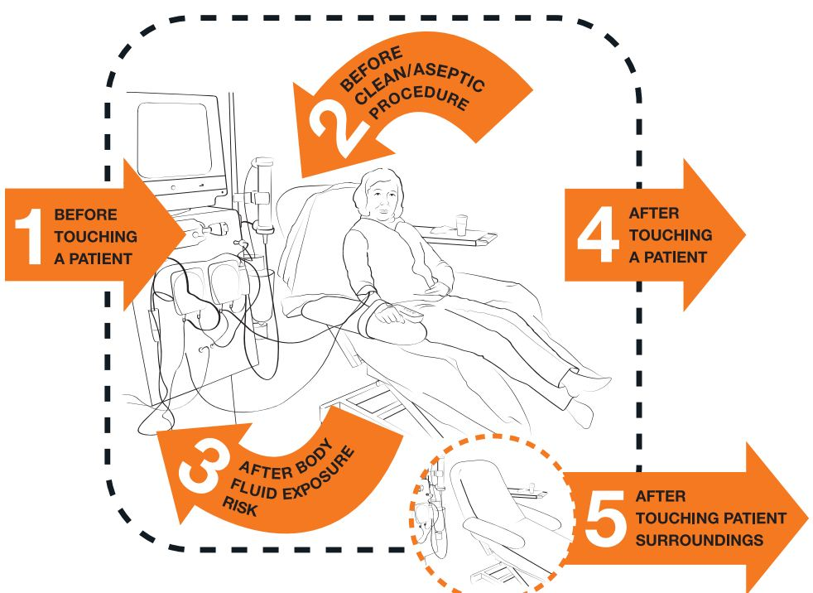
5 Moments for Hand Hygiene
According to the World Health Organization, there are “5 moments for hand hygiene” in health care:
  Before touching a patient
  Before clean/aseptic procedure
  After body fluid exposure
  After touching a patient
  After touching a patient’s
  surroundings⁵
Notes:
SAY:
According to the World Health Organization, there are “5 moments for hand hygiene” in health care:
Before touching a patient – Clean your hands before touching a patient when approaching him or her to protect the patient against harmful germs carried on your hands.
Before clean/aseptic procedure – Clean your hands immediately before any aseptic task to protect the patient against harmful germs, including the patient’s own germs, entering his or her body.
After body fluid exposure – Clean your hands immediately after an exposure risk to body fluids (and after glove removal) to protect yourself and the health care environment from harmful patient germs.
After touching a patient – Clean your hands after touching a patient and his or her immediate surroundings when leaving to protect yourself and the health care environment from harmful patient germs.
After touching a patient’s surroundings – Clean your hands after touching any object or furniture in the patient’s immediate surroundings, when leaving—even without touching the patient—to protect yourself and the health care environment from harmful patient germs.⁵

Slide 17
Educating Staff
Teach staff proper hand-washing techniques
  Use of ABHR
  Soap and water
  When to conduct hand hygiene
  WHO’s “5 moments for hand hygiene”
Ensure hand hygiene supplies are always available
Instruct staff to remind patients and families to wash their hands
Place reminders such as fliers, index cards, and other materials throughout the facility
Complete monthly hand hygiene audits and share and display results consistently to staff
Notes:
SAY:
Educating staff is important for teaching staff proper hand-washing techniques, and there are ways to make hand hygiene fun! Create healthy competition among shifts, teams, staff, and physicians to see who is most consistently and correctly washing their hands according to proper techniques. Remind staff, patients, and family members that washing hands should take 15 seconds, or as long as it takes to sing “Happy Birthday”. Fifteen seconds seems like a short amount of time, but try timing yourself one time and you may realize it is actually longer than you think.
Teach staff proper hand-washing techniques, including:
Use of ABHR
Soap and water
When to conduct hand hygiene
WHO’s “5 moments for hand hygiene”
In addition to education, ensure hand hygiene supplies are always available and instruct staff to remind patients and families to wash their hands. Reminders such as fliers, index cards, and other materials throughout the facility are helpful tools. Complete monthly hand hygiene audits and share and display results consistently to staff to show them their habits and areas showing as well as still needing improvement.

Slide 18
CHARGE! — Access Site
Preparation and Cleansing
Infection control worksheets include proper steps to prepare and cleanse the access site prior to and after hemodialysis
Appropriate preparation and cleansing includes—
  Scrub CVC hubs and skin over AV fistulas and grafts with appropriate antiseptic agent
  Use an alcohol-based chlorhexidine (>0.5%) or other appropriate antiseptic agent solution as the first-line agent for skin antisepsis
  Apply antimicrobial ointment to catheter exit sites during dressing changes or use a chlorhexidine-impregnated sponge dressing⁶
Notes:
SAY:
The third intervention in CHARGE is A, which stands for access site preparation and cleansing.
Appropriate cleansing and preparation of the access site prior to and after hemodialysis is another essential step in infection prevention in dialysis patients. A common theme among established checklist practices is the use of aseptic/antiseptic techniques. Aseptic technique is a set of specific practices and procedures performed under carefully controlled conditions with the goal of minimizing contamination by pathogens. Scrubbing CVC hubs and the skin over AV fistulas and grafts with appropriate antiseptic agents should be taught to frontline staff and reinforced through in-service training and observation.
Using an alcohol-based chlorhexidine (>0.5%) solution or other appropriate antiseptic as the first-line agent for skin antisepsis, particularly for central line insertion and during dressing changes, is recommended. Current recommendations also include the application of antimicrobial ointment to catheter exit sites during dressing changes or using a chlorhexidine-impregnated sponge dressing.

Slide 19
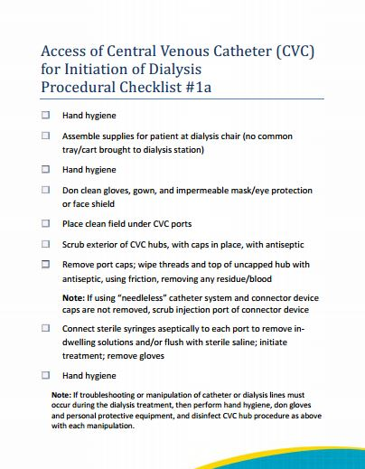
Catheter Initiation Poll
How Often Do You Think All of These Steps Are Performed at Your Facility?
Clinical Care
Notes:
SAY:
Included in this slide is a procedural checklist with proper steps for access of CVC for initiation of dialysis. This checklist can be used as a tool in your facility to determine if you have taken all of the necessary steps to prevent VAIs in your hemodialysis patients. The checklist includes procedures such as hand hygiene steps with other key steps to safeguarding the patient’s safety.
ASK:
How often do you think all of these steps are performed at your facility?
DO:
Discuss which steps are performed and how often, as well as how your dialysis facility can improve upon these processes.

Slide 20
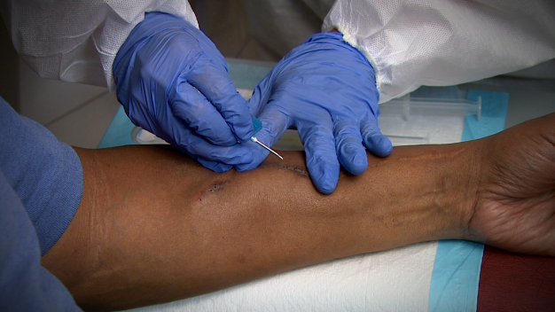
Access Site Care With an Arteriovenous Fistula (AV Fistula)
Before cannulation
Skin over access site should be washed by the patient or scrubbed by care provider with an antiseptic agent
Locate/palpate access site
Scrub skin over access site with antiseptic agent
Apply clean bandage after dialysis termination
Notes:
SAY:
Proper clinical care must be followed for care of the access site with an arteriovenous fistula (AV fistula).
Before cannulation, the skin over the access site should be washed by the patient or scrubbed by a care provider with an antiseptic agent. Next, the access site should be located/palpated. Scrub skin over access site with antiseptic agent and apply a clean bandage after dialysis termination.

Slide 21
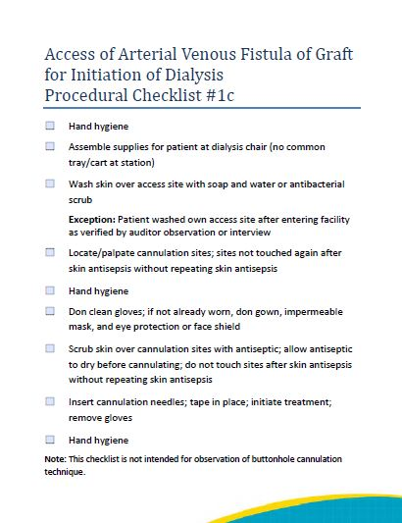
AV Fistula or Graft
Initiation Poll
How Often Do You Think All of These Steps Are Performed at Your Facility?
Clinical Care
Notes:
SAY:
Included in this slide is a procedural checklist with proper steps for accessing both AV fistulas and grafts for dialysis initiation. This checklist can be used as a tool in your facility to determine if you have taken the necessary steps to prevent VAIs in your hemodialysis patients. The checklist includes procedures such as hand hygiene steps with other key steps to safeguarding the patient’s safety.
ASK:
How often do you think all of these steps are performed at your facility?
DO:
Discuss which steps are performed and how often, as well as how your dialysis facility can improve upon these processes.

Slide 22

Specific Interventions May Help
Offer educational sessions on creating clean and aseptic fields and how to maintain them
Watch supplemental videos with staff
Teach staff proper techniques to cleanse access sites
  “Scrub the Hub” technique for CVCs
  Cleansing of skin over AV fistulas and grafts
Use checklists to ensure all steps are being followed
Audit your facility to determine areas for improvement
Notes:
SAY:
Interventions specific to infection prevention topics and dialysis clinical processes may help with quality improvement within your facility. Intervention examples include offering educational sessions on creating and maintaining clean and aseptic fields and watching supplemental videos with staff. Videos are available on AHRQ’s Web site and YouTube channel. Teach proper techniques to cleanse access sites to staff including the “scrub the hub” technique for CVCs and proper cleansing of skin over AV fistulas and grafts.
The use of checklists can help ensure all steps are being followed, and audit tools can assist your facility to determine areas for improvement.

Slide 23
CHARGE! — Reduce and
Remove Catheters
Reduce and remove hemodialysis catheters to increase usage of the hemodialysis gold standard: fistulas
Compared with hemodialysis patients with fistulas, hemodialysis patients with catheters are—
  15 times as likely to get infections⁸
  More likely to be hospitalized⁸
  Twice as likely to die⁷
Notes:
SAY:
The next intervention in CHARGE, R, stands for reduce and remove catheters.
Reduce and remove catheters to increase the usage of fistulas, which are the hemodialysis gold standard in infection prevention. Compared to hemodialysis patients with fistulas, patients with catheters are 15 times as likely to get infections, they are more likely to be hospitalized, and they are twice as likely to die when compared to patients with fistulas.

Slide 24
Poll: Do You Know the Percentage of Patients With Catheters in Your Facility?
Yes
No
The Centers for Medicare and Medicaid Services (CMS) guideline states at least 68 percent of patients should have fistulas. The National Kidney Foundation aims for no more than 10 percent of patients with catheters.
Notes:
ASK:
Do you know the percentage of patients that have catheters in your facility?
SAY:
The Centers for Medicare & Medicaid Services (CMS) guideline recommends that at least 68 percent of patients should have fistulas. The National Kidney Foundation aims for no more than 10 percent of patients with catheters within a given facility.
DO:
If the percentage of patients that have catheters in your facility is higher than these recommended guidelines, this module will help to offer next steps in reducing the proportion of patients with catheters within your facility.

Slide 25
Barriers to Using Lowest Risk Access (i.e., Fistulas)
No dedicated vascular access (VA) surgeon for the facility
Competition for VA surgeon resources
Training of VA surgeons regarding catheter risks and creating fistulas in complex patients
Case mix and severity; fistulas are not options for all patients
Suboptimal pre–kidney disease care
Patient or facility staff preference
Lack of knowledge regarding implications of choice
Lack of support of fistula first by team members⁸
Notes:
SAY:
We want to reduce and remove catheters where applicable and have every patient use the lowest risk access type possible for them. Listed are some of the common barriers to this, including lack of a dedicated vascular access (VA) surgeon for the facility, competition for VA surgeon resources, and inadequate training of VA surgeons regarding catheter risks and creating fistulas in complex patients. Other barriers to using lowest risk access include case mix and severity; fistulas are not options for all patients. Patient and team member preferences and lack of support by team members for using fistulas first also create obstacles to reducing the use of catheters.

Slide 26
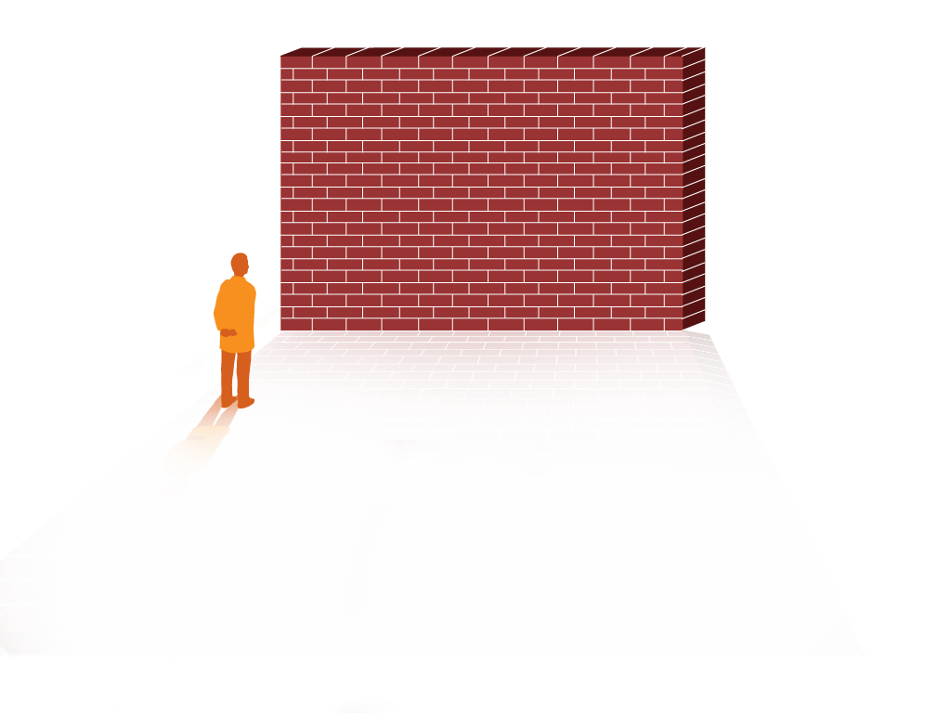
Barriers to Using Lowest Risk Access: Areas You Can Impact
Patient or facility staff preference
Lack of knowledge regarding implications of choice
Notes:
SAY:
While there are many barriers to using the lowest risk access type, not all of them can be addressed in the facility unit. For instance, you cannot change the suboptimal pre–kidney disease care of the patient, nor can you be held responsible for the training of vascular access surgeons. But what you can do still has the potential to make a huge impact. Those are the sections we will focus on: overcoming patient and staff preferences for catheters and improving knowledge regarding the implications of choice.

Slide 27
Evaluate all Catheter Patients for an AV Fistula
Develop a protocol for catheter initiation and removal
  Patients with a catheter should be reviewed and discussed by the vascular access team. A documented plan for permanent vascular access evaluation and placement should be part of the patient's permanent medical record.
Track all catheter patients for early removal of catheters
  Develop and implement protocols to track all catheter patients for opportunities for removal of catheters as soon as possible.⁸
Notes:
SAY:
In alignment with the Fistula First change concept 7, evaluate all catheter patients for an AV fistula. Develop a protocol for catheter necessity, placement, and removal. Patients with a catheter should be reviewed and discussed by the vascular access team. A documented plan for permanent vascular access evaluation and placement should be part of the patient's permanent medical record. Additionally, you should track all catheter patients for removal of catheters as soon as possible.

Slide 28

Offer Cannulation Training for Staff
Train all appropriate dialysis staff on appropriate cannulation
Use protocols for initial dialysis treatments with new AV fistula patients⁸
Notes:
SAY:
In alignment with Fistula First change concept 8, implement a training program in your facility. Some staff may not feel comfortable cannulating new or difficult fistulas. Offering continuing training opportunities in-house may alleviate this fear as more experience is acquired. Identify your experienced staff members. These staff members should cannulate all new fistulae and train inexperienced staff. Develop a regular training schedule and protocol for cannulating new fistula patients.

Slide 29

Educate Staff
Provide continuing education for all caregivers
Develop routine in-servicing and education programs in vascular access for facility staff⁸
29
Notes:
SAY:
In addition to cannulation training, provide other continuing education for facility staff. This could include periodic in-service training by nephrologists, surgeons, and interventionists to communicate the value of fistulae over other access types and best treatment practices for patients with fistulae. Provide data and case studies to staff. Explain the benefits of fistulae and your facility’s actions to increase fistula usage.

Slide 30
Educate Patients
Facilities should educate patients on—
Practices that can improve the quality of their care and their outcomes
Benefits of fistulas to encourage catheter patients to switch⁸
Notes:
SAY:
Patients should be educated just as well as staff. Facilities should educate patients on practices that can improve the quality of their care and their outcomes, as well as the benefits of fistulas that may encourage catheter patients to switch.
DO:
Show the “Patient Engagement in Infection Prevention” video.

Slide 31
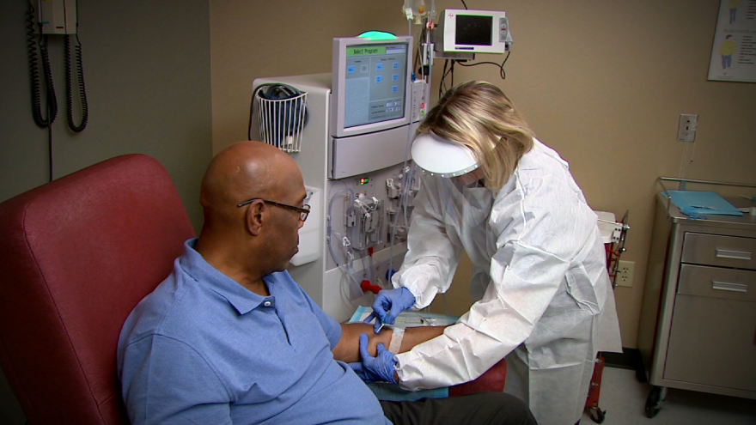
CHARGE! — Great Connection and Disconnection
Every time a patient’s bloodstream is accessed, a potential risk for infection exists
Great connection and disconnection technique can reduce this risk
Notes:
SAY:
The next intervention in CHARGE is G, which stands for great connection and disconnection.
Every time a patient’s bloodstream is accessed, a potential risk for infection exists. A great connection and disconnection technique can reduce this risk.

Slide 32
Proper Protocol for Connection — Catheter
Use proper hand hygiene
Assemble supplies at dialysis chair
Use appropriate personal protective equipment (PPE)
Place a clean field under ports
Scrub the hub
Connect sterile syringes, one at a time removing anticoagulant and checking that blood aspirates into syringe before connecting blood line⁹
Notes:
SAY:
There are a few steps to implementing proper protocol for catheter connection.
1. Always perform proper hand hygiene and don new gloves before connection. Antiseptic hand hygiene should be performed immediately before donning sterile gloves prior to insertion of a central venous catheter.
2. Assemble all supplies needed at the dialysis chair.
3. Use appropriate personal protective equipment (PPE) to prevent contamination of skin or clothing by body fluids containing pathogenic micro-organisms, which may then be transferred to the facility staff member or other patients. For CVC insertion, a disposable plastic apron and sterile gloves will usually be sufficient. Disposable plastic aprons and gloves are single-use items worn for one procedure and then discarded. Hands should be decontaminated after removing PPE.
4. Place a clean field under ports. Before the procedure, the environmental surfaces involved should be effectively cleaned and disinfected.
5. Scrub the hub. Clamp the catheter and disinfect the hub with caps removed using an appropriate antiseptic. Scrub the sides (threads) and end of the hub thoroughly with friction, making sure to remove any residue (e.g., blood). Using the same antiseptic pad, apply antiseptic with friction to the catheter, moving from the hub at least several centimeters towards the body. Hold the limb while allowing the antiseptic to dry. Use a separate antiseptic pad for each hub/catheter limb. Leave hubs “open” (i.e., uncapped and disconnected) for the shortest time possible. Always handle the catheter hubs aseptically. Once disinfected, do not allow the catheter hubs to touch nonsterile surfaces.
6. Connect sterile syringes one at a time, removing anticoagulant and checking that blood aspirates into the syringe before connecting the blood line.

Slide 33
Proper Protocol for Disconnection — Catheters
Use proper hand hygiene
Assemble supplies and don personal protective equipment (PPE)
Place a new clean field under CVC ports
Reinfuse the extracorporeal circuit
Scrub the hub and disconnect blood lines aseptically
Scrub hub again to remove any residue and recap ports⁹
Notes:
SAY:
The following steps follow protocol for disconnecting a catheter:
1. Always perform proper hand hygiene and don new gloves before connection. Antiseptic hand hygiene should be performed immediately before donning sterile gloves prior to insertion of a central venous catheter.
2. Assemble all supplies needed and don personal protective equipment as mentioned in the previous slide.
3. Place a new clean field under CVC ports.
4. Reinfuse the extracorporeal circuit.
5. Disconnect the blood line from the catheter and disinfect the hub with a new antiseptic pad. Scrub the sides (threads) and end of the hub thoroughly with friction, making sure to remove any residue (e.g., blood).
6. Scrub the hub again to remove any residue and recap ports antiseptically.
DO:
Play “Initiating Dialysis With a Catheter: Catheter Exit Site Care” video available on AHRQ’s Web site.

Slide 34
Proper Protocol for Connection —
Fistula and Graft
Proper hand hygiene
Assemble supplies at dialysis chair
Wash skin over access site with antiseptic agent if patient has not done in advance
Locate/palpate access site
Don PPE
Scrub skin over access site with antiseptic agent
Insert needles and secure with tape⁹
Notes:
SAY:
Protocol for fistula and graft connection is very similar to that of catheter connection and follows these steps:
1. Always perform proper hand hygiene and don new gloves before connection. Antiseptic hand hygiene should be performed immediately before donning sterile gloves prior to connection of a fistula or graph.
2. Assemble all supplies needed and don personal protective equipment as mentioned in the previous slide.
3. Wash skin over access site (the patient may perform this step in advance otherwise it should be done by the care provider with an antiseptic agent).
4. Locate/palpate access site.
5. Don personal protective equipment.
6. Scrub skin over access site with antiseptic agent.
7. Insert needles and secure with tape at the same angle the needle was inserted.
DO:
Play “Initiating Dialysis With Fistula or Graft: Accessing Medication Port To Administer Medication” video available on AHRQ’s website.

Slide 35
Proper Protocol for Disconnection —
Fistula and Graft⁹
Use proper hand hygiene
Assemble supplies at dialysis chair
Don PPE
Reinfuse extracorporeal circuit
Remove leads aseptically and hold needle sites with clean gauze and clean gloves or disinfected clamps until bleeding subsides
Apply clean bandage after dialysis termination
Notes:
SAY:
Protocol for fistula and graft disconnection is very similar to that of catheter disconnection and follows these steps:
1. Always perform proper hand hygiene and don new gloves before connection. Antiseptic hand hygiene should be performed immediately before donning sterile gloves prior to disconnection of a fistula or graph.
2. Assemble all supplies needed and don personal protective equipment as mentioned in the previous slide.
3. Reinfuse extracorporeal circuit.
4. Remove leads aseptically and hold needle sites with clean gauze and clean gloves or disinfected clamps until bleeding subsides.
5. Apply a clean bandage after dialysis termination.

Slide 36
CHARGE! — Evaluation of Team
Infection Control Practices⁹
Do
Implement infection control practices
Study
Evaluate results of infection control practices¹⁰
Act
Focus on places for improvement identified through evaluation
Plan
Assemble your team and assign roles
Notes:
SAY:
The final intervention in CHARGE! is E, which stands for evaluation of team infection control practices.
The evaluation can be done in a simple plan-do-study-act, or PDSA, cycle.
Plan–This is the stage where you assemble your team and assign roles, while planning out your infection control practice improvements.
Do–This stage is where you implement infection control practices.
Study–This stage is focused on evaluating the results of the infection control practices implemented.
Act–The Act stage focuses on finding areas for improvement identified through evaluation and altering your plan based on what is learned.

Slide 37
Review Data Monthly
Discuss and evaluate data trended over time for VAI rates and process measures. Review data monthly in quality assessment
and performance improvement (QAPI) meetings.
Are your infection rates high compared with other facilities?
Are your infection rates stagnate or increasing? If so, what are some of the potential causes?
Are you implementing all of the recommended improvement processes? If not, why?
What are some opportunities for improvement based on your monthly audits?
Notes:
SAY:
It is important to discuss and evaluate the data trending over time for vascular access infection rates and process measures.
ASK:
When reviewing data, ask:
Are your infection rates high compared to other facilities?
Are your infection rates stagnant or increasing rather than falling? If so, what are some of the potential causes?
Are you implementing all of the recommended improvement processes? If not, why?
What are some opportunities for improvement based on your monthly audits?

Slide 38
Provide Feedback to Your Facility
Provide specific outcomes feedback to all decision makers and staff. Some possible opportunities to share include:
Report out at staff meetings
Post a rate board in the break room (or go bold! Post it in the facility entryway visible to all)
Incorporate feedback into training opportunities
Share information informally with other staff
Notes:
SAY:
The data you collect through your quality improvement evaluation should be shared with your team. Provide specific outcomes feedback to all decision makers and staff.
Some possible opportunities to share include:
Report out at staff meetings
Post a rate board in the break room (or go bold! Post it in the facility entryway visible to all)
Incorporate feedback into training opportunities
Share information informally with other staff

Slide 39
Incorporate Evaluation Into Existing Processes
Encourage review of all CHARGE! sections either through your team meetings or through your facility’s QAPI process
Assess other quality improvement processes in your facility. Can data collected be used for other projects?
Make evaluation a regular component of standard procedures so that it is sustainable
Notes:
SAY:
Incorporate your evaluation results into existing processes to further improve. Encourage review of all CHARGE! sections either through your team meetings or through your facility’s QAPI process. Assess other quality improvement processes in your facility. Make evaluations a regular component of standard procedures so that it becomes a sustainable process within your facility.
ASK:
Can data collected be used for other quality improvement projects?

Slide 40
Next Steps
Offer staff training
  Have staff watch videos on Agency for Healthcare Research & Quality’s (AHRQ) Web site
  Provide cannulation training for staff members for AV fistulas, AV grafts, and catheters
  Identify “expert cannulators” on your staff to serve as peer educators
Reinforce proper techniques
  If you see someone conduct a great connection or disconnection, let them know you appreciate their help in reducing infection risk
Use NOTICE checklists as reminders for the steps for great connections and disconnections
Conduct monthly process audits
  Supply patients with information about the benefits of fistulas
Notes:
SAY:
The information covered in this module and in Clinical Care of the Hemodialysis Patient can help you understand the importance of the CHARGE! model and its interventions to reduce vascular access infections in your dialysis center. You and your team can take next steps in your facility to improve the level of clinical care, beginning with offering staff training. Have staff watch videos provided and offer cannulation training for staff members for AV fistulas, AV grafts, and catheters. Identify “expert cannulators” on your staff to serve as peer educators. Reinforce proper technique—if you see someone conduct a great connection or disconnection, let them know you appreciate their help in reducing infection risk. Use checklists and audit tools as reminders for the steps for great connections and disconnections. Conduct monthly process audits and supply patients with information about the benefits of fistulas.

Slide 41
References
Lafrance JP, Rahme E, Lelorier J, et al. Vascular access-related infections, definitions, incidence rates, and risk factors. American Journal of Kidney Disease. 2008; 52:982-993. PMID: 18760516.
Bertrand LJ. Bacterial infections in the hemodialysis patient: Pathogenesis and prevention. Kidney International. 2005; 67:2508-2519.
National Institutes of Health, National Institute of Diabetes and Digestive and Kidney Diseases. U.S. Renal Data System, USRDS 2009 Annual Data Report: Atlas of Chronic Kidney Disease and End-Stage Renal Disease in the United States. 2009. http://www.usrds.org/atlas09.aspx. Accessed September 3, 2014.
U.S. Department of Health and Human Services, U.S. Department of Defense, U.S. Department of Veterans Affairs. End-Stage Renal Disease Facilities. In: National Action Plan To Prevent Healthcare-Associated Infections: Roadmap to Elimination. Washington, D.C.:U.S. Department of Health and Human Services; 2013. http://www.health.gov/hai/pdfs/hai-action-plan-esrd.pdf. Accessed September 3, 2014.
World Health Organization Guidelines on Hand Hygiene in Health Care: First Global Patient Safety Challenge, Clean Care is Safer Care. Geneva, Switzerland: World Health Organization; 2009. http://whqlibdoc.who.int/publications/2009/9789241597906_eng.pdf. Accessed September 3, 2014.

Slide 42
References
Centers for Disease Control and Prevention. Guidelines for the prevention of intravascular catheter-related infections. MMWR 2002;51(No.RR10):1-26. http://www.cdc.gov/mmwr/pdf/rr/rr5110.pdf.
Wasse, H. Catheter–related mortality among ESRD patients. Seminars in Dialysis. 2008; 21(6):547-9. PMID: 19000119.
Fistula First. http://www.fistulafirst.org. Accessed January 15, 2013.
Hemodialysis Central Venous Catheter Scrub-the-Hub Protocol. http://www.cdc.gov/dialysis/PDFs/collaborative/Hemodialysis-Central-Venous-Catheter-STH-Protocol.pdf. Accessed September 3, 2014.
Institute for Healthcare Improvement. Science of Improvement: Testing Changes. http://www.ihi.org/resources/Pages/HowtoImprove/ScienceofImprovementTestingChanges.aspx. Accessed September 3, 2014.

