Slide 1
Culture of Safety in Hemodialysis Facilities
An Adaptation of “Introduction to Comprehensive Unit-based Safety Program (CUSP)” for Dialysis Facilities

Slide 2
Objectives
Discuss the elements of a comprehensive, unit-based approach to safety (CUSP) and its impact on improving patient care
Review team assembly and its impact on patient care
Name leadership engagement techniques
Review communication techniques that support patient-centered care
Assemble a team to lead culture of safety improvement efforts
Conduct a learning from defects exercise
Notes:
SAY:
After viewing this module, you will be able to:
Discuss the elements of a comprehensive, unit-based approach to safety and its impact on improving patient care
Review team assembly and its impact on patient care
Name leadership engagement techniques
Review communication techniques that support patient-centered care
Assemble a team to lead culture of safety improvement efforts
Conduct a learning from defects exercise

Slide 3
Overview
The importance of reducing harm
Key elements of comprehensive unit-based safety
  Understand the Science of Safety
  Assemble the Team
  Engage Senior Leadership
  Implement Teamwork and Communication
  Learn From Defects
Next steps
Notes:
SAY:
This Culture of Safety module aims to provide you with a comprehensive overview of the importance of reducing harm in your facility and the key elements of the Comprehensive Unit-based Safety Program (CUSP) which include the science of safety, assembling a team, engaging senior leadership, teamwork and communication, and learning from defects. Finally, the module will discuss next steps you can take in your facility to create a culture of safety among employees.

Slide 4
The Importance of Reducing Harm
Would you want a loved one to be a patient at your facility? On your shift?
Would you want to be a patient in the facility where you work?
Can you say with 100 percent certainty that your facility does all it can to protect patients from infections and other harms?
If not, then improvement is a priority
Notes:
SAY:
Reducing harm at the facility level is important. As we begin this module, think about what it is like to be a patient at your facility.
ASK:
Would you want to be a patient in the facility where you work? Can you say with 100 percent certainty that your facility does all it can to protect its patients from infections and other harms?
SAY:
If not, then improvement is a priority.

Slide 5

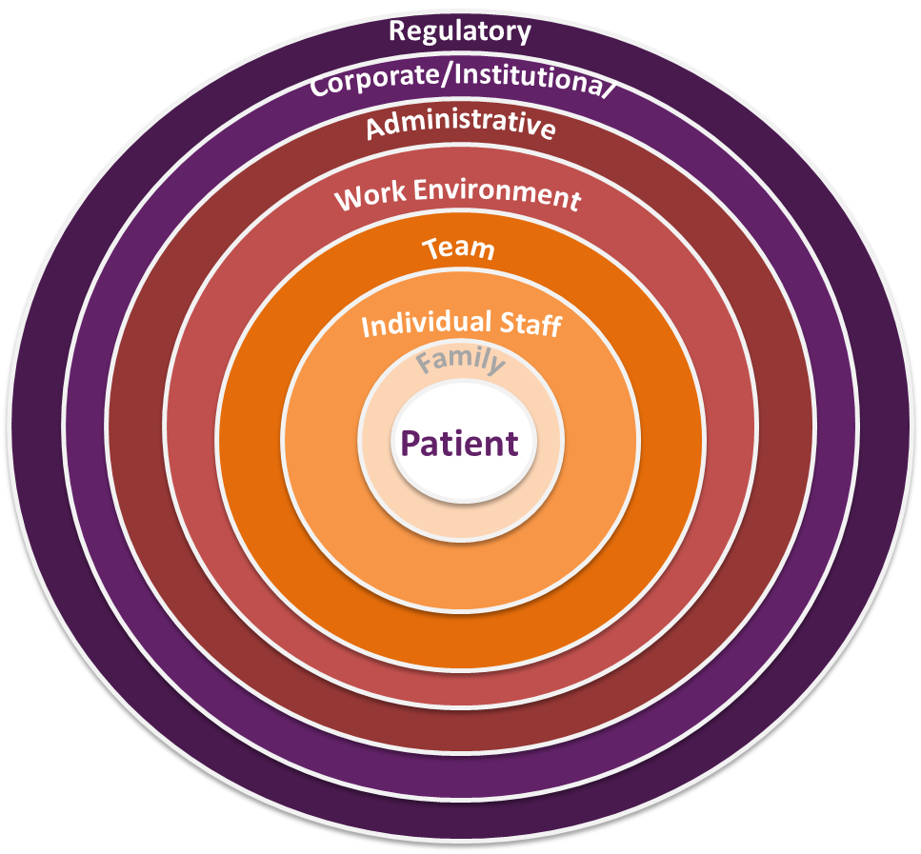
System-Level Factors Influence
Patient Care¹
As seen in CUSP®
Notes:
SAY:
Clinical changes are not enough to influence patient care. Sustainable, highly reliable change must occur at the unit or systems level to ensure that patients receive the best care possible.
At any given time, several system factors simultaneously influence facility culture and patient safety. As you view this diagram, remember that it is not just the interactions between a group and the patient but how communication and policies within a level impact members of that tier and the levels above and below it. These intra-level factors also impact patient care. For instance, a patient care team may interact directly with a patient, which impacts care, but the way the team members interact with one another and communicate concerns can indirectly affect care.
Let’s discuss a few levels in this diagram:
One factor is patient characteristics. Patient characteristics, such as medical history, acuity, primary language, and the ability to participate in the development of the care plan, can influence patient safety. In dialysis facilities, we see a large variation in patients and patient capacity, which can impact care. Additionally, with many patients, family or personal caregivers play important roles in day-to-day activities.
Another system factor is the individual staff. Providers should understand the relationship between their own knowledge, skills, and attitudes, and ways these factors may benefit or detract from the quality of care patients receive. Providers should be comfortable speaking up if they do not agree with task assignments and protocols or when they see patient safety risks. Evidence suggests a direct relationship between the willingness of staff to speak up and some patient outcomes.
Team factors are equally important. Team factors may involve issues with teamwork, communication, inadequate supervision, and training.
The work environment can be a major factor. Noisy, dirty, distracting, and poorly lit work environments can wreak havoc on the delivery of high-quality patient care and should be addressed when attempting to diagnose system-level influences on patient care.
Besides unit factors, there are administrative factors. When staffing issues, admission policies, and protocols prove to be insufficient for the needs of the patient and provider, they will affect the quality of care. Staffing and coverage shortages cause patients to suffer through missing the attention necessary to recover. Additionally, staffing and coverage issues can increase the likelihood of medication or health care procedure errors, downgrading the type of care patients receive. The facility type and budget limitations may affect a patient’s care plan. While these factors are the furthest removed from the patient, they continually alter care delivered during hospital recovery.
And last are regulatory factors. Regulations such as federal mandates affect how care is delivered. Once again, these factors are removed from the patient yet continually alter care delivered.

Slide 6

Importance of System-Level Factors
  Ignoring system-level factors will influence—
  Sustainability of change efforts
  Impact of change efforts
  Staff morale
  Patient care
Notes:
SAY:
System-level factors are important. Ignoring system-level factors will decrease the sustainability and impact of change efforts, staff morale, and patient care.
When assessing the sustainability of change efforts, it is important to take into consideration the likelihood the staff will adapt to change. Asking if the intervention will last is important to ensure that teams are able to determine the next steps for the project. When assessing the impact of change efforts, staff can assess the spread of the intervention and next steps to ensure project sustainability. When examining staff morale, special consideration should be taken to include assessments of feelings or interests related to the project.

Slide 7
Overview of CUSP
As seen in CUSP®
CUSP is a comprehensive, unit-based safety program
Comprehensive: takes into account all factors contributing to defects and harm
Unit-based: views harm prevention as a team-based effort, including the patient and his/her family as partners in care
Notes:
SAY:
The acronym CUSP stands for Comprehensive Unit-based Safety Program. The framework is comprehensive as it calls attention to all factors that contribute to defects and patient harm. The framework is unit-based because it respects the local wisdom of frontline providers and considers harm prevention a team-based effort.
The CUSP model was originally developed with funding from the Agency for Healthcare Research and Quality, or AHRQ, a national safety innovator. CUSP dovetails with and supports a range of quality and safety improvement models.

Slide 8
Overview of CUSP, Continued
As seen in CUSP®
Five-step program to change culture at a unit or facility level
First used in a hospital intensive care unit (ICU) setting, has been adapted for other settings
Successfully used in the Michigan Keystone Project, On the CUSP: Stop CLABSI to improve safety culture and reduce central line acquired bloodstream infection rates in ICUs
Works best when partnered with a technical component such as the clinical changes suggested in the clinical modules of this toolkit
Notes:
SAY:
CUSP consists of five components to change culture at a unit or facility level. CUSP aligns with and supports a wide range of safety tools and approaches. Improving culture within the health care setting requires the culture model to be based on the understanding that all culture is local and that work to reform culture must be owned at the unit level. The CUSP framework accomplishes this through stressing the fact that patient harm is not an acceptable cost of doing business. Additionally, CUSP is unique in that it can be applied by anyone, anywhere, in any unit, at any time.
Patient safety pioneers recognized early that communication and culture were key to creating safer, error-free systems. These pioneers borrowed from other high-reliability fields, like nuclear power and commercial aviation, which uses checklists and guided communication tools to reduce lapses in team functioning, errors, and the likelihood of harm.
An infection reduction project of the Michigan Health and Hospital Association Keystone Center for Patient Safety proved that CUSP was successful in improving the safety culture. In 2003, the Michigan Keystone Center launched an AHRQ-funded project to reduce central line-associated bloodstream infections in select Michigan intensive care units. The project was extremely successful, and the participating Michigan ICUs continue to sustain central line-associated bloodstream infections, or CLABSI, rates of zero percent, even today.
CUSP works best when partnered with technical components, such as the clinical changes suggested in the Clinical Care module of this toolkit.

Slide 9
Key Elements of CUSP
As seen in CUSP®
  Understand the Science of Safety
  Assemble the Team
  Engage Senior Leadership
  Implement Teamwork and Communication
  Learn From Defects
Notes:
SAY:
CUSP comprises the following key elements, each addressed within the framework:
Understanding the Science of Safety
Team Assembly
Leadership Engagement
Communication and Teamwork
Learning From Defects or Errors

Slide 10
The Science of Safety
As seen in CUSP®
Every system is perfectly designed to achieve the end results it produces
Safe design principles must be applied to technical/clinical work and teamwork
Teams make wise decisions when there is diverse and independent input
Notes:
SAY:
Every system is perfectly designed to achieve the end results it actually produces. This means that outcomes are always a result of the process being performed. If you want a different result, you must change the system. This is the same ideology behind the Quality Assurance and Performance Improvement (QAPI) process.
Safe design principles must be applied to technical work and teamwork. A culture of safety is useful for improving many facets of the workplace. For example, a culture of safety helps improve teamwork and communication, strengthening morale, which may result in less staff turnover and more staff innovations that stem from the increase in dialogue, mutual understanding, and respect. Science of safety can be used for any improvement project.
Teams make wise decisions when there is diverse and independent input. We encourage you to engage all of the facility staff in your quality improvement activities. Later on, you may use these same principles for additional projects.

Slide 11
Health Care Defects
As seen in CUSP®
In the U.S. health care system:
7 percent of hospital patients suffer a medication error ²
Rates in hemodialysis facilities are unknown, but one chain found a 12.5 percent error rate³
On average, every patient admitted to an intensive care unit suffers an adverse event^{3,4}
44,000 to 99,000 people die in hospitals each year from medical errors⁵
The total death rate due to infection is 76 per 1,000 patient-years in hemodialysis patients, with sepsis being responsible for three quarters of these infection-related deaths⁶
Notes:
SAY:
Because outcomes are a result of the imperfect systems they come from, there are defects in our systems. Defects, or errors in systems, lead to unwanted outcomes such as harms (harming a patient) or adverse events (anything unwanted, even if no harm is caused). Maintaining a culture of safety in your dialysis facility is effective in reducing adverse events.
DO:
Select a few facts about the U.S. health care system on this slide to read aloud.
SAY:
There are both preventable harms and unpreventable harms to patients. Our goal in quality improvement projects is to bring the number of preventable harms to zero.

Slide 12
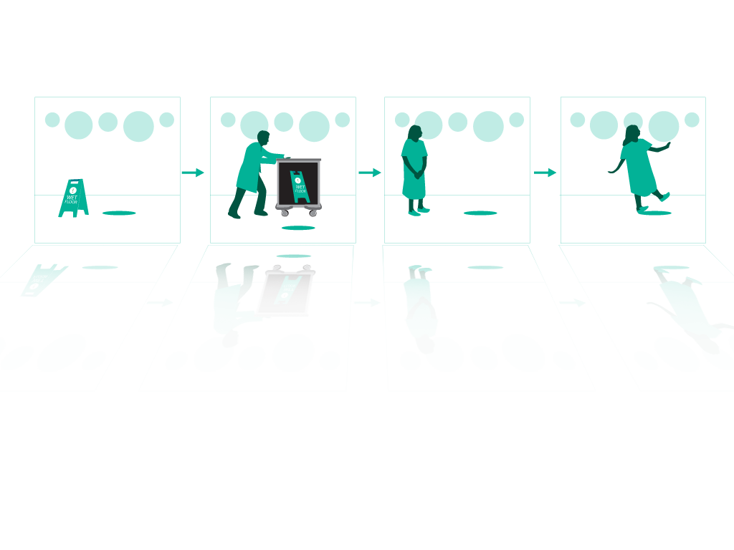
How Do Errors Happen?
As seen in CUSP®
People are fallible
Medicine is still treated as an art, not a science
Systems do not catch mistakes before they reach the patient
Defects in the system lead to errors
Notes:
SAY:
Providers, executives, and managers need to understand why errors occur. The first step in comprehending why they happen is accepting that people are not perfect. Even the most knowledgeable and experienced provider is influenced by the environment in which he or she works and can be responsible for mistakes that harm patients and their families. In understanding and acknowledging this fallibility, providers can redesign care and delivery processes to improve patient care.
Defects can lead to errors. Defects are defined in this module as any error or process that keep you from meeting your quality improvement goals. In analyzing how errors occur, frontline providers must recognize the scientific nature of medicine. By treating medicine and care delivery as a science instead of an art, providers can scrutinize their processes using evidence-based practices. As a result, providers must increase their ability to learn from mistakes and implement procedures to help prevent serious errors from occurring again.
Errors also occur because systems frequently do not catch mistakes before they reach the patient. Standardizing procedures, such as applying checklists and creating independent assessments for key processes, further aids in the development of high-quality patient care by allowing providers to mitigate risks before a harmful event takes place.

Slide 13
Principles of Safe Design
As seen in CUSP®
Standardize
Create independent checks
Learn from defects
Notes:
SAY:
The principles of safe design consist of the following: Standardize processes, create independent checks, and learn from defects. These principles guide teams in scrutinizing their environment and the processes to deliver safe patient care. It is important that teams evaluate their processes and learn from defects and, when possible, share what they learn with other similar care settings.
When learning from defects, teams identify:
What happened?
Why did it happen?
What will we do to reduce the recurrence?
How will we know it worked?
In determining what defect occurred, teams reconstruct the timeline of the event by placing themselves in the midst of the incident as it unfolded. Analyzing what happened and why it happened helps the team understand the contributing factors and processes. Through proposing, prioritizing, and implementing solutions, facility teams seek to minimize the chances the defect will reoccur.
Facilitywide assessment of the effectiveness of the interventions allows the team to ensure effective solutions are sustained, ineffective solutions are revised, and frontline staff members are aware their input is critical to continual quality improvement as embodied by the Learning From Defects exercise.

Slide 14

Standardize When You Can
As seen in CUSP®
Standardization alleviates duplication of labor and resources
Examples include—
  Checklists
  Standardized staff training
Notes:
SAY:
Standardization is one principle of safe design that alleviates duplication of labor and resources, improving efficiency and preventing errors in health care. Protocols and checklists reduce patient harm through improved standardization and communication. Checklists and protocols improve outcomes by reducing variation and controlling processes. Performing critical tasks the same way every time can reduce human fallibility in the fast-paced environments of dialysis centers and other health care facilities. Standardized staff training in which all staff receive the same instructions for day-do-day tasks and protocols reduces the variation in operations, creating guidance for staff that may otherwise attempt to do the same tasks in a variety of ways.

Slide 15
Create Independent Checks
As seen in CUSP®
Independent checks ensure high-quality patient care
Examples include—
  Protocols, or set of rules to explain a procedure
  Automated reminders in electronic records
  Use of checklists
Notes:
SAY:
Creating independent checks is another principle of safe design. QAPI teams are able to focus on patient care and have confidence that any accidental breach in protocol will be caught by a check or team alert when the break occurs. An example of an independent check that everyone is familiar with is the beeping noise a car makes when the driver does not buckle his or her seat belt, which is an automated reminder to buckle up. Similarly in facilities, machines beep and flash when there is a problem. Independent checks can be built into a process, such as an automated reminder in an electronic record or on a checklist.

Slide 16
Learn From Defects
As seen in CUSP®
Identification of defects or system errors
Multidisciplinary discussion of causes or contributing factors
Sharing of findings to mitigate future occurrence of error
Ask your team four questions:
  What happened?
  Why did it happen?
  What will we do to reduce the risk of recurrence?
  How will we know we reduced the recurrence risk?
Notes:
SAY:
Learning from defects is the principle of safe design that allows your team to examine what went wrong and to determine how to prevent it in the future. When learning from defects, teams identify:
What happened?
Why did it happen?
What will we do to reduce the risk of recurrence?
How will we know it worked?
By identifying the defect or error, the team can engage in a multidisciplinary discussion of causes or contributing factors leading up to the error, and share findings to mitigate the future occurrence of error.

Slide 17
Principles of Safe Design Apply to
Technical/Clinical Work and Teamwork
As seen in CUSP®
Standardize when you can
  To eliminate unnecessary or repetitive steps and simplify processes for complying with evidence or protocols
Create independent checks
  This ranges from increasing regulation to streamlining workflow processes. These independent checks can prevent unnecessary procedures and medication errors that result in patient harm.
Notes:
SAY:
The principles of safe design that were just reviewed apply to technical/clinical work and teamwork just as they do with other fields. Remember to standardize when you can by eliminating unnecessary steps and simplifying processes. An example of standardization is having hand-washing stations that are conveniently located with the needed supplies stocked.
Additionally, create independent checks to ensure processes are followed. Audits, along with checklists, are types of independent checks. These independent checks can prevent unnecessary procedures and medication errors that cause patient harm.

Slide 18
Teams Make Wise Decisions as a
Result of Diverse and Independent Input
As seen in CUSP®
Appreciate the wisdom of crowds
Emphasize that health care is a team effort
Develop an environment where frontline providers can voice concerns, and are acknowledged when they express concerns
Gather as many viewpoints as possible
Notes:
SAY:
Teams make wiser decisions as a result of diverse and independent input. Input from providers and colleagues may vary drastically when compared with input from patients and patients’ family members, yet they are equally important at understanding how decisions will affect the big picture and the culture of safety for everyone. Appreciate the wisdom from crowds and unique insight that another team member may have, even if it differs from yours. Other viewpoints are necessary to making sure that no aspect needed to make a decision gets missed. Developing an environment where frontline providers, and not just doctors, can voice concerns, is ideal to improving the culture of safety in your facility. Acknowledging team members for speaking up and expressing concerns reinforces a culture of teamwork and communication and helps prevent errors that may have been missed if the team remained silent. All team members need to be active participants to improve the culture of safety at your facility.

Slide 19
Keys to the Science of Safety
As seen in CUSP®
Every system is designed to achieve the results it produces
The principles of safe design are standardize when you can, create independent checks, and learn from defects
The principles of safe design apply to technical/clinical work and teamwork
Teams make wise decisions when there is diverse and independent input
Notes:
SAY:
To summarize key concepts of the Science of Safety, remember the following: every system is designed to achieve its observed results, so if you are not achieving the results you want, redesign your system. The principles of safe design are: standardize when you can, create independent checks, and learn from defects. The principles of safe design apply to technical/clinical work and teamwork, and teams make wise decisions when there is diverse and independent input.

Slide 20
Assembling the Team
As seen in CUSP®
Understand the importance of your improvement team
Develop a strategy to build a successful team
Identify characteristics of effective teams and barriers to team performance
Define roles and responsibilities of team members
Notes:
SAY:
Team assembly will play a critical role in the success of your intervention. These next few slides will cover the importance of the improvement team to the success of the intervention; development of a strategy to build a successful team; identification of effective team characteristics and barriers to performance; and definition of roles and responsibilities of team members.

Slide 21
Overview of the Unit- or Facility-Based Team
As seen in CUSP®
Understands that patient safety culture is local
Composed of engaged frontline providers who take ownership of patient safety
Includes staff members who have different levels of experience
Tailored to include members based on clinical intervention
Meets regularly (weekly or at least monthly)
Notes:
SAY:
To ensure the CUSP initiative is successful, the team should be actively involved, willing to spread the intervention, and committed to sustaining the gains across the facility. Remember that achieving the goals of the intervention rests with the CUSP team.
To encourage efficient implementation of the initiative, all team members should understand and apply the following concepts:
Culture is local.
The team is composed of engaged frontline providers who take ownership of patient safety.
The team includes members with different levels of experience.
The team is tailored to include members based on the clinical intervention.
The team meets regularly.
The team has access to resources necessary for the intervention.
The success of the CUSP initiative will depend on the team. The individuals that comprise the team are responsible for starting and sustaining the initiative, so their engagement and belief in the project will greatly contribute to positive results.
To embody the local culture of the facility, the CUSP team should also include frontline providers with varying backgrounds and clinical expertise. For example, when collaborating to solve medication dosage errors, members of the CUSP team may find it helpful to invite the pharmacist to join their team. The members of the team will apply their wisdom and background to engage other team members, develop educational materials, and execute the project. The collaboration between numerous disciplines and experience levels will help staff successfully carry out the CUSP initiative on the facility.

Slide 22
Team Members
As seen in CUSP®
Nurses
Dialysis technicians
Nurse managers
Physicians
Administrators
Facility leadership
Patients and their families
Cleaning staff
Support staff
Notes:
SAY:
Each team should include members playing some of the roles listed on the slide. Key team members include: nurses, dialysis technicians, nurse managers, facility leadership, and the patients and their families. While it is important that your team is multidisciplinary, all teams should include these individuals.
With regard to facility leadership, it can be determined by the nature of your facility. The facility leadership are those staff members with decision-making power for the whole facility. For some facilities, this may be the nurse manager, in others it may be the administrator or regional manager. Your team will need to determine which is most appropriate for your facility. Once you begin assembling the key players for your team, your team will be comprehensive enough to develop and carry out a plan to eliminate harm at your facility.

Slide 23
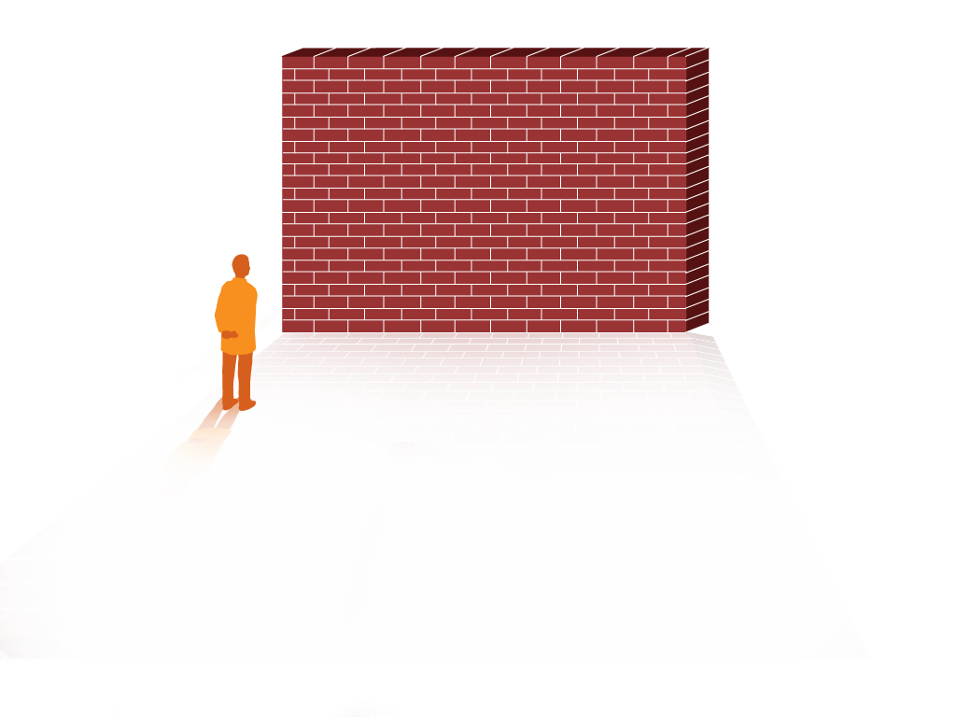
Teamwork Barriers
As seen in CUSP®
As seen in CUSP®
Inconsistency in team membership participation
Lack of time
Lack of information sharing
Hierarchy
Varying communication styles
Presence of conflict
Lack of coordination and followup
Misinterpretation of cues
Lack of role clarity
Notes:
SAY:
Barriers to teamwork include:
Inconsistent team membership participation
Lack of time and information sharing
Hierarchy
Varying communication styles
Conflict
Lack of coordination and followup
Misinterpretation of cues
Lack of role clarity
Inconsistency in team membership limits the strength and resiliency of the team. Teams that lack sufficient structure with a wide variety of input or that lack fully involved members will encounter difficulties with their performance. Teams that do not or are unable to devote the necessary time and energy to the initiative will also run into challenges with functionality. Time commitments should be shared equally among team members.
Hierarchy may impede team success by limiting opportunities for communication and interaction. If team members feel intimidated, the outcome of the initiative will be diminished.
Additional barriers to successful teamwork are conflict, lack of coordination, misinterpretation of cues, and lack of role clarity. While disputes are common in groups with diverse opinions, it is important to remember that conflict resolution and team interaction will help strengthen the initiative. Maintaining clear roles and task coordination will alleviate task or labor duplication, further promoting the success of the initiative.
ASK:
Can you provide examples of how some of these barriers might influence teamwork in your facility?

Slide 24

Engaging Champions for Your Team
As seen in CUSP®
Champions support your efforts and will help spread your project to others
Once recruited, champions will help secure buy-in or operational support for your efforts
Champions help mitigate teamwork barriers
Notes:
SAY:
An important component of your team will be to engage champions from each discipline. In their role on the team, champions will help:
Support your efforts and spread your project to others
Secure buy-in and operational support for your project
Mitigate teamwork barriers that hinder performance and project success
Champions are leaders for your project. They will work closely to engage others in your work and will help ensure that project efforts are successful to the overall vision and goal.

Slide 25
Engage Team Members Using the 4 Es⁷
As seen in CUSP®
Engage (adaptive)
How does this make the world a better place?
Senior leaders
Educate
(technical)
What do we need to know?
Execute (adaptive)
What do we need to do? What can we do with our resources and culture?
Team leaders
Evaluate (technical)
How do we know we improved safety?
Staff
Notes:
SAY:
The 4 Es engagement model will assist in identifying and recruiting team members. The 4 Es help teams implement patient safety interventions by focusing change efforts around technical and adaptive work. The model features four elements for starting and sustaining initiatives: engage, educate, execute, and evaluate. These four elements depict the primary means for engaging team members to ensure patient safety initiatives are carried out in a way that encourages sustainability.
Engage
Engagement primarily embodies adaptive work, in which teams help staff understand the results of preventable harm caused by a clinical problem. This is done by sharing stories about patients affected by a problem and by estimating the number of patients harmed. Emphasizing team members’ involvement in improving the facility lends not only to the success of the initiative but also to the sustainability of the effort.
Educate
Education uses predominantly technical work and requires teams to guarantee that staff and senior leaders understand what is necessary to prevent a given clinical problem.
Execute
Execution of a sustainable intervention requires adaptive work. Team members will apply a plan of action based on the facility’s resources and culture and analyze their roles within the plan.
Evaluate
Evaluation is technical work and requires that the team collect and submit data to analyze the success of an initiative. In addition to data submission, this work requires team members to ask themselves, “How do we know we improved safety?”
ASK:
Think of a time when you needed to share an idea with a colleague. Re-create the encounter but use the 4 Es to convince him or her of the value of your idea and answer these questions:
How does this make the facility a better place?
What do we need to know?
What do we need to do?

Slide 26
Engagement Stages
As seen in CUSP®
Engagement: “To involve oneself or become occupied; to participate fully and deeply”
Active support of the project
Engaged
Apathy
Aversion
Uninvolved
Notes:
SAY:
One definition of engagement is “to involve oneself or become occupied; to participate fully and deeply.” Full engagement in this initiative will require teams to actively support the project and its goals.
As exemplified by the upward sweeping arrow, the stages of engagement while assembling a team to participate in this project may include feeling uninvolved, aversion, apathy, and fully engaged. When teams are fully engaged in the program, their performance improves, and the overall likelihood of the initiative’s success increases.
ASK:
How can you involve facility staff members in the initiative? How will you maintain their interest in and support of the project?

Slide 27
Project Leader’s Role
As seen in CUSP®
Encourages facility staff involvement
Obtains staff feedback
Manages documentation of improvement activities
Educates staff about project
Notes:
SAY:
Now we will explore each team members’ role. We will start with the project team leader. This individual will:
Be a frontline provider—a staff nurse, nurse manager, nurse educator, or physician;
Encourage staff involvement in the initiative;
Obtain staff feedback;
Manage documentation of project activities; and
Educate staff about safety culture and quality improvement.
The project team leader serves as the team’s primary contact within the project. This individual will organize and lead the team, articulate clear goals, make decisions using the collective input of team members, promote and facilitate good teamwork, and promptly disseminate information to the team members.
As a provider, the project leader should be familiar with the facility’s staff’s interests and needs. The project leader’s perspective on the initiative and its outcomes will endorse the sustainability of the project and provide other team members, such as senior leadership, with the opinions and needs of fellow providers. The project leader is responsible not only for recruiting facility staff to participate in the initiative, but also for maintaining facility staff interest and involvement after the initial excitement about the initiative has faded. The project leader will need to be aware of and attuned to the facility staff’s interests and needs. The project leader also will be accountable for obtaining and analyzing facility staff feedback related to the program.
Essentially, the project leader will be the public face of the initiative and will serve as another point of contact between the staff and the team.
ASK:
Can you identify a potential project leader at your facility who fits these characteristics?

Slide 28
Senior Leader’s Role
As seen in CUSP®
Helps the team prioritize improvement efforts
Helps the team navigate organizational bureaucracy
Ensures the improvement team has resources to fix problems
Makes rounds and meets monthly with members of health care team in the facility
Notes:
SAY:
The senior leader:
Helps the team prioritize improvement efforts,
Helps the team navigate organizational bureaucracy,
Ensures the team has resources to fix problems, and
Makes rounds and meets monthly with members of the health care team on the facility.
The senior leader partners with the team and takes an active role in the initiative. Senior leadership members should possess the authority to mobilize the resources needed to help the team resolve its patient safety issues.

Slide 29
Nurse Manager’s Role
As seen in CUSP®
Supports improvement activities
Ensures safety assessment results are shared with staff
Assigns project leaders to interventions
Assists with scheduling senior partnership
Manages local resources
Notes:
SAY:
The nurse manager partners with the team and takes an active role in the initiative. The nurse manager on the team:
Supports team activities,
Ensures staff safety assessment results are shared with staff,
Assigns project leaders to interventions,
Assists with senior leader partnership, and
Manages local resources.
The nurse manager supports project activities by communicating the team’s needs to the facility nurses. The nurse manager is likely the nurse opinion leader; accordingly, he or she already serves as the key contact for the nurses and helps empower them throughout the initiative. The nurse manager makes sure the staff safety assessment results are shared with staff and the team findings are shared at meetings.
Nurse managers also oversee the distribution and maintenance of local resources. These resources may include staff time, supplies, or education and training, all of which greatly influence the outcome of the initiative.

Slide 30
Characteristics of a Strong Team
As seen in CUSP®
Role Clarity
Norms
Effective Team
Communication
Effective Group Processes
Leadership
Buy-in and Support
Conflict Resolution
Education
and Engagement
Notes:
SAY:
The effective group processes of successful teams include:
Role clarity,
Effective team communication,
Conflict resolution,
Education and engagement,
Senior leadership buy-in, and support, and
Norms
Successful teams have reliable processes in place for team members to work and communicate efficiently. Effective group processes provide opportunities for teams to hone their skills in the areas of leadership, role clarity, and development of shared interests, as well as collaboration and feedback.
Effective group work requires that all members share responsibility for group decisions and group interaction while working together on the initiative.
Effective group work requires that all members share responsibility for group decisions and group interaction while working together on the initiative.

Slide 31
Team Performance
Inputs
Environment
Dialysis facility and context
Team composition
Task design
Outputs
Change in:
Performance
Attitudes
Behaviors
Processes
Inside team
Outside team
Team traits
Notes:
SAY:
Team performance will determine the effectiveness of the initiative. Bearing this in mind, the inputs, processes, and outputs the team encounters are interconnected and influential in team development.
The team’s performance will be influenced by the:
Environment,
Facilities and context,
Team composition, and
Task design.
Environmental factors affect the implementation and sustainability of the initiative.
Seeking team members from varying clinical backgrounds and with different levels and types of experience will help tailor the initiative to the needs of the facility. Devoting attention to task design will contribute to the success of the initiative.
As well as the inputs, processes alter the outcome of any initiative. These processes may require interactions that take place inside the team (internal) or outside the team (external) or involve team traits.
Internal team processes focus on the resources the team developed to organize and manage the workload at the organizational level. The qualities of the team and leadership will determine the results of the intervention within the facility, whether the intervention is successful or must be delayed, and the general direction of the initiative. Depending on the inputs and processes of the team, the team’s outputs effect a change in staff performance, attitudes, and behaviors.
Bearing in mind that team inputs, processes, and outcomes are interconnected, teams will be able to modify their initiative to fit the needs of their facility. In doing so, they are ensuring the sustainability of the initiative and developing processes that will help support its goal.

Slide 32
Keys to a Successful Team
As seen in CUSP®
The improvement team will include health care providers, support staff, and leadership staff
The “4 Es” is a highly effective tool for recruiting team members
Team members work together to identify barriers and address them as a group
For teams to be successful, the roles and responsibilities of team members need to be clearly defined
Notes:
SAY:
In summary, successful teams:
1. Include health care providers, support and leadership staff
2. Use the 4Es to recruit team members
3. Collectively identify barriers and collaborate to address them
4. Have clearly defined roles and responsibilities

Slide 33
Engaging Senior Leadership
As seen in CUSP®
Engaging leadership at your facility will ensure that—
  Your efforts have leadership buy-in
  The organization supports the team's work
  Your team will have adequate resources to complete necessary tasks
Notes:
SAY:
Facility leadership is crucial to intervention success. Without senior leadership support, it is difficult to create and sustain change in your facility. Engaging leadership at your facility will ensure that:
Your efforts have leadership buy-in. Buy-in from top staff has the direct effect of trickling down into facility culture and can impact overall policy and process changes to improve safety culture in your facility.
The organization supports your work. It can be very challenging to make any change without the support of the organization.
Your team will have adequate resources to complete necessary tasks. With the right support, leadership can allocate resources to get the job done. Resources may be in the form of providing extra staff to assist in quality improvement work or extra money in the budget to spend on staff training.

Slide 34
Characteristics of a Senior Leader
As seen in CUSP®
Has facilitywide decision-making authority
Actively engaged in progress of project
Interested in clinical care but not required to be a clinician
Willing to learn from, listen to, and work with staff to improve patient safety on the facility
Notes:
SAY:
For many of you, it will be easy to identify who your senior leader is. This may be the leader who is responsible for your other QAPI projects. However, the following guidelines are used to determine a potential leader when one isn’t identified.
For the team and the project to function at optimal effectiveness, the senior leader should be:
Someone with decision-making power;
Actively engaged;
Interested in clinical care; and,
Willing to listen, learn, and work with staff to improve patient safety and the quality of health care delivery in the unit.
The senior leader is unique among the senior team members and works with the team to improve quality of care. Senior team members need to be in a high enough position to authorize the use of required resources to help facility-based teams resolve their patient safety issues. Senior leaders should be familiar and comfortable with the goals of the project. Senior team members who have a vested interest in the quality of care make great team members.

Slide 35
Responsibilities of a Senior Leader
As seen in CUSP®
Emphasizes effective communication
  Encourages transparent communication
  Establishes clear goals for unit safety
  Outlines clear project goals and expectations for leaders and staff on teams
Meets regularly with the National Opportunity to Improve Care in ESRD (NOTICE) team
Supports the technical and adaptive work of change
Collaborates to develop and implement a plan addressing safety issues
Holds staff accountable for reducing patient harm
Notes:
SAY:
The senior team member will be responsible for:
Participating in efforts to improve communication,
Meeting with the team monthly,
Understanding and supporting the technical and adaptive work of change,
Collaborating with others to develop and put into effect a plan that addresses the safety issues the facility staff and other sources identify, and
Holding all staff accountable for carrying out agreed-upon activities designed to reduce patient harms.
ASK:
Are there senior leaders in your facility who you believe would take on these responsibilities?

Slide 36
Responsibilities of a Senior Leader
As seen in CUSP®
Considers patient risks and involves frontline personnel in creating approaches to mitigate those risks
Reviews project data with team and works with direct care providers to establish an improvement plan
Holds staff accountable for reducing infection risks
  Expects resistance and is prepared to address it
  Holds all team members, including senior leaders, accountable for implementing the plan
Notes:
SAY:
In addition, senior leaders are responsible for considering patient risks and involving frontline providers in creating new ways to mitigate those risks, reviewing data with the team and working to establish an improvement plan, and holding staff accountable for risks. When holding staff accountable for reducing infection risks, the senior leader expects resistance and is prepared to address it, and therefore holds all team members, including senior leaders, accountable for implementing the plan.

Slide 37
How To Engage the Senior Leader
As seen in CUSP®
Acknowledge the senior leader’s perspective (“What’s in it for me?”)
Increase the visibility of your senior leader on your unit
Ensure a senior leader is assigned to each NOTICE team and participates regularly in meetings
Work closely with your senior leader to address identified safety issues on your unit
Notes:
SAY:
Leadership and frontline providers serve different roles within the facility. As a result, their interests in the program and the skills they will contribute to the initiative will vary greatly.
To begin, present senior leadership with the benefits of participation in the project. Remember to appeal to the senior leader’s interest in maintaining patient safety, as well as the facility’s financial gains that will result from participating in the initiative. Display statistics that show how the initiative may reduce both patient harm and the aggregate costs of treating harms for the facility.
Next, increase the visibility of the leader. By simply posting a photo and the name of your team’s leader on a bulletin board, you are creating a tool for all staff members to readily identify their senior leadership team member.

Slide 38
Strengthening Teamwork and Communication⁷
As seen in CUSP®
Effective teamwork and communication strategies contribute to—
Reduced length of stay
Lower staff turnover
Higher quality of care
Greater ability to meet family member needs
Better patient outcomes
Improved patient experience with improved patient satisfaction scores
Notes:
SAY:
By taking the time to engage in effective communication, team members can contribute to the safety of their facility for their colleagues and patients. Effective teamwork has a positive effect on improving the quality of care for patients and their family members, better patient outcomes, a greater ability to meet family member needs, and improved patient satisfaction scores. Facility teams also benefit by having strong teamwork and communication, which improves staff satisfaction by empowering staff in their roles.

Slide 39
Factors Hindering Communication
As seen in CUSP®
Interruptions
Task absorption
Verbal abuse
Fatigue
Not following plan of care
Ambiguous orders or directions
Change in team members
Workload
Notes:
SAY:
Several elements can affect communication and information exchange.
Interruptions limit the ability of team members to discuss and comprehend necessary information. Staff communication which excludes other team members reduces task focus and absorption. Verbal abuse creates a hostile environment in which team members do not feel comfortable sharing ideas or collaborating to solve an issue.
Fatigue decreases the level of attention and energy that team members can devote to the project. Ambiguous orders or instructions cloud expectations and plans. Changes in team memberships strain existing work relationships between established team members and the newest additions to the team. Heavy workloads hinder clear communication by reducing opportunities for interaction.

Slide 40
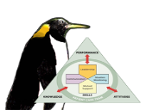
Components of Effective
Communication⁸
As seen in TeamSTEPPS®
Complete
Clear
Brief
Timely
Notes:
SAY:
TeamSTEPPS - review
Not all communication is effective communication. Many times, delivered messages will not have the intended effect upon a receiver after interpretation. A message can be misconstrued and incorrectly understood in many ways, which wastes time and resources and threatens patient safety in the clinical environment.
Effective communication consists of the following components:
The communication must be complete.
Communicate all relevant information.
The communication must be clear.
Convey information that is plainly understood.
The communication must be brief.
Communicate the information in a concise manner.
The communication must be timely.
Offer and request information in an appropriate timeframe.

Slide 41
Barriers to Effective Teamwork⁸
As seen in CUSP®
Working Conditions
  Lack of coordination or followup
  Distractions
  Misinterpretation of cues
  Hierarchy
  Physical proximity
  Shift changes
Team Composition
  Inconsistency in team membership
  Lack of role clarity
  Defensiveness
  Conventional thinking
  Conflict
  Fatigue
  Complacency
  Varying communication styles
  Personalities
Resources
  Lack of time
  Workload
  Processes
  Technology
Notes:
SAY:
As mentioned previously, several barriers may exist in a dialysis facility that can prevent effective teamwork.
Working conditions, such as poor communication during shift changes, misinterpretation of cues, and lack of coordination or followup, can undermine the culture of safety at your facility. A lack of necessary resources, including technology or standardized processes, can also prevent effective teamwork by preventing your team from communicating effectively. Problems in team composition, such as staff fatigue, different communication styles, and lack of role clarity, may also play a role. Identifying key barriers to effective teamwork on your team is the first step to determining ways to improve.
ASK:
What barriers to communicating effectively does your team face?

Slide 42
Task Assistance
As seen in CUSP®
As seen in CUSP®
Team members protect each other from work overload situations
Effective teams place all offers and requests for assistance in the context of patient safety
Team members foster a climate where it is expected that assistance will be actively sought and offered
Notes:
SAY:
An efficient teamwork and communication environment consists of an understanding and willing team attuned to the needs of its patients and fellow team members. Effective teams identify barriers, differences in personality styles, and areas where communication may fall through the gaps, while making sure to:
Protect each other from work overload situations by assisting in tasks;
Place all offers and requests for assistance in the context of patient safety; and
Foster a climate where it is expected that assistance will be actively sought and offered.
A member of an effective team feels comfortable asking for help, as well as offering help to their peers.

Slide 43
Feedback
As seen in CUSP®
  Timely—give soon after the target behavior has occurred
  Respectful—focus on behaviors, not personal attributes
  Specific—be specific about what behaviors need correcting
  Directed toward improvement—provide directions for future improvement
  Considerate—consider a team member’s feelings and deliver negative information with fairness and respect
Notes:
SAY:
Feedback, as a form of mutual support, is information provided for the purpose of improving team performance. To be effective and to promote a supportive climate, feedback must be:
Timely, and given soon after the target behavior has occurred in order for the information presented to have the most effect;
Respectful, focusing on the behaviors, not personal attributes;
Specific to the behavior that needs correcting and not overall behavioral patterns, et cetera;
Directed toward improvement by providing directions for future improvement; and
Considerate of the team members’ feelings by delivering negative information with fairness and respect.

Slide 44
Teamwork and
Communication Summary
As seen in CUSP®
Effective communication plays an integral role in the delivery of high-quality, patient-centered care
Barriers to efficient teamwork and communication influence the outcomes of the team
Research supports the connection between communication errors and patient care delivery
Easy-to-use tools and strategies can be implemented to improve the effectiveness of teamwork and communication in dialysis facilities
Notes:
SAY:
In summary, effective communication plays an integral role in the delivery of high-quality, patient-centered care. Barriers to efficient teamwork and communication are abundant and can have a negative influence on the outcomes of the team. Research supports the connection between communication errors and patient care delivery. Easy-to-use tools and strategies can be implemented to improve the effectiveness of teamwork and communication in dialysis facilities.

Slide 45
What is a Defect?
As seen in CUSP®
A defect is any system error or process that inhibits meeting your quality improvement goals
In this case, it is anything in your facility that increases patient risk for vascular access infections, such as inappropriate hand hygiene or unwillingness of staff members to assist others
Notes:
SAY:
As you learned in the Culture of Safety module, every system is perfectly designed to achieve its end results. This means that outcomes are always a result of the process being performed. Within processes, there are always areas for improvement and barriers to attaining the outcomes you desire.
A defect is any error or process that stands in the way of meeting your quality improvement goals. An example of a defect is anything in your facility that increases patient risk for VAIs, such as inappropriate hand hygiene or unwillingness of staff members to assist others.

Slide 46
Examples of Defects in Dialysis Facilities
Defect | Intervention
Patient Care Technician (PCT) is unable to find cannulation site with gloves on. PCT removes gloves and palpates the site and then proceeds to insert the needle without hand hygiene or re-gloving. | Staff should be instructed to never remove gloves when cannulating the access. If the staff member is unable to identify a site for cannulation, request assistance from an expert cannulator.
Facility routinely uses catheters due to staff preference. | Train staff on benefits of fistula usage and proper fistula cannulation techniques.
Alcohol-based hand rub (AHBR) is not being used after glove removal. | Place AHBR dispensers near trashcans and gloves to make it readily available.
Notes:
SAY:
The table in this slide lists examples of defects in dialysis centers and ways to intervene to improve upon the defect.
DO:
Read the following defect examples individually or as a team and brainstorm how you would intervene to improve patient safety around that harm.
ASK:
What defects exist in my dialysis facility?

Slide 47
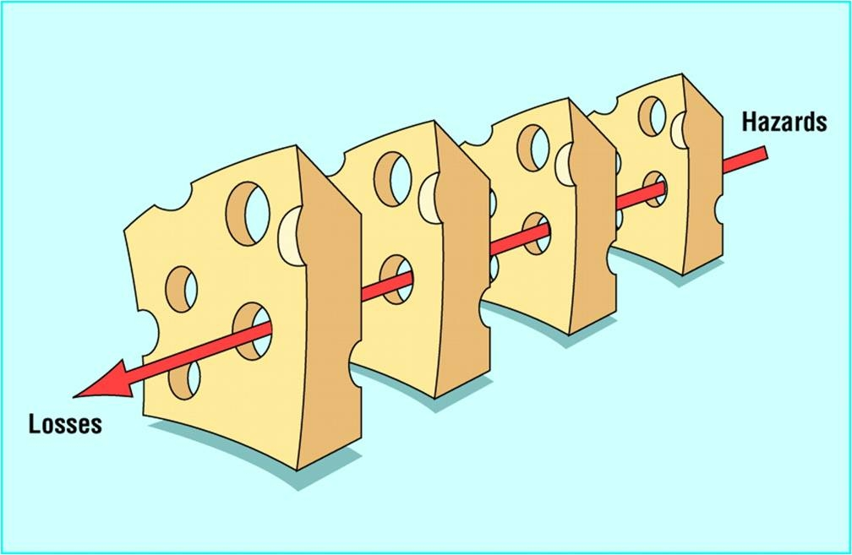
How Defects Impact Patient Harm⁹
As seen in CUSP®
Excerpted from the “Swiss Cheese” Model – James Reason, 1990. Reason J. Human Error. Cambridge: University Press; 1990.
Notes:
SAY:
When combating defects, the facility staff must understand where and how breakdowns in safety occur. The Swiss cheese model portrays how defects permeate the facility-level systems and contribute to patient harm. The cheese itself represents the facility-level systems, and the holes that are synonymous with Swiss cheese symbolize the opportunities for defects to permeate established systems and cause patient harm. As exemplified on the previous slide, defects can be found everywhere. Bearing this in mind, facility staff members are responsible for being aware of their patients and the environment to prevent defects from permeating their systems and contributing to patient harm.
DO:
Using one of the defects listed on the previous slide, work through how a defect could occur using the Swiss cheese model.

Slide 48
Tools To Identify and Learn
From Defects
As seen in CUSP®
Learning from Defects Form
Staff Safety Assessment
Safety Issues Worksheet for Senior Executive Partnership
Root Cause Analysis
Other Tools Used in Your Facility
Do you have tools you already use in your facility?
Notes:
SAY:
Several tools can help your facility team identify and learn from defects. These include:
1. Learning From Defects Form
2. Staff Safety Assessment
3. Safety Issues Worksheet for Senior Executive Partnership
4. Root Cause Analysis
5. Other Tools Used in Your Facility
ASK:
What tools, if any, do you already use in your facility to identify and learn from defects?

Slide 49
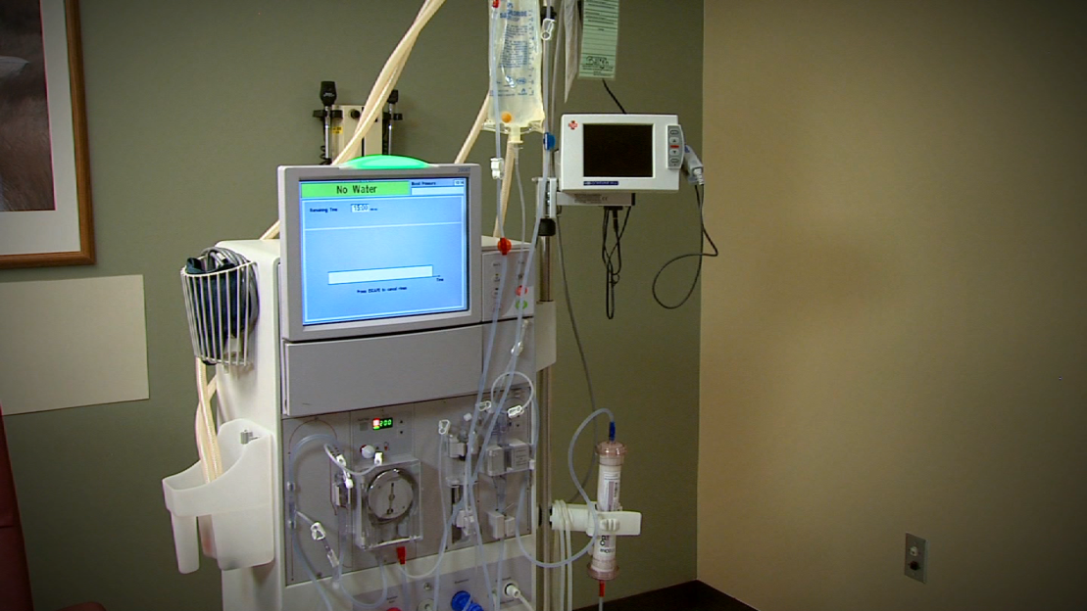
Undermining a Culture of Safety — Video
As seen in CUSP®
Notes:
SAY:
This short video shows many ways to undermine a culture of safety in a dialysis center. Think about the defects you see in this video while reviewing content in the next few slides.
DO:
Play the video.

Slide 50
Learn From Defects: 4 Questions
As seen in CUSP®
1. What happened?
2. Why did it happen?
3. What will you do to reduce the risk of recurrence?
4. How will you know the risk is reduced?
Notes:
SAY:
When learning from defects, use the following questions to guide the assessment and understanding of the event.
What happened?
Step 1. Reconstruct the timeline to understand what happened.
Step 2. Put yourself in the place of those involved and in the middle of the event as it was unfolding.
Step 3. Try to understand the thinking and reasoning behind their actions and decisions.
Step 4. Try to view the world as they did when the event occurred.
Why did it happen?
Step 1. Visualize the factors that led to the event.
Step 2. Identify the contributing factors.
Step 3. Prioritize the contributing factors.
What will you do to reduce the risk of recurrence?
Step 1. Develop interventions for two to five of the most important factors.
Step 2. Rate the interventions on level of importance to your facility.
Step 3. Select the highest rated interventions.
Step 4. Develop an action plan for implementation.
How will you know the risk is reduced?
Question 1. Did you create a policy or procedure (rate strong or weak)?
Question 2. Do staff members know about the policy or procedure?
Question 3. Are staff members using the procedure as intended?
Question 4. Do staff members believe risks were reduced?
DO:
Identify one defect in the video. Use the four questions to walk through a discussion of that defect.

Slide 51
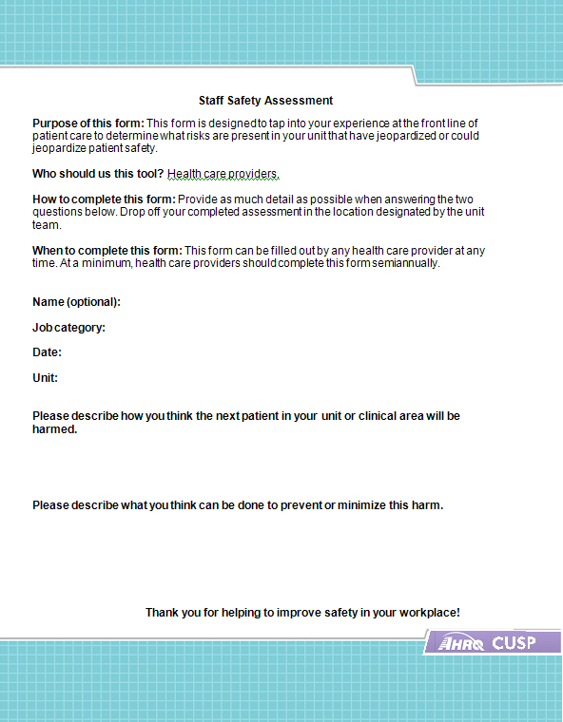
Staff Safety Assessment
Step 1. What are clinical or operational problems that have or could have jeopardized patient safety?
Step 2. How might the next patient be harmed in our unit?
Step 3. What can be done to minimize harm or prevent safety hazards?
Notes:
SAY:
The Staff Safety Assessment helps teams ask three simple questions about patient safety and is designed for all health care providers. Staff should provide as much detail as possible when completing the assessment, especially the second question. The objective of this form is to access the knowledge at the frontlines of patient care to determine risks that have jeopardized or could jeopardize patient safety. Frontline staff members are the eyes and ears of patient safety. Data they provide can be used to prepare a list of improvement opportunities that has face validity and creates a focus for Safety Culture activities.
Team members can use the Staff Safety Assessment results to:
Report defects to staff and the senior executive,
Prioritize defects by the potential level of risk to one or more patients,
Select one defect to address with the support of the senior executive,
Develop a plan for addressing the selected defect, and
Ensure identification of defects is an ongoing process.
DO:
Ask the three questions on the slide.

Slide 52
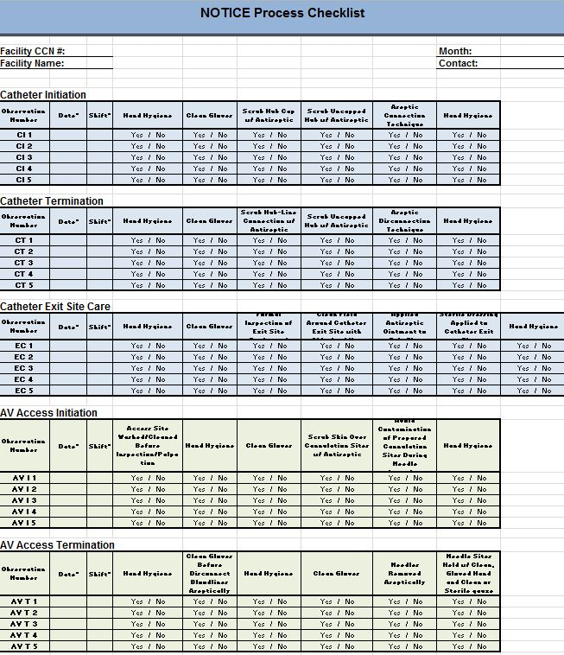
Audit Tool Results
Step 1. What are clinical problems that have or could have jeopardized patient safety?
Step 2. How might the next patient be harmed in our unit?
Step 3. What can be done to minimize harm or prevent safety hazards?
Notes:
SAY:
An audit tool serves as an observation tool for staff to document the implementation of proper clinical processes that have a direct effect on patient safety. The NOTICE audit tool includes observation of catheter insertion, catheter termination, catheter exit site care, arteriovenous (AV) access initiation and AV access termination. The objective of this form is to access the knowledge at the frontlines of patient care to determine which risks are present that have jeopardized or could jeopardize patient safety. Frontline staff members are the eyes and ears of patient safety. Data they provide can be used to prepare a list of improvement opportunities that has face validity and creates a focus for safety culture activities. The audit tool can be modified depending on your facility and common focal processes that have the ability to impact patient safety.
Team members can use audit tool results to:
Report defects to staff and the senior leader,
Prioritize defects by the potential level of risk to one or more patients,
Select one defect to address with the support of the senior leader,
Develop a plan for the selected defect, and
Ensure identification of defects is an ongoing process.
DO:
Ask the three questions on the slide. Share copies of the NOTICE audit tool for staff to review.

Slide 53
Sharing and Communicating:
Learnings and Solutions
Team meetings — monthly
Meeting to review data — monthly
Meeting with senior leaders — monthly or more often
Senior leader review of data — monthly
Presentations to colleagues as needed, including leadership, frontline staff, and business groups
Notes:
SAY:
After working through the learning from defects processes, teams will be able to summarize and share their findings with their colleagues and senior management. This should be done on a routine basis to keep leadership and staff abreast of current defects in processes and progress in improvements. Sharing information with colleagues and senior leaders helps promote a culture of safety by being honest about areas of improvement and allowing the team to learn from examples of defects – not only from an internal team, but from other teams within the facility or organization.

Slide 54
Learn From Defects Summary
Defects or failures are clinical or operational events that you do not want to happen again
Tools help teams identify defects and identify ways to keep them from occurring in the future
Learning From Defects is an ongoing process
Notes:
SAY:
In summary, defects are defined here as any error or process that keeps you from meeting your quality improvement goal. The tools listed in this module can help teams identify defects and ways to keep them from reoccurring. Learning from defects is an ongoing process, and sharing examples helps colleagues and senior leaders share in the learning process of improving the culture of safety within your facility.

Slide 55
Next Steps
Create your team with attention to who is on the team
Develop your plan for implementing the 4 Es with your team members
Determine who your senior leader should be
Identify how the leader will work with staff to bring about sustainable change
Develop a plan so all staff in your facility understand the three principles of safe design
Identify opportunities to improve teamwork and communication by reviewing barriers the team identified while learning from a safety defect
Select a tool that best addresses providers’ concerns
Notes:
SAY:
Begin your journey creating a positive culture of safety in your facility with these next steps:
Create your team with attention to who is on the team
Develop your plan for implementing the 4 Es with your team members
Determine who your senior leader should be
Identify how the leader will work with staff to bring about sustainable change
Develop a plan so that all staff in your facility understand the three principles of safe design
Identify opportunities to improve teamwork and communication by reviewing barriers the team identified while learning from a safety defect
Select a tool that best addresses providers’ concerns

Slide 56
Additional Resources and Tools
Tools discussed in this module are available on the AHRQ Web site.
These additional resources may be helpful for your teams as you implement quality improvement in your facilities:
  CUSP Toolkit
  TeamSTEPPS
  5 Diamonds
  Quality Assurance and Performance Improvement (QAPI)
This module modified existing CUSP Toolkit materials for the hemodialysis setting. The CUSP and TeamSTEPPS models were not specifically designed for hemodialysis settings and they will need to be modified to accommodate your clinical environment.
Notes:
SAY:
Tools discussed in this module are available on the AHRQ Web site.
These additional resources may be helpful for your teams as you implement quality improvement in your facilities:
CUSP Toolkit
TeamSTEPPS
5 Diamonds
QAPI
This module modified existing CUSP Toolkit materials for the hemodialysis setting. The CUSP and TeamSTEPPS models were not specifically designed for hemodialysis settings and they will need to be modified to accommodate your clinical environment.

Slide 57
References
Figure adapted from Vincent C, Taylor-Adams S, Stanhope N. Framework for analyzing risk and safety in clinical medicine. BMJ. 1998;316:154–7.
Bates DW, Cullen DJ, Laird N, et al. Incidence of adverse drug events and potential adverse drug events. JAMA. 1995;274(1):29-34. PMID: 7791255.
Capelli JP, Jacoby M, Taraschi K. Enhancing dialysis services, revenue, quality, and efficiency through computerization. The impact of medication error reduction. Nephrology News & Issues. 2002 December;16(13): 34-36, 38-41. PMID: 12596329.
Donchin Y, Gopher D, Olin M, et al. A look into the nature and causes of human errors in the intensive care unit. Crit Care Med. 1995;23:294-300. PMID: 12679512.

Slide 58
References
Andrews LB, Stocking C, Krizek T, et al. An alternative strategy for studying adverse events in medical care. Lancet. 1997 Feb 1;349(9048):309-313. PMID: 9024373.
National Institutes of Health, National Institute of Diabetes and Digestive and Kidney Diseases. US Renal Data System, USRDS 2009 Annual Data Report: Atlas of Chronic Kidney Disease and End-Stage Renal Disease in the United States, 2009.
Shortell SM, Marstellar JA, Lin M, et al. The role of perceived team effectiveness in improving chronic illness care. Med Care. 2004 Nov; 42:1040–1048.PMID: 15586830.
Agency for Healthcare Research and Quality, U.S. Department of Defense. TeamSTEPPS 2.0: Core Curriculum. Agency for Healthcare Research and Quality; March 2014. www.ahrq.gov/teamsteppstools/instructor/index.html. Accessed September 3, 2014.
Pronovost PJ, Wu AW, Sexton JB. Acute Decompensation after Removing a Central Line: Practical Approaches to Increasing Safety in the Intensive Care Unit. Annals of Internal Medicine. 2004 June;140(12): 1025-1033. PMID: 15197020.

