Slide 1
Patient Engagement in Hemodialysis Facilities

Slide 2
Objectives
Understand what patient and family engagement is in the context of end-stage renal disease (ESRD)
Learn how to recognize and overcome obstacles to engaging patients and their families
Equip your facility to engage patients in each of the six CHARGE! components
Determine the next steps you’ll take to better engage patients and their families in your infection reduction efforts
Notes:
SAY:
From reviewing this module, you will:
understand what patient and family engagement is in the context of end-stage renal disease;
learn how to recognize and overcome obstacles to engaging patients and their families;
equip your facility to engage patients in each of the six CHARGE! components; and
determine the next steps you’ll take to better engage patients and their families in your infection reduction efforts.

Slide 3
Overview
Defining Patient Engagement
Importance of Patient Engagement
Barriers to Engaging Patients and Their Families
Effectively Engaging Patients and Their Families
Next Steps
Notes:
SAY:
This presentation is meant to give you a comprehensive overview on how to engage patients and their families in hemodialysis facilities. It begins with a definition of patient engagement and its importance. You will learn common barriers to engaging patients and their families in care as well as strategies to overcome these challenges. Finally, the module will discuss next steps you can take to implement and improve engagement and communication.

Slide 4
Defining Patient Engagement
Patient engagement is the act of involving patients and their families as active partners in the planning, delivery, and evaluation of patient care
Patient Care
Patient
Facility Staff
Family or informal care givers at the facility
Family or care givers that may never be at the facility
Notes:
SAY:
Patient engagement is the act of involving patients and their families as active partners in the planning, delivery and evaluation of patient care. The ultimate goal of patient and family engagement is to create a set of conditions that let patients, family members, clinicians and facility staff work together as partners to improve the quality and safety of care. This partnership is important because health care quality and safety directly affect patients and families. Patients and family members take part in changes and improvements by providing input from their point of view. It is valuable for the facility to invite patients and family members to give feedback about their experiences and ways they could improve.
At any given time, several system factors simultaneously influence patient care. It’s important to remember that more people than just the patient and facility staff impact the quality of patient care. Some of these relationships are visible in the facility, such as the patient family members and informal patient caregivers who come to treatments. However, other family members and caregivers play important roles but will never come to the facility. It is paramount to acknowledge the role of these relationships on care and engage all players, as desired.

Slide 5
Importance of Patient Engagement
Patients have the right to understand and participate in care planning and decision making
Engagement can positively affect treatment processes and outcomes and facilitate the development of trust and cooperation with caregivers, which in turn positively affects delivery of care
Notes:
SAY:
The principle that all patients and their families have the right to understand and participate in care planning and decision making drives patient and family engagement. Patient engagement positively affects treatment outcomes and facilitates the development of trust and cooperation with caregivers.
The benefits of patient and family engagement are not only for the patients and families. Facilities benefit from engagement by improving overall quality of care, patient safety, morale, and patient outcomes.

Slide 6
Patient Engagement in Dialysis
Patient engagement can impact—
Scheduling and arriving for sessions on time
Diet and fluid intake compliance
Other behaviors that can help or hinder dialysis process
Behaviors specifically related to infection prevention such as cleansing access sites prior to treatment
Notes:
SAY:
Patient engagement, or lack thereof, can have significant impact in a hemodialysis setting. It can impact:
Arriving for sessions on time - More engaged patients may be more likely to follow up with their scheduling and arrive to their sessions on time if they understand the importance of arriving on time and how it impacts their health and other patients;
Diet and fluid intake compliance – More engaged patients may be more compliant with diet and fluid intake if they understand how it affects their health and their diagnosis;
Other behaviors that can help or hinder dialysis process; and
Behaviors specifically related to infection prevention such as cleansing access sites prior to treatment.

Slide 7
POLL: Select All Statements That Apply to Your Facility
Our facility places a strong emphasis on patient and family engagement.
Staff are often frustrated with patients and their families for lack of compliance with recommended behaviors.
Most of our patients and families are eager to work with facility staff to obtain the best dialysis outcomes.
We have specific plans for how to engage patients and their families in our efforts to prevent infection.
Notes:
DO:
To determine the level of patient and family engagement in your facility, read the following statements and ask participants to select the statements that apply to their facility by using an audience response system, discussion, or show of hands:
Which of these statements apply to your facility?
Our facility places a strong emphasis on patient and family engagement.
Staff are often frustrated with patients and their families for lack of compliance with recommended behaviors.
Most of our patients and families are eager to work with facility staff to obtain the best dialysis outcomes.
We have specific plans for how to engage patients and their families in our efforts to prevent infection.
Use the statement you chose to think about how your facility engages patients and their family in your facility, and how you can improve.
ASK:
How does my facility engage patients and their families in their care?
What barriers does my facility face when engaging patients and families in their care?
Moving forward, how can my facility improve the way we engage patients and families in their care?

Slide 8
Barriers to Engaging Patients and Their Families
Variability
Each patient is different.
Time
Ownership
It is unclear whose responsibility it is to engage patients.
Engaging patients takes time.
Notes:
SAY:
Let’s talk about some of the barriers to engaging patients. Note the three distinct barriers that most facilities face in patient engagement:
Variability–each patient is different and has different expectations and levels of interest in engagement.
Time–patient engagement takes time, which can be difficult to come by in a busy dialysis facility.
Ownership–Many staff members are unsure whose responsibility it is to engage patients. If roles are unclear, staff members may wrongly assume that other staff are leading the patient engagement communication.

Slide 9
Variability
Variability in levels of engagement can stem from—
Preferences for being engaged
Patient support structures
Levels of medical knowledge and understanding
Levels of health literacy
Levels of cognitive functioning
Levels of physical capacity to do things you may recommend
Levels of trust in medical professionals and other staff
Notes:
SAY:
Variability exists in the basic desire that individuals wish to be engaged: Some patients want active roles, while others don’t think they are responsible for their care. If someone doesn’t want to be engaged or doesn’t think their care is their responsibility, it will be very difficult to engage them.
Then, there are patient support structures: Some have no one, others have many people to call on for support. This plays a role in engagement, including how many family and caregivers can potentially be engaged.
If patients have low levels of medical knowledge or low health literacy, it will take more effort to engage them. They may feign disinterest to hide a lack of knowledge.
A variety of patients are on dialysis, and some may not have the levels of cognitive functioning necessary for engagement in their care.
Other barriers relating to variability include levels of physical capacity and levels of trust for staff and the medical profession in general.

Slide 10
Time
Time is needed to—
Understand the level of variability, time and ownership that patients and families desire
Develop strategies for effectively engaging each patient and their family
Coordinate engagement planning across facility staff and patients’ physicians
Notes:
SAY:
Time can act as a barrier due to the high volume of competing priorities, making it difficult to find the time to engage patients. Time is needed to understand the level of variability, time, and ownership that patients and families desire; to develop strategies for effectively engaging each patient and their family; and to coordinate engagement planning across facility staff and patients’ physicians.
ASK:
Give an example of when time constraints have been a barrier for you.

Slide 11
Ownership
Factors that impact ownership
Responsibility for engaging patients unclear
Importance of staff coordination in patient engagement efforts not understood
Potential conflict or confusion if staff efforts uncoordinated
Roles of the patient, family, and staff unclear—who owns what territory
Notes:
SAY:
Ownership becomes an obstacle to patient engagement when it is unclear who among staff is responsible for engaging patients. This may happen because staff may not understand the importance of staff coordination in patient engagement efforts; may be conflicted or confused if staff don’t coordinate engagement efforts and are asking patients to do conflicting things; or may be conflicted or confused about their role, as well as the role of the patient and family. Each staff member is responsible to other staff members and should also clearly understand their responsibility to their patients and family members that they care for.
ASK:
Give an example of when ownership has been a barrier for you.

Slide 12
Strategies for Overcoming Obstacles
Make overcoming obstacles a priority
Discuss which barriers are most important and challenging to address in your facility
Determine and implement approaches to overcome each of these obstacles:
Variability
Time
Ownership
Notes:
SAY:
The first thing that must be done to begin to overcome these barriers and obstacles is to make overcoming them a priority. When patient and family engagement is not a priority in your facility, staff may continue to make excuses or shy away from engaging patients and families to their fullest potential. Take the initiative to discuss which of the barriers are most important and challenging to address in your facility. Using this information, determine and implement approaches to overcome them.

Slide 13
Effectively Engaging Patients and their Families — Care Contracts
Care Contract¹
Solidifies patients’ roles in their care
Encourages the patient’s adherence to recommendations given by facility staff members
Creates clear expectations for at-home care with guidelines written in plain language
Respects the rights of patients and providers
Focuses on the relationship between the patient and the provider rather than just one side
Includes the patient and the family on the team rather than working with the team
Notes:
SAY:
The CHARGE mnemonic device stands for Culture of Safety, Hand Hygiene, Access Site (Preparation/Cleansing), Reduce and Remove Catheters, Great Connection/Disconnection Technique, and Evaluation of Team Infection Control Practices, all things that staff and patients can take part in to reduce infections in dialysis. We’ll walk through a few ways to engage patients in these processes. Not all of these approaches are appropriate for every patient, but many are appropriate for most patients. We will start with some general strategies to involve patients in creating a culture of safety and then focus on specific ways to engage patients. This video gives some examples of ways other facilities have engaged patients in their infection prevention efforts.
DO:
Show the “Patient Engagement in Infection Prevention” video.
SAY:
One method of engagement is drafting care contracts between care providers and patients to formalize a path of care agreement. A care contract solidifies patient roles in care, encourages the patient’s adherence to recommendations given by facility staff members, and creates clear expectations for at-home care with guidelines written in plain language. It can also be used to stress respecting patients’ and providers’ rights, focusing on the relationship between the patient and the provider, and including the patient and the family on the care team.

Slide 14
Example of a Care Contract¹
For Health Care Professionals
For Patients
I pledge to:
Treat my patients as I would want to be treated
Listen to my patient and family members’ concerns and answer all of their questions
Engage patients in their care to the extent that they like
Ensure that patients understand their treatment to the best of their availability
I pledge to:
Communicate my questions and concerns to dialysis staff
Be an active participant in my hemodialysis treatment
Arrive or reschedule dialysis appointments on time
Notes:
SAY:
This is an example of a care contract. Care contracts can be modified as necessary to fit the needs of your facility and each specific patient and their families. Care contracts add accountability and clarity on both the patient and provider sides.
DO:
Read some of the components of the example care contract aloud.
ASK:
Do you use a care contract in your facility?
If not, what statements would you include in your care contract? Create a sample care contract like the one above to reflect the way you wish to partner with your patients and families in their care.

Slide 15
Effectively Engaging Patients and Families — Health Literacy
According to the National Assessment of Adult Literacy, nearly 9 out of 10 adults may lack the skills needed to manage their health and prevent disease due to health literacy levels.²
Notes:
SAY:
Health literacy plays a major role in patient engagement. Health literacy is the degree to which individuals have the capacity to obtain, process, and understand basic health information and services needed to make appropriate health decisions, and is dependent on factors such as: culture, communication skills of patient and health-care provider, knowledge of health topics, and demands. According to the National Assessment of Adult Literacy, nearly 9 out of 10 adults may lack the skills needed to manage their health and prevent disease due to health literacy limitations.
Use language accessible to your patients in discussions with them regarding their care. When we use words patients are not familiar with and do not define them or ensure understanding, it is like having a discussion in another language. Unless patients fully understanding care concepts, it is unrealistic to expect their engagement. Low health literacy has been linked to poor health outcomes, including higher rates of hospitalization, less frequent use of preventive services, and higher health-care costs.

Slide 16
Effectively Engaging Patients and Families — Health Literacy²
Low health literacy has been linked to poor health outcomes:
Higher rates of hospitalization
Less frequent use of preventive services
Higher health care costs
Communication method
Use plain language
Limit content
Have friendly demeanor
Employ the teach back method
Notes:
SAY:
There are ways to effectively communicate with low health literacy patients to assist them in understanding and participating in their care.
Plain language is communication that users can understand the first time they read or hear it. With reasonable time and effort, a plain-language document is one in which people can find what they need, understand what they find, and act appropriately on that understanding.
Key elements of plain language include: organizing information so that the most important points come first, breaking complex information into understandable chunks, using simple language and defining technical terms, and using the active voice. Limiting content to small, necessary amounts is vital so that time can be spent ensuring that the patient understands everything. It may be easy to get frustrated when you feel like you’ve explained the same thing over and over again, but a friendly demeanor can be key to communication with people with low health literacy. If communication is friendly, patients are more likely to ask questions or let you know when they need more information. When you’re unsure whether the patient understands, use the teach back method. Ask the patient to explain what he or she just heard you say. These techniques are simple, but they require training yourself in a new approach. Practice using plain language and the teach back method with coworkers in team meetings by role-playing the patient and provider role to become more comfortable.

Slide 17
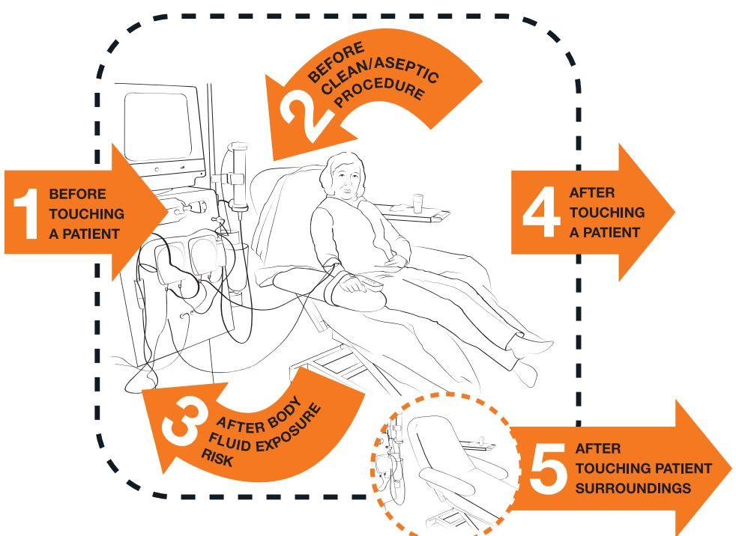
Patients and their Families in CHARGE — Hand Hygiene
Educate patients about WHO 5 steps of hand hygiene³
Ask patients to be your second set of eyes
Acknowledge when you do a great job
Let you know their concern when they notice you miss a step
Notes:
SAY:
Educate patients about the World Health Organization (WHO) five steps of hand hygiene. Ask patients to be your second set of eyes by acknowledging when you do a great job and letting you know their concern when they notice you miss a step. Doing this includes patients in their care and can help health care workers remember to always practice good hand hygiene.

Slide 18
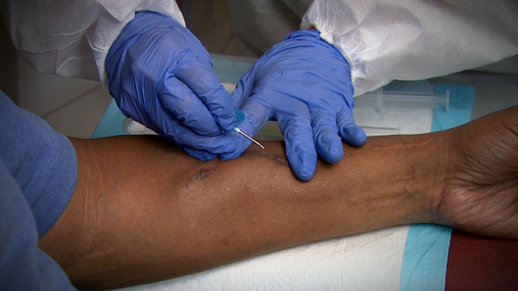
Patients and their Families in CHARGE — Access Site (Preparation/Cleansing)
Access site (preparation/cleansing)⁴
Fistula cleansing
Teach patients how to cleanse their fistulas and why it helps reduce VAIs
Encourage them to clean the site themselves prior to cannulation
Notes:
SAY:
Patients with fistulas can prepare their own access sites prior to initiation. Teach patients how to cleanse their fistulas and how proper cleansing helps to reduce vascular access infections (VAIs). Encourage patients to clean the site themselves prior to cannulation. Use the teach-back method to confirm patients understand all of the steps involved.

Slide 19
Patients and their Families in CHARGE — Reduce and Remove Catheters
Reduce and remove catheters⁵
Educate about benefits of fistulas
Involve patients in decision making
Notes:
SAY:
In alignment with Fistula First, a resource for vascular access management, educate patients about the benefits of fistulas, the hemodialysis gold standard. Fistula First also advises involving patients in the decision-making process. Facilities can also educate patients to improve quality of care and outcomes such as prepping puncture sites and applying pressure at needle sites, among other things.

Slide 20
Patients and their Families in CHARGE — Great Connection/Disconnection Technique
Involve patients in infection prevention techniques
Example: Ask catheter patients to wear masks
Empower patients to assist in handling distractions
Example: Hurried family members or caregivers may be more willing to relax and wait if the patient explains the importance of a proper disconnection, which also frees the tech to focus on proper disconnection
Notes:
SAY:
One way to engage patients in their care for this step is to involve patients in infection prevention techniques such as asking catheter patients to wear masks. Another way is to empower patients to assist in handling distractions. In this example, the patient works to handle distractions from family or caregivers by explaining to them the importance of a proper disconnection, which also frees the tech to focus.
DO:
Play NOTICE Encouraging a Culture of Safety video. Ask staff to highlight times in the video where the patient encourages positive behaviors in staff.
ASK:
What are some ways you will try to encourage engagement in your facility?

Slide 21
Patients and their Families in CHARGE — Evaluation
Involve patients in the Quality Assurance and Performance Improvement (QAPI) process
Share data with patients
Ask patients to provide feedback on improvements
Include patients as advisers when possible
Notes:
SAY:
Involving patients in the Quality Assurance and Performance Improvement process allows for the transparency of data between health-care providers and patients. Facilities can post infection rates in waiting rooms and other visible areas. Training videos can be shared via television or video feeds for patients.
Other ways to include patients in the quality improvement process are asking patients to provide feedback on improvements in care and including patients as advisers when possible. Patients can be involved on QAPI teams to help learn from defects, defined here as any error or process that keep you from meeting your quality improvement goals.

Slide 22
Next Steps
Meet with your team to discuss how you will roll out the steps of patient engagement
Modify draft Patient Contract to meet your specific needs
Share and discuss the contract with patients
Practice communication methods with your team members until you feel comfortable with the teach back method and communicating in plain language
Use communication methods discussed with patients
Notes:
SAY:
You can take steps in your facility to improve patient and family engagement and communication.
These include:
Meeting with your team to discuss how you will roll out the steps of patient engagement;
Creating or modifying a draft Care Contract to meet your patient and provider specific needs;
Sharing your Care Contract with patients to discuss;
Practicing communication methods with your team members until you feel comfortable with the teach-back method and communicating in plain language; and
Using communication methods discussed with patients.

Slide 23
References
The Universal Patient Compact: Principles for Partnership. National Patient Safety Foundation. 2008. http://www.npsf.org/wp-content/uploads/2012/02/Patient-Compact_PSAW-2012.pdf. Accessed September 3, 2014.
U.S. Department of Health and Human Services. Office of Disease Prevention and Health Promotion Quick Guide to Health Literacy: Fact Sheet. http://www.health.gov/communication/literacy/quickguide/factsbasic.htm. Accessed September 3, 2014.
World Health Organization Guidelines on Hand Hygiene in Health Care: First Global Patient Safety Challenge, Clean Care is Safer Care. Geneva, Switzerland: World Health Organization; 2009. http://whqlibdoc.who.int/publications/2009/9789241597906_eng.pdf. Accessed September 3, 2014.
Centers for Disease Control and Prevention. Guidelines for the Prevention of Intravascular Catheter-Related Infections. MMWR 2002 ;51(No.RR10):1-26. http://www.cdc.gov/mmwr/pdf/rr/rr5110.pdf. Accessed September 3, 2014.
Arteriovenous Fistula First. Change Concept 10: Education for Caregivers and Patients. http://www.fistulafirst.org/HealthcareProfessionals/FFBIChangeConcepts/ChangeConcept10.aspx. Accessed September 3, 2014.

