Slide 1
Module 6: Sustainability

Slide 2
Objectives
Define sustainability and understand the importance of maintaining positive change
Describe the link between sustainability and spread
Develop a plan for sustainability
Discuss the steps needed to sustain efforts
Describe lessons learned from examples of success across multiple settings

Slide 3
Definition of Sustainability¹⁻⁴
Ensuring gains are maintained beyond the life of the project, or the institutionalization or integration of programs into ongoing organizational systems
Sustaining the ideas, beliefs, principles, or values underlying an initiative, or “when new ways of working and improved outcomes become the norm”

Slide 4
Importance of Sustainability⁵
Variability in health care
Continuous high-quality care and reliable safe practices
Measureable outcomes
Prevent project fatigue
Control processes
Monitor progress
Engage senior leaders
Establish improvement culture and engaged staff
Create cultural legacy

Slide 5
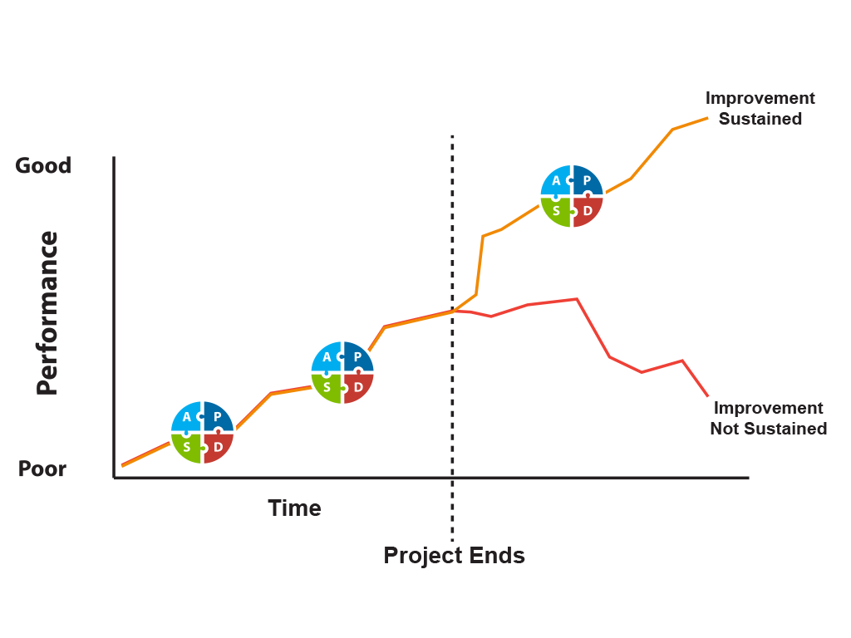
Sustainable Change After Project End?¹

Slide 6
What Does Sustainability Mean for Your Facility?
How do you see other projects sustained in your facility?
Are values, beliefs, and practices incorporated into the mission of your organization and/or are they incorporated into existing processes?
Are other quality assurance and performance improvement (QAPI) initiatives aligned?

Slide 7
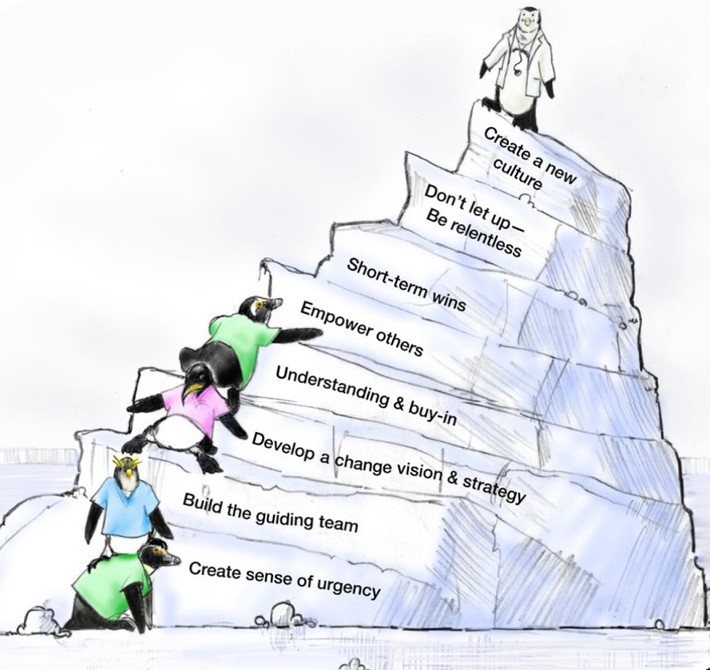
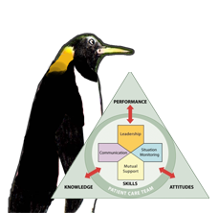
Facilitators of Sustainable Change⁵
As seen in TeamSTEPPS®

Slide 8
Sustainability and Spread⁶
Spread is covered in detail in the Spread module of the AHRQ CUSP Toolkit available on the AHRQ Web site. https://www.ahrq.gov/professionals/education/curriculum-tools/cusptoolkit/modules/spread/index.html
Sustainability
Embedding a successful improvement into the culture and norms of a facility
Spread
Implementing a successful improvement across multiple settings and/or facilities

Slide 9
Planning for Sustainability
Plan early for sustainability and spread
Implement essential steps to create a sustainability plan

Slide 10
Planning Early
Develop plan for financial, staffing, and other resources
Identify leaders and program champion(s)
Learn how to create a sustainable plan
Educate staff
Build a measurement system

Slide 11
Steps to Creating a Sustainability Plan
Identify and develop program champion(s)
Build the implementation team
Empower frontline staff
Establish a sustainability measurement plan
Identify and Address Barriers to Sustainability
Engage staff with stories
Recognize and celebrate success

Slide 12
1. Identify and Develop Program Champion(s)
Program champion(s) will—
  Communicate and reinforce resident safety and program goals as a priority
  Have physician, nursing, and administrative support
  Be motivational and inspiring
  Have influence
  Be able to communicate the vision
  Serve as a coach
For more information on coaching, please see the Role of the Nurse Manager module within the AHRQ CUSP toolkit

Slide 13
2. Build the Implementation Team
This team will ideally include the following members:
  Facility team lead
  Administrator
  Data coordinator
  Survey coordinator
Identify a team leader to address team member concerns throughout the project
Include your program champion to persuade and motivate
Understand the program goals and components
Notes:
This team will be different for LTC

Slide 14
3. Empower Frontline Staff
Frontline staff should—
Feel comfortable bringing up resident safety concerns to other team members or team leaders
Speak up when a potential break in resident safety protocol may occur or actually occurs
Be commended, and not punished, for speaking up about resident safety
As seen in TeamSTEPPS®

Slide 15

The Sustainability Team
PLAY VIDEO:
Video 2.3: A Collaborative Effort - https://youtu.be/Phd60ZMPs_U
Notes:
Video 2.3: A Collaborative Effort

Slide 16
4. Establish a Sustainability Measurement Plan
Assess readiness for sustainability
Build measurement system for collecting process, outcomes, and quality improvement data
Determine what, when, and how to measure performance and who will collect the data
Establish robust followup and transparent feedback system that uses data to continuously improve performance

Slide 17
5. Identify and Address Barriers to Sustainability
Active involvement of administrative and clinical champions can address barriers by—
  Motivating team members to support program interventions
  Highlighting positive staff experiences as a result of new procedures
  Dedicating time and resources to help carry out the interventions

Slide 18
6. Engage Staff With Stories
Stories are a powerful way to engage staff in ways that numbers cannot
Encourage your team leaders to discuss actual resident stories to drive home important lessons

Slide 19
7. Recognize and Celebrate Success
Recognizing success, large and small and both early on and long term, is important to sustainability.

Slide 20
Steps for Sustaining Efforts⁷
Collect, review and share data with facility administration and frontline staff
Communicate and engage
  How is staff reminded of the project on an ongoing basis? Posters with CAUTI rates? Announcements such as “100 days since the last CAUTI”?
Align with other QAPI efforts
Celebrate successes
Incorporate into orientation and training
Address barriers to sustainability with workable solutions

Slide 21
Potential Barriers to Sustainability
Lack of organizational infrastructure and resources
Staff turnover
Organizational skepticism
Individual resistance to change

Slide 22
Workable Solutions to Sustainability Barriers
Lack of organizational infrastructure and resources
  Develop strategies and flexibility to account for resource fluctuation
  Plan financial resources for maintaining improvements beyond the project end
Staff turnover
  Embed newly developed processes into new staff orientation and organizational policies
  Train staff continuously, including train-the-trainer education
  Develop volunteer network to assist in case of staffing fluctuations and/or shortage (funding, staff turnover)

Slide 23
Workable Solutions to Sustainability Barriers¹
Managing skepticism
  Present ongoing evidence that the new process is a better one
  Show staff and stakeholders real data
  Reserve staff time away from normal duties to work on proposed improvements
  Encourage active senior leader engagement
    Consider measuring how frequently senior leaders/administrators review sustainability data/outcomes as indicator of engagement at this level

Slide 24
Assessing your Sustainability Plan
What is your sustainability measurement plan?
  What data will be acceptable?
  How often will it be reviewed?
How will you make this as part of daily operations?
  Included in orientation of new staff?
  Included in competency of existing staff?
  How will you make sure excitement will be the same in a year or two as it is today?

Slide 25
Sustainability Examples: Data⁸
Baptist Memorial Health Care created a measurement system including—
  An appointed facilitator
  A process for collecting, reporting and inputting data into system database
  Generation of graphics to show performance trends
  Communication to senior leadership and medical staff
  Data-based refinement of the improvement plan

Slide 26
Sustainability Examples: Ongoing Training⁹
Partners in Care in New York City utilized a train-the-trainer model to deliver communication training to all staff on an ongoing basis.
Incorporating training into ongoing training and orientation assures that that all staff have consistent information and expectations.

Slide 27
Key Concepts Review
Sustainability helps organizations embed processes into their organizational culture
Organizations must be prepared to address barriers that can hinder sustainability
An effective sustainability plan includes –
  Planning early in the improvement process
  Easy to reach goals
  Program champion
  Fit within organizational mission
  Ongoing evaluation and transparency of measures

Slide 28
References
Clinical Excellence Commission (CEC); Enhancing Project Spread and Sustainability – A Companion to the Easy Guide to Clinical Practice Improvement. Sydney: CEC: 2008.
Scheirer MA. Is Sustainability Possible? A Review and Commentary on Empirical Studies of Program Sustainability. American Journal of Evaluation. 2005 Sep;26(3):320-347.
Weiss H, Coffman J, Bohan-Baker M. Evaluation’s Role in Supporting Initiative Sustainability. Cambridge, MA: Harvard Family Research Project; 2002. http://www.hfrp.org. Accessed March 22, 2014.
​NHS Modernisation Agency. Improvement Leader’s Guide to Sustainability and Spread. NHS Modernisation Agency. Ipswich, England: Ancient House Printing Group; 2002.
Kotter J. Leading Change. Harvard Business School Press, Boston, MA, 1996, as cited in TeamSTEPPS Fundamentals Course: Module 8. Change Management: Instructor's Slides: TeamSTEPPS Fundamentals Course. November 2008. Agency for Healthcare Research and Quality, Rockville, MD. http://www.ahrq.gov/professionals/education/curriculum-tools/teamstepps/instructor/fundamentals/module8/igchangemgmt.html.

Slide 29
References
Spread module, CUSP Toolkit. Rockville, MD: Agency for Healthcare Research and Quality; December 2012. http://www.ahrq.gov/professionals/education/curriculum-tools/cusptoolkit/modules/spread/index.html. Accessed March 22, 2014.
Swerissen H. Understanding the Sustainability of Health Programs and Organisational Change. A Paper for the Victorian Quality Council. June 2007.
5 Million Lives Campaign. Getting Started Kit: Rapid Response Teams. Cambridge, MA: Institute for Healthcare Improvement; 2008. www.ihi.org. Accessed March 22, 2014.
Ozga M. Partners in Care: How the nation’s largest home health agency is transforming its culture. Chicago, IL: Pioneer Network: January 2012. http://www.phinational.org/sites/phinational.org/files/clearinghouse/partnersincare-casestudy-20120103.pdf. Accessed November 20, 2014.
Tool 6A: Sustainability Tool: Preventing Falls in Hospitals: A Toolkit for Improving Quality of Care. January 2013. Agency for Healthcare Research and Quality, Rockville, MD. http://www.ahrq.gov/professionals/systems/hospital/fallpxtoolkit/fallpxtk-tool6a.html.

