Slide 1
Designing & Delivering Whole-Person Transitional Care
The Hospital Guide to Reducing Medicaid Readmissions
Webinar 2: Analyze Data and Patient/Caregiver Perspectives
(Section 1 of the Guide)

Slide 2
Agenda
Describe Medicaid readmission patterns
Describe the 15-part data analysis to understand all-payer and payer specific readmissions at your hospital
Describe the patient/caregiver interview process to understand readmissions from the patient perspective

Slide 3
Objectives
Understand 3 ways in which Medicaid readmission patterns are similar to and 3 ways Medicaid readmission patterns are different from Medicare readmission patterns
Understand why understanding the patient perspective is helpful for identifying opportunities for improvement & designing effective strategies
Understand the tools available to support this work

Slide 4

Table of Contents
Introduction
Why Focus on Medicaid Readmissions?
How to Use This Guide
Analyze Your Data
Survey Your Current Readmission Reduction Efforts
Plan a Multi-Faceted Data-Informed Portfolio of Strategies
Implement Whole-Person Transitional Care for All
Reach Out to Collaborate With Cross-Continuum Providers
Enhance Services for High-Risk Patients

Slide 5


List of Tools
Data Analysis
Readmission Review
Hospital Inventory
Community Inventory
Portfolio Design
Operational Dashboard
Portfolio Presentation
Conditions of Participation Handout
Whole-Person Transitional Care Planning
Discharge Process Checklist
Community Resource Guide
Cross Continuum Collaboration
ED Care Plan Examples
The guide comes with 13 customizable tools to be used in hospital teams’ day-to-day operations.

Slide 6
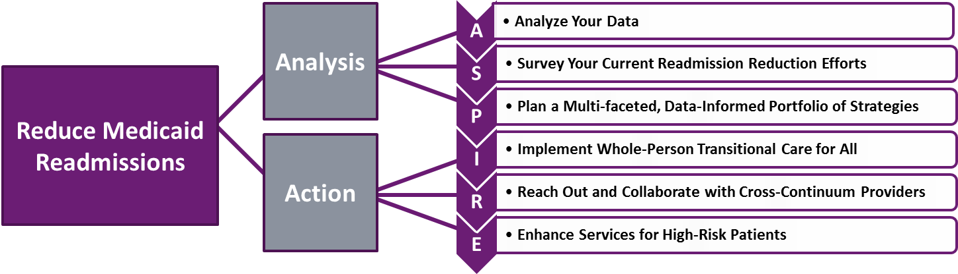
The ASPIRE Framework

Slide 7
All Payer and Payer-Specific Readmission Analysis

Slide 8
Why Analyze Your Own Data?
Your hospital-specific readmission patterns may differ in important ways from national patterns: especially true for safety net hospitals.
Look at:
Readmission rates by payer
Top 10 diagnoses leading to the most readmissions
Proportion of all readmissions with a behavioral health comorbidity
Readmissions by discharge disposition

Slide 9
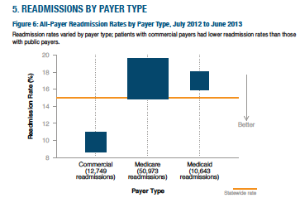
Readmission By Payer Type
Source: Massachusetts Center for Health Information and Analysis

Slide 10
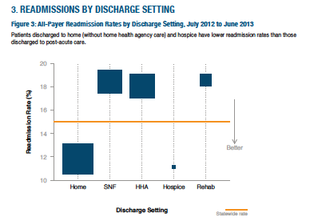
Source: Massachusetts Center for Health Information and Analysis
Discharge Disposition | Medicare (% discharges to) | Medicaid (% discharges to)
Discharge to Home | 55% | 84%
Discharge to SNF/IRF/LTAC | 24% | 5%
Discharge to Home with Home Health | 14% | 8%

Slide 11

Conditions With the Largest Number of Adult Hospital Readmissions by Payer, 2011
Anita L. Hones, Ph.D., M.P.H., Marguerite L. Barrett, M.S., H. Jiang, Ph.D., and Claudia A. Steiner, M.D., M.P.H.
Top 10 Medicare Dx:
CHF
Sepsis
COPD
Arrythmia
Pneumonia
UTI
Acute renal failure
AMI
Complication of device
Stroke
Top 10 Medicaid Dx:
Mood disorder
Schizophrenia
Diabetes complications
Comp. of pregnancy
Alcohol-related
Early labor
CHF
Sepsis
COPD
Substance-use related
Methods:
-Used CCS groupers
-Included OB

Slide 12
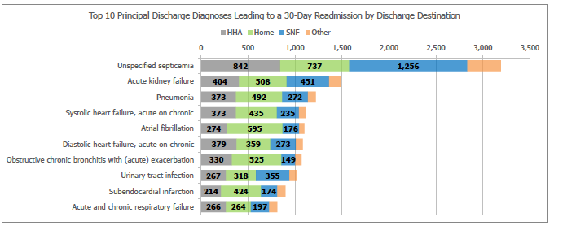
Top 10 Principal Discharge Diagnoses Leading to a 30-Day Readmission by Discharge Destination
Source: CMS data, courtesy of VHQP

Slide 13
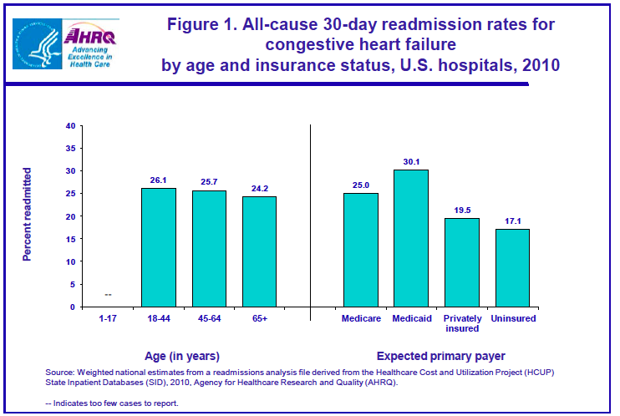

Slide 14
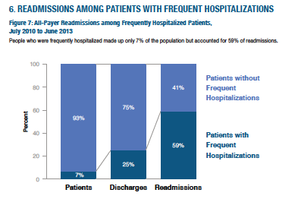
Readmissions for Patients with High Utilization
4+ hospitalizations/year
Readmission rate 40% v. 8%
74% of discharged to home
Top Discharge Diagnoses:
  Mood disorders
  Schizophrenia
  Diabetes
  Chemotherapy
  Sickle cell
  Alcohol
  Sepsis
  Heart Failure
  COPD
  Source: Massachusetts Center for Health Information and Analysis and Jiang et al. HCUP Statistical Brief #184 Nov 2014

Slide 15
15-Point Analytic Plan: All Payer and Payer-Specific
Total discharges (exclude deaths and transfers to inpatient care settings)
Total readmissions
Readmission rate
Proportion of discharges and readmissions, by payer
Days between discharge and readmission, <4 days, <10 days, 11-30 days
Top 10 diagnoses resulting in highest number of readmissions
Percent of all readmissions accounted for by the top 10 diagnoses
Proportion of all discharges with any behavioral health (including substance use) condition
Proportion of all readmissions with any behavioral health condition
Discharge disposition (home, home with home health care, skilled nursing facility)
Readmission rate by discharge disposition
Number of patients with a personal history of high utilization (4 or more admissions / year)
Number of discharges among this group (“high utilizers”)
Number (and percent of total) of readmissions among this group (‘high utilizers”)
Readmission rate among high utilizers

Slide 16
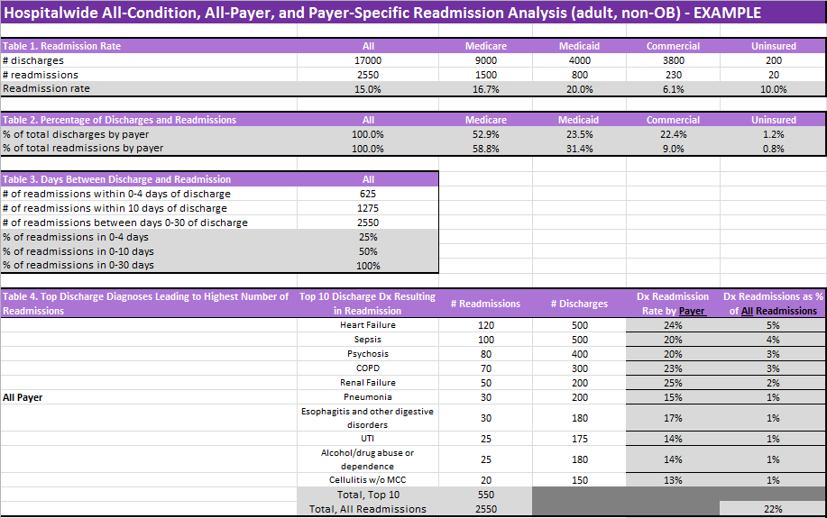
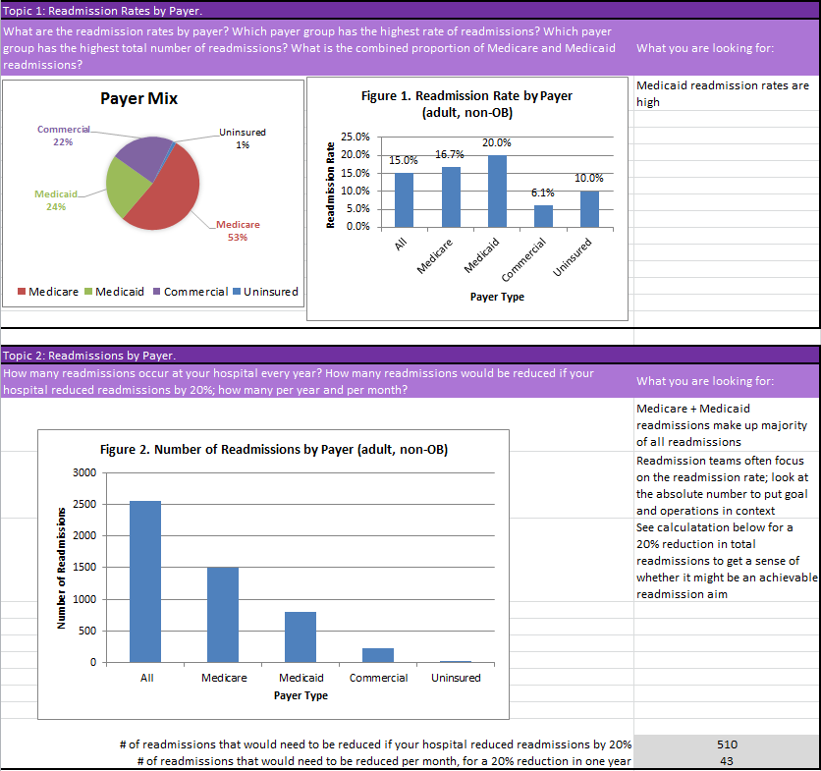
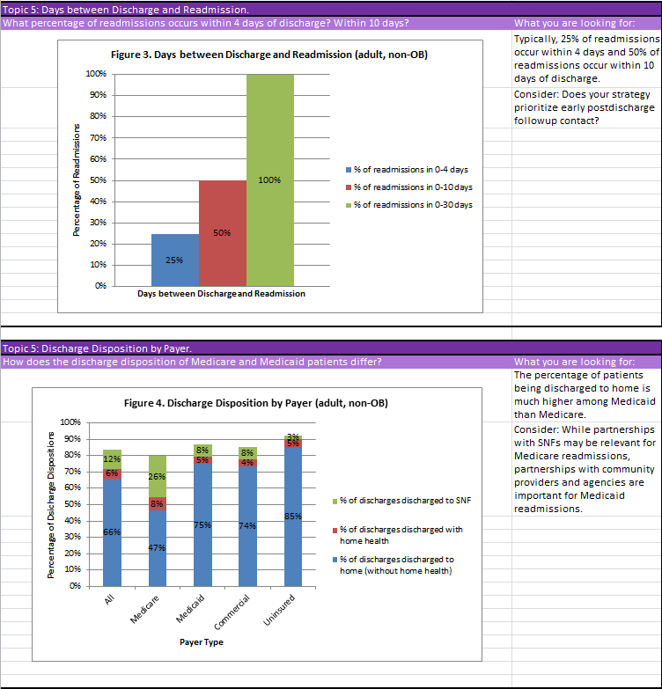
Data Analysis Tool

Slide 17
Ask your patients “Why”
Elicit the story behind the chief complaint; identify root causes

Slide 18
Review readmissions from “whole person” view
41 woman with longstanding HIV never hospitalized in past; hospitalized for pneumonia, started on HIV medications and antibiotics and told to follow up with HIV and PCP providers. Readmitted 8 days later.
61 man with 8 hospitalizations this year for shortness of breath returns to the hospital 10 days after discharge with shortness of breath.
“Billing data aren’t going to tell you whether a patient needed a pharmacy intervention, needed a place to live, or couldn’t afford their medications.”

Slide 19
41 woman with HIV hospitalized with pneumonia
1st hospitalization:
  Longstanding HIV, never previously hospitalized
  Diagnosed with pneumonia, found to have high HIV viral load
  Lives with mother – unaware of her HIV
At discharge:
  Discharged on new anti-retroviral medications
  Discharged on new antibiotics for the pneumonia
  No infectious disease or primary care appointments made
Readmission:
  Returned 8 days later for persistent coughing
  Returned because instructions said return if symptoms don’t improve
  “It would have helped if they made the appointment for me”

Slide 20
61 man with 8 hospitalizations this year for SOB
1st hospitalization:
  This really isn’t his “first” hospitalization, is it?
  Intern H&P presents case as if new presentation to hospital
  Discover he is marginally housed
  Discover he has personality disorder issues
  Refuses to work with physical therapy
At discharge:
  Patient can not be placed in facility due to a criminal history
  Discharged to “home,” told to follow up with PCP (hasn’t been in over a year)
Readmission:
  Reports he gained 20 lbs in 8 days
  “Oh honey, it always takes them about a week to tune me up”
  Grabs remote, turns on TV and orders dinner

Slide 21
Do not over-medicalize root causes of readmissions
Kaiser Permanente team reviewed 523 readmissions across ~14 hospitals:
  Found an average of 9 factors contributed to each readmission
Philadelphia team interviewed patients who returned to ED after discharge:
  Average age 43 (19-75)
  Majority had a PCP; cited ED gave more tests, quicker answers
  Most reported no problem filling medications
Found primary root cause for return: fear and uncertainty
Patients need more reassurance during and after episodes of care
Patients need access to advice between visits
Feingenbaum et al Medical Care 50(7): July 2012
Rising et al, Annals of Emergency Medicine 2015

Slide 22
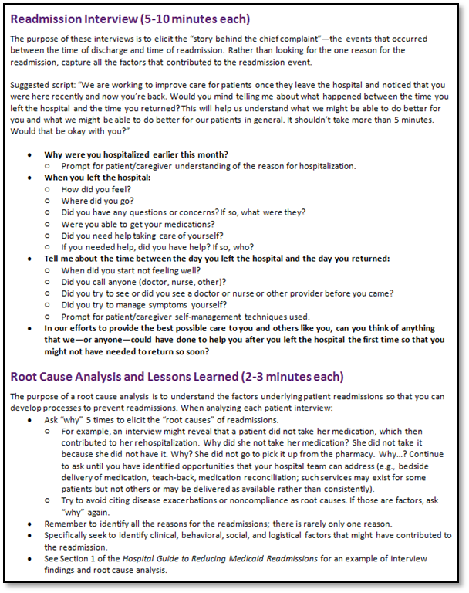
Readmission Review Tool
Purpose:
To understand patient perspective
To understand root causes
To understand there are multiple factors
To identify opportunities for improvement
To develop a better plan for the patient
To develop better services to offer
Recommendation:
Conduct at least 5 during planning
Review all readmissions

Slide 23
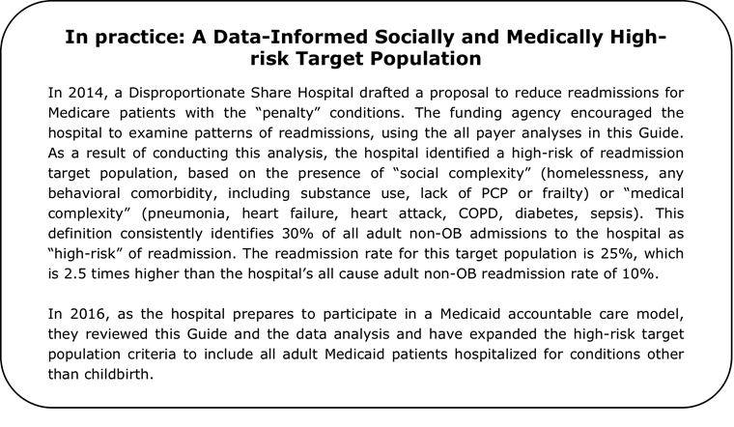
Using Data to Identify Your High Risk Populations

Slide 24
Summary
Know your data
Elicit the root causes of readmissions
Use this information to:
  Identify groups of patients with high readmission rates
  Determine how to target readmission reduction efforts
  Better understand “why” patients return
  Identify opportunities for improvement
  Design strategies that will address patients’ transitional care needs

Slide 25
Thank you for your commitment to reducing readmissions
Amy E. Boutwell, MD, MPP
Collaborative Healthcare Strategies
amy@collaborativehealthcarestrategies.com
Angel Bourgoin, PhD & Jim Maxwell, PhD
John Snow, Inc.
Angel_Burgoin@jsi.com; Jim_Maxwell@jsi.com

