Slide 1
Designing & Delivering Whole-Person Transitional Care
The Hospital Guide to Reducing Medicaid Readmissions
Webinar 3: Review & Update Readmission Reduction Efforts

Slide 2
Agenda
Describe the purpose of conducting an inventory of efforts and resources relevant to reducing readmissions
Describe how that inventory can be used to conduct a gap analysis and identify services or partners that are needed to better meet the transitional care needs of the population
Describe how to use a driver diagram to design and communicate a portfolio of strategies that can be expected to achieve the hospitals’ readmission reduction goals

Slide 3
Objectives
Understand the utility of leveraging and coordinating all existing resources – in the hospital and the community – to strengthen your readmission reduction efforts
Understand the importance of knowing the gaps that exist and considering how to fill them
Understand the importance of designing a data-informed portfolio of strategies that can be reasonably be expected to achieve the hospital’s readmission reduction goals

Slide 4
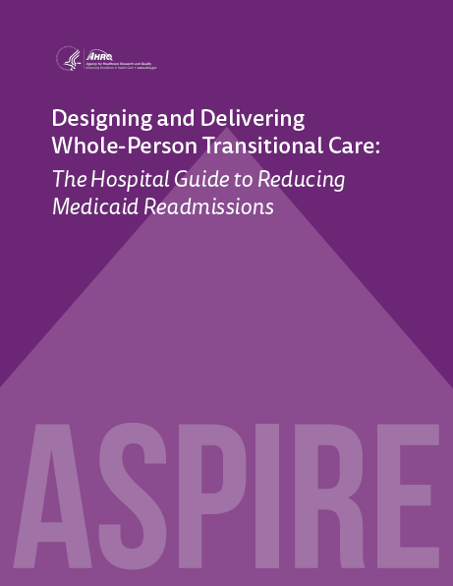
Table of Contents
Introduction
Why Focus on Medicaid Readmissions?
How to Use This Guide
Analyze Your Data
Survey Your Current Readmission Reduction Efforts
Plan a Multi-Faceted Data-Informed Portfolio of Strategies
Implement Whole-Person Transitional Care for All
Reach Out to Collaborate With Cross-Continuum Providers
Enhance Services for High-Risk Patients

Slide 5

List of Tools
The guide comes with 13 customizable tools to be used in hospital teams’ day-to-day operations.
Data Analysis
Readmission Review
Hospital Inventory
Community Inventory
Portfolio Design
Operational Dashboard
Portfolio Presentation
Conditions of Participation Handout
Whole-Person Transitional Care Planning
Discharge Process Checklist
Community Resource Guide
Cross Continuum Collaboration
ED Care Plan Examples

Slide 6
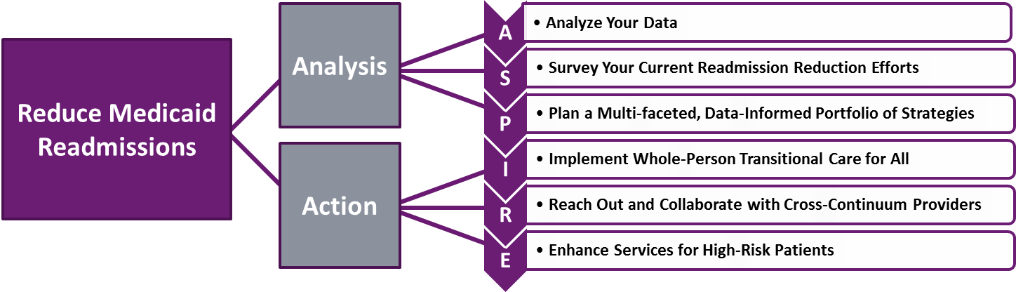
The ASPIRE Framework

Slide 7
“We run the care coordinator pilot; I think nursing is working with IT on getting a high-risk flag in the record. I don’t know how that is coming.…”

Slide 8
Inventory Hospital-Based Efforts & Resources
Readmission reduction activities have proliferated over time
Some efforts may have developed in isolation from one another
Resources or assets may exist that could be leveraged
  Readmission flags, high risk flags in EMR
  Post-discharge follow up calls
  Centralized appointment scheduling
  Pharmacists or pharmacy technicians
  ACO, bundled payment teams

Slide 9
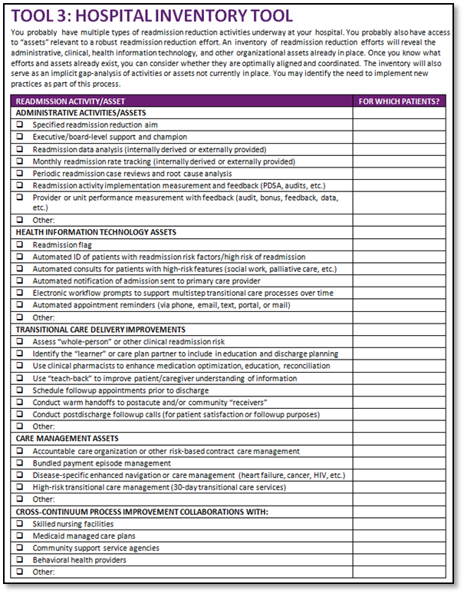
Hospital Inventory Tool
Use this tool to:
Identify readmission reduction efforts across departments
Identify whether efforts are coordinated
Identify whether there is duplication
Identify gaps – in administrative support
Identify gaps – in clinician engagement
Get specific – what specifically is happening in the ED? Who leads that effort?, etc.

Slide 10
“You don’t understand, there are just no resources in the community”

Slide 11
Inventory Community Efforts & Resources
Post-acute and community providers may offer services and supports hospital staff are unaware of
Health plans may offer high risk patients transitional care and/or care management
Resources or assets may exist that could be leveraged
  Practices that are patient centered medical homes: care manager
  Home health agencies that specialize in behavioral health
  Health homes offering outreach, engagement, case management
  Housing agencies with case management services

Slide 12
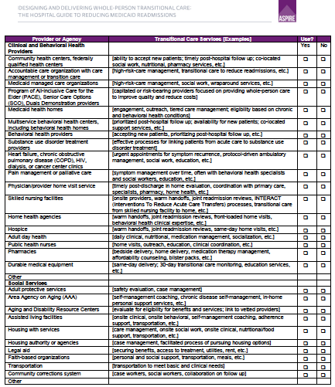
Community Inventory Tool
Use this tool to identify:
Peer supports?
Navigators?
Medical-legal advocates?
Behavioral health providers
Medicaid MCO care managers?
Formal partnerships?
Informal arrangements?
Optimizing available resources?
Is linkage as easy as it needs to be?
Gaps in services and supports?

Slide 13
Medicaid Managed Care Organizations (MCOs)
MCOs can assist with:
  Identify PCP
  Home Nursing
  Medication adherence
  Discharge planning from all levels of care
  Disease Management
  Complex Case Management
  Coordination of services
Examples:
  Transitional care staff
  Complex care managers
  Behavioral health care managers
  Mobilize resources to meet basic health-related needs

Slide 14
Living Room at Turning Point
Living Room provides a safe, non-sterile, inviting environment
Developed to provide an alternative option to the ED for people experiencing a behavioral health crisis
Outcomes of the Living Room include:
  $348, 036 average savings from avoided Emergency Room visits in 2013
  93% of people who accessed the Living Room did not proceed to an Emergency Room visit
  84% of people who arrived in crisis to the Living Room report their crisis has been resolved at time of departure
  People who accessed the Living Room in crisis spent an average of 2 hours in resolving their crisis, which is much less than an emergency room length of stay for psychiatric presentation
Source”Saving Lives and Treasury, 2015 www.CBHA.net

Slide 15
Adult Day Health Care
Medical Adult Day Care is an ambulatory setting for adults with chronic physical conditions or cognitive impairments such as : Stroke, CHF, COPD, Diabetes, Dementia, Mental Illness, Developmental Disabilities and Neuromuscular Disease.
Interdisciplinary Team consisting of a : Center Director, Registered Nurse, Licensed Social Worker, Dietician, CNA , GNA, CMA , and Therapeutic Recreational Director.
Services: Individualized Care Plans, Daily Nurse Assessments, PT, OT, medication administration, wound care.
Illinois Department of Human Services Adult Day Care Information

Slide 16
Bon Secours Baltimore Health System
Internal Inventory
Peer recovery coaches in the ED
Outcomes Management
Social Work
Behavioral Health Program
Clinics provide post-discharge
follow up <7-10 days for anyone
IT: ACO patients flagged
IT: Use CRISP for notifications
What’s needed next:
Care coordination model for high risk patients
Create care plans for high utilizers
Integrate medical and behavioral health care clinical information
Continue to innovate to meet need of patients
Community Inventory
Health Enterprise Zone
The Coordinating Center
Homeless Outreach Program
Transitional Housing Providers
Home Health Agencies
Skilled Nursing Facilities
Baltimore Area Agency on Aging
Collaboration w UM Midtown
Source: presentation to HSCRC Care Coordination workgroup, Dec 2014

Slide 17
Reflect on Findings to Date
Which high-risk populations are currently served?
Which high-risk populations are not being served?
Are the current readmission reduction processes and/or services consistently implemented for the current target population? How do you know?
Are the current readmission reduction processes and/or services inconsistently implemented for the current target population? Can this be improved? How?
Do the strategies offered for the current target population effectively address the transitional care needs and root causes of readmissions? How do you know?
Have the strategies offered for the current target population reduced readmissions for the target population? How do you know?
Are there opportunities to better serve the current target population and reduce readmissions even more?
Are there opportunities to serve new target populations? Which populations? With what services, process improvements, and/or partners?

Slide 18
Take a Data-Informed Approach
What is our aim?
What does our data show?
Who should we focus on?
What should we do?
Many teams start in the reverse order!

Slide 19
Create a Data-Informed Strategy
1. Specify the goal and target population
  The goal should be data-informed and specify what will be achieved for whom, by how much, and by when
2. Identify 3-4 primary ways by which the aim will be achieved.
  Consider: improving hospital-based transitional care processes, collaborations with cross-setting partners, and delivering enhanced services
  There may be others depending on your target population and resources available

Slide 20
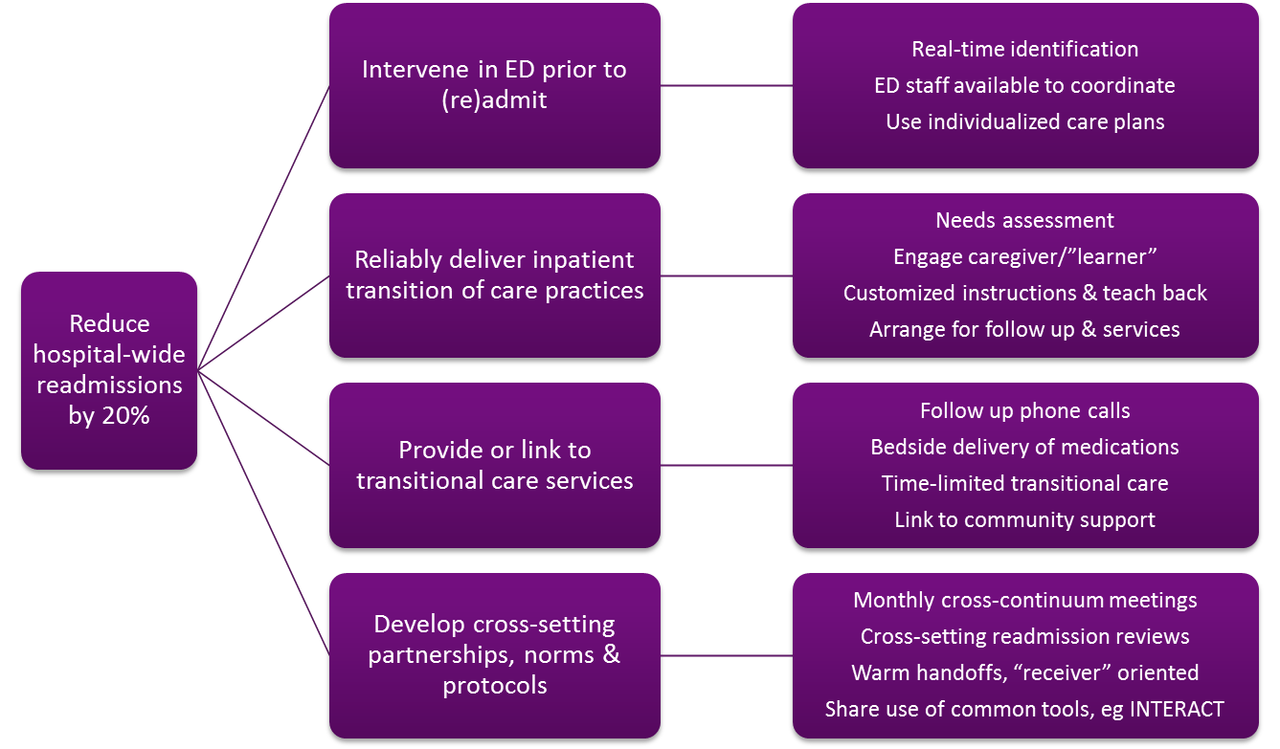
Example 1: Baltimore Hospital

Slide 21
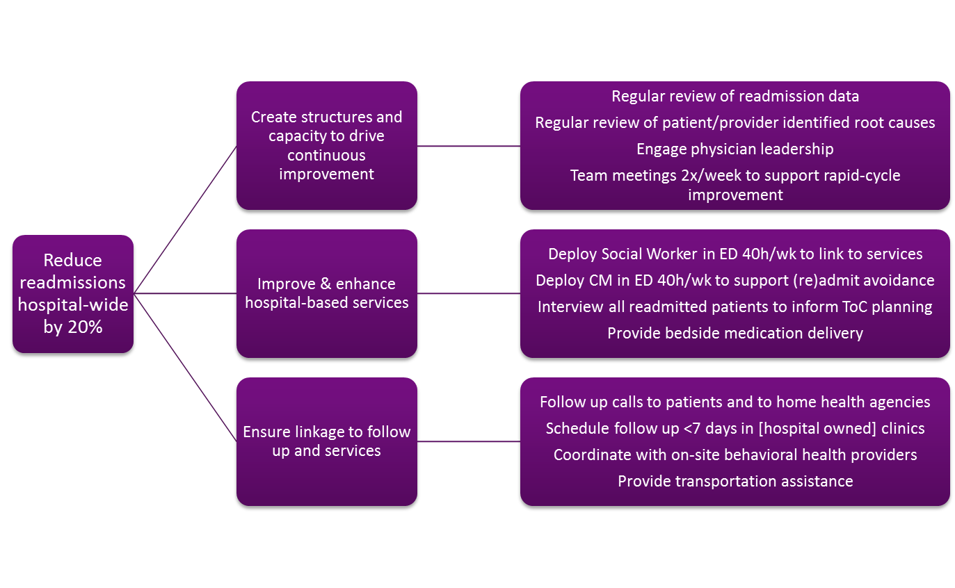
Example 2: Chicago Hospital

Slide 22
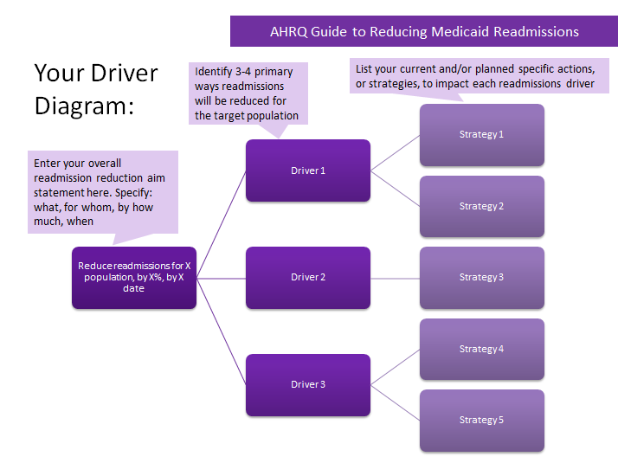
Driver Diagram Tool

Slide 23
Analyze Your Strategy: Is it Complete?
Are all readmission reduction related activities captured?
Will this strategy address the root causes of readmissions for your target population?
What target populations have not been prioritized? Why?
What strategies have not been prioritized? Why?
Are the following data-informed or high-leverage elements included? If not, why not?
  Medicaid adults
  Behavioral health
  Social support needs
  High utilizers
  High risk diagnoses based on your data (sepsis, renal failure, sickle cell, etc)
  Discharges to post-acute care settings
  Collaborations with: MCOs, BH providers, clinics, social services, housing services
Does this strategy align with value based /alternative payments and other incentives?
  Medicare readmission penalties? Medicare value-based purchasing (total cost)?
  Medicaid readmission penalties? Medicaid MCO at-risk contracts? DSRIP goals?
  Board-level goals relating to quality, patient experience, disparities, or stewardship?

Slide 24
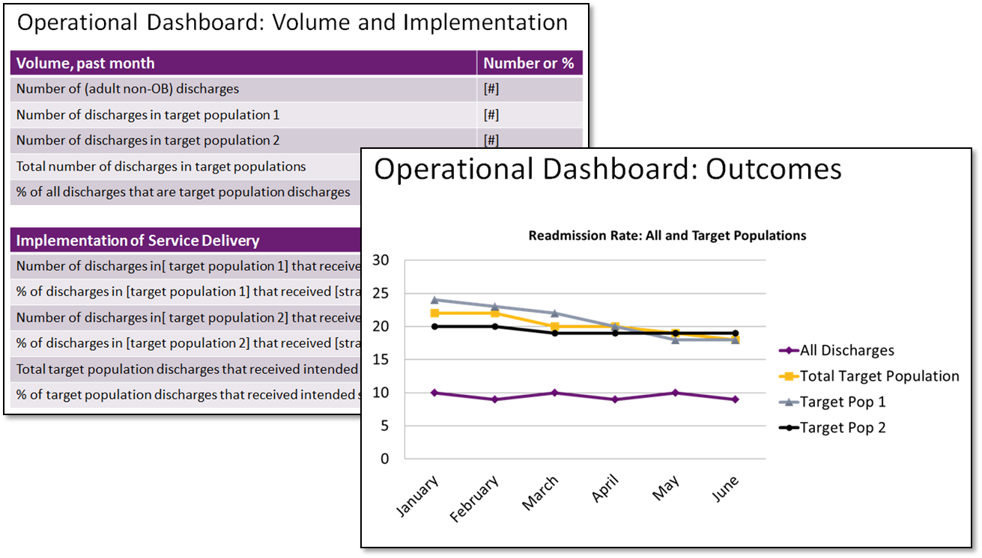
Establish an Operational Dashboard to Track Implementation and Outcomes (Tool 6)

Slide 25
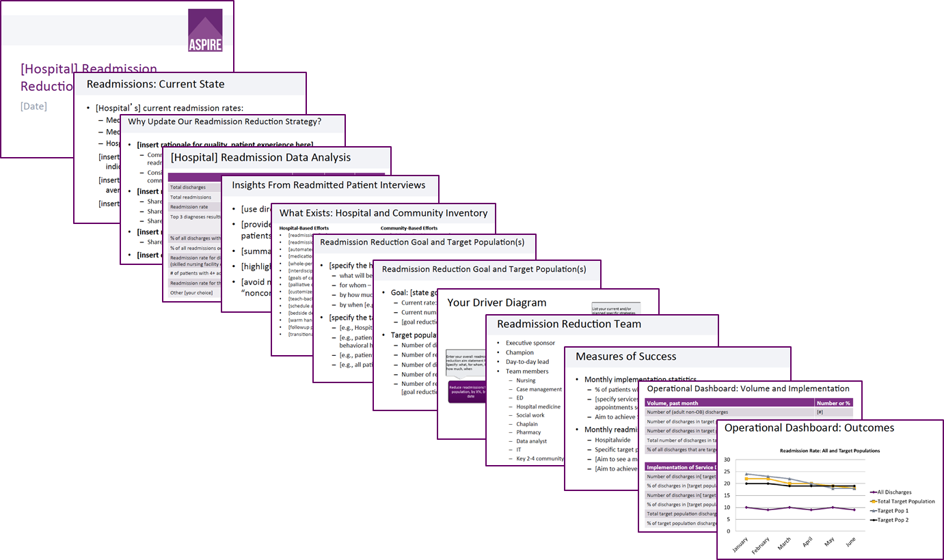
Portfolio Presentation Tool (Tool 7)
Notes:
dont change.

Slide 26
Summary
Inventory readmission reduction efforts and related resources and organizational assets
Inventory community-based services; focus on identifying Medicaid-relevant resources
Reflect on findings of data and interviews; reflect on what is and is not present in the hospital and community
Articulate a readmission reduction strategy that leverages existing resources, fills gaps and will meet patients’ needs

Slide 27
Thank you for your commitment to reducing readmissions
Amy E. Boutwell, MD, MPP
Collaborative Healthcare Strategies
amy@collaborativehealthcarestrategies.com
Angel Bourgoin, PhD & Jim Maxwell, PhD
John Snow, Inc.
Angel_Burgoin@jsi.com; Jim_Maxwell@jsi.com

