Slide 1
Designing & Delivering Whole-Person Transitional Care
The Hospital Guide to Reducing Medicaid Readmissions
Webinar 5:Reach Out to Collaborate with Partners Across Settings

Slide 2
Agenda
Describe the important position that hospitals are in to lead delivery system transformation in their communities through aligning and leveraging resources to address whole-person needs
Describe why investing effort to identify Medicaid-relevant providers and agencies is core to effective efforts to reduce readmissions
Describe a step-wise approach to creating “effective referral pathways” to reduce barriers to linking patients to needed and available services

Slide 3
Objectives
Cast aside the assumption that “there are no resources in our community”
Identify Medicaid-relevant providers, including community and health plan based care management services
Develop working relationships and processes for making it easier and more effective to ensure linkage to services

Slide 4

Table of Contents
Introduction
Why focus on Medicaid Readmissions?
How to Use This Guide
Analyze Your Data
Survey Your Current Readmission Reduction Efforts
Plan a Multi-Faceted Data-Informed Portfolio of Strategies
Implement Whole-Person Transitional Care for All
Reach Out to Collaborate With Cross-Continuum Providers
Enhance Services for High-Risk Patients

Slide 5

List of Tools
The guide comes with 13 customizable tools to be used in hospital teams’ day-to-day operations.
Data Analysis
Readmission Review
Hospital Inventory
Community Inventory
Portfolio Design
Operational Dashboard
Portfolio Presentation
Conditions of Participation Handout
Whole-Person Transitional Care Planning
Discharge Process Checklist
Community Resource Guide
Cross Continuum Collaboration
ED Care Plan Examples

Slide 6
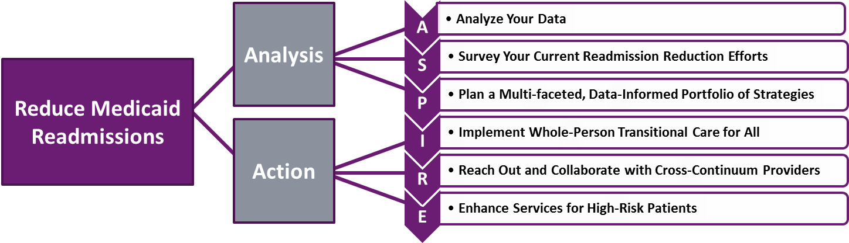
The ASPIRE Framework

Slide 7
“We would be thrilled if someone from the hospital called us”

Slide 8
Cross-Continuum Collaboration: Whose Job is It?
It’s the hospital’s job!
CMS policies signal that hospitals are expected to lead delivery system transformation to more effectively deliver care across settings
Hospitals that do reach out to post-acute and community based providers and agencies find those partners are very receptive

Slide 9
“There are many resources in the city, but it can be hard to find them. We need to inventory them and collect this information in one place”

Slide 10
Identify Medicaid-Relevant Partners
Medicaid-Relevant Clinical Providers
Medicaid-Relevant Service Agencies
Behavioral Health Centers
Community Health Centers
Behavioral Health Homes
Resident Physician Clinics
Patient Centered Medical Homes
Substance Use Treatment Centers
Adult Day Care Centers
Medicaid Managed Care Plans
Health Homes
Group Homes
Housing Authority
Transportation Providers
County Health Departments
Food Assistance
Legal Advocacy Assistance
Peer Support

Slide 11
Look for Care Management Resources
Accountable care organizations
Patient-centered medical homes
Bundled payment initiators
Health homes
Behavioral health homes
Medicaid managed care organizations
CMS demonstration initiatives
State Innovation Model initiatives
Duals-demonstration programs
Medicaid Delivery System Reform Incentive Payment (DSRIP) programs
Medicaid Delivery System Transformation Initiatives (DSTI) programs
Local or national foundation grant-funded initiatives
State agency funded initiatives
State behavioral health agency
Housing authority or housing agencies
Peer support programs
Faith-based organizations
Volunteer organizations

Slide 12
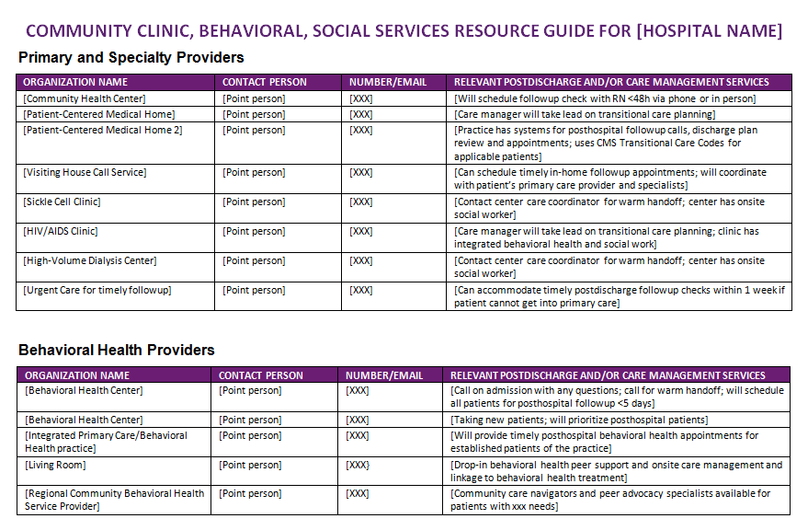
Community Resource Guide (Tool 11)

Slide 13
Develop “Referral Pathways” to Ensure Effective Linkage to Services
Make doing the right thing the easy thing for staff

Slide 14
Cross Continuum Coordination – Getting Started
If you are just getting started:
Hold regularly scheduled monthly meetings
Start with a “coalition of the willing” – doesn’t need to be perfect
Invite new partners/ agencies as you learn about them
Allow 3-4 months for the group to gel
Start with common agenda items:
  Readmission data
  Readmitted patient stories
  Readmission stories from “receiver” perspective
  Handoff communication
  What information do “receivers” need that they frequently don’t have?

Slide 15
Cross Continuum Coordination – Getting Specific
Prepare
Preparation is valuable to ensure that your collaboration is goal-oriented and data-informed. Understand the patient-related and logistical issues you are trying to address through this partnership.
Reach out to a service provider, or group of providers who provide similar services, to initiate a transparent, data-informed planning discussion to explore improving linkages to services for patients. Set up a meeting.
Prepare data on your hospitals’ target population, how many target population discharges there are per day/week, and a description of your working understanding of what factors contribute to readmissions.
Prepare questions to learn more about the services they offer and their capabilities.

Slide 16
Cross Continuum Coordination – Getting Specific
Ask
Specific requests direct the conversation towards action. Be open to new ideas as well as requests that may be made of your hospital team.
Capacity: Ask the provider/agency to consider whether they have capacity to accept a consistent volume of referrals for post-hospital care. What volume of daily/weekly referrals could they absorb?
Timeliness: Timely post-hospital contact is a priority, ask the provider/agency to work with you on developing a process to ensure linkage to services, optimally prior to discharge or within 1-2 days.
Getting started: Ask the provider/agency if you can test the new process of linking high-risk patients to their services on the next 10 patients who have a need for their services.

Slide 17
Cross Continuum Coordination – Getting Specific
Test
Test 10 patients
  Get started. Start small. Expect to learn and iterate.
Reflect
  How did it go? For patients? For the hospital staff? Receiving staff?
Decide
  Whether to adopt, adapt, or abandon elements of the process.
Continue to improve
  Identify ways to make effective linkage easy.

Slide 18
Cross Continuum Coordination – Getting Specific
Measure
The only way to know whether the referral pathways are working is to measure performance. Measure the following aspects of the process:
Reliability of Hospital-based Needs Assessment
  How many patients were identified to need the service this month?
  Are we effectively screening and identifying the need in the hospital?
Effectiveness of the “Referral Pathway”
  How many patients were referred to the service this month?
  How many patients were effectively linked to the service this month?

Slide 19
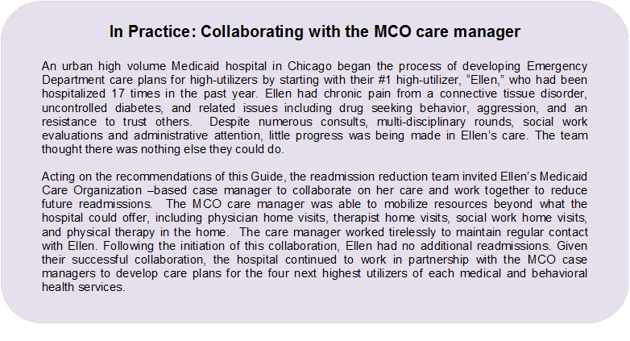

Slide 20
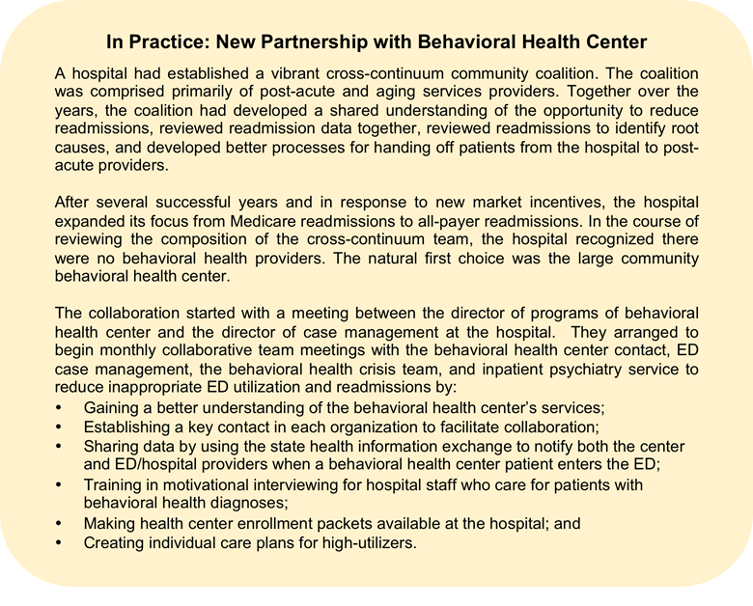

Slide 21
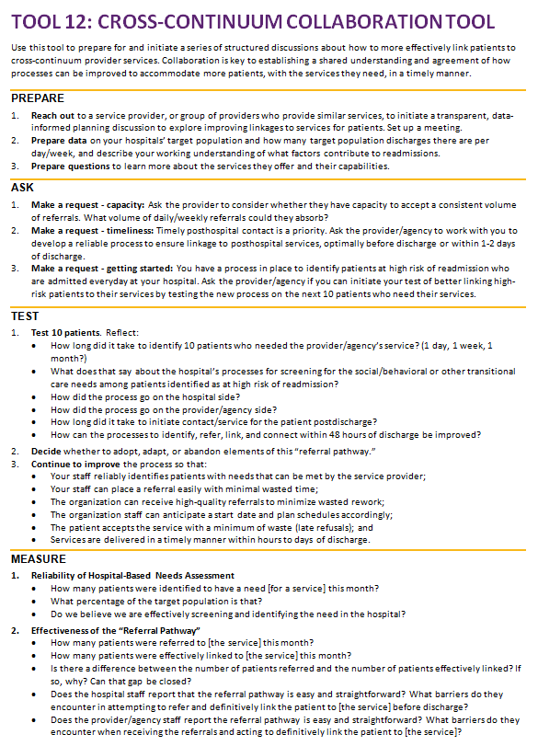

Slide 22
Summary
Develop improvement-oriented collaborations with the providers and agencies that can best meet your patients’ transitional care needs
Specifically seek to identify Medicaid-relevant providers and agencies: health centers, behavioral health centers, health homes, etc.
Identify and actively collaborate with care management entities; identify ways to efficiently connect with a care manager if one exists
Develop “referral pathways” to reduce barriers (time, knowledge, frustration) to linking patients with needed post hospital services

Slide 23
Thank you for your commitment to reducing readmissions
Amy E. Boutwell, MD, MPP
Collaborative Healthcare Strategies
amy@collaborativehealthcarestrategies.com
Angel Bourgoin, PhD & Jim Maxwell, PhD
John Snow, Inc.
Angel_Burgoin@jsi.com; Jim_Maxwell@jsi.com

