Slide 1
Designing & Delivering Whole-Person Transitional Care
The Hospital Guide to Reducing Medicaid Readmissions
Webinar 6: Enhance Services for High-Risk Patients

Slide 2
Agenda
Describe strategies to enhance services for high-risk patients
Give examples of how transitional care services and high utilizer programs effectively meet “whole-person needs”
Describe the usefulness of an emerging tool: the ED Care Plan
Identify ways to reduce readmissions from the ED

Slide 3
Objectives
Enhanced services go beyond standard care to provide services and support in the post-hospital time period
Adapt transitional care models to address “whole-person needs”
Develop new services to improve care for frequently hospitalized patients
Use care plans to improve care over time and across settings
Engage the ED in efforts to reduce readmissions

Slide 4
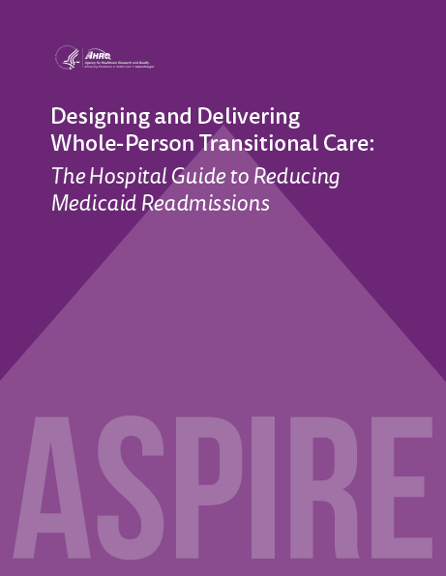
Table of Contents
Introduction
Why focus on Medicaid Readmissions?
How to Use This Guide
Analyze Your Data
Survey Your Current Readmission Reduction Efforts
Plan a Multi-Faceted Data-Informed Portfolio of Strategies
Implement Whole-Person Transitional Care for All
Reach Out to Collaborate With Cross-Continuum Providers
Enhance Services for High-Risk Patients

Slide 5

List of Tools
The guide comes with 13 customizable tools to be used in hospital teams’ day-to-day operations.
Data Analysis
Readmission Review
Hospital Inventory
Community Inventory
Portfolio Design
Operational Dashboard
Portfolio Presentation
Conditions of Participation Handout
Whole-Person Transitional Care Planning
Discharge Process Checklist
Community Resource Guide
Cross Continuum Collaboration
ED Care Plan Examples

Slide 6
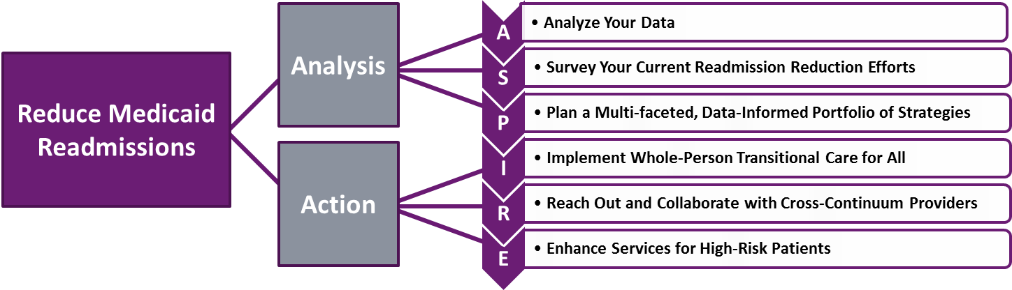
The ASPIRE Framework

Slide 7
“I think that there’s always going to be a group of folks that’s always going to need somebody to help them. That’s never going to change.”

Slide 8
Enhanced Services
Additional services and supports in the time following hospitalization;
Services not provided to all patients as part of routine care;
Offered to subgroups identified as “high risk” of readmission;
Delivered prior to and after discharge, often for 30 days;
Deployed at provider expense so as to reduce readmissions;
Delivered by hospital staff or by contracted staff from other entities

Slide 9
High Risk Target Populations
There may be several target populations at high risk of readmission identified by your data analyses
Consider the following high risk target populations:
  Adults with sickle cell disease;
  Adults residing in group homes or other residential settings;
  Patients discharged to short term skilled nursing facilities;
  Adults with a personal history of repeated hospitalizations in the past year
One “standard” transitional care model would not likely meet the needs and address the root causes of readmissions for all these populations
Design “enhanced services” to meet the needs of each target population

Slide 10
Transitional Care for High-Risk Patients

Slide 11
Transitional Care Services
“Our [navigators] are flexible, proactive, and persistent; they address all needs. Each of them has incredible interpersonal skills.”

Slide 12
“Whole-Person” Adaptations to Transitional Care
Navigating
Hand-holding
Arranging for….
Providing with….
Harm reduction
Meet “where they are”
Patient priorities first
Relationship-based

Slide 13
Social Work-based Transitional Care
“Bridge model”
Engage with patients with clinical, behavioral health and social needs
Assess for transitional care needs
Expect needs will change over time
Use motivational interviewing
Identify services in place
Assess eligibility for services
Discuss finances in context of needs and priorities
Link directly to services
Brief short term therapeutic support
Coordinate with clinical and social service providers

Slide 14
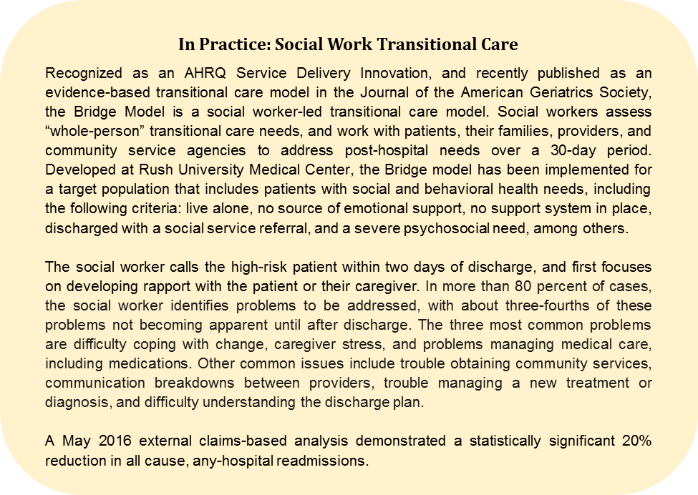

Slide 15
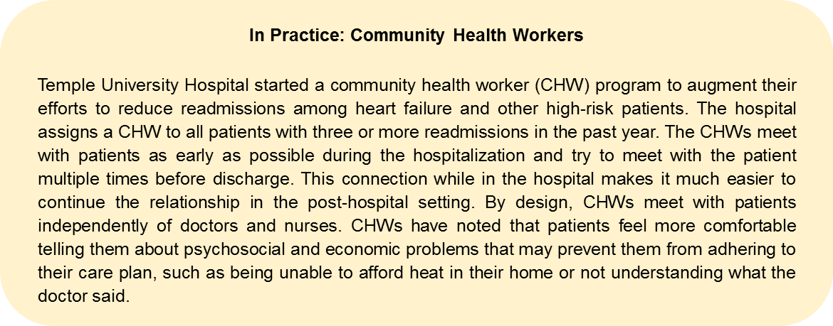

Slide 16
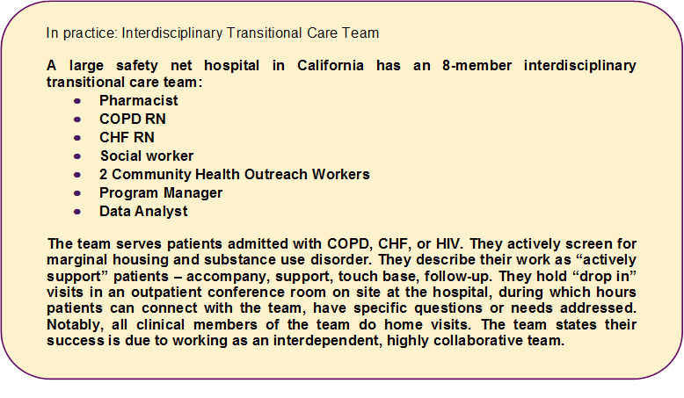

Slide 17
Improving Care for High Utilizers

Slide 18
Principles to Guide High Utilizer Programs
Identify the patient in real-time
Engage the patient while they are on-site
View utilization as a symptom of unmet needs
Prioritize engagement
Deploy an interdisciplinary team
Be proactive in post-hospital follow up
Be patient and persistent
Have resources to deploy to meet short term needs
Use care plans to improve care across settings and over time

Slide 19
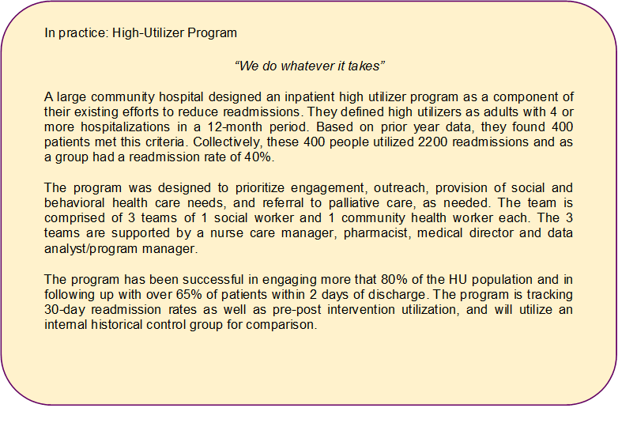

Slide 20
Using Care Plans to Improve Care Over Time and Across Settings

Slide 21
Types of Care Plans: Observations from the Field
Longitudinal Care Plan
  A comprehensive plan to achieve health-promoting goals and objectives. Specific goals regarding clinical, behavioral, and/or functional status are often included, and are measured via serial assessments over time. Longer term; care management over time.
Transitional Care Plan
  Identifies post-hospital needs, patient priorities, and readmission risks and the plan to address those needs, priorities and mitigate risks in the 30 days post discharge. Focus on ensure linkage to providers and services within the 30 day transitional period.
ED Care Plan
  Summary information for the ED provider to inform safe, effective, and consistent care in the ED and facilitate discharge with team-based follow up, as appropriate.

Slide 22
ED Care Plan: Emerging Tool in the Field
Purpose: Improve the management of the high-risk patient the next time they come to the ED
Audience: ED clinical staff
Content:
Executive summary of prior utilization and testing;
Identification of the driver of hospital utilization;
Recommendations for consideration
Identification of a point of contact

Slide 23
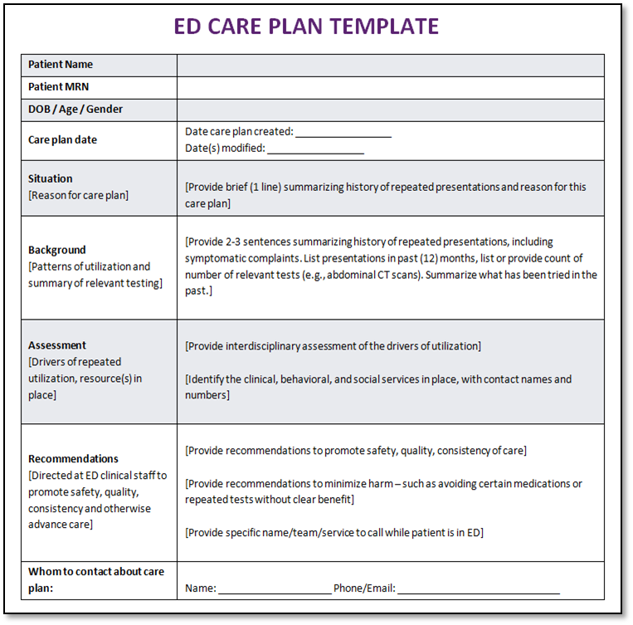
ED Care Plan Template

Slide 24
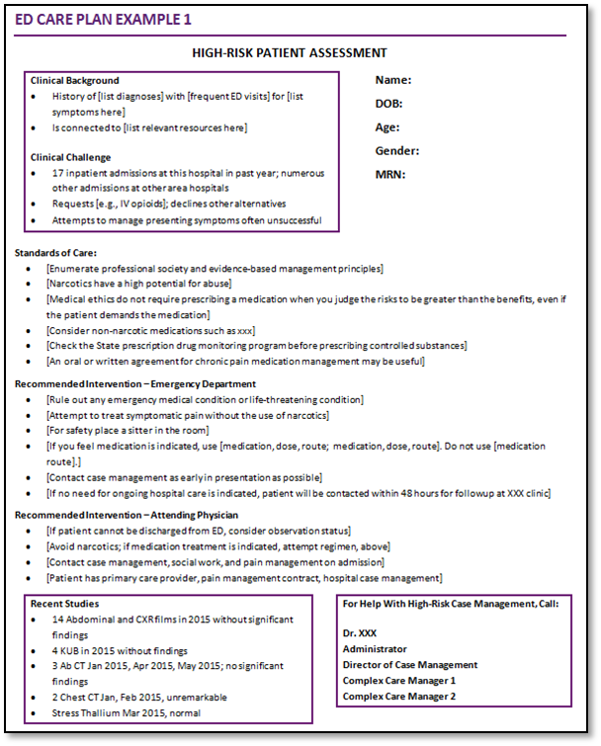
ED Care Plan Example 1

Slide 25
ED Care Plans: Lessons from the Field
Brevity: No more than 1 page; the essential summary information in a way that saves time and promotes quality, informed decision making.
Audience: Who is your intended audience? ED doc? Develop the “clinical snapshot” and recommended interventions with the end-user in mind.
Summarize the “utilization” part of “high utilizer:” This summary is not just a clinical summary, but a utilization profile. Quantify prior visits, admissions, tests, consults to convey what has been done in the past.
Delegate the synthesis, collaborate on the plan: Delegate the drafting of the care plan summary to a member of the high-risk care team. Meet as a team to develop recommendations and next steps.

Slide 26
Engage the ED in Reducing Readmissions

Slide 27
“In previous times, the path would’ve been to simply admit the patient, and we’ll sort it out 5 days later. We’re becoming more accustomed to having resources in the ER to help us discharge patients from the ED. That’s a culture change.”

Slide 28
Reducing Readmissions from the ED
Create a 30-day return flag on the ED Tracker Board
  Be sure to communicate what their desired response to the flag is
Use the 30-day return flag to notify the high risk care team
  Real-time notification to allow team to work with ED on safe discharge
Use care plans and care teams’ involvement in the ED
  Communicate baseline clinical status, recurrent utilization, next steps
Consider developing “treat and return” pathways
  Inventory the capabilities of post acute providers and post in ED
Engage hospitalists in decision to admit
  Create a collaborative culture to reduce avoidable decisions to admit

Slide 29
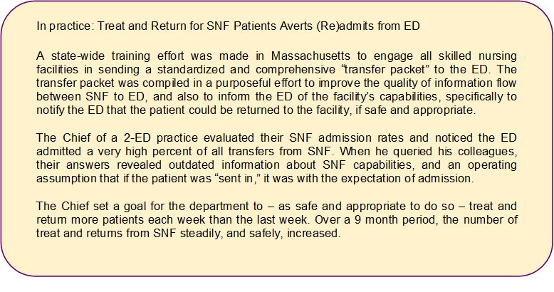

Slide 30
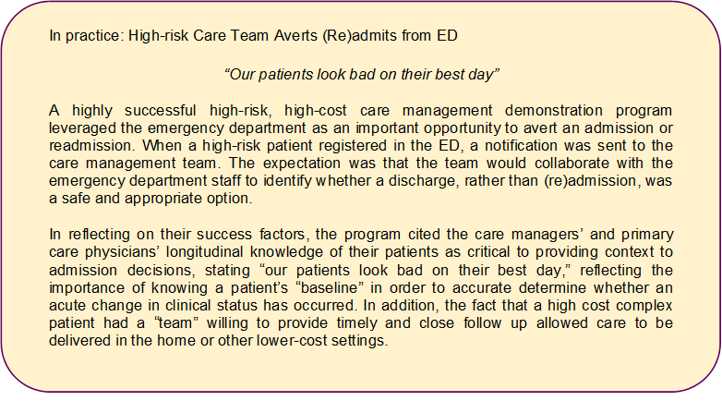

Slide 31
Summary
Deploy enhanced services for patients at high risk of readmission
Match the enhanced services to the needs of the high risk patient population; consider different services for different populations
Do not over-medicalize services
Develop care plans for patients who are frequently hospitalized
Engage the ED in your efforts to reduce readmissions

Slide 32
Thank you for your commitment to reducing readmissions
Amy E. Boutwell, MD, MPP
Collaborative Healthcare Strategies
amy@collaborativehealthcarestrategies.com
Angel Bourgoin, PhD & Jim Maxwell, PhD
John Snow, Inc.
Angel_Burgoin@jsi.com; Jim_Maxwell@jsi.com

