Slide 1
Tool 5: Portfolio Design
Brief Description: A PowerPoint deck that includes examples of readmission reduction portfolios that can be modified to develop the data-informed, multifaceted “portfolio” of readmission reduction efforts in your hospital.
Purpose: To facilitate the formulation of your hospital’s readmission reduction plan as a set of data-informed and complementary strategies that support your readmission reduction aim.
This tool helps you consolidate your strategic planning by creating a multifaceted portfolio of strategies using a driver diagram. A driver diagram is a tool used in quality improvement and delivery system redesign that serves as an organizing framework to convey the theory of change. A driver diagram identifies the three or four primary ways you will achieve your aim. In relation to each “primary driver” are “secondary drivers”: the mechanisms by which each primary driver will be achieved. For further guidance, see the Massachusetts Health Policy Commission Community Hospital Acceleration, Revitalization, and Transformation Investments (CHART) Driver Diagram Guide and the CMS Center for Innovation’s Defining and Using Aims and Drivers for Improvement How to Guide
Instructions:
Draft the driver diagram to reflect your hospital’s current or desired readmission reduction strategy.
Conduct a team meeting to answer the gap analysis questions. Consider whether anything is missing.
Finalize the driver diagram as a living document that will be periodically reviewed and modified.
Use the driver diagram to formulate a workplan and develop an operational dashboard to track progress.
Staff: Readmission reduction leadership team.
Time Required: 3-4 hours.
Additional Resource: See Section 3 of the Hospital Guide to Reducing Medicaid Readmissions.

Slide 2
Create a Driver Diagram – 1
Refer to Guide Section 3 for additional information
Specify the goal and target population.
The goal should be data informed and specify what will be achieved (e.g., a reduction in readmissions) for whom, by how much, and by when.
Identify three or four primary ways the aim will be achieved.
Consider: improving hospital-based transitional care processes, collaborating with cross-setting partners, and delivering enhanced services in the set of primary drivers. There may be others depending on your target population and resources available.
You might identify which of these efforts are currently in place and which you are identifying as new elements in the portfolio of efforts.

Slide 3
Create a Driver Diagram – 2
Analyze your first draft driver diagram to consider:
Are all readmission reduction-related activities captured?
Will this strategy address the root causes of readmissions for your target population?
What target populations have not been prioritized? Why?
What strategies have not been prioritized? Why?
Are the following data-informed or high-leverage elements included? If not, why not?
Medicaid adults
Behavioral health
Social support needs
High utilizers
High-risk diagnoses based on your data (sepsis, renal failure, sickle cell disease, etc.)
Discharges to postacute care settings
Collaborations with managed care organizations (MCOs), behavioral health providers, clinics, social services, housing services
Does this strategy align with value-based/alternative payments and other incentives?
Medicare readmission penalties? Medicare value-based purchasing (total cost)?
Medicaid readmission penalties? Medicaid MCO at-risk contracts? Delivery System Reform Incentive Payment goals?
Board-level goals relating to quality, patient experience, disparities, or stewardship?

Slide 4
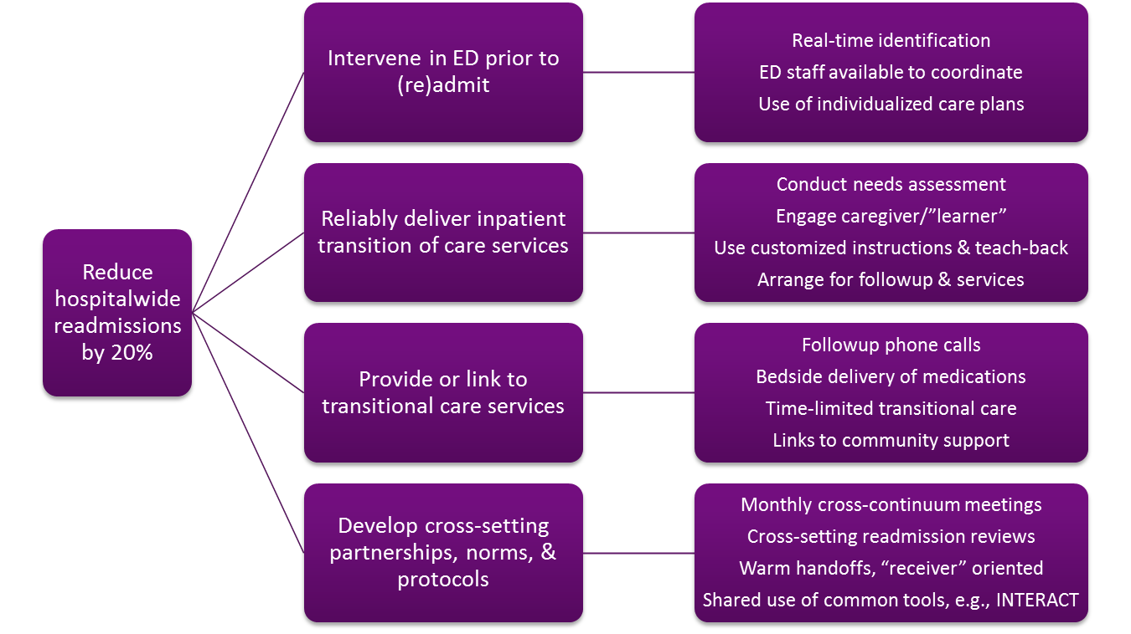
Example 1: Baltimore Hospital

Slide 5
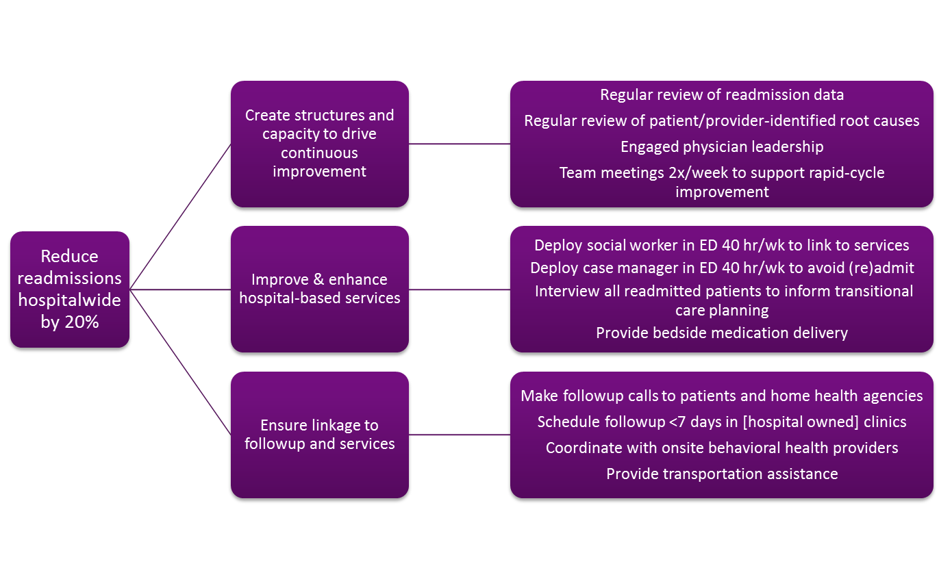
Example 2: Chicago Hospital

Slide 6
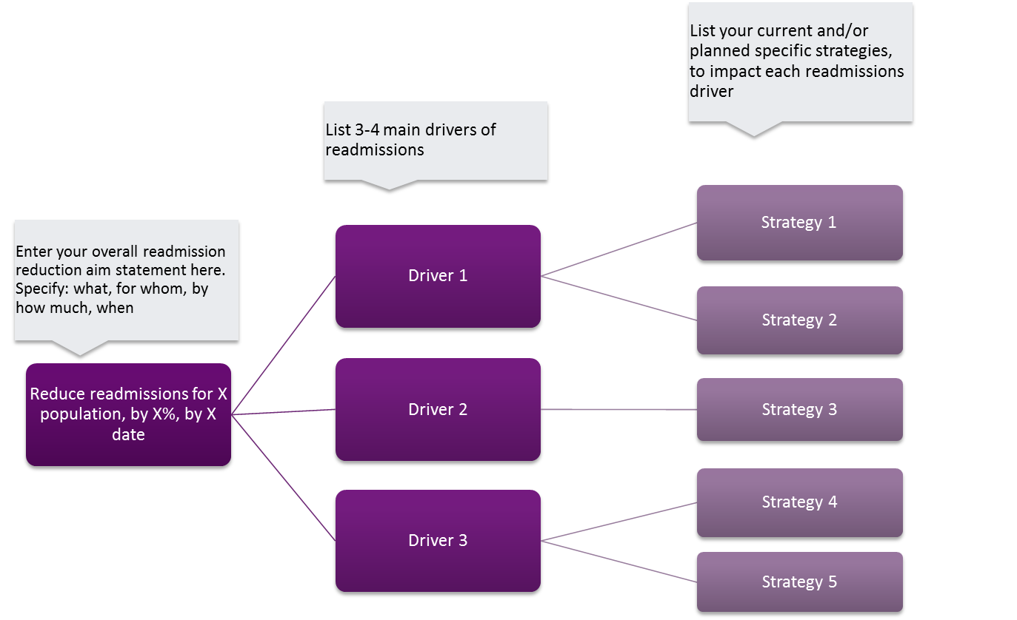
Your Driver Diagram

