Slide 1

Preventing Pressure Injuries in Hospitals
ADD Name of Hospital Here
Module 1 – Understanding Why Change Is Needed

Slide 2

Ice Breaker
Describe an interesting fact about yourself.

Slide 3
Compelling Reasons To Implement Program
Pressure injury rates continue to escalate.
  The incidence of pressure injuries increased by 80% from 1995 to 2008.
  Every year, 2.5 million patients develop a pressure injury.
  Because of the ever-increasing number of obese, diabetic, and elderly patients, rates are predicted to continue to rise.

Slide 4
Compelling Reasons To Implement Program
Pressure injuries increase costs.
  Pressure injury treatment costs as much as $11 billion each year.
  Individual patient care costs $20,900 to $151,700 per pressure injury.
  Patients with pressure injuries need more care.
  Longer inpatient stays often result.
Since 2008, CMS no longer allows higher diagnosis-related group (DRG) payments for patients with >Stage 2 pressure injuries.
Most pressure injuries are preventable.
Centers for Medicare & Medicaid Services, 2008

Slide 5

Practice Insight
Approximate Cost of HAPI ⎯ Stage 3, 4, Unstageable, and DTI
Hospital-Acquired Pressure Injuries, January–June 2015
Hospital-Acquired Pressure Injuries, January–December 2014
STAGE | # HAPI | ~ COST
Stage 1 | 0 | N/A
Stage 2 | 6 | N/A
Stage 3 | 4 | $172,720
Stage 4 | 0 | $0
Unstageable | 4 | $172,720
Deep Tissue Injury | 8 | $345,440
TOTAL | 16 | $690,880
STAGE | # HAPI | ~ COST
Stage 1 | 3 | N/A
Stage 2 | 14 | N/A
Stage 3 | 7 | $302,260
Stage 4 | 0 | $0
Unstageable | 5 | $215,900
Deep Tissue Injury | 15 | $647,700
TOTAL | 27 | $1,165,860

Slide 6
Prevention Works
Multicomponent prevention programs reduce pressure injury rates.
  Systematic reviews show that pressure injury prevention programs result in statistically and clinically significant reductions in pressure injury rates.
  Rates can drop 50% to 100%.
  Other benefits include optimal patient care and avoiding the cost of treating Stage 3 and above injuries.
  Sullivan, 2013

Slide 7
Are You Ready for This Change?
Introductory Executive Summary for Stakeholders (Tool 0A)
Stakeholder Analysis (Tool 1B)
Does senior leadership support this initiative? (Tools 1C, 1D)
Who will take ownership of this effort?
What resources are needed? (Tool 1E)

Slide 8

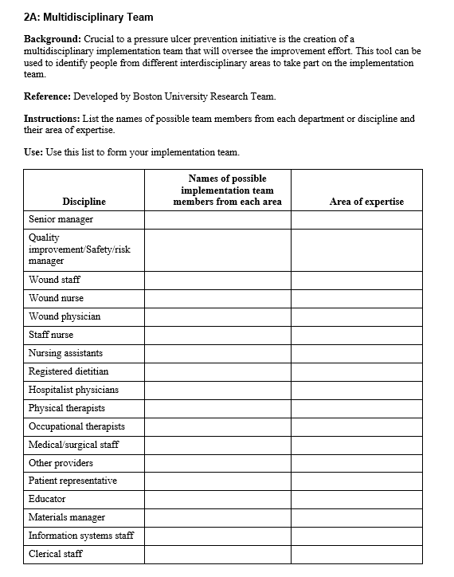
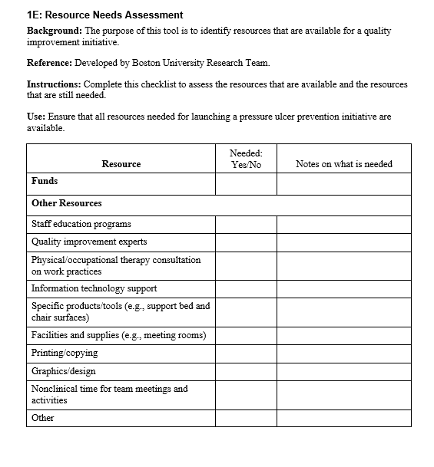
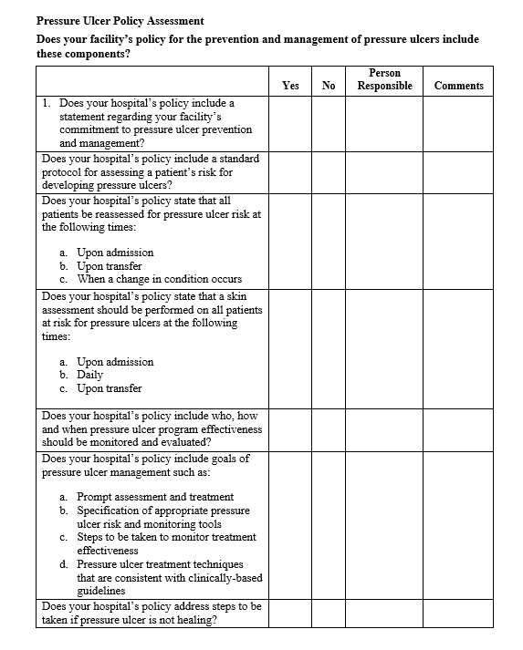
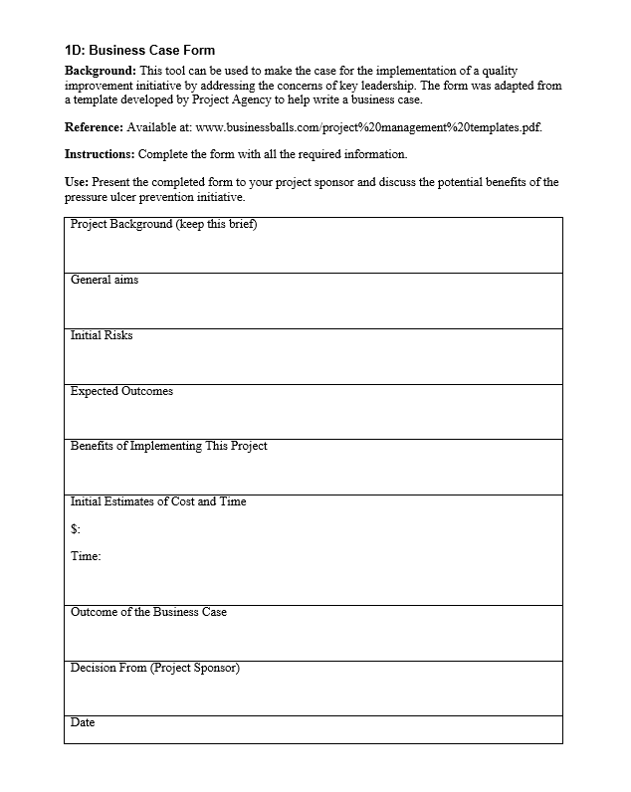
Practice Insight
Value of Pre-Assessment Tools

Slide 9
Training Objectives
Educate hospital leadership and Implementation Team on the Preventing Pressure Ulcers in Hospitals Toolkit to facilitate the change process in hospitals.
Develop hospital-specific action plans for implementing a pressure injury prevention program using the Toolkit.
Address the specific challenges of preventing pressure injuries in the hospital.
Use and adapt the tools and resources to implement the Pressure Injury Prevention Program.

Slide 10
Today’s Group Dynamics
Your Implementation Team Leader (or the designee) will present current assessments of your hospital’s procedures and policies.
Everyone here plays an important role.
  We encourage all to participate in planning activities.

Slide 11
Today’s Group Dynamics
“Parking lot” to capture your ideas:
  We’ll try to address your comments, but we may need to address them later during the Implementation Phase.
Much ground to cover today

Slide 12
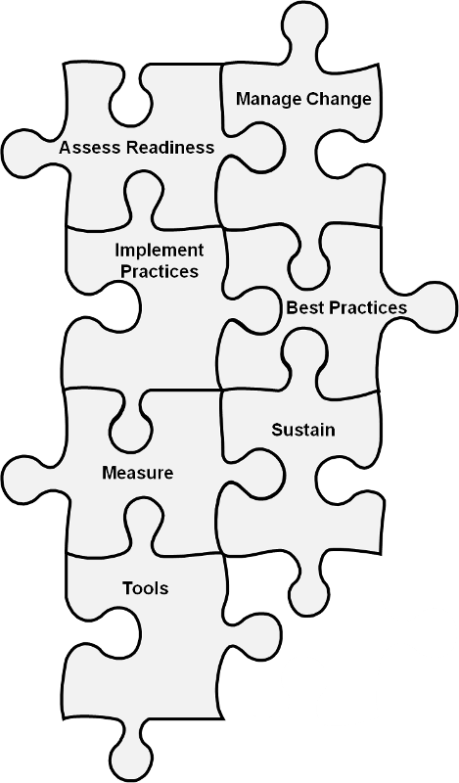
Implementation Training
The Toolkit focuses on:
Reducing pressure injuries during a patient’s hospital stay.
Successfully negotiating the change process at your hospital.

Slide 13
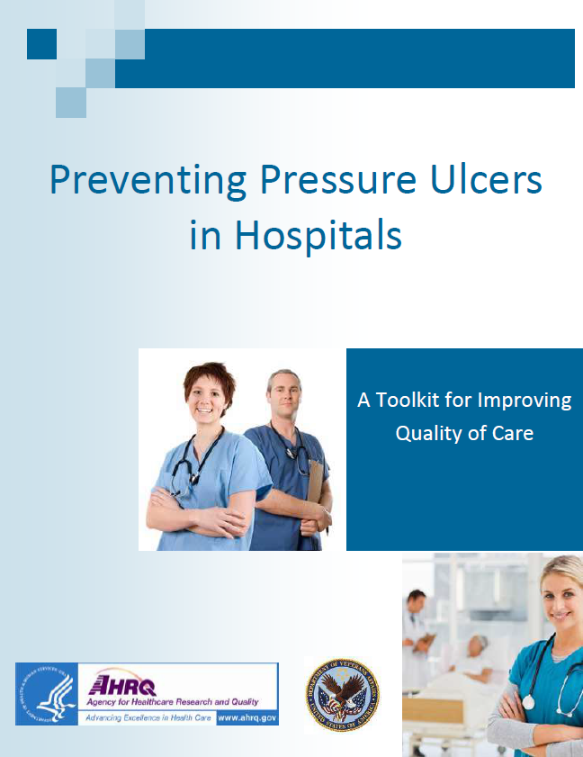
Preventing Pressure Ulcers in Hospitals Toolkit
Toolkit Sections:
Is your hospital ready for this change?
How will you manage change?
What best practices in pressure injury prevention do you want to use?
How do you implement these best practices in your organization?
How do you measure pressure injury rates and pressure injury prevention practices?
How do you sustain an effective Pressure Injury Prevention Program?

Slide 14

Toolkit Approach
The Toolkit focuses on an interdisciplinary approach.
  This approach pulls staff members from many areas with needed expertise to address the problem.
  Pressure injury prevention requires active engagement of multiple disciplines and teams that care for the patient.
  No clinician working alone can prevent pressure injuries.

Slide 15
Toolkit Approach
The Toolkit includes accurate, evidence-based, and effective risk assessments that call for:
  Critical thinking and clinical judgment—not just memorizing how to conduct assessments.
  Consistency in approach.
  Risk identification and communication at the earliest possible time.

Slide 16

Toolkit Approach
The Toolkit focuses on optimizing effectiveness of interventions by:
  Tailoring interventions to address individual risk factors.
  Assessing their effectiveness.
  Modifying interventions as appropriate.

Slide 17
Sustainment
“Holding the gains and evolving as required, definitely not going back to the old way.”
Maher L, 2013
Maher L, 2012

Slide 18
When Should We Worry About
Sustaining the Gains?
Actions to ensure sustainability must start at the beginning of a project.
If you leave it to the end, it will be too late to make any changes that are needed to maximize the potential of sustainability.
It is very important to ensure you have things in place from the beginning to achieve and sustain the best improvement outcome you can.
Notes:
People typically think that any consideration or action that might be needed to ensure sustainability of their improvement initiative can wait until the end of the project. We know that if you leave it to the end, it will be too late to make any changes that are needed to maximize the potential of sustainability.
Think about it in terms of baking a cake. If all the ingredients are measured out correctly, if the mixing is carried out in the right way, if the cake tin is prepared correctly, if the oven is at the right temperature, and the cake is baked for the prescribed amount of time, it is highly likely that the cake will turn out as expected or desired; however, by the end, it is often too late to rectify any problems.

Slide 19
Steps to Sustainability
Your Journey
Managing Change Checklist
Implementation Team composition
Team Leader has been identified and is in place.
Members with necessary expertise/role have been identified/invited.
Linkage to senior leadership has been defined and established.
Team startup
Team agenda and charge are clearly stated.
Team has necessary training and resources to get started.
Current state of pressure injury practice and knowledge
Current practice and policies have been systematically examined.
Challenges to good practice have been identified at organization and unit levels.
Staff knowledge has been assessed.
Starting the work of redesign
Approaches to redesign have been explored and chosen.
Gap analysis has been conducted between current practice and recommended practice.
Setting goals and plans for change
Specific goals have been set.
A plan for making changes to meet those goals has been initiated.
A preliminary plan for sustaining the changes is in place.
Source: AHRQ Preventing Pressure Ulcers in Hospitals Toolkit

Slide 20
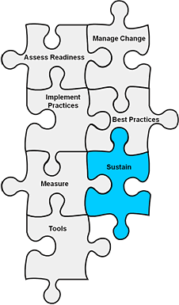
Sustaining Change
Sustain: Changes need to become so integrated into existing organizational structures and routines that they are no longer noticed as separate from business as usual.

Slide 21
High-Reliability Organizations
High-reliability organizations:
  Provide consistent performance at high levels of safety over long periods of time.
  Practice “collective mindfulness,” understanding that even small failures in safety protocols or processes can lead to catastrophic or adverse events if action is not taken to solve the problem.
  Eliminate deficiencies in safety processes through the use of powerful tools to improve their processes.
  Create an organizational culture that focuses on safety; they are constantly aware of the possibility of failure.
  Chassin MR, Loeb JM, 2013
  Chassin MR, Loeb JM, 2011

Slide 22
Components of Sustainability
Four key strategies:
  Engage Leadership
  Measure Continuously/Evaluate for Change
  Collaborate With All Disciplines
  Hardwire Practices and Educate

Slide 23

Leadership Support
High-level senior leadership buy-in
Designated pressure injury prevention Implementation Team Leader
Designated pressure injury prevention Implementation Committee/Interdisciplinary Team

Slide 24
Engage Leaders
It is the right thing to do—patient stories, their stories.
WIFM: What’s in it for me/them?
  Cost avoidance estimation
  Patient throughput
  Turnover reduction
Leaders: Aligning improvement efforts and organizational priorities
Senior executives: Sharing prevention plans (project charter), communicating needs and progress
Duval-Arnould J, Mathews SC, Weeks K, et al., 2012
Waters HR, Korn R Jr, Colantuoni E, et al., 2011

Slide 25
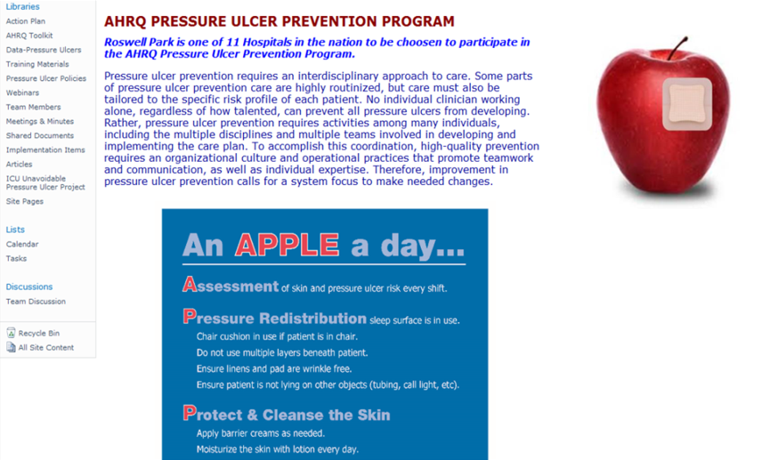
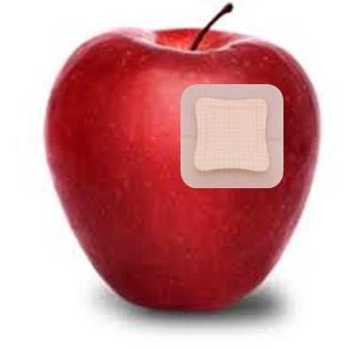
Practice Insight
Project Charter: Multidisciplinary Pressure Ulcer Prevention Program
Key Stakeholders: WOC, Nursing Staff, Physical Therapy, Nutrition
PROJECT DEFINITION
CRITICAL SUCCESS FACTORS
One of 11 U.S. hospitals chosen to participate in the AHRQ Pressure Ulcer Prevention Project.
Pilot Units: ICU, 6W, 7E
By using the toolkit provided by AHRQ, we will implement effective pressure ulcer prevention practices. The Toolkit’s content draws on literature on best practices in pressure ulcer prevention and includes both validated and newly developed tools that will be used by the Implementation Team charged with leading the effort to plan and put the new prevention strategies into practice.
GOAL: Decrease the overall rate of hospital-acquired pressure ulcers Stage 2 or greater to 1.0 or less.
How do we know we are successful?
By decreasing the # and rate of Stage 2 and above hospital-acquired pressure ulcers
By improving documentation within the EHR and provider notes (includes billing/coding)
By improving comparative rates and standing within Leapfrog, NDNQI, and U.S. News & World Report
By developing guidelines, interventions, processes, and tools that will assist staff in preventing and identifying skin issues earlier
SHAREPOINT SITE
IMPLEMENTATION TEAM
PROJECT LEADER: RN, CWOCN, OCN
UNIT LEADERS: 3 RNs and 1 HCA
CORE TEAM:
MS, CPHQ
RN, MSN, CWOCN
RN, BS, CWOCN
RN, BSN
RN, BSN
RN, MSN
RN, MSN, OCN
PhD
An APPLE a day keeps skin breakdown away

Slide 26
Engage Leaders
Leadership support:
  Seek vice president or higher.
  Engage support for team’s work.
  Rounding on unit—be purposeful.
    Script the rounds.
      How will the next patient in this unit be harmed?
      How can I help to remove barriers so that the safety defects we are most concerned about can be better addressed?
      How well does teamwork occur on this unit?
      What doesn’t work well?
    Use learning board as unit’s meeting point.
    Sexton JB, 2010

Slide 27

Practice Insight
Engage Leaders in Rounding on Units

Slide 28
Components of Sustainability
Four key strategies:
  Engage Leadership
  Measure Continuously/Evaluate for Change:
    Harness the power of local data to drive improvement efforts.
    Track prevention practices.
    Learn from defects.
  Collaborate With All Disciplines
  Hardwire Practices and Educate

Slide 29
Using Data for Continued Improvement
Continue to collect process and outcome data.
Set targets for process and outcome data.
Gather information from defects.
Use the data to identify opportunities and hardwire practices.
Share data with:
  Improvement Team.
  Frontline staff.
  Leadership.

Slide 30
Purpose of Measurement
Measuring pressure injury prevalence and incidence rates and looking at prevention practices tells you:
  If any areas of care can be improved.
  If you are meeting your aims.
  If practice changes improve incidence.
  If you are sustaining improvements.
If you don’t know where you are,
how do you know if you are improving?

Slide 31
Examining Processes To Understand Outcomes (Example)
Before intervention

Slide 32
Components of Sustainability
Four key strategies:
  Engage Leadership
  Measure Continuously/Evaluate for Change
  Collaborate With All Disciplines:
    Collaborate with multiple disciplines.
    Identify physician and nurse champions.
    Tap into the wisdom of frontline staff.
  Hardwire Practices and Educate

Slide 33

Power of Collaboration
Senior leadership support is important, but change comes most effectively from frontline staff. Tap into their wisdom.
Multidisciplinary collaboration
is essential to carrying out
pressure injury prevention.
Gaining buy-in from all involved
results in shared ownership of
positive prevention results.

Slide 34
Sustainable Collaboration
The pressure injury prevention group should:
  Continue to meet (or merge with an existing group).
  Report up through a quality structure.
  Have a vision with clearly defined goals and an associated action plan. (Update every 6-12 months.)
The Team and its goals should be:
  Aligned with its organization’s goals of preventing harm.
  Part of the dashboard.

Slide 35
Collaborative Relationships
Implementation Team
Large interdisciplinary team charged with designing and implementing pressure ulcer change project
Wound Care Team
Interdisciplinary group
of experts who provide
day-to-day care of skin and wound needs
Unit Champion (liaison between teams for individual units)
Unit-Based Team
Staff on the unit who provide daily care to patients, which includes skin and pressure ulcer assessment as part of all aspects of patient care needs

Slide 36
Components of Sustainability
  Four key strategies:
  Engage Leadership
  Measure Continuously/Evaluate for Change
  Collaborate With All Disciplines
  Hardwire Practices and Educate:
  Standardize care: prevention practices.
  Include practices in patients’ daily goals.
  Train new staff in evidence-based prevention practices.

Slide 37

Resource Needs Assessment
Your Implementation Team Leader filled out the Resource Needs Assessment (Tool 1E) with support from your hospital supervisors, managers, and administrators.
  This checklist helps identify
  needed resources:
    Funds
    Staffing needs
    Information technology
    support
    Products/tools
Tool 1E

Slide 38
Resource Needs Assessment
Team Leaders: Let’s share results of this assessment for your organization.

Slide 39
Team Charge
Implement a Pressure Injury Prevention Program within 8-10 months.

Slide 40
References
Centers for Medicare & Medicaid Services. Memo on never events, July 7, 2008. SMDL #08-004. http://downloads.cms.gov/cmsgov/archived-downloads/SMDL/downloads/SMD073108.pdf.
Chassin MR, Loeb JM. High-reliability health care: getting there from here. Milbank Q 2013 Sep;91(3):459-90. https://www.ncbi.nlm.nih.gov/pmc/articles/PMC3790522/. Accessed June 16, 2017.
Chassin MR, Loeb JM. The ongoing quality improvement journey: next stop, high reliability. Health Aff (Millwood) 2011 Apr;30(4):559-68. http://content.healthaffairs.org/content/30/4/559.long. Accessed June 16, 2017.
Duval-Arnould J, Mathews SC, Weeks K, et al. Using the Opportunity Estimator tool to improve engagement in a quality and safety intervention. Jt Comm J Qual Patient Saf 2012 Jan;38(1):41-7,1.
Maher L. Starting for Success. Partners In Care Programme: Webcall One. Health Quality & Safety Commission New Zealand. Counties Manukau Health. 2013. https://www.hqsc.govt.nz/assets/Consumer-Engagement/Partners-in-Care-Resource-page/Webex-1-starting-for-success-Oct-2013.ppt. Accessed June 16, 2017.
Maher L. Welcome to the Partners In Care Webex 6 – 3 October 2012. Health Quality & Safety Commission New Zealand. NHS. https://www.hqsc.govt.nz/assets/Consumer-Engagement/Partners-in-Care-Resource-page/Sharing-Partner-in-Care-Webex-6-Oct-2012.ppt. Accessed June 16, 2017.
Sexton JB. Engaging Leaders Webinar. 2010.
Sullivan N. Chapter 21. Preventing in-facility pressure ulcers. In: Making Health Care Safer II: An Updated Critical Analysis of the Evidence for Patient Safety Practices. Evidence Reports/Technology Assessments, No. 211. Rockville, MD: Agency for Healthcare Research and Quality; 2013.
Waters HR, Korn R Jr, Colantuoni E, et al. The business case for quality: economic analysis of the Michigan Keystone Patient Safety Program in ICUs. Am J Med Qual 2011 Sep-Oct;26(5):333-9.

