Slide 1
How To Manage Change
ADD Hospital Name
Module 2

Slide 2
QI Change Process
Change process strategies can be applied to other quality improvement (QI) efforts:
Hospital falls
Catheter-associated urinary tract infections
Deep vein thrombosis or pulmonary embolism after knee and hip replacement
Blood incompatibility

Slide 3
Module 2 Goals
Identify actions needed to improve organizational readiness.
Maximize the possibility of successful implementation by addressing these questions:
How can you set up the Implementation Team for success?
What needs to change, and how do you redesign practice?
How should goals and plans for change be developed?
How do you bring staff into the process?

Slide 4
Expected Outcomes
Finalize Implementation Team members and assign roles. (Tool 2A)
Present the completed process analysis on one patient care unit. (Tool 2C)
Present the assessment of current pressure injury prevention policies and procedures. (Tools 2D, 2E, and 2F)
Team Leader or designee completed assessment and folds recommendations into the action plan.

Slide 5
Expected Outcomes
Begin to write a draft Pressure Injury Prevention Action Plan, tailored to this hospital (see Tool 2I).

Slide 6
Implementation Team Guidelines
How often will you meet?
What are the ground rules for managing meeting time and communication?
How will you communicate with each other?
How will you communicate successes?
How will the Team do its work?
Small group work
Working meetings

Slide 7
Finalize Team Members
The first goal is to finalize the Implementation Team members and assign roles.

Slide 8
Successful Implementation Team
A strong link to hospital leadership
Members with the necessary expertise (Tool 2A)
Access to resources needed to accomplish the aim
Links to quality improvement expertise
Members who influence the areas involved in pressure injury prevention
Includes Pilot Unit Manager

Slide 9
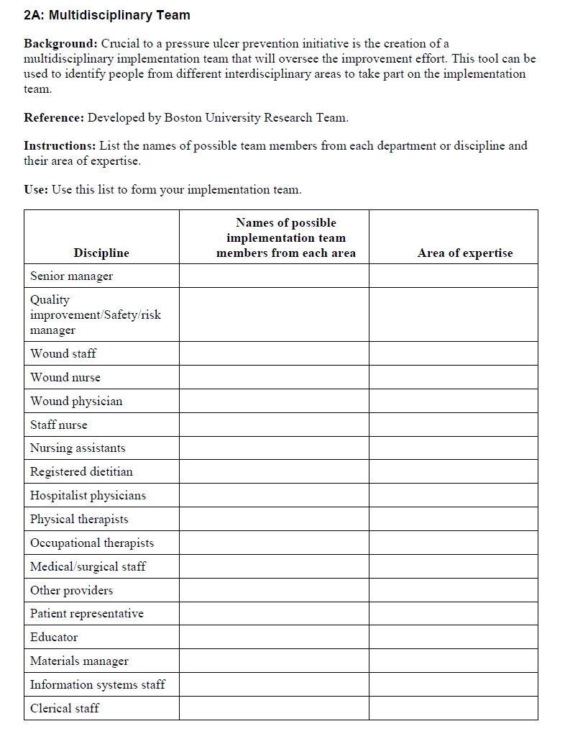
Multidisciplinary Team (2A)
Tool 2A

Slide 10
QI Process
Link the Pressure Injury Prevention Program with quality improvement.
This information helps you define resources this hospital has for quality improvement.
Plan, Do, Study, Act is one systematic approach to analysis and implementation.
Tool 2B
Page 27

Slide 11
QI Process
Your Implementation Team Leader filled out many assessment forms already.
We’ll be working to find solutions for positive change.
Let’s hear from your Implementation Team Leader about this hospital’s QI program and how to link with QI.

Slide 12
Collaboration
Pressure Injury Implementation Team
Wound Care Team
Unit Team

Slide 13
Collaborative Relationships
Implementation Team
Interdisciplinary team charged with designing and implementing pressure ulcer change project
Wound Care Team
Interdisciplinary group of experts who provide day-to-day care of skin and wound needs and are a resource for staff and patient/family
Unit-Based Team
Staff on the unit who provide daily care to patients, including skin and pressure ulcer assessment and care planning

Slide 14
Assess Current Pressure Injury Processes
Understand current processes in patient care units.
Use process mapping to examine key processes (Tool 2C).
Assess current practices on a representative sample of units; do process mapping.
Which practices need changing? Determine how to build in new practices.
Do the care processes follow best practices?

Slide 15
Practice Insight
Use of Shadowing To Assess Current Practices

Slide 16
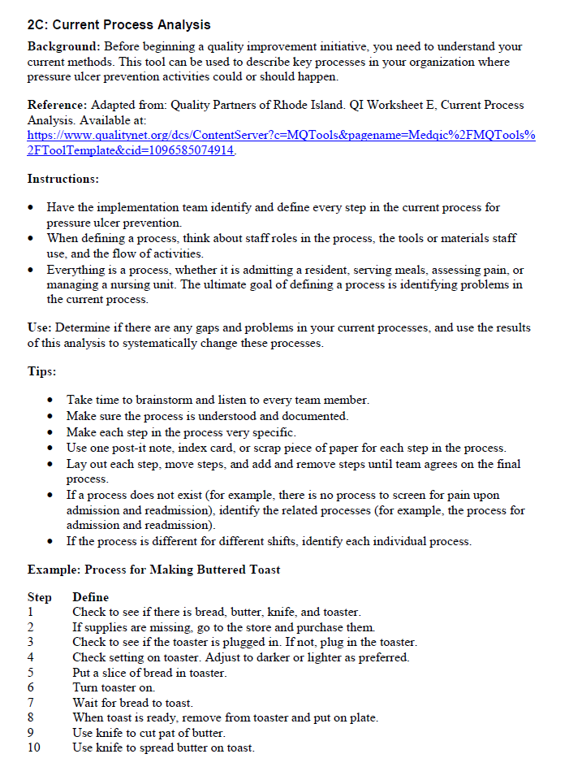
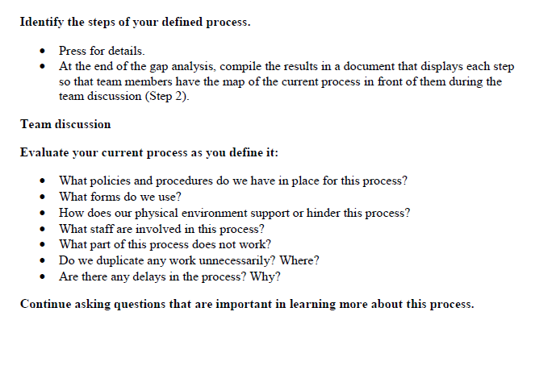
Current Process Analysis (2C)
Tool 2C

Slide 17
Current Process Analysis (2C)
Let’s hear from the team member(s) who completed the process analysis.
Share process mapping from the unit.
Point out key processes being used.

Slide 18
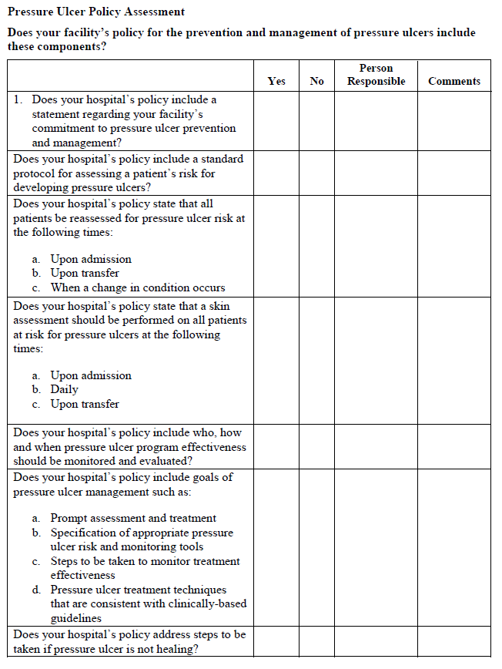
Assess Current Policies (2D)
Tool 2D

Slide 19
Assess Current Policies
The Implementation Team Leader identified the policies in place and areas for improvement.
You’ll want to address these areas in the Action Plan.
In Module 3, we’ll compare this assessment with best practices.
A group you designate may opt to do further fine tuning at a later time.
Let’s look at completed Tool 2D now.

Slide 20
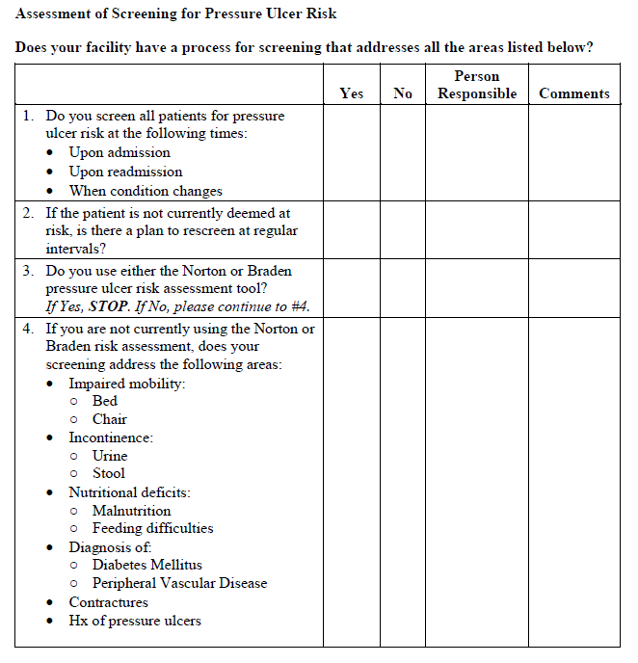
Assess Pressure Injury Screening Practices
Tool 2E

Slide 21
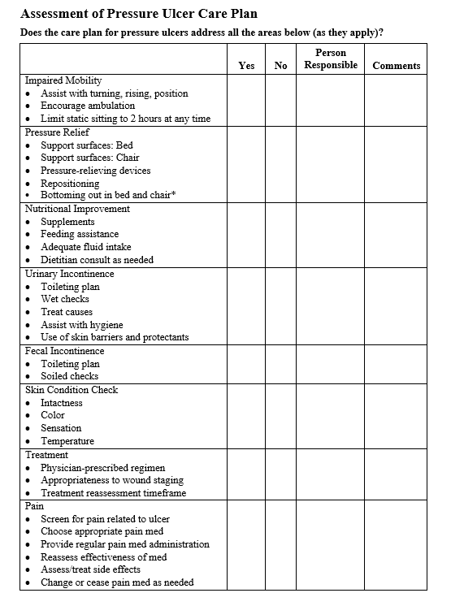
Assess Pressure Injury Care Planning Practices
Tool 2F

Slide 22
Implementation Action Plan
The Implementation Action Plan for change should address the following:
Membership and operation of the Implementation Team
Standards of care and practices to be met
How gaps in staff education and competency will be addressed

Slide 23
Implementation Action Plan
The Implementation Plan also addresses:
Plans for rolling out new standards and practices, where needed.
Staff accountability for monitoring implementation.
How changes in performance will be assessed.
How this effort will be sustained.

Slide 24
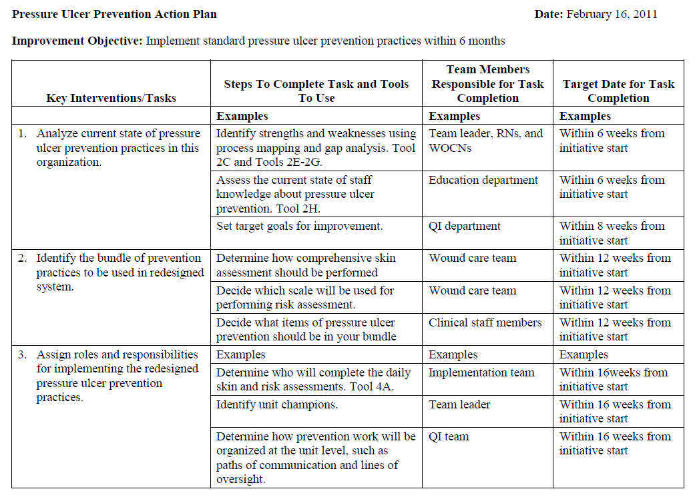
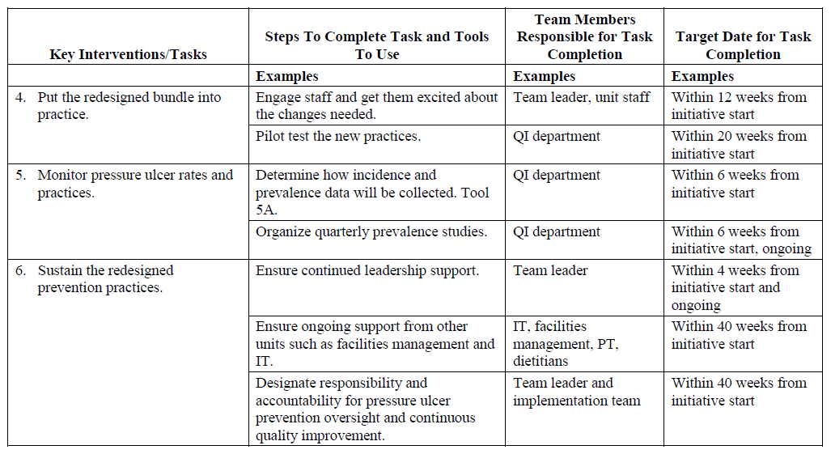
Sample Action Plan
Tool 2I

Slide 25
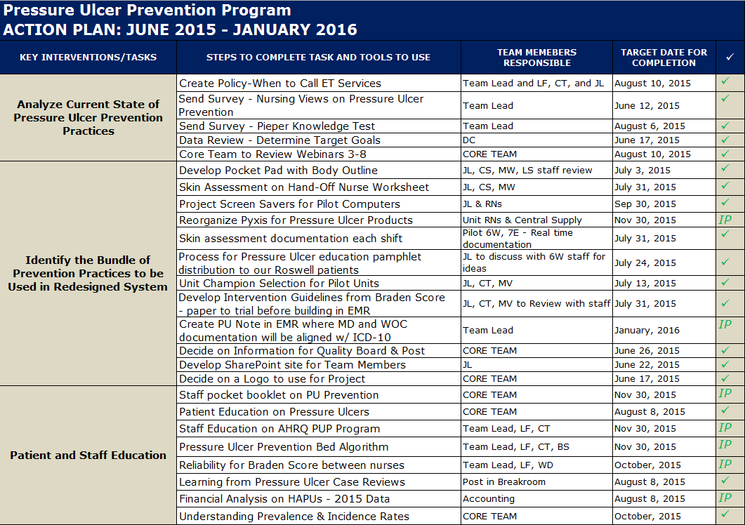
Practice Insight

Slide 26
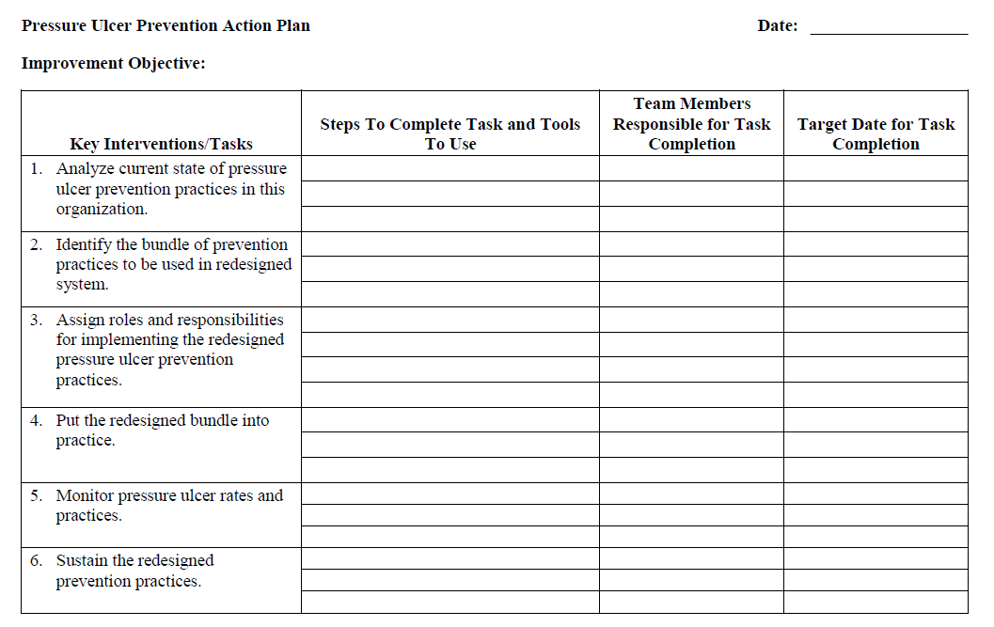
Action Plan
Let’s go over Tool 2I together.
Let’s discuss action steps for Key Intervention 1.
Then we can determine who is responsible for this task and when it tentatively will be completed.
Refer to your Action Plan Template.

Slide 27
Summary
Completed assessment of current policies and practices:
Pressure Injury Policies
Risk Screening Assessment
Care Planning Assessment
Current Process Analysis
Set up the Implementation Team
Developed a draft Action Plan for Key Intervention 1
Working document that can be revised

