Slide 1
Best Practices in
Pressure Injury Prevention
ADD Hospital Name
Module 3

Slide 2
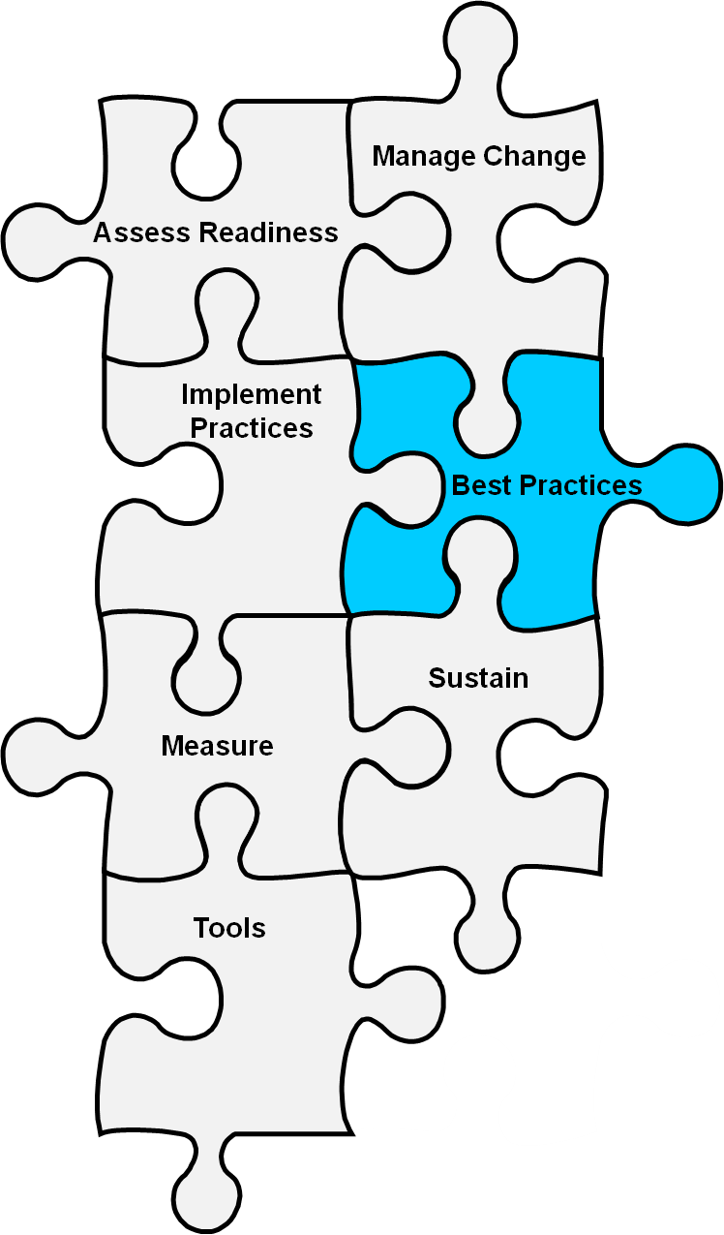
Best Practices
Best practices are those care processes—based on literature and expert opinion—that represent the best ways we currently know of preventing pressure injuries in the hospital.
AHRQ Patient Safety Network (PSNET) https://psnet.ahrq.gov/

Slide 3
Module 3 Goals
Identify opportunities for improvement:
  Which pressure injury prevention practices to use
  How to perform a comprehensive skin assessment
  How to conduct a standardized assessment of pressure injury risk factors
  How to incorporate risk factors into care planning
Note: At various points during the module, we’ll discuss which best practices you want to include in your prevention program.

Slide 4
Bundle of Best Practices
Pressure injury prevention practices checklist:
  Comprehensive skin assessment
  Standardized pressure injury risk assessment
  Care planning and implementation to address areas of risk

Slide 5
Comprehensive skin assessment
BEST PRACTICE

Slide 6
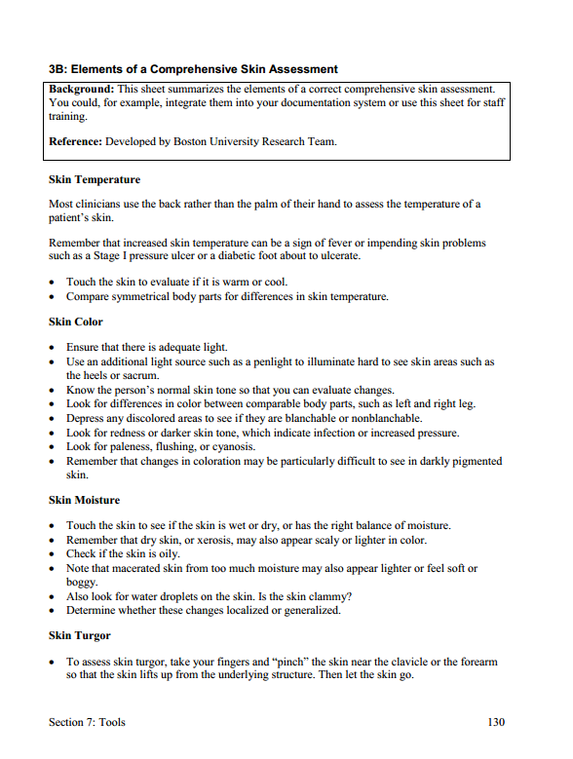
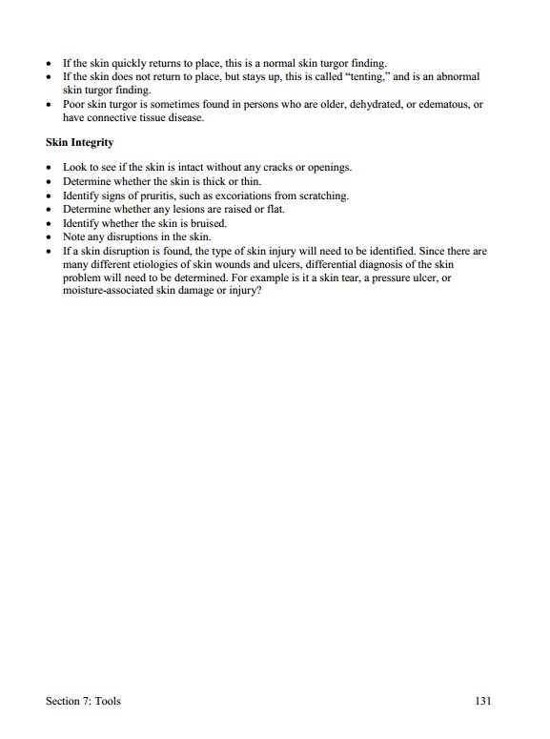

Comprehensive Skin Assessment
Examine the entire skin (from head to toe) for abnormalities.
Tool 3B

Slide 7
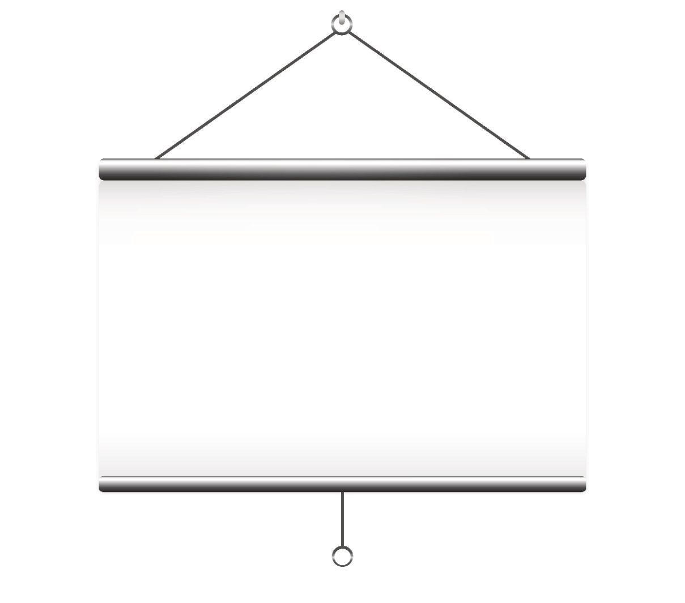
How To Do a Skin Assessment
Video Clip of Skin Assessment

Slide 8
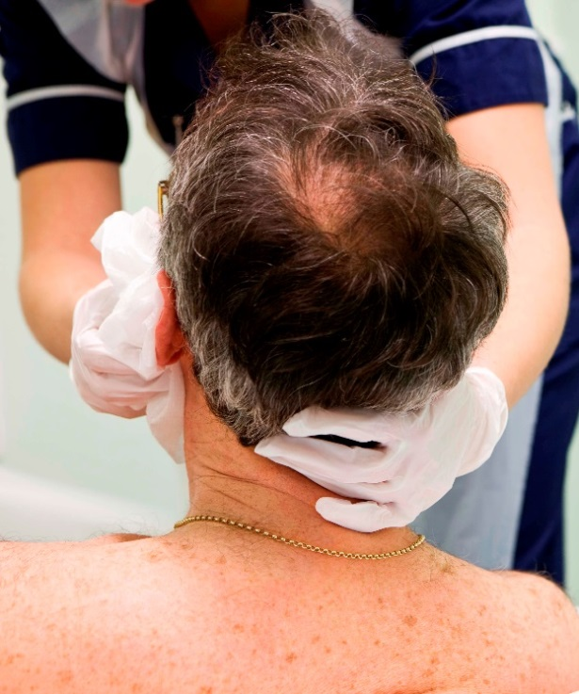
Skin Assessment Frequency
Not a one-time event
Repeated on a regular basis
Optimally done daily in a systematic manner by a single individual at a dedicated time
May be integrated into routine care—any time the patient is cleaned or turned

Slide 9
Medical Device Skin Assessment

Slide 10

Reporting and Documenting
Skin assessment results must be documented in the medical record. Then staff must be made aware of the assessment.

Slide 11
Barriers to Practice
Finding time for skin assessments
Determining correct etiology of wounds
Using inadequate documentation forms
Lacking ways to empower staff to report abnormal skin findings:
  Consider using Tool 3C: Pressure Ulcer Identification Pocket Pad.

Slide 12
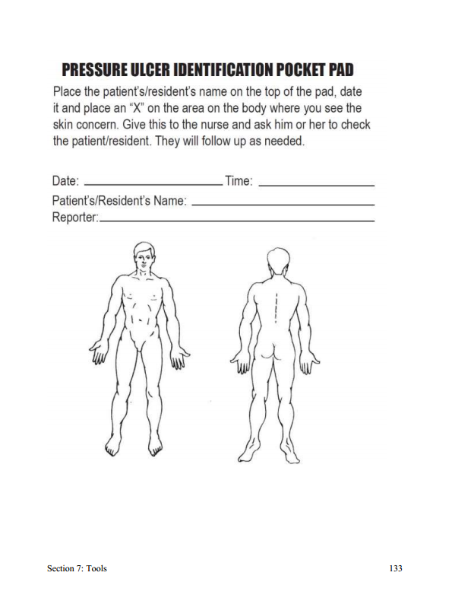
ID Pocket Pad
Tool 3C

Slide 13

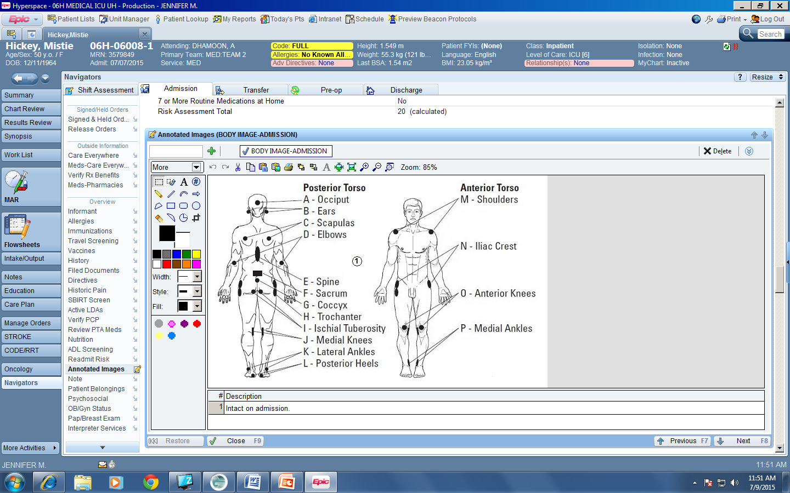
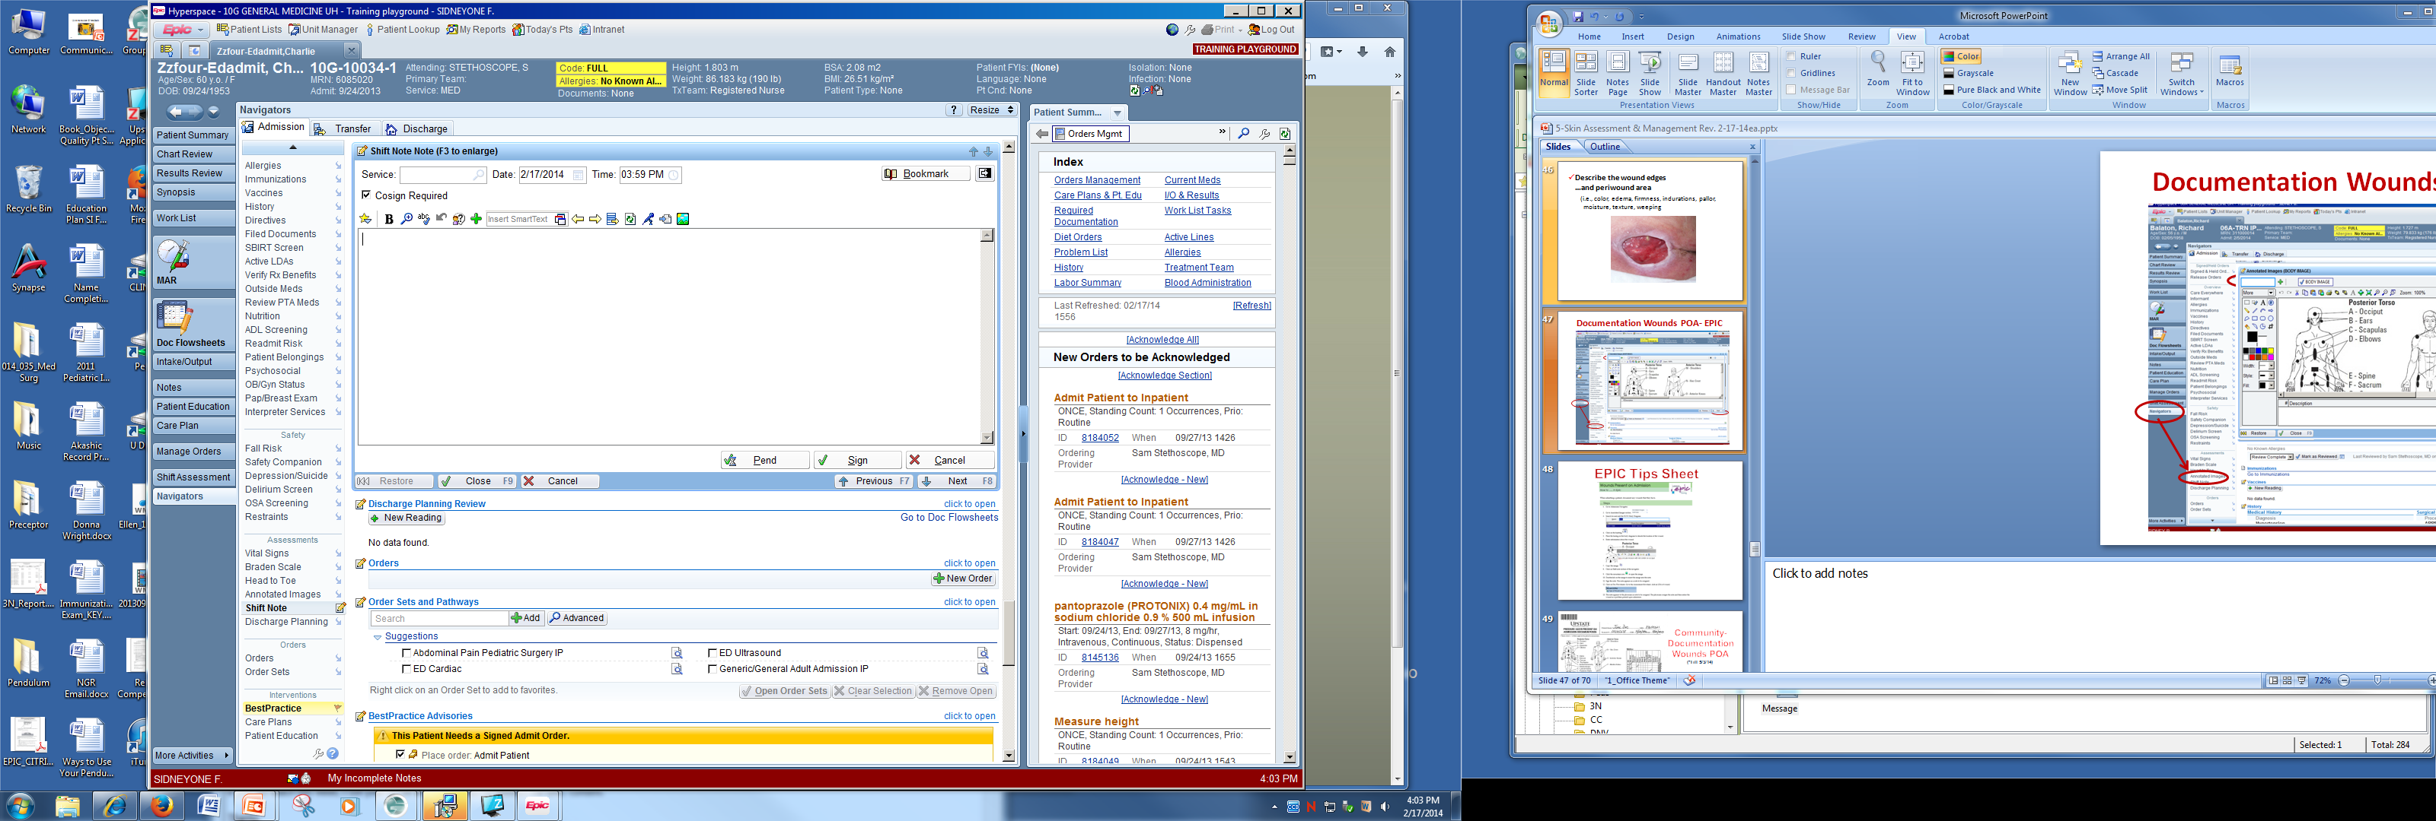
Practice Insight
Complete within first 24 hours of admission
Cosign required
If pressure injury is POA, make sure that document is sent to be cosigned by the medical provider.
Annotated image needs to be completed on all admissions even if no skin disruption is found.
Or note location if skin disruption noted

Slide 14
Improving Assessment Practice
Ask a colleague to confirm skin assessment.
Perform skin assessment with an expert.
Ask for clarification.
Use available resources.
See tips for making assessments part of the routine.
Page 42

Slide 15
Pressure Injury risk assessment
BEST PRACTICE

Slide 16
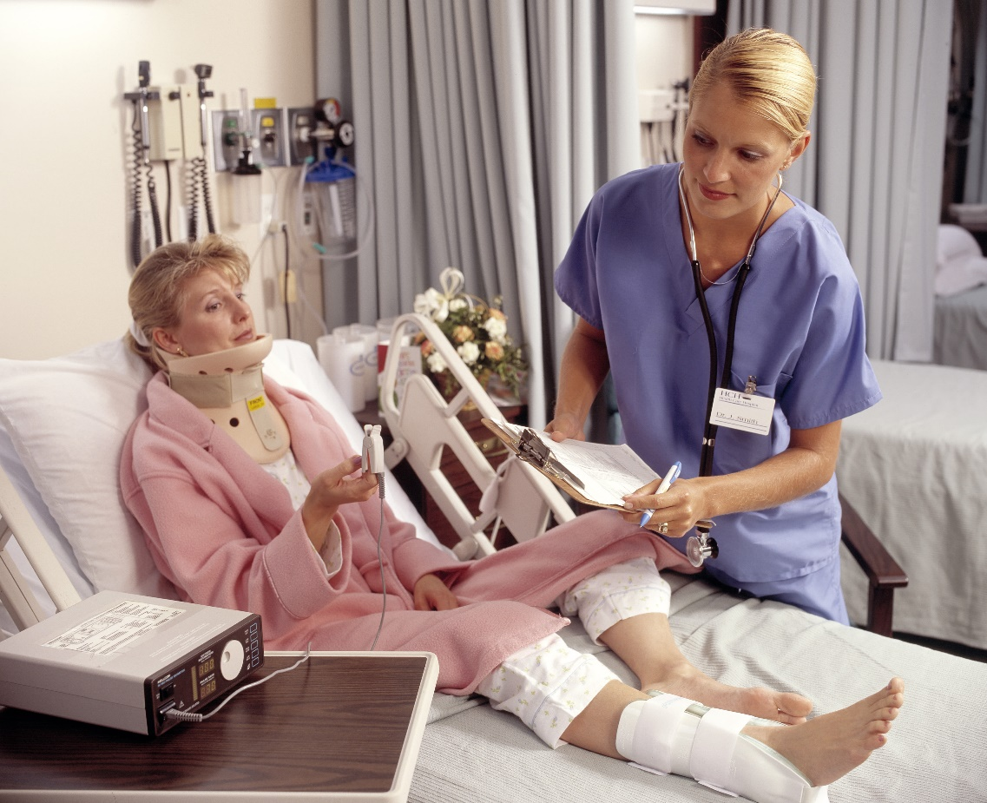
Pressure Injury Risk Assessment
Next step in prevention
Goal: to identify patients at risk

Slide 17
Risk Assessment Scales
Only one part of risk assessment
Meant to be used in conjunction with a review of other risk factors and clinical judgment
  More factors to consider
Especially helpful in identifying patients at mild to moderate risk
Two widely used scales:
  Braden Scale (Tool 3D)
  Norton Scale (Tool 3E)
Page 44

Slide 18

Braden Scale
Six subscales, scored from 1-4 or 1-3:
  Sensory perception
  Moisture
  Activity
  Mobility
  Nutrition
  Friction/shear

Slide 19
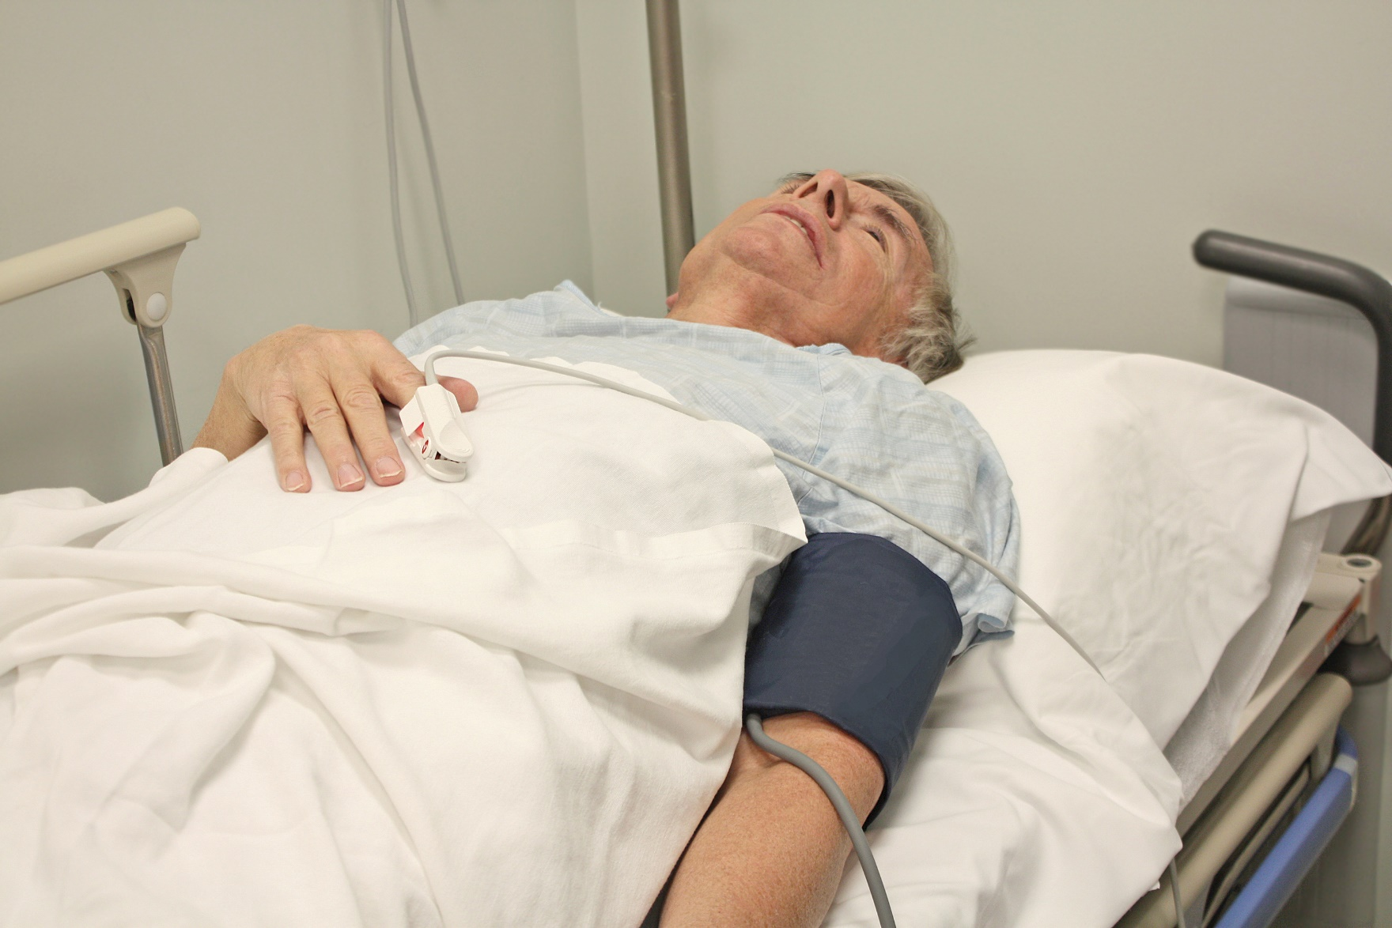
Risk Assessment Case Study – Mr. K

Slide 20
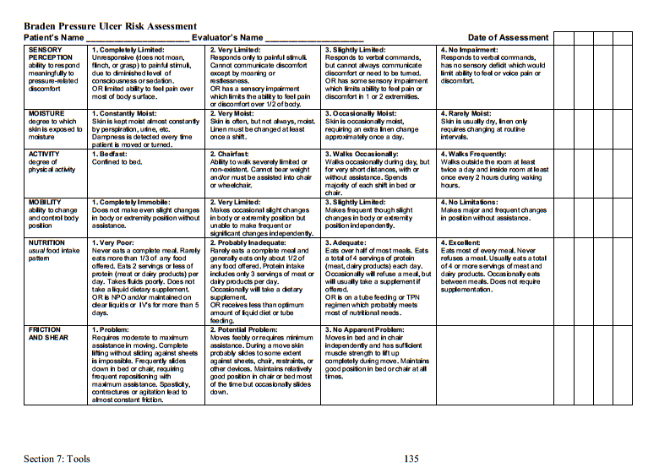
Braden Scale – Mr. K

Slide 21
How Often?
Recommendations vary.
In general acute care settings, do risk assessment upon admission, then daily or with a significant change in condition.
In critical care settings, frequent assessments should be done, such as at every shift.
For risk assessment in pediatrics.
Page 46

Slide 22
Documentation
Have computerized (or paper) form in medical record.
Incorporate results in daily patient flowsheet.
Include results in patient report or handover.

Slide 23

Next Steps
Knowing which patients are at risk is not enough; you must also do something about it.
Care planning guides what will be done to prevent pressure injuries.

Slide 24
Pressure Injury care planning
BEST PRACTICE

Slide 25
Care Planning
A process to transfer the patient’s risk assessment information into an action plan to address his or her needs:
  Implement care practices so that your patient does not develop a pressure injury.
  Develop a care plan for any area of risk.
  Tailor the plan to fit the patient’s needs.
  Modify as needed to capture your patient’s response to interventions and any changes in condition.

Slide 26
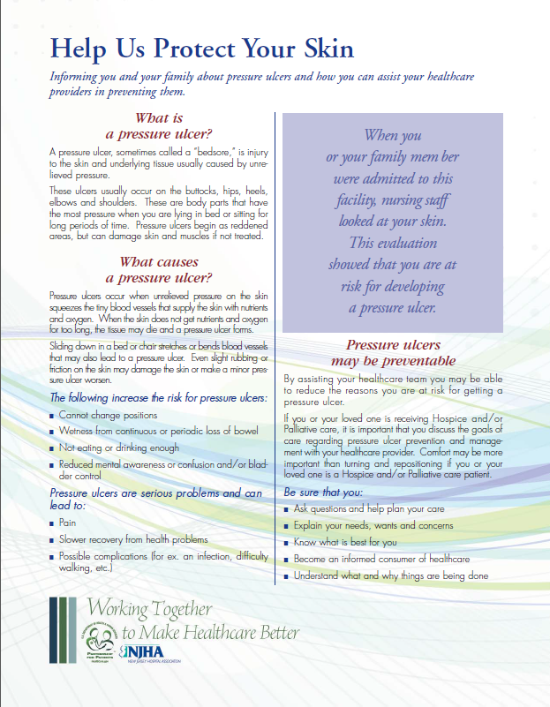
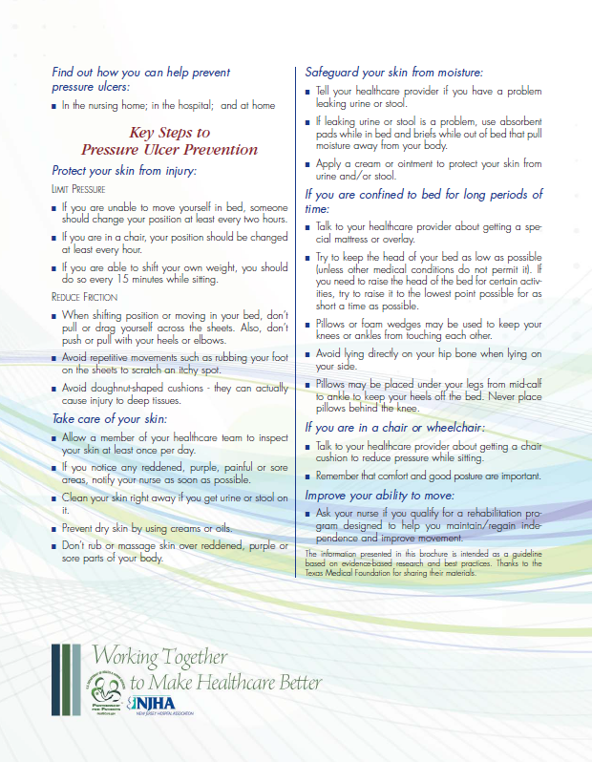
Patient and Family Education
Tool 3G
Updated brochure available at: http://www.njha.com/media/43477/puconsumereng.pdf

Slide 27
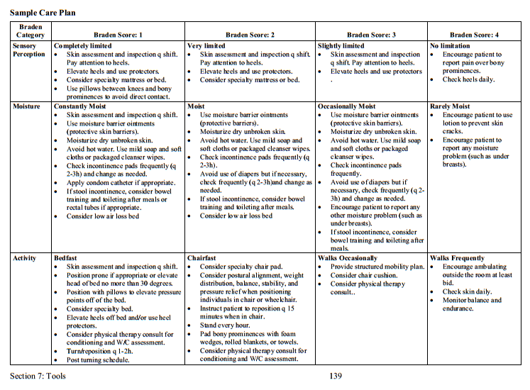
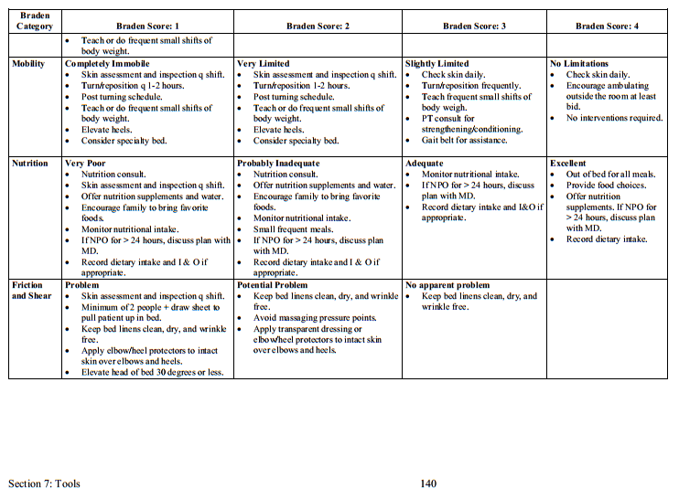
Sample Care Plan
Tool 3F

Slide 28
Practice Insight
EHR Care Plans Triggered Based on Risk Assessment
Braden Scale for Predicting Pressure Sore Risk
SENSORY PERCEPTION | 1. Completely Limited | 2. Very Limited | 3. Slightly Limited | 4. No Impairment
MOISTURE | 1. Constantly Moist | 2. Very Moist | 3. Occasionally Moist | 4. Rarely Moist
ACTIVITY | 1. Bedfast | 2. Chairfast | 3. Walks Occasionally | 4. Walks Frequently
MOBILITY | 1. Completely Immobile | 2. Very Limited | 3. Slightly Limited | 4. No Limitation
NUTRITION | 1. Very Poor | 2. Probably Inadequate | 3. Adequate | 4. Excellent
FRICTION & SHEAR | 1. Problem | 2. Potential Problem | 3. No Apparent Problem
© Barbara Braden and Nancy Bergstrom, 1988. Used with permission. |  |  |  | Total Score
Sensory Perception
Less than 3
Sensory Perception Care Plan Triggered
Moisture
Less than 4
Moisture Care Plan Triggered
Activity
Less than 3
Activity Care Plan Triggered
Mobility
Less than 3
Mobility Care Plan Triggered
Nutrition
Less than 3
Nutrition Care Plan Triggered
Friction & Shear
Less than 3
Friction & Shear Care Plan Triggered
Notes:
Care plans are “triggered” based on each individual assessment category. This approach allows early prevention to begin with as little as one risk category and does not depend on the total Braden score.

Slide 29

Improve Care Planning
Ensure that staff appreciate the value of care planning.
  Let staff know their roles and responsibilities in reducing pressure injury incidence.
  Empower staff to carry out their roles.

Slide 30

Improve Care Planning
Make care planning more streamlined—link to the assessment task.
  Document using the computer to tie the assessment directly to the care plan (saves time).
  Use prompts to update the plan as your patient’s condition changes (helps ensure his or her needs will continue to be met).

Slide 31
Improve Care Planning
Examples of prompts linked to routine practice:
  Generate a reminder to conduct pressure injury risk assessment when a patient is in the OR for more than 4 hours.
  Order support surfaces and skin care products for patients you identify as at risk.
  Include the care plan in shift reports and patient handoffs.
Remember: Let all levels of staff know what is required daily so they automatically carry out the task.

Slide 32
Identify your bundle of best practices

Slide 33
Identify Best Practices
Comprehensive skin assessment
Standardized risk assessment:
  Norton? Braden? Waterlow?
  Another validated scale?
Care planning

Slide 34
Identify Best Practices
Comprehensive skin assessment:
  Would you recommend that each admitted patient receive a skin assessment?
  When would you recommend it get done again, if needed?
  How do you want the assessment to be conducted?

Slide 35
Identify Best Practices
Risk assessment:
  Which standardized risk assessment scale do you plan to use?
  When do you plan to complete risk assessments?

Slide 36
Identify Best Practices
Care plan:
  Does your current pressure injury planning process suffice for your prevention program?
  Or should it be revised? If so, who will revise it?

Slide 37

Best Practices
Need to be customized:
  Each patient has a different set of pressure injury risk factors, so care must address each patient’s unique needs.

Slide 38
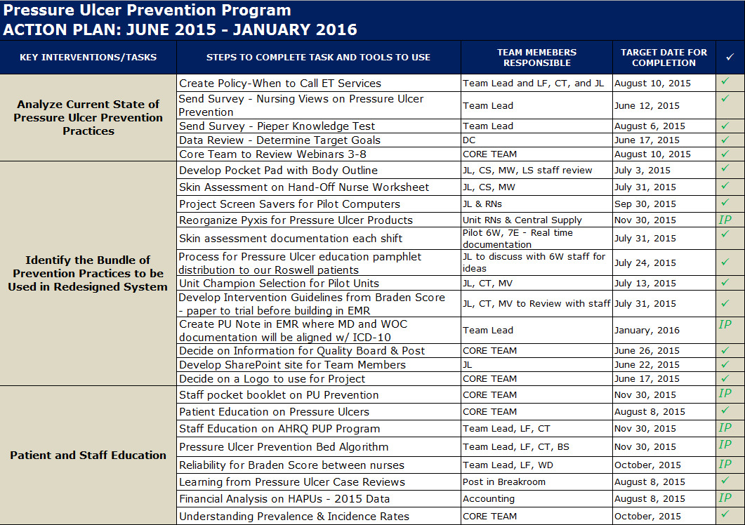
Practice Insight

Slide 39
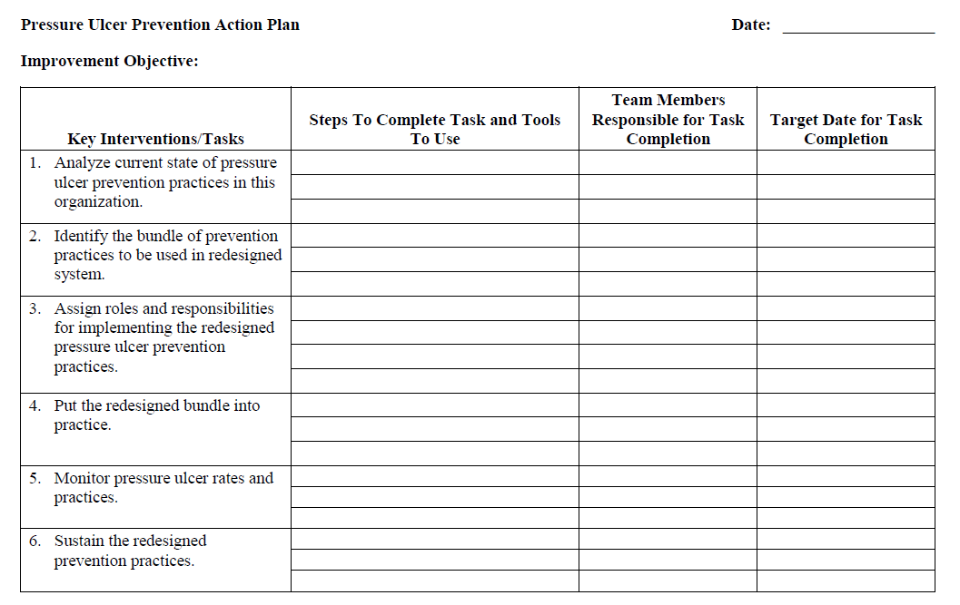

Action Plan
Discuss action steps for Key Intervention 2.
Determine who is responsible for this task and when it will be completed.
Refer to your
Action Plan Template.

Slide 40
Summary
We reviewed:
  Comprehensive skin assessment.
  Braden and Norton risk assessment tools.
  Care planning.
You identified best practices for your hospital.
You completed Key Intervention 2 of the Action Plan.

