Slide 1
How To Implement the Pressure Injury Prevention Program in Your Organization
ADD Hospital Name here
Module 4

Slide 2
What We Have Done Thus Far
Up to this point, you have:
Looked at your organization’s readiness to improve pressure injury prevention (Module 1).
Examined current practices and identified aspects needing improvement (Module 2).
Examined best practices and made preliminary decisions on what best practices will be included in your Pressure Injury Prevention Program (Module 3).

Slide 3
Following Best Practice
The Implementation Team will work with the Unit Teams and Wound Care Team to implement the new prevention practices.

Slide 4
Implementation Planning Goals
Determine the roles and responsibilities of staff in preventing pressure injuries.
What role will the Unit Team and Wound Care Team play?
What role will the Unit Champions play?
When will they be oriented and integrated into the implementation process?
How should prevention work be organized at the unit level?

Slide 5
Planning Goals
Plan how you will:
Put best practices into operation.
Manage the change process on patient care units.
Pilot test the new best practices.

Slide 6
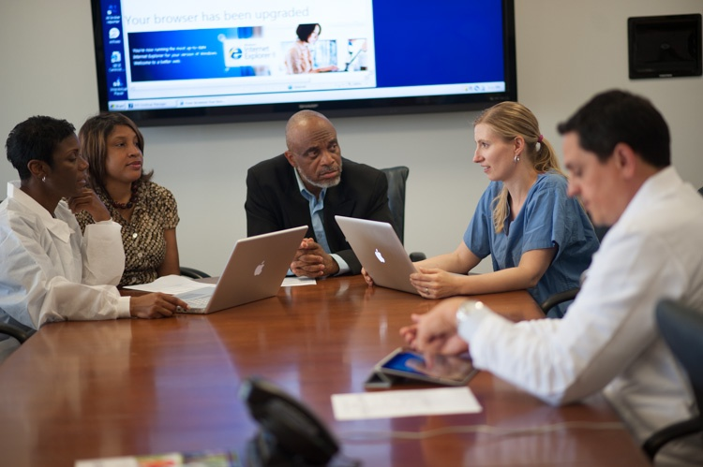
Planning Goals
Plan how you will:
Get staff engaged and excited about pressure injury prevention.
Educate staff on new best practices.

Slide 7
Staff Roles
Assign staff to perform each specific task in your set of best practices, based on training and experience.

Slide 8
Staff Roles
In some cases, a group will perform the task based on specific roles, such as a group of certified nursing assistants.
Other tasks may be assigned to a specific person.
In that case, be sure to assign a backup person.

Slide 9
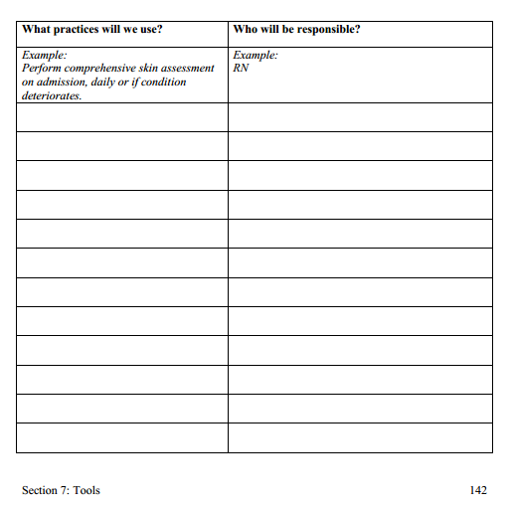
List of Best Practices
Preliminary list of best practices
Tool 4A

Slide 10
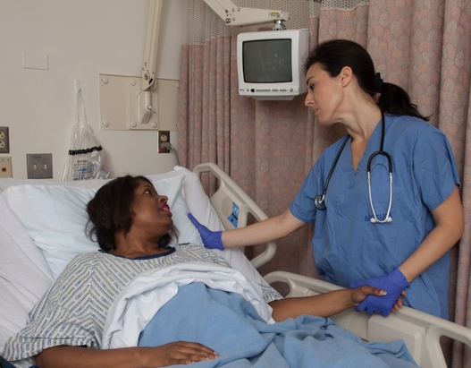
Staff Roles

Slide 11
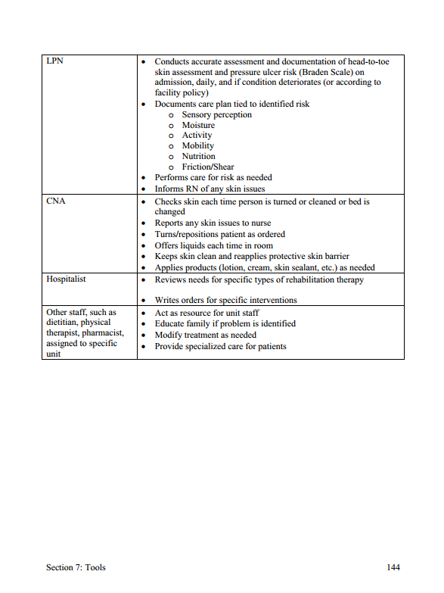
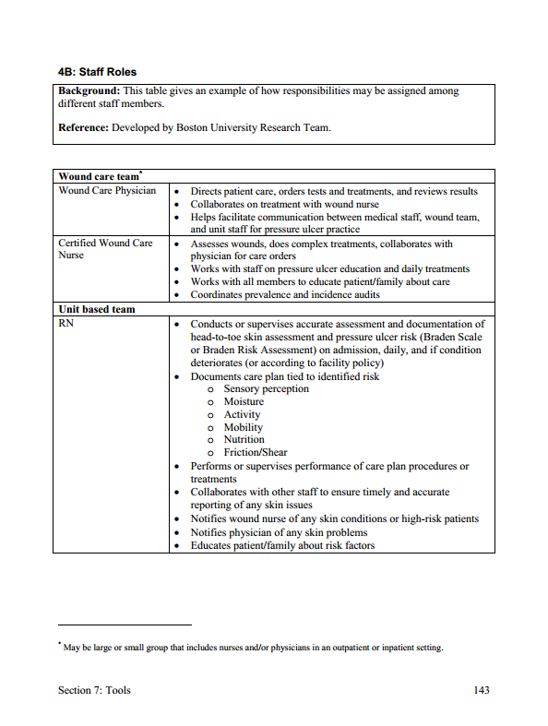
Staff Roles
Examples of how responsibilities may be assigned
Tool 4B

Slide 12
Staff Roles
Using Tool 4B, think about how you may want to divide responsibilities.
Members of the Unit Team
Hospital staff members whose work brings them to the unit or includes interacting with the unit
Consider forming a small Task Force.
Appoint a Task Force Team Lead, and ask for volunteers to work on this task.

Slide 13
Wound Care Team Role
Serves as this hospital’s content experts on pressure injury prevention
Has experts and resources in current wound care practice
May be a formal or informal department, or an individual clinician

Slide 14
Unit Team Role
Staff members who provide daily direct patient care by:
Conducting skin assessments.
Conducting pressure injury risk assessments.
Planning care for risk prevention.
Ensuring care is performed and documented.

Slide 15
Unit Team
The Unit Team works collaboratively with the Wound Care Team.
Unit staff tell the Wound Care Team about high-risk patients or if skin problems occur.
Pages 59-61

Slide 16
Unit Team
Make sure you include a written plan for orienting and monitoring temporary staff.

Slide 17
Unit Champion
Staff member who serves as the liaison between the Implementation Team, the Wound Care Team, and the Unit Team
Most familiar with the program goals, care processes, and outcome data to be used
Critical during the implementation process (may be temporary)
Ideally, one champion per shift, per unit

Slide 18
Practice Insight
Hospital leadership supported:
Save Our Skin Unit Champion 4-hour boot camp
Key result: 40% knowledge increase
Bimonthly Unit Champion pressure injury prevention/ wound care lunch and learn sessions

Slide 19
Staff Turnover
All hospitals experience the challenges of staff turnover.

Slide 20
Practice Insight
Staff Turnover

Slide 21
Communication Patterns
Good communication needs to occur among staff at all levels.
Within the unit (among nurses, nurse assistants, physicians, and patients and their families)
Among unit staff, the Implementation Team, the Wound Care Team, and senior management

Slide 22
Communication Patterns
Communicate how changes are actually happening.
Unit Champions can present updates on implementation at regularly scheduled meetings.
This can be done thoroughly and succinctly with the least amount of time and effort.

Slide 23
Integrate Prevention Into Ongoing Processes
Necessary for sustainability.
Integrated into regular communications (e.g., shift handoffs).
Make certain procedures (such as skin assessments) universal so staff do not have to decide which patients they apply to.
Ensure nurses have access to supplies.
Create visual cues/logos (turning clocks to remind staff when repositioning is due).
Other examples?
Page 65

Slide 24
Electronic Health Record Opportunities
What information about pressure injury risk factors is already part of the patient record?
What is the most logical place in the record to collect, organize, and assess information about patient pressure injury risk factors and any necessary precautions?
Additional suggestions?
Page 66

Slide 25
Manage the Change Process
Ensure staff understand new roles.
Ensure staff understand reasons for change and agree change is needed.
Convey that pressure injury prevention is part of high-quality care and is valued by all, including senior hospital leadership.

Slide 26
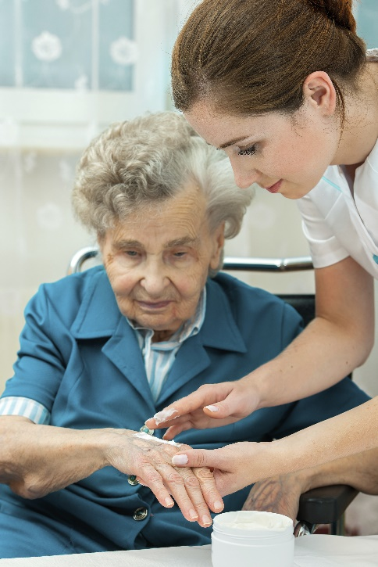
Manage the Change Process
Have adequate access to supplies:
Dressings
Skin creams
Engage staff to gain support and buy-in to tailor new practices.
Encourage staff to speak up if supplies and equipment are lacking, missing, or broken.

Slide 27
Monitor Implementation Progress
Baseline measures of pressure injury rates and processes should be obtained before any change.
Tracking care processes to prevent pressure injury is a measure of implementation success and should translate to better outcomes.
Outcome measures: track changes in pressure injury rates.
Inform the Implementation Team and staff about results.

Slide 28
Monitor Implementation Progress
Close the loop.
Have the Implementation Team report to the unit what it did with the information the unit provided.

Slide 29
Communicate Success
Methods for sharing updates and information on successes from prevention activities to the rest of the hospital include:
Posters with results in the units or lunchroom.
Newsletter articles.
Email blasts.
Announcements on the hospital’s Web page.
Discussions during staff meetings.

Slide 30
Sustain Pressure Injury Prevention
Close the information loop. Inform senior leaders and middle managers about progress.
Keep clinical staff informed about progress with pressure injury prevention.

Slide 31
Staff Education and Training
Develop an education plan.
Adults learn best through experiential activities.
Don’t forget prevention education for the patient and family members and significant others.
See Tool 3G: Patient and Family Education.

Slide 32
Staff Education and Training
You can use a variety of educational approaches, such as didactic methods (e.g., lectures and interactive presentations).

Slide 33
Practice Insight
Problem: assessment/care plan/documentation
Staff Education: RN, CEO, CNO, PCT
2-hour didactic competency training:
Braden risk assessment and patient comorbidity review
5 in 5 Visual Assessment Tool for pressure injuries
Many visuals of actual patients
Appropriate interventions based on risk – review of all products
How to document implementation and maintenance of plan
1-hour hands-on skills lab – 3 scenarios
Key results:
Assessment/care planning accuracy improved from 50% to 90%.
Continued issue with documentation.

Slide 34
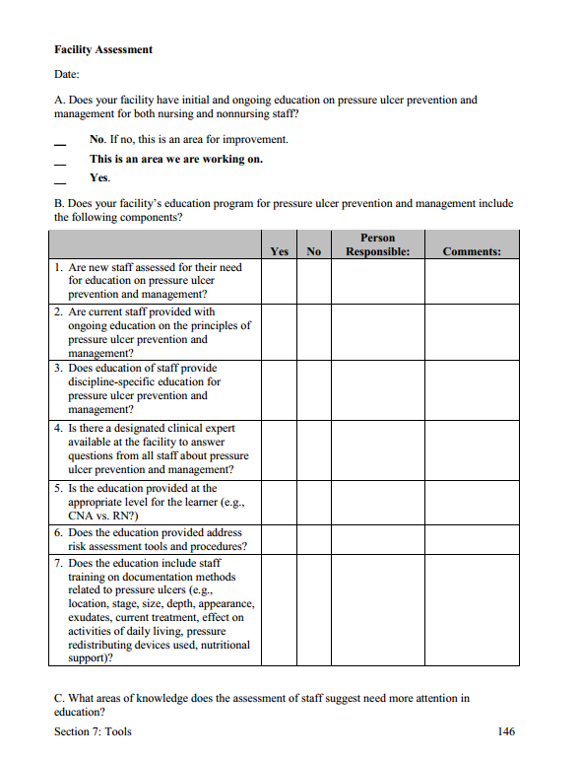
Group Activity: Assess Staff Education
Assess current staff education.
Assess educational needs.
Tool 4C

Slide 35
Staff Knowledge Assessment
Tool 2G: Pieper Pressure Ulcer Knowledge Test

Slide 36
Staff Education and Training
Regular/ongoing education means including pressure injury prevention in four areas of training:
Annual education for all staff
Staff competencies
New staff orientation
Training of temporary staff

Slide 37
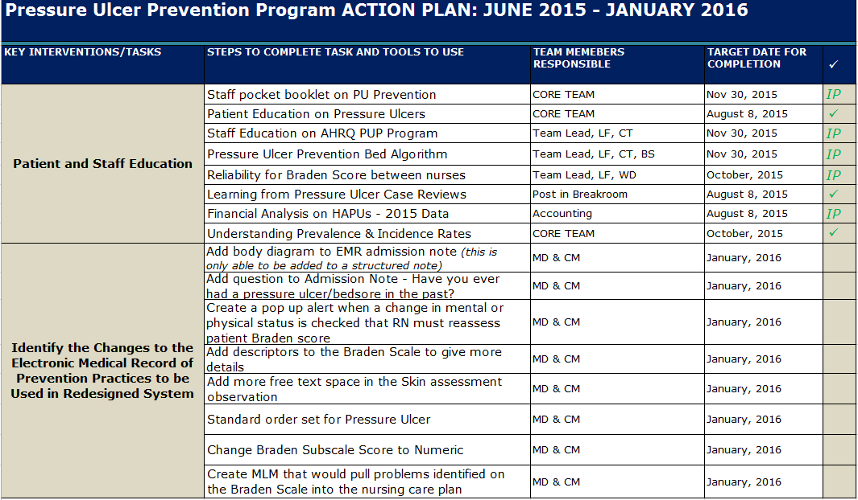
Practice Insight
12

Slide 38
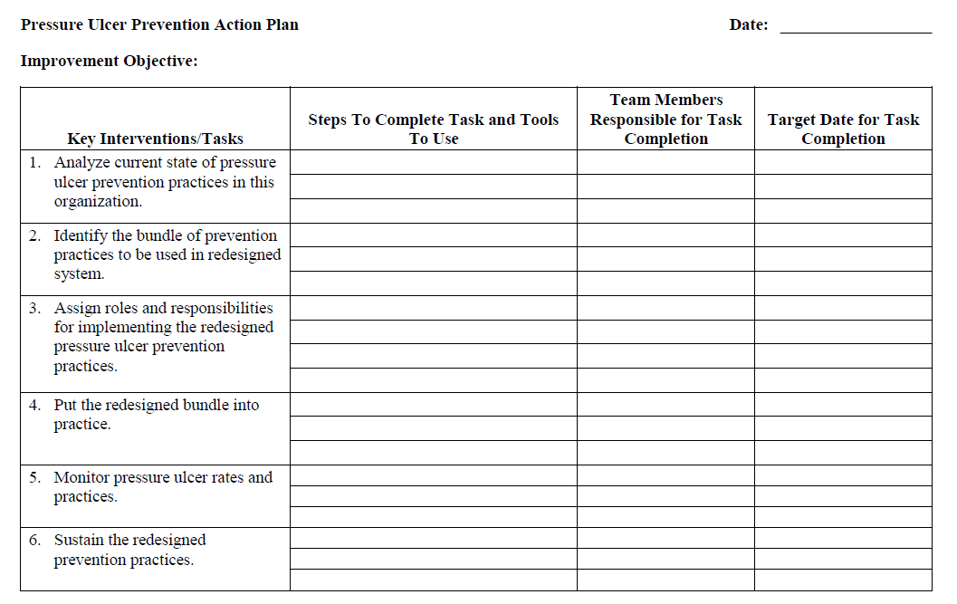
Action Plan
Action Steps for Key Interventions 3 and 4
Refer to your Action Plan

Slide 39
Summary
To summarize, we addressed the following:
Roles and responsibilities of the Unit Team, Wound Care Team, and Implementation Team in preventing pressure injuries
Importance of the Unit Champions
Communication during implementation
Staff training needs to learn new practices
Action Plan for putting the prevention program into practice

