Slide 1
How To Measure
Pressure Injury Rates and Prevention Practices
ADD Hospital Name Here
Module 5

Slide 2
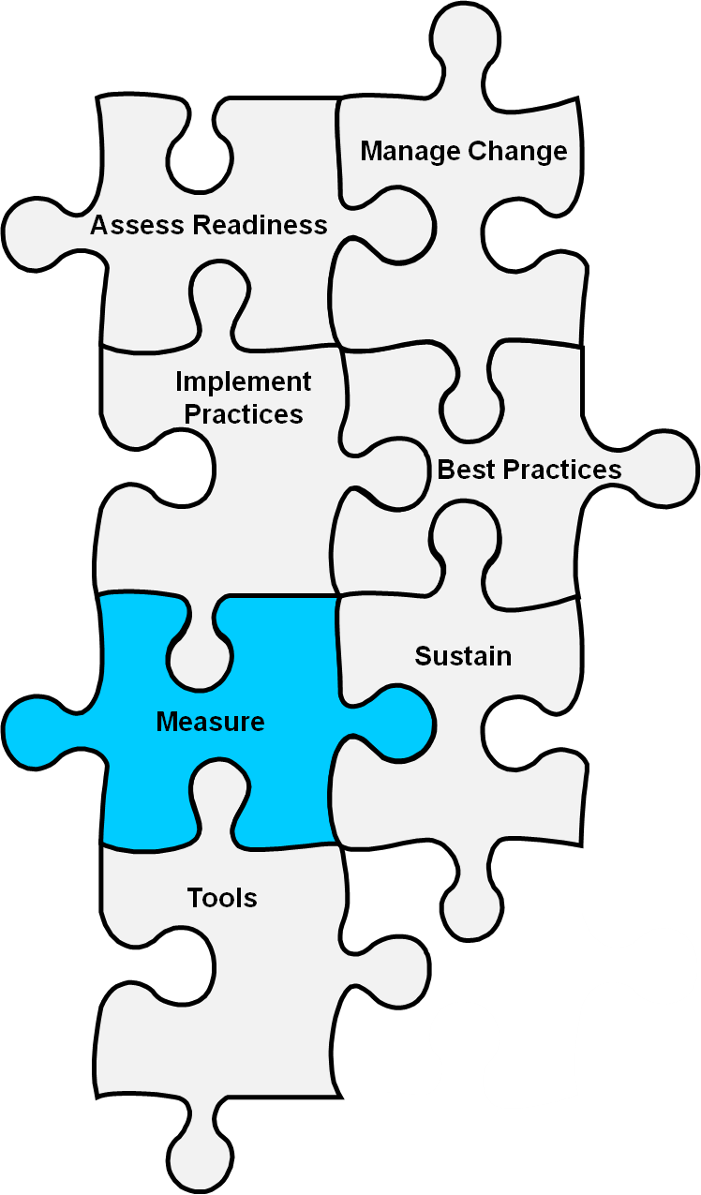
Basic Quality Improvement Principle
If you can’t measure it, you can’t improve it.

Slide 3

Quality Improvement Principle
Pressure injury rates and prevention practices must be counted and tracked as one component of a quality improvement program.

Slide 4
Module 5 Goals
The Implementation Team will agree on and develop a plan for:
  Measuring pressure injury rates.
  Measuring pressure injury prevention practices.
  Communicating trends in pressure injury rates to key stakeholders.

Slide 5
Definition of Pressure Injury
National and international (NPUAP-EPUAP) pressure injury definition:
Localized damage to the skin and underlying soft tissue, usually over a bony prominence or related to a medical or other device. The injury occurs as a result of intense and/or prolonged pressure, or pressure in combination with shear.
National Database of Nursing Quality Indicators (NDNQI) uses the same definition.

Slide 6
Pressure Injury Definition
Do you use the NPUAP definition to measure and monitor pressure injuries?
  If not, what other definition would be appropriate for this hospital?
Definition should be incorporated into:
  Policies and procedures.
  Root cause analyses/huddles.
  Staff education (definition and stages).

Slide 7
Pressure Injury Staging
There are four stages of pressure injuries.
The stages range from mild reddening of the skin to severe tissue damage that can become infected, extending into muscle and bone.

Slide 8
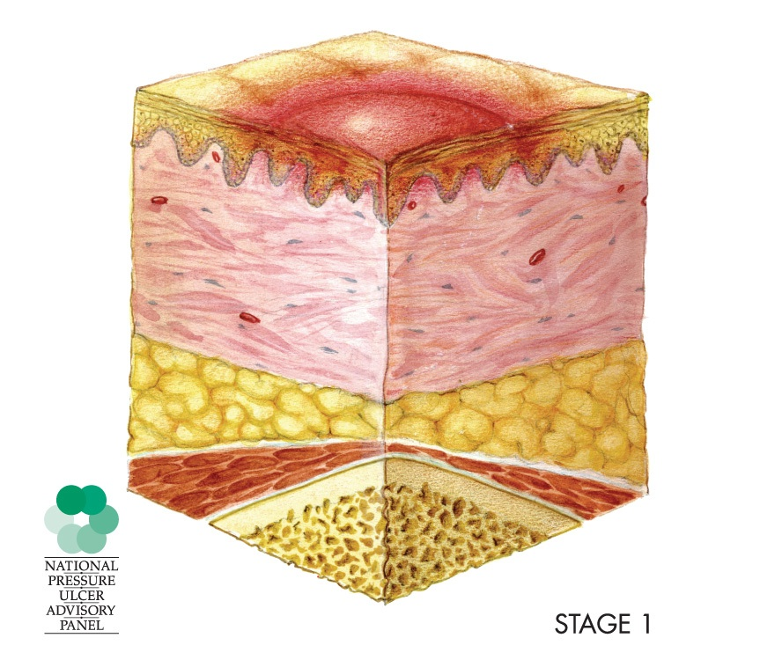
Stage 1
Intact skin with nonblanchable redness of a localized area, usually over a bony prominence

Slide 9
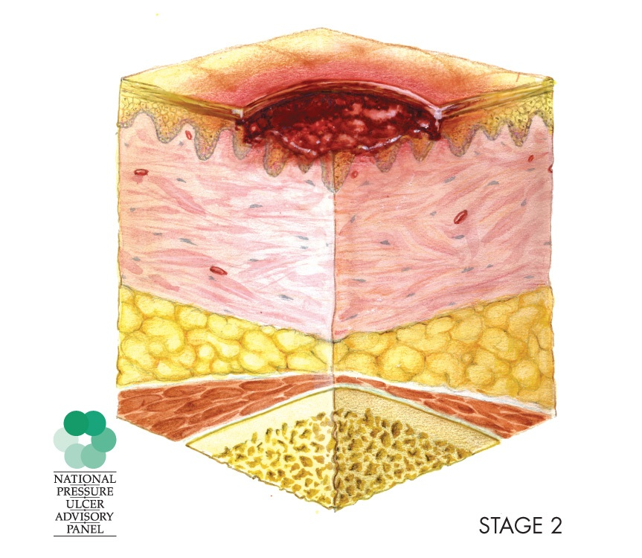
Stage 2
Shallow open injury with a red-pink wound bed
No slough

Slide 10
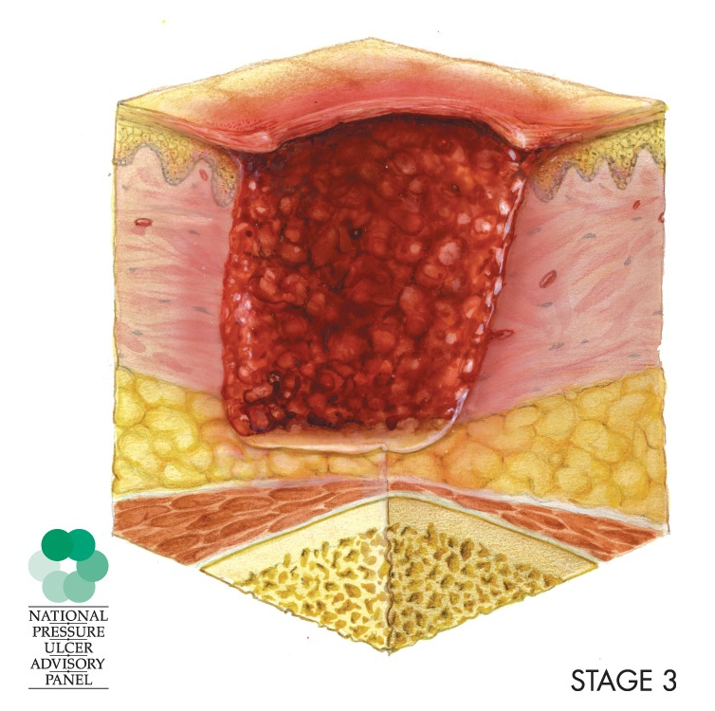
Stage 3
Full-thickness tissue loss
Visible subcutaneous fat
No exposed bone, tendon, or muscle

Slide 11
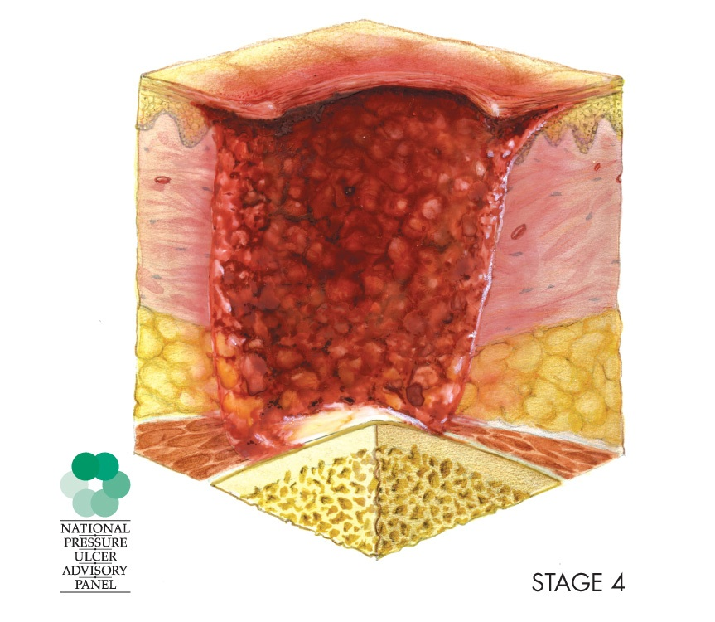
Stage 4
Full-thickness tissue loss
Exposed bone, tendon, or muscle

Slide 12
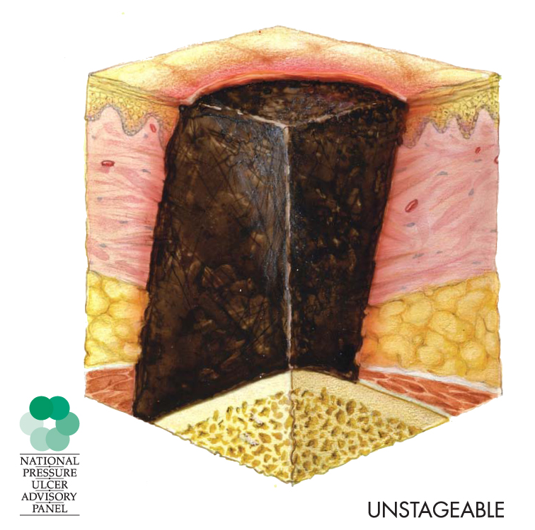
Unstageable
Full-thickness skin and tissue loss in which the extent of tissue damage within the injury cannot be confirmed because it is obscured by slough or eschar.
If slough or eschar is removed, a Stage 3 or 4 pressure injury will be revealed.

Slide 13
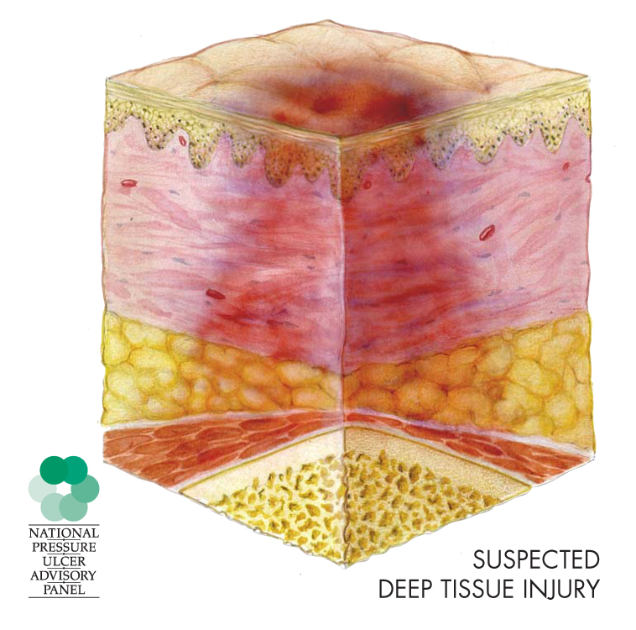
Deep Tissue Injury
Persistent nonblanchable deep red, maroon, or purple discoloration

Slide 14
What Should Be Monitored?
It is recommended that you regularly monitor:
  An outcome measure, preferably pressure injury incidence or prevalence rates.
  At least one or two care processes, such as skin assessment and pressure injury risk assessment.
  Key aspects of the infrastructure to support best care practices, such as clear lines of responsibility for overseeing the accuracy of skin assessments.

Slide 15
Measuring pressure Injury rates

Slide 16
Measure Only Pressure Injuries
Many types of skin lesions may develop in hospitalized patients.
Pressure injuries are areas of soft tissue damage caused by pressure or pressure and shear.
Do not count skin lesions not related to pressure, such as skin breaks or maceration from friction/moisture.
If not sure, ask the Wound Care Team or Nurse.

Slide 17
Measures
Measures used in monitoring pressure injury rates:
  Incidence
  Prevalence

Slide 18
Incidence Rate
Describes the number or percentage of patients developing a new pressure injury while in the hospital or on a particular unit.
Provides the most direct evidence of the quality of your care.
Should be the focus of your quality improvement efforts.

Slide 19
Prevalence Rate
Prevalence rate describes the number or percentage of patients who have a pressure injury while in the hospital or unit.
  Point prevalence reflects a single point in time.
  Period prevalence reflects a prolonged period of time, such as an entire hospital stay.
  Point and period prevalence include injuries present on admission and new injuries that develop in your facility or unit.

Slide 20
Calculation Requirements
Conduct a comprehensive skin assessment on every patient.
Document the results of the assessment, noting:
  Presence of an injury.
  Number of injuries.
  Location of injuries.
  Stage of the deepest injury.

Slide 21
Common Methodology
Monitor pressure injury rates:
  Choose a date.
  Have an outside expert perform a skin exam on each patient.
  Document the presence of each pressure injury:
    Stage of injury
    New injury or present on admission
This process helps you determine incidence and prevalence rates.

Slide 22
Incidence Calculation
Monthly Unit Numbers | Example
# of patients who develop a new pressure injury after admission | 21 patients with a new pressure injury
# of patients who develop a new >Stage 2 injury after admission | 5 patients with a new >Stage 2 pressure injury
# of patients admitted during the month in question | 227 patients admitted
# of patients with a new pressure injury divided by # of patients admitted | 21/227 = .093 5/227 = .022
Times 100 | .093 X 100 = 9.3% with an acquired pressure injury .022 X 100 = 2.2% with an acquired Stage 2 or greater pressure injury

Slide 23
Prevalence Calculation
Monthly Unit Numbers | Example
# of patients with any pressure injury (count only patients, not the # of injuries) | 17 patients with any pressure injury
# of patients with a >Stage 2 pressure injury | 5 patients with >Stage 2 pressure injury
# of patients admitted during the month in question | 183 patients
# of patients with a pressure injury divided by # of patients admitted during the month in question | 17/183 = .093 5/183 = .027
Times 100 | .093 X 100 = 9.3% with a pressure injury .027 X 100 = 2.7% with a Stage 2 or greater pressure injury

Slide 24

Who Will Calculate Rates?
When you complete your Action Plan, you will:
  Identify sources of data to complete.
  Select a person or team responsible for doing the calculations and tracking.
  Count the number and stage of pressure injuries in a month.

Slide 25

Stage 3 and 4 Injuries
All pressure injuries are important to address.
Yet Stage 3 and 4 injuries are very serious.
Study what led to the occurrence.
  Usually when a deep pressure injury develops, it reflects a system failure.
Conduct a root cause analysis.
Page 81

Slide 26
Use of Data
Examine the rates for trends over time:
  Graph the data to visually examine.
  Are the rates getting better or worse?
  Can you relate changes in rates to changes in practice?
  Rates are probably quite different by patient unit.
  Focus on trends over time. There will be fluctuations. Don’t overreact.

Slide 27
Displaying Data/Storytelling
Run charts.
Annotation: Show your interventions.

Slide 28
Annotated Run Chart Example
Intervention: Unit education, biweekly audits
Pilot Unit: ICU

Slide 29
Annotated Run Chart Example
Intervention: Annual education fair for all hospital staff and Shadowing Program in pilot units
Pilot Units: Med-Surg Unit and Critical Care Unit

Slide 30
Annotated Run Chart Example
Before intervention

Slide 31
Painting the Picture With Data
Data can tell you:
  Is your program improving?
  Are your patients safer?

Slide 32

Use of Data
Find ways to disseminate the information to key stakeholders and unit staff.
  Post monthly rates where all staff can see how the unit is doing.
  Send reports to leadership.

Slide 33

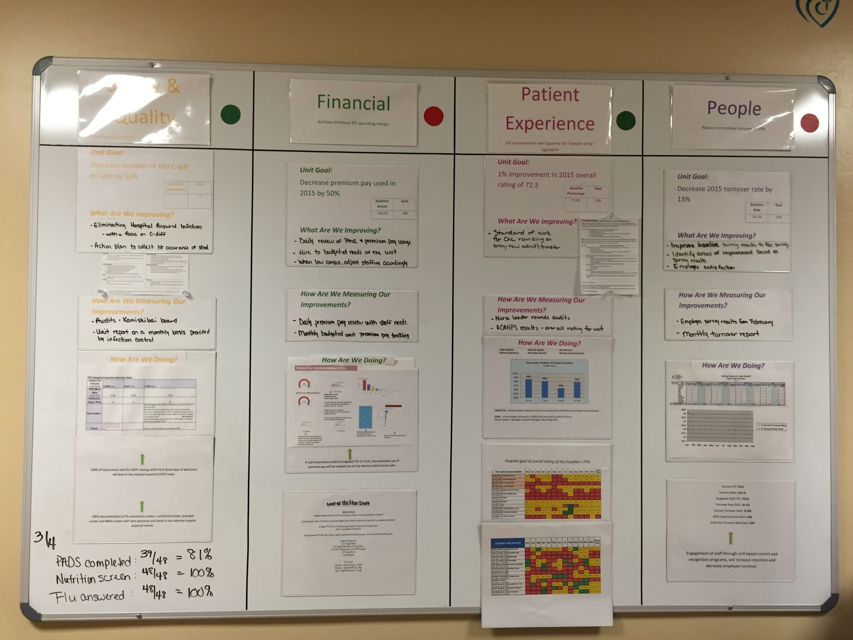
Practice Insight
Visibility board shows:
  Immediate feedback each week.
  Best practice plans for improvement.
  Unit goal.
  Trended data.

Slide 34
Measuring Key Processes of Care

Slide 35
Measuring Prevention Practices
Measuring pressure injury rates tells you how your facility is performing.
Measuring pressure injury prevention practices may tell you how to improve care.
  If the pressure injury rate is high, what specific areas should you focus on?
  Are key practices to reduce pressure injuries being used consistently?

Slide 36
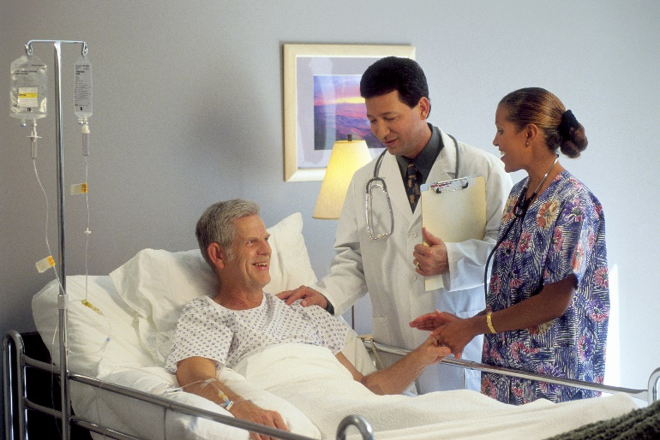
Which Prevention Practices
Should Be Measured?
Initially, look at three practices:
  Performance of comprehensive skin assessment within
  24 hours of admission
  Performance of standardized risk assessment within
  24 hours of admission
  Performance of care planning that addresses each risk factor identified during risk factor assessment

Slide 37
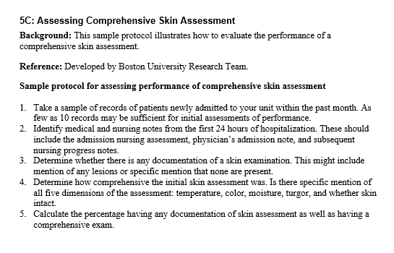
Performance Review of Comprehensive
Skin Assessment
Ensure that a skin assessment was performed within 24 hours of admission.
Use Tool 5C: Assessing Comprehensive Skin Assessment.
Tool 5C

Slide 38
Risk Factor Assessment Within 24 Hours
Use the Braden Pressure Injury Scale (or the one this hospital agreed on).
Ensure the known risk factors for pressure injuries are assessed.
Tool 5D provides a sample protocol for assessing performance.

Slide 39
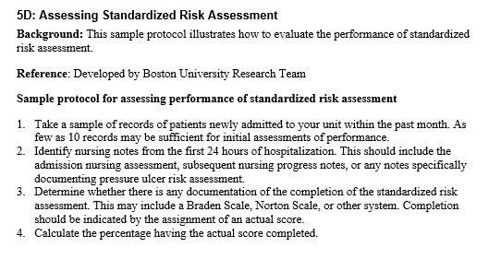
Risk Assessment Measurement Example
If available, use data from your
EHR to support calculation of this measure.
Tool 5D

Slide 40
Assessment of Care Planning
All the risk factors identified in the pressure injury risk factor assessment need to be addressed in the patient’s care plan.
Act on the care plan:
  Use critical thinking.
  Tailor your approach to each patient, based on the patient’s risk factors.
Ensure that the care plan addresses all areas of risk.

Slide 41
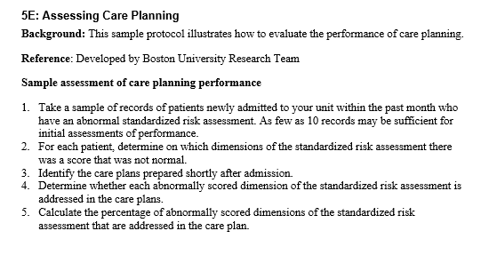
Care Plan Measurement Example
Tool 5E

Slide 42
Pressure Injury Prevention Practices
Good performance on these key processes is critical to preventing pressure injuries.
There is always an opportunity for improvement if you aren’t doing as well as you’d like.
Examine what the problem is, and plan how to overcome this barrier.

Slide 43
Action plan for measuring progress

Slide 44
Measurement Action Plan
Action Plan Tool To Measure Pressure Injury Rates and Prevention Practices
Measure Pressure Injury Rates
Key indicator | Who is responsible? | Completion date for plan
Incidence and/or prevalence pressure injury rates are calculated.
Pressure injury rates are monitored at least quarterly, and preferably monthly.
Information on rates is disseminated to key stakeholders and staff.
Root cause analysis is conducted for each >Stage 2 pressure injury.
Measure Pressure Injury Prevention Practices
Key indicator | Who is responsible? | Completion date for plan
Comprehensive skin assessment is performed accurately within 24 hours of admission.
Pressure injury risk factor assessment is performed accurately within 24 hours of admission.
Care plan addressing every deficit on pressure ulcer risk factor assessment has been developed and is being implemented.

Slide 45
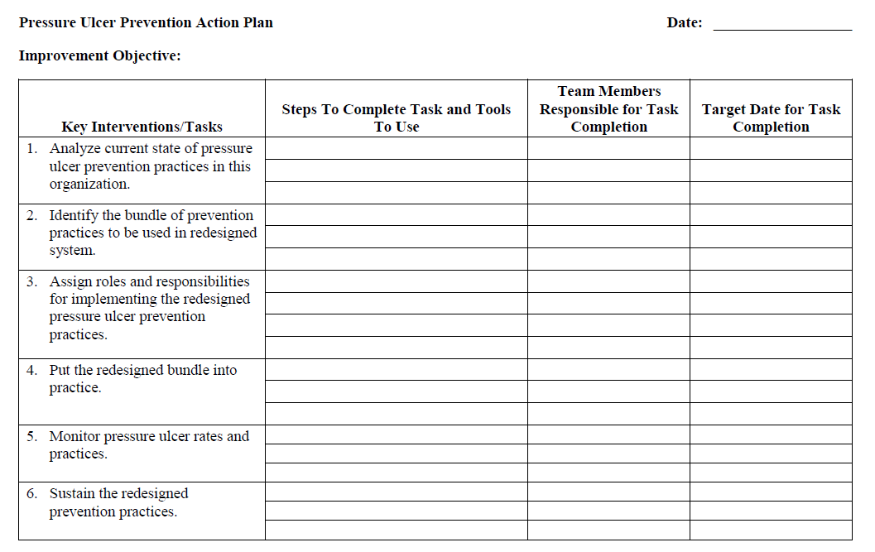

Action Plan
Your Measurement Action Plan becomes Key Intervention 5.
Refer to your
Action Plan
Template.

Slide 46
Summary of Accomplishments
Discussed:
  Measuring pressure injury rates
  Measuring pressure injury prevention practices
  Communicating the trends in pressure injury rates to key stakeholders
Developed a Measurement Action Plan
Developed an overall Pressure Injury Prevention Program Action Plan

Slide 47
Next Steps
Over the next several weeks, we will meet weekly to refine your Action Plan for the Pressure Ulcer Prevention Program.
Thank you for being part of this Team to make this hospital safer for patients.

