Slide 2
The Agency for Healthcare Research and Quality (AHRQ)
Pediatric Quality Indicators
Background for Hospital Board & Senior Leadership
Date

Slide 3
Why are we here today?
Understand the importance of the AHRQ Pediatric Quality Indicators (PDIs).
Understand the financial and clinical implications of the PDIs for our organization.
Endorse the PDIs as a tool for implementing and monitoring improvement.
Make the PDIs a priority within our organization.
Notes:
Presentation objectives.

Slide 4
Leadership is key to improvement
Hospital boards and senior leadership are increasingly turning to the AHRQ QIs as a tool for monitoring performance, particularly on patient safety.
To be successful, improvement efforts within hospitals need to have attention and active support from boards and senior hospital leadership.
Your active support will demonstrate that the hospital has made it a priority to improve quality and patient safety for pediatric patients.
This support will help to motivate our staff to engage fully in improvement activities.

Slide 5
Pediatric health care quality is important
The safety of our patients is a priority.
Hospital quality indicators are increasingly available to consumers.
Medicaid is no longer reimbursing hospitals for some hospital-acquired conditions and safety events for patients covered by Medicaid (including children).
Pediatric indicators can be used to assess performance and compare against peer hospitals.

Slide 6
What is AHRQ?
The Agency for Healthcare Research and Quality:
  Is part of the U.S. Department of Health and Human Services.
  Supports research designed to improve the outcomes and quality of health care, reduce health care costs, address patient safety and medical errors, and broaden access to effective services.
  Sponsors, conducts, and disseminates research to help people make more informed decisions and improve the quality of health care services.
  Acts as the regulator for Patient Safety Organizations that are certified under the Patient Safety and Quality Improvement Act.

Slide 7
What are the AHRQ
Pediatric Quality Indicators?
The PDIs are a set of 16 indicators that reflect quality of care inside hospitals and adverse events that children, adolescents, and, where specified, neonatal patients may experience as a result of exposure to the healthcare system.
PDIs measure events likely to be preventable through changes at the system or provider level.
PDIs are measured using hospital administrative data.
One PDI (PDI 19) is a composite measure.
Eight out of 16 provider-level PDIs are endorsed by NQF.

Slide 8
Where can I find more information on the AHRQ PDIs?
More information on the PDIs, including specifications and benchmarks, is available at http://www.qualityindicators.ahrq.gov/modules/pdi_resources.aspx.
Notes:
The following list can be provided as a handout.
List of PDIs
NQI 01 Neonatal Iatrogenic Pneumothorax Rate
NQI 02 Neonatal Mortality Rate
NQI 03 Neonatal Blood Stream Infection Rate
PDI 01 Accidental Puncture or Laceration Rate
PDI 02 Pressure Ulcer Rate
PDI 03 Retained Surgical Item or Unretrieved Device Fragment Count
PDI 05 Iatrogenic Pneumothorax Rate
PDI 06 RACHS-1 Pediatric Heart Surgery Mortality Rate
PDI 07 RACHS-1 Pediatric Heart Surgery Volume
PDI 08 Perioperative Hemorrhage or Hematoma Rate
PDI 09 Postoperative Respiratory Failure Rate
PDI 10 Postoperative Sepsis Rate
PDI 11 Postoperative Wound Dehiscence Rate
PDI 12 Central Venous Catheter-Related Blood Stream Infection Rate
PDI 13 Transfusion Reaction Count
PDI 14 Asthma Admission Rate
PDI 15 Diabetes Short-term Complications Admission Rate
PDI 16 Gastroenteritis Admission Rate
PDI 17 Perforated Appendix Admission Rate
PDI 18 Urinary Tract Infection Admission Rate
PDI 19 Pediatric Safety for Selected Indicators
PDI 90 Pediatric Quality Overall Composite
PDI 91 Pediatric Quality Acute Composite
PDI 92 Pediatric Quality Chronic Composite

Slide 9
Why were the PDIs developed?
Because quality and safety are so important, the AHRQ PDIs were developed to help hospitals:
  Screen for potential quality and safety problems in children using easily accessible data.
  Compare themselves with other hospitals using national standardized measures to assess quality of hospital care.
For more information, see General Questions About the AHRQ QIs. AHRQ Quality Indicators. Rockville, MD: Agency for Healthcare Research and Quality; July 2004. www.qualityindicators.ahrq.gov/FAQs_Support/default.aspx.

Slide 10
How were the AHRQ PDIs developed?
The AHRQ PDIs were developed through four processes:
  Identification of candidate indicators
  Literature review
  Empirical analyses
  Panel review
Once developed, the PDIs were vetted by expert panels of clinicians.
The initial set of PDI indicators was released in 2006.
For more information, see Measures of Pediatric Health Care Quality Based on Hospital Administrative Data: The Pediatric Quality Indicators. Rockville, MD: Agency for Healthcare Research and Quality; 2006. http://www.qualityindicators.ahrq.gov/modules/pdi_resources.aspx; and
Pediatric Quality Indicators. Rockville, MD: Agency for Healthcare Research and Quality; July 2010. http://www.qualityindicators.ahrq.gov/Downloads/Modules/PDI/V42/Pediatric_Ind_10_update.pdf.
Notes:
Additional background information is available at
http://www.qualityindicators.ahrq.gov/Downloads/Resources/Presentations/2010/QI_101_2011-03-02-current.pdf.

Slide 11
Why use the AHRQ PDIs?
The AHRQ PDIs identify quality topics for monitoring and performance improvement:
  Use hospital administrative data
  Highlight potential quality concerns
  Identify areas that need further study and investigation
  Allow monitoring of changes over time
Because we cannot always measure “quality of care” per se, we use certain measures as an “indicator” of quality.
For more information, General Questions About the AHRQ QIs. AHRQ Quality Indicators. Rockville, MD: Agency for Healthcare Research and Quality; July 2004. www.qualityindicators.ahrq.gov/FAQs_Support/default.aspx.

Slide 12
ICD-10-CM Conversion
Change from ICD-9-CM to ICD-10-CM occurred in October 2015:
  Addition of information relevant to ambulatory and managed care encounters
  Expanded injury codes
  Creation of combination diagnosis/symptom codes
  Addition of 6th and 7th characters
  Incorporation of common 4th and 5th digit subclassifications
  Laterality
  Greater specificity in code assignment
The AHRQ PDIs have been updated to reflect this change.
ICD-10-CM = International Classification of Diseases, 10th Revision, Clinical Modification.

Slide 13
How are the AHRQ PDIs structured?
Definitions based on:
  ICD-10-CM diagnosis and procedure codes
  Often along with other measures (e.g., MS-DRG, MDC, sex, age, procedure dates, admission type)
Numerator = number of cases with the outcome of interest (e.g., pediatric cases with pressure ulcer)
Denominator = population at risk (e.g., hospitalized patients)
Observed rate = numerator/denominator
Some AHRQ PDIs measured as volume counts
MS-DRG = Medicare Severity diagnosis-related group; MDC = major diagnostic classification.
Source: www.qualityindicators.ahrq.gov/resources/Presentations.aspx.

Slide 14
An Example: Pressure Ulcer (PDI 02)
Numerator: Discharges with ICD-10-CM code of pressure ulcer in any secondary diagnosis field among cases meeting the inclusion and exclusion rules for the denominator.
Denominator: All medical and surgical discharges age 17 years and younger defined by specific DRGs or Medicare Severity DRGs.
Several exclusions (e.g., length of stay <5 days, principal diagnosis of pressure ulcer).
Source: http://www.qualityindicators.ahrq.gov/Downloads/Modules/PDI/V45/TechSpecs/PDI%2002%20Pressure%20Ulcer%20Rate.pdf

Slide 15
How can the AHRQ PDIs be used in quality assessment?
AHRQ PDIs can be used to flag potential problems in quality of care.
AHRQ PDIs can be used to assess performance and compare against peer hospitals.
Examples of hospital use of AHRQ QIs in the literature have examined the impact of:
  Health information technology on quality of care.
  Hospital board quality committees on quality of care.
  The effectiveness of nurse staffing on care delivered.
Source: www.qualityindicators.ahrq.gov/Default.aspx and AHRQ Quality Indicator Toolkit Literature Review.

Slide 16
Delete this slide
If you already have your current PDI data available: use slides 16-17 and delete slides 18-19.
If you do not have your PDI data available: use slides 18-19 and delete slides 16-17.
DELETE THIS SLIDE.

Slide 17
Current performance on the AHRQ PDIs
Example
INSERT GRAPHS OR TEXT FROM YOUR HOSPITAL’S DATA HERE.
Notes:
Instructions: Insert your current hospital performance on the PDIs. Consider adding a descriptive title (e.g., “Opportunities for improvement in 5 PDIs”).

Slide 18
Next steps for QI team
Identify priorities for quality improvement.
Establish goals and performance targets.
Formulate an action plan to develop a multidisciplinary team for AHRQ PDI work.
Notes:
Instructions: Indicate here what the steps are that need to be completed in order to move your Quality Indicator improvement initiatives forward.

Slide 19
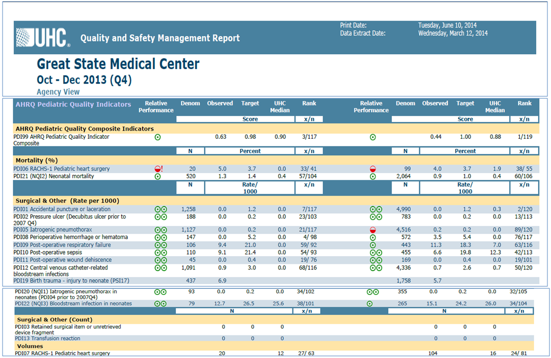
Sample report on hospital performance on the AHRQ PDIs
Notes:
Instructions: Include an example of a report that can be developed at your institution to review hospital performance on the PDIs.

Slide 20
Next steps for QI team
Run AHRQ PDI report with most recent quarter’s data.
Review AHRQ PDI report at next board meeting.
Identify priorities for quality improvement.
Establish goals and performance targets.
Formulate an action plan to develop multidisciplinary team for AHRQ PDI work.
Notes:
Instructions:
1. Indicate here what the steps are that need to be completed in order to move your Quality Indicator improvement initiatives forward.
2. Consider running QIs on data from previous quarters as well to generate a trend line.

